Slide 1
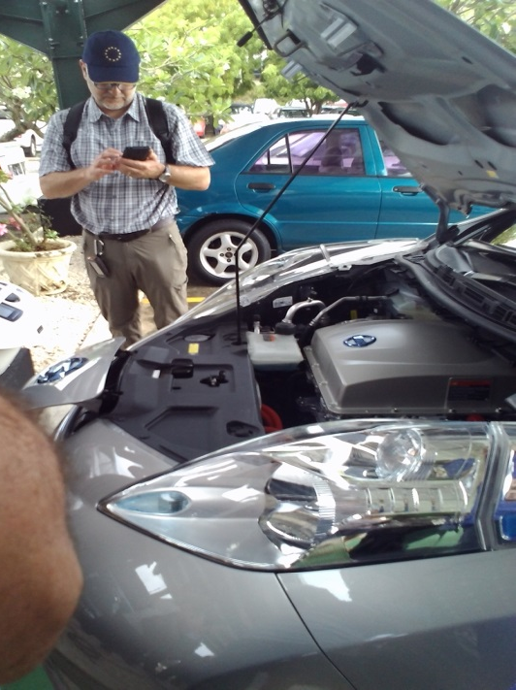


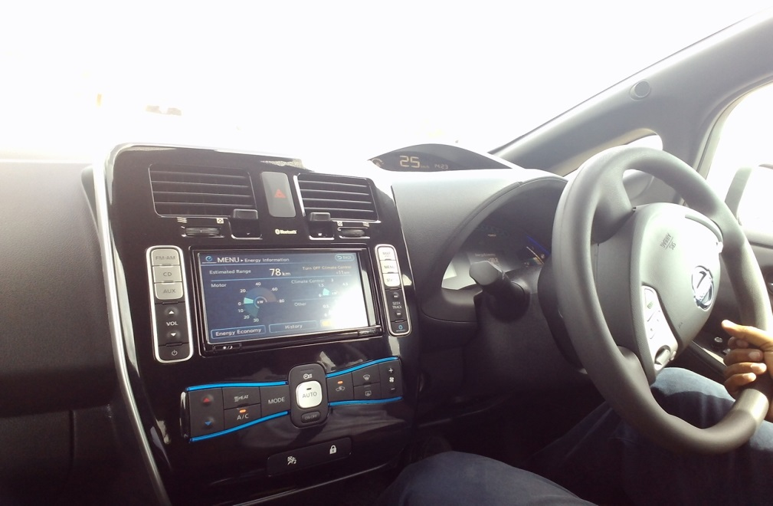
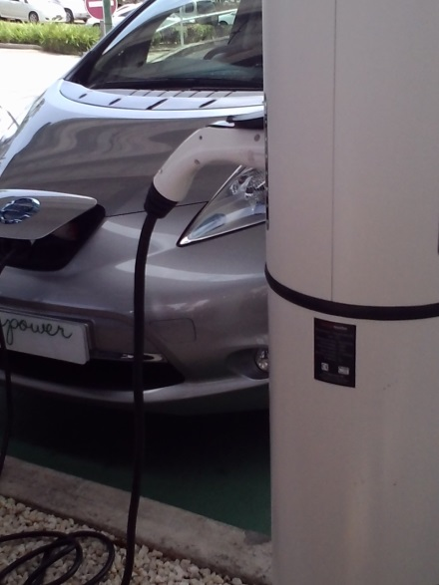
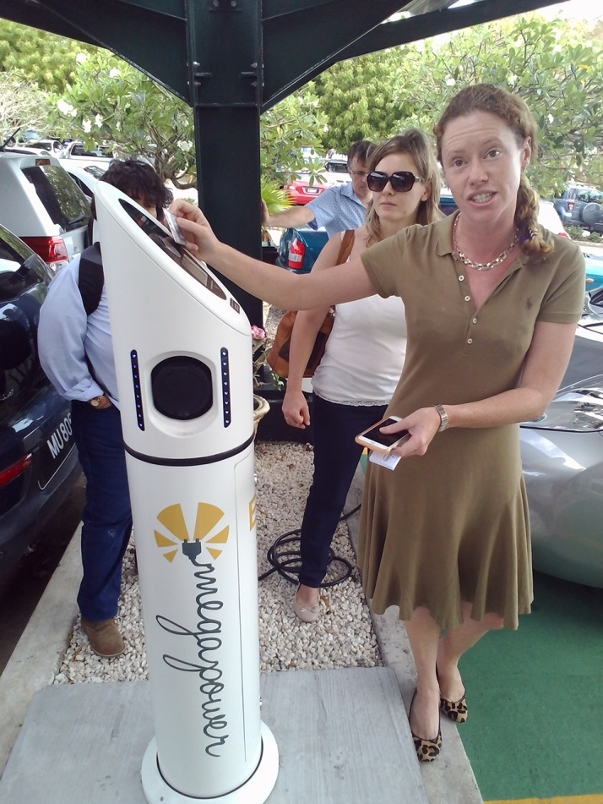
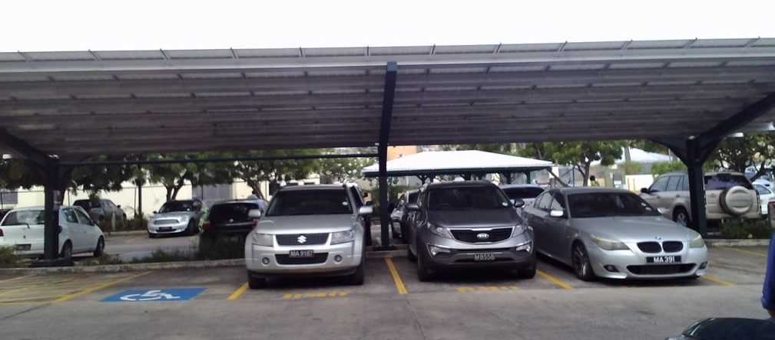
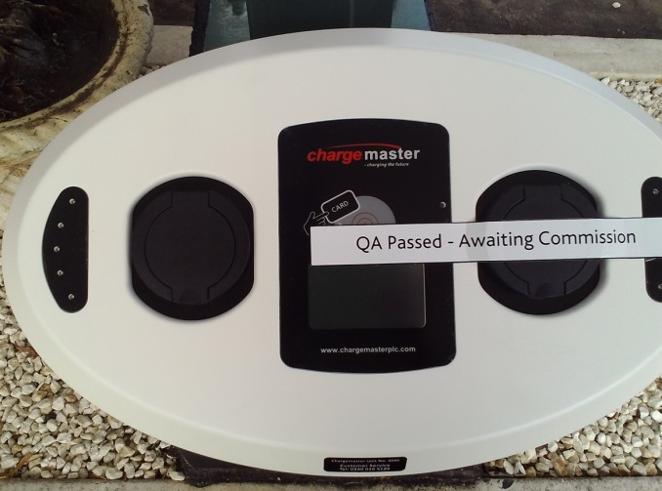
Notes:
Car batteries cost approx $5500 USD, Co owns 2 solar power pannels/ sheds, port to charge the cars are available all over Bds, A subscriptionis paid ontly and recorded on your card, one can monitor the charging remotley, customers are charged for parking as well as a deterrent, home devices are sold for charging ,

Slide 2
Megapower’s vision is for a network of publicly accessible charging stations, powered by renewable energy sources, enabling the rapid uptake of electric vehicles in Barbados and the Caribbean
What did we see?
A company with a tremendous development potential which could have a serious impact on fossil fuel use reduction across the Caribbean
A successful story thanks to grant funding provided by Carib Export Dev Agency
A promising technology with a significant potential for costs saving for businesses, individual users and government alike, as well as job creation opportunities
Notes:
Panel 265*8 = 2kwh

Slide 3
What we learned?
The use of EV vehicles is safe, and a more sustainable use of energy
Reduction in duties on the vehicles needs to be at least to be on par with other vehicles. Duties on Zero Emissions vehicles average $15, 000 usd. Current Gov position on duties not favourable for market development consistent (i.e. push for higher duties on 0-emission than equiv gas model probably to protect existing market)
Co. is committed to expanding their work locally and regionally. It has begun penetrating C’bbean Markets ( Dominica, St Lucia). It is a growing market - In 2014 60 cars were sold. Over 110 vehicles sold over last 2 years to 85 customers and increasing. Plans to order approx. 23 more vehicles including commercial vehicles
Gov action can affect either + or – market develop.
Notes:
Electronic Vehicles

Slide 4
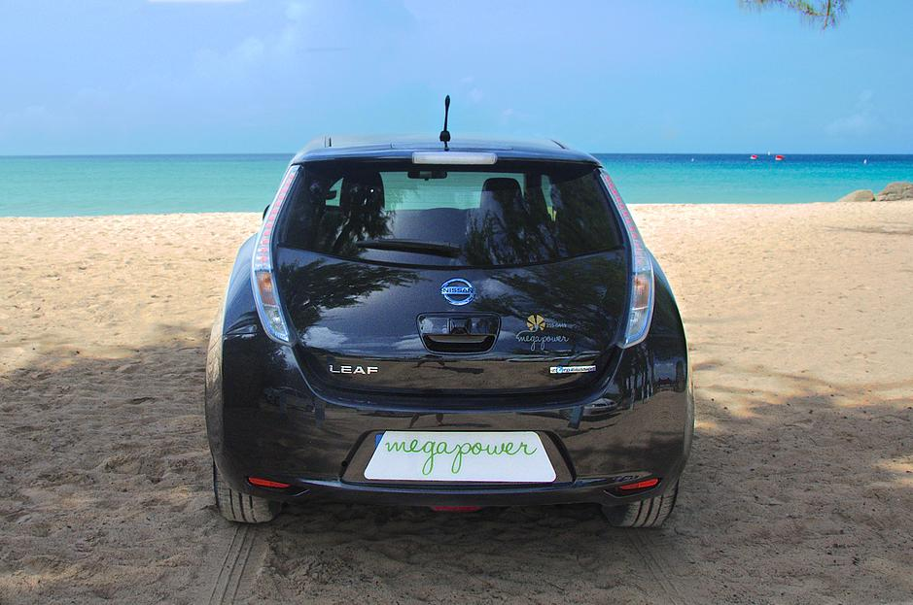
How can we apply it?
Regardless how promising the prospects of a new technology are, one needs to first ensure that Gov supports its development before the market can expand.
The government should consider a tax incentive.
Greater promotion should be made of Carib Export Development Agency as a seed funding opportunity.
Need to ensure that seed funding is sufficient to cover for market testing phase so that benefits of product can be promoted to general public, including Gov.
Success stories such as this one should be highly promoted and public awareness increased in order to lobby Gov to support the development of the industry.

