Slide 1

Blending
Caribbean Investment Facility
Ongoing requests for grant in Dominican Republic
in water and energy sectors

Slide 2
Project No. 1
Support to the Investment Programmes of INAPA and CORAASAN
(Water Sector)

Slide 3


Support to the Investment Programmes of INAPA and CORAASAN
Lead financial institution: AFD
Partner country authority: Ministry of Finance
Implementation entities:
Instituto Nacional de Agua Potable y Alcantarillado (INAPA)
Corporación de Agua y Alcantarillado de Santiago (CORAASAN)
Financing plan:
AFD loan 45 M€
French government loan 65 M€
National contribution 9 M€
CIF grant 10 M€
Total 129 M€

Slide 4
Support to the Investment Programmes of INAPA and CORAASAN
Main objectives of the project:
Increase the efficiency of water services.
Reduce wastewater discharges into the environment.
Improve INAPA and CORAASAN's financial sustainability.

Slide 5
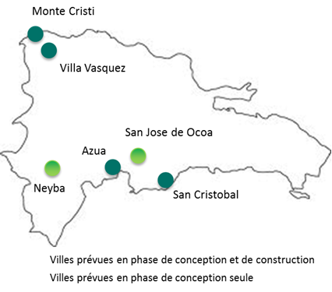
Support to the Investment Programmes of INAPA and CORAASAN
INAPA: Investment and capacity building
Design and construction of sewerage networks and wastewater treatment plants in 6 towns
Improvement of water network efficiency in 1 town

Slide 6
Support to the Investment Programmes of INAPA and CORAASAN
INAPA: Investment and capacity building
Design and construction of sewerage networks and wastewater treatment plants in 6 towns
Improvement of water network efficiency in 1 town
Training and operation support to INAPA
Implementation of INAPA-INFOTEP (institute for vocational training) partnership for water and sanitation technical training (CIF: 1.5 M€)

Slide 7
Support to the Investment Programmes of INAPA and CORAASAN
INAPA: Investment and capacity building
Design and construction of sewerage networks and wastewater treatment plants in 6 towns
Improvement of water network efficiency in 1 town
Training and operation support to INAPA
Implementation of INAPA-INFOTEP (institute for vocational training) partnership for water and sanitation technical training (CIF: 1.5 M€)
Supporting INAPA's deconcentration process in 5 provinces (administrative / financial / technical / operational level) following AIDB/AECID program in 7 provinces: creation of regional offices, equipment, computerized database, laboratory, water meters, etc. (CIF: 7 M€ for investment + 1.5 M€ for TA)

Slide 8
Support to the Investment Programmes of INAPA and CORAASAN
CORAASAN: Investment and capacity building
Extension of the water and sanitation systems in Santiago
Technical assistance and capacity building at CORAASAN

Slide 9
Support to the Investment Programmes of INAPA and CORAASAN
What made the project right for blending?
There was not really a strong need of a grant element to finance the project. The CIF grant cannot be seen as financial leverage since the loans are already ensured.
However the CIF grant would largely contribute to INAPA's strengthening and consequently to the sustainability of the project.

Slide 10
Support to the Investment Programmes of INAPA and CORAASAN
How did we decide on the size of the grant (level of concessionality)?
We understand that the strategy from AFD was to request a "substantial but reasonable" amount (10 M€) and then design activities for this amount, instead of defining the needs first… (number of water meters could be an adjustment variable). No feasibility study available. The EU delegation asked to better justify the nature of the investments.

Slide 11
Support to the Investment Programmes of INAPA and CORAASAN
What concrete results do we expect and what are the risk that they will not arise?
Against the financial risk, a conditionality in the AFD loan requires prior mobilization of the national contribution
Strengthening and capacity building of INAPA and deconcentration process should improve their efficiency and sustainability
Social risk is underestimated: improving the service and installing water meters doesn't mean necessarily people will better accept to pay. To establish a culture of payment and break the vicious circle "poor service - low recovery rate", we recommend an extensive social action plan.
A major obstacle to financial sustainability is the water tariff. We recommend a water and wastewater tariff study. Self-financing of water corporations is actually not a priority objective of the government (energy sector first).

Slide 12
Project No. 2
Santo Domingo Eastern Water Transmission Line Extension
(Water Sector)

Slide 13
Santo Domingo Eastern Water Transmission Line Extension
Lead financial institution: AECID
Partner country authority: Ministry of Finance
Implementation entity: CAASD
(Corporación de Acueductos y Alcantarillados de Santo Domingo)
Financing plan:
EIB/AFD/AECID(FONPRODE) loans 65.5 M€
National contribution/CAASD 8.0 M€
AECID grant 8.3 M€
CIF grant 10.0 M€
Total 91.8 M€

Slide 14
Santo Domingo Eastern Water Transmission Line Extension
Main objectives of the project:
Increase coverage and improve drinking water supply and sanitation in a more efficient and sustainable way for urban areas of Santo Domingo Este.
Improve technical, operational and commercial management of CAASD, generating a framework that encourages community participation in WASH.

Slide 15
Santo Domingo Eastern Water Transmission Line Extension
Infrastructure project in Santo Domingo Este (83.8 M€):
Main water transmission line reinforcement and extension
Yield production increased from 8 to 10 m3/s (+25%)
Water distribution network and house connections in 3 specific areas
Sewerage network and wastewater treatment plant in 1 specific area (pilot project)
Total population in project area: 1,200,000 inhabitants
The CIF grant would finance the supervision of works and a feasibility study on sewerage networks and wastewater treatment in a second phase (3.8 M€).

Slide 16
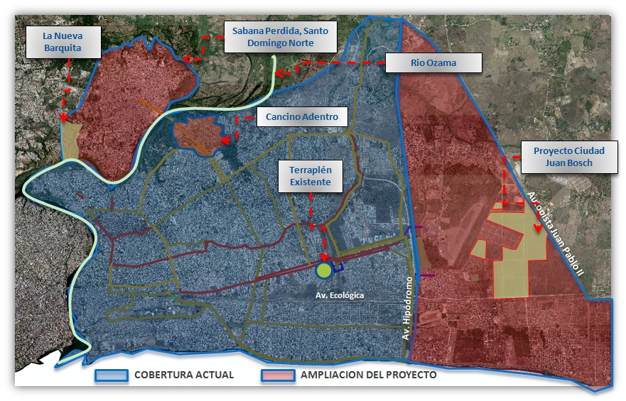
Santo Domingo Eastern Water Transmission Line Extension

Slide 17
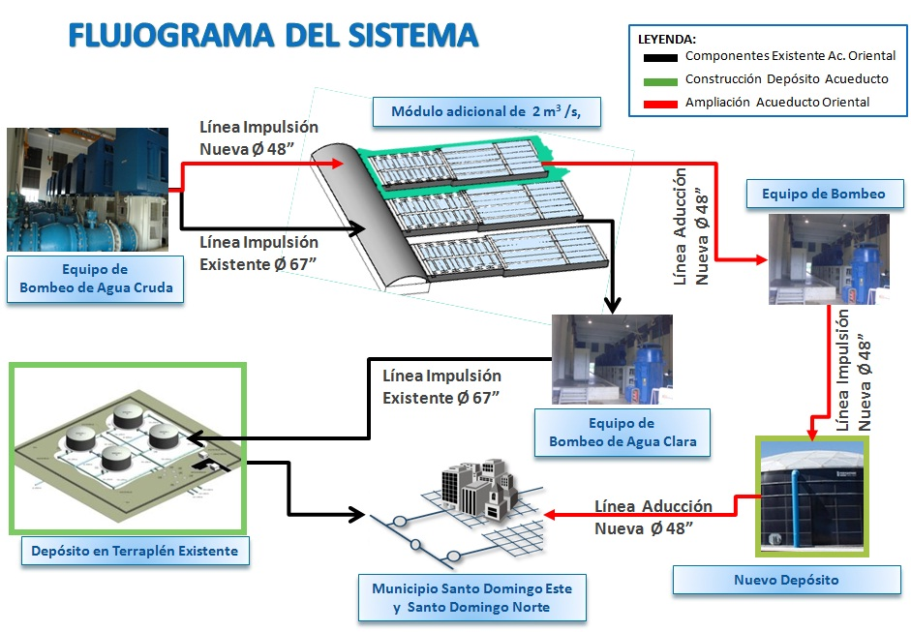
Santo Domingo Eastern Water Transmission Line Extension

Slide 18
Santo Domingo Eastern Water Transmission Line Extension
CAASD capacity building (8.0 M€):
Operation and maintenance of water system
Technological and organizational support for the system management
Commercial management and community involvement
Unaccounted-for-water programme, water network zoning, energy efficiency programme, water quality control, GIS, water network modelling, commercial management plan, social action plan
The CIF grant would finance part of the capacity building (5.9 M€) and communication and visibility (0.3 M€).

Slide 19
Santo Domingo Eastern Water Transmission Line Extension
What made the project right for blending?
The financial set-up is at present uncertain: no formal commitment from the government to subscribe to the required loan nor from financial institutions to provide it. The grant component (AECID + CAASD + CIF) is intended to represent a core funding working as leverage.
If the main international partners in the water sector (AECID and possibly EIB, AFD and EU) do join, it could represent a critical mass to advocate for significant reforms in the water sector and a chance to influence policy.
The CIF grant will largely allow for the institutional strengthening of the CAASD and more broadly ensure a more efficient and sustainable management of water and sanitation in Santo Domingo overall.

Slide 20
Santo Domingo Eastern Water Transmission Line Extension
How did we decide on the size of the grant (level of concessionality)?
The request is based on in-depth technical and socio-economic studies and a reliable cost estimate of the components proposed for CIF grant.

Slide 21
Santo Domingo Eastern Water Transmission Line Extension
What concrete results do we expect and what are the risk that they will not arise?
The expected results are: improved water and sanitation services in Santo Domingo Este neighborhood, efficient operation of water system and sustainable management of water resources, financial sustainability of CAASD and possibly significant reforms in the water sector.
The first risk, linked to blending, is on the financial set-up: government in a situation of restricted fiscal space to take a loan, no commitment from financial institutions, CIF deadline (September 2015).
Environmental risk, the project expanding the water system without building in the first phase a sanitation system at the same scale.
A major obstacle to financial sustainability is the water tariff.

Slide 22
Project No. 3
CDEEE Energy Loss Reduction Programme
(Energy Sector)

Slide 23
CDEEE Energy Loss Reduction Programme
Lead financial institution: EIB
Partner country authority: Ministry of Finance
Implementation entities: CDEEE, EDEEste, EDENorte, EDESur
(Corporación Dominicana de Empresas Eléctricas Estatales)
Financing plan:
EIB loan 94.4 M€
WB loan 115.5 M€
CIF grant 9.4 M€
Total 219.3 M€

Slide 24
CDEEE Energy Loss Reduction Programme
Main objectives of the project:
Improve the national electricity distribution system and the availability of power supply to consumers.
Increase the financial sustainability and the commercial efficiency of the EDEs, hence limiting their dependence on government subsidies.

Slide 25
CDEEE Energy Loss Reduction Programme
Two main priorities for the Dominican government:
Implementation of a nationwide loss reduction programme
The present project is the second phase of a programme that started in 2009. The first phase (USD 214 million) has been very effective, increasing the Cash Recovery Index in the involved feeders from 30-70% to 65-95%.
Modification of the generation mix to include cheaper fuels and more efficient technologies (other project)
Developing new coal plants and converting fuel oil based generation into natural gas.

Slide 26
CDEEE Energy Loss Reduction Programme
Components of the project:
Rehabilitation of medium-low voltage electricity networks and metering systems to reduce vulnerability to thefts and tampering.
Strengthening of the EDEs’ commercial activities for contracting and monitoring irregular users.
Actively engaging with the communities to introduce the culture of paying for electricity and to educate people on safe and efficient use of electricity.

Slide 27
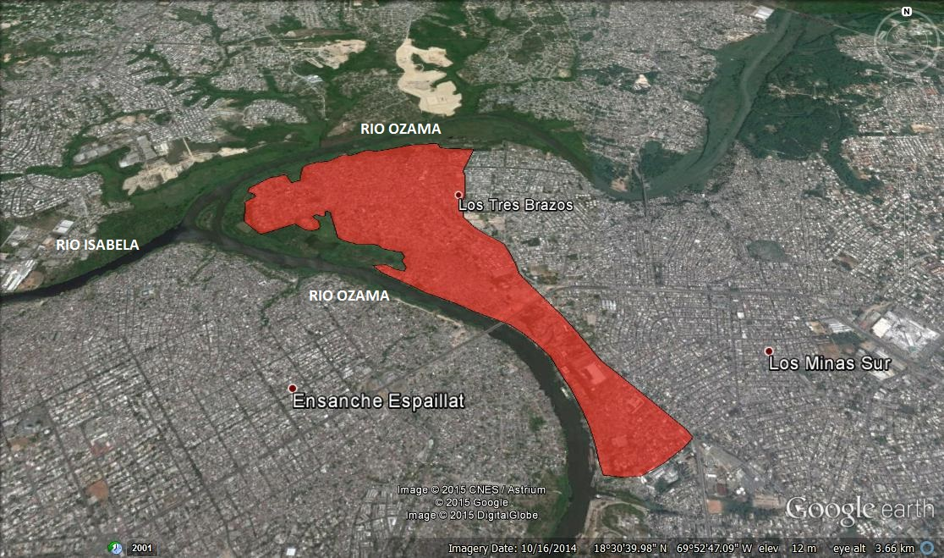
CDEEE Energy Loss Reduction Programme
The project is geographically distributed over the territory of the DR, with circa 60% of the investments concentrated in the outskirts of the capital Santo Domingo.
It comprises:
59 feeders financed by EIB and WB,
1 additional feeder proposed for a CIF grant in an area of Santo Domingo Este with high poverty rate.

Slide 28
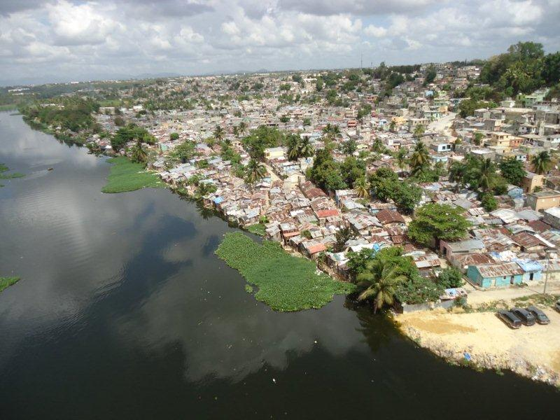
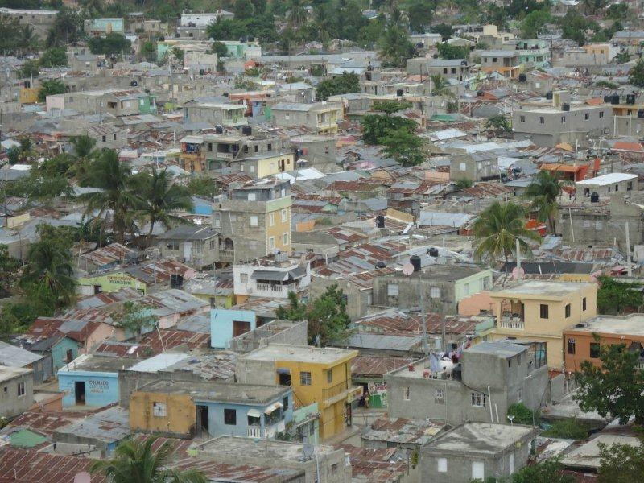
CDEEE Energy Loss Reduction Programme
Los Tres Brazos
Santo Domingo Este
Río Ozama

Slide 29
CDEEE Energy Loss Reduction Programme
What made the project right for blending?
Project highly relevant: problems of the energy sector are a major obstacle to economic development, business climate, poverty reduction, and a major cause of public deficit.
Limited fiscal space; grant always welcome, although representing less than 5% of the total.
Having 4 major international partners (IDB, WB, EIB and EU) supporting the sector could be an opportunity for coordinated policy dialogue to advocate for reform.
The feeder financed by CIF in a very poor area would not be dealt with soon by CDEEE and the EDEs since they are giving priority to more profitable areas.
The project should have positive climate change mitigation.

Slide 30
CDEEE Energy Loss Reduction Programme
How did we decide on the size of the grant (level of concessionality)?
It was "agreed" between EU and EIB to request for about 10 M€. The EU delegation suggested that the CIF funds feeders in poor areas and EIB identified one large area matching with the budget.
The economic benefit of the associated investments was evaluated on the basis of the power interruptions that will be avoided valued at the estimated social cost of power cuts. This results in an EIRR of 27%. The financial benefit is calculated on the basis of the additional revenues coming from the improvement of the Cash Recovery Index. The associated FIRR is estimated at 15%.

Slide 31
CDEEE Energy Loss Reduction Programme
What concrete results do we expect and what are the risk that they will not arise?
The expected results are: installed or upgraded electricity transmission and distribution lines, reduction of losses and reduction of consumption, efficient operation and financial sustainability of EDEs and possibly reforms in the energy sector.
Risk on the financial set-up: government not committed yet to take the EIB loan, i.e. to include it in its mid-year 2015 budget revision, CIF deadline (September 2015).
Social risk for the CIF component due to the difficult social situation in this neighborhood (poverty, insecurity, low education level, low social organization), with an extra-challenge for the outcomes of the project. To be mitigated by strong accompanying measures.

