Slide 1
Supporting democracy throughout the electoral cycle
The future of electoral assistance
Florence VANDENDORPE, DEVCO B1

Slide 2
Part 1. EU electoral assistance in 2007-13
What are we talking about?

Slide 3
EU funds dedicated to electoral assistance in 2007-13

Slide 4
The contribution of each finantial instrument

Slide 5
Benefiting geographic zones (their share of the global spending)

Slide 6
Implementing partners
Partners: UNDP 342.758.614,37 € (61%)
27 Projects over 5 M€ (288.834.161,63€ = 52%)
  5 actors, 21/27 projects run by UN, 0 local actors
47 projects over 3 M€ (366.474.360,02€ = 66%)
  9 actors, 32/47 projects run by UN, 1 local actor (Gov. Ghana)
Notes:
Les autres acteurs sont:
IOM, GIZ, AFD,IDEA, TRANSTEC, INTERPEACE

Slide 7
Part 2. Current challenges

Slide 8
Programmation
Late programmation
Increasing budgets related to the introduction of expansive technologies (Ex. biometrics)
Lack of approaches adapted to fragile and conflict-prone contexts
Very few projects with non-State electoral stakeholders (political parties, parliaments, media, local authorities…)
A few partners tend to occupy the field
More mission requests than our credits allow (incl. in case of EC-UNDP JTF)

Slide 9
Implementation
No more news from projects during implementation unless problems arise
Lack of human resources in EU Delegations
Concerns related to the visibility and political leverage of the EU in some countries
Who knows the Operational Guidelines of the EC-UNDP Partnership in electoral assistance?

Slide 10
Monitoring and evaluation
Poor long-term results in some contexts (DRC, Fiji…)
Few opportunities to share experiences and discuss lessons learnt among EU Delegations → no institutional memory
Requests for an experts database

Slide 11
Part 3. Looking forward
Proposals

Slide 12
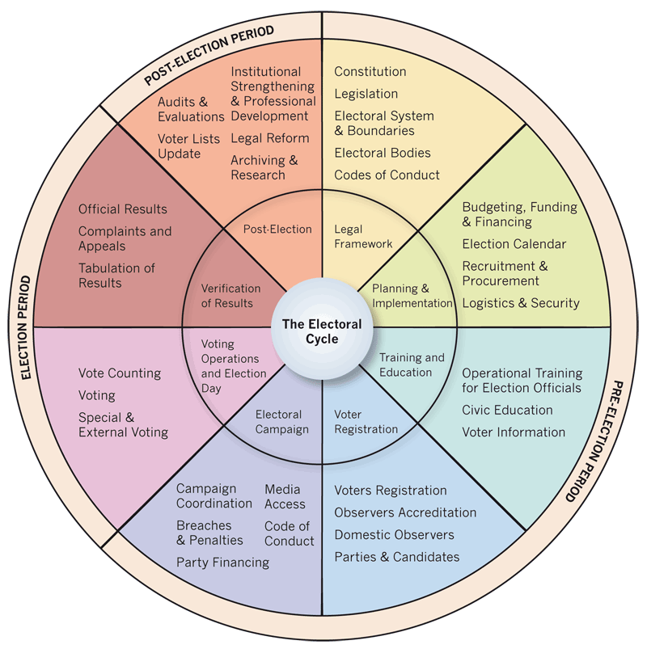
Cover the whole electoral cycle

Slide 13
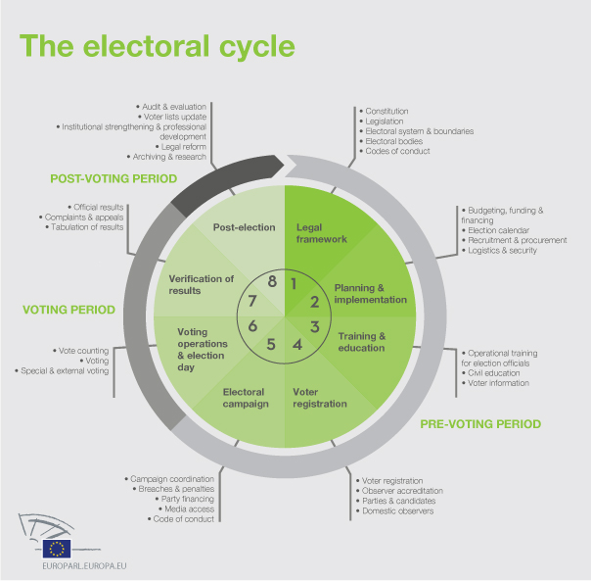

Slide 14
What is an approach based on the electoral cycle ?
Addressing different needs may required choosing different partners
Formulate the project well ahead of elections
Most activities take place in-between elections

Slide 15
Select the proper funding modality according to the needs
Budget support?
Action Grant?
Pool fund?
Service contract?
Programme Estimate?
Direct technical assistance to the EMB?
Notes:
Il y a déjà 30 projets qui sont financés par des action grants.

Slide 16
Results-based approaches
Budget support
Towards the introduction of benchmarks and conditionalities in UNDP-managed projects
Increased involvement of EU Delegations in the follow-up of projects

Slide 17
Address electoral violence
Include specific conflict prevention/mediation components
Create parterships with representatives from segregated groups
Articulate with activities funded by other instruments: EIDHR, LA/NSA, ICsP
Programme Ermès
NB: Long-term approach

Slide 18
Improve EC-UNDP collaboration
Current revision of the Operational Guidelines
Produce templates and clear guidance for reporting
Kick-off trainings?
Formulation Missions to be redefined

Slide 19
Share experiences
Increase the circulation of information among EU Delegations
Capacity4Dev??
Develop specific trainings for EU staff

Slide 20
Your proposals are welcome!
Thank you

