Slide 1

ElectriFI
An innovative funding initiative stimulating private sector investments aiming at increased access to electricity

Slide 2
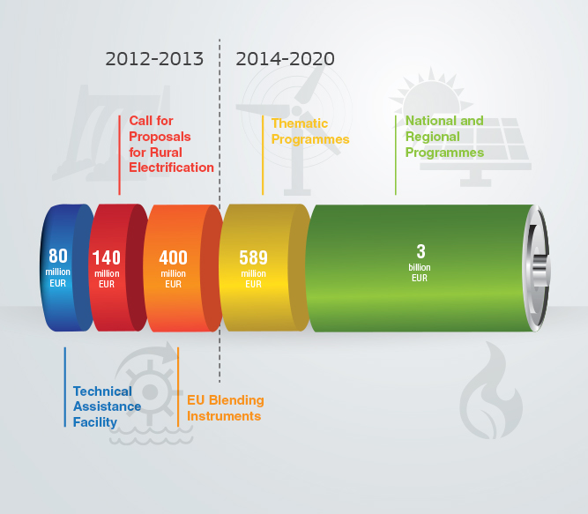
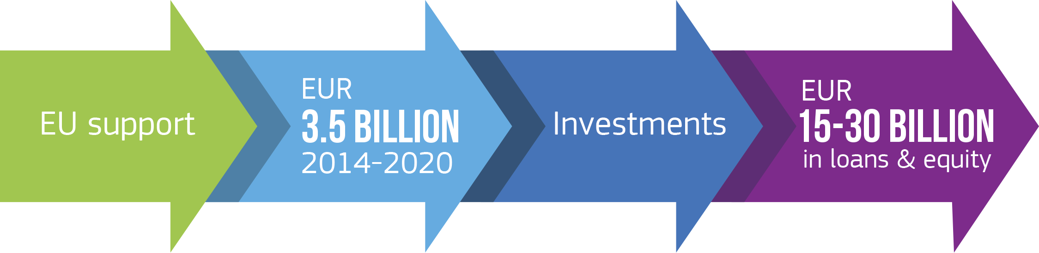
More than EUR 4 billion for the fight against energy poverty so far
EUR 600 million mobilised already in 2012-2013.
More than EUR 3.5 billion allocated for 2014-2020.
Significant leveraging investments. Fill gaps in energy infrastructure and power businesses, schools, homes and hospitals.

Slide 3
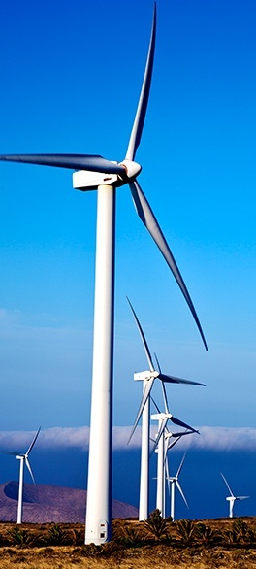
Technical Assistance Facility
Catalysing reforms – improving investment environment
Calls for Proposals for Rural Electrification
Empowering rural communities
EU Blending Instruments
Fuelling inclusive growth

Slide 4
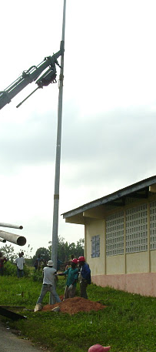
Challenges for Investments
Main "obstacles" identified
  Lack of equity
  Lack of skilled developers
  Lack of scale to cover transaction cost
  Lack of affordable long term debt
  Lack of interactions between LAs-CSOs and private investors
Market imperfections to be addressed by the Convertible Grants scheme:
  Increase in risk capital to substitute for the lack of equity
  Increase long term debt availability
  Increase project scaling up possibilities
  Increase number of projects reaching financial close through structuring / arranging / advising

Slide 5
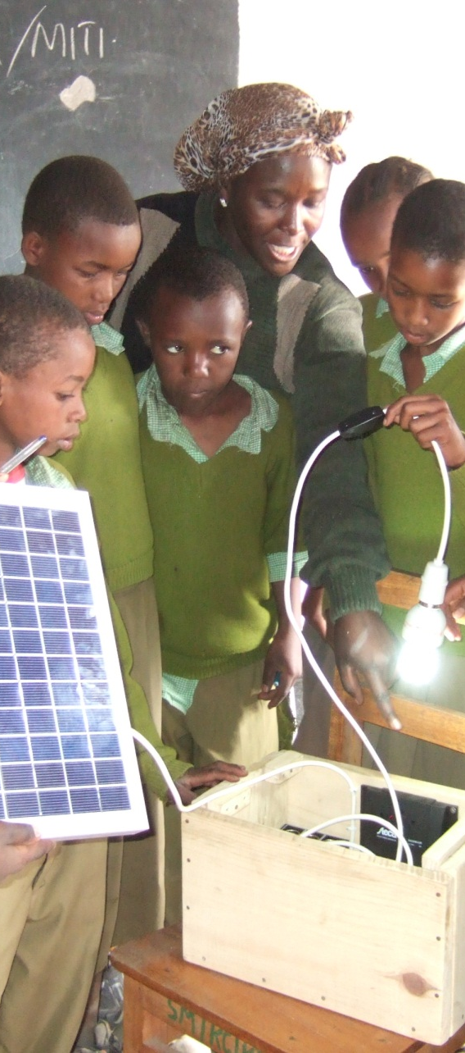
ElectriFI objectives:
boost investments increasing access to electricity and modern energy services as a driver for development, through unlocking the existing potential of the private sector
bridge the financial gap by making available early stage development risk capital, namely grants, that may convert into subordinated debt and which will be paid back when investments succeed

Slide 6
Funding Structure
EQUITY
Assets / Investments
DEBT
FINANCIAL GAP

Slide 7
Project Preparation
EQUITY BY INVESTOR
Typically 50% of Total Funding
CONVERTIBLE GRANT
Typically 50% of Total Funding

Slide 8
Project Financing
EQUITY
Assets / Investments
Typically 30 to 40% of Total Funding
ElectriFI contribution
SENIOR DEBT
Typically 60 to 70% of Total Funding

Slide 9
Project Financing
EQUITY
Assets / Investments
Typically 30 to 40% of Total Funding
ElectriFI contribution
DEVELOPMENT
AND/OR COMMERCIAL
SENIOR DEBT
Typically 60 to 70% of Total Funding

Slide 10
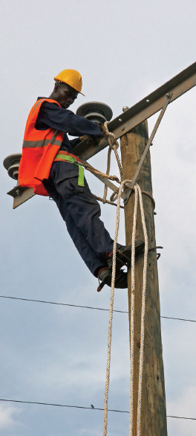
How is the Financial gap bridged?
Financial gap in equity
  convertible grant
  subordinated debt
  at a very early stage through convertible grants: monies made available will convert into subordinated debt upon reaching certain milestones (such as completion of feasibility studies, financial close, project completion, etc.) or
  at a somewhat later stage through direct investment by subordinated debt or
  at a very late stage through contingent risk capital to be used to cover delay damages, cost overruns, etc. in order to reach completion of investments
  FLEXIBILITY IS FORESEEN (Guarantees, equity etc)
CONSESSIONAL

Slide 11
ElectriFI Support: Early Stage Development Capital
(illustrative)
€
Subordinated Loan
Cash flow for subordinated debt service and dividends
Convertible Grant
Cash flow for senior debt service
O&M costs
-
0
2
4
6
8
10
12
year
Pipeline Boosting & Enhancement
Contingent Subordinated Debt
Pilot phase
Growth
Scaling up

Slide 12
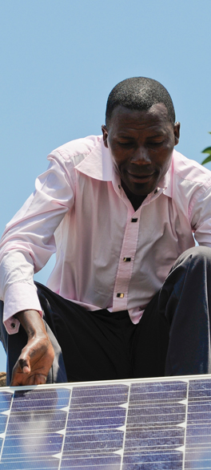
Support features
Different business models require different support structure in terms of:
the percentage of the (convertible) grant to the total investment budget;
the pace, the milestones and the preconditions for releasing the EU support;
the objective criteria for a project to be considered successful and requested to repay the grant;
the repayment modalities including i.a. the repayment timeframe, the interest rate (concessional or zero rate) etc.;
the exit strategy

Slide 13
What will be the applications submission framework?
Projects proposals submitted via EDFIs under the blending framework
FMO mandated by EDFIs to be in the lead for the administration of this support scheme
In the Start Up Phase Technical Assistance could be provided to boost and enhance a pipeline and to counteract weakness in:
  Feasibility studies
  Projects bankability

Slide 14
Thank you for your attention!
For more information: http://ec.europa.eu/europeaid/energy
http://capacity4dev.ec.europa.eu/topic/energy

