Slide 1
Caribbean:
Our Story, Our Vision, Our Strategy
MAY 2015

Slide 2
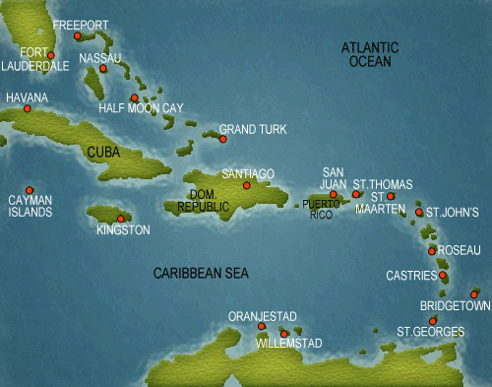
Caribbean Overview
Grand Bahama Power Company
Ownership: 80.4%
Employees: 165 Customers: 20K
Dominica Electricity Services
Ownership: 51.9% Employees: 225 Customers: 35K
St. Lucia Electricity Services
Ownership: 19.1%
Employees: 262 Customers: 69K
Barbados Light & Power Company
Ownership: 100% Employees: 450 Customers: 125K
Notes:
Emera has been invested in the Caribbean for the last 7 years. Our first foray was into Lucelec in St. Lucia back in 2007, followed by GBPC in 2008, BLPC in 2011 and finally Domlec in 2013. While all part of the Caribbean, each island is vastly different in culture, topography and size.
Barbados is the smallest of the islands in size but has the most people. There are about 600 people per square km vs. 36 people per square km in Grand Bahama. Dominica has about 100 people per square km but it is very mountainous and difficult terrain.
That means that for GB’s 50,000 customers there is 138 km of transmission lines while BLPC has 81 km of transmission lines for it’s 125,000 customers. Domlec peaks at 17 MWs for 35000 customers and Grand Bahama peaks at about 80 for it’s 19,500 customers.

Slide 3
The Emera Strategy
Market Opportunity
Demand For Cleaner Affordable Energy
▪ Environmental Regs & Standards
▪ Social & Political Demand
▪ Fuel-Source Diversification
▪ Energy Independence & Stability
Drivers
The Emera Strategy
▪ Renewables
▪ Transmission (renewables to market)
▪ Gas Generation and Transportation
▪ Utilities
Leverage the unique linkages and adjacencies of Emera’s assets, capabilities & relationships to create growth and development opportunities.
Focus
Dividend Target:
6% CAGR through 2019
75-85% Regulated Earnings
Strategic Initiatives
Maritime Link and Labrador Island Link | New England Transmission | New England Gas Generation | Gas supply in Maritimes, New England & Caribbean | ‘Fuel to Assets’ Projects | ‘Greening’ of Generation | Renewing Ageing Infrastructure

Slide 4
Emera Caribbean Strategy
Drivers
The Emera Strategy
▪ Renewables
▪ Transmission (renewables to market)
▪ Gas Generation and Transportation
▪ Utilities
Leverage the unique linkages and adjacencies of Emera’s assets, capabilities & relationships to create growth and development opportunities.
Focus
The Emera Caribbean Strategy
 | Customer Trust and Support | Intelligent Grid Investments | ‘Fuel to Assets’ Investments | Renewing Ageing Infrastructure
Sustainable Energy Solutions
The Enabler: Operational and Service Excellence

Slide 5
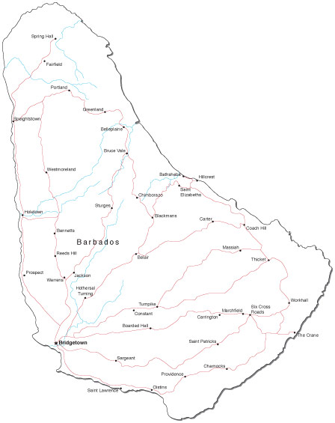

Barbados
Clean Energy Enablers
Government
Sustainable Energy Framework
National Sustainable Energy policy (draft)
Energy SMART Fund
Tax Incentives
Solar Water Heater Successes
New Electric Light and Power Act & Regulations
Utility
Emera corporate strategy
BLPC Renewable Energy Rider (RER)
BLPC Intermittent Renewables Penetration Study
BLPC Demand Side Management study (DNV GL)
St. Lucy Energy Gateway (Solar/Wind/Storage)
Environment
Volatile hydrocarbon fuel prices
No economic natural gas in low volumes
Funding Agency desire
Customer and Stakeholder desire
Significantly lower renewable prices
Smart Grid technology maturity

Slide 6
Barbados
Clean Energy Opportunities
Solar PV
8 MW currently installed
Plans are in place for 20 MW by end of 2015
Plans are in place for 30 MW by mid 2016
Plans being developed for 40 MW by late 2016
BLPC have modelled 65 MW Solar PV to be immediately possible without significant storage
Wind
No significant wind is currently installed
Wind is the most economic renewable resource
BLPC have modelled 15MW to be immediately possible, and complimentary to the solar PV load profile
Land control and setbacks are a challenge
Public engagement and support is required
Land searches and partially developed private projects are the next steps

Slide 7
Barbados
Clean Energy Opportunities
Waste to Energy
Govt/Cahill plans for B$650 Million plant (40MW net - 75MW gross)
Waste study indicates island capacity for 14MW
BLPC is developing back-up plans, with private industry support.
A solution is needed for the islands growing garbage problem
Biomass
Sugar cane industry is currently being “restructured”
Proposed 25MW Combined Heat and Power plant at Andrews
We have significant concerns on the long term viability of the main biomass sources (bagasse, river tamarind)
A Possible Solution?
Combine the above two opportunities into one
WTE/Biomass CHP plant of about 25MW.
Less duplicated infrastructure
Less risk

Slide 8
Barbados
Clean Energy Opportunities
Smart Grid
Advanced Metering Infrastructure communications is under test in Barbados
Emera is developing an agreement with major world players on high level Smart Grid integration
GBPC initial deployment is planned for late 2015
This is the key to high penetration of renewables
Biofuels
Jatropha trials continuing in Grand Bahama and commencing in Dominica
Applicability for Barbados being reviewed
Local Biodiesel is in use in vehicles at BLPC
Marine
The development of floating Offshore Wind is under review with University of Maine and DCNS
A MoU for Ocean Thermal development with DCNS is under review
Emera Inc. is a leader in tidal generation development in Nova Scotia.

Slide 9
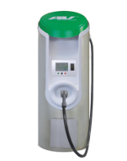
Barbados
Clean Energy Opportunities
Electric Transportation Now
Over 100 Electric vehicles on the island
Electric vans are now arriving weekly
More than 20 Public charging stations available
Level 3 high speed DC charging station to be installed by Emera/Megapower in Q3 2015
Lobbying government for a reduction in EV import duties
Ensuring the EV network is an integral part of the Smart Grid vision
Electric Transportation Future
Shore to Ship electrical supplies
Electric Bus or Trolleybus network
Electric Private hire vehicles (Taxi, rental)
Vehicle to Grid integration (V2G)

Slide 10
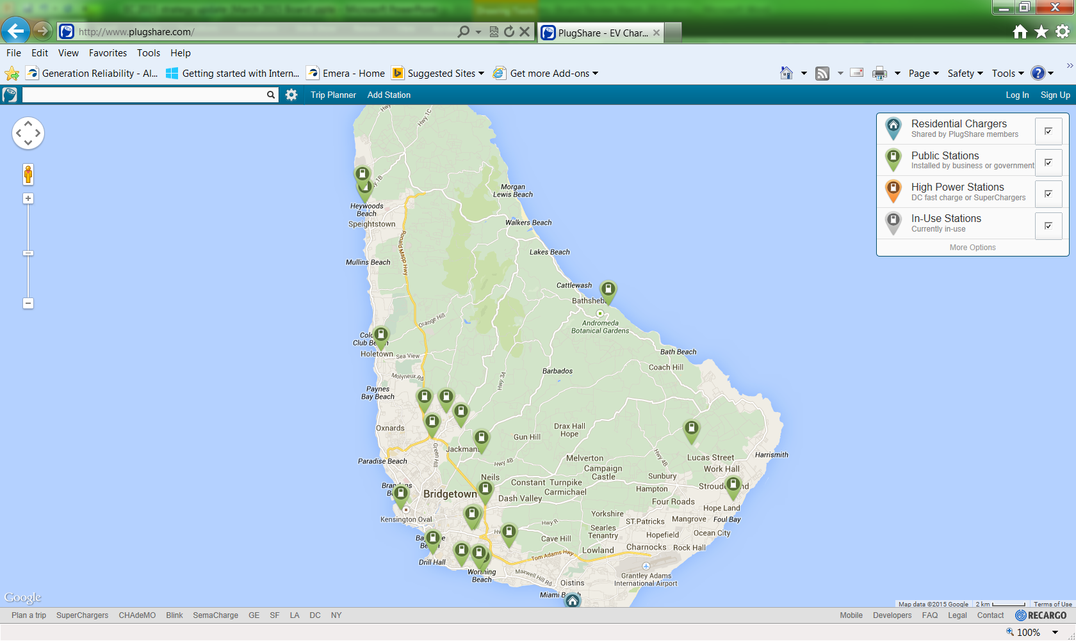
Barbados Public EV Charging Stations

Slide 11
Barbados
e-Showcase for the World
Tourism
100% Clean Energy
100% Fuel Electrification
Electric Transportation System
Plug in Cruise Ships
Industry Leading Energy Efficient Hotels
… This is a draw, a differentiator… and a cost reducer
Showcase for the World
Siemens, ABB, GE and Toshiba are engaged with Emera in visioning a sustainable renewable infrastructure plan, integrating Energy, Water, Transportation and Tourism
The Big Opportunities
Electric Transportation
Sustainable Tourism
Marine Energy technology hub
Inter Island Connections (geothermal, marine tech)

Slide 12
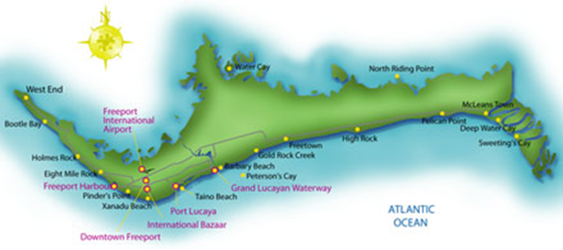
Grand Bahama Island
Strategic Investment Initiatives
Compressed Natural Gas
  Planned Introduction of Compressed Natural Gas (CNG) from Florida (2016)
  Conversion of generators at West Sunrise Plant (WSP)
  Evolve to a distribution point for provision of CNG to other customers
  Provide other energy (waste heat) and CNG to other customers
Solar PV
Develop Utility Scale Solar PV
  Install Solar Resource characterization measuring equipment
  3 MW at West Sunrise
  5 MW at Sands Brewery Site
  Leverage Barbados’ experience
  Develop niche solar hybrid solutions
Emera Caribbean working on opportunities for the Cays (solar/battery/diesel)

Slide 13
Grand Bahama Island
Alternative Fuels Development
Develop biodiesel production from Jatropha, as a pilot program
5 Acres in Abaco under development
Ongoing pilot in Grand Bahama
Development of local biodiesel production underway
Intelligent Grid System investment
Advanced Metering Infrastructure Deployment planned to begin in late 2015
Operational and Service Excellence
Consolidation of Generating Plant operations
Investment in integration and automation of business processes
Optimization of automatic vehicle location systems with outage management Continued investment in Competency Based Training
Continued implementation/refinement of the Asset Management strategy Possible integration with Water Company metering/billing initiative
Pre-pay metering to reduce bad debt

Slide 14
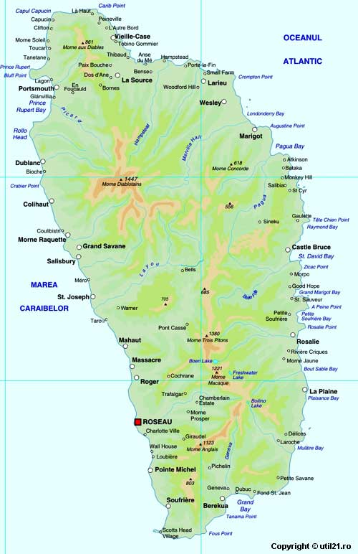
Dominica
        Geothermal Energy Development
        Building new transmission lines
        DOMLEC is planning to build new transmission supporting the geothermal project being developed by the Government & a French consortium
        Potential to stabilise or lower electricity prices and improve energy security
        Commercial operation of the geothermal plant expected to commence in 2017
        Adding Solar PV
        DOMLEC undertaking development of small and intermediate solar to add to its energy mix, and for ‘self use’
        This will displace diesel generation during the peak hours of the day
        Electric Transportation
        Domlec is about to trial its first EV, a Nissan Van

Slide 15
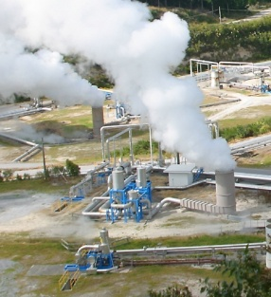
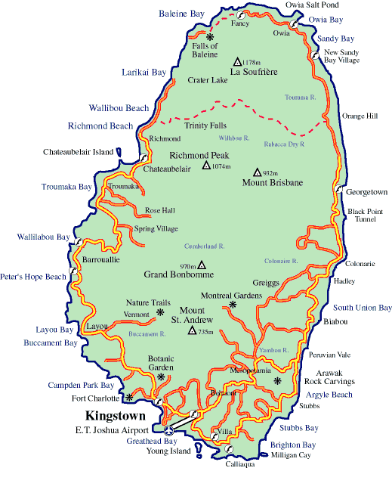
St. Vincent
        Geothermal Energy Development
Photo of a typical geothermal development
        Transforming St. Vincent’s Energy Future
        Exploration for the development of a 10-15 MW geothermal power plant in St. Vincent
        Emera Caribbean is partnering with Reykjavik Geothermal from Iceland
        Drilling to commence in 2015
        Commercial operation by 2018
        Transformational project with the potential to displace 75% to 90% of imported diesel fuel
        Improve energy security
        Stabilize electricity prices
        Establish Emera Caribbean as a regional leader in geothermal energy
        Strengthen relationship with the government owned utility, VINLEC
        Grow our presence in the region

Slide 16
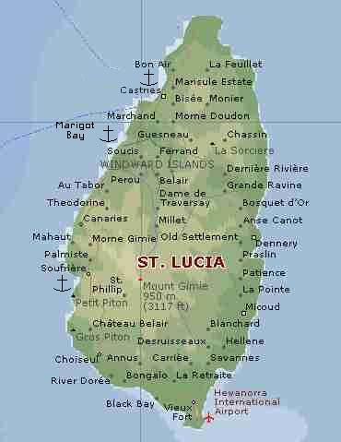
St. Lucia
        Clean Energy Development
        Geothermal Energy
        Geothermal to be undertaken by ORMAT/UNEC under an agreement with the Government
        World Bank to help fund initial scientific assessment
        LUCELEC in preliminary PPA discussions
        Solar & Wind
        LUCELEC has a LOI with a developer to partner on wind energy assessment and if feasible jointly develop a wind farm
        DNV consultants are undertaking a grid integration study to look at interconnection issues
        DNV is also preparing an RFP for a 3 MW solar project
        Electric Transportation
        LUCELEC has just imported a Nissan Leaf and has installed a public charging station

Slide 17
Clean Energy Long Term Goals (Barbados)
NEW CLEAN GENERATION
2015 - 2017
18 MW Utility Solar | 2018 - 2020
20 MW Small IPP Solar | 40 MW* Waste to Energy | 2020 - 2029
10 MW Large Wind | 25 MW* Biomass - Andrews | Economic Energy Storage |  | 2029 - 2045
5 MW Small Wind | 20 MW Small IPP Solar | 20 MW Utility Wind |  | Offshore Wind 200 MW
2 MW Solar Thermal/Heat Recovery | 5 MW Solar Thermal/Heat Recovery | 10 MW small wind |  | Ocean Thermal 60 MW
55 MW Clean Energy | Liquid Biofuel available | 10 MW Utility Solar |  | Geothermal from Dom/St. V.
 | AMI/Grid Mitigation | 15 MW Solar Thermal/Heat Recovery |  | Large Scale Energy storage
 | 145 MW Clean Energy | Jatropha Biofuel Available
 |  | 200 MW Clean Energy
 |  |  |  | 100% Clean Energy
ELECTRIFICATION
2015 - 2017 | 2018 - 2020 | 2020 - 2029 |  | 2029 - 2045
500 Electric Vehicles | 2,000 Electric Vehicles | 10,000 Electric Vehicles |  | 50,000 Electric Vehicles
Electric Vehicle Charging Network | Flexible Rate Structures | Integration of Water Authority Assets |  | Electric Transportation Systems
Natural Gas Conversions | Hotel Room Efficiency Investment | Fully Integrated Smart Grid
Energy Efficiency | LED Streetlights | Electric Bus Transportation
Demand Side Management Plan | Plug in Cruise ships | Demand Side Control
 | Demand Side Management actions | Additional Hotel Room Capacity
Increasing Efficiency > Increasing Utilisation > Decrease Gasoline, LPG, Natural Gas Usage > Lower System Energy Costs > Lower FX requirements
LEGACY GENERATION PHASE OUT
2015 - 2017 | 2018 - 2020 | 2020 - 2029 |  | 2029 - 2045
LSD B 60 MW | LSD B 60 MW * | LSD B 60 MW * |  | LSD B 60 MW *
LSD A 48 MW | LSD A 48 MW | LSD A 40 MW |  | 60 MW
Steam 38 MW | Steam 38 MW | Seawell 40 MW |  | *Could convert to Dual Fuel if Gas available
Garrison 13 MW | Seawell 73 MW | 159 MW |  | *Could convert to Biodiesel if economic
Seawell 73MW | 219 MW
232 MW
Managing Stranded Asset Risk > Reducing dependence on Fuel Oil > Lower System Energy Costs > Lower FX requirements
Note: This is an indicative strategic vision for discussion purposes.
This is not an approved plan.

Slide 18
Barbados
Next Steps
Alignment on “One Plan”
Consolidation/rationalisation of all the “100%” visions
Buy-in of all 100% proponents on “One Plan”
Confirm the size, cost and risk of WTE and Biomass projects
Carry out a macro-economic cost/benefit study
Confirm regulatory framework for IPP’s and the Utility
Develop confidence in the investment community by “doing”, not studying
Develop and commit to one public business plan, led by Government, standing shoulder to shoulder with :
Emera / Barbados Light & Power Co.
The Fair Trade Commission
Local and Regional Industry
Funding Agencies (IDB, EU, GIZ etc.)
BREA
University of the West Indies
Central Bank
Barbados Chamber of Commerce & Industry
National Petroleum Corporation
100% proponents (Emera, UWI/Hohmeyer/BREA, Viking, Williams etc.)
Waste to Energy proponents (DoE, Cahill)
Biomass Proponents (DoA, BCIC, ISP)

