Slide 1


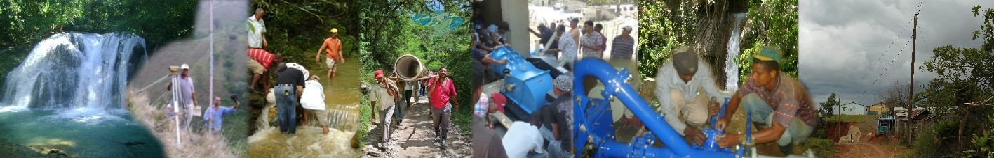
Rural Electrification Programme
based on renewable energy sources

Slide 2


Overall Objective of the Project
Improve the quality of life of rural poor communities in remote areas and mountainous regions of the Dominican Republic through the implementation of projects to produce electricity from renewable sources of energy and to reduce dependence on fossil fuels.
Assist in promoting the use and management of renewable energy sources in a context directed towards human development, encouraging the creation of a network of relations based on mutual cooperation and common interest.

Slide 3

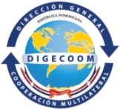



Donor Partners
European Union
National Authorising Officer Office
Dominican Institute of Hydraulic Resources (INDRHI)
Rural and Suburban Electrification Unit (UERS)
Small Grants Programme (PPS/PNUD)
United Nations Development Programme (UNDP)

Slide 4
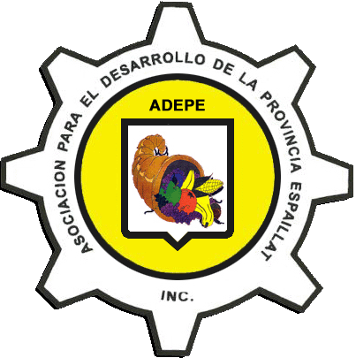
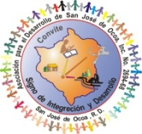




Local partner organizations
Asociación para el Desarrollo de la Provincia Espaillat (ADEPE)
Asociación para el Desarrollo de la Provincia de San José de Ocoa (ADESJO)
Centro para la Educación y Acción Ecológica (Centro Naturaleza)
Fundación Sur Futuro
Visión Mundial
Juntayaque

Slide 5
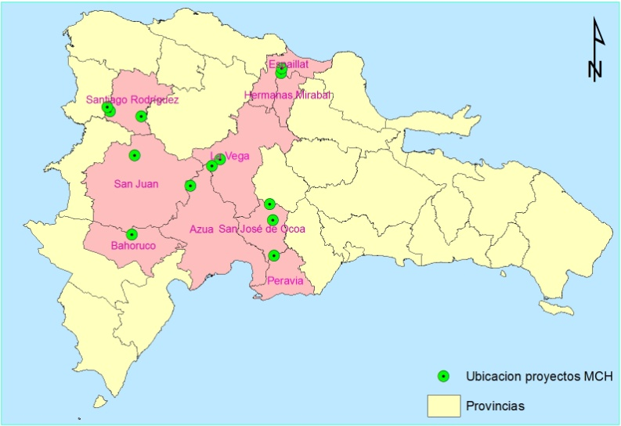
Project location

Slide 6
Starting situation in the communities
Very poor rural communities (low quality housing, low income, primarily dependent on agriculture, limited access to credit, etc.).
Communities isolated from the National Interconnected Electric System
  Use of gas kerosene, cuaba, candles and some homes with solar panels for lighting.
  Unavailability of energy for productive use.
  Power consumption (only in poor lighting and other small domestic uses) of more than 300 pesos (6.70 USD) per family.
Remote communities
Limited communication
Many children do not receive the amounts of hours of classes needed.
Restricted supply centres and in homes no sources or conditions for food preservation

Slide 7
Expected results
33 systems of renewable energy installed and fully functioning
31 Micro-Hydroelectric systems, with capacity ranging between 5 - 150 KW
1 Wind based system delivering <50KW
1 Energy generating system based on mixed energy sources (bio fuel and solar energy)
Micro-enterprises created
Based on the provision, generation and distribution of mixed sources of Renewable Energy Sources (RES) in 4 communities.
Community based associations +
National Association of cooperatives
For the management and administration of energy systems, based on the principle of mutual partnership, help and solidarity and crossed subsidization.

Slide 8
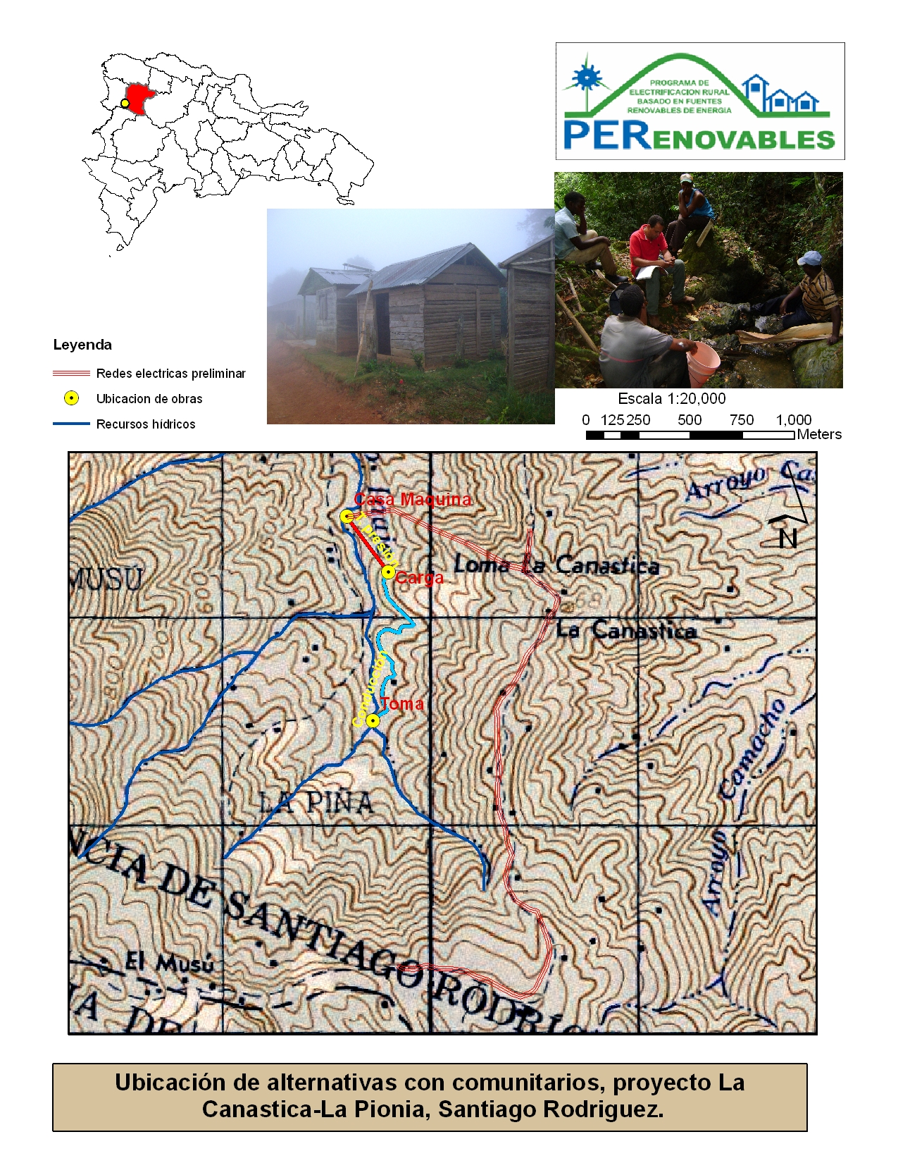
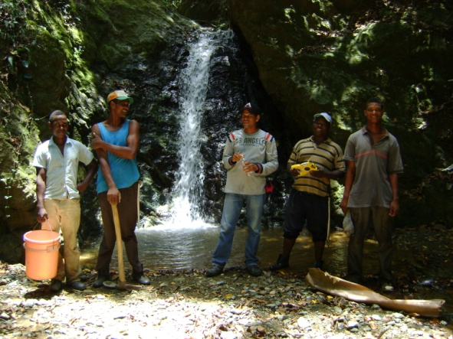
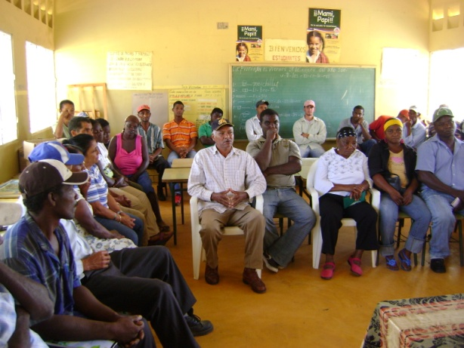
PROCESS:
Feasibility studies
Evaluation of potential
Socialization process

Slide 9
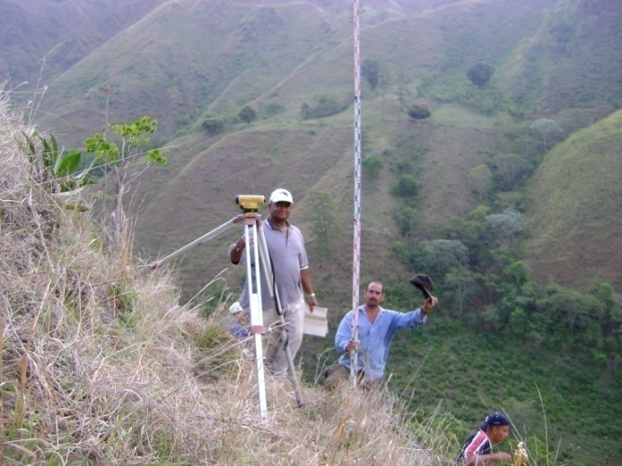
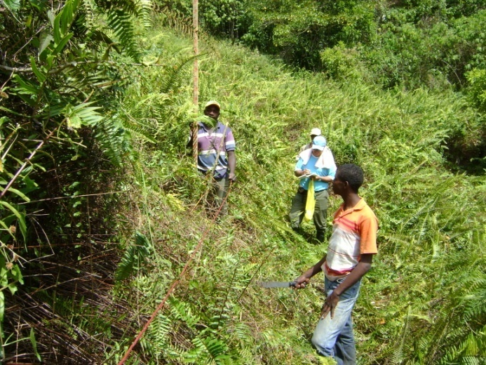
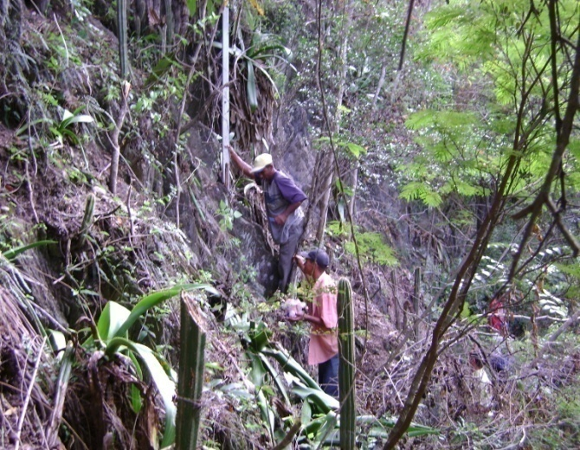
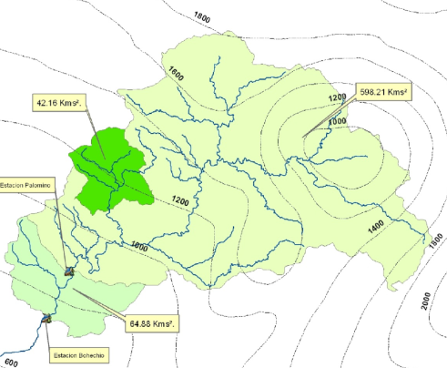
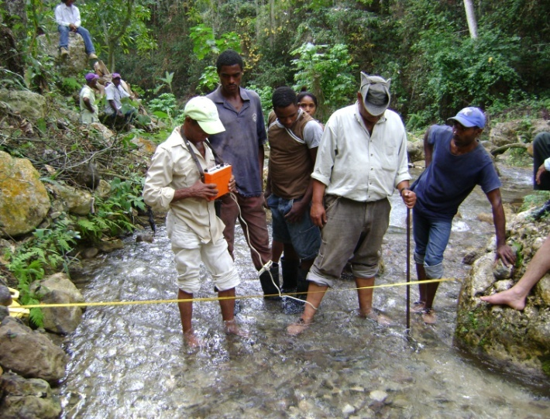
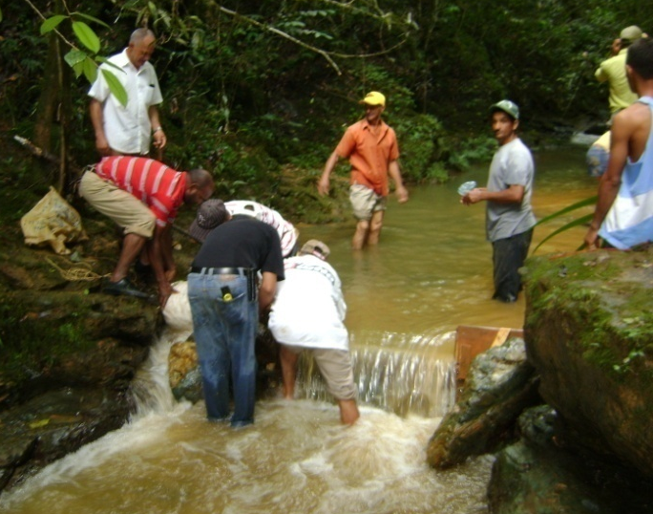
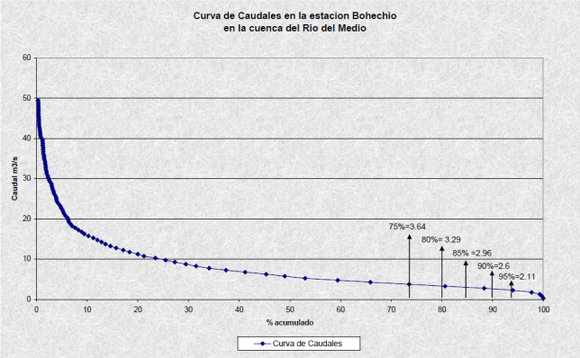
Feasibility studies
Surveying
Hydrological studies

Slide 10
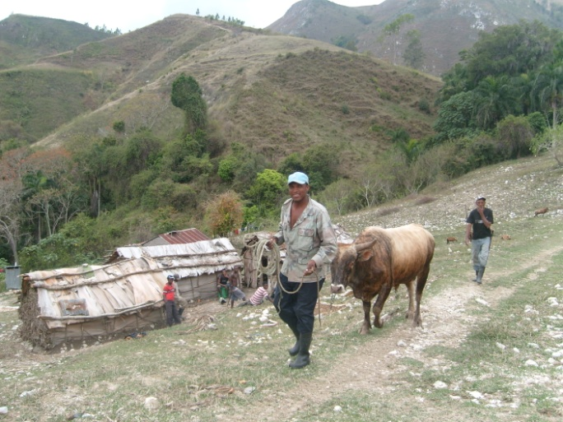
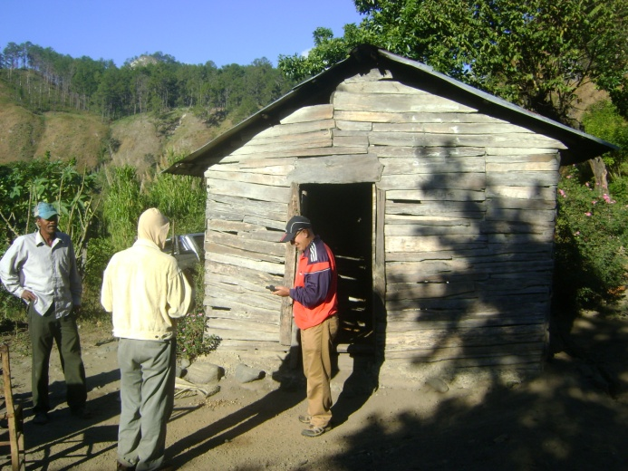
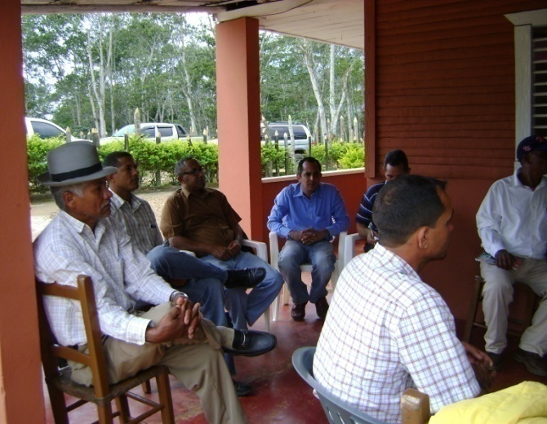
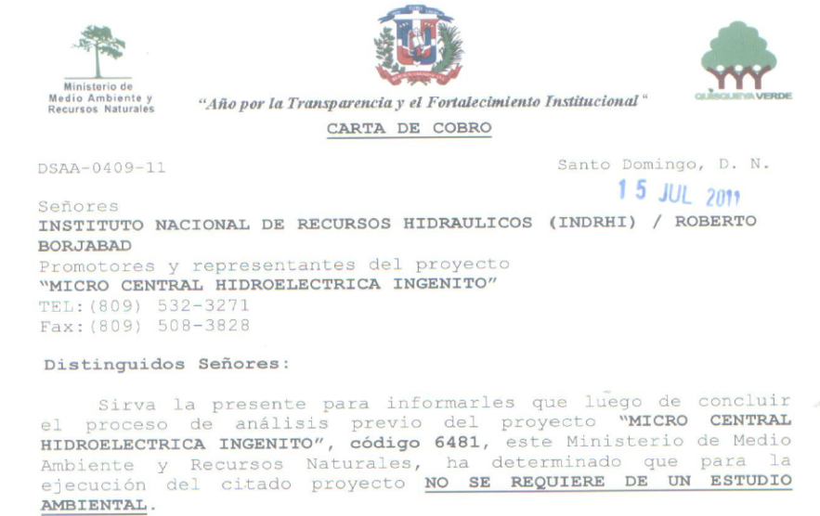
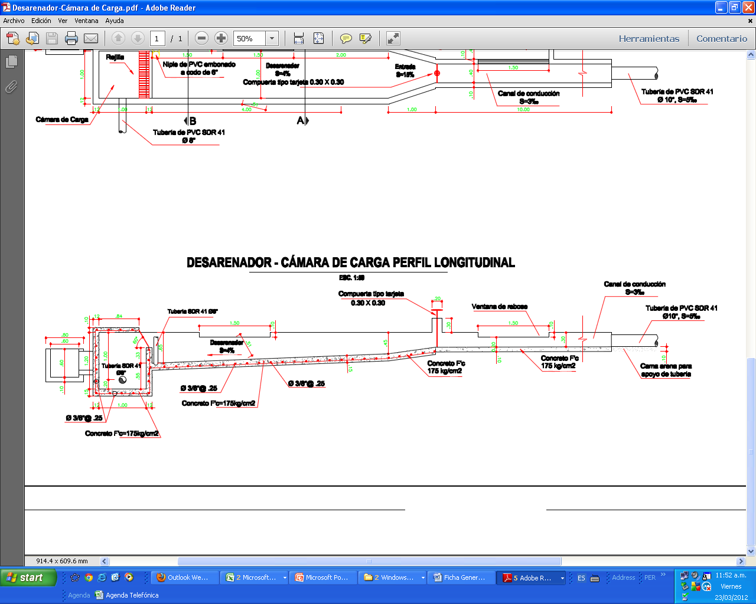
Feasibility studies
Base line study
Designs, budgets
Environmental permits

Slide 11
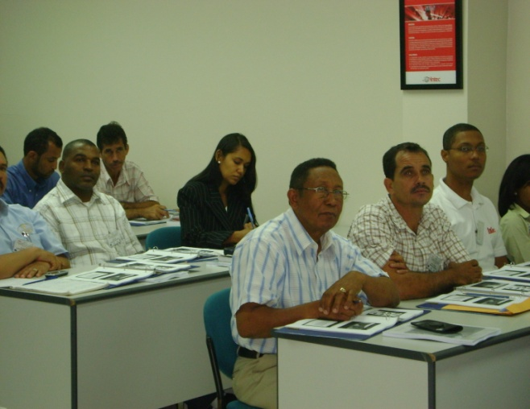
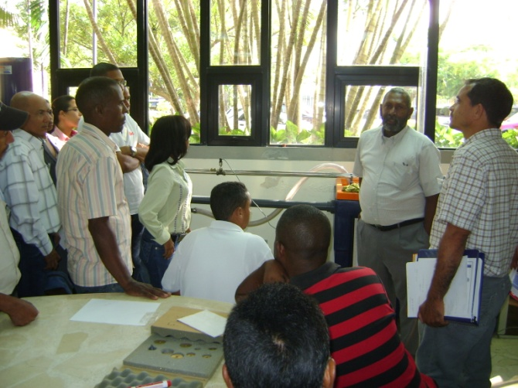
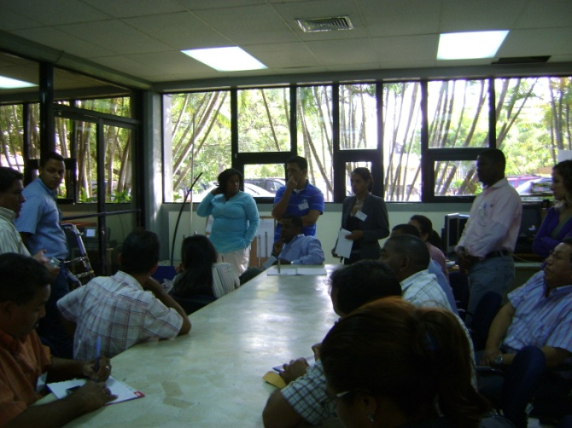
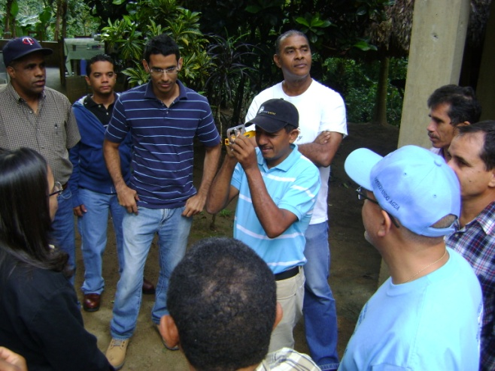
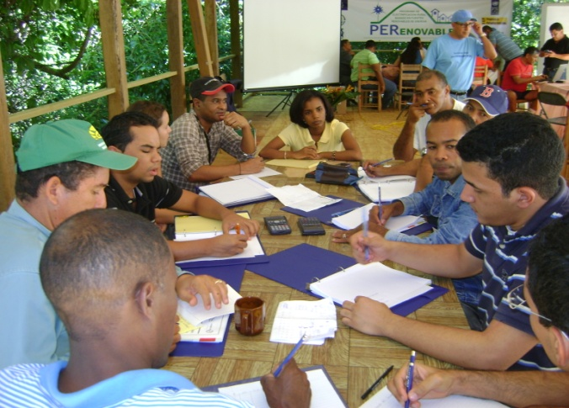
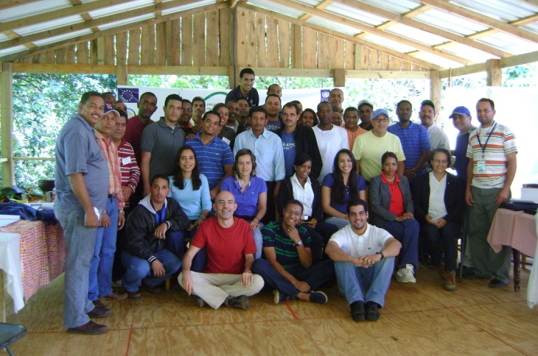
Capacity building
Workshop for the design, implementation and management of community micro hidro projects

Slide 12
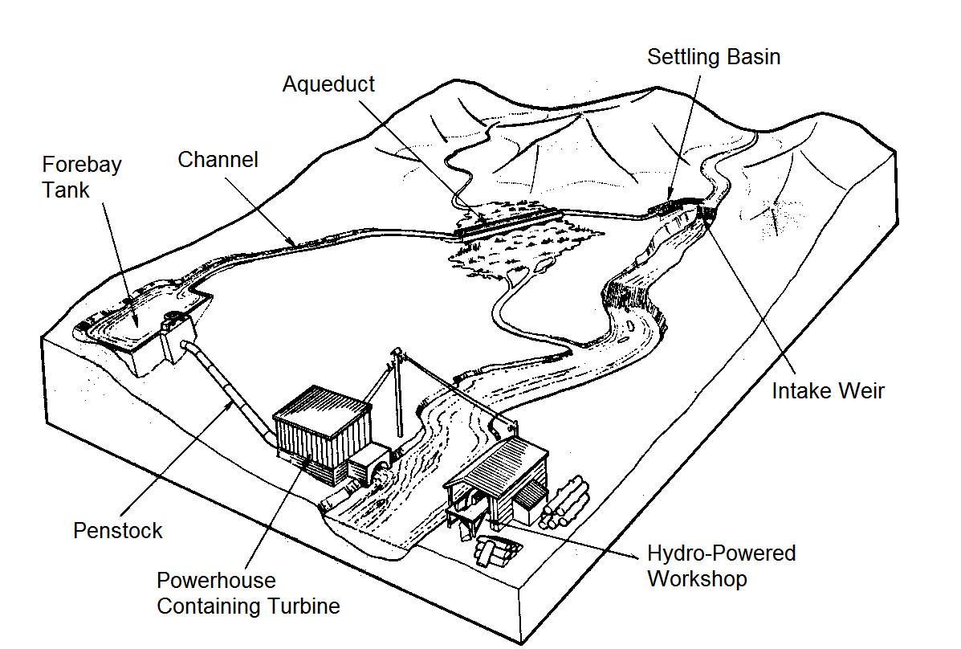
Construction process
  Construction of civil works and equipment installations and electrical networks

Slide 13
Construction process
    Training and environmental conservation
      Workshop in basic plumbing
      Workshop in basic electricity and security
      Climate Change Workshop
      Reforestation
      Establishment brigades for fire control
    Management and community organization
      Participatory planning
      Workshops defining and establishing management system
      Institutional strengthening workshops and accounting management
      Workshops on rational energy use and definition of the tariff system.
      Constitution of the entity responsible for the system
      Exchanges of experience with other projects.

Slide 14
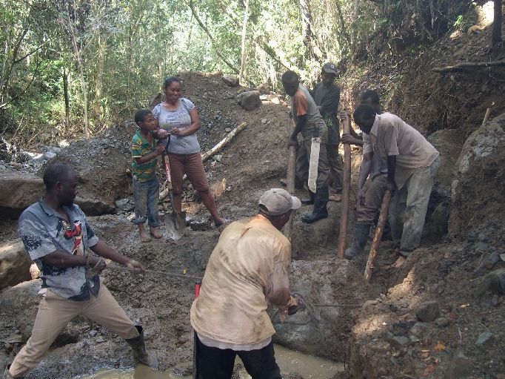
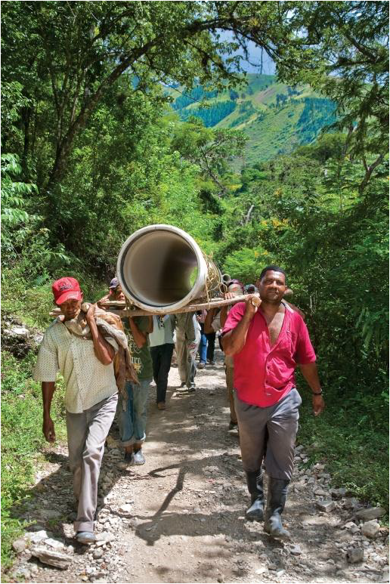
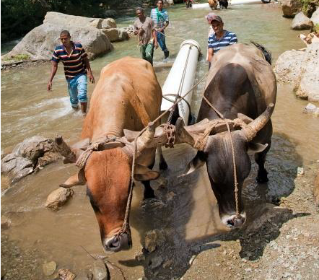
Construction process
Removing rocks. MCH La Canastica-La Peonía.
photo/ Centro Naturaleza.
Transport of material. MCH Ingenitos.
photo/Fundación Sur Futuro.
MCH Ingenitos. photo/Fundación Sur Futuro

Slide 15
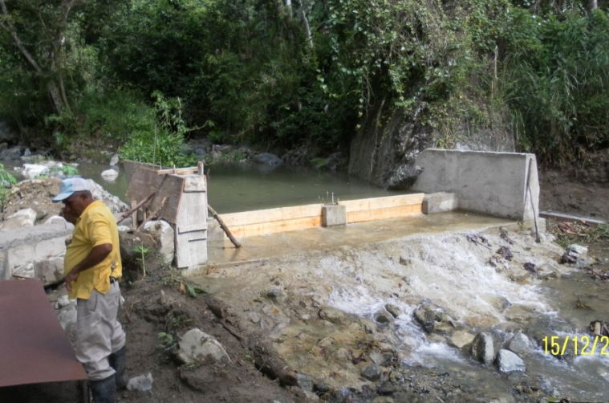
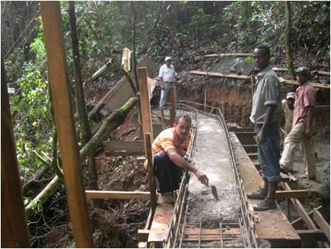
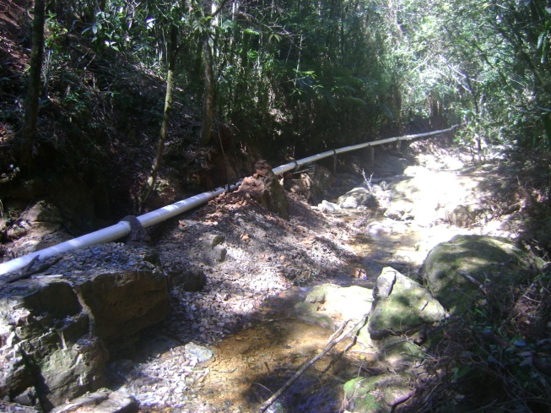
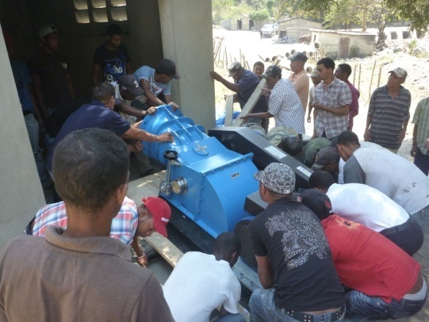
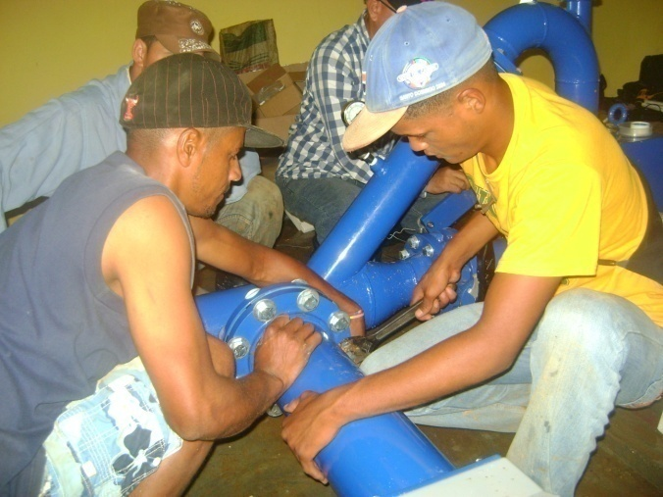
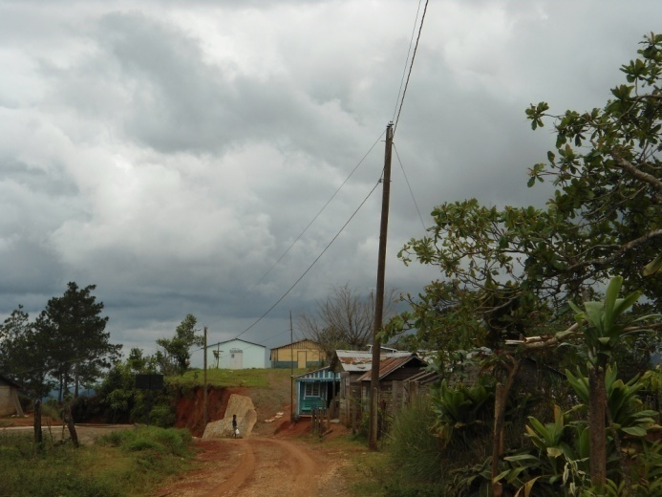
Construction process
Forebay tank construction. MCH La Bocaina. photo/ADESJO.
Channel construction. MCH La Canastica. photo/Centro Naturaleza
Penstock. MCH La Cabirma. photo/PER
Movilizando Turbina a Casa de Máquina. MCH Ingentitos.
Instalation of turbine. MCH La Canastica.
Electricity grids

Slide 16
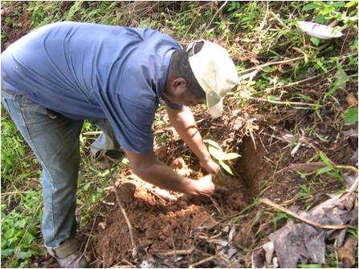
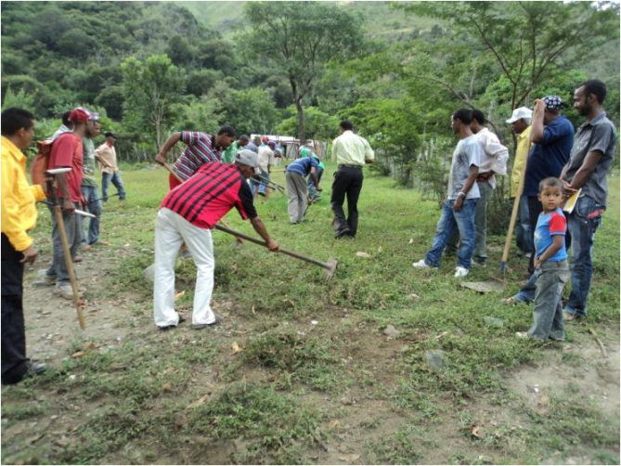
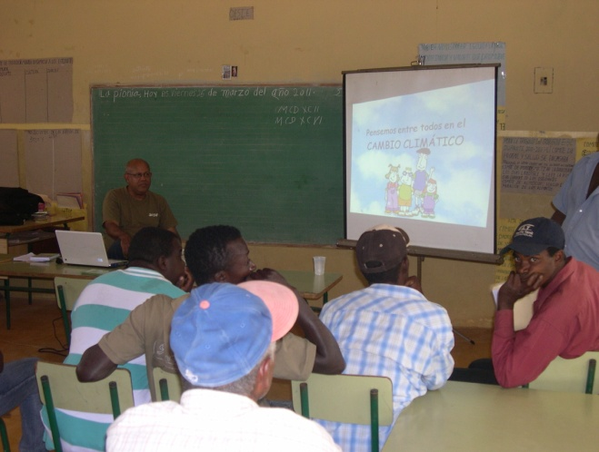
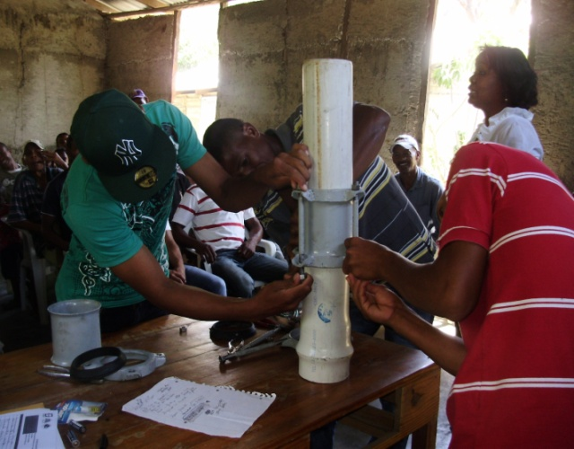
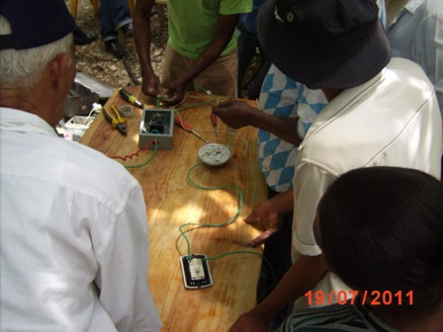
Training and environmental conservation
Reforestation campaign.
photo/Centro Natrualeza
Fire brigades training.
photo/Fundación Sur Futuro
Climate Change Workshop.
photo/Centro Naturaleza.
Basic Plumbing workshop
photo/Fundación Sur Futuro
Electricity and security workshop
photo/Visión Mundial.
Electricity and security workshop
photo/Fundación Sur Futuro.

Slide 17
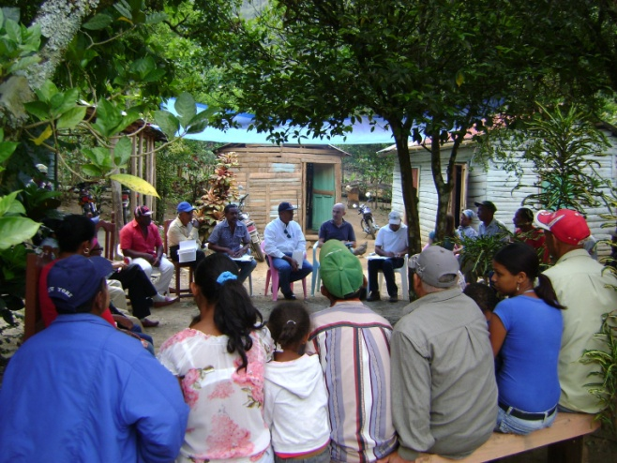
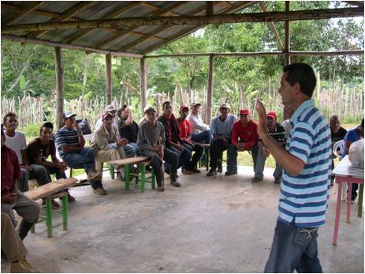
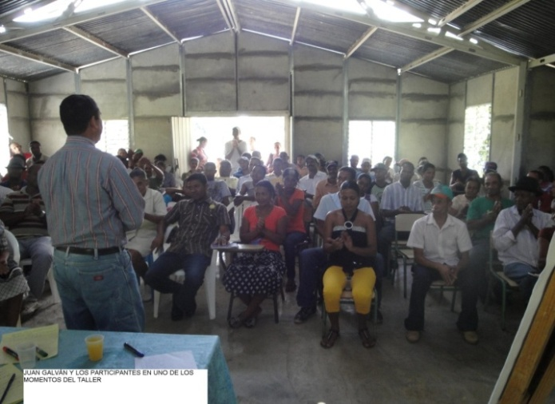
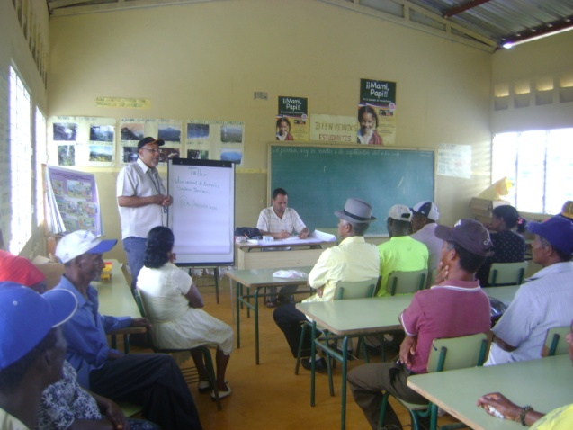
Management and community organization
Participatory Training Workshop in La Bocaina.
Workshop to define the management system. MCH La Cabirma.
photo/Centro Naturaleza.
Management Workshop. photo/Fundación Sur Futuro.
Accounting management workshop. Ingenitos.
Workshop on tariff system and rational use of energy.

Slide 18
Project Summary
Results | Planned | Final
Renewable energy systems installed | 33 | 13
Community organizations responsible for the management of the systems | 32 | 13
National Association of Cooperatives created | 1 | 0
Establishment of small micro-enterprises | 4 | 3
Beneficiaries | 3,350 f | 1,400 f
Duration | 60 M | 76 M
Budget (total cost) | 5,088,323.25 EUR | 2,995,323.02 EUR
EU Contribution | 2,499,997.5 EUR | 1,451,950.20 EUR

Slide 19
Lessons Learned
Need of detailed studies where works have very specialised technical specifications and require detailed information at local level.
Inter-agency cooperation and communication is important where the operations are under the responsibility of different actors with dissimilar capacities.
Proper planning is important in processes that involve multiple actors
Ensure timely information to relevant partners on issues related to the implementation of the project to mitigate the risks associated with lack of resources and delays.
Communities can take the lead in their own development and can guaranty the sustainability of the project if they are properly trained and involved in the implementation process.

Slide 20
Video

Slide 21
Additional information
Delegation of the European Union to the Dominican Republic
Ave. Abraham Lincoln #1063, Ensanche Serrallés
Santo Domingo, D.N., República Dominicana
Teléfono: (809) 227-0525
Fax: (809) 227- 0509 / (809) 227-0510
http://eeas.europa.eu/delegations/dominican/index_es.htm
United Nations Development Programme (UNDP)
http://www.do.undp.org/content/dominican_republic/es/home/operations/projects/environment_and_energy/per_renovables/

