Slide 1
Conflict Analysis

Slide 2
Some recent examples
- Bosnia and Herzegovina (BiH)
- Central African Republic (jointly with the UN)
- Chad
- Democratic Republic of Congo (DRC)
- Guatemala (led by the Delegation, in coordination with Member States)
- Lebanon
- Liberia
- Libya
- Syria
Northern Nigeria
Sudan
Yemen
Upcoming: Gulf of Guinea
Kenya
Somalia
Notes:
Ben

Slide 3
Causes of conflict
 | Security | Political | Economic | Social
International
National
Local

Slide 4
Doing the grid
Think about all the factors – political, economic, social etc.
Structural and proximate causes
Don’t worry about where in the grid, get it down
Remember external factors

Slide 5
 | Security | Political | Economic / environment | Social
International | - Weaknesses in regional response |  | Lake Chad
National | Heavy handed security response Weak capacity | - Corruption - Poor governance | exclusive growth Reliance on oil | - Ethnic tensions
Local | - Weakening of traditional systems | - Elite capture of Sharia | Poverty | - Land rights
Notes:
Ben

Slide 6
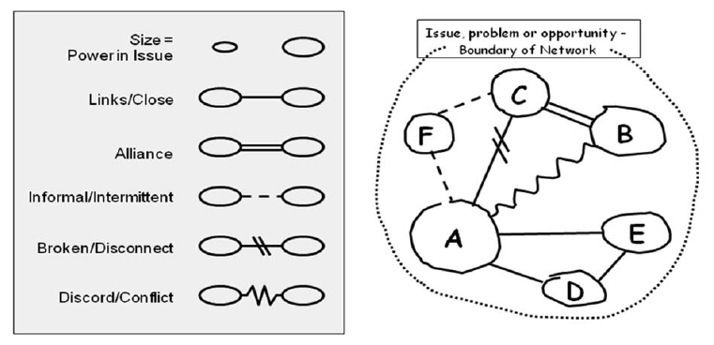
Stakeholder analysis

Slide 7
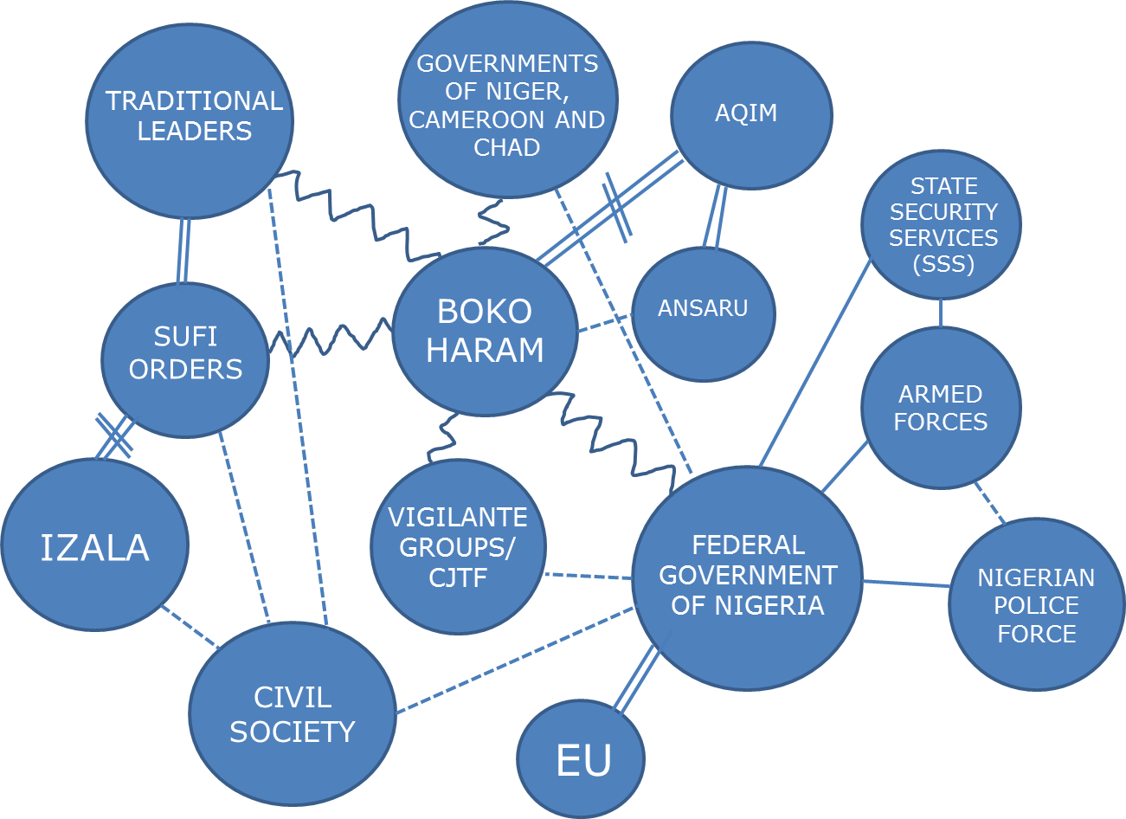

Slide 8
Resources and documents
EU Staff Handbook for Operating in Situations of Conflict and Fragility
EU guidance note on Conflict Analysis
Ask your PSC rep for a copy of the Northern Nigeria conflict analysis and PFCA

Slide 9
Close

Slide 10
Drivers of peace
What helps resilience against violence and escalation? What are the institutions or actors that promote peace?
Causes
Stakeholders
What are political, economic , political, social, security or other factors that are structural (long term) or more proximate causes for current conflict dynamics?
Who are the stakeholders acting or affected by the conflict? How are they related? What are their position, but also what are their (hidden) interests and sources of power?
Conflict dynamics
What is driving conflict and violence? Are their patterns and triggers for violence? What is the impact of the conflict(s)?
Scenarios
Options
What are possible future developments? Which factors will determine future development in one or the other direction.
What priorities / objectives do we see to address the conflict?
What are options to realise them?
Responses
What has / is the EU doing?
What are others doing?
How can we assess this vis-à-vis the conflict dynamics?

