Slide 1


Slide 2
Countries or areas of countries at risk from humanitarian emergencies that could overwhelm national response capacity and lead to a need for international assistance

Slide 3
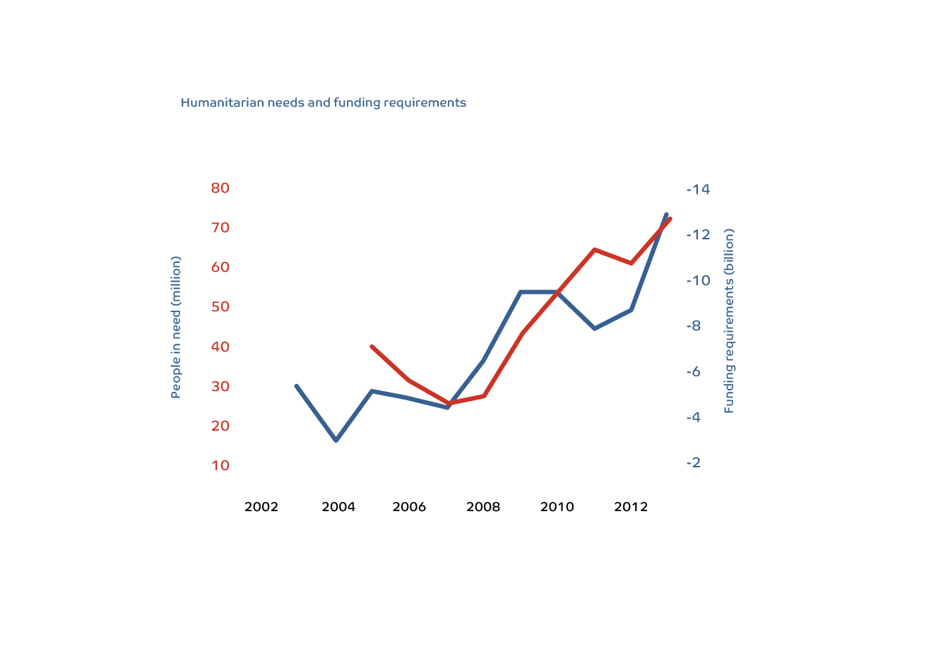

Slide 4
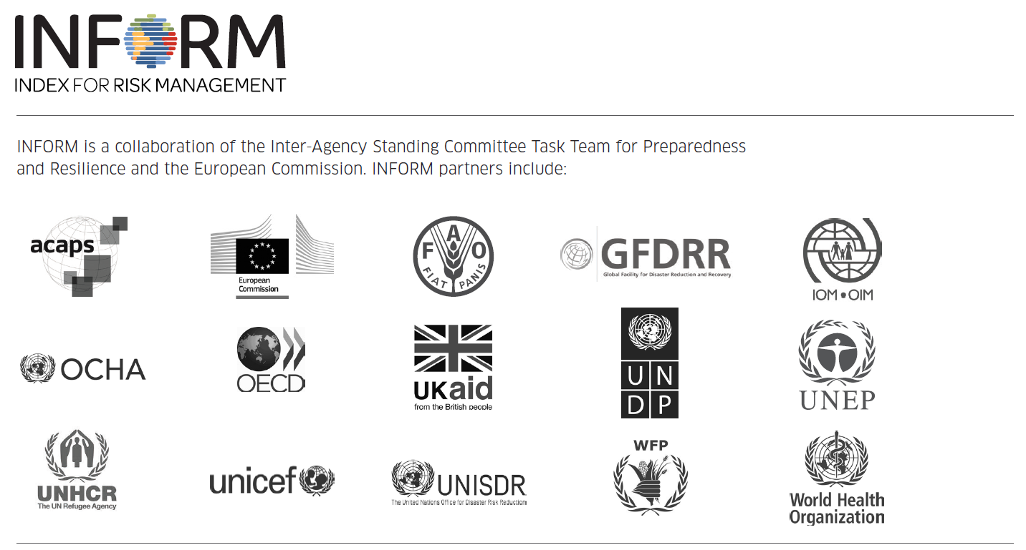

Slide 5
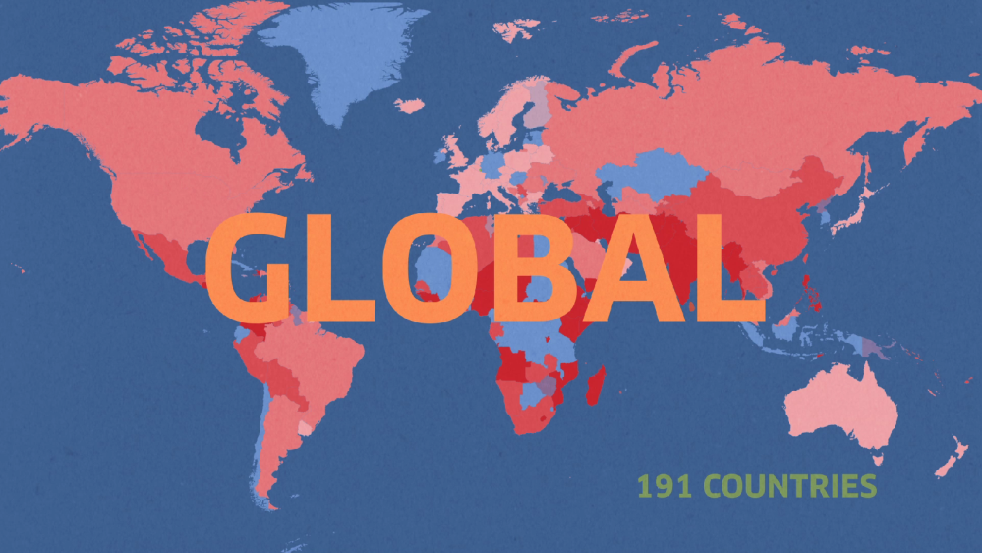



Slide 6
INFORM
OR INFORM COMPONENTS
FOCUS INDICATORS
GEOGRAPHICAL PRESENCE
ORGANISATION SPECIFIC INDEX
+
+
=

Slide 7
INFORM at ECHO: “new” Global Vulnerability & Crisis Assessment - GVCA
INFORM@EC
Global Risk and Crisis Assessment
INFORM
Risk Index
Focus element
Crisis Index
INFORM
Haz&Exp
Vulnerability
Coping Cap
Recent Conflicts
Recent disasters
Uprooted

Slide 8
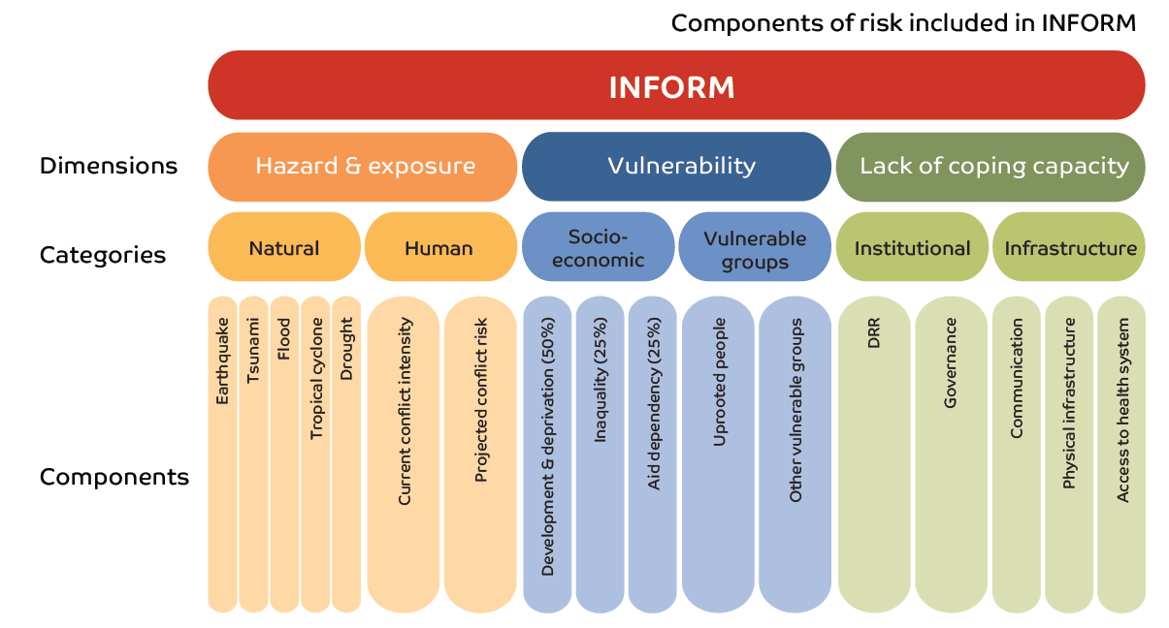
Global Conflict Risk Index
(1st step in the EEAS Conflict EWS)

Slide 9
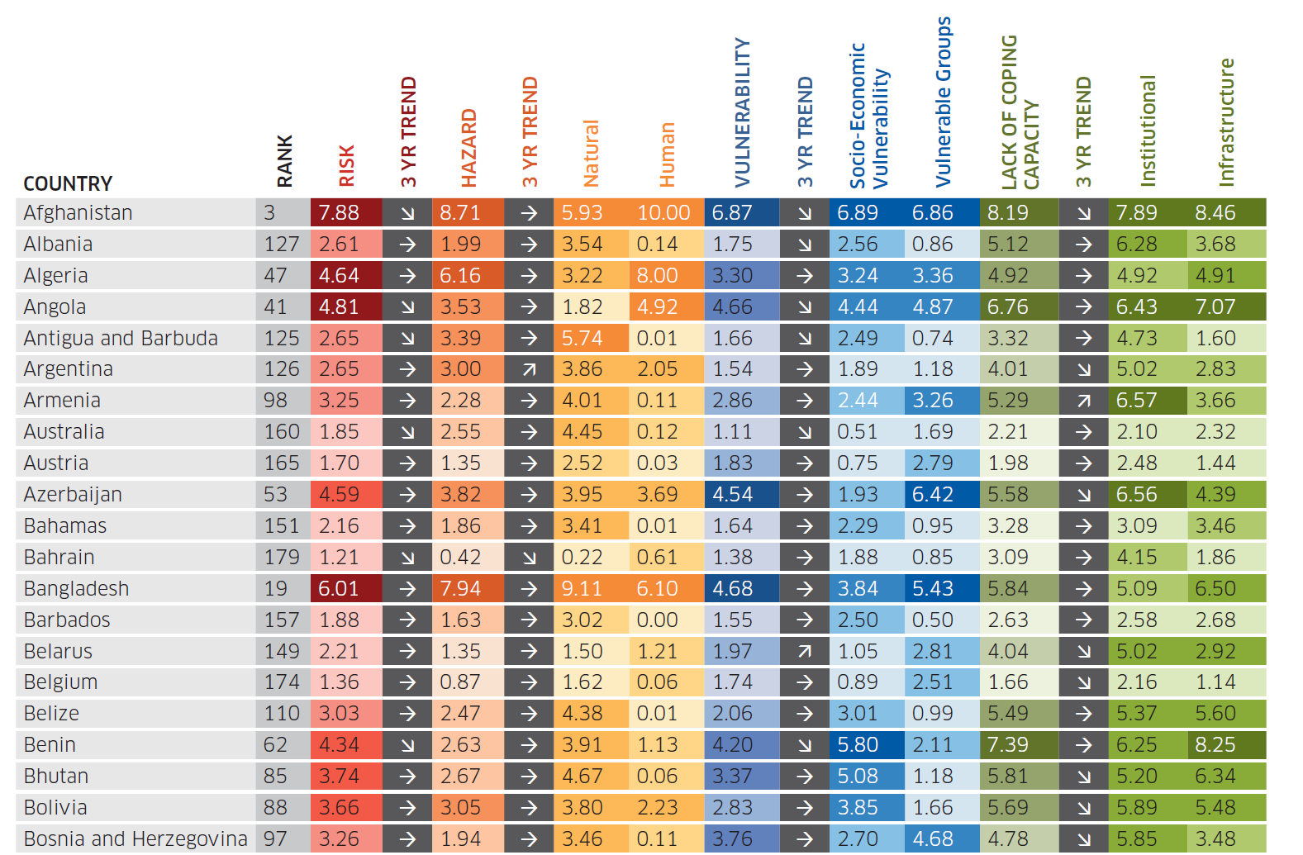

Slide 10
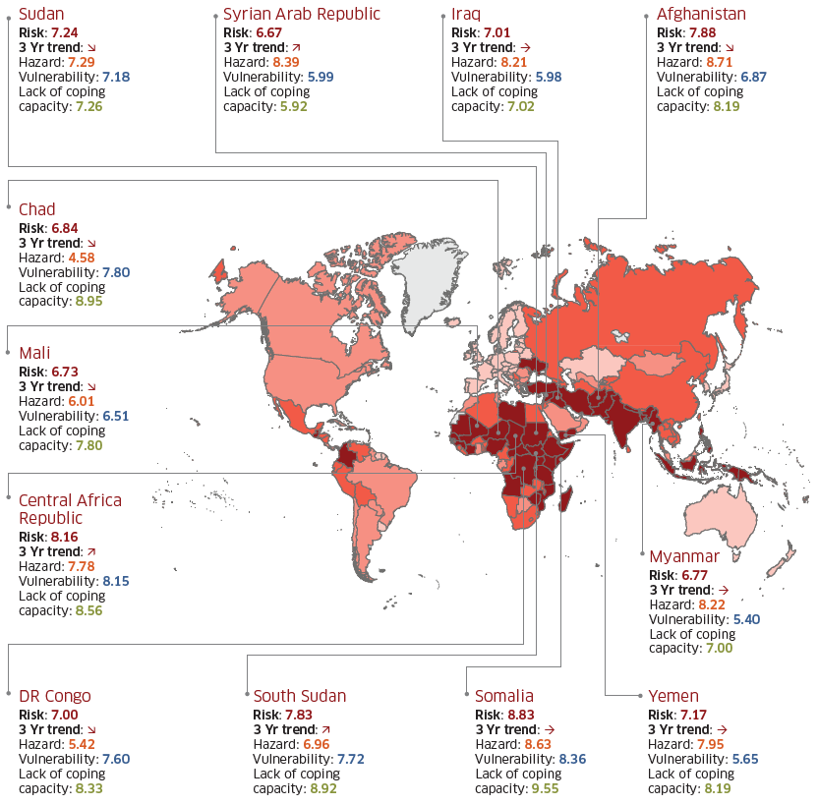

Slide 11
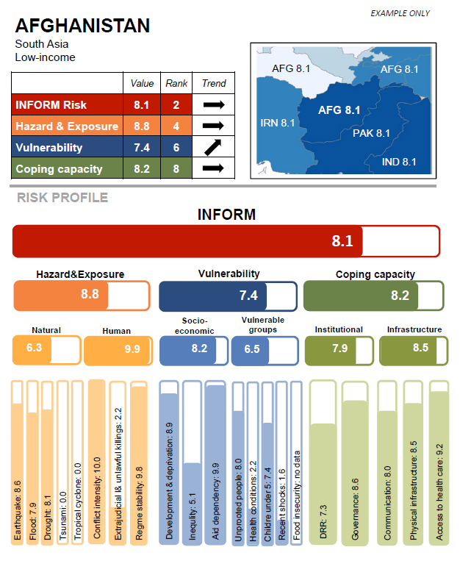
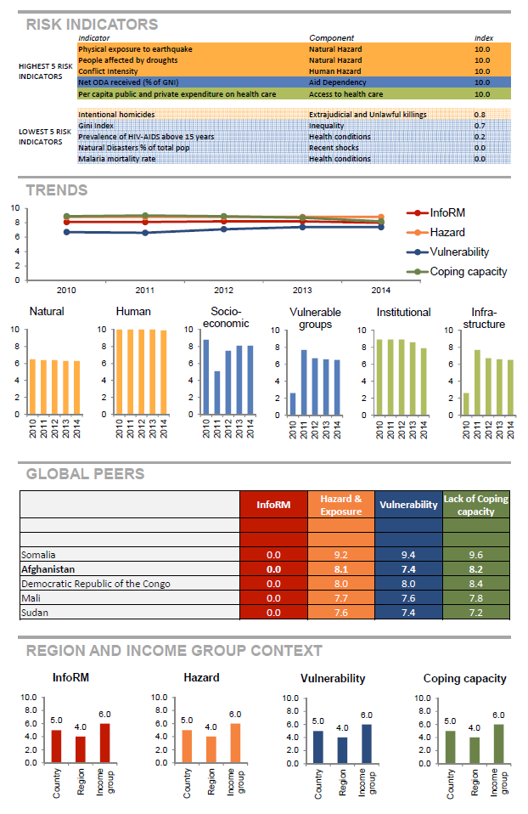

Slide 12
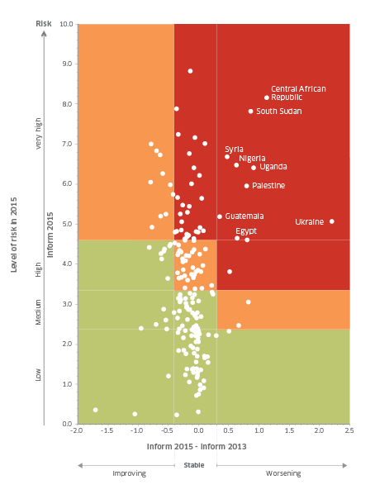
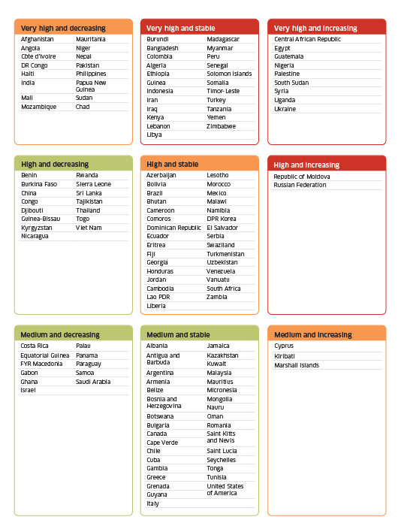

Slide 13
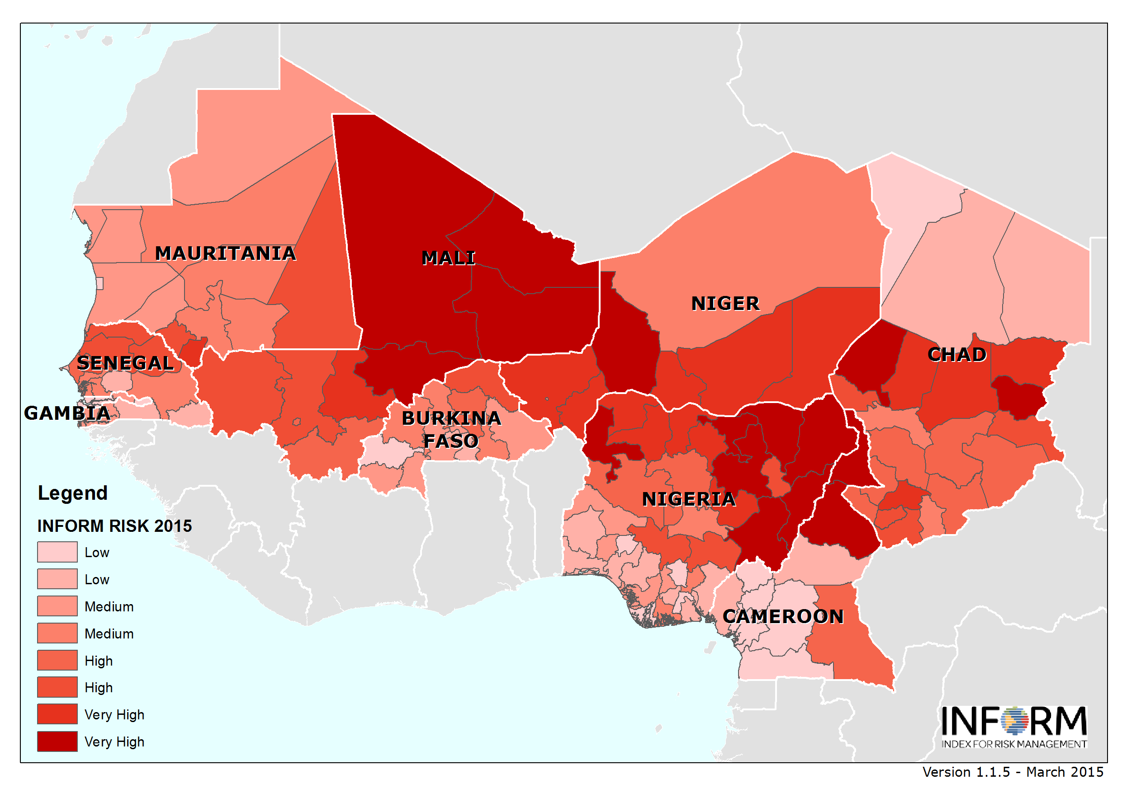

Slide 14
WWW.INFORM-INDEX.ORG

