Slide 1

Eye on Earth 2015 Summit

Slide 2






Eye on Earth Summit 2015

Slide 3
Eye on Earth: Vision & Mission
  Eye on Earth Vision
A world where environmental and associated social and economic information, combined with citizen engagement, improves decisions leading to sustainable development.
  Eye on Earth Mission Statement
Eye on Earth networks and builds capacity across diverse knowledge communities to improve decision-making for sustainable development.

Slide 4
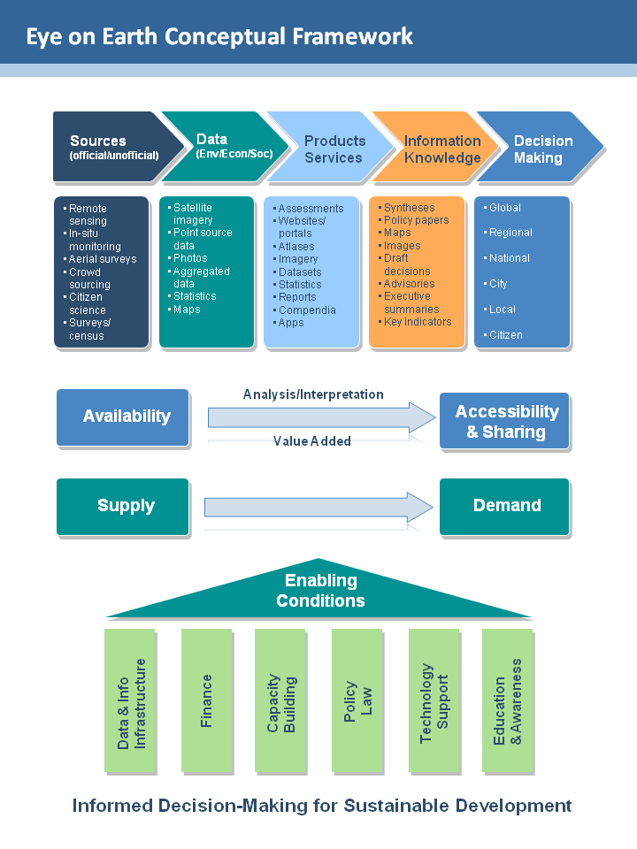
Scope
of the
Eye
on
Earth
Summit

Slide 5


Eye on Earth Alliance
The Alliance provides the strategic direction for the movement and builds global support for Eye on Earth.
Alliance is organising the 2015 Summit.

Slide 6
Summit Themes
Three different themes
Data Demand
Data Supply
Enabling Conditions

Slide 7
Summit 2015 - Overview
Date:
6-8 October, 2015
Attendees:
  650 attendees
  Diverse audience of thought leaders
  Attend in personal capacity
Tagline:
Informed decision-making for sustainable development
Website:
www.eoesummit.org

Slide 8
Summit 2015 – Overview (contd)
Speakers and delegates from public sector, private sector and civil society
5 plenary sessions (including Special Initiatives and regional stream)
25 breakout sessions (average of 4-5 for each parallel sessions). Each breakouts has its own raison d’ etre, its own key questions and expected outcomes
29 side events
Souq zone for showcasing, debating and networking

Slide 9



The Venue
St. Regis Hotel, Saadiyat Island, Abu Dhabi

Slide 10
Activities
PechaKucha
Lightning talks
Technology demos
Networking
Exchange of ideas and experience
Brokering collaboration

Slide 11
Expected Outcomes of Summit
Partnerships established (thematic, regional, ..e.g. SIDS, Polar)
Eye on Earth Alliance and Network strengthened and expanded
Call for action to address critical issues e.g. Framework and an Information infrastructure for SDG reporting
Capacity building pilots for SDG data and information
Projects funded (portfolio of 81 projects)
Role of citizen science promoted (every citizen has potential to monitor)
Role of crowdsourcing promoted (gather data quickly for decision-making)

Slide 12

Role of citizen science
The Telegraph 13 October 2009
Six-year-old girl finds rare moth
A shrub-eating moth has been discovered in Britain for the first time - thanks to the keen eye of a six-year-old girl.
An Open University spokeswoman said: ''The UK moth fauna is very well-studied so it's unusual for brand new species to be found.
An Euonymus Leaf Notcher - a rare shrub-eating moth never before seen in the UK, found by Katie Dobbins, 6,
Notes:
EoE Community includes representation from Government, UN, non-governmental sector, private sector, academia and civil society in all parts of the world.
The EoE Alliance seeks to continue to build and mobilise global support to advance the overall EoE mission.
The EoE partnership continues to grow. Today, the EoE Alliance is made up of AGEDI, the Group on Earth Observations (GEO), the International Union for Conservation of Nature (IUCN) UNEP and the World Resources Institute (WRI).
The strategic direction and vision of EoE is managed by the EoE Alliance.
The five core organisations possess a diverse yet complementary set of expertise and their collective strengths will be harnessed to drive the EoE agenda forward.

Slide 13
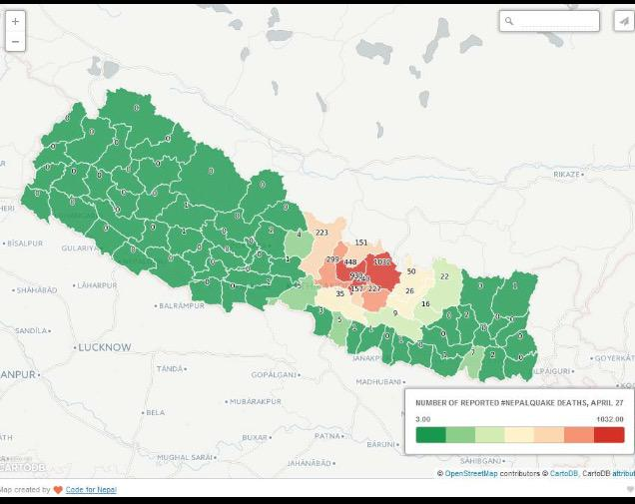
Role of crowdsourcing – Nepal Earthquake: Distribution of fatalities
Notes:
EoE Community includes representation from Government, UN, non-governmental sector, private sector, academia and civil society in all parts of the world.
The EoE Alliance seeks to continue to build and mobilise global support to advance the overall EoE mission.
The EoE partnership continues to grow. Today, the EoE Alliance is made up of AGEDI, the Group on Earth Observations (GEO), the International Union for Conservation of Nature (IUCN) UNEP and the World Resources Institute (WRI).
The strategic direction and vision of EoE is managed by the EoE Alliance.
The five core organisations possess a diverse yet complementary set of expertise and their collective strengths will be harnessed to drive the EoE agenda forward.

Slide 14
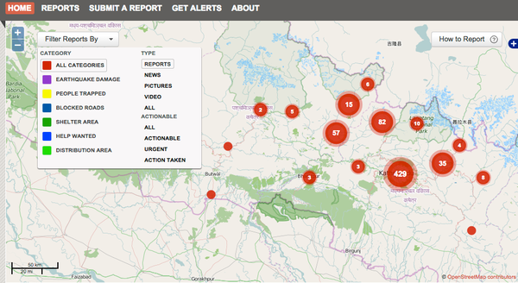
Role of crowdsourcing – Nepal Earthquake
Impacted areas (categories clustered)
Notes:
EoE Community includes representation from Government, UN, non-governmental sector, private sector, academia and civil society in all parts of the world.
The EoE Alliance seeks to continue to build and mobilise global support to advance the overall EoE mission.
The EoE partnership continues to grow. Today, the EoE Alliance is made up of AGEDI, the Group on Earth Observations (GEO), the International Union for Conservation of Nature (IUCN) UNEP and the World Resources Institute (WRI).
The strategic direction and vision of EoE is managed by the EoE Alliance.
The five core organisations possess a diverse yet complementary set of expertise and their collective strengths will be harnessed to drive the EoE agenda forward.

Slide 15
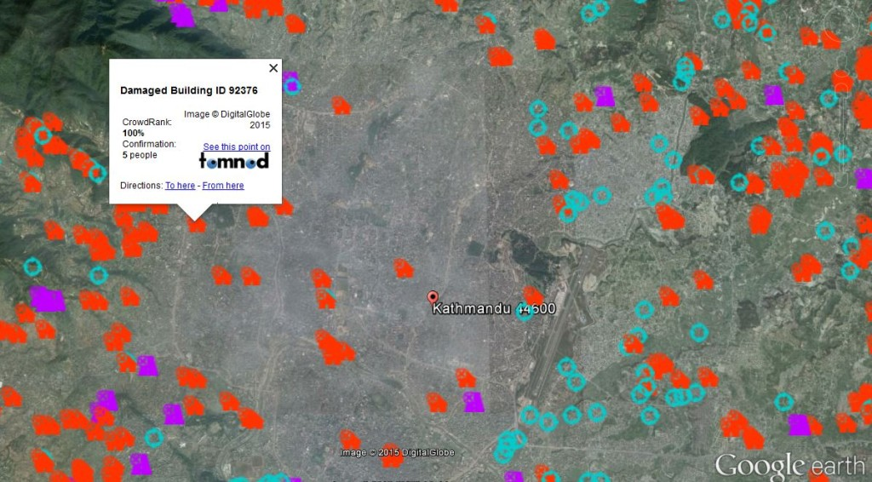
Role of crowdsourcing – Nepal Earthquake:
Distribution of damaged buildings
Notes:
EoE Community includes representation from Government, UN, non-governmental sector, private sector, academia and civil society in all parts of the world.
The EoE Alliance seeks to continue to build and mobilise global support to advance the overall EoE mission.
The EoE partnership continues to grow. Today, the EoE Alliance is made up of AGEDI, the Group on Earth Observations (GEO), the International Union for Conservation of Nature (IUCN) UNEP and the World Resources Institute (WRI).
The strategic direction and vision of EoE is managed by the EoE Alliance.
The five core organisations possess a diverse yet complementary set of expertise and their collective strengths will be harnessed to drive the EoE agenda forward.

Slide 16
Thank You
gerard.cunningham@unep.org
Eye on Earth Coordinator
UNEP
Nairobi

