Slide 1
The task manager as a facilitator of change
You, your partners and your colleagues

Slide 2
Session schedule
What is facilitation
Facilitation to get things done
Role play
Know yourself

Slide 3
Defining facilitation
From the French word ‘facile’, “easy”. Facility. To make easy, to enable
Assist to communicate in an efficient and effective way, without dictating what will happen
The art of managing (group) discussions

Slide 4
Why facilitation
Focussing on purpose and desired outcome
Providing a structure for (group) activities
Creating a climate for problem solving
Testing results
External / ‘neutral’

Slide 5
Link between participation - facilitation - learning
actor
actor
facilitator
Contents
actor
actor
actor
Facilitation enables people to take part in a learning process in an effective way

Slide 6
The facilitator needs to have:
A clear vision of what you are trying to achieve (prevent ‘negotiated nonsense’)
A set of theories, assumptions and values about how to bring about change
A set of techniques and tools to guide your actions

Slide 7

The balancing act
Results
Formal
Individual interests
People
Informal
Common interest

Slide 8
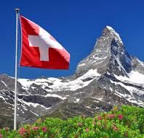
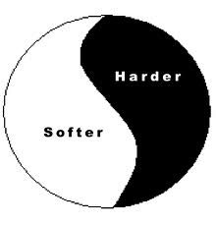
The dilemma
There is no such thing
as a neutral facilitator
CD support managers are
both facilitators and influencers

Slide 9
Example: What will you do?
As the co-chair of the technical SWG on education in a middle-eastern country you are preparing the agenda for a preparatory meeting among donors. How to cooperate among donors will be an important topic to be decided upon.
You receive a phone call from the representative of a big donor that she will not be able to come and will sent one of her staff. This will likely delay decision making because this staff does not have the mandate to commit to decisions. You also know that this donor is not so eager to join harmonisation efforts.
Delay will harm programme quality (fragmentation) and, more importantly, the relationship with the main sector partners will likely suffer.
What will you do ……………. ?

Slide 10
“Difficult” participants
What to do with:
The silent participant
The talkative participant
The ‘know-it-all’ participant
The aggressive participant
The negative participant
The clown
The too positive participant

Slide 11
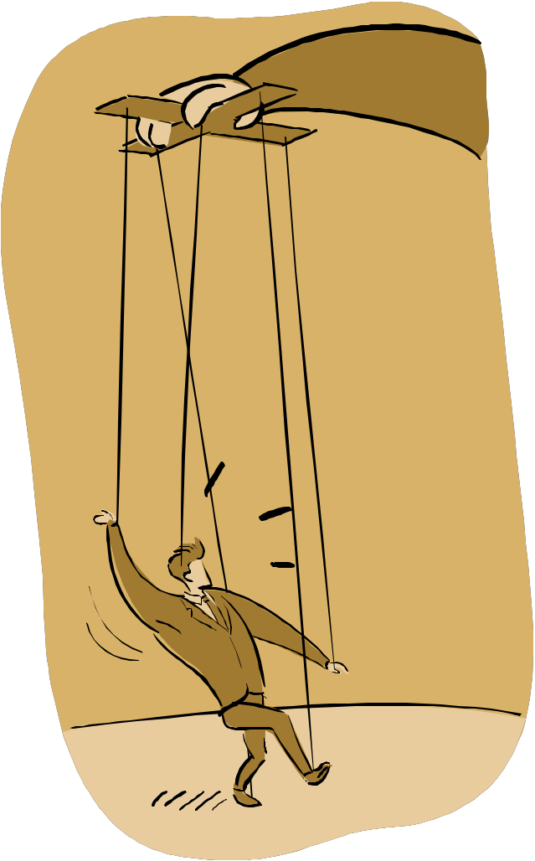
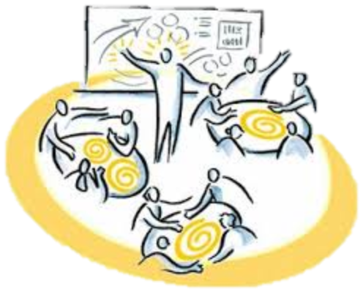
Balancing facilitation and influencing
How to get things done
and still be a nice person

Slide 12
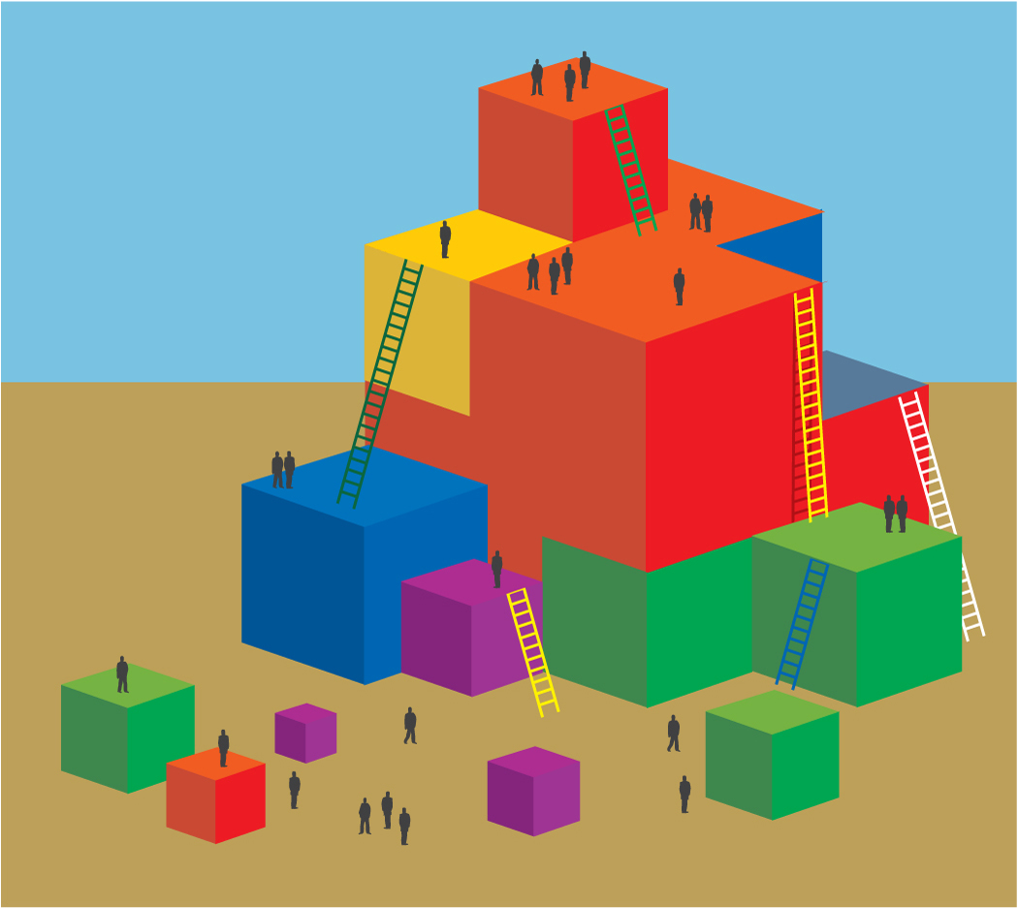
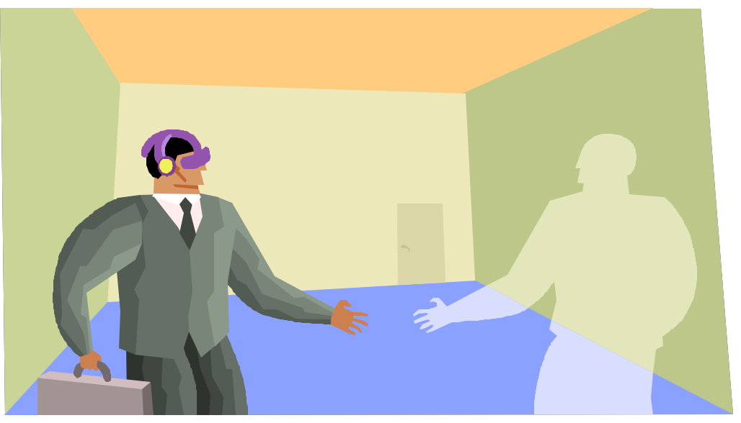
Your reality
Facilitators are (also) ‘political entrepreneurs’
In their organisation
With their partners

Slide 13
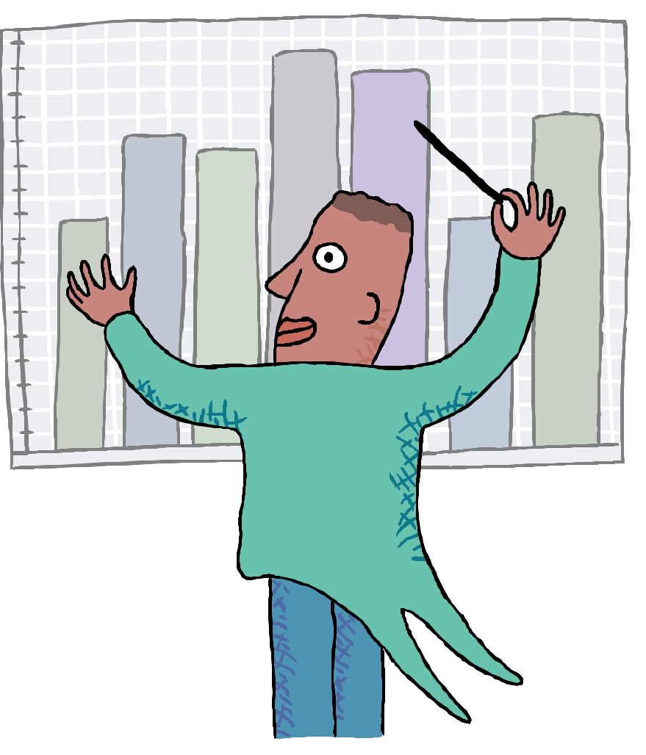
‘Political behaviour’ in CD programmes is:
Unavoidable
A positive, necessary force for innovation
By definition controversial
Three learning processes:
Get knowledge and insight
Get skills and practice
Most crucial: investigate/revise your attitude towards power and political behaviour

Slide 14
Role play
The donor meeting
Notes:
After the role play and discussion:
What would be next steps as facilitator?
What would be the facilitation traps?

Slide 15
Core Quadrants
Your qualities and pitfalls

Slide 16
Facilitator qualities
Exploring Results focussed Empathetic Participatory Confrontational | Encouraging Trustworthy Structured Well prepared ......

Slide 17
Core quadrants
Core quality
Pitfall
overdo
Jovial
Non-committal
opposite
antidote
Allergy
Challenge
overdo
Missionary
Committed

Slide 18
Example core quadrants
Decisive
Pushy
overdo
Flexible
Inconsistent
opposite
antidote
Passive
Accomodating
overdo
Rigid
Reliable

Slide 19
Activity
Your quadrants

Slide 20
Interpersonal conflicts
Respect
ful
Indirect
overdo
opposite
antidote
Honest
Indiscreet
Straight
overdo
overdo
opposite
antidote
Indulgent
Courteous
overdo

Slide 21
Cooperation in team
Intelligent
Distant
overdo
opposite
Analyst
antidote
Convin-
cing
Blabber-
mouth
Jovial
overdo
overdo
opposite
Organiser
antidote
Obscure
Reflective
overdo

