Slide 1
Discussion II:
Session 5.4.
Natural Resources/
Choice and Recognition

Slide 2
Choice and Recognition
Politics of Choice – your choices
  Actors, Powers, Accountabilities?
Effects of Recognition on Local Democracy
  Partnering and power transfers = Recognition
All interventions change local institutional landscape. So, if you worry about imposing democracy, then worry also about what else you might impose – you are imposing.

Slide 3
Effects of Choice and Recognition on Local Democracy
Representation
      Empowering Representation = Representation?
        Means of Transfer/Conditionality
        Mix of Institutions
Citizenship and Forms of Belonging
      Residency → Universal Citizenship
      Interest → Sub-groups → Exclusive
      Identity → Sub-groups → Exclusive
Public Domain
      Maintaining public space
      Enclosure through privatization and desecularization
Public Domain→ Representation and Belonging

Slide 4
Autonomy / Citizenship
Leaders: Significant Discretionary Power – so that citizens have a reason to hold them to account.
Citizens: Means to hold leaders accountable
  Not possible without leaders who can’t be held accountable and how have not significant powers.
  Counter-power
  They must have power – poverty impedes
  Development is necessary for democracy
Development and democracy are complementary

Slide 5
Problems?
What happens in practice? 83 cases (2nd Session)
  No power transfers → No public domain
  No downward accountability → No responsiveness
  No citizenship → No response
  ➔No democracy
Elites, Line Ministries, Presidential regimes
Capacity nonsense – capacity follows power
Overdetermination of the Line Ministries
Tools?
  Framework → know what representation/democracy is
    Know the parts ➔ Actors to involve; Powers to transfer; Accountabilities to promote
  Fight → It is a politics of redistribution
  Arguments for why this redistribution good for the rich and powerful
  Create constituents who can demand change – create promise

Slide 6
LINE MINISTRIES
Education
Health
Infrastructure
LG
Telecommunications
Environment
Cooperation
FEDERATE?
LGs

Slide 7
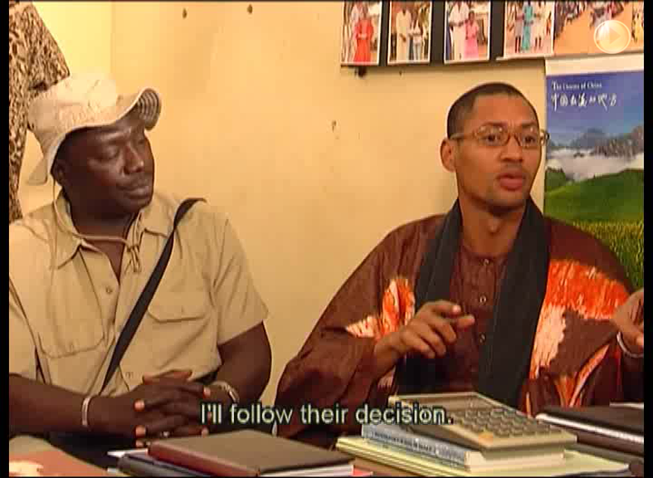
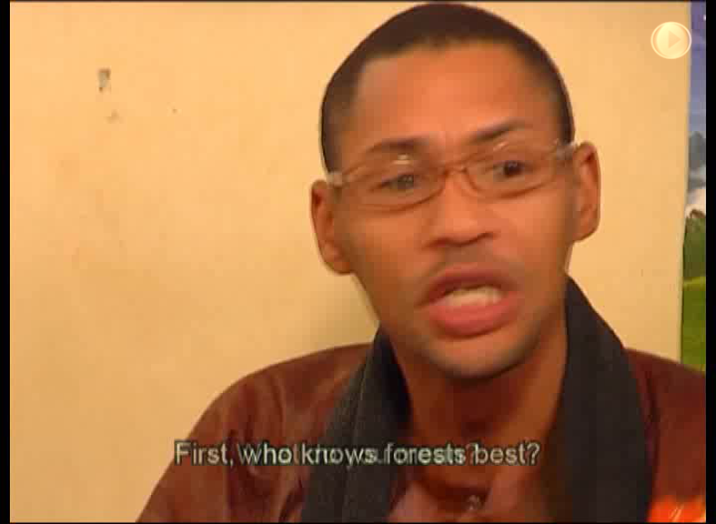

Slide 8
Interactions
Local Governments
Administrators
Civil Society – NGOs, CBOs, PVOs, GONGOs, BONGOs
Projects
Which interaction? Not equal like Aphonso But subordinate.

Slide 9
Ideal Nested
Accountability
of Institutions
Central Government
Ministries:
-Health
-Environment
-Education….
Accountability
Power Transfer
Democratic
Local
Government
Administrative
Local Authority
Individual or
Corporation
Customary
Authority
NGO/ PVO
CBO
Committees
Local Populations
Local Territories = Jurisdiction of LG

Slide 10
This Black Slide is for Talking

Slide 11
Forms of Resistance
Choosing non-democratic local Actors (authorities)
  Actors/parallel institutions
  ‘Participation’ processes
Retention of discretionary Powers
  Non-discretionary– without autonomy
  Non significant – without value
  Insufficient – based on the ‘capacity’ argument
Manipulation of Accountability Relations
  Upward accountability only
  Unaccountability
  Poorly structured elections without other accountability mechanisms

Slide 12
Some Principles
Capacity follows power
Legitimacy follows power
Discretionary power enables democratic responsiveness
Responsiveness makes leaders legitimate
Means of holding authorities accountable are the basis of citizenship
Citizenship is also based on the liberty and capabilities founded on surplus (a la Sen)
Emancipation requires all of these elements.

Slide 13
Additional Principles
Sectoral transfers are more important than fiscal transfers – fiscal transfers are a distraction
Subsidiarity principles are important
  Counter-experts are necessary to develop them

Slide 14
This Black Slide is for Talking

Slide 15
Designing Effective Decentralization Reforms
1. Choose Downwardly Accountable Institutions
  →Principles of Institutional Choice
2. Transfer Positive Powers
  →Subsidiarity Principles: Guidelines for Power Transfer

Slide 16
Principles of Institutional Choice
Choose democratic local institutions where they exist; Call for them where they do not→ Scrutinize and re-design local electoral processes to make elected bodies democratic
Choose and focus on fewer institutions.
Do not transfer public powers to private institutions [not even to PMU—which can bypass government]
Use Participation as a tool not a substitute for local democracy→ Inclusion of marginal groups….
Use committees as tools within democratic structures not in place of them
Nest institutions so that any institution with powers over “public” or collective resources is subordinated to democratic authorities
  NGOs, Local administrative authorities, Local forest services, customary authorities should be accountable to local elected authorities
  Disciplining effect of just hierarchy

Slide 17
Ideal Nested
Accountability
of Institutions
Central Government
Ministries:
-Health
-Environment
-Education….
Accountability
Power Transfer
Democratic
Local
Government
Administrative
Local Authority
Individual or
Corporation
Customary
Authority
NGO/ PVO
CBO
Committees
Local Populations

Slide 18
Risks of Institutional Design & Choice
Delegitimating & making a farce of democracy
  Unresponsive elected officials accountable upward
Undermining fledgling democratic institutions
  Institutional proliferation
    Disempowering democratic institutions
    De-legitimizing democratic institutions
    Diffusing public attention and capacity for accountability
  Privileging instrumental over procedural objectives
    Circumventing democratic institutions
Strengthening/legitimizing despotic institutions
    Encapsulating individuals in culture by enforcing custom and customary authority
    Uncritical privileging of legitimacy →legitimate institutions not all good
Fragmenting rather than consolidating identities
    Reinforcing identity-based belonging
    Undermining formation of national identity
    Favoring division over integration →resulting in conflict
Discouraging formation of citizenship
    Discouraging residency based forms of belonging
    Discouraging identity with government and the state—national identity
    No accountability means no engagement →citizenship is engagement
Mismatch with existing authorities and institutions—the instantiation question

Slide 19
Subsidiarity Principles
Focus on creating local discretion [w/constraints]
Devolve lucrative opportunities
Separate technical from political decisions—devolve political decisions.
Shift oversight and approval to a legal control model—function of forest service to assure compliance with laws, not to approve every decision.
Keep in mind that capacity follows power
Use taxation of resource to retain value [must set at higher level—do not only give locals revenues from fines.]
Shift from Planning to Minimum Standards [next]

Slide 20
Subsidiarity Principles II
Limits and Context of Powers
Shift to uniform minimum standards from a planning approach
  Planning not needed →Standards needed
  Delimit Space of Discretion
  Eliminate double standards between communities and corporations
  [That much forest management being required of local communities by forest services is unnecessary is unthinkable—gather the data to make it thinkable!]
Incentives—local people do not choose to invest in the environment
  Treat NRM investments as other public works—pay labor
  Project solutions—reduce co-pay, pair projects, green windows

Slide 21
Risks of Inappropriate Power Transfer
Undermining fledgling democratic institutions
  Privileging instrumental over procedural objectives
    DG vs. other groups working at counter purposes
Undermining citizen engagement and crystallization of civil society
  Not worth influencing authorities without power
Discouraging legitimization of the state
  No discretion = no responsiveness = no legitimacy
  Legitimacy follows power
Preventing capacity formation
  Capacity follows power

Slide 22
Are we Getting the Institutions & Powers Right?
Most decentralization theory is based on an IF-THEN proposition:
  IF we have the right institutions with the right powers
  THEN we get all these positive outcomes
But we’re not getting to ‘IF’ in most cases
→New institutionalism is being stomped out by a larger set of political-economic forces
[Sort of like “Bambi Meets Godzilla”]

Slide 23

Democratic Decentralization Theory Meets
Political Economy and Embeddedness

Slide 24
A few Questions?
Why is decentralization resisted?
  How do we make it attractive to governments?
  How do we coordinate donors—for an integrative democratic approach (ILD)?
What is the best mix of institutions?
  What is the function of different layers (local vs. regional) decentralization?
  How many layers of decentralization make sense?
  How many institutions should be elected or appointed?
How do we avoid elite and party capture?
How do we make decentralization into the building of legitimate “good government”?
How do we instantiate local democracy?
Is decentralization good for people? For ecology?
How will REDD affect forest livelihoods?

Slide 25
THE END

Slide 26
The End

