Slide 1

Teacher Policy
Development Guide
International Teacher Task Force
October 2015

Slide 2
Structure of the Guide
Chapter 1 – Introduction
Chapter 2 – Framing policy based on country context
Chapter 3 – Dimensions of teacher policy
Chapter 4 – Developing a national Teacher Policy
Chapter 5 – Developing an Implementation Plan
Each chapter contains case studies and examples of good practice from a wide variety of countries and contexts

Slide 3
Chapter 1 - Introduction
Chapter sets out the purposes of the guide, intended audience and rationale.
1.1 Purpose and scope:
  Overview; Policy responses; Implementation steps
  Teachers – public & private
1.2 The guide’s audience:
  Public authorities; Private education providers; Education stakeholders
1.3 Justification/rationale of the guide:
  Importance education & teachers - learning quality
  Human resources & budgets
  Education reform success

Slide 4
Chapter 2 – Framing Policy: the country context
Chapter 2 outlines the need for coherence and integration in the development of a teacher policy. It examines the foundations and guiding principles for a teacher policy, then summarizes and reviews major policy tools & instruments from international organizations useful for teacher policy development & review

Slide 5
Chapter 2 (continued)
2.1 The teaching profession and national education sector plans and policy
2.2 Foundations and guiding principles for a teacher policy
Vision or mission statement and objectives
Targets, benchmarks and timelines
Comprehensive coverage of key dimensions
Assessing the environment: difficulties/challenges/gaps
Sound data and management
Coordination mechanisms
Funding needs and sources
Participation and stakeholder commitment
Evaluation and revision

Slide 6


Chapter 2 (continued)
2.3 Using the existing tools: analytical works and available policy documents on teachers and education :
  ILO and UNESCO
  UNESCO
  UNESCO & UIS
  International Task Force on Teachers for EFA
  ILO
  World Bank
  OECD

Slide 7

Chapter 3 – Dimensions of Teacher Policy
Chapter 3 examines the most important dimensions a teacher policy needs to address. Many of these are interrelated and need to be addressed together as part of a holistic, integrated teacher policy.
These elements must be seen in the context of a specific country or education
system. The chapter sets out the
basic principles (not exhaustive)
of 9 key dimensions then provides
references to further detailed sources.

Slide 8

Chapter 3 (continued)
3.1Teacher recruitment and retention
3.2 Teacher education (initial and continuing)
3.3 Deployment
3.4 Career structures/paths
3.5 Teachers’ employment and working conditions
3.6 Teacher reward and remuneration
3.7 Teacher standards
3.8 Teacher accountability
3.9 School governance

Slide 9
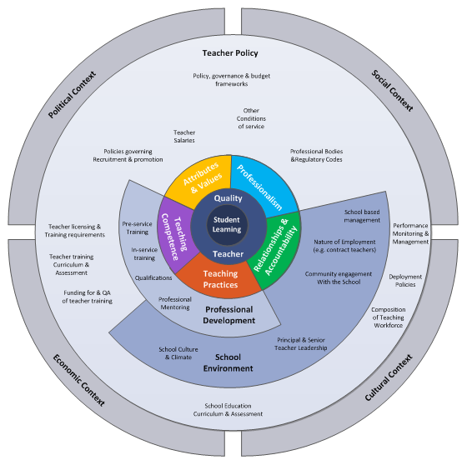
Schema of teacher policy issues

Slide 10
Chapter 4 – Developing a national Teacher Policy
Chapter 4 considers practical issues relating to the process of developing a teacher policy.
Builds on Chapter Two (framing teacher policies in different contexts)
And on Chapter Three (dimensions of teacher policy)
Is to be read in conjunction with Chapter Five (implementing national teacher policies).

Slide 11
Chapter 4 (continued)
  4.1 Key phases in developing a National Teacher Policy
    Consultation – ongoing, meaningful, throughout process
    Effective teacher involvement
    Phase 1: Issue Identification and Agenda-Setting
    Phase 2: Policy Formulation – Analysis, principles and options/choices
    Phase 3: Adoption/Decision – Laws & legal decisions
    Phase 4: Implementation – Communication and Dissemination
    Phase 5: Monitoring and Evaluation

Slide 12
Key stages in developing a National Teacher Policy
Agenda setting
Policy formulation
Consultation
Adoption/decision
Implementation
(communication/
dissemination + roll out)
Monitoring/
Evaluation
Responsibility of ...
Responsibility of ...
Responsibility of ...
Responsibility of ...
Responsibility of ...
Responsibility of ...

Slide 13
Chapter 4 (continued)
  4.2 Roles and Responsibilities - Relevant bodies in the Design, Draft & Validation of Teacher Policy
  Country-specific, transparent, information for all
  4.3 Costing
  Multi-year budgeting & fiscal frameworks, priorities, planning, barriers
  4.4 Conditions for successful policy development
  New & Existing Policy Consistency; Strategic Planning; Engaging Teachers; Evidence-Informed Policy Development; Country Ownership; Education Ministry Capacity
  4.5 Timeframe and Roadmap
    Government leadership, feasible timeframes, roadmap goals & priorities

Slide 14
Chapter 5 – Implementation Plans
Chapter 5 considers how to develop a clear and manageable policy implementation plan
5.1 Legislative process and approval in implementing policy:
  Drafting, financial levers, technical support
5.2 Executive or administrative decisions to implement policy: programmes and regulations
  Authorities & guidelines/tools to implement

Slide 15
Chapter 5 – Implementation Plans
5.3 Tools and schedule of work
  Plan of actions
    Activity statement, outputs, targets, benchmarks, indicators, timelines
    Costs & funding
    Implementation structures, roles & responsibilities
    Dialogue schedule
      Within government, between authorities
      With stakeholders, especially teacher unions/organizations
      With development partners
  Log frames & Work plans: advantages, limits
  Guidelines & other instruments

Slide 16
Chapter 5 – Implementation Plans
5.4 Monitoring & evaluation
  Responsible unit, monitoring periods, annual review & reports
  Evaluation: mid-term, end of period
  Indicators: limited, focused on gaps, results-based, stable over time
  Quantitative & qualitative: the importance of social dialogue with stakeholders, especially teachers
5.5 Organizational arrangements for implementation
  Responsibilities: leadership and management
  Implementation capacity: individuals & institutions
  Governance: implementation bodies/structures
5.6 Costing implementation:
  All implementation aspects & funding sources

Slide 17
Questions for the audience
Does the guide highlight the critical elements in framing teacher policy? (Chapter 2)
Does it include the major dimensions of a comprehensive teacher policy? (Chapter 3)
What are the challenges of policy development and implementation, based on your experience? Does the guide adequately cover these ? (Chapters 4,5)

Slide 18
Thank you for
your attention
We look forward to
receiving your feedback
International Teacher Task Force
www.teachersforefa.unesco.org
Contacts:
Edem Adubra: e.adubra@unesco.org
Hiromichi Katayama: h.katayama@unesco.org

