Slide 1

Third meeting of the PFD
Brussels, 17-18 March 2015
Support to the PFD:
Capacity development and research

Slide 2

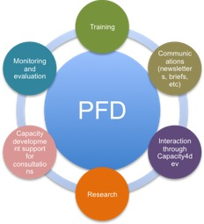
Notes:
Various tools work together to support the PFD, bringing communication and information from members to the Forum and from the Forum to the members.
You are by now familiar with the newsletters, meeting reports and summaries.
We are using more and more the groups on capacity4dev to share information. Now that we have a dedicated communications expert to moderate the group, we hope to have more interaction here.
The first version of the PFD consultation toolkit has been finished with your input. It is one tol that you can use to strengthen input into the PFD.
We have begun the monitoring of the PFD and will continue this via a survey after this PFD
We will be able to tailor training to fit your needs with our new training expert
And finally, you have asked for research to support gathering information, consultation and monitoring. We have a dedicated budget to research in this next phase of the PFD.

Slide 3
Research support
The task team will:
• propose potential research topics,
• annually agree a research agenda, and
• oversee the completion and inclusion of this new research in the PFD meetings
Notes:
200, 000 Euros over 3 years for research

Slide 4
Criteria
Relevance of the topic to global PFD members and the PFD agenda
Longevity of the topic in the life of the PFD (has this topic been discussed previously for
potential research?)
Relevance of the topic in the current discussions on development policy
Need for such research (it does not exist already or is not readily accessible)
Ability of task team members to guide the work

Slide 5
Process
Regional task team (TT) members raise selected topics to
full TT after consultation with regional PFD members
2. Topics may be suggested following discussion within the PFD.
3. TT members will review based on the above-mentioned
criteria, and agree on the research agenda
3. The EU will work with the task team members to select the
appropriate person(s) or organisation to carry out the research.
4. Once completed, research will be submitted to all task team members and then with the wider PFD membership.

Slide 6
Next Steps
TT meeting on March 19 to start discussing current suggested research
Determine research workplan for the next year

