Slide 1
COMMISSION STAFF IN DELEGATIONS
DEVCO Annual Seminar Education/VET
19 October 2015
Manos Papaioannou – Head of Unit DEVCO R4 – Human Resources

Slide 2
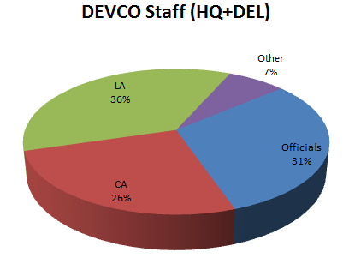
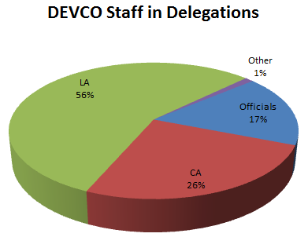
DEVCO Staff (Total: 3350)
35% in Headquarters
65% in Delegations
Data on October 2015
Other includes INT, JPD, END, PREST

Slide 3
NEAR Staff (Total: 1692)
35% in Headquarters
65% in Delegations
Data on October 2015
Other includes INT, JPD, END, PREST

Slide 4
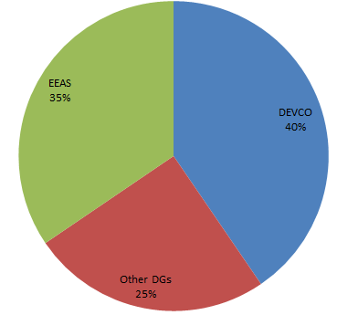
More figures…
EU staff in Delegations: 5306
Commission Staff in 134 countries
Average ratio between COM/EEAS staff in DEL: around 2/1
Data on October 2015
Figures only include Officials, Contract Agents and Local Agents

Slide 5
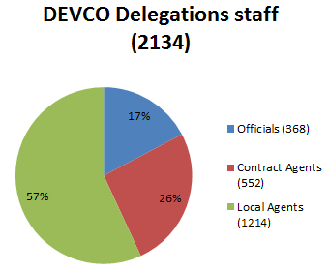
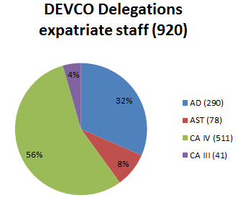
Data on October 2015
Figures only include Officials, Contract Agents and Local Agents
Data on October 2015
Figures only include Expatriate Staff
(Officials and Contract Agents)

Slide 6
Data on October 2015
Data on October 2015
Figures only include Expatriate Staff
(Officials and Contract Agents)

Slide 7
Highlights
DG DEVCO is the second biggest Commission Service (after JRC), employs the third highest number of ADs (5% of all Commission ADs) and the highest number of contract staff "AD level equivalent" (32% of all staff falling under this category in the Commission).
DG DEVCO also employs the highest number of local agents (60% of the local agents in the Commission).

Slide 8
DEVCO role for its staff in Delegation
Job description
Appraisal & Promotion for officials
Appraisal & Reclassification for contract agents
Rotation for officials
Mobility for contract agents
Management of rights: external activities, CCP, parental leaves, invalidity processes
Training
Residual duty of care
Center of gravity (COMDEL)

Slide 9
COM staff – Duty of care
Decision adopted by the EEAS on the security level in Delegation (11 April 2014)
Decision on non-family posting
MoU COM-EEAS
Foresees an increased role for DEVCO in the decision-making process leading to an evacuation or return of staff (=change of evacuation level)
Essential staff to be determined by DEVCO/NEAR

Slide 10
Use of staff/Flexibility arrangements
  Commission Officials (funded from Heading V):
    Cannot perform CFSP or CSDP tasks
    may contribute to work of Delegation outside normal line of duty up to 20% of working time: if relevant experience; if doesn't jeopardize performance of core tasks; and if tasks do not exceed reasonable proportion of working time (<20%)
  DEVCO CA & LA (funded from programmes)
    Cannot be used for other work than programme preparation, implementation & evaluation

Slide 11
Hot topics
Synergies and Efficiencies Review
DEVCO Reorganisation
DEVCO Staff survey analysis and follow up
Staff Rebalancing and other optimisation measures in Delegation:OPTIMUS under implementation
Creation of Middle management posts in Delegations
Policy on Heads of Cooperation
Implementation of regionalisation of administrative functions (EEAS)
Rotation of officials 2015 is completed. Rotation 2016 has been launched on 03 July
Certification exercise has been launched on 7 October – Deadline to apply: 05 November
DEVCO specialist competition ongoing

Slide 12
Hot topics
Mobility of CA 2015 is completed. Mobility 2016 has been launched in September 2016
CA's careers (new draft implementing measures)
European Union Emergency Trust Fund for Stability and Addressing Root Causes of Migration in Africa

Slide 13

Questions?

