Slide 1
Selecting relevant value chain/s for Impactful Development Policies
Value Chain Knowledge Sharing for Action
Frederic Lançon
Frederic.lancon@agrinatura-eu.eu

Slide 2
Background and objective
Value chain a dominant entry point to conceive, policies, strategies and development programs.
EUDs are facing challenges in translating their priorities into a value chain approach.
How justifying investing resources in the analysis of a value chain?
Value chain analysis versus Value chains:
How a value chain approach can be mobilized with other objective such as territorial development, diversification/agroecology…?

Slide 3
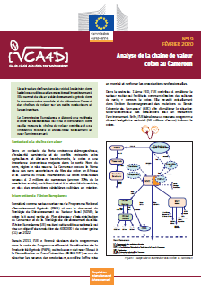
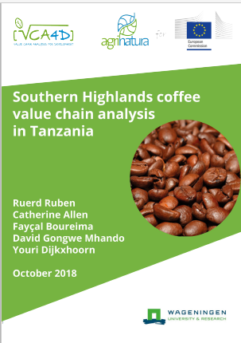
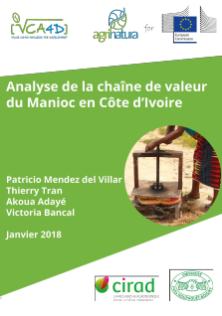
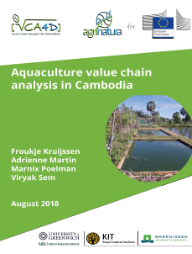
Reminder: VC conceptual framework
VC refers to a tangible form of economic organisation based on strong interdependence between actors, from supply to distribution, governed by a VC driver (e.g. processing companies) or by public authorities (e.g. marketing boards).
Coffee VC Tanzania
Cotton VC Cameroon
VC can be defined as a representation of the economic system, including different forms of governance, that do not necessarily rely on strong interdependence.
- Any combination of seller and buyer in the economic system corresponding to the production of a good from a raw material to a processed form
Cambodia Aquaculture
Côte d’Ivoire Cassava
https://capacity4dev.europa.eu/projects/value-chain-analysis-for-development-vca4d_en
Notes:
VC can be considered either as a singular tangible form of economic organisation based on strong interdependence between the actors from the supply to the distribution – systems largely integrated, strong hierarchical and centralized governance, for instance a cotton VC or a sugar VC is structured around the agro-industrial processing; supplier cannot have other opportunity to sell their product. The same type of governance and can be associated with norms and their impact on the dominance of actors on other.
Or value chain can be defined as a concept, a representation of the economic systems, including different forms of governance, where interaction do not necessarily rely on strong interdependence and where actors at different stage keep a certain autonomy in selecting with whom their interact and shifting to new activity
In the first case VC might be an actual tangible organisation so the approach will be limited to this cases. Which is not always the case . Say otherwise, any combination of seller and buyer in the economic systems corresponding to the production of a a good from a raw material to processed, transform one can be analysed as a value chain (including the tangible one that are conceptually a particular VC among other types)

Slide 4
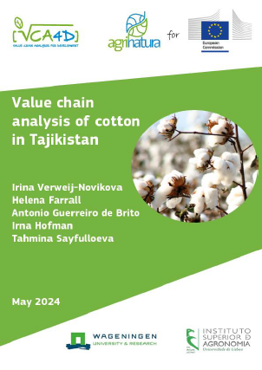

The obvious cases – VC analysis for ongoing projects
EUD is already supporting a VC and needs a VC study to assess if there is a need to adjust and shift the initial policy target.
The study is used to consolidate or revise policy options already taken.
For instance, in the case of Tajikistan, EU has already developed a strong partnership with the cotton sector and is promoting better practices (BCI)
EUD has decided to support a particular VC and needs a baseline study to back up the formulation of its actions plan.
VCA4D has been often mobilized to build a baseline for action formulation: Niger Cowpea and groundnut
Combining a baseline with an update study allows to assess impact and changes induced or not by a project .
Issue related to attribution of impact to multiple causes
So far only one update has been implemented by VCA4D in the case of Honduras Coffee in connection with the expected impact of the EUDR
Changes in the VC structure and governance end environment may require adjustment in the actions and targeting.
Notes:
The EU has decided to support a particular VC, sector a specific value chain and need a baseline to back up the formulation of its actions plan.
VCA4D has been often mobilized to build a baseline for action formulation: Niger Cowpea and groundnut
EU is already supporting a VC and need a VC study to assess if there is a need to adjust and shift the initial policy target. The study is used to consolidate or revised option already taken.
For instance in the case of Tajikistan, EU has already developed a strong partner ship with the cotton sector and which to promote better practices (BCI)
Combining a baseline with another study allows to assess impact and changes induce or not by the on-going activities. Issue related to attribution issues, an update of previous study allows to identify changes in the VC structure and governance and assess if the any changes is required in action formulation and targeting.
So far only on update study has been implemented by VCA4D in the case of Honduras Coffee in connexion with the expected impact of the EUDR.

Slide 5
Selecting a value chain from scratch
What for?
What are the overall objectives pursued by the EU in the country and alignment with national policy?
Value chain shall be considered as a leverage to achieve a goal (that is not necessarily supported by a unique value chain)
Growth, income and employment generation
Currency earning
Contributing to food security and nutrition
Social inclusion for targeted group: youth, women, poor farmer
Geographical target: marginalized area….

Slide 6
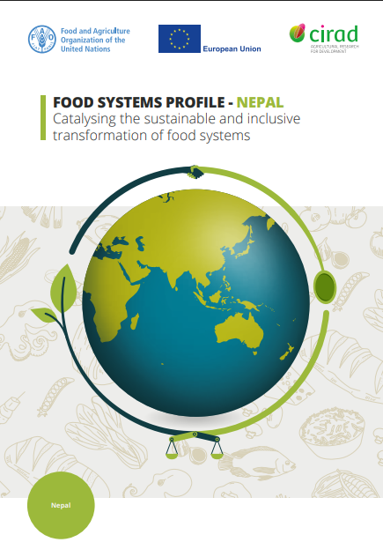
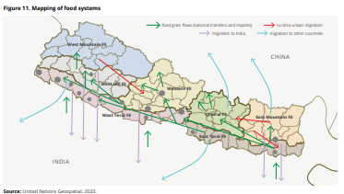
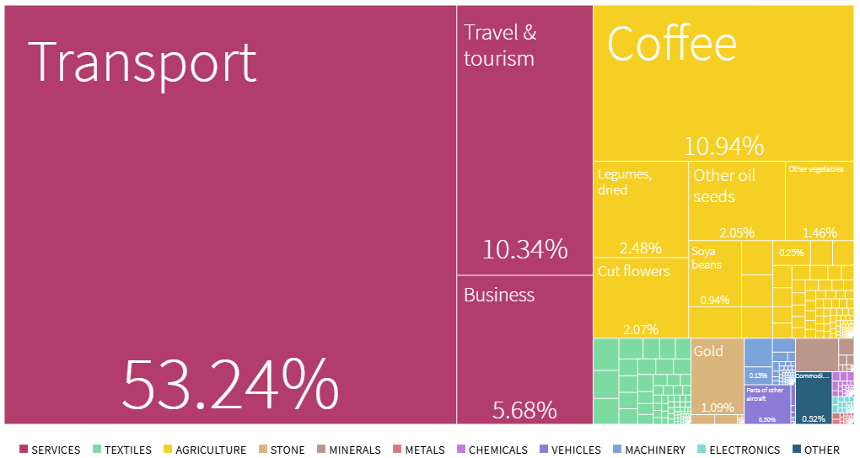
Selecting a value chain from scratch
On what ?
Against this set of goals, a preliminary mapping of the agro-food system can be undertaken based on existing data and secondary sources.
There are several sources on the www : FAO country sheet, WB, FAS of the USDA, complexity analysis….
Main lines of the agro-system characterization:
Supply side:
Production area/ agroecological zone
Agricultural raw and processed product import
Demand size
Agro food export
Food and expenditure survey
Food balance sheet
Economic weight: detailed national account (seldom available)
VC exported oriented versus VC targeting the domestic market: a continuum
Review of trends for the major features and policy changes
https://openknowledge.fao.org/items/52fb1af8-8ba3-4b62-b08a-4a6b201ee527
https://atlas.hks.harvard.edu/countries/231/export-baske t
Notes:
Against this set of goals a preliminary mapping of the agro-food systems can be undertaken based on existing data and secondary sources. This exercise is often done in the framework of agricultural policies or food policies documents, prepared by the national administration or by development institution: IMF country report
There are several sources on the www : FAO country sheet, WB, FAS of the USDA, complexity analysis….
Main line of the agro-system characterization characterization:
- Supply side:
- Production area/ agroecolgical zone
- Agricultural raw and processed product import
- Demand size
- Agro food expert
- Food balance sheet
- Food and expenditure survey
Economic weight: Detailed national account (seldom available)
Economic weight: Detailed national account (seldom available)
VC exported oriented versus VC targeting the domestic and urban market
A false opposition. A continuum of interdependent systems
Review of the policy issue and food systems assessments to analyse trends/ dynamic and challenges.

Slide 7
Selecting a value chain from scratch
Defining the entry point
VC logical flow from production to end-user: tendency to emphasise issues at the production stage…
…but critical bottlenecks could be at a stage other than production.
Potential impact of changes in the VC context
- Regulation… EUDR
- Environmental, drought, temperature…
- Economic: trade tariff, energy cost, debt…
- Politics: change of political regime with new objectives, post war/crisis situation
Notes:
VC logical flow from production to end-user, - tendency to limit emphasis on the up-stream part, and consider what is going on at the downstream part as secondary but critical bottle neck issue could be at another stage than production – beware not to be too much influenced by an agrarian perspective
Potential impact on value chains of changes in the context
Regulation… EUDR
Environmental, draught, temperature…
Economic: trade tariff, energy cost, debt…
Politics: change of political regime with new ambitions, post war/crisis situation

Slide 8
One value chain versus many value chains
Maximizing the knowledge potential of one VC analysis
Not obvious to identify the key factors that lead to elicit one value chain (i.e a raw product).
There is a risk to select one value chain on the potential outcome usefulness and impact of the analysis
But…
A unique VC analysis does not mean one system, but take into account co-products and different markets
Leading, major value chains provide core resources to actors and the economy.
The value chain can be seen as a geological core, a representative sample of the complexity that facilitates the identification of key issues and determining factors for the formulation of an action plan that goes beyond the value chain
- Implementing an innovation platform, setting an interprofessional body, improving transportation infrastructure…
Notes:
Accommodating a simplified approach focusing on a value chain with the complexity of the agr-food systems.
Not obvious to identify the key factors that lead to elicit one value chain (i.e a raw product) although one product does not means one systems, but take into account co-produts and different markets.
A VC taken has a “model” representative of how invsetsing in support can lead to the expected impact/
Leading value chain that provide core resources to actors and allows them to invest in improved practices – shifting from monoculture to new cropping method….
Value chain can be considers as geological core, a spatial probe, that provide an insight to assess the relevance of a policy action: i.e promoting neaw ways of doing business, promoting institutiona arrangements….
There is risk and bet. To select one value chain on the potential outcome usefulness and impacT

Slide 9
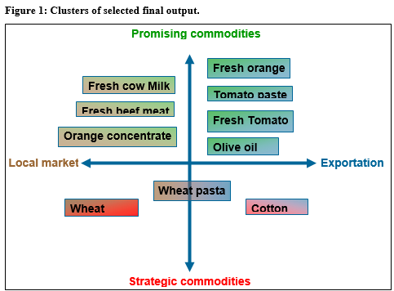
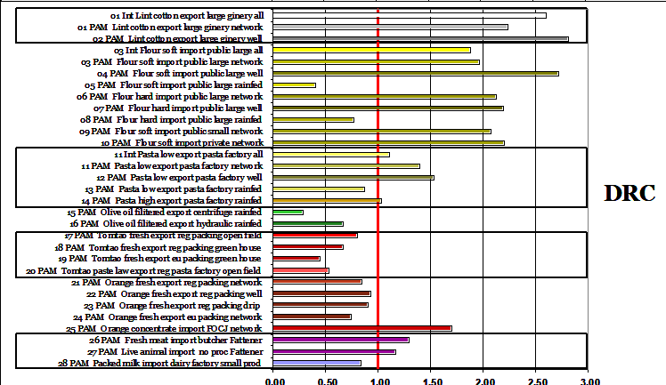
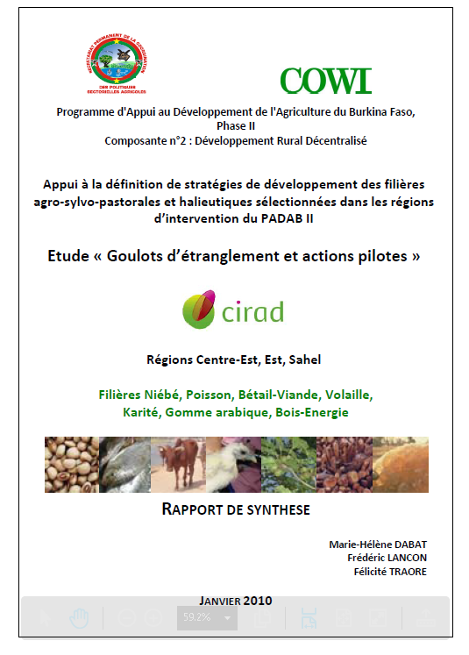
One value chain versus many value chains
Working on a group of value chains
Analysing a portfolio of VCs fits to specific issues and entry point at different spatial scales:
Agro-ecological, diversified cropping systems
Respond to territorial approach,
Formulate of a comprehensive agricultural or development national policies.
Strengthen the analytical power:
Comparison,
Interaction between value chain
But…
Cannot replace the selection process: selecting multiple VCs can be as challenging as selecting just one
Consider how to adjust means (human, financial resources and times) and analytical practices (methodology) to the objective and challenges addressed.
Adjusting the depth of the analysis
https://www.fao.org/4/ad923e/ad923e00.htm

Slide 10
Take away messages
A value chain analysis should respond to a question…
… although it can reveal unexpected constraints or issues, it is not “a data mining process”
Selecting, backstopping of a given value chain or value chains is already an analytical process
Shorten of human resources is often a critical constraint to expand the VC coverage: building analytical capacity is key

