Slide 1

The importance of teacher professional development
SESSION 7:
Reaching and Teaching children
in crisis and fragile environments
James Lawrie, Senior Education Adviser

Slide 2
My experience
of Professional Development
In 5 minutes:
1) Describe the best PD experience you can recall in the last 5 years
2) Describe the worst PD experience- the complete waste of time you once experienced

Slide 3
Feedback
Who initiated your involvement in the PD/training experience?
Where/who provided the PD input? Was the individual suitably qualified?
How did it link to your daily work?
Top reason why it was so good/bad?

Slide 4


Teachers’ experience
of PD in fragile locations

Slide 5
In-service teacher development
Planned long term programme vs. unplanned by frequent vs. ad hoc
Delivered by an expert vs. delivered by a non-expert
Multi-dimensional inputs vs. mono-dimensional
Linked to a framework vs. without a suitable framework
Measured vs. not measured
In workplace support vs. in external locations

Slide 6



TPD Guide
James Lawrie
& Mary Burns

Slide 7
Why produce a guide to TPD?
Frustration (at the state of the sector)
Improve (teacher education)
(To gain) Understanding
Commitment (to the cause)

Slide 8
What is the guide and who is it for?
1 Conversation (Nov 2012)
20 Specialists
19 Blogs
2 years
7 Recommendations
162 Pages
Guide for:
Policymakers, Practitioners, Donors, Teacher Training colleges, INGOs, …and anyone working for and with teachers operating in low income and fragile settings

Slide 9
Two years in production…
19 Education blogs from sector specialists, 300 + comments
Guide structured by 7 recommendations (and peer reviewed)
Annotate bibliography
Chapters drafted (with literature review)
Blogs and comments coded, analysed, themed

Slide 10
Limitations
Narrow topic / broad context
Focus on a narrow topic (TPD) within a broad context (fragile environments)
Limited reliable research
Available research on TPD in fragility is sparse, and it is hard to establish its rigor or quality
No silver bullet
TPD must be part of a system of reforms addressing: teacher selection, recruitment and preparation; salary and motivation; teaching materials and resources; and effective educational leadership
Notes:
Narrow topic / broad context. This guide focuses on a narrow topic (teacher professional development (TPD) or teacher “in-service” education) within a very broad context (fragile environments).
Limited reliable research. The real limitation rests with available research on professional development in fragile contexts which is, at best, scant. Of what little that does exist, it is hard to ascertain either rigor or quality.
No silver bullet. Effective teacher professional development, though a central ingredient in improved teacher quality, must be part of a system of reforms that address teacher selection, recruitment and preparation; teacher salary and motivation issues; adequate teaching materials and resources; and functioning and effective leadership at every level of the educational system.
This is not the last word in teacher professional development in fragile contexts – it is a first step ...

Slide 11
Fragile and low-income settings
“My students are mothers and fathers. They are working full-time jobs and some sell drugs to survive. They don’t know their fathers or sometimes even their mothers. They carry guns to protect themselves on their way to school, if they come at all. My students have been arrested and murdered. They see people shot and killed in their neighborhoods on a weekly basis.”
Notes:
Fragility is not just conflict or post-conflict … it has multiple causes and effects (gang violence, poverty, political instability, natural disaster, weak political systems, ethnic or religious conflict)
Fragility disproportionately impacts the most poor and marginalized people
High-poverty and institutionally weak areas are least well-equipped to resist the effects of fragile conditions on their education systems

Slide 12
7 Recommendations
Recommendation 1: Focus on teachers in fragile contexts – as professionals, learners and individuals
Recommendation 2: Develop, apply, measure and institutionalize standards for teacher professional development
Recommendation 3: Create professional development opportunities that promote teacher collaboration
Recommendation 4: Provide teachers with ongoing support
Recommendation 5: Invest in high-quality teacher educators
Recommendation 6: Build instructional leadership at all levels of the educational system
Recommendation 7: Use ICT to provide access to content, professional development and professional learning communities

Slide 13


1: Focus on teachers as professionals, learners and individuals

Slide 14
Focus on teachers as professionals, learners and individuals
Focus on teachers as professionals, members of a community and as individuals coping with fragility.
Establish international standards on quality teaching.
Develop strategies for improved TPD with sufficient funding.
TPD needs to be adapted to context and culture.
TPD should see teachers as learners and focus on best practices.
Notes:
To raise teacher quality and TPD educational planners and implementers must focus on teachers as professionals, as individuals, as members of a community and as people coping with the effects of fragility.
Donors and policymakers should work together to establish international standards on quality teaching, and develop strategies for improved TPD with sufficient funding.
Despite the impulse to rapidly scale, research is increasingly clear that successful TPD should be adapted to context and culture.
We must see teachers, as we do students, as learners and design professional development that focuses on best practices and offers accommodations and supports that promote, not impede, teacher learning.

Slide 15

2: Set standards

Slide 16
Develop, apply, measure
and institutionalize standards
Teaching should be based on a set of qualifications and governed by standards and competencies.
TPD in fragile contexts lacks of standards, goals, sufficient research and metrics for success.
Therefore, anyone can claim to be delivering quality TPD.
Notes:
Teaching, especially in fragile contexts, is a specialized skill that should be based on a set of qualifications and governed by standards or competencies.
Definitions of quality professional development in fragile contexts remain elusive, with a lack of standards, lack of goals, limited research and a lack of metrics for success.
Given this void, anyone or any organization can claim to be delivering quality or professional development or “solutions” to issues around poor teacher quality

Slide 17
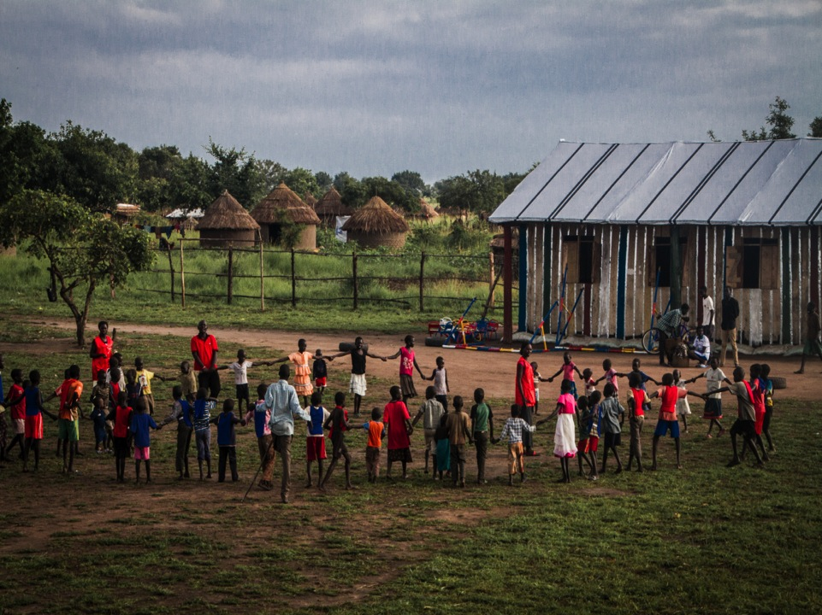
3: Promote teacher collaboration

Slide 18
Create opportunities that promote teacher collaboration
Successful TPD is grounded in teacher collaboration.
Create opportunities such as: peer classroom visits, peer-teaching, teacher learning communities and circles
Effective collaboration requires time and space, support from school leaders, access to external expertise, a sense of autonomy and, a belief that everyone has something to offer.
Notes:
Successful teacher professional development is often grounded in teacher collaboration.
Peer classroom visits and peer teaching have combined benefits of modeling, two-way support, shared reflection and complementary skills development.
Opportunities for shared collaboration and reflection, such as teacher learning communities, learning circles and the Professional Teaching and Learning Cycle, have been used in a number of fragile contexts and bring teachers together through a process of shared enquiry and collaboration.
Effective collaborative practice requires time and space, support from school leaders, access to external expertise, a sense of autonomy and a belief that everyone has something to offer.

Slide 19

4: Ensure ongoing support

Slide 20
Provide teachers with ongoing support
Support is crucial for new teachers, teachers operating in difficult conditions, and teachers with limited training
Coaching (peer or external) empowers teachers with skills and strategies enacted independently
Face-to-face support: classroom-observation, feedback, project-based learning, formative assessment and distance education.
Distance-based support: video/audio instruction, online learning, mobile-phone coaching, video training, etc.
Notes:
Support is especially important for new teachers, teachers operating in difficult conditions and teachers with limited professional training or education of their own.
Support for teachers in fragile contexts can involve face-to-face support, classroom-observation, feedback, project-based learning, formative assessment and distance education.
Coaching (video-coaching, peer-coaching, external coaching) empowers teachers to enact a particular set of skills and strategies independently and with fidelity and quality.
Technology or distance-based support can involve audio instruction, mobile-phone coaching, video training and online learning.

Slide 21
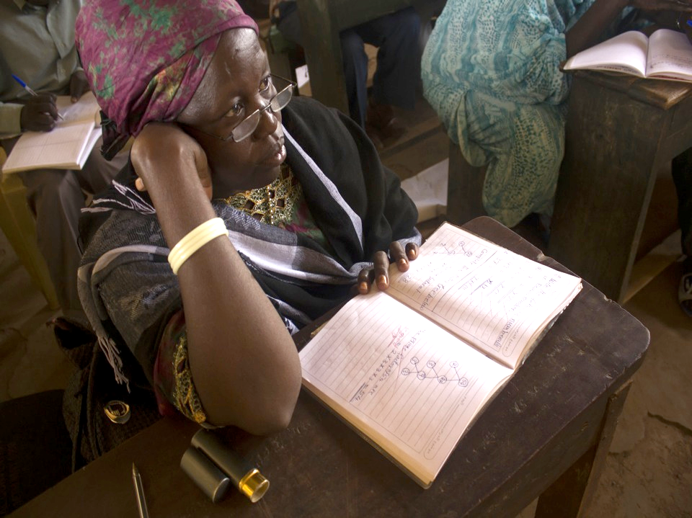
Credit: Emmanuel Kenyi / Save the Children
5: Invest in teacher educators

Slide 22
Invest in high-quality teacher educators
Fragile environments need pragmatic solutions to recruit, prepare and support teacher educators as pre-service systems are often weak.
Good teacher educator posses skills of an effective teacher, as well as the ability to model teacher practices.
Provide teacher educators with actual classroom experience, high-quality training and ongoing support to improve their ability to link practice with theory
Notes:
Pre-service education systems are often weak in fragile contexts; therefore, quality professional development and professional development providers becomes even more critical.
Fragile environments need pragmatic solutions to recruit, prepare and support teacher educators.
The skill sets required for a good teacher educator are similar to those of effective teachers, as well as the ability to model intended teacher practices.
Improving the quality of teacher education will require providing teacher educators with actual classroom experience, improving their ability to link practice with theory and providing these individuals with high-quality training and ongoing support.

Slide 23
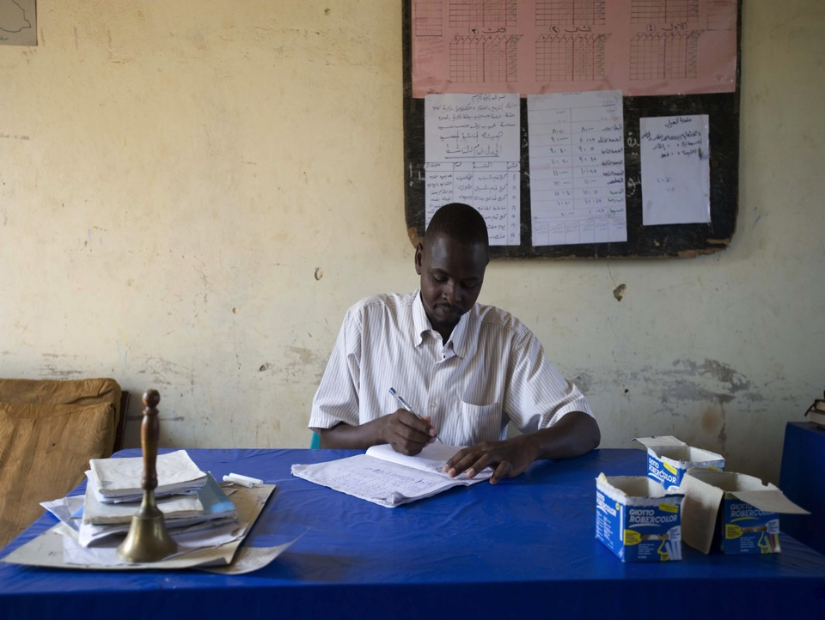
Credit: Rachel Palmer / Save the Children
6: Strengthen instructional leadership

Slide 24
Build instructional leadership
at all system levels
Poor administration, resource shortages, unpredictable staff movements and high turnover in fragility are obstructing effective school leadership
Need of in-service and tailored PD for school leaders to develop and apply their instructional leadership skills.
Provide opportunities for leaders to collaborate, such as TPD or developing national school leadership standards can all positively affect teacher development.
Notes:
The behaviors required for effective nurturing of teacher performance are too often absent in school leaders in fragile contexts.
Fragility-specific barriers to effective school leadership (poor administration, resource shortages, unpredictable staff movements and high turnover) negatively impact teacher performance and student learning.
In-service professional development for school leaders and tailored programs for new and aspiring leaders can help individuals develop and apply instructional leadership skills.
Providing opportunities for leaders to collaborate, involving leaders in teacher development and developing national school leadership standards can all positively affect teacher development.

Slide 25
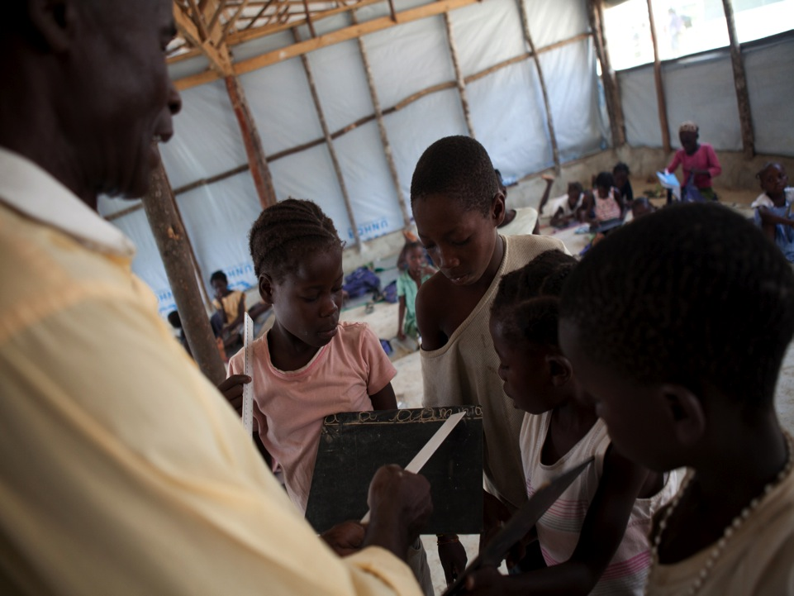
7: Apply technology

Slide 26
Use ICT in professional development
Use ICT to provide access to content, professional development and professional learning communities
ICT should be embedded within a framework of good practice in TPD.
Still, human relationships are critical to success of ICT.
Eight forms of ICT are examined- each offering opportunities for TPD.
Notes:
ICT is not a teacher professional development panacea. For successful use, ICT should be embedded within a framework of good practice in teacher professional development (TPD).
The importance of maintaining a level of human relationships is one of several critical success factors that need to be considered.
Eight forms of ICT are examined, each of which offers opportunities for teacher development

Slide 27
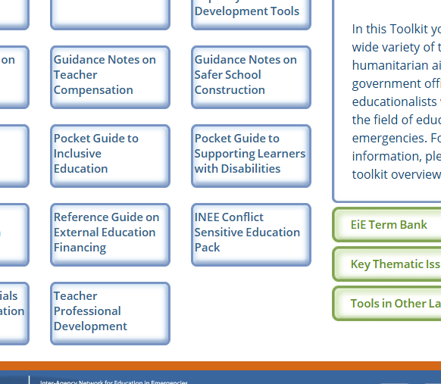
INEE TOOLKIT: toolkit.ineesite.org

Slide 28
Recommendations and critique
Do the recommendations address the ‘big issues’ in the countries where you work? How? Or why not?
Have you seen examples of this recommendation in practice? Where, and how?
Is this recommendation(s) implementable in your locations? What are the driving and/or restraining forces?

Slide 29
Teachers and the SDGs
Indicators of achievement are shifting from inputs to outcomes
From teachers trained to teachers demonstrating improved classroom teaching
How does this affect your programming?

Slide 30
Recommendations into practice
Standards / Competency-based TPD in Tanzania and Bangladesh (SCI Programme)
Pillars of Save the Children’s model
National Teacher Standards / Competency Frameworks
Multi-dimensional professional development
Continuous formative assessment of teachers
Accelerated accreditation of non-qualified teachers

Slide 31
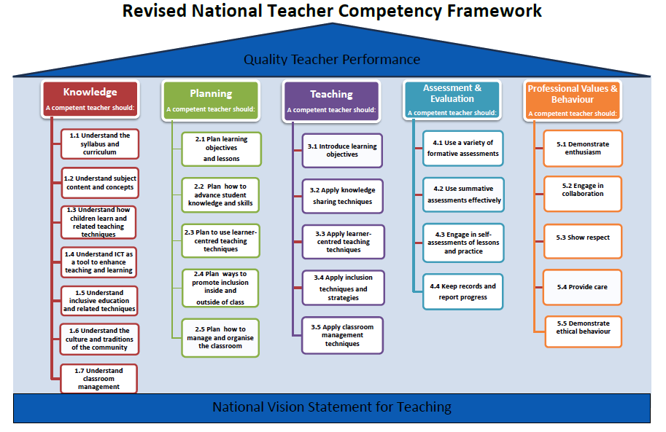

Slide 32
Linking humanitarian
to development settings
Linking relief, rehabilitation and development (LRRD)
ECHO

Slide 33
…and finally
Would you like any further information from me?
Hand me your card with a question / issue written on the back, and I will endeavour to respond.

Slide 34

j.lawrie@savethechildren.org.uk

