Slide 1
Setting the Scene: How to link VET with the world of work?
The quest to make TVET structures work!!!
Dynamics of the South African system in transition
Brussels
19-21st October 2015
Salim Akoojee
Adjunct Ass. Professor: University of the Witwatersrand, Johannesburg, South Africa
International Research Associate: eduVOC
Hong Kong
E-mail: salimakoojee@live.co.za
salimakoojee@gmail.com

Slide 2
This presentation
An attempt to understand the relationship between (T)VET and the world of work (using the South African case)
Unpacking assumptions about the nature of VET (in different contexts)?
Unpacking assumption of notion of ‘world of work’
Experiences from the ground
  Involvement as Chair of Technical Task Team (Human Resources Development Council of South Africa – A Tripartite Policy ‘think-tank’ to resolve skills deficits at highest level (Chaired by Deputy President)
  Experiences from involvement in the sector in South Africa (and Africa) and now Asia - TVET in and for (sustainable) development in developing contexts)

Slide 3
Current importance reinforced
Far from being the weakest link in education systems, TVET is emerging as a cornerstone for the transformation of education and training. Indeed, the development of skills through TVET is now one of the most often-cited priorities by ministers of education in both developing and developed countries ...
(Tang, 2011, p.14)
Tang, Q, (2011) ‘TVET for a Changing World: Global Developments, Local Resonance’, in NORRAG NEWS, Towards a New Global World of Skills Development? TVET's turn to Make its Mark, No.46, September 2011, pp. 14-15, available: http://www.norrag.orgQian Tang, UNESCO, Paris

Slide 4
International skills development context
Assumption that skills by itself will not necessarily lead to national development but that without skills, the possibility for individual and national development is that much more difficult
The importance of TVET to national development is described as “….the master key that can alleviate poverty, promote peace, conserve the environment, improve the quality of life for all and help to achieve sustainable development (Nick Burnett 2008).
“a well-functioning training system can protect against unemployment, especially among the young. Periods of economic crisis can, therefore, be an opportunity for countries to examine how well equipped their VET systems are to deal with change and to innovate
(OECD, 2009)

Slide 5
Inequity
the triumph of globalization and market capitalism has improved living standards for billions while concentrating billions among the few. It has lowered inequality worldwide but raised inequality within most countries
(The Conference Board, 2011) – Richard Freeman (Harvard)

Slide 6
What we are up against!
Contextual realities revisited

Slide 7


Slide 8
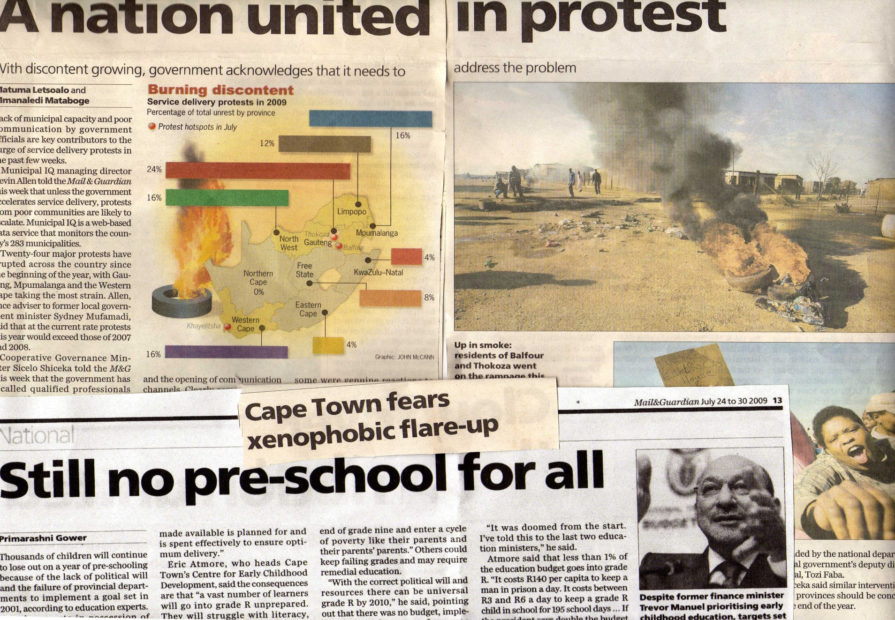

Slide 9
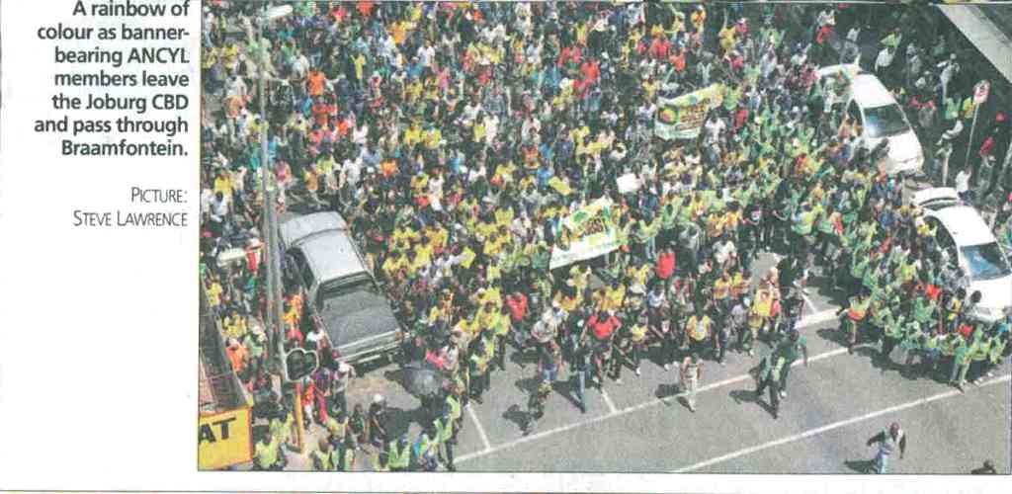

Slide 10


Slide 11
National Development challenges (and responses)
Skills need to respond to twin challenges of Colonialism and Apartheid and reality of Uneven Development
A meaningful long-term response to: Poverty, Unemployment, Growth, Crime, Xenophobia, power crisies, infrastructural considerations for FIFA Word Cup
The PIE Challenge
  Poverty,
  Inequality and
  (Un) Employment
National Response
  RDP (1994) -GEAR (1996) - ASGISA (2005), HRDSA (2008+)
  New Growth Path and Infrastructural Development Plan (IDP)
Notes:
Socio-economic Context
Poverty:
45% lives on less than US $2 per day J seeking and N Nattrass (2002) in Everatt 45/55 % live in poverty…about 18-24 million pp.
1 in 10 Africans malnourished
1 in four African children stunted
From Everatt (2003) ….77-8, “poverty is a defining characteristic of South Africa and has clear racial,gender and spatial dimensions” (Everatt, 2002, p. 77)
Unemployment
Formal unemployment conservatively 36%...(of 26,3 million people bet. 15-65)..10 million unemployed …conservatively… higher for females…
from 1996-1999 rate of employment increased by 2%..
According to Pundy Pillay, even growth sectors had shed jibs despite their expansion..argues in HRD directory that not skills deficiency that results in unemployment but the inability of major growth sectors (financial, banking, energy, financial and engineering..industries that experienced skills shortages) have not increased employment…job creation…growth 1,8%..although sectors grew on average 3,7%. .
Inequality
Rising gini coefficient (transforming the present..dept of social development,,,in everatt)…
1991 9% of richest were black…..1996…22%..
“…the poorest remain obdurately and overwhelmingly black” )from Transforming the present, Whiteford and Seventer)
Sustained argument that inequality changing from race to class based…now poverty knows no colour
Impact on Redistribution
“…it seems apparent that reliance on market forces to achieve anything other than gradualist elite redistribution is misplaced” (Everatt…p. 79)

Slide 12
Source :Pretoria News Tuesday January 22 2013

Slide 13

Current response ☹
Over 40 000 temporary jobs for Cape Town's unemployed
2015-07-13 17:56
Cape Town - Thousands of jobless Capetonians
will benefit from over 40 000 temporary jobs during
the current financial year.
According to a statement by the
City of Cape Town, unemployed locals
will benefit from 42 500 short to medium-term
job opportunities offered through its
Expanded Public Works Programme (EPWP).
dedicated budget for the last four financial years,
including the new financial year, is R466m.
Tammy Petersen, News24

Slide 14
The new world of work (for development)!!!

Slide 15
That Precarious Present-Future
There is a need for an understanding of an international new order that can ( or unable to) create employment
The economic crises have shown that we need to reconfigure our understanding of the labour market; this includes education and training systems.
The accelerating rate of unemployment shows the unwillingness or inability of the economy to generate employment as a response to mechanisation brought by technological developments that require fewer, but more sharply skilled employees.
The implications of this reality has not yet been thoroughly examined but will become the focus of attention as the reality of precarious employment practices become more ingrained and its skills development implications realised.

Slide 16
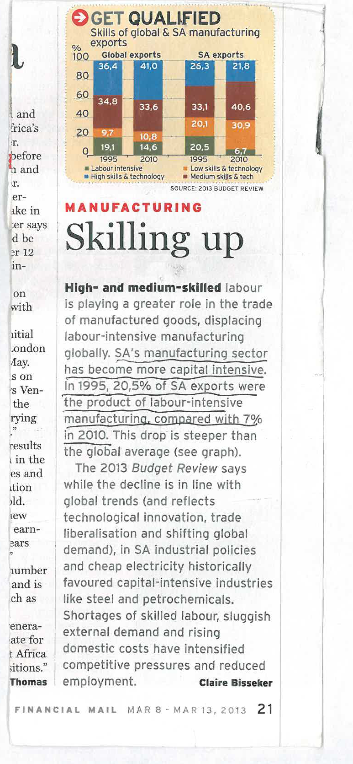
The reality: Capital Intensive Manufacturing

Slide 17
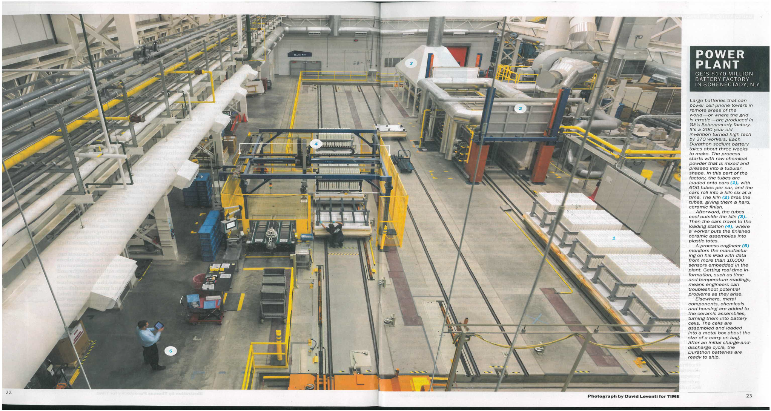
The New Power Plant
TIME 13.04.2013p. 22/23
Notes:
Ges 170 Million Dollar producing large batteries that can power cell-phone towers in remote areas in the world – or where the grid is erratic – are produced in GE’e Schenectedy (NY Rust belt). Batteries are designed to keep cells connected even when the grid goes down. (5) A process engineer monitors the manufacturing on his IPAD with data from more 10 000 sensors embedded in the plant. Getting real time information, such as time and temperature readings meaning that engineers can troubleshoot potential problems as they arise (TIME, p. 23, 22.04.2013)

Slide 18
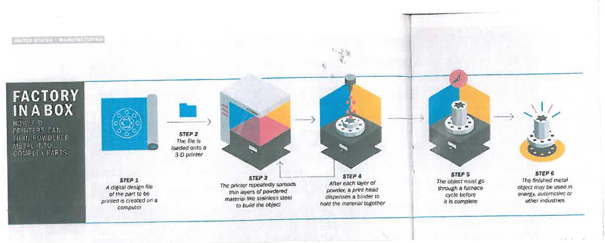
The New Factory in a Box
How 3-D Printers can turn Powdered Metal into Complex Parts
(REF. TIME: April 22, 2013 (p. 24-25)

Slide 19
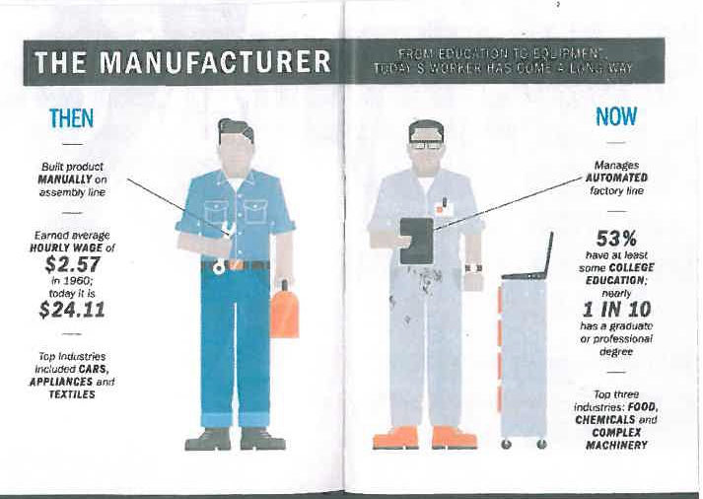
The ‘New’ Manufacturer
(Ref. Time. April 22, 2013 P.24/5)
Notes:
These factories of the future have more machines and fewer workers – and these workers must be able to master the machines. Many new manufacturing jobs require at a least two-year tech degree to complement artisanal skills such as welding and milling. The bar will only get higher. Many experts believe it won’t be too long before American employers expect a four-year degree – a job qualification that taht will eventually be required in many other places around the world too (Time, 22.04.2013, p. 20)

Slide 20
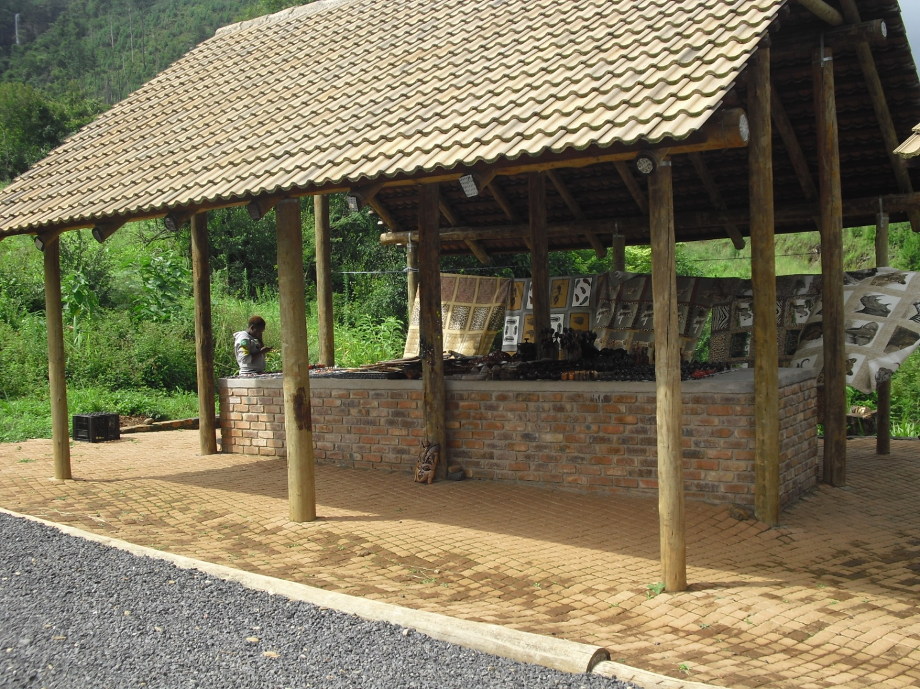
Give me hope .....Joanna.....

Slide 21
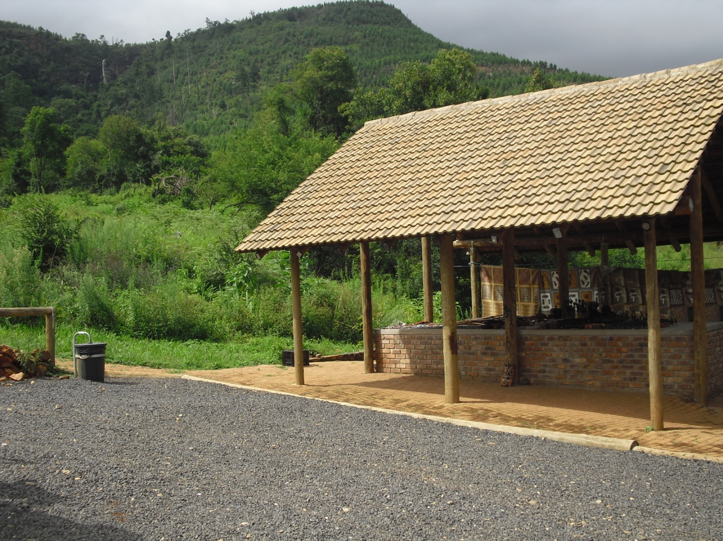
Bridal Veil Falls: Sabie/Mpumalanga

Slide 22
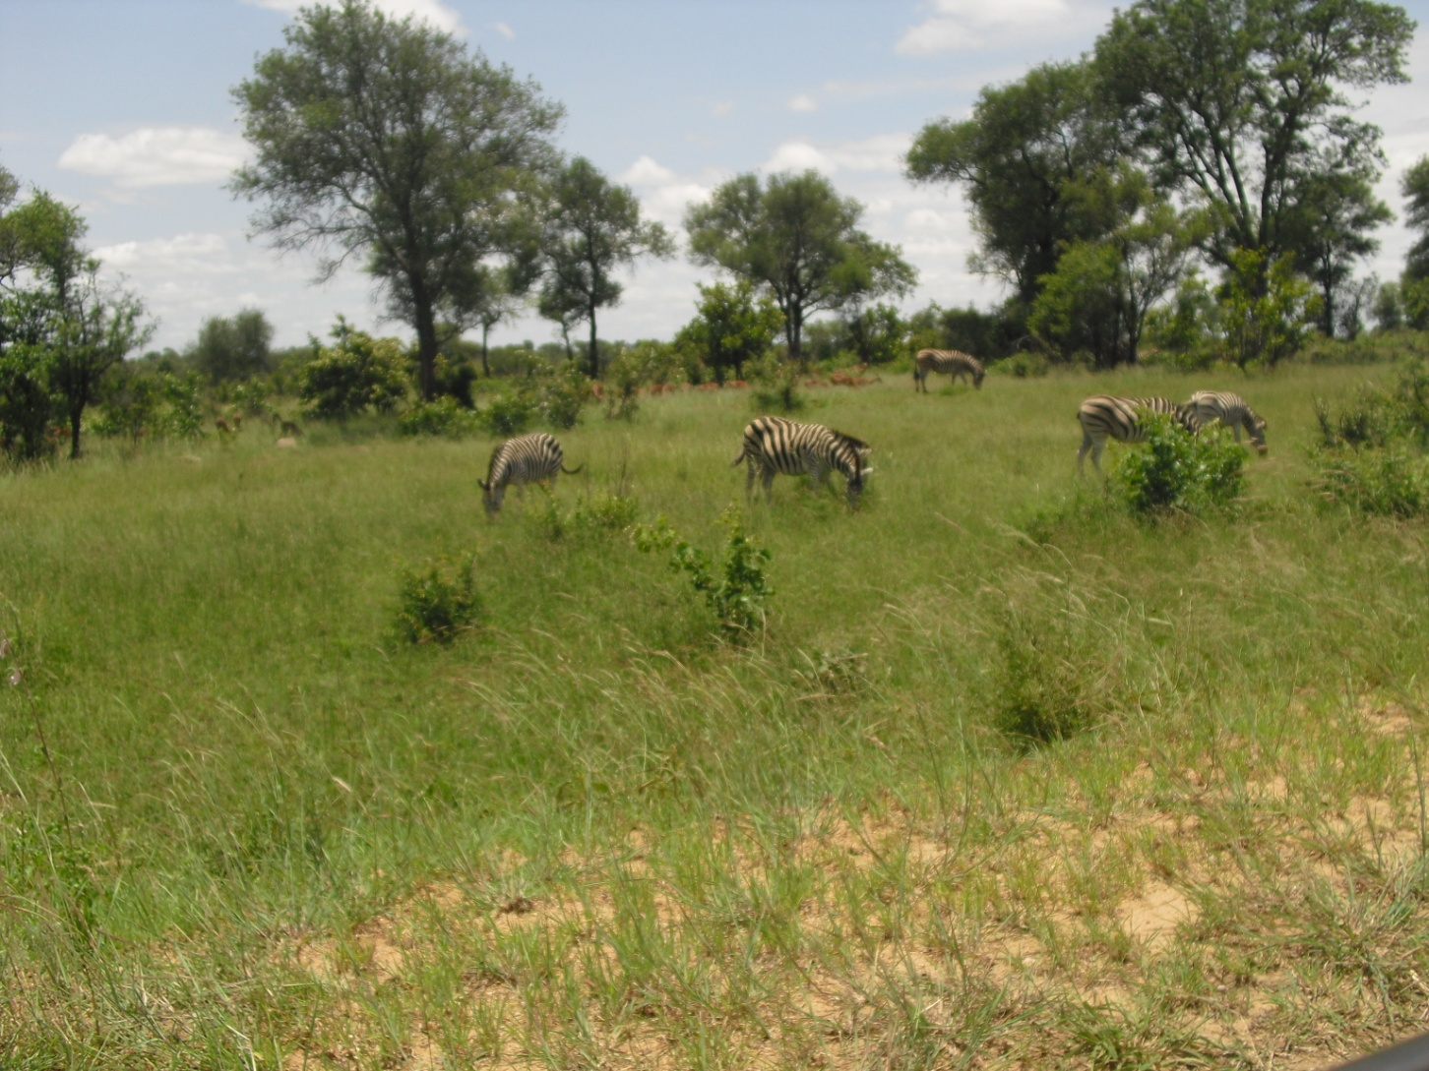

Slide 23
VET in South Africa-Challenges
The South African reality

Slide 24

Post School Education and Training System
A single, integrated, coherent and well articulated post-school system is located within the:
Expansion of post school provision to improve access and success
Strengthening institutions to improve quality of teaching and learning
Setting out a vision and pathways for achieving a coherent post school system with articulation, collaboration and coordination between the different components, as well as alignment between the various institutional types and between education and training institutions and the labour market

Slide 25
What is an TVET College
TVET Institution – Intermediate level
  School -----------FET College-------------------University
Current: responsive to post-school learners i.e post 16
  Primary School (Gr 1- - Gr 7) 7 yrs
  Secondary School (Gr 8 – Gr 12) – 5 yrs
Mid level skills – artisan, hairdressing, plumber, electrician etc
50 in country, 286 campuses
Current enrolment around 457 000 students in total

Slide 26
Key critique of the sector
The FET College System is not effective. It is too small and the output quality is poor. Continuous quality improvement is needed as the system expands. The quality and relevance of courses need urgent attention. When quality starts to improve and the employability of graduates begin to increase, demand for FET services will rise automatically. Simply growing the sector without focusing on quality is likely to be expensive and demoralising for young people, further stigmatising the system.
Source: (NDP: 2012)

Slide 27
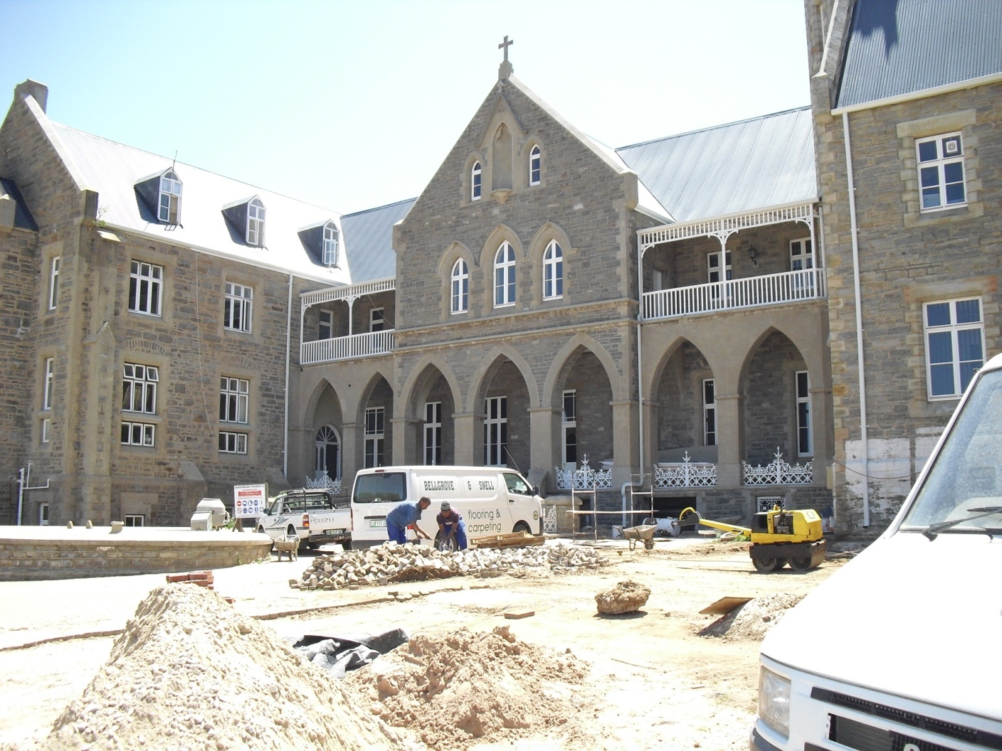
TVET College Overview
Intentions
- Education and Training synergy
Quality - NQF
Reorganise and strengthen
Initiatives
Cash injection, occasional - 2005 - Racapitalisation
Curriculum review – NATED-NC(V)
Achievements
Equity and open-ness
Enrolment demographics: white to black
Reorganisation or sector (post 2001) – Mergers and rationalisation (150 – 50 colleges)
Campus focus

Slide 28
Structural reconfiguration
Department of Higher Education and Training (DHET)
(former) Department of Labour
(Workplace Education and Training)
Sector Education and Training Authorities
Skills Levy
Department of Labour (DoL)
Workplace Labour relations
Employment
Labour Relations
Labour Market Policy
Employment Equity
Sector Education and Training Authorities
(former) Department of Education
(Public-ly funded and Private supply-side post-school entities)/institutions
FET Colleges
Universities of Technology
Universities (Research)
Schooling
Dept. of Education (now DBE)
Schooling
(circa 6-18yrs)
FET Colleges
Universities of Technology
Universities (Research)
Schooling

Slide 29
Technical Vocational Education and Training
Challenges
Close on 2 million students enrolled in public and private PSET programmes in 2012.
54% in HEIs
32% in TVET Colleges (DHET, 2013)
Universities
953 373
FET
Colleges
509 643
TVET Colleges
2.5 million
Universities
1.6 million
FET
Colleges
320 679
Universities
761 000
South Africa,2007 (DHET, 2008)
South Africa,2012 (DHET, 2013)
2030 Vision (White Paper)

Slide 30
The Department of Higher Education
a coherent and single post‐school education and training system that is structured both
  to meet the aspirations of youth and adults and
  to ensure that education, training and skills development initiatives respond to the requirements of
    the economy,
    our rural development challenges, and
    the development of an informed and critical citizenry -Ministry
Separation of School and Post-School Education and Training System

Slide 31
Role of the TVET College Sector : Economy
To create alignment and coherence within the post-school education and training system and the country’s development agenda in terms of the New Growth Path, Industrial Policy Action Plan II, Human Resource Development Strategy, National Skills Development Strategy III, National Development Plan and National Ten-Year Innovation Plan
Need to create a skilled and capable workforce that can contribute to an equitable growth path with the TVET College sector at the centre of skills development
50 colleges spread across 264 campuses with the establishment of an additional 12 campuses and 2 skills centres in under-served and impoverished communities
TVET colleges are required to produce mid and high-level skills that are necessary to drive the South African economy

Slide 32
Challenges Facing the FET College Sector
Poor governance and management, especially financial management
Rampant corruption and fraudulent practices by both students, staff and management
Poor teaching and learning, in 2012 the average retention rate in the NC(V) programme was 61% while the certification rate was approximately 42%
Poor planning, especially planning for College sector expansion
Limited, if any mainstreaming of student support services, especially for students with disabilities and special learning needs
Lack of student commitment and discipline:
  - A lack of respect for College property
  - Poor attendance
  - Abuse of the DHET FET College Bursary Scheme

Slide 33
Measures Undertaken and Implemented
TVET student headcount enrolments increased by 90% from 345 566 in 2010 to 657 690 in 2012
Building of 12 new VET campuses and refurbishment 2 other campuses
NSFAS student bursary funding at VET Colleges has increased from R318 million in 2010 benefitting 61 703 students to R1.988 billion in 2013 targeting 222 817 students
Opening of SETA offices at VET colleges to improve student and lecture placement for Work-Integrated Learning (WIL)
VET college Administrators to restore teaching and learning
Introduction of a Framework for Lecturer Qualifications
Launch of SAFETSA to harness student innovation towards improving teaching and learning outcomes in the sector

Slide 34
Reviewing the national importance of TVET
Lessons from experience: HRD Technical Task Team

Slide 35
Premises for VET College transformation
Measures to strengthen and support FET (TVET) colleges in expanding access and improve quality
Reality that sector (was)/is a moving target.
  Change in nomenclature (from FET to VET) - only tip of the iceberg....range of interventions (DHET/Colleges/SETAs etc etc) already underway
Focus on key terms in TTT’s mandate
  expanding access and
  improving quality of provision
Recognition that quality can (only) be achieved through, and by means of open and unfettered institutional access, and that true access cannot be achieved without attention being paid to quality.
Ultimately the task was/is unable to be effectively carried out without key systemic considerations.

Slide 36
Need to rethink essences: Premises, Promises and Impacts
Purpose
  What they are intended to do?
  Respond to whom/which economy? Formal/Informal/other
  Lifelong learning agenda
Composition: Who is in them?
  pre-employed/employed/retrenched/youth/adult/NEETs etc
  Role of Government/Industry - Who is the ultimate beneficiary?
What capacity is needed and where?
  Notion of capacity? Levels – Leadership/management/staff
  Governance (national/regional/institutional) – include relationship with other actors.
  Centralisation/Decentraisation
Funding and curriculum
  Who funds
  To whose benefit?

Slide 37
TVET Colleges and the Developmental State
How can skills development support the creation of a developmental state? (DHET White Paper: 2014).
Relationship between TVET and the economy has always been central to its existence (raison d'etre).
Reality that the new labour market/economic calls for a new role for the college sector (not simply formal labour market…notion of ‘township LM’).
Catalytic role of TVET colleges in the PSET system to enable the reality of a developmental state to be realised.
Relationship between TVET colleges and national development trajectory crucial.
Thus, for instance Infrastructural Development Plan needs to make TVET colleges CENTRAL (as opposed to a marginal afterthought) to its achievement

Slide 38
The Vision – An overview
Nature | Immediate Term | Medium Term | Long Term
Focus | Labour market (formal and informal labour market) | Labour market (formal and informal labour market) Community/local needs (CETC and TVET Colleges) | Expanded, comprehensive and differentiated colleges
Target Group | Pre-employed Employed Unemployed/ Post-employed | Youths and Adults (both pre-employed and employed and un/post employed)
Alignment with | DTI (Industrial Policies) EDD (National Dept) Local Labour markets SBD (entrepreneurship) | Economic and Community | Responsiveness to the learner (in broadest sense)
Purpose | The main purpose of these colleges is to train young post-school leavers, providing them with the skills (incorporating knowledge and attitudes) necessary for employment (formal) | Youths and adults “building skills for work and life” Main purpose to provide labour market needs and community development | Economic, equity and transformation
Learning Mode | F/T, with P/T provision (WIL crucial) | F/T, with P/T provision (WIL crucial) - Community engagement | Multiple modes – online, e-learning, blended learning
Occupational routes

Slide 39
What we were up against
..an actionable, integrated and aligned national Human Resource Development Plan for South Africa (HRD Plan)
Strategic Objective | Performance Indicator | Short Term Targets (1 year) | Medium Term Target (3-5 years)
2.1 To strengthen FET colleges to expand access | % increase in the number of learners enrolled in FET colleges | Factors impeding increased access in FET colleges identified | Over 1.25 million enrolments achieved
2.2 To improve the quality of provision within FET colleges | % FET programmes meeting local economic needs | Status quo review conducted and recommendations made | National Certificate Vocational (NCV) reviewed and PQM improved
 | % learner throughput in all programmes | Factors impeding Strong relationships between industry and FET colleges identified | 75% throughput rate achieved
 | % increase of lecturers with required qualifications and industry experience | Framework for developing strong relationships between industry and FET colleges developed | 25% increase on baseline

Slide 40
Conclusion: How to link (T)VET to World of work
What constitutes VET vis a vis SD/TVSD?
What purpose is the sector expected to fulfil?
What is the ‘world of work’ that we speak about?
How we think about the challenge is how we will essentially attempt to resolve it.

Slide 41
Some implications-TVET and World of Work
Need for understanding the new labour market
Need for ensuring that we deal with past as it needs to be dealt with....de-romanticisation called for...
Understanding that much of our training and ethic has been result of that past
The new order needs to be understood...
Implications for skills and precariat labour market
Urgent need to understand limitation of the apprenticeship numbers game being played

Slide 42
The TVET-LM Linkage
Education and Skills Development
Livelihood
Labour Market

Slide 43
Role of Education and Training
Lifelong Learning/Human Development//Potential
Education and Training (TVET)
Livelihood source (Labour Market)

Slide 44
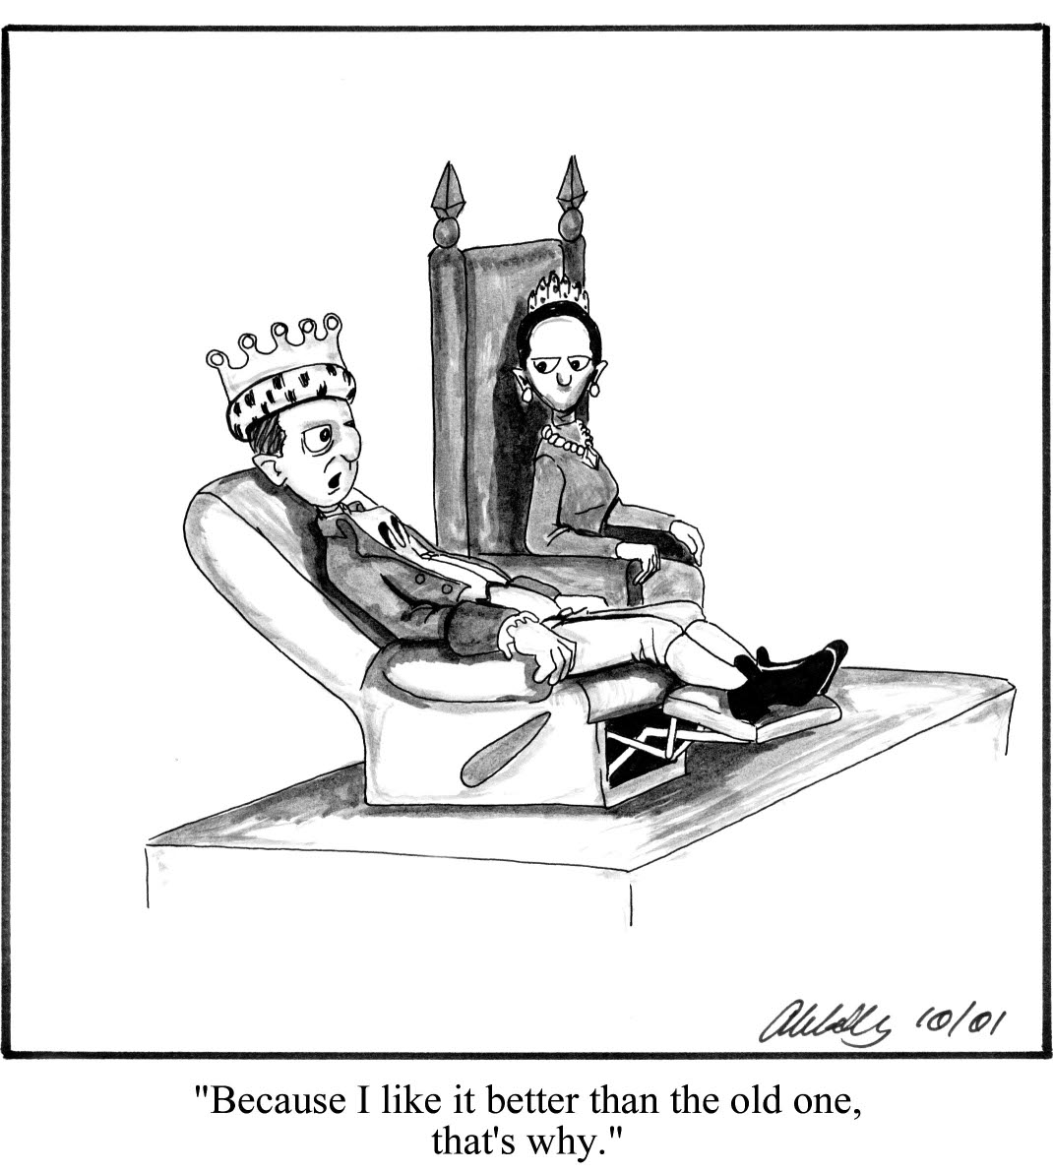
Just…might require an attitude(-nal) review…..

