Slide 1
Using ETF’s TORINO PROCESS building blocks for assessing VET development
Mihaylo Milovanovitch
Senior Expert, European Training Foundation

Slide 2

The Torino Process
A participatory process leading to evidence-based analysis of VET policies in a given country.
Inspired by the Copenhagen and Bruges processes, and about to incorporate the Riga conclusions.
Three editions so far: 2010, 2012 and 2014.
Fourth edition in preparation (2016)

Slide 3
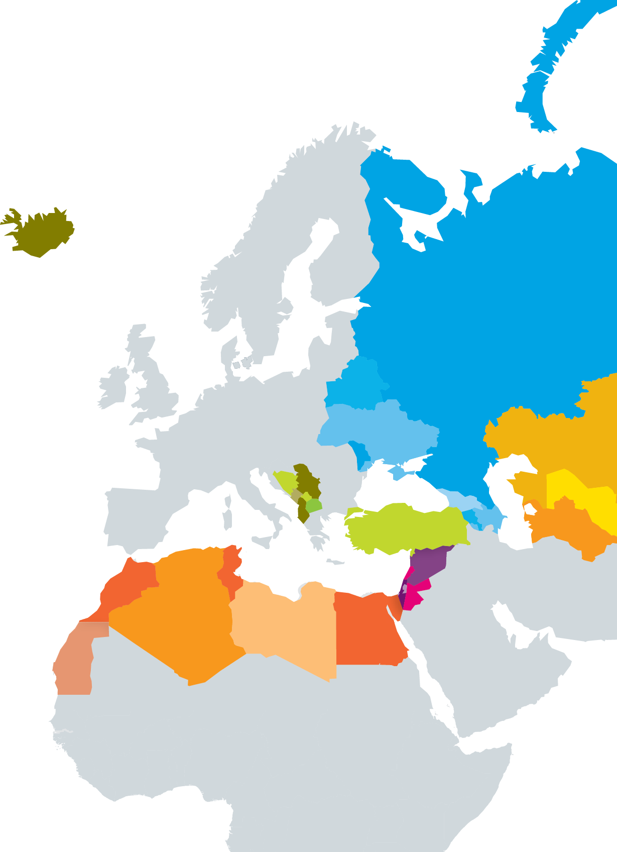
Torino Process Coverage
SOUTHERN AND EASTERN MEDITERRANEAN
Algeria, Egypt, Israel, Jordan, Lebanon, Libya, Morocco, Palestine, Syria, and Tunisia
EASTERN EUROPE
Armenia, Azerbaijan, Belarus, Georgia,
Republic of Moldova, Russia, and Ukraine
SOUTH EASTERN EUROPE
AND TURKEY
Albania, Bosnia and Herzegovina, former Yugoslav Republic of Macedonia, Iceland, Kosovo, Montenegro, Serbia, and Turkey
CENTRAL ASIA
Kazakhstan, Kyrgyzstan, Tajikistan, Turkmenistan, and Uzbekistan
TORINO PROCESS

Slide 4
Purpose of the Torino Process
TO BUILD CONSENSUS
on the possible ways forward in VET policy
and system development, including:
determining the state of the art and vision
for VET development in the country
AND
after the 2012 edition, an assessment
of whether countries are achieving the
results they want and measuring progress
in the reform implementation.

Slide 5



VET deliverables
Consistency
Taste
Expectations
…….
Water
Pots
Cooking time
Matching sauce
Qualifications
……
VET elements/blocks
TORINO PROCESS

Slide 6

A. VISION AND STRATEGY
B. ADDRESSING ECONOMIC AND
LABOUR MARKET DEMAND
C. ADDRESSING SOCIAL AND
INCLUSION DEMAND
D. INTERNAL EFFICIENCY
E.GOVERNANCE AND MANAGEMENT
Inclusive
Coordinated
Feasible
Implemented
Skills demand forecast
Link to LMS
Promoting/supporting EL
Inclusiveness
Evidence on/anticipation of needs
Assessment
Staff policy
Accreditation
?
Qualifications
Work-based learning
?
?
Distribution or responsibilities
Autonomy
Financing of VET

Slide 7
VOCATIONAL EDUCATION AND TRAINING
How does the Analytical Framework define ‘VET’?
‘VET’ refers to the system of both initial
and continuing VET delivery.
Initial vocational education and training (IVET) is the one carried out in the initial education system, usually before
entering working life.
Continuing vocational education and training (CVET) is the one after initial education and training or after entry
into working.
Source: Cedefop

Slide 8
www.etf.europa.eu
mmi@etf.europa.eu

