Slide 1

Promotion of TVET Systems
Priorities and experiences of GIZ
The International Seminar on Good Practice Exchange
of Vocational Education and Training (VET)
and Entrepreneurship Training
Tilman Nagel, GIZ Germany
Head of Section Education, TVET and Labour Markets

Slide 2

GIZ profile
A German federal enterprise
GIZ’s purpose is to promote international
cooperation for sustainable development
and international education work.
As a 100% federally owned, public-benefit enterprise, we support the German Government in achieving its objectives in the field of international cooperation for sustainable development.

Slide 3
TVET means for GIZ
Lifelong Learning Partly as a public good Partly according to market mechanisms
Human Capital Development Employability Improving competitiveness of enterprises, sectors, regions
Personal Development Promoting the potential of the individual
Social Capital Formation Social inclusion Social development Innovation
TVET has two pillars
  education systems
  sustainable economic development

Slide 4
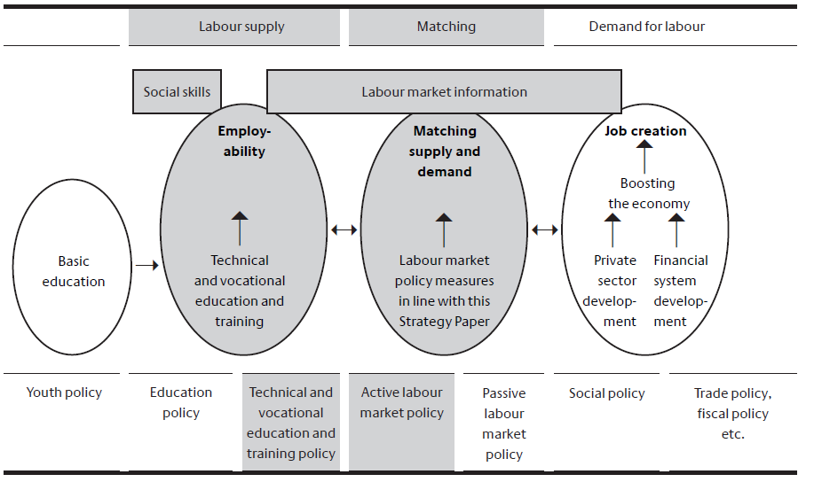

Slide 5
Phases of the transfer of the dual approach in German development cooperation
System approach
the dual system is transferable and can be implemented in other countries
transfer of system components and adaption on the local conditions
from the 90s until the 2009
from the 2010s on
From the 70s until the 90s
System component approach
Key element approach
the “spirit of the dual system” must be adapted to the specific conditions

Slide 6
Key factors of the German TVET approach
Private – Public Cooperation
Learning in the work process
Acceptance of standards
Qualified vocational education and training staff
Institutionalised research and consultancy
Notes:
Cooperation between the state and trade and industry
By working together, the state and trade and industry can secure the basic conditions under which vocational education and training can take place. These range from sharing funding to developing and implementing curricula and extend to include the testing and certification of competences which have been acquired.
Learning in the work process
The aim of German vocational education and training is to create comprehensive employability skills – the ability to work autonomously. A combination of learning within the real work situation and school-based learning is the best way of developing the professional, methodological and social competence required to achieve this.
Acceptance of national standards
Inter-company occupational standards and uniform examination standards guarantee the quality of qualifications. Comparable training qualifications and certificates form the basis for employability, mobility and social acceptance and foster lifelong learning.
Qualified vocational education and training staff
The training which teaching and training staff undergo is a central quality component. An integrated VET concept requires teachers and trainers to combine the qualities of pedagogue and skilled worker within the same person.
Institutionalised research and consultancy
Educational and labour market research enable ongoing adaptation of vocational education and training to meet technical, economic and social development. Occupational information and advice provide support in the selection of initial and continuing training measures and in making the transition to the employment system.

Slide 7
Key Decisions to be Taken / Questions to be answered
Overall goal: Reduction of youth unemployment? Increasing relevance of TVET for labour market? Expansion of access to TVET? Sustainable financing?
Is there a sufficient platform for a „greater“ reform? What kind of incentives will be available?
Short- and medium-term deliverables: what are the success stories needed?
Where / how to start (regions, sectors, businesses)?

Slide 8
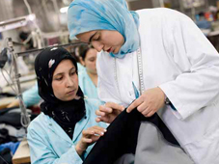
Case Study
Support to the
TVET reform in Egypt

Slide 9
Technical Secondary Education in Egypt
Technical secondary education enrolls 2.1 million of the 3.7 million youth in secondary education
Technical education has been subject to criticism:
  Insufficient and irrelevant training
  Poor skills acquisition
  Skill mismatches
  Expensive
Old polices and targets drive enrolment, not the quality resp. labour market needs

Slide 10
Promising reforms
Dual system combines school (2 days) and work experience (4 days)
Students are jointly evaluated by teachers and employers leading to a secondary degree
Curriculum reflects employer input improving relevance
Costs are shared by Government and employers
Modeled after the German Dual System, but adapted to Egypt’s circumstances and institutions

Slide 11
Achievements
Program now in its 20th year (6 years without direct international support)
30,000 enrollees
Covering 24 of 27 Governorates, 32 occupations, and 1,900 employers
More than 76 technical secondary schools participating
“Regional Units for Dual System” as self-financed matchmakers

Slide 12
Challenges
Quality assurance of in-company training
Institutional capacity needed to administer the program
30,000 enrollees still small in comparison (1.5 %)
Moving from a “boutique” to a large scale programmme:
    jobs growth
    management of quality
    difficulty of reaching rural areas
    reaching out to smaller enterprises means higher cost

Slide 13
Thank you for your attention!
Looking forward to our continued discussion….

Slide 14
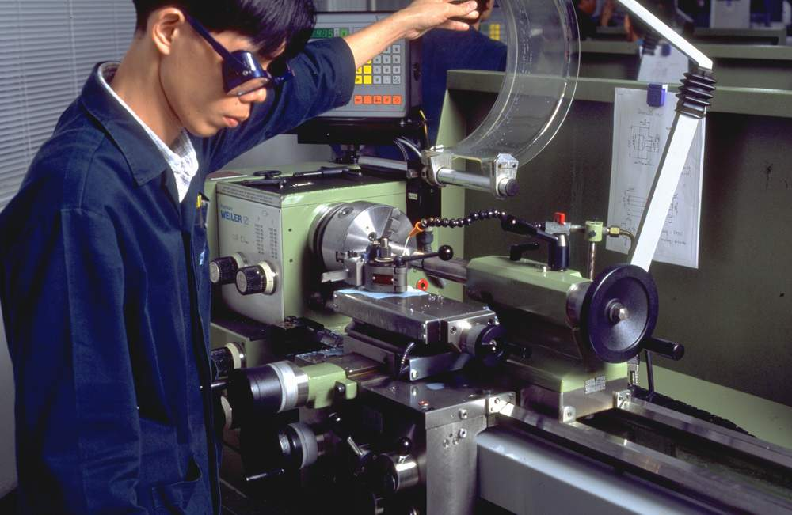
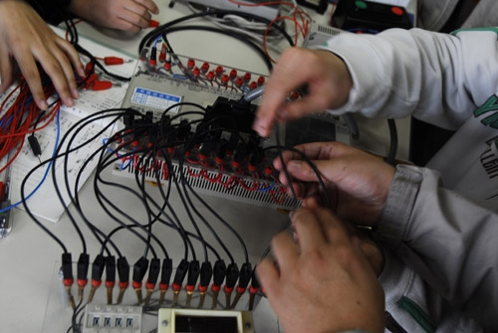
TVET Cooperation – A Core Competence of GIZ
Currently, GIZ manages…
… about 100 VET projects in 60 countries
… with a contract volume of more than 450 million Euro
… and more than 200 international and 500+ national experts worldwide
… for different clients like German ministries, multinational organisations, foreign governments, foundations and enterprises.

Slide 15

Initial situation in many countries:
Vicious circle of VET
Less attractive jobs for VET graduates
Lack of cooperation between government and private sector
Chronic underfinancing, lack of investment by SME, no recognition of qualifications & certificates
Bad reputation of VET
(“VET for the rest”)
Lower quality of education and training, lower qualification of applicants and graduates

Slide 16
Example: Car Mechatronics, PR China
WP1 + WP2
Pre-Selection of Schools
Evaluation of Schools
WP4
Development / Adaptation
of Curricula
WP7
Additional procurement for workshops
WP8
Introduction of Assessment and Certification based on Learning Outcomes
WP10
Country-wide intro-duction of new programme
Further advice to VET reform
Monitoring/
evaluation
WP5
Training of Trainers
WP 3
Establish-ment of Model Classes
WP 6
Improvement of Training Organisation
WP9
Certification of Schools
(to ensure sustainability)

Slide 17
Key factors: sustainability
Participation
joint development
joint management
Willingness to change
Target groups
Ownership
Flexible management
Staff
System compatibility
Evaluation
Needs assessment
Baseline study
Stakeholder analysis
Cooperation
with the private sector
with the public sector
with stakeholder
Vision
+
Strategy
M&E system
Labour market
Follow-up concept
Exit strategy
Follow-up measures
Education / VET system
Organizational capabilities
Functioning organizational structure
adequate equipment (incl. curricula)
Financial resources
Cooperation
with partners
with German DO
with international DO
© Stockmann 2012

