Slide 1
SESSION 8
Introduction
Olga Strietska-Ilina
Skills and Employability Branch
Employment Policy Department
ILO, Geneva

Slide 2
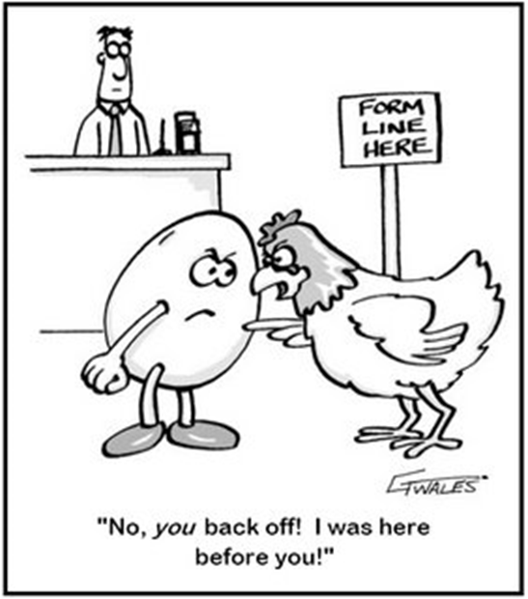
A feedback loop
Jobs
Skills

Slide 3


Implications:
Functions and policy options
To inform policy making
(adjust or plan?) …
… and/or to inform individual decisions?

Slide 4

Key terms
Labour supply and demand
Hard-to-fill vacancies / skill-shortage vacancies
Skills
Labour shortage
Knowledge and competency
Skills shortage
Skills gaps
Occupation
Qualification
Notes:
Just to make sure we speak the same language and understand what we are talking about.
Skill: ability to carry out a mental or manual activity, acquired through learning and practice. An overarching term which includes knowledge, competence and experience.
Competency: ability to actually apply the knowledge – actually do what is specified as an expected training outcome.
Occupation: a grouping of jobs which have a repeating set of main tasks and duties across industries. Occupational classifications (ISCO) and levels of these.
Qualification: certified outcome of training / education. Classifications. ISCED.
Skill needs: another overarching term which refers to both quantitative and qualitative needs. NOT THE SAME AS DEMAND! Supply-demand =need.
Skill shortage – another overarching term which stands for both skill gaps and labour shortage. Is a lack of adequately skilled individuals in the labour market. Shortages result either from labour shortages / labour market tightness (when unemployment levels are low) or from an insufficient number of individuals possessing the specific skills required.
Skills gap – qualitative. Occurs when the skills a person already possesses is below that required for them to carry out their duties competently.
Labour shortage – quantitative
Difficult to fill vacancy is not the same as skill shortage (working conditions play a role, or poor recruitment practices)
Repeated difficulties in filling vacancies in a certain occupation form a difficult to fill occupation. May be =to shortage occupations but again not necessarily.
TNA – training needs assessment. A training need exists when there is a gap between what is required the skill required to perform job tasks and the skill possessed. An assessment is a process of collecting and analysing information and data. TNA ≠ skill needs assessment. TNA serves purely training needs and is usually performed at the level of company, training institution or industry. SNA is a lot broader and serves broader policy objectives, including that of initial and continuing e&t policy, all forms of HRD, financing of training, migration policy etc.

Slide 5
Skill Mismatch
Mismatch
Surplus
(too many skills e.g. unemployed, inactive, new entrants)
Shortage
(not enough e.g. hard to fill vacancies)
May co-exist

Slide 6
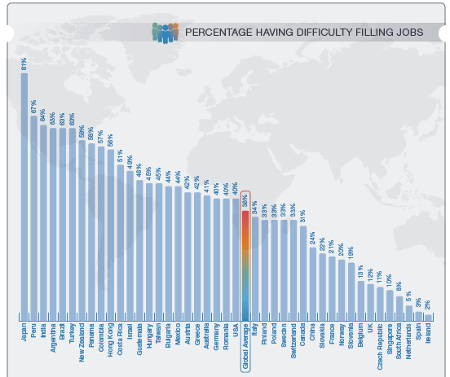
Manpower Group Talent shortage survey of employers 2014
201 mln unemployed globally (ILO, 2014)

Slide 7
Skill Mismatch
Mismatch
Surplus
(too many skills e.g. unemployed, inactive, new entrants)
Shortage
(not enough e.g. hard to fill vacancies)
Mismatch
Qualification mismatch
Skill gaps and mismatch
May co-exist
May co-exist
E.g. :
Overeducated but underskilled
Undereducated but overskilled
Over/undereducated and over/underskilled

Slide 8
Horizontal and vertical mismatches
Quantity
Overqualified
Education level
Overskilled
Education field / skill type
Underskilled
Quality
Underqualified

Slide 9
Definitions
Skills mismatch is an encompassing term which refers to various types of imbalances between skills offered and wanted on the labour market. It applies equally to the current and the potential workforce, to those already in employment and to job seekers.

Slide 10


Skill mismatch over time
Skills obsolescence
  Skills need to be maintained
  Skills not used become obsolete
Career mismatch – when jobs and skills mismatch does not approximate over time
Current and potential mismatch

Slide 11
Examples of mismatch indicators
Unemployment rate by level of education
Wage dynamics
Share of over / under qualified
Hard-to-fill/skills shortage vacancies
Skills gaps reported by employers
Subjective mismatch reported by workers / graduates

Slide 13

Why does mismatch happen?
Global drivers of change
Demographic change
Educational attainment
Globalization of markets
Technology and innovation
Climate change and transition to low carbon economy
Work organisation change

Slide 14
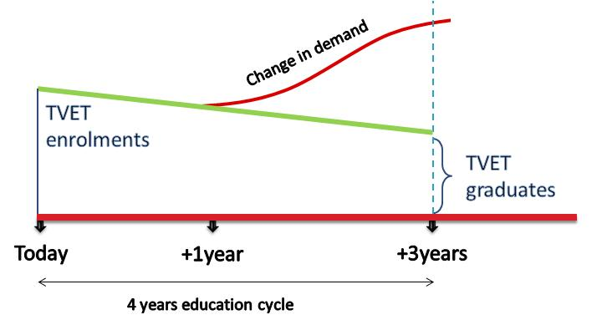
Why to anticipate skills
Demand for skills is changing faster than training is delivered

Slide 15

Labour market imperfections
  Time lag between skill supply and labour market demand
  Limited geographical mobility
  Public goods
  Industrial or investment policies
  (incentives, subsidies)
  Positive externalities
  Irrational decisions of labour market actors
  (careers, wages)
  Inflexible wages
  Imperfect competition (monopsonistic firms)
  Imperfect information on jobs and skills availability
Notes:
Positive externalities : e.g. Governments have broader objectives in the market, such as equity, social inclusion.
Similarly, industrial or investment policies may create demand in a certain sector or specific occupations (e.g. high technology related ones). – e.g. promoting trade or meeting environmental objectives.

Slide 16
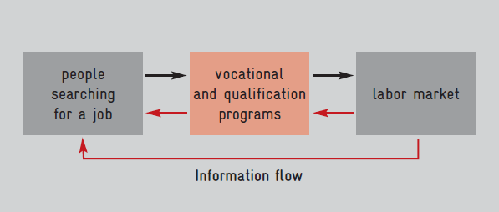
Optimal functioning of labour markets

Slide 17
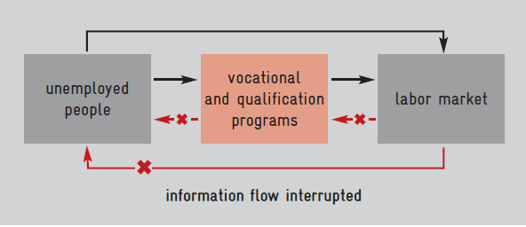
Information deficit

Slide 18
Labour market information
(LMI)
Any information concerning the size and composition of the labour market, the way it functions, its problems, opportunities and employment-related intentions of its actors.
Labour market information system (LMIS)
Skill needs
assessment
and anticipation
Institutions
(soc. Dialogue)
Analytical capacity
Tools
Data
Notes:
A large overlap but not equal.
LMI includes law, regulations, administrative records which is not part of Skill needs anticipation. LMI does not concern skills only – but employment, poverty, job quality etc. On the other hand, skill needs analysis includes specific studies and forecasts which might not be considered a standard LMI, although may be included in LMIS for dissemination and channelling.
Questions?

Slide 19
Skills development
Initial TVET
youth
Active labour market policy
Job seekers
Workplace learning
Workers
15 - 24
2 – 5 years
TVET system
training centres
companies
Retraining measures
1 week – 1 year
Employment services
Public and private TPs
1 hour – any length
On-the-job
Off-the-job
Schools
Universities
Public and private TPs
Notes:
Which information you want to find out, who will be users and what is the time span

Slide 20
Information needs
Initial TVET
Mid-to-long term forecasting (quantity)
Active labour market policy
Short-to-medium term skill needs forecasting and assessments
Workplace learning
Link between longer-term strategy in enterprise development and skill needs assessment
On-going information on changes in labour market demand in terms of quality (competences, skills gaps)
Information on current labour market signals
Immediate to long-term assessments
Notes:
Which information you want to find out, who will be users and what is the time span

Slide 21
Definitions
Skills needs anticipation broadly refers to activities to assess future skills needs in the labour market in a strategic way, using consistent and systematic methods, and based on social dialogue.

Slide 22
Policy cycle
Skill needs assessment &
anticipation
Skills development policy /
Curriculum design /
Competency standards
Skills development
(delivery)
Monitoring of training relevance
Evaluation of training outcomes and their relevance to the labour market needs

Slide 23
Examples of anticipation methods
Quantita-tive models
Delphi method
Foresight
Tracer studies
Employer surveys
Focus groups

Slide 24


ILO policy specific tools for skill needs anticipation and assessment
Guidelines for inclusion of skills aspects in employment-related analyses and policy formulation. (applied in Cambodia, Fiji, Sudan)
Skills for trade and economic diversification (STED). (Egypt, Jordan, Viet Nam, Tajikistan, Ukraine, Macedoania, Bangladesh, Kyrgyzstan, Malawi, Cambodia, Myanmar, Tunisia)
Anticipating skill needs for green jobs: A practical guide. (Based on research in over 30 countries).
Using technology foresights for identifying future skill needs. MSM Skolkovo - ILO. (Armenia, Viet Nam)

Slide 25
Generic tools for skill needs anticipation and assessment
The compendium of six guides on anticipating and matching skills and jobs (Cedefop, ETF, ILO):
  Using labour market information. (S.Africa, Middle East)
  Developing skills foresights, scenarios and forecasts (Tunisia, Armenia, Viet Nam).
  Working at sector level. (Sri-Lanka, Kyrgyzstan)
  The role of employment service providers. (Tajikistan, Albania)
  Developing and running an establishment skills survey. (Tunisia, Egypt, Iraq, Tajikistan, Timor-Leste)
  Carrying out tracer studies. (Lebanon, Tajikistan).

Slide 26

Thank you!

