Slide 1

Skills for Trade and Economic Diversification
Olga Strietska-Ilina
Skills and Employability Branch
Employment Policy Department
ILO, Geneva

Slide 2
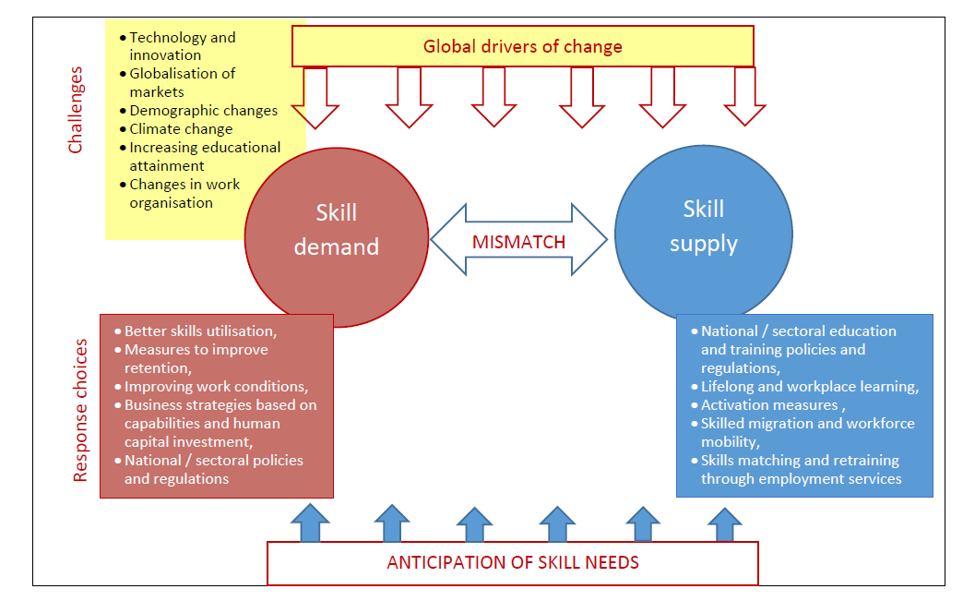
Coordination!

Slide 3
What is STED?
STED helps to identify and anticipate skills needed to improve performance of internationally tradable sectors
In sectors that have:
  employment potential
  potential to increase exports
  Potential to contribute to economic diversification
Designed to use skills to:
  Improve productivity and competitiveness
  Improve position in international trade
  Diversify production and services
  Drive growth in output and sales
  Create more decent employment

Slide 4
Development Logic of STED
Developing the
right skills
Strengthens Business Capabilities of Target Sectors
Greater Productivity & Market Competitiveness
STED is not a straightforward Training Needs Analysis (TNA).
We do not just ask employers what skills they want and need.
We seek to identify what most needs to be done on skills to have a significant impact along this chain, and to take / facilitate / inspire action to achieve this.
More Sales in Traded Markets
More Employment in Decent Jobs

Slide 5
STED Designed to Drive Coherence between
Skills and Trade / Industrial Strategy
Skills
(Anticipation, Implementation)
Trade,
Industrial
Strategy
STED
Sectoral
Approach
Stakeholder /
Tripartite
Approach

Slide 6
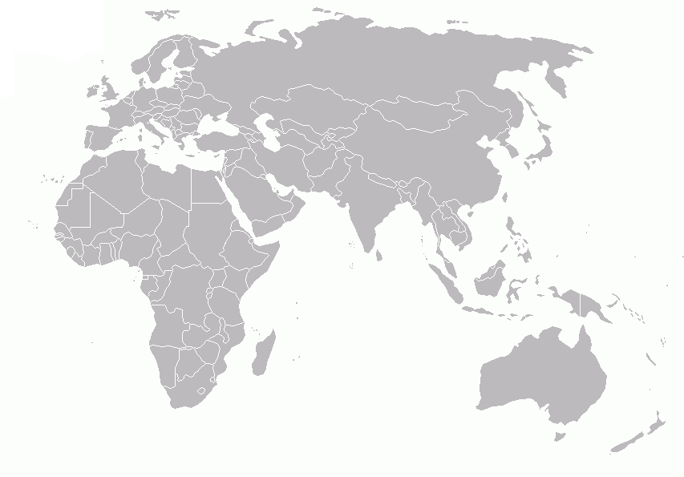
STED applications so far
Ukraine
Year: 2010
Sectors: Metal Industry, Tourism
Kyrgyzstan
Year: 2011
Sector: Garments
Viet Nam
Sectors:
Tourism
Seafood
Macedonia
Year: 2011
Sectors: Tourism, Food Processing
Cambodia
Sectors:
Food Processing
Light Manufacturing
Myanmar
Sectors:
Tourism
Vegetable &fruits
Jordan
Sectors:
Pharmaceuticals
Food processing
Tunisia
Sectors:
Metal fabrication and metallurgy
Agri-food
Egypt
Sectors:
Food processing
Furniture
Malawi
Sectors:
Oilseeds sector
Horticulture Sector
Bangladesh
Sectors:
Agro Processing,
Pharmaceuticals

Slide 7
Across sectors - upgrading capabilities in trade intensifies need for …
Modern operating technologies (automation, computers)
Modern work organization (including people management)
Compliance with standards and regulations
Quality control, assurance, improvement
Flexibility, responsiveness and reliability responding to needs of customers
Engagement and promoting improvement by suppliers (upward in value chain)
Marketing, sales management, channel management
Product and process change / transfer / innovation
Agility, strategy, change management

Slide 8
Links Between Business Capability Bottlenecks and Skills (observed in STED)
Business Capability Area | Examples of Linked Skills
Efficiency and effectiveness of operations | Technical skills of machine operators, assemblers, crafts, technicians … Production management skills, including people management, engineering … Core work skills of workers at all levels required for modern work organization and productivity improvement
Compliance with standards | QA and compliance skills Regulatory management skills Laboratory scientist and technician skills
Marketing , sales, distribution | Marketing skills, channel management skills Sales management and sales skills
Innovation, design and product development | Design engineers, scientists, designers Marketers
Supply chain management and logistics | Logistics management, logistics workers Supply chain management
Development of value chain | Modernization of farming skills (food processing)

Slide 9
STED in Viet Nam – Sector Selection
Consultation with tripartite constituents
Consultation with other development partners (World Bank, UNIDO …)
Consistent advice that project should:
  Focus activities at provincial level in Viet Nam context
  Build on existing ILO work to establish credibility with stakeholders
Shortlisted sectors based on:
  Scope for employment growth
  Relevance of skills to growth in decent employment
  TVET level skills important to growth
  Relevance of support on skills analysis
  ILO’s existing standing with sector (crowded technical assistance environment)
  Avoiding duplication
Chose tourism sector, with a particular focus on MSMEs
Chose target provinces for opportunity to collaborate with other ILO projects

Slide 10

Skills for Trade in Viet Nam
Tourism Project sites in provinces (central Viet Nam)
  Thua Thien-Hue
  Quang Nam
  Khanh Hoa
Beach tourism, rural tourism, heritage tourism
3 UNESCO World Heritage sites between Thua Thien-Hue and Quang Nam

Slide 11
STED Process in Viet Nam
Choice of sector
Desk research - Report on Tourism Development: Facts and Figures in Thua Thien-Hue, Quang Nam and Khanh Hoa, also national level data and analysis
Survey of employers in two provinces (117 per province)
Consultation with tripartite stakeholders, providers of education and training, including workshops
Synthesis of information
Development of provincial level recommendations in collaboration with stakeholders
Implementation at provincial level | STED Report | Working on wider implementation at national level

Slide 12
STED Process in Viet Nam:
Key relationships
General Department of Vocational Training (GDVT) - MoLISA
Provincial Departments of Tourism
Training institutions in target provinces
Business associations and employers’ organizations (Cooperative Alliance, VCCI, and provincial employer organizations)
Provincial Departments of Labour (DoLISA)
Workers’ organizations (VGCL)
Collaboration with:
  other ILO tourism projects in same provinces
  tourism projects of other development partners
  national level forum for development partners working in skills

Slide 13
Top occupations that enterprises need training (data for Hue from the survey)

Slide 14
Implementation (some examples)
Provincial Level
Pilot of a training course for tourism drivers
Participation of staff from TVET colleges specialising in tourism in careers guidance course and careers guidance master trainers course
Collaborating with Cooperative Alliance and another ILO project on launch of “trainerless training” courses for tourism MSMEs
Training workshops for provincial officials in Thua Thien-Hue and Quang Nam on tourism development planning and data assessment
Russian language courses for employees in tourism sector in Khanh Hoa
Course for trainers of UNESCO World Heritage tour guides
Initiative to enhance collaboration mechanism between schools and businesses in tourism sector has been arranged.
Teacher training in TVET colleges (practical skills in housekeeping, cooking, restaurant, bar)
National level
Support for initiative to establish a Tourism Sector Skills Council (a key national issue is to resolve issues with competing tourism skills standards, which are delaying curriculum reform)

Slide 15
Thank you!

