Slide 1
Domestic Revenue Mobilisation
10 - 12 June 2025

Slide 2
DRM, an introduction

Slide 3

DRM introduction
Quiz time!
Notes:
https://www.menti.com/ykaribwn8o
What is the average tax revenue to GDP ratio in developing countries?
5 percent, 10 percent, 15 percent, 25 percent, 35 percent
What is the average tax revenue to GDP ratio in developed countries?
5 percent, 10 percent, 15 percent, 25 percent, 35 percent
Why taxation is crucial for developing countries?
Please rank these elements:
Financing public expenditure, Building Nation State, Reducing Inequalities, Reinforcing democracy…

Slide 4
DRM (Introduction)
Tax Revenue to GDP ratio
  OECD countries: 34 percent in 2022 (Mexico 16.93%, France 46.08%, USA 27.66%)
  Least developed countries: Around 10.8 percent in 2019
  Africa: 15.6 percent (2021) Nigeria, Equ. Guinea, Congo, DRC less than 10 percent.
ECOWAS, WAEMU, CEMAC: 20 percent (one of the convergence criteria).
World Bank, UN:
  Below 15 percent, Fragile States (unable to deliver basic public goods and services).
  Depends on the definition of the failed, failing, and fragile States
Notes:
Links to databases:
UN:
https://www.wider.unu.edu/project/grd-%E2%80%93-government-revenue-dataset
World Bank: https://data.worldbank.org/indicator/GC.TAX.TOTL.GD.ZS
IMF: https://data.imf.org/?sk=77413f1d-1525-450a-a23a-47aeed40fe78
OECD: https://data.oecd.org/tax/tax-revenue.htm
ECOWAS: Economic Community of West African States
WAEMU: Western African Economic and Monetary Union

Slide 5
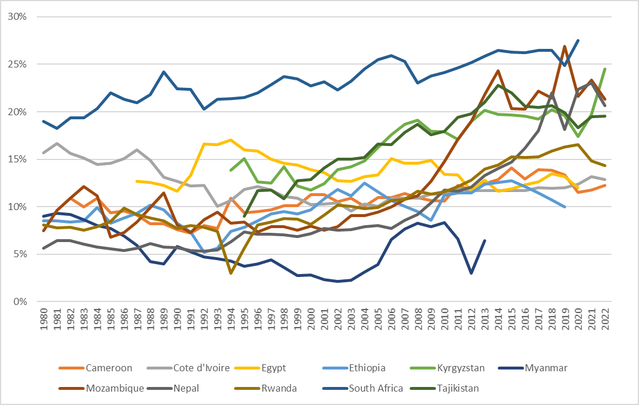
Tax revenue (% GDP)

Slide 6
Composition of tax revenue
Notes:
Source: IMF World
Note: Aggregated direct and indirect taxes for Angola, Myanmar, Rwanda
Aggregated indirect taxes for Cameroun, Nepal

Slide 7
Why do developing countries tax so little?
Low tax effort?
  Tax effort = Actual tax revenue / Tax potential
  Tax potential or tax capacity = The maximum amount of revenue a country could reasonably collect.
  Empirical estimations of tax potential (Stochastic Frontier Analysis)
Determinants of tax capacity (and tax effort)
  GDP/capita
  Size of the agricultural sector
  Openess (import+export/GDP)
  Others: Education, urbanization, corruption, financial development…
Tax effort => A measure of tax gaps
  Tax policy gap: Tax expenditures (exemptions, reduced rate, tax credits…)
  Compliance gap: Fraud, tax evasion, tax administration capacity.

Slide 8
Tax effort evaluation

Slide 9
Caveat: The quality of GDP assessment
Notes:
Chained means GDP data uses a year-by-year chain linking method for compensating for monetary inflation and deflation.
This is the recommened method for ensuring GDP calculations are up to date.

Slide 10
Caveat: Previous examples

Slide 11
Tax performance and tax effort
Quiz time!
Notes:
https://www.menti.com/vaqgysma2h
Tax effort
Are tax effort and tax perfomance equivalent?
Yes,
No *
Does tax revenue increase with the size of agriculture?
Yes,
No *
What would be the impact of GDP rebasing on tax performance?
A decrease *
An increase
No impact

Slide 12
Why do developing countries tax so little?
Informal sector and small-scale firms
  Economic activities that are not regulated by the state
  Dual approach of development economics: Formalization process.
Natural resource sector
  Resource curse/blessing
Weak political institutions
  Low contestability of power/accountability, corruption.
  Aid (curse): Samaritan dilemma
Lack of political will to reform
  Lobbying, corruption
  Lack of information, administrative capacity (?).
Notes:
Informal economy refers to economic activities that are not regulated by the state and do not fall under formal labor laws, taxation, or business registration.
Hart (1973): First introduced the term "informal sector", defining it as small-scale, self-employed, and unregulated economic activities in developing countries.
ILO (1972): The International Labour Organization (ILO) defined the informal economy as comprising self-employed workers, street vendors, home-based workers, and unregistered enterprises

Slide 13
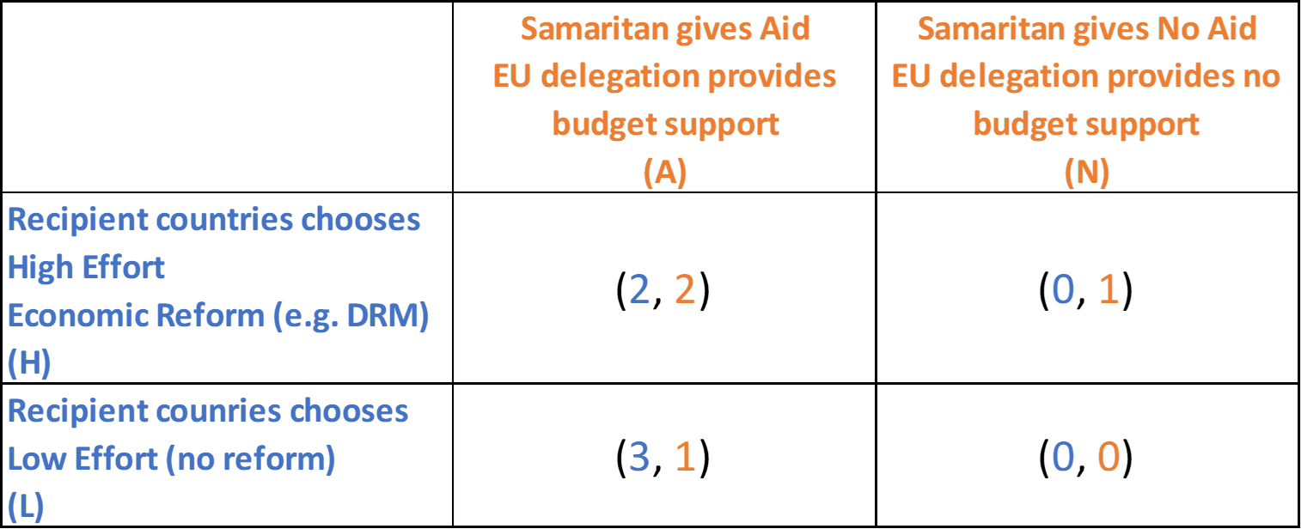
Samaritan dilemma
Notes:
The Samaritan's dilemma, first introduced by economist James M. Buchanan in 1975, refers to a situation in which a benevolent actor (the Samaritan), who wishes to help a less
fortunate party (the recipient), inadvertently encourages dependency or underperformance by committing to provide assistance unconditionally. This moral hazard arises because
the recipient, anticipating aid, may reduce their own effort or contribution.

Slide 14
Samaritan dilemma (Resolution)

Slide 15
Samaritan dilemma (Resolution)
  How resolving the Samaritan dilemma?
  Establish a credible commitment to withhold aid when effort is low.
  Conditionalities.
  Role of DRM reforms for budget support.
    Foreign aid is funded by taxpayers in the North (rich countries).
  S.M.A.R.T. indicators

Slide 16
Why DRM? (And for what?)
Tax is an important source for financing public expenditures.
  Alternative ways: Debt (limit), seignoriage (Zimbabwe=>hyperinflation)
  ODA (Solving the Samaritan dilemma)
    Addis Tax Initiative (August, 2015) => 4th International Conf. in Sevilla (2025)
    Tax = Priviliged tool for financing SDGs
But to finance which public expenditures?
  Which social contract? EU values?
  US, UK contract vs continental EU contract
  Health, Education => Public good or private good? Public or private spending?
    Education: Primary school vs Higher education
    Health: Communicable diseases vs Cosmetic surgeries
  Infrastructures: Firms, workers…
  Pensions system
    Pay-as-you-go (PAYG) systems vs Funded systems
  Subsidizing fossil fuel consumption?
Notes:
Social contract:
US, UK vs Continental model
Health, Education => Public or private spending?
Taxation in Economic Science
Public economics
Market failure => The State = Benevolent Leviathan
Theory of optimal taxation: Mirrlees and Diamond (1974)
Public Choice School
But, State failure.
Buchanan and Tullock (1962): The calculus of consent: Logical fondations of Constitutional Democracy.
Posner: Theory of regulation
Political economy
Voting models
Tax system analysis: tax policy and tax administration. Gillitzer and Slemrod (2015), Tax system, MIT Press.

Slide 17
Beyond revenue, DRM: A tool for State building
Taxation = « The Thunder of History », Schumpeter
  Taxation and wars (Income tax in Europe, US)
Monopoly of legitimate violence, Weber
Taxation and democracy
  No taxation without representation
  Does taxation lead to representation? Empirical evidence.
State capacity
  Taxation, tax administration, tax policy
Notes:
Schumpeter 2018: “The Crisis of the Tax State’’
The history and future of the tax state: Possibilities for a new fiscal politics beyond neoliberalism – ScienceDirect
The monopoly on violence as the defining conception of the state was first described in sociology by Max Weber in his essay Politics as a Vocation (1919)
A failed state is a state that has lost its ability to fulfill fundamental security and development functions, lacking effective control over its territory and borders. Common characteristics of a failed state include a government incapable of tax collection, law enforcement, security assurance, territorial control, political or civil office staffing, and infrastructure maintenance.[2] When this happens, widespread corruption and criminality, the intervention of state and non-state actors, the appearance of refugees and the involuntary movement of populations, sharp economic decline, and military intervention from both within and without the state are much more likely to occur.
In the early 2020s, Afghanistan, the Central African Republic, DR Congo, Haiti, Libya, Pakistan, Somalia, South Sudan, Sudan, Syria, and Yemen have all been described as failed states. There are concerns that Lebanon, Myanmar, and South Africa may also be on the path to becoming failed states in the near future.

Slide 18
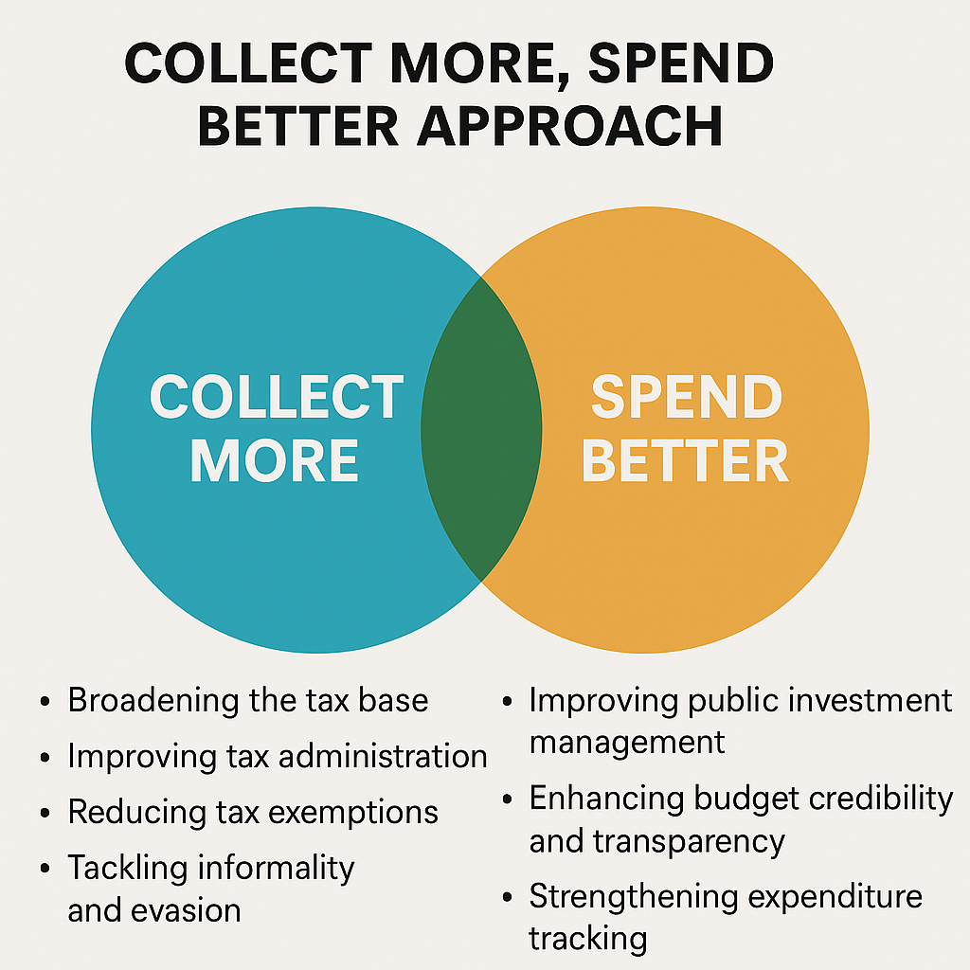
DRM as a tool to build a modern State
History of Western European countries
Virtuous fiscal circle
  More tax revenue => more demand for accountable use of public funds => More efficient public expenditures => Broader tax bases => More tax revenue =>…
  Increasing citizens’ trust in the State
  A counter-example: The case of resource rich countries and a solution (the creation of sovereign funds to freeze the impact of windfall revenue)

Slide 19
Why the D in DRM?
Domestic because of the worldwide tax transition:
    Decrease in tariff rates and revenue (Free trade, WTO)
    Increase in the taxation of domestic activity.
Example:
  Replacing tariffs by VAT (see the case of Ethiopia).
  Successful? It depends on countries’ economic structures.
  An issue in resource rich countries (VAT does not tax exportation).
  The risk of tariff policy backlash with Trump tariffs war.

Slide 20
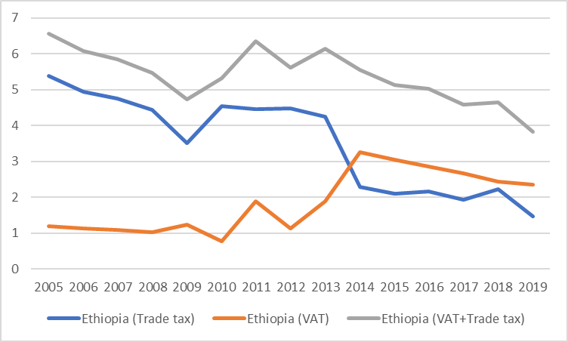
Tax transition: Ethiopia (% GDP)
Notes:
Incomplete tax transition: Revenue losses at the end ?

Slide 21
Tariffs (Customs duties)
Free trade
  Tariffs distort market efficieny by raising prices, reducing trade volumes, and protecting inefficient domestic firms.
  Trade liberalization maximizes global welfare and comparative advantage (Ricardo).
Protectionism
  Tariffs protect domestic industries, preserve jobs, and foster self-sufficiency (agriculture?).
  Strategic trade policies, bargaining.

Slide 22
Tariffs
Tariffs => Risk of inflation, rent-seeking behavior, redistributive issue of globalization process (winner and looser) => politics.
EU example: Economic integration => Political integration
The U.S.-China trade war (2018-2019):
  Increase in tariffs on over $360 billion in goods.
  Job Losses: 300,000 jobs in US due to higher production costs and retaliatory measures.
  Temporary Gains: Some industries (e.g., steel) benefited in the short term, but overall employment suffered.
Notes:
Peterson Institute for International Economics (2020)

Slide 23
Questions?

Slide 24
II. Tax Policy and Tax Administration

Slide 25
Tax policy and Tax Administration
Quiz time!
Notes:
https://www.menti.com/oghb1f3fur
Please rank your replies
Increasing tax rates
Broadening tax bases
Reinforcing tax audits
Introducing new taxes
Reorganizing tax and customs administrations

Slide 26
Tax policy and tax administration
Tax system: Tax policy and Tax administration
Tax policy:
    Finance Law, Tax Code or Act, Sectoral Codes (Mining, Petroleum, Forest, Agricultural…).
Tax administration:
    Organization of the tax authority: Administrations, Revenue Agency, privatization/autonomisation…

Slide 27
Tax Policy (Goals)
Increasing the tax revenue to GDP ratio.
Improving the efficiency (neutrality) of the tax system.
  Raising more revenue at a lower cost: Administrative cost, compliance cost, less distortion in resource.
Improving the fairness of the tax system
  Equity, gender issue, reducing inequality.

Slide 28
Tax Policy (Instruments)
Direct Taxes
  Personal Income Tax (PIT), Corporate Income Tax (CIT)
Indirect Taxes
  Value Added Tax (VAT), Excises
Other taxes
  Property taxes, fees
Tax expenditures
  Reduced rates, exemptions…
Beyond taxes
  Tariffs, Quasi-taxes, informal taxes…

Slide 29
General recommendations in tax policy
Principles:
  Simplicity, efficiency, equity, fairness, inclusiveness
Potential trade-off.
  For instance, an equitable PIT may be very complex to administer.
Low tax rates and large tax bases.
  Reducing or increasing some tax rates, suppressing some taxes.
  Broadening tax bases.
  Streamlining tax expenditures.

Slide 30
Questions?

Slide 31
Tax administration (Goals)
Collect the right amount of tax
  …at the right time
  …at minimal cost to the government
  …while imposing the least burden on taxpayers
Customs remain very important in LDCs to raise revenue (VAT, excise, tariffs)
  Maintain a balance between trade facilitation, revenue generation and border protection.
  Ensure proper classification and valuation of goods
  Clear goods promptly but manage risks well
Notes:
“How a tax system is administered affects its yield, its incidence, and its efficiency. Tax administration is too important to policy outcomes to be neglected by tax policy reformers.”
Bird (2011)
Customs is often the largest source of VAT
Potential trade-off: Doing Business (easing importation) vs DRM (collecting revenue)

Slide 32
Tax administrations (Tools)
Taxpayer registration (TIN)
  Online publication of TIN? (e.g. Burkina Faso).
  Blockchain technology (EU VAT number).
E-Filling, Taxpayer services
  Reducing direct interactions between taxpayers and tax inspectors (source of corruption)
Audit, Objections and appeals
Functional organization of tax administration
  Customer segmentation: Large Taxpayer Unit
  Semi-Autonomous Revenue Authority (SARA)
  Tax farming: The privatization of tax collection, a long history
Notes:
TIN: Tax Identifier Number
Functional organization of tax administration
Olden days, many countries had organized their tax administrations by tax type:
- income tax department
- sales tax department
- excise tax department
Each tax department would have a complete set of functions
It should also be properly organized. When tasked with administering several taxes, as most are, some tax administrations are organized by type of tax. These tax‐type organizations may have a VAT section and an income tax section. Modern tax administrations, however, recognize the similarity of functions across taxes and are organized by function, gaining efficiency with principal activities across functions and allowing for the integrated treatment of taxpayers across taxes.
Tax administrations organized by function have sections responsible for – across all taxes combined – registration, taxpayer services, return and payment processing, collections, audit, and objections and appeals, in addition to support units responsible for human resources, information technology, legal services, planning, budgeting, performance monitoring and evaluation, and internal audit. Functional organization allows for an integrated look at the taxpayer base during registration, the revenue stream during payment processing, and the net outstanding tax owed during collections.
Segmentation: LTU, MTU, STU
The introduction of LTUs contributes to the effort of rationalizing a tax administration by consolidating all its functions under one umbrella for large taxpayers. The emphasis on segmentation of taxpayers according to size, of which the LTU is one organizational form, occurred initially in Latin America in the late 70s, and is considered as one of the most important features of the modernization of tax administrations in developing countries. It consists in establishing a self-contained office within the tax administration, acting as a single clearance window for large taxpayers for the main domestic taxes: income taxes, VAT, sector-specific taxes (e.g. resource royalties), etc.
Many tax administrations also recognize that the taxpaying population is complex and vary taxpayer treatment by the taxpayers' size. They usually define 'large taxpayers' as those taxpayers with assets or turnover above a certain threshold and, in some cases, taxpayers in certain industries (e.g., financial institutions, extractives, telecoms), since these taxpayers pose the highest risk to tax revenues. Large taxpayers represent as little as 10 percent or less of all taxpayers, but can often account for 80-90 percent or more of total tax collections. Large taxpayers are often also involved in complex international transactions, may wield influence within business and government circles, and usually maintain proper books and records.
Although definitions may vary, medium‐size taxpayers are roughly those taxpayers that are not large, but are above the threshold over which registration and payment of VAT is required. In contrast with large taxpayers, medium-size taxpayers often have less formal structures, such as sole proprietorships or partnerships; have moderate levels of activity that are often cash based; and possibly use less diligent bookkeeping resulting in opportunities to under‐record income and evade taxes.
A potentially much larger segment of small or micro‐businesses, including self‐employed professionals, poses difficulties to identify, regulate, and ensure that their tax contributions are commensurate with their size and capacity to pay. A large share of this group may be in the informal sector. Proper record‐keeping is often non‐existent, and the whereabouts of taxpayers may be difficult to determine. The demarcation between the large, medium, and small taxpayer segments can sometimes be ambiguous. In many countries, the dividing lines are based on turnover. The cutoff between segments and any related special measures are determined by balancing the desire of the tax administration to closely monitor the larger amount of revenue from larger taxpayers and the limited ability of the tax administration to closely administer the larger number of smaller taxpayers.
Semi-Autonomous Revenue Authority (SARA)
As alluded to above, one trend in developing countries, is for tax administrations, usually through legislation, to become semi-autonomous revenue authorities (SARAs) in hopes that this arrangement will lead to more adequate funding, higher salaries and other benefits. The SARA model has received a great deal of attention among tax and customs administration experts, finance ministries and international donor organizations. SARAs are tax administrations that have greater than usual autonomy along several organizational design dimensions, including: legal character, financing, governance, personnel policy, procurement policy, and accountability relationships. Many SARAs also combine tax and customs administration under one roof.
The autonomy, which may differ significantly across countries, is a signal to a more credible audit policy, since control should be realized without any political interference. For Taliercio (2004), SARA is even a credible commitment of the government towards more competent, effective, and fair tax collection.
Many advocates see SARAs as solutions not only to inadequate budgets and salaries, but also to low rates of tax compliance, ineffective tax administration staff, and corruption. The SARA model, in effect, takes the tax administration out of the MOF and reconstitutes it as a semi-autonomous entity. While there are many variations around a similar basic theme, the principal characteristics include: personnel systems outside of the civil service purview; self-financing mechanisms (often with a given percentage of gross collections); and boards of directors that usually include the Minister of Finance, other key Ministries, and private sector representatives. A recent IMF conference listed several common arguments in favor of establishing SARAs, including easier reform, addressing civil service rewards, reduced corruption, and autonomy from political motivations. However, the IMF added that, except for "autonomy from political motivation," most of the expected benefits have not been realized.
EU deserves particular credit for the establishment of the Indirect Tax Authority in Bosnia and Herzegovina, which is a SARA.
Tax farming:
From the Roman Empire through the French Monarchy, regimes sold the rights to collect taxes to “tax farmers,” who then kept a fraction of the tax revenue they collected from a given area. US states similarly experimented with highly incentivized “tax ferrets” to collect property taxes in the 19th century.
But the empowered tax officials in these regimes were unpopular, and over the past several hundred years the world has moved increasingly to salaried tax officials.
The issue remains poorly studied/hidden in developing countries.

Slide 33
Beyond tax administration: Corporations
Legal tax liability and legal remittance responsability
Firms collect/remit 85 percent of total tax revenue.
  83 percent in US; 87 percent in UK; 90 percent on average in OECD
  VAT, excise, due by consumer paid by seller.
  Whitholding mechanisms (payroll, employer; capital income, banks)
  CIT, tariffs due and paid by firms.
The firms’ accounting service: The more powerful tool to collect taxes at low cost for tax administration (but with higher compliance costs).
  E-tax reform can reduce this compliance costs.
  An issue: Corporation tax exemptions may limit the scope of legal remittance responsability.
Notes:
OECD. 2017. “Legal Tax Liability, Legal Remittance Responsibility & Tax Incidence: Three
Dimensions of Business Taxation,” OECD Taxation Working Paper Series

Slide 34






Digitalization process: The case of Kenya (IMF study)
Digital tax administration
Biometric ID and digital payments
  Financial inclusion and literacy
Notes:
Awaiting taxpayer information.
Going beyond tax to GDP ratio – reforms implemented by the Kenyan authorities:
Simplified tax administration by introducing iTax and allowing mobile-based tax payment;
Enhanced core education through e-education services and development of tertiary training in software development;
Engaged in promoting basic digital and financial literacy;
Adopted legislative and related frameworks to mitigate cyber risks;
Increased use of social media by the authorities, especially during the pandemic;
Collaborated with private sector to develop contact tracing apps
Digital tax administration systems
E-filling, e-invoicing (iTax system)
Mobile payments
Biometric identification and digital payment systems
Lower bureaucratic inefficiencies
Improved targeting and delivery of benefits and public services
Financial Inclusion and literacy
Deliver e-learning services and tertiary training in software development;
Strengthen basic digital and financial literacy;

Slide 35
General recommandations in Tax/Customs administration
Improve taxpayer databases (Tax Identifier Number)
  Lack of coordination between tax administration and customs.
Improve taxpayer services
Simplify tax payment processes
  Lowering compliance costs
Risk-based audit (e.g. mirror analysis)
Reinforce internal control (corruption)
Appeals processes (often inadequate, unfair or nonexistent)
Favor the formalization/incorporation of the economy
Notes:
To facilitate voluntary compliance, tax administrations must provide all necessary information, support, and taxpayer education across all tax administration functions. These must be tailored according to taxpayer segment and / or type of tax, and must include answers to frequently asked questions, easily accessible instructions, generalist officers responding to routine issues, expert advice for complex queries, and multiple service channels (e.g., web information, paper brochures, and telephone inquiries).
USAID's Business Climate Reform project in Georgia (2005‐2009) aggressive implementation of IT improvements, including:
a one‐stop web portal for the public that enabled easy access to information on tax and customs legislation, procedures, forms, and other revenue related issues;
electronic registration, tax / trader card issuance, property tax calculation; and
e‐filing for all tax obligations.
The taxpayer service initiatives in Georgia led to a dramatic rise in registration and tax compliance by the public. Among others, the number of registered taxpayers increased by 121 percent between 2005 and 2008, and tax receipts rose from only 12% of GDP before the Rose Revolution to close to 25%, even amid reforms that lowered tax rates and eliminated a number of unproductive taxes.
Risk-based audit
Reduces discretion in audit selection
Selects cases based on defined risks
Deploys limited audit resources to highest risks
Rewards compliant taxpayers by leaving them alone
Leads to fewer but better quality audits

Slide 36


TADAT
TAX ADMINISTRATION DIAGNOSTIC ASSESSMENT TOOL

Slide 37
The TADAT Framework _ April 2019 Edition
TADAT = Tax Administration Diagnostic Assessment Tool
Assessing the health of key components of a country’s tax administration system at National and Sub-national level (2019)
The Field Guide being currently revised (EU TAG: DG REFORM/TAXUD/INTPA)
TADAT assessments are particularly useful in :
    Identifying the relative strengths and weaknesses in tax administration.
    Facilitating a shared view on the condition of the tax administration among all stakeholders
    Setting the reform agenda, including reform objectives, priorities, initiatives, and implementation sequencing.
    Facilitating management and coordination of internal or external support.
    Monitoring and evaluating reform progress by way of repeat assessments at 2 to 3-year intervals.

Slide 38
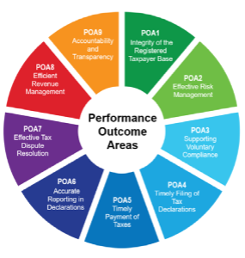
TADAT Framework (cont’d)
SCOPE [Core Taxes] CIT : Corporate Income Tax
PIT : Personal Income Tax
PAYE : Pay As You Earn
VAT : Value Added Tax
Domestic Excise Taxes (2019)
Performance Outcome Areas – revision of the field guide started in Nov 2023
                1. Integrity of the Registered Taxpayer Base
                2. Effective Risk Management
                3. Supporting Voluntary Compliance
                4. On-Time Filling of Declarations
                5. On-Time Payment of Taxes
                6. Accurate Reporting in Declarations
                7. Effective Tax Dispute Mechanism
                8. Effective Revenue Management
                9. Accountability and Transparency
Notes:
VAT : For the small number of countries that do not have a VAT, an indirect tax equivalent such as sales tax should be used.
PAYE : Pay As You Earn : Amounts withheld by employers. Social security contributions (SSCs) may also be included in assessments where they are a major source of government revenue and are collected by the tax administration, as is increasingly the case in a number of tax administrations.
Domestic Excise Taxes : with a focus on the categories of goods/services that contribute 70 percent of the total domestic excise revenue by value
Excise : an internal tax levied on the manufacture, sale, or consumption of a commodity

Slide 39
TADAT Framework (cont’d)
9 Critical Performance Outcomes Areas
POA 1, POA 2,…
32 high-Level Indicators
POA 1-1 ; POA 1-2,…POA 9-28
55 measured and scored dimensions (A to D)
Scoring Methodology : Method M1 (weakest link) and Method M2 (average)
POA 1-1.C, POA 1-2. D, … POA 9-28 C+

Slide 40
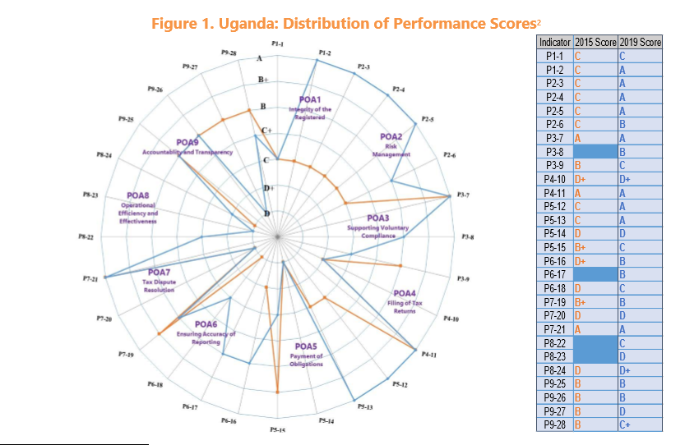
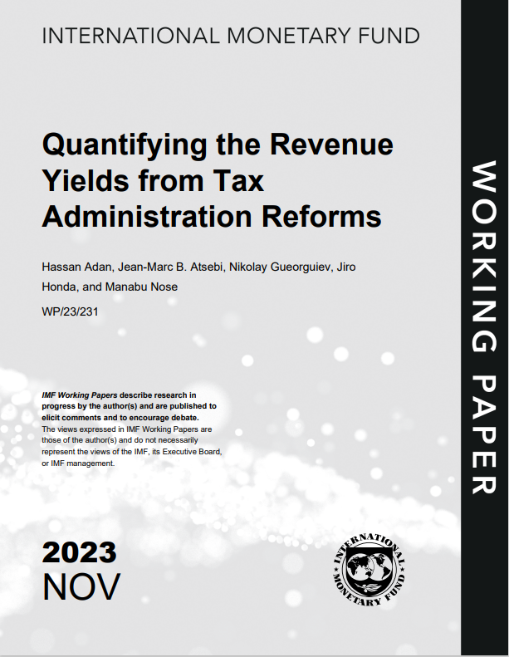
TADAT Framework (cont’d)
UGANDA

Slide 41

TADAT Framework (cont’d)
From November 2013 to December 2024
Assessment Package at www.TADAT.ORG
Σ 194 Assessments
o/w 150 National Assessments
o/w 49 Sub-National Assessments (Brazil, Nigeria, Uganda, Kenya)
o/w 37 Repeat National Assessments (
+/- 25 % reports published only (pls contact DEVCO E1)
3 Assessments commissioned by the DG INTPA
6 Assessments commissioned by the EU DG Reform
jean-bernard.de-milito@ec.europa.eu

Slide 42
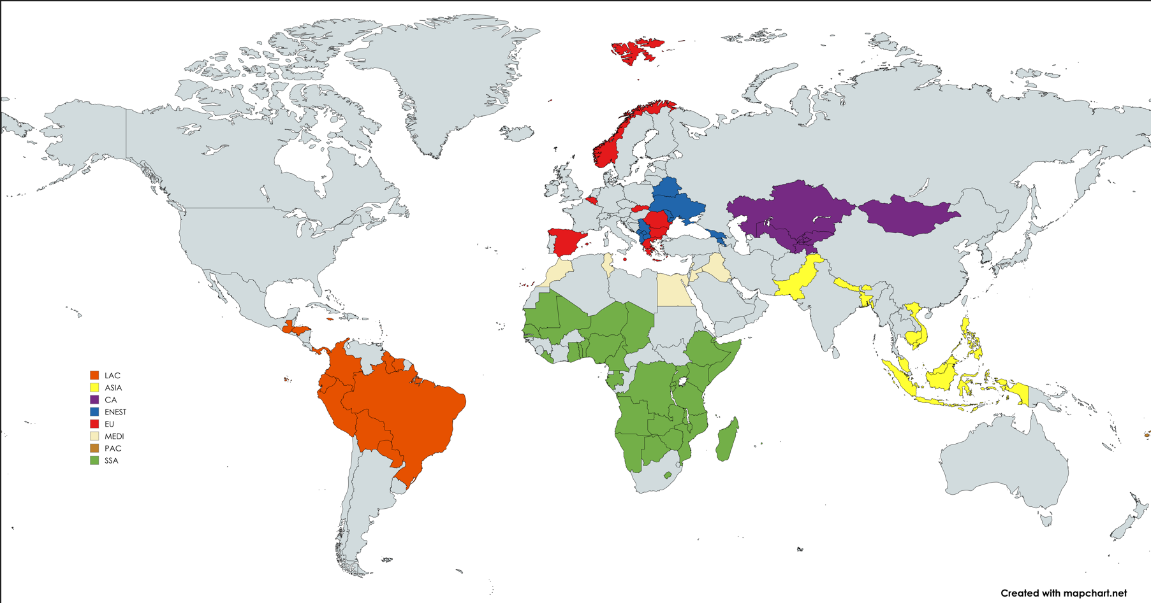
TADAT : a diagnostic tool with a global scope

Slide 43
A tool applicable across regions and income levels

Slide 44
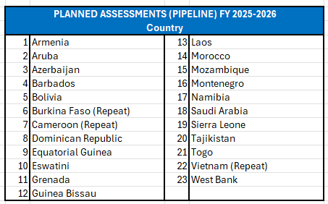
Notes:
This page need to be updated (can’t find information), or removed

Slide 45
TADAT Framework (cont’d)
The whole cycle (1-4) takes app min 12/15 weeks :
1. Assessment Initiation
2. Pre-Assessment
3. In-country Assessment
4. Post-Assessment
Post-TADAT Assessment Dialogue
A Team consists of 4-5 (certified) Trained TADAT Assessors
A TADAT assessment costs approximately €150.000 - € 200.000

Slide 46
Questions?

Slide 47
Worldwide Long-Term Trends in Tax Reform
Tax transition (DRM)
  Increased pressure to reduce tariff duties (free trade)
  Increased reliance on VAT
Increased tax competition for foreign direct and portfolio investment
  Switch to dual income tax system
Reduction in top tax rates of PIT
Reduction in top tax rates of CIT
Notes:
For a somewhat dated study on trends in tax reform, see Norregaard and Khan: https://www.imf.org/external/pubs/ft/wp/2007/wp07274.pdf
Revenue Mobilization in Developing Countries. IMF. 2011: https://www.imf.org/external/np/pp/eng/2011/030811.pdf
Eliminate archaic taxes, such as stamps, legal seals
Eliminate sales and turnover taxes
Introduce VAT
Reduce import duties and introduce more uniform rates
Reduce excises
Strengthen and modernize CIT and PIT
- some discussion of Dual Income Taxes
- some discussion of Flat Tax
- interest in eliminating CIT – see Estonia and Moldova
Almost whole world has VAT now
PIT and CIT rates have come down considerably
Lots of international competition in CIT rates
In rich countries we have closed “tax incentives” and lowered rates, while revenues continue to climb
In poor countries we have often increased “tax incentives” and lowered rates, sometimes revenue increased.

Slide 48
Questions?

Slide 49
III. Taxonomy of Taxes

Slide 50
Taxonomy of Taxes
Quiz time!
Notes:
https://www.menti.com/kc15gbuwwo
What is the main source of tax revenue?
Corporate Income Tax, Personal Income Tax, Value Added Tax, Tariffs, Property Tax
Which tax instrument is the most efficient to reduce inequality?
Corporate Income Tax, Personal Income Tax, Value Added Tax, Tariffs, Property Tax
Which tax may discriminate against women?
Corporate Income Tax, Personal Income Tax, Value Added Tax, Tariffs, Property Tax

Slide 51
Taxonomy of taxes
Indirect taxation
  VAT
  Excises
Direct taxation
  PIT
  CIT
Others
  Property taxes
  Natural resources taxation

Slide 52
VAT
Tax on consumption
An important source of tax revenue in almost all the countries (exc. USA)
VAT: Tax innovation (France, 1947; 190 countries)
  Delegate the effort of tax collection to the private sector (VA Chain)
Tax transition: Decrease tariff rates and adopt VAT
C-efficiency of VAT= VAT/(t*GDP)
VAT is neutral (?)
VAT liability threshold: A critical turnover (bunching)
  Below the treshold, firms are equivalent to final consumers.

Slide 53
VAT parameters in relevant countries

Slide 54
The regressivity of VAT
Classic approach (developed countries)
  Final consumer (household) pays VAT.
  VAT is inequitable since poorer households consume relatively more than richer households.
  Multiplication of VAT rates and VAT exemptions in order to protect the poorest household and restore some progressivity for VAT.
Developing countries
  Does the poorest household have access to the market?
  Farmer are selfconsumers.
  Poorer households have informal consumption (informal stores).
  Moreover, VAT acts as a protective tariff for these farmers since their activity is below the threshold.
  VAT exemption on food products, which are locally produced, reduced the income of farmers.
  Unique VAT rate is simpler to administer.
Notes:
See Bachas, Gadenne and Jensen, 2020, Informality, consumption taxes and redistribution, NBER. https://www.nber.org/system/files/working_papers/w27429/w27429.pdf

Slide 55
Main VAT issues (1)
VAT exemption or zero VAT rate
  Tax incidence: Protecting the poorest?
  Zero rate: Exportations (not consumed locally)
Tax expenditure issue.
  Does VAT exemption target the right (poorest) households?
  VAT exemptions vs Cash transfers (Collect more, spend better)
Non deductibility => VAT = Sales tax
  Petroleum products: Risk of smuggling?
  The Chinese example: Gradual introduction of VAT through the deductibility
VAT credit refunds
  Source of VAT fraud in EU (carousel)
  Developing countries unable to refund VAT credit especially in resource rich countries => VAT exemption.
Notes:
VAT credit refund:
The issue of VAT credit refunds: Very sensitive issue in resource rich countries
Exporters (extractive industries) are taxed at zero rate.
Thus, exporters are eligible to VAT refund for the VAT paid on their inputs.
The issue is that governements in developing countries are not able to refund these amounts.
VAT becomes a turnover tax at a very high rate.
Firms’ reactions: No payment of the other taxes (CIT) or compensation; Demand for VAT exemptions.

Slide 56
Main VAT issues (2)
VAT and informality
  VAT taxes intermediary consumption of non VAT liable firms (small enterprises)
  VAT is then a powerfull tool to tax informal sector (small firms).
  VAT exemptions favor informal firms.
Notes:
VAT and informality
VAT: an indirect way to tax informal firm
Third-party reporting feature of the VAT => Backward linkages
VAT revenue is partly or mainly raised on intermediate consumption of informal firms.
Purchase of inputs by non VAT liable firms and sold by VAT liable firms
Ex.: Oil products, power, telecommunications…

Slide 57
Questions?

Slide 58
VAT
Quiz time!
Notes:
https://www.menti.com/oghb1f3fur
As a taxpayer, is it better to be exempted from VAT or to be taxed at zero rate?
To be tax at zero-rate
VAT is an important tax to
Reduce poverty
Raise revenue
Favor formal firms
Tax savings
Favor investment
Does VAT exemption reduce the consumer price of the good?
Incidence theory

Slide 59
Excises and Green taxes
Sin tax
Tobacco, alcohol, soft drinks?
Very regressive
Earmarking? Discourage bad behavior?
Luxury tax
Gold, diamonds, yachts
Usually progressive
Revenue focus
Externalities (Green Tax)
Unit or value of products that cause pollution or other “negative” externalities
Unclear, more regressive
Tax on pollutants in factories, hydrocarbons

Slide 60
Excises
Ad valorem, specific (ad quantum) or both
Excises (like VAT) remain heavily collected at the border (importations).
Elasticity of demand
  Ramsey law (neutrality purpose): The rate is inversely proportional to the demand elasticity.
  E.g. Petroleum products (no close substitute), highly taxed.

Slide 61
Green taxes
Protecting the environment:
  Targetting polluting activities (production, consumption)
  Double dividends: raising revenue and modifying behavior (contradiction)
Pigou vs Coase (tax vs pollution right market, bargaining)
Tax à la Pigou
  Internalize negative externalities/spillovers
  Taxing the carbon content of goods and services.
EU Carbon Border Mecanism (implemented by 2026): Cement, steel, aluminum, fertilizers, electricity =25 percent of total CO2 emission.
  75-245 Euro per ton => Increases the price of concerned goods, favors EU production.
  Impacted partners: Russia, Ukraine, Turkey, UK, South Korea, China, India, US
  Given past exports and their modality of electricity production.

Slide 62
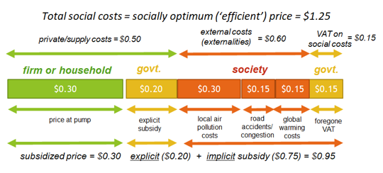
Green tax and fuel subsidies
IMF approach of fuels subsidies

Slide 63
Questions?

Slide 64
Excises
Quiz time!
Notes:
https://www.menti.com/oghb1f3fur
An excise tax may be
Specific
Ad valorem
Both
A carbon tax aims at
Internalizing the cost of pollution by raising the price of some inputs
Reducing poverty
Modifying consumption and production behaviours
Reducing inequality

Slide 65
Direct taxation
Notes:
https://www.imf.org/-/media/Files/Publications/WP/2022/English/wpiea2022026-print-pdf.ashx
https://digitalcommons.lib.uconn.edu/cgi/viewcontent.cgi?article=1549&context=law_papers#:~:text=Summary.,they%20earn%20in%20developed%20countries.

Slide 66
"The hardest thing in the world to understand is the income tax.”
— Albert Einstein

Slide 67
PIT (Personal Income Tax)
Taxing individual or household’s income
  Wages, rent revenue, capital income (capital gain, dividends, interest), profit.
  Gender issue.
  Family coefficient in Africa (relevant?)
Residence or Citizenship?
  Bhagwati tax: Taxing brain drain (India/USA/doctor)
Several sources of individual income: wages, rent, capital income, profit (self-entrepreneurs)
Three main systems
  Comprehensive (global) income tax; Dual income tax; Flat tax
Which top margin tax rate? Progressivity of PIT.
Social Security Contributions

Slide 68
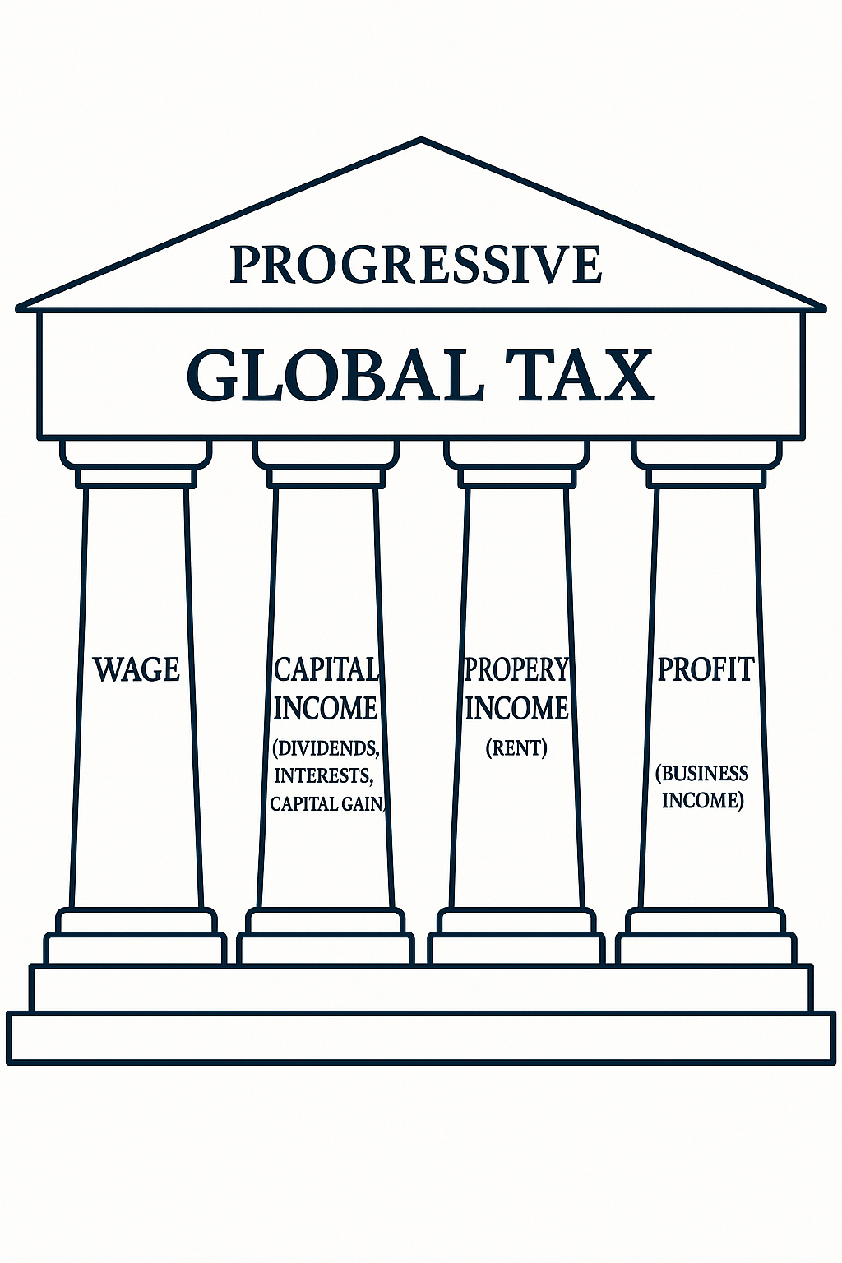
Global Income Tax (=> Dual Income Tax => Flat Tax)

Slide 69
Tax wedge
The difference between the total labor cost of employing a worker and the worker’s net earnings.
  Sum of personal income taxes and employee and employer Social Security Contributions net of family allowances/ Total labor costs.
An indicator of the dissuading effect of labor tax and SSC on formal employment.
Marginal effective tax rate: Variation in tax wedge
Progressive/regressive tax wedges => Traps
  Inactivity trap: Short-term incentive for an inactive person to move to paid employment.
  Low-wage trap: Financial incentive to increase a low level of earnings by working more hours.

Slide 70
Tax Wedge (2) https://www.oecd.org/en/publications/taxing-wages-2024_dbcbac85-en.html
Notes:
OECD 2023:
The personal average tax rate is defined as personal income tax plus employee SSCs as a percentage of
gross wage earnings.
Table shows the personal average tax rates in 2023 for a single worker without children at the average wage level, with the average worker’s gross wage earnings expressed in US dollars with equivalent purchasing power.
Figure provides a graphical representation of the personal average tax rate decomposed between income tax and employee SSCs.
On average, the personal average tax rate for a single worker at average earnings in OECD countries was 24.9% in 2023.

Slide 71
Questions?

Slide 72
PIT
Quiz time!
Notes:
https://www.menti.com/oghb1f3fur
PIT is a tax
On individuals
On households
On firms
On international trade
On pollution

Slide 73
CIT (Corporate Income Tax)
Tax on profit
  Definition of Profit (very complex)
  Physical person (self-employee) and corporations
More important revenue in developing countries than in developped ones.
  Highly concentrated in developing countries (<30 firms = 70% of CIT revenue)
  Minimum tax based on turnover (0.5 to 2 percent of turnover)

Slide 74
Agressive tax planning: BEPS and GLoBE (OECD)
Multinational Enterprises & Tax havens
Avoid to pay tax in a country by manipulating the costs or reducing the turnover through transfer pricing, debt shifting…
  Double Tax Agreement (DTA)
Ex.: Minimizing turnover
  Concerned sectors: Extractive industry, exporting sectors.
    Reducing reported turnover
    Decreasing CIT, mining royalties, government oil share
  Hedging contract between a subsidiary located in a standard tax rate country and a subsidiary in a tax heaven.
    Selling the produced good below its market value.
    Example : Glencore in Zambia

Slide 75
Solutions
Transparency, whitholding tax regimes (but limited by DTAs)
  Country by country report (EU)
Arm’s length principle,
  Reduce transfer price: Compare transfer price to market price.
Thin capitalization rule
  Earning stripping ratio (30 percent of EBITDA)
OECD/BEPS package and inclusive framework
Minimum effective tax rate at 15 percent (GloBE, OECD, G20) implemented in 2023.
  Extractive industries excluded.
Digital Sales Tax: Google, Amazon… Tax on turnover (2-3 percent).
  US vs France, Germany, Italy
Notes:
DTA: Double Tax Agreement
EBITDA: Earnings before interest, taxes, depreciation, and amortization
BEPS: Base erosion and profit shifting
GloBE: Global anti-base erosion model rules

Slide 76
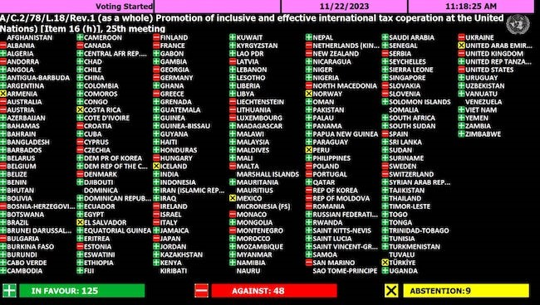
Vote on the transfer of international tax negotiations to the United Nations (22/11/2023)
Notes:
The proposal put forward by the African Group to transfer international tax negotiations to the United Nations
formally known as the “Resolution on the Promotion of Inclusive and Effective International Tax Cooperation”—was
adopted on Wednesday, 22 November 2023. With 125 votes in favor, this vote represents a historic victory for Africa in
the face of opposition from the bloc of Western countries.

Slide 77
Questions?

Slide 78
CIT
Quiz time!
Notes:
https://www.menti.com/oghb1f3fur
What are the tools to transfer profit towards a tax heaven?
Debt shifting
Transfer pricing
Offshoring
Hedging
What are the tools to fight agressive tax planning?
Transparency (Country by country reports)
Arm’s length principle
Close firms
International tax coordination

Slide 79
Property Taxes
The missing tax in developing countries (3-5% of GDP in OECD)
Tax on land and fixed assets (first step towards a Wealth tax)
Efficient and redistributive tax
Political issues (very sensitive):
  Property rights,
  Value assessment (2 mechanisms: rural, urban),
  Blockchain (Sweden, Ghana, Rwanda)
Revenues increase
Local budget
Property values increase
Services and infrastructure
Notes:
Ahmad, E., Brosio, G., and J Gerbrandy, 2017, Property taxation. Economic features, revenue potential and administrative issues in a development context, EU

Slide 80
Questions?

Slide 81
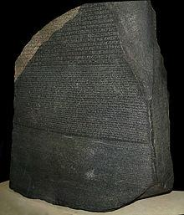
Tax expenditures
What is this stone?
Notes:
Rosetta stone

Slide 82
Tax expenditures
Tax expenditure is a transfer of public funds resulting from a reduction of tax obligations in relation to a standard, rather than direct public spending (OECD, 2010).
  Tax reliefs, tax subsidies or tax aids
  Exemptions, reduced rates…
Two conditions for tax expenditures:
  (1) a reduction in government tax revenue, and
  (2) a deviation from the tax norm, called the benchmark tax system.

Slide 83
Tax expenditure assessment
An important tool to streamline tax systems.
  Proliferation of tax expenditures (=the results of lobby groups or policy).
  Tax expenditures seem less harmful than direct tax due to the lack of their estimation.
Improving fiscal transparency:
  The publication of tax expenditures estimations as an Appendix to the Finance Law.
Reinforcing the power of the MoF on the tax system.
A new database: https://gted.net/
  97 covered countries.

Slide 84
Tax expenditures promoting investment: Tax incentives
Another kind of tax competition (less transparent)
Discretionary or rule
  Investment code, Special Economic Zone, Free Area Law, Individual tax agreements, etc
Who ask for tax exemptions/derogations?
  Lobby groups (firms)
  Sectorial ministers (mining, oil, tourism, agriculture, etc)
    Mining code, Tourism code, Agricultural code…
Recommandation: Moving from tax exemption to tax credit

Slide 85
Tax expenditure in favor of consumption
Reduced or zero VAT rates
  Incidence theory: Assuming that the reduction in tax rate will be reflected in prices.
  VAT exemption versus cash transfer:
    Targetting versus simplicity/political considerations.
Recommandation: Moving from subsidizing goods to subsidizing households
PIT:
  Mortgage interest deductibility: 59 Billions of USD in 2016 (US: Nation of owners)
  Family quotient, credit for child dependent (France after WW2),
  Deductions for medical expenses, for education expenses, etc.
Beyond the estimation of tax expenditures, their equity…
Notes:
These examples of tax expenditures may depend on the definition of the Benchmark Tax System.
The equity of tax expenditures is more and more studied.
For instance, in lot of African countries, piped water and electricity are VAT exempted for a first social bracket. Is it equitable?
Recent analysis of the redistributive power of cash transfers versus VAT exemptions
https://www.sciencedirect.com/science/article/pii/S0305750X21003570

Slide 86
Beyond tax expenditures: Tax gaps
Tax policy gap
  Difference between tax due under “optimal” tax policy and that under current tax policy.
  Focus on tax policies to close loopholes, broaden base, and tax expenditures.
Tax compliance gap
  Difference between tax due under current tax policy and that actually collected.
  Focus on efficiency and effectiveness of tax administration, reinforcing voluntary compliance, good tax governance, and fighting evasion and illicit financial flows

Slide 87
Questions?
The efficiency of tax incentives?
The equity of indirect tax exemptions?

Slide 88
Issue 1: Informality and taxation
Informality
  An endogenous outcome as the result of firms’ and workers’ behaviors.
  Small firms or/and tax frauds
Lower tax revenue in general
  Informality => Limited State capacity => Consequence: Lower tax revenue
  Narower tax bases (direct effect) and contagion effect between formal and informal firms (indirect effect).
Informal sector => More competitive (lower barrier to entry) => Lower profit => Lower tax revenue (p=Cm).
Notes:
BEPS: Base Erosion and Profit Shifting
https://www.oecd.org/tax/beps/

Slide 89
An overview of formal/informal activity
Notes:
The distinction between sel-employees and informal worker may be difficult.
Rauch model: Formalizing informality

Slide 90
Solutions to deal with informality
Reducing the tax burden (e.g. tax wedge, tax incentive)
  Tax incentive to formalize firms: The case of Benin, a failure.
  Tax credit to formalize labor: The case of France, a costly succes.
Reducing the compliance cost
  Simplification: Special tax regimes for SMEs
  One-Stop shop
  Digitalization and E-taxation platform
  Blockchain, AI
Withholding mechanism
  A third party (the payer) deducts and remits taxes on behalf of the taxable entity (the payee) at the point of transaction.
  Role of digital platforms:
      Airbnb: A tax remittance agent, Tourist taxes (France, Italy, and Spain).
      Amazon Marketplace: A fiscal intermediary, VAT due by sellers (UK, EU, Mexico)
      Reviewing the de minimis rule (tariff war)

Slide 91
The case of Benin: A failure
Benin (SSA country): Informal sector: 90% of labor force
Policy: The Government of Benin—supported by the World Bank—implemented a formalization campaign primarily in urban areas in 2014, providing:
  Free business registration
  A full tax exemption for a period of two years for firms that voluntarily formalized
Key Findings (RCT, empirical causality)
  Extremely Low Uptake of the Incentive
    Fewer than 1% of informal firms opted to formalize.
  Mistrust of the State and Policy Credibility
    A widespread belief that formalization might expose to future tax liabilities, inspections, or regulatory burdens.
  Lack of Perceived Economic Benefits
    No perception of tangible gains from formalization (access to credit, public procurement, legal protections, or social insurance).
  Conclusion: The fiscal barrier was not the main constraint.

Slide 92
The case of France: Tax credit for household services
Policy Objective: To reduce the prevalence of informal labor in the domestic and personal services sector (e.g. cleaning, childcare, elderly care), tax deductions and credits for households that employ workers legally in their home.
Mechanism:
  Households employing a certified service provider or individual can deduct 50% of the eligible cost from their PIT.
  In 2017, the credit became refundable for low-income households, increasing equity and access.
Key Findings:
  Increased Formal Employment:
    Elasticity of formalization to tax price reductions: -0.4 and -0.6.
  Reduction of Informality:
    Substitution away from undeclared workers toward legally hired ones.
  Equity (pre-2017):
    Before the 2017 reform, the system disproportionately benefited higher-income households.
Cost–Benefit Trade-offs: A substantial fiscal cost (~€5 billion annually).

Slide 93
Issue 2: The fragmentation of taxing power
How tax policy is defined in the country?
  Who does determine the tax law?
  MoF versus other Ministries (e.g. Ministry of Mining)
Implementation of tax policy
  Who does collect tax?
  Quasi-tax/Parafiscalité
Ex.: Dem. Rep. Congo, DGRAD
  Agencies…

Slide 94
Issue 3: Inequalities
Progressivity of PIT
Regressivity of indirect taxation
Wealth taxation (property tax)
Tax fairness => Fiscal fairness
  Commitment to Equity
  « Analyzing the tax side without the spending side can be misleading. »
  Lustig: https://commitmentoequity.org/
Notes:
Resource curse: a resource rich country has a lower growth rate.
EITI: https://eiti.org
Progressivity:
A mining tax regime is progressive if the mining rent share for the government increases automatically with the profitability of the mining project.
Sharing the rent => sharing the risk too
FARI (Fiscal Analysis of Resources Indsutries)
Estimate the Average Effective Tax Rate of a given mining project.
IMF: http://www.imf.org/external/np/fad/fari/

Slide 95
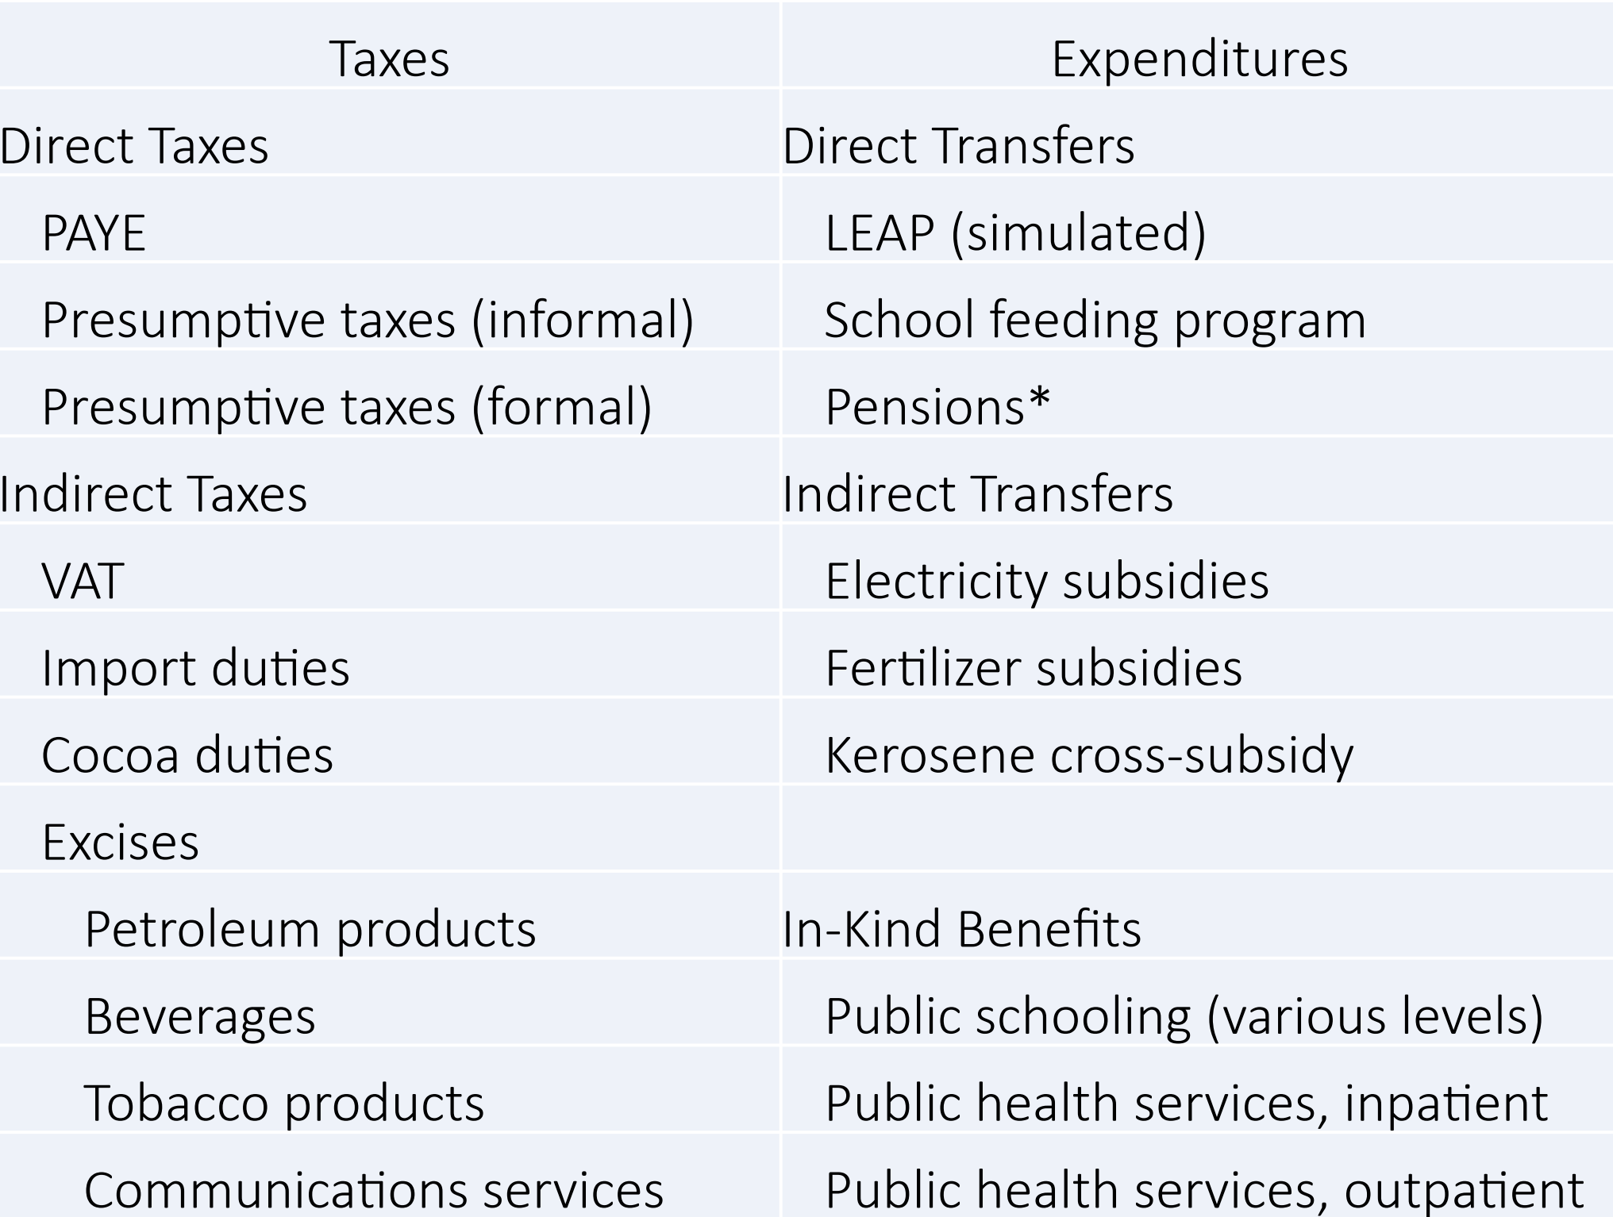
Ghana Example

Slide 96
Issue 4: Natural resources tax regime and tax reform (EU Policy Note E1)
Resource curse (oil, mining)
Main recommandations for Natural resource tax regimes
  Transparency (EITI)
  Simplicity (e.g. Ring fencing principle)
  Stability (Asymmetric stability clauses)
  Progressivity
Ad valorem Royalty, CIT…

Slide 97
To go further: Tax incidence
How the tax burden is shared between producer and consumer?
  Whoever is paying the tax (consumer or producer).
  Does a tax on beer (excise) increase the price of beer or reduce the profit of brewery?
Depends on
  Elasticity of price demand (consumer), substitutability of the taxed good, service or factor.
  Market structure (monopoly, oligoploy, perfect competition).
Pass through analysis
Beyond, Marginal Excess Burden of taxation,
  Haberger triangle, CGEE, DSGE
Notes:
Tax exemptions on foodstuff => Reduction of the price of food?
The agricultural sector is tax exempted.
CGE: Computable General Equilibrium
DSGE: Dynamic Stochastic General Equilibrium

Slide 98
Lets talk about Budget Support DRM Indicators
Some hints …

Slide 99
Building a DRM indicator for Budget Support
SMART indicators:
  Specific, Measurable, Achievable, Relevant, Timely
Final goals:
  Increasing the tax revenue to GDP ratio (quantity)
  Improving the quality of the tax system
    Tax system: Tax policy and revenue (tax and customs) administration,
    Transparency, fairness, inequality, gender
    Environment (Green taxation)
Which instruments? Policy or administration?
  Trade-off between large or specific indicator (political commitment)

Slide 100
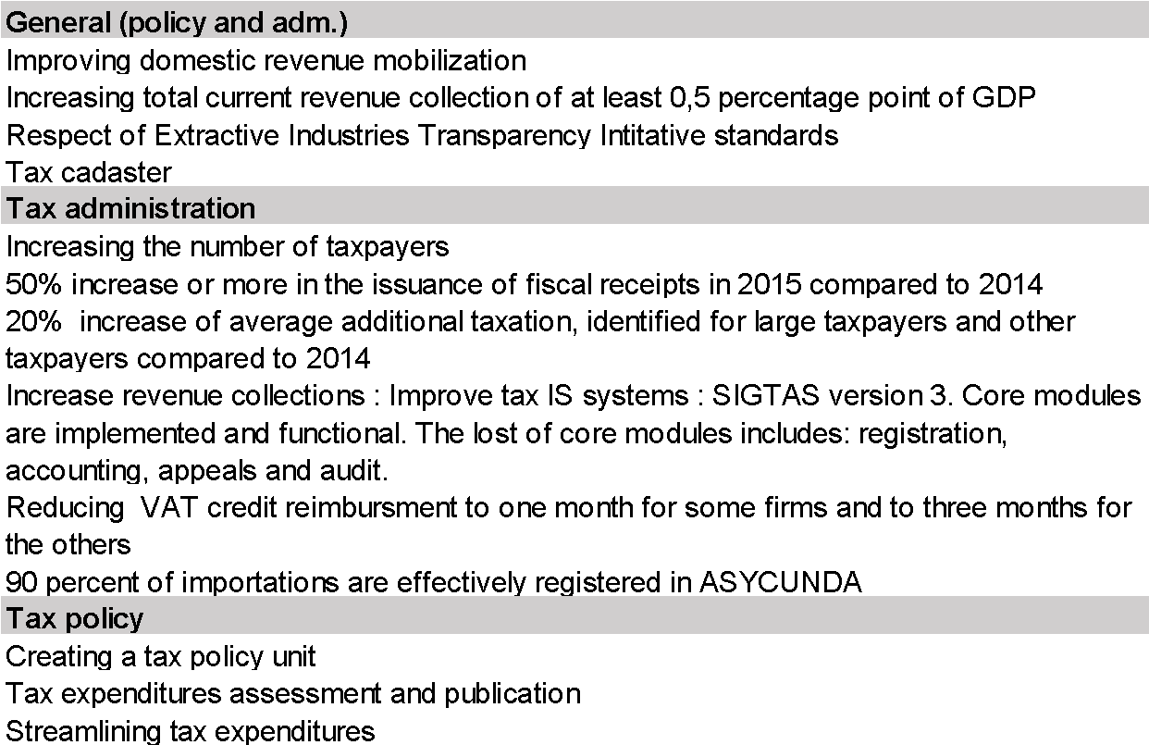
Some examples of DRM indicators
Notes:
Improving domestic revenue: By which percentage (measurement issue)?
Increasing total current collection oat at least 0.5 percent of GDP: Too broad; may trigger tax harassment…
Respect of Extractive Industries Transparency Initiative standards: The EU supports EITI initative (resouce rich countries).

Slide 101
Potential SMART indicators
EITI 2.1 to 2.6 Publication and disclosure:
  Legal framework and fiscal regime, Contract and license allocations, License register, contracts, Beneficial ownership, SOEs participations
Disclose feasibility studies connected to each exploitation license
Adopt and apply a ring-fencing rule
Adopt the 6th method for production/exportation
Assess AETRs of the extractive industry
Promoting tax expenditures assessment and publishing results participate to budget transparency.
Improve the VAT mechanism (Local content)
Improve the progressivity of the extractive industry tax regime by:
  Adopting mining royalty/CIT rates increasing in commodity prices

Slide 102
Questions?
Do you have any experience in building a DRM indicator?
Beyond DRM indicator for budget support purpose, are you engaged in tax policy dialogue with the authorities?
Which DRM issues do you have?

Slide 103
IV. International Agenda – FATF and EU listings
DG FISMA, DG TAXUD and FPI

Slide 104

Thank you
© European Union 2025
Unless otherwise noted the reuse of this presentation is authorised under the CC BY 4.0 license. For any use or reproduction of elements that are not owned by the EU, permission may need to be sought directly from the respective right holders.
Notes:
Update/add/delete parts of the copy right notice where appropriate.
More information: https://myintracomm.ec.europa.eu/corp/intellectual-property/Documents/2019_Reuse-guidelines%28CC-BY%29.pdf

