Slide 1


WORK BASED LEARNING
IN PALESTINE
Enhancing Capacities for Institution Building Program (ECIB)

Slide 2
Socio-Economical Background

Slide 3
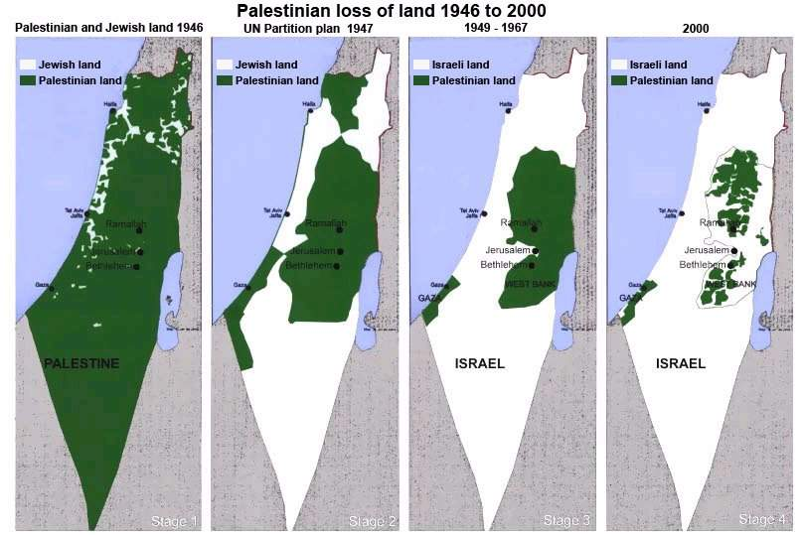
Palestine : Recent History

Slide 4
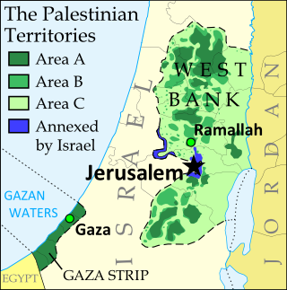
Palestine : A Complex Environment
The Palestinian Territories:
Area A: Full Palestinian Control
(on the ground)
Area B: Joint Palestinian-Israeli Control
Area C: Full Israeli Control
East Jerusalem: ?

Slide 5
Demographic Situation
Basic Country Data (source ETF)
Population: 4,42 M in West Bank and Gaza Strip
1,4 M living inside Israel
5,6 M living in exile (1/2 population of Jordan)
Population Growth: 2.66% in 2012
Fertility Rate: 4.4% per women
Share of population: -14 : 44.1% (among the highest in the world)
15-29 : 29%
-30: 72% !
consequences:
enormous pressure on social services (schools, health and housing)
Need for future jobs will only increase in particular among youth

Slide 6
Economy and Labour Force
GDP is severely affected by political instability and (lack of) progress of the peace process, i.a. thanks to international support:
  6% in 2003-2005
  +9% in 2010-2011
  Sharp decline (negative growth) in periods of crisis with 63% of population under poverty line
Distribution of employment by economic activity:
  63.1% service sector and increasing
  15.3% construction
  11.3% manufacturing, quarrying and mining
  10.3% agriculture
Labour force participation:
  Relatively stable around 40 % (West Bank & Gaza)
  Great disparity between male (69%) and female (17.4%)

Slide 7
Unemployment
23.4% (35% females) in 2013
Young people in particular: 43.9%
Remarkable! Young educated people are more affected: higher education degree (24.5%) versus secondary diploma (20.4%)
Main cause: mismatch between the specific needs of the labour market (skilled labour) and the qualification of the graduates
Paradox: only 6% of the students in secondary cycle enrolls in the TVET system much below the needs of the labour market. Reason:
  low enrolment of women and mainly in traditional female sectors
  System as a whole not attractive offering only limited number of traditional qualifications
  Negative perception of TVET, partly because of lack of relevance to the labour market due to inefficiency and low quality

Slide 8
BTC Target
Contribute to tackling 40% of youth unemployment in Palestine by:
Improving the qualitative and quantitative aspects of Work Based Learning (WBL) Initiatives
in the Technical and Vocational Education and Training (TVET) programmes in Palestine

Slide 9
Focus of ECIB/WBL Program
Work Based Learning (different forms)
TVET Subsector
Capacity Building
Gender and disadvantaged groups
Notes:
The 1st key issue:
Apprenticeships, internships, scholarships, etc.: The project will not be dependent on any strict definition of the above nor be limited to either; in general under “work based learning” it is to be understood as any kind of scheme facilitating the transition from school to work resulting in a trainee spending time at the work floor during, or right after graduation, including informal apprenticeships and first employment promotion. But it wont include simulated WBL, nor job seekers WBL.
The 2nd key issue:
TVET subsector: The programme focuses on the TVET sub-sector, including private sector providers, vocational training centres, over industrial schools to technical colleges at the higher education level. The programme will not focus on academic (university) systems as such, but could be integrated or aligned to relevant administrative and management examples of similar schemes.
The 3rd key issue:
Capacity building: The programme aims to enhance the institutional capacity of the governmental and private sector institutions involved in technical and vocational skills development in order to allow them to facilitate, supervise and implement work-based learning models at national, district and local level.
The 4th key issue:
Gender and disadvantaged groups: The programme aims at opening up opportunities for youth from lower income families with focus on pro-poor, pro-gender, environment-friendly and pro-good governance orientations by providing well-targeted scholarships. The programme seeks to pro-actively enhance the access to training and coaching of economically and socially disadvantaged learners.

Slide 10
What is WBL?
During the last decades, work-based learning has gained increasing interest by many national and international policy makers as a best practice to enable youth and un-employed to acquire practical and useful skills for the labour market.
Definition:
Work-based learning refers to learning that occurs when people do real work. This work can be paid or unpaid, but it must be real work that leads to the production of real goods and services

Slide 11
Why work-based learning? (1)
The advantages are numerous for all stakeholders involved:
Through apprentice contributions, subsidies or payments from training funds, work-based learning is very cost-efficient for the in-company training learners (2/3 cheaper !)
As the learners are trained in specific professional skills in the company, the productivity of the trainee is increased considerably over halfway the work-based learning period. From that moment, the net benefit for the company is higher than the cost for the trainee
The learner on the other hand is trained in professional, required skills from the labour market during the WBL. This increases his employability on the labour market and generally have higher wages than other school leavers

Slide 12
Why work-based learning? (2)
Empirical research has shown that companies offering WBL have reduced costs in recruitment as WBL trainees are often hired after the WBL period
The subsidies and funding of the WBL system from government, are outweighed by the tax revenues (payroll, VAT, …) and savings in social security and unemployment benefits (for youth)
Education and training providers (TVET centres, colleges, school,…) benefit from the system by enhancing the quality of education through the interaction with companies (curricula, training, equipment,…)

Slide 13
WBL in Palestine
In Palestine, there is a great need in bridging the gap between the skills required by the labour market and the skills offered through Technical and Vocational Education and Training (TVET).
The current work-based learning (WBL) system(s) in Palestine is/are characterized by lack of:
  Centralized governance (separate government departments with separate TVET policies)
  Systematic relation and cooperation between social partners (including companies) and TVET
  Legislation, rules and regulations (no laws and bylaws related to WBL, no social protection for learners, few formal apprenticeships,...)
  Finance for TVET providers: insufficient funding and autonomy to raise income
  Capacity of stakeholders (government, TVET providers, companies,…) by means of tools and instruments to support the quantity and quality of WBL

Slide 14
Where to Start?
Inception Study:
A Mapping and assessment of current and past practices and initiatives in the field of work-based learning
An Action Plan for:
  Spearheading and institutionalization of WBL
  Capacity enhancement of ministries, PSOs, Social partners and TVET institutions
  Introduction of different funding schemes (WBL fund, Scholarships)
A Benchmark, including qualitative and quantitative indicators

Slide 15
Execution and Management
Managed by an ad hoc technical committee with representatives of main stakeholders to:
ensure integration in all ministries & private sector
provide regional references: GIZ, ETF, ILO, EU, SDC, etc.
facilitate a joint tracking (and planning) of TVET => initiate M&E committee (feed into Torino process)

Slide 16
Multi-level Approach
ECIB-BTC follows a coordinated approach in the TVET sub-sector through a multi-level focus on work-based learning by:
  ensuring systemic change by enabling the necessary institutional and sustainable environment for TVET and Work-Based Learning at the national level
  providing direct access to work-based learning for disadvantaged youth
  empowering the public and private partners to implement more TVET relevant to the labour market

Slide 17
The ECIB-WBL Program
Title: Enhancing Capacities for Institution Building (ECIB) Program
Budget: 5 million euros by Belgian Government
5 year program: July 2013 - July 2018
Implementation: MoEHE, MoL, BTC & Partners
Expected Results
  Result 1: At the national level relevant policy makers, private sector organizations and other social partners are capacitated and working together to facilitate and supervise the implementation of different work-based learning schemes.
  Result 2: At the local level relevant stakeholders are capacitated and are implementing work-based learning
  Result 3: Economically and socially disadvantaged youth have improved access to training and coaching

Slide 18
R1 : CAPACITY BUILDING
WBL is core to market relevant TVET
& therefore by definition
CANNOT STAND ALONE
TVET governance
Decent Work
NQF
TVET curricula development (modular, market relevant, …)
Occupational licensing
WBL
Facilitation/ nurture of PS involvement/ guidance
CVS: lifelong learning, upgrading
LMIS
Career guidance
Copyright ILO

Slide 19
R2 : WBL fund = motor for change
Establishing an integrated system, demand driven TVET provision that encourages WBL practices
Strengthen existing WBL experiences with a potential multiplier effect
Stimulating innovative WBL schemes and pilots
Specialized & targeted WBL training schemes
Upgrade skills of youth in informal apprenticeships

Slide 20
R3: Targeted Scholarships
Objective: TARGET to ensure equal access to TVET & WBL for disadvantaged groups and gender:
Agreed & verifiable selection criteria (social background)
Stimulate employment (seek co-financing to ensure sustainability)
Eligible costs: transport, tuition fee, uniforms, insurance, etc.
Back-to-back to WBL fund

Slide 21
Digesting the 100+ recommendations of the inception study into
Different WBL Work Packages

Slide 22


Applying the 4 ILO Building Blocks
4. Financing
3. Legal
Framework
2. Roles
and Responsibilities
1. Social
Dialogue

Slide 23
Work Packages
# Work Packages | Subject
1 | legislation
2 | insurance
3 | Road maps
4 | WBL pilot fund
5 | Gaza WBL & TVET
6 | upgrading of informal apprenticeships
7 | HR upgrading
8 | local hub for PS
9 | Tutor training (MC)
10 | TVET trainer upgrading
11 | Scholarship scheme
12 | M&E of WBL
13 | Communication
14 | tbd
15 | tbd
 | # work packages to be outsourced or implementation to be coordinated with other TVET actors
OUT 1 | social dialogue
OUT 2 | WBL curricula
OUT 3 | Gaza TVET upgrade
OUT 4 | M&E system
OUT 5 | PPP@schools
OUT 6 | quality management
OUT 7 | TVET providers' strategic plans
OUT 8 | career counseling
OUT 9 | skills upgrading of technical trainers
OUT 10
ILO: labour law & template contract
ILO: regional references
GIZ & SDC: support to TVET (CoC)
GIZ: complex tasks
GIZ & ILO: TVET support
GIZ & ILO: TVET support
ILO: Jordan ex.
GIZ & ETF: Torino process; ILO: qualitative survey (SM)
GIZ: HRD & ILO ITC
GIZ: LET Councils
GIZ, ILO, etc.
ILO: regional toolkit
GIZ: CoC
GIZ: HRD
GIZ & ILO: TVET support
GIZ & ETF: Torino process; ILO: qualitative survey (SM)
GIZ
GIZ, World Skills, etc.
GIZ: HRD
Distribution of activities over # tangible work packages
Division of labour in cooperation with other development actors

Slide 24
Joint TVET Management

Slide 25
Joint implementation of TVET strategy
current situation
interim set up
long term structure
Informal TVET Coordination Group (TFPs)
TVET & LM WORKING GROUP
Legal Steering Committees
# project Steering Committees
TVET Management Team
A national TVET & LM Agency or Body
FP @ MoEHE
FP @ MoL
TVET & LM Programme Committee
COMM
HRD
WBL
PMT
M&E
CGC
OSS
# of committees on M&E etc.
POC
CURR
LET
NQF
LMIS
QA

Slide 26
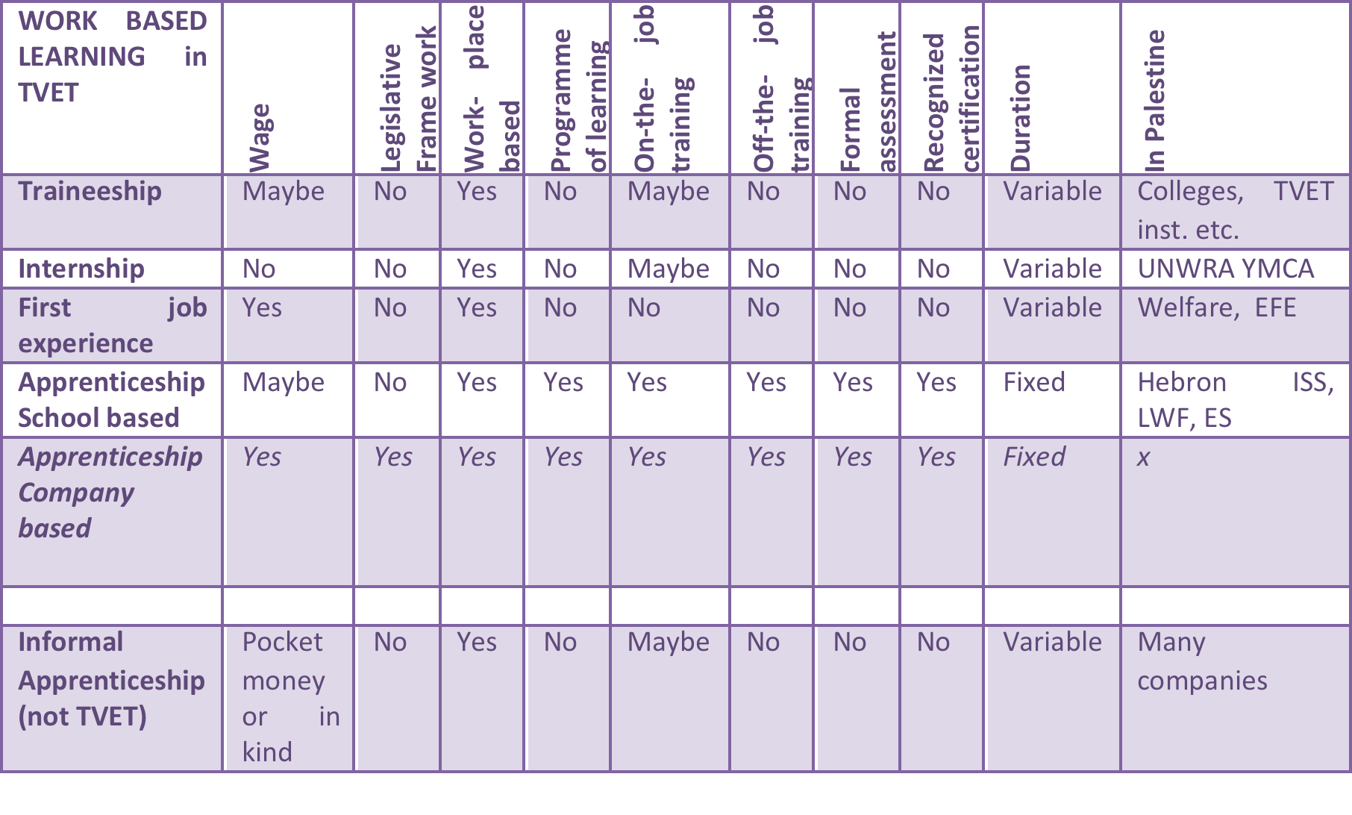
Mapping of various WBL schemes existing in Palestine

Slide 27
Master Craftsperson &
TVET Mentor Training

Slide 28
Master Craftsperson Training & TVET Mentor Training
Labour Market Characteristic: over 90% small and medium businesses often in a informal setting (family business)
Need: Capacity enhancement of the private sector to absorb learners at their work place (WBL)
Development of a MC Toolkit: information briefs, case studies, international good practices, templates and tools (user friendly)
Standard 3-4 days training for private sector operators
Pilot project (June 2015) in cooperation with Syntra (Belgium)
Methodological package will be integral part of regional ILO-toolkit on quality apprenticeships
Include a training package for TVET-schools mentors for WBL

Slide 29
Elements of the Training Module
PART I: Training scheme on Master Craftsperson
Background on work-based learning with roles and tasks of the several stakeholders in WBL as well as possible scenarios of a WBL-system
PART II: Training manual for the trainer
The manual for the trainer of the training sessions for the Master Craftsperson
PART III: Manual for the Master Craftsperson
The manual for MC is target at the participants of the training who are the future Master Craftsperson
Annex 1: Course Agenda : outlines of the training sessions
Annex 2: Competence profile of Master Craftsperson
Annex 3: Glossary
Annex 4: Template of a Skills Development Plan
Annex 5: Template of a Logbook
Annex 6: Presentation of the train-the-trainer session
Annex 7: Evaluation form for the training ‘Becoming a Master Craftsperson’

Slide 30
Remaining Challenges
Adequate legal framework
Absence of governance structure and the effective cooperation between the different stakeholders at macro, meso and micro level
Search for companies that are able and willing to participate
Low number of students in TVET (les than 6%) and overall low quality of TVET in particular the quality of the training/instructors staff and TVET staff in ministries
Bad reputation of TVET education and WBL by public and employers
Lack of employment (in particular in Gaza)
Lack of reliable data and performant data collecting systems
Lack of funding mechanisms in absence of donors (sustainability)
Political and security situation caused by occupation

Slide 31

Worldskills
https://www.youtube.com/watch?v=jrZqZffkMVI

Slide 32
Work Based Learning (ECIB)
Invest in the Palestinian labour force
Private sector relevance in TVET
Multiple stakeholder approach:
MOEHE, MOL,
Private sector, Unions…
Increasing employability of man and women

Slide 33

Work Based Learning
Closing the gap between TVET and the labour market
Thank You!

