Slide 1
Innovation in Teaching
European Commission Education and TVET Seminar
20th October 2015
Purna Kumar Shrestha
Lead Education Adviser
VSO International

Slide 2
Objectives of the session
By the end of the session, participants will :
have understanding of VSO’s innovative approach to teacher training.
learn about VSO’s Unlocking Talent through Technology Flagship projects –Papua New Guinea and India and Malawi.
learn about lessons and challenges while considering innovations in teaching in low-resource country contexts.

Slide 3
Group work : 10 minutes
What policy initiatives has the government introduced to improve teacher effectiveness and children’s learning outcomes in country where you work?

Slide 4
What is VSO doing to change improve teaching and learning ?
Creating child friendly learning environment through teacher capacity development
Using tablet technology to improve the quality of instruction available at Standards 1 and 2 in literacy and numeracy
Working closely with civil society to promote social accountable policies to promote a conducive environment for education

Slide 5

Unlocking talent
Reading, Writing & Numeracy
Child-focused educational software
Sustainable and scalable implementation through a network of local organisations, the government agencies and partners
Notes:
Unlocking Talent Project currently targeting 70 schools
30 ipads per school
Use of literacy and numeracy software for learners with disabilities
Teacher training

Slide 6

Unlocking talent
Maths
Comprehensive course – not just practice
Teacher figure that speaks in the child’s language
Available in 30+ languages
Continual encouragement for child, and certificates

Slide 7

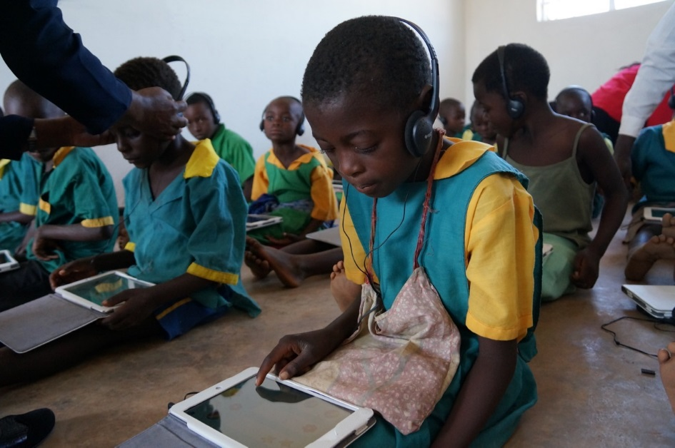
Literacy / Reading
Comprehensive course ( alphabet, phonics, stories)
Different reading modes and levels
Local experts for language and cultural adaptation
Notes:
Random controlled trial conducted by University of Nottingham University showed 18 months gains in numeracy within a 8 week period
Currently University of Nottingham University and University of Malawi engaged to strengthen the project evidence base within 3 years of project implementation.

Slide 8
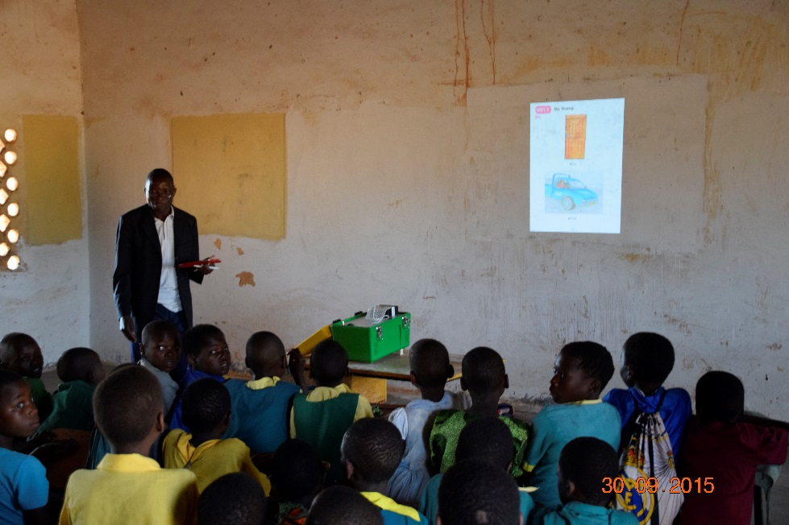
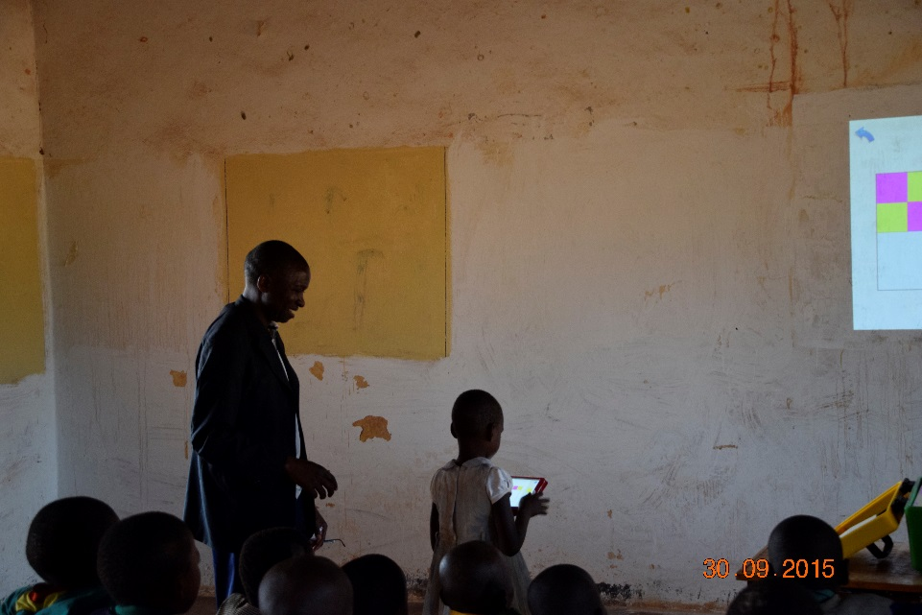
Solar Projector
Portable LED projector to use inside the classrooms
Curated set of resources for the teacher to use with their children
Improving both content and delivery
.

Slide 9
Technology in VSO Papua New Guinea Education Programme
SMS Story
  Improve the teaching of reading and writing in English in elementary schools
  Sent daily lesson plans and stories to teachers in rural areas by SMS
  Teachers received a poster showing how to use the stories, but no other training
Language Support Program
  Improve pre-service English teacher training by developing a new training curriculum
  Production of teacher training videos and song audio files
  Documents, videos, and audio files were distributed on micro SD cards
  SMS reminders, email, document sharing, mobile phone closed user group
Every Child Reading
  Improve the English curriculum, with scripted lessons and reading books
  Micro SD cards were again used to distribute resources
  SMS reminders
Notes:
2.5 million subscribers
Many teachers now own or use mobile phones
91.9% of the teachers in this study own mobile phones

Slide 10
Five key strategies
Duration of primary pre-service training has increased from two to three years, with more emphasis on literacy and numeracy.
The first national survey of the English language proficiency of primary teachers was conducted
Primary teachers and trainers were asked their opinions about teacher education in a review pre-service primary teacher training).
A standards-based curriculum has been introduced, together with classroom libraries, and scripted daily lessons for elementary English
All primary language pre-service courses in early reading and writing have been replaced or updated.
Notes:
(first time education research in PNG used a phone bank

Slide 11
SMS stories in PNG and India
https://www.youtube.com/watch?v=v-Mu88otTlA

Slide 12
Pair work
Reflecting on three examples, what three things would you take away with you while considering ways of improving teaching and learning ?

Slide 13
Learning - Success Factors
Addressed teachers’ and students’ need
Made teachers’ lives easier
  Lessons were easy to access
  Teachers with limited skills weren’t overwhelmed or intimidated
Focus on content
  Stories were engaging and culturally relevant
  Based on proven instruction methods
  Developed in conjunction with education authorities
Scalable

Slide 14
Success Factors
Rigorous M&E
  Random controlled trial
  Data analysis
Assessment of children’s learning
Evidence of change in teacher practice
  Random lesson observation
  Teacher interviews
Built capacity of local researchers

Slide 15
Primary Research Question:
Can mobile phone text message lesson plans and stories for teachers improve the reading ability of students in elementary classrooms in Papua New Guinea?

Slide 16
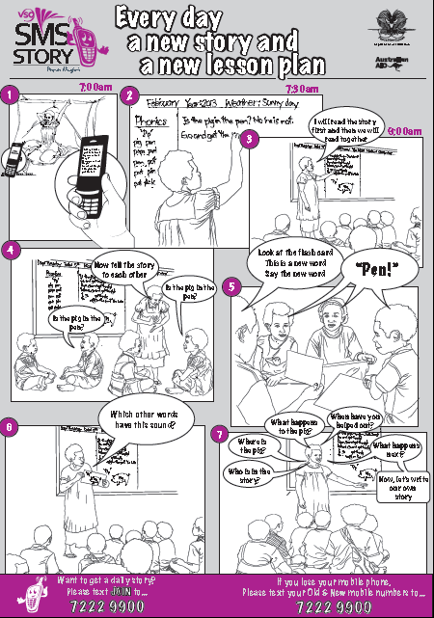

Slide 17
Example story Term 1, Week 2
 | Story | Lesson Plan
Mon | I sit and nap. I nap at the tap. I sit and nap at the tap. Papa naps at the tap. We sit and nap. | 1. Teach sound ‘n’. (nap). 2. Teach: nap, we. 3. Revise words, sounds and letters used last week. 4. Write and read story. 5. Make flash cards: s, a, t, i, p, n, c/k. Use cards.
Tues | The ant sits at the tap. The ant sips at the tap. The ant naps at the tap. I sit on the ant. Ants in my pants! Ow! | 1. Revise all words, sounds and lettters. 2. Teach: ant, pants, Ow! 3. Write and read story. 4. Use flash cards. Say sound on each card, class says sound on each card. Repeat

Slide 18
Example story Term 2 Week 5
 | Story | Lesson Plan
Mon | A long, long time ago there was a sad King. “Please bring me a man to sing me a song,” he said. A man came running and sang a song but the King was still sad. | 1. Follow the poster. 2. Teach new sound ‘ng’. 3. Teach new ‘ng’ words: long, king, bring, sing, song, running, still. 4. What other words use the ‘ng’ sound?
Tues | A long, long time ago there was a sad King. “Please bring me a gold ring to look at.” he said. A girl came running with a ring of gold but the King was sad. | 1. Follow the poster. 2. Teach new words: gold, ring, look. 3. Why might the King be sad? What makes you sad? When are you sad? What makes you happy?

Slide 19
Familiar decodable word reading:
Familiar sight word reading:
Invented words:
Oral reading (read a story) fluency:
Reading comprehension:
ability to read commonly used decodable words
ability to read familiar but non-decodable words selected from the 100 most common English words.
ability to read words that could exist, but do not have meaning.
ability to read a story of 55 words. The test was timed to one minute.
ability to answer questions about the story read in the previous section.

Slide 20
Time period 2013 | Data category | Number
Term 1 | Student reading assessment | 2478
 | Teacher interview | 114
Term 2 | Teacher phone interview | 37
 | Random lesson observations | 38 classrooms/lessons
 | Teacher interview | 42 teachers
Term 3 | Random lesson observations | 44 classrooms /lessons
 | Teacher interview | 44
Term 4 | Student reading assessment | 1986
 | Teacher interview | 102

Slide 21
School characteristics are the same for control and active schools
Characteristics |  | Treatment group
 |  | Active | Control
Gender | Male | 32 | 35
 | Female | 19 | 16
Total |  | 51 | 51
Average teacher's age |  | 34 | 37
Average years of teaching |  | 10 | 10
Teacher qualification | Certificate | 35 | 38
 | Still in training | 7 | 6
 | None | 2 | 3
Training in phonics | Yes | 17 | 10
 | No | 33 | 39

Slide 22
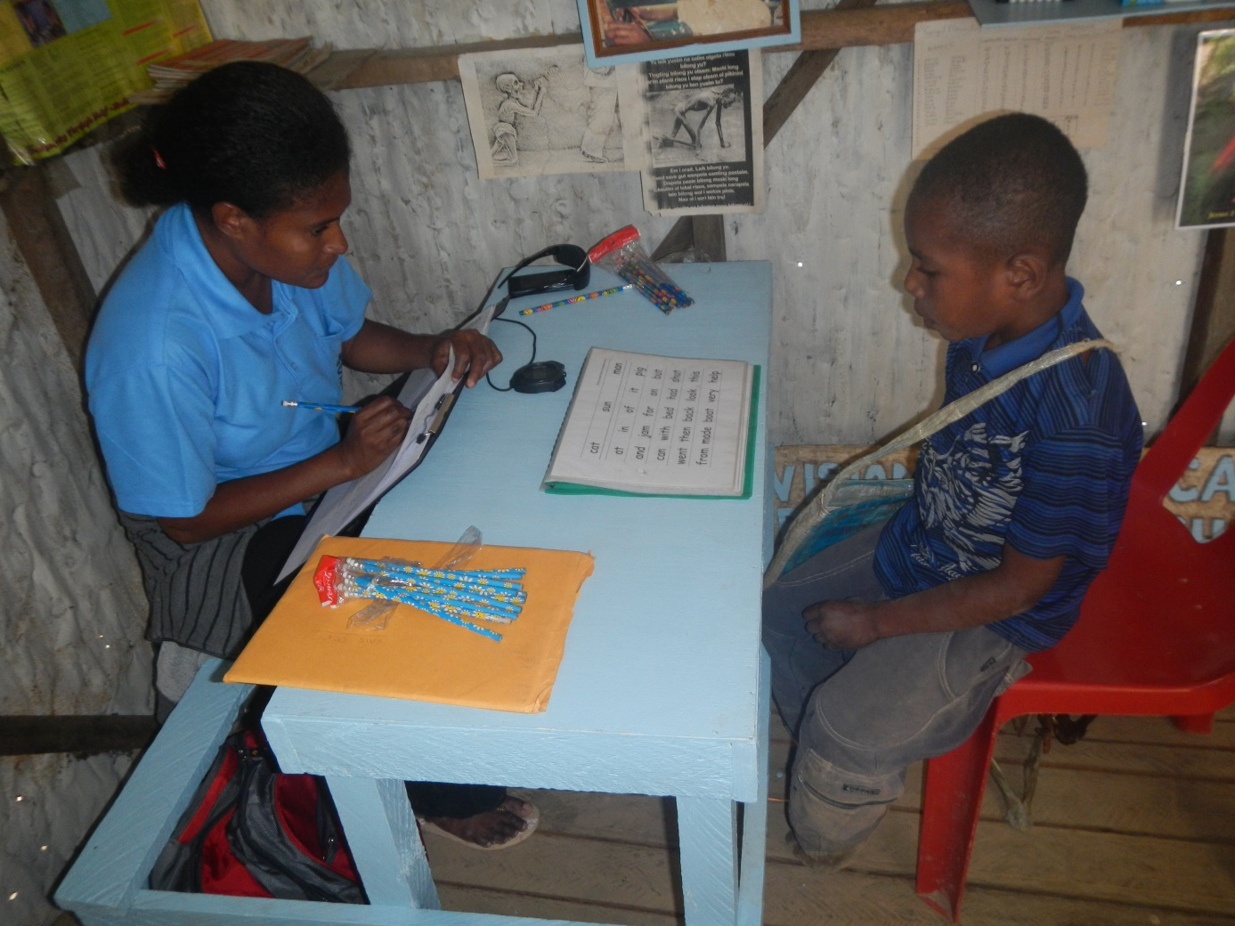
Reading assessments

Slide 23
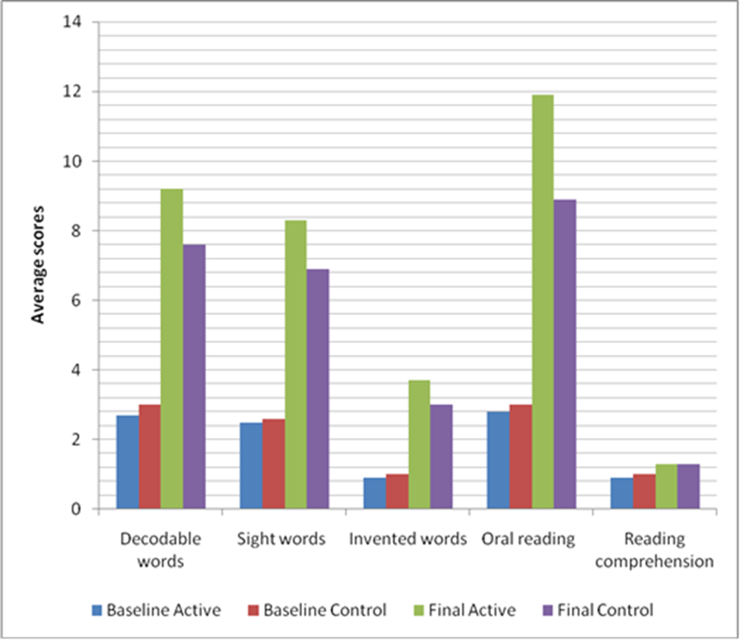
Statistics from different reading tests

Slide 24
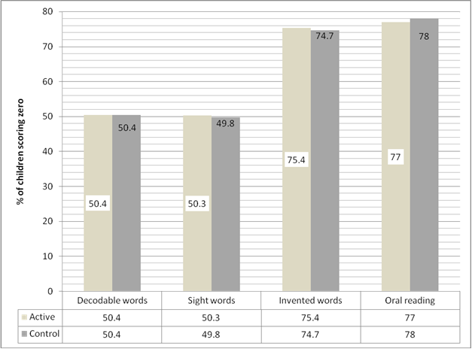
Children who could read no words in our tests in term 1

Slide 25
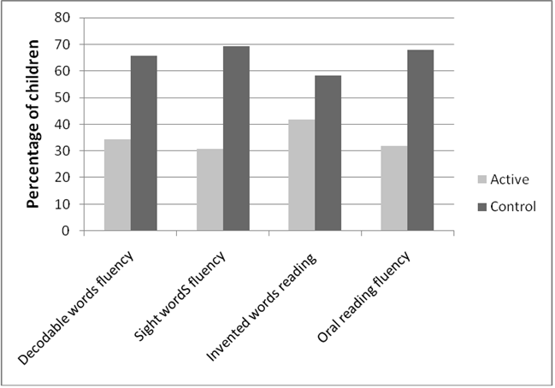
Children who could read no words in term 4

Slide 26
Good Practice Observed in Active schools
98% of children read story aloud from chalkboard
83% of pupils answering, relevant questions.
69% observed teachers teaching sounds
79% observed teachers explaining new English words
98% of teachers read story to the class from the chalkboard
50% of observed pupils read in groups

Slide 27
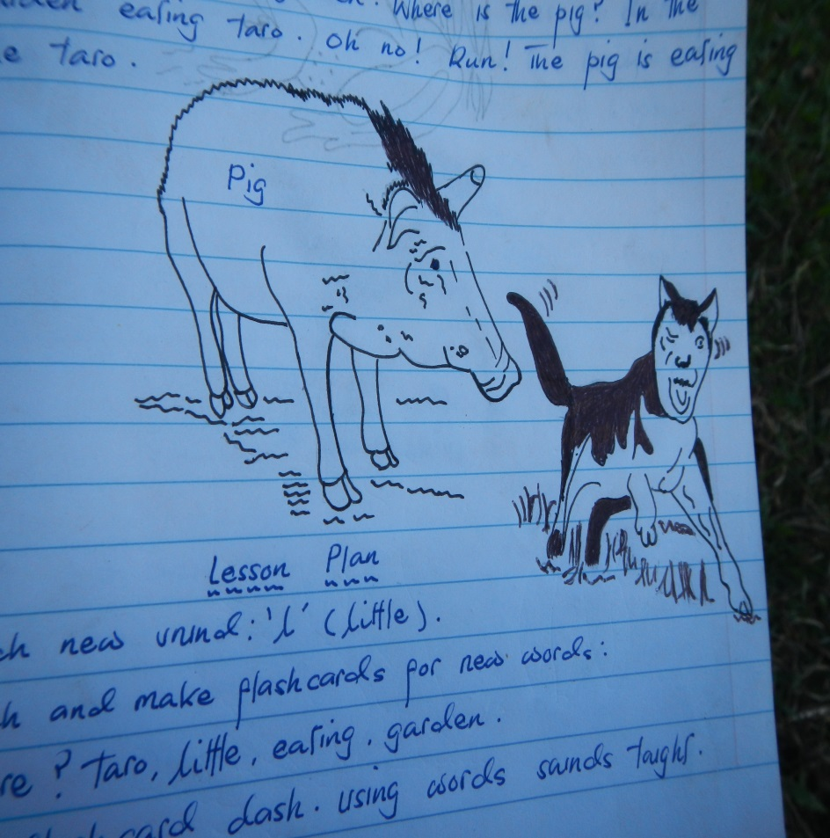
Positive Teacher Feedback
All teachers used stories
All teachers rated lesson plan and story content good or very good
81% of teachers write the story in a notebook
98% of teachers thought the stories and lesson plans had influenced the way they teach reading
53% now prepare their lessons
94% thought they had gained more competence in teaching.

