Slide 1
Annual Education and TVET Seminar
19-23 October 2015, Brussels
Session 10: Learning and Assessment

Slide 2
Learning and assessment
Learning- Issues and Challenges
  Starting with learners
  Learning in crisis
  What's our response?
Assessment – Issues and Challenges
  Purposes and Priorities
  Issues in Assessment - measuring success?
  What does this mean for us?

Slide 3
Learning – issues and challenges
  If you can read this,
  thank your teachers.

Slide 4
Learning – starting with learners
Policy framework for improving the quality of teaching and learning
Source: EFA Global Monitoring Report, 2005
Notes:
TFAS= International Task Force on Teachers for EFA (funded by the GPGC)

Slide 5
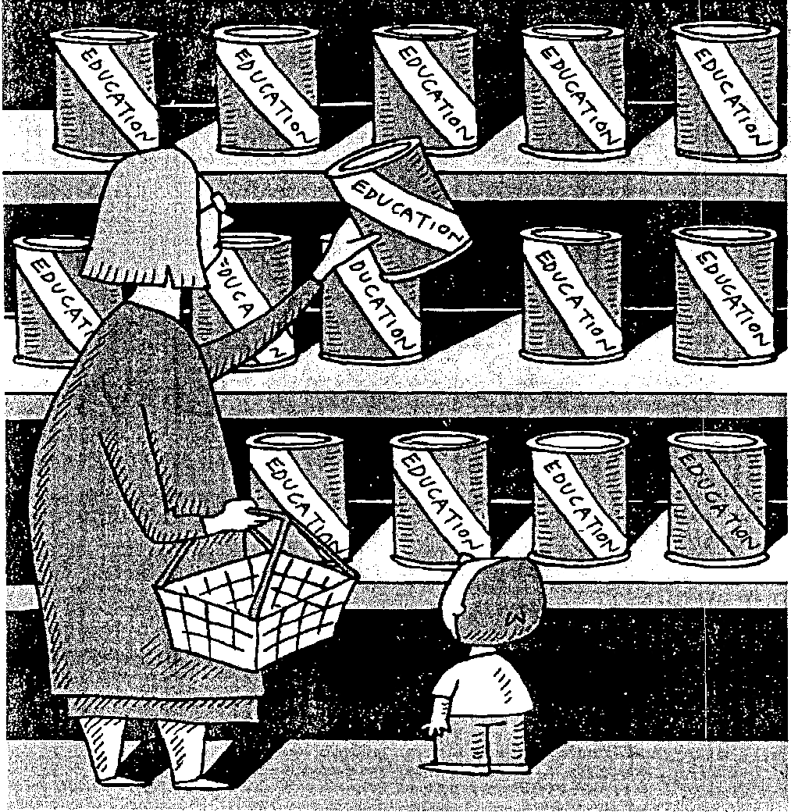
Learning = ?

Slide 7
Learning - what's important?
- Knowledge, skills, values and attitudes
- Basic / foundation knowledge and skills
- Emotional and social well-being
- Cognitive and affective learning
- Academic / non-academic (vocational) knowledge
- Learning to know, to do, to live together and to be

Slide 8
Learning – what's important?
'Children have to learn about the Kim dynasty of course, the benefits they have brought, and the horrors of US imperialism, but they also learn to read and write: 99% of adults are literate'
Martine Bulard, Le Monde Diplomatique, August 2015

Slide 9
Learning – our global ambitions
SDG 4: By 2030, ensure inclusive and equitable quality education and promote life-long learning opportunities for all
Target 1: By 2030, ensure all girls and boys complete free, equitable and quality primary and secondary education leading to relevant and effective learning outcomes
Target 6: By 2030, ensure all youth and at least [x] % of adults, men and women, achieve literacy and numeracy

Slide 10
Assessment
What do we mean?
Discussion Paper on Learning Assessments
December 2014

Slide 12
Assessment – purposes and priorities
Exams and assessment – similar but different
Exams – based on school curricula - intended to sort all children for future options
Formative assessment – provides feedback to teachers re all children's performance – to improve learning
Summative assessment – measurement of learning to test the 'health of education' – often sample-based

Slide 13
Assessment levels
Assessment can take place at various levels:
1 Classroom / school
2 Sub-national (districts, provinces etc)
3 National assessments
4 Participation in regional learning assessments
5 Participation in international learning assessments
- 1 and 2 can be formative and/or summative
- 3, 4 and 5 are usually summative

Slide 14
International learning assessments (ILAs)
1. Programme for International Student Assessment (PISA) 2.Trends in International Maths and Science Study (TIMMS) 3. Progress in International Reading Literacy Study (PIRLS)
- Develop cross-country comparisons
- Provide league tables to rank achievement
- Measure international learning trends over time
- Monitor/evaluate quality of student learning outcomes
- Support within-country analysis to compare

Slide 15
Regional learning assessments (RLAs)
1. Latin American Laboratory for Assessment of Quality in Education (LLECE)
2. Southern and Eastern African Consortium for the Monitoring of Education Quality (SACMEQ)
3. Program for the Analysis of Educational Systems of the CONFEMEN (PASEC)

Slide 16
PISA for Development (PISA-D)
Based on PISA – measuring cumulative learning achievement of 15 year-olds in reading, maths and science
PISA-D launched 2014 to increase developing country participation – improving contextual relevance and policy focus – inc. youth literacy, girls education and ways of assessing out-of-school children.

Slide 17
PISA for Development (PISA-D)
1st cohort - 7 countries – Cambodia, Ecuador, Guatemala, Honduras, Paraguay, Senegal and Zambia
Considering extending to eg Rwanda, South Africa
1. Extending test instruments to wider range of performance
2. Tests and surveys ++ to capture contextual info eg households
3. Approaches to assess out-of-school youth.

Slide 18
National capacities for assessment?
Key factors from SACMEQ:
- Organisational culture of host ministry
- Technical/advocacy skills of national co-ordinating bodies
- Other forces impacting on education reform
and more broadly:
- Integrate assessments within policy-making processes
- Improve staff capacities, technical quality of assessments
- Communication and dissemination strategy (media ++)

Slide 19
System Approach for Better Education Results (SABER)
Diagnostic toolkit allows countries to assess current capacities for assessment; to plan to develop assessment systems; and to learn from other policies and practices
3 drivers of information – enabling context, system alignment, assessment quality.
Rating: latent, emerging, established, advanced
'strengthen the enabling context … enhancing institutional quality before assessment quality is more likely to succeed'

Slide 20
National capacities in Brazil and India
Over 20 years Brazil has developed a reliable nationwide tracking of enrolment and learning levels. Lessons:
- Developing national capacities – a long-term project
- Political leadership is vital
- Clear policy framework/ownership by designated body
- Assessment body not overloaded with tasks
- Build staff capacity
- Still to develop links between assessment and TTIs
India – ASER citizen-led annual assessment, for 10 years

Slide 21
Learning assessments - Challenges
Developing a culture that values and uses evidence
High political stakes - lack of consistent political interest
Recognising learning assessment is only one aspect of quality education + must assess what children know, understand and can do in relation to the curriculum
Improve understanding of trajectory of learning, and cross-sectional + longitudinal comparisons – tight links with EMIS

Slide 22
Learning assessments - Challenges
Finance – (eg PISA 2015 – €182,000 + in-country costs)
Weak institutional capacities for implementation and use
Ability to gain insights from, or use, the results
Benefitting from inter-country exchange of expertise and good practice

Slide 23
ILAs/RLAs – better capacity in LMIC?
P4D to improve institutional capacities …… but no evidence yet of impact on capacity for national learning assessment.
SACMEQ – some evidence – positive feedback, ICT capacity, drive to institutionalise in regular functions
- Compromises to achieve cross-national consensus
- League tables – little value in guiding policy reform
- Barriers related to assessment programme, analysis of outcomes, dissemination, system constraints, politics

Slide 24
ILAs/RLAs – better capacity in LMIC?
Little known about use of assessment data in political decisions, policy-making and teaching practices.
Political fear of weak performance (low ranking), exposure of inequities and demands for accountability
In SACMEQ only Mozambique used results to promote pedagogical innovations

Slide 25

Learning and assessment?

Slide 27
Issues in focusing assessment
Most assessment on reading, language, maths and science:
Widely seen as the critical foundation for further learning
But – focuses on these subjects risks narrowing and dividing the curriculum + encouraging teaching to the test.
Even with good results it is often not clear if these are due to increased subject time, rote learning to tests and whether learning in other subjects suffers

Slide 28
From assessment to better learning …
Assessment can show learning gaps (between standards and performance) and links between achievement and student/school characteristics – and can guide allocation of resources to promote learning for the disadvantaged
But this needs continuity of political will; priority for equitable, quality learning; clear standards/curricula; high-quality teachers; high-quality pre- and in-service training; and having systems of accountability.

Slide 29
…. and also ……
Early Grade Reading Assessment (EGRA) – testing of reading of grade 2 children. Many languages. Issues inc.: a) risks focus on mechanics of reading only; b) needs complementary efforts to promote purposes/joy of reading
Learning Metrics Partnership: Capacity support/policy strengthening to develop and use common learning metrics for maths and reading. Based on using results of range of assessments, data that are 'nationally relevant and internationally comparable; peer-to-peer capacity support; and improving data use and policy interface. In phase 1.

Slide 30
Learning and assessment – so what?
What does this mean for us?

Slide 31
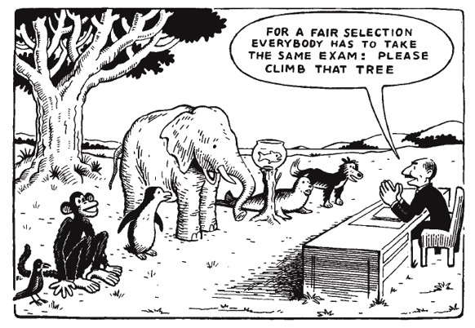
Final food for thought ………

