Slide 1
Good Practice Guide
Communication & Visibility for EU Project Partners

Slide 2
Communication approach
Broad, structured approach: move from a project-specific to a broader, sector-wide communication strategy to break silos and encourage collaboration across projects – creating unified communication & amplifying efforts.
Focus on objectives and impact: prioritise impact and meaningful outcomes over visibility alone.
Defining key messages: overarching messages aligned with EU’s strategic goals to guide how content is packaged, and which channels are best for delivery.
Audience segmentation: identifying and targeting specific audiences for more focused communication.
Conception before production: Anchor communication efforts in relevant data, ensuring they are relatable and tailored to the local context. Prioritise strategic planning and message development to create impactful and context-sensitive materials, while maintaining efficiency to avoid overextending the development phase.

Slide 3
Communication approach
Always-on campaign framework:
Continuous engagement: maintain a steady stream of EU messaging through regular updates on social media, partnerships, and collaborations with local stakeholders.
Campaign moments: amplify specific milestones (project launches, significant achievements) through targeted campaigns, maximising visibility and impact.
Measurable goals: set parameters and metrics for each campaign to track engagement rates, knowledge retention, and behavioral changes, shifting focus from awareness to consideration.
Targeted messaging: identify and address misconceptions through resonant messaging that connects deeply with the audience.

Slide 4
Why an always-on, campaign-led approach?
Sustained conversations: goes beyond event-based communication to initiate and maintain ongoing dialogues around key themes.
Measurable impact: focuses on continuous measurement of communication efforts to ensure ongoing relevance and adjustment based on insights.
Structured framework: outlining a clear campaign framework that breaks down activities into manageable phases with set timelines and objectives.
  Each phase will have targeted activities with specific, measurable objectives and timelines/roadmap.
Sets a benchmark for success: provides realistic expectations and a way to track success.

Slide 5

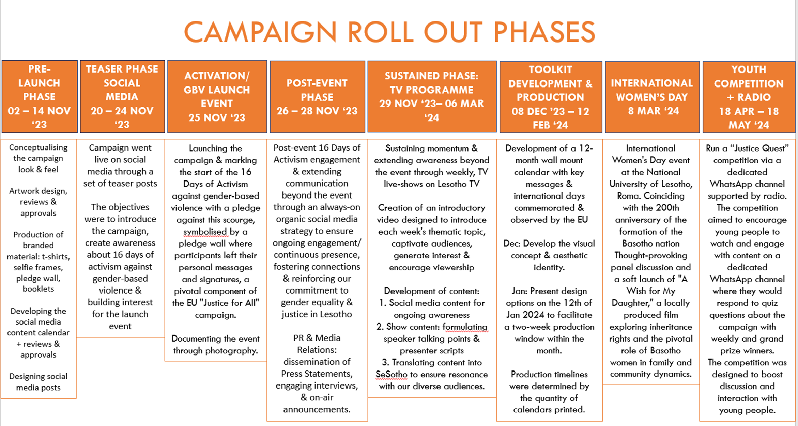
Campaign approach (reference)

Slide 6

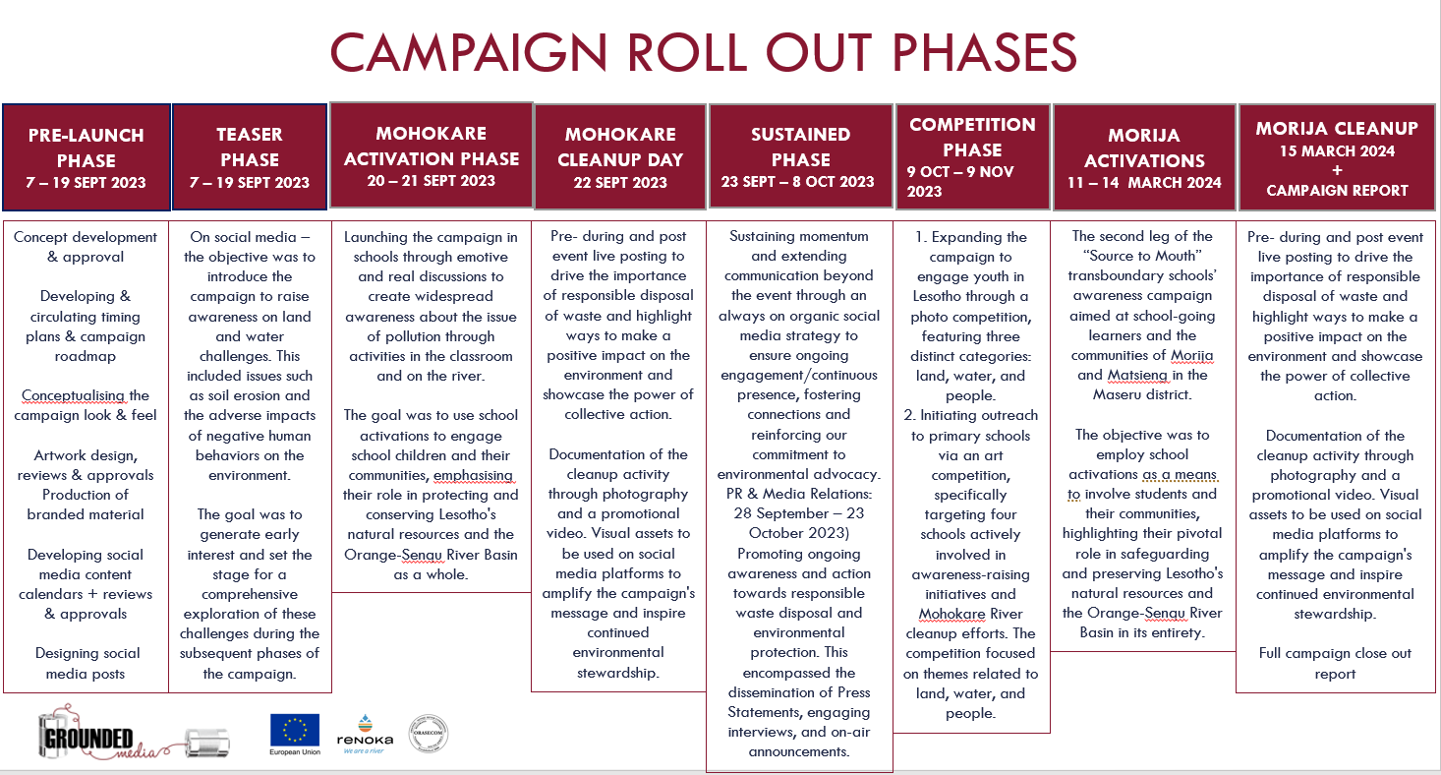
Campaign approach (reference)

Slide 7
Visual Identity

Slide 8
Visual Identity
To ensure cohesive and impactful communication across all EU-funded projects in Lesotho, the following guidelines outline the importance and implementation of a unified visual identity:
Strategic importance: A strong visual identity is more than aesthetics – it’s a strategic tool that amplifies messaging. It fosters an emotional and cultural connection with local audiences, enhancing recognition and trust while reinforcing the EU’s role as a committed partner in Lesotho’s development.
Localised resonance: The visual identity must resonate deeply with the people of Lesotho. By aligning designs with local contexts and cultural sensitivities, the EU can create a relatable and authentic presence that strengthens its impact and relatability.
Comprehensive branding guidelines: To maintain consistency, all implementing partners will receive a comprehensive brand guideline document. This guide includes essential details on logos, colours, fonts, patterns, and ready-to-use templates to ensure uniformity in visual communication.
Capacity building and training: Key communication focal points and project managers will receive one-on-one training on how to apply the visual identity effectively. These sessions aim to equip partners with the skills to integrate EU branding seamlessly into their communication materials, ensuring adherence to the guidelines.
Monitoring and support mechanisms: A monitoring system will be established to oversee the application of the visual identity across projects. This system will include periodic evaluations and provide ongoing support to partners, ensuring compliance and fostering continuous improvement in communication practices.

Slide 9
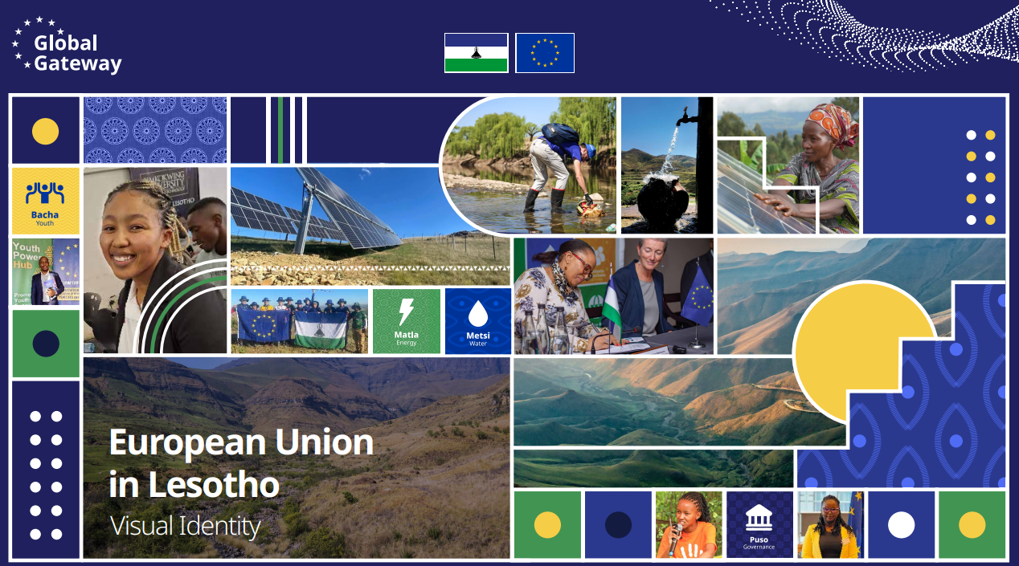
Visual Identity

Slide 10
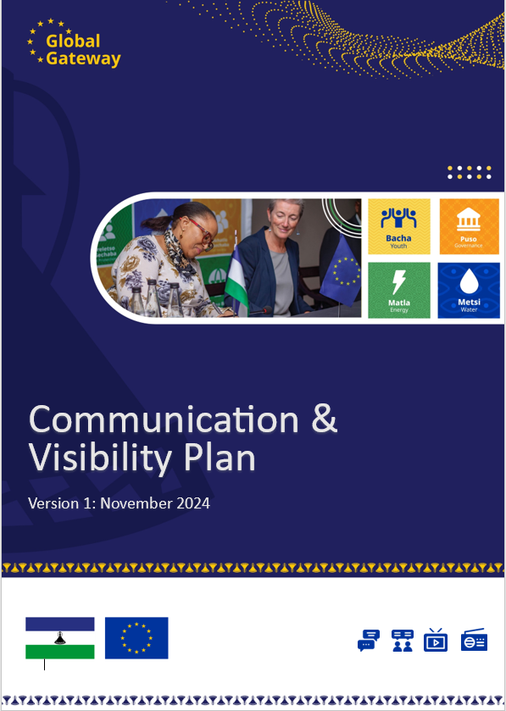
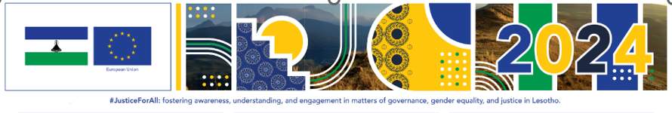
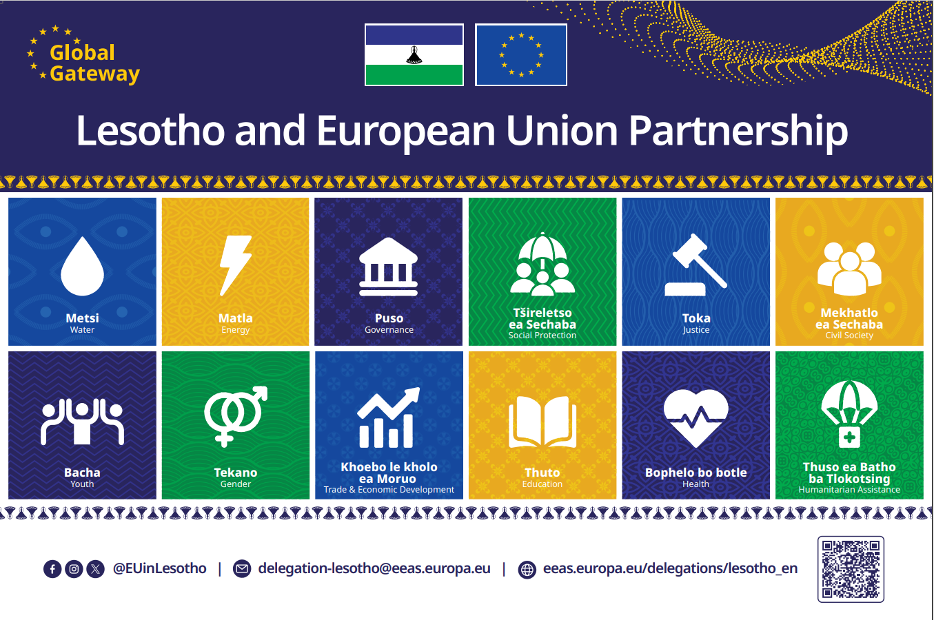
Visual Identity

Slide 11
2-Pagers/Factsheets
To ensure clarity, engagement, and alignment with best practices for EU communication, the recommended layout for public-facing documents follows this structure:
Introduction: Open with a brief, engaging overview to set the tone and context for the document. Clearly articulate the purpose and importance of the project or programme to immediately capture the reader’s interest.
Why: Address the core reasons and rationale behind the project or initiative. Highlight the specific problem it aims to solve and the benefits it brings to the community or target audience. Emphasise the EU’s added value in addressing these issues.
How: Explain the approach or methods being employed to achieve the project’s goals. Provide a concise description of processes, strategies, or partnerships involved, ensuring clarity for a non-technical audience.
What: Detail the expected outcomes, deliverables, or actions of the project. Accompany this section with a brief summary to ensure it doesn’t come across as abrupt or overly technical.
Background: Include a comprehensive background section that provides deeper context about the project, its origins, and its objectives. Place this section at the end of the document to allow the introductory sections to gauge the reader’s interest first.
Tips for layout optimisation:
Use visual hierarchies: Ensure headings and subheadings are clear and visually distinct to guide the reader effortlessly through the document.
Keep it concise: Aim for 2–3 paragraphs per section, particularly for public audiences, to maintain interest and avoid overwhelming detail.
Engage with visuals: Incorporate relevant images, infographics, or call-out boxes to break up text and emphasise key points.
By prioritising the "Why" and "How" on the first page, documents can immediately engage the reader, making the EU’s message accessible and impactful.

Slide 12



2-Pagers/Factsheets

Slide 13
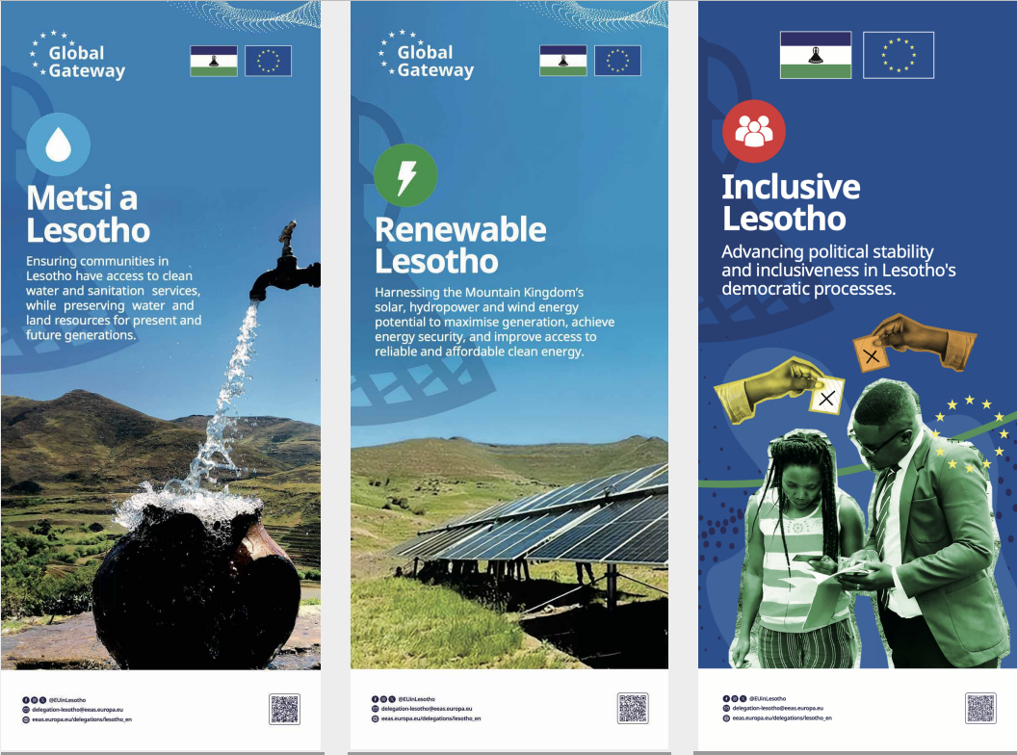
Pullup Banners

Slide 14
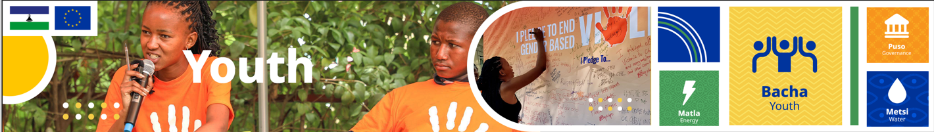
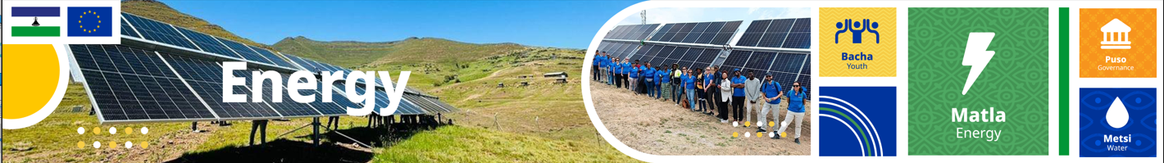



User-friendly, editable templates

Slide 15
Communication & Visibility
Requirements for implementing partners

Slide 16
Communication & Visibility (C&V) Plan
Implementing project partners are required to develop a Communication and Visibility (C&V) Plan and get the EU’s approval before starting operational activities, unless agreed otherwise.
Implementing partners to consult EU counterparts while preparing and implementing their C&V Plan.
The C&V plan encompasses the following elements: narrative with clear messages, objectives, audiences, approach, activities that have a delivery timeline, impact measurement, risks, and an appropriate budget.
The plan explains what the action is and why it is needed; emphasising shared values, interests and envisioned impact.
It is crucial for the plan to demonstrate the action’s added value, enhancing awareness and understanding of the EU’s external actions in line with the engagement’s scale, scope, and ambition.
Notes:
The C&V Plan/equivalent is our compass to provide guidance but it is expected that some factors may change therefore we should treat this is a working document that will be constantly updated.
Bearing in mind the yearly project reports, it would be advised for project partners to include narrative reports with analysis/statistics, lessons learnt, key highlights/successes, challenges and recommendations

Slide 17
Communication and Visibility
Communication and visibility is not an "add-on" element but integral part to all projects.
Identified communication activities should focus not only on what the action is, but why it is needed, including emphasising shared values, interests and impact.

Slide 18
C&V Plan: Core elements
Narrative: Why & what | understand the audience | test & refine: ensure messages are clear, relevant, and impactful.
Objectives: Clear, relevant & measurable | time-bound: define deadlines for achieving objectives.
Audiences: Segment audiences: tailor messages for wider and specialised audiences.
Approach: Channels | Content | Partnerships & networks to amplify reach.
Activities: Tailored activities that align with project objectives & target audiences.
Measuring impact: KPI-driven monitoring using defined Key Performance Indicators. Ensure indicators are relevant, credible and easy to monitor.
Risks: Identify risks | Mitigation | Adjustments: in cases of unforeseen risks, modify activities with EU approval.
Budget: Compile a budget and allocate costs wisely. Ensure the budget reflects the scale and nature of activities.
Notes:
The C&V Plan/equivalent is our compass to provide guidance but it is expected that some factors may change therefore we should treat this is a working document that will be constantly updated.
Bearing in mind the yearly project reports, it would be advised for project partners to include narrative reports with analysis/statistics, lessons learnt, key highlights/successes, challenges and recommendations

Slide 19
Messages
Define key messages: start by articulating the "Why" and "What" before the "How“
Audience segmentation: define key audiences and frame content to align with the audience's values and motivations to increase recall, impact, and action.
Objective-based framing: align messages with clear objectives and communication goals to tell a cohesive story.
Visual identity: the EU is in the process of developing a unified visual identity which is a strategic tool to amplify messaging.
Amplify impact: adopt storytelling techniques to make messages more compelling and relatable.

Slide 20
Visual storytelling
Audio-visual tools and visual storytelling should be key in message delivery for maximum engagement and clarity.
Ensure visuals are relevant and support the message being communicated.
Use high-quality images, infographics, and videos to enhance messages and increase engagement.
Share success stories/Human-Interest stories, testimonials, and case studies to illustrate the impact of communication actions whenever possible.
Obtain consent to use pictures, real faces and stories of individuals whose lives have been impacted by the action. Press Releases:

Slide 21
Human Interest Story guidelines
Highlight the EU’s role – Introduce the EU early: Establish the EU’s involvement at the beginning of the story.
Strategic use of quotes: Include statements from EU representatives like the Head of Delegation to underscore the EU’s role. Keep the tone collaborative while celebrating partner contributions.
Consistent attribution: Always refer to the EU in conjunction with implementing partners and not solely the partners to maintain EU visibility.
Structuring the story/Include context: Provide a compelling project background that provides an explanation for readers.
Focus on impact: Highlight the tangible benefits of the project
Call-to-Action (CTA): Always include a CTA that encourages readers to engage more with the project and share links to other auxiliary channels such as the Website, social media pages etc.
Amplify on social media: use personal quotes from beneficiaries and community leaders to humanise the narrative.
Emphasise community-led sustainability to inspire others.
Where possible, employ an ecosystem focus: Highlight interconnected impacts made possible by the project.
Human element: Use imagery that reflects the daily benefits of the project while respecting dignity and privacy. Avoid close-up images showing faces: Opt for wide shots showcasing community life or project outcomes to ensure inclusivity and discretion.
Evocative context: Highlight activities enabled by the project, such as equitable access or improved living conditions.
Tone and style: Use a collaborative voice, acknowledge all partners but keep the EU’s role prominently featured throughout. Use positive, inclusive and inspirational language. Avoid jargon and use accessible, relatable terms to engage broader audiences.
By following these guidelines, we can consistently develop HIS narratives that not only capture the essence of community transformation but also elevate the EU’s visibility and commitment to sustainable development.

Slide 22
Language
Use clear, simple language for all external communication.
Always include a Clear Call To Action – what's in it for the reader/viewer?
  The recommendation is to use hashtags, links, or direct calls to action to guide the audience to additional resources or information. Examples include "Learn more at [website link]", "Join the conversation with #ProjectName", or "Sign up for updates".
Use language and examples that resonate with audiences to increase relevance and impact.
Maintain a consistent tone and style across all communications
  Adopt the usage of ownable assets like colours, iconography and patterns.
Ensure alignment with the overall communication approach and key messages.

Slide 23
Tone, language & personality
Tone & language | Personality
Tone: Authentic, collaborative, empowering, relatable, inclusive and grounded in shared goals. Language: Plain, accessible, inclusive, simple language, free of jargon and technical terms; prioritising Sesotho where appropriate to ensure clarity and connection. | Public facing personality: Authentic, empowering, collaborative, caring, helpful and community-led. Stakeholder facing personality: Solution-oriented, collaborative, sustainable, mentor/capacitator, knowledgeable and informed.

Slide 24
Online communication guidelines
Tagging and acknowledging EU support
  Acknowledge EU support in all communication materials (e.g., "Funded by the European Union" or "Co-funded by the European Union").
  Always tag and mention the EU in Lesotho in social media posts.
Website communication
  Include ongoing EU-funded project updates on websites, emphasising the added value and impact achieved.
  Use human-interest stories to engage audiences, focusing on significant changes brought by the projects.
Social media engagement
  Leverage owned social media accounts for project visibility throughout the project lifecycle.
  Prioritise the use of images, videos, and infographics for better engagement on social media platforms.
Content requirements
  Submit concepts, draft, and final content to the EU for review and approval.
  Ensure content features the EU emblem and necessary funding statements.

Slide 25
Standard communication materials
Comprehensive branding: as part of the visual identity, project partners will receive a set of standard communication materials, including:
  Social media static posts template/example
  Factsheets/2-pager template
  PowerPoint presentation template
  Newsletter template
  Pull-up banner, wall banner, social media banner and website banners templates
Branding consistency: clear brand guidelines will ensure consistent use of the EU identity, with no need for creating separate logos for individual projects.
Co-branding guidelines: clear co-branding standards for partners to ensure aligned communication efforts.

Slide 26
Ongoing project updates: Press Releases and Media Engagement
Ensure timely and consistent updates on project milestones, shared with key media outlets for public visibility.
Press statements should clearly demonstrate the partnership between the EU and the partner in achieving set goals and should have clear, concise headlines.
It's crucial to articulate the "what", "why" and the "how" to provide a clear understanding of the purpose and significance of the collaboration. The leading paragraph should answer the who, what, when, where, why, and how questions.
The EU's contribution should be prominently highlighted to emphasise its role in the success of the initiative.
Quotes, evidence and statistics: use data, statistics, and concrete examples to support the claims and highlight the impact of the partnership.
Call to Action: where appropriate, include a call to action or next steps to engage the audience further or direct them to more information.
Contact information: provide contact details for media inquiries, including names, phone numbers, and email addresses.

Slide 27
Ongoing project updates: Quarterly Newsletter
Quarterly updates: a newsletter distributed every quarter will share project updates and maintain stakeholder engagement.
Increased transparency: serves as a reporting tool to keep stakeholders informed of milestones and achievements.
Building trust: consistent communication builds trust and strengthens relationships with stakeholders.
Amplifying visibility: newsletter distribution allows for better visibility of EU-funded projects over time. Where possible, include images, infographics, and project impact stories for better engagement.
Activities calendar: a newsletter will also serve as a platform for ongoing project updates and could feature an activities calendar for the quarter, offering a clear overview of upcoming events and initiatives, helping to maintain engagement and align efforts across projects.
All project partners are requested to share their communications calendar, key dates, and planned activities every 6 months.

Slide 28
The EU emblem
Single most important brand visual.
Apart from the emblem, no other visual identity or logo may be created or used by project partners to highlight EU support, unless previously agreed on.
All recipients of EU funding have a general obligation to use the EU emblem in their communication to acknowledge the support received under EU programmes and contribute to the visibility of the EU on the ground.
The EU emblem must be correctly and prominently displayed.
The most up-to-date guide that includes links to the right downloadable logos and their approved/recommended placement can be found here.

Slide 29
Explaining the EU
Project partners must ensure accurate and correct information about the EU, its institutions, and policies in all communications.
General statement: “The European Union is an economic and political union of 27 countries. Founded on the values of respect for human dignity, freedom, democracy, equality, rule of law, and human rights. It promotes sustainable development globally”.
For press statements, a pre-approved "About the EU" statement is available and can be adapted to fit the narrative during the release stage, ensuring consistency in messaging.
Definitions: more detailed information about the EU should use statements approved by the EU unless explicitly instructed otherwise.
Internet links: partners must link to official EU sources like the EU in Lesotho website when providing further information.

Slide 30
Thank you

