Slide 1
Greening EU Cooperation Toolbox
A toolbox to deliver on our environmental and climate objectives under the Global Gateway
Webinar 3: Greening Global Gateway investments

Slide 2
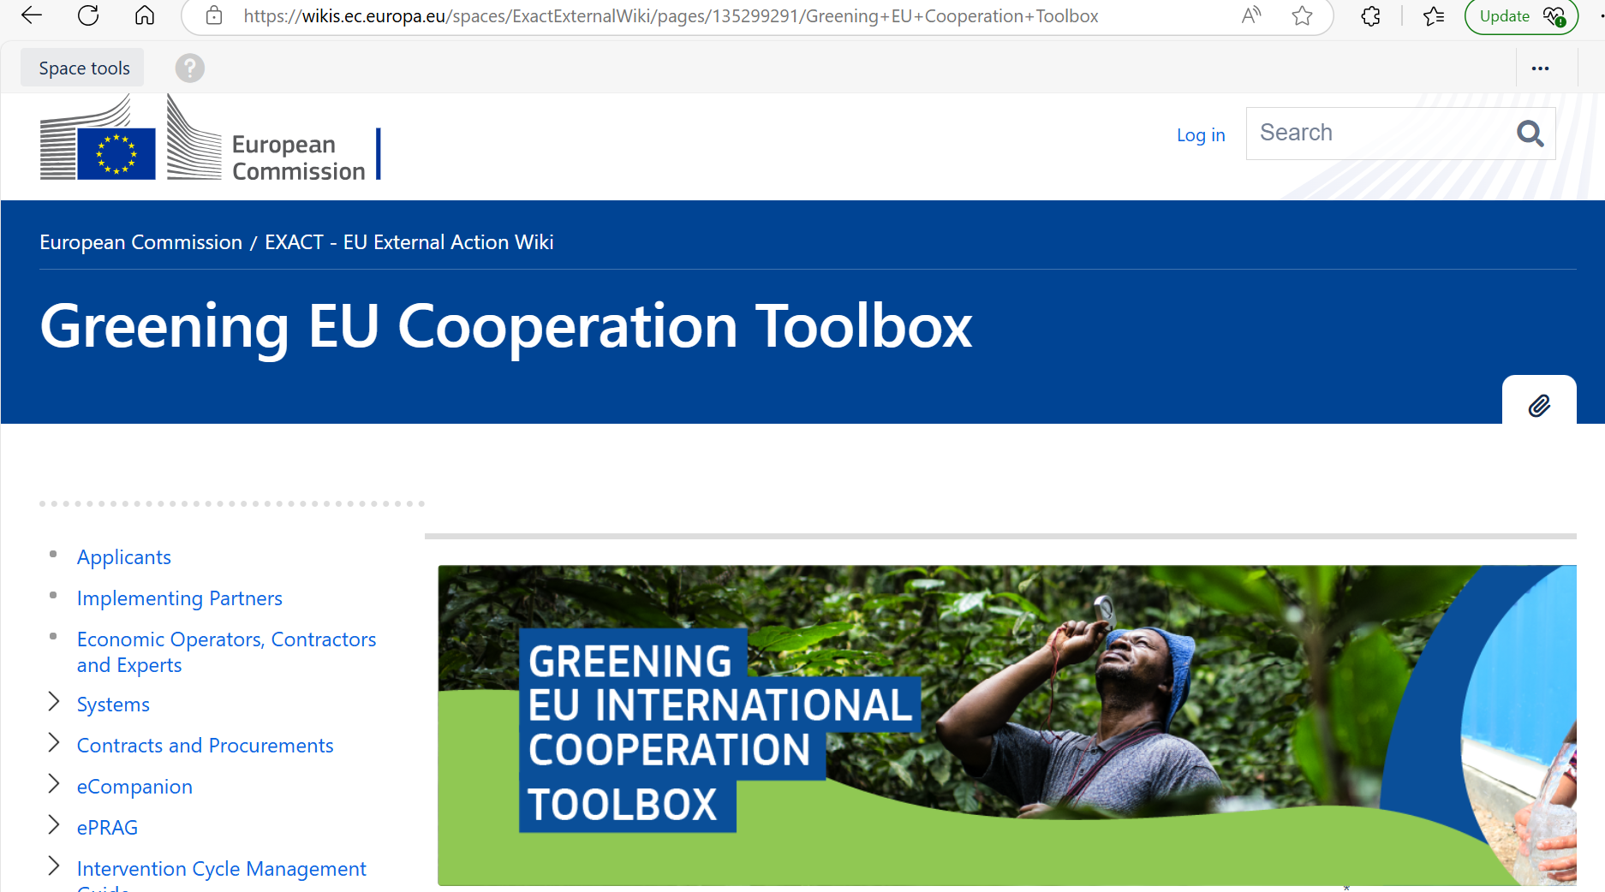

link
link
Notes:
Greening EU Cooperation Toolbox - EXACT External Wiki - EN - EC Public Wiki

Slide 3
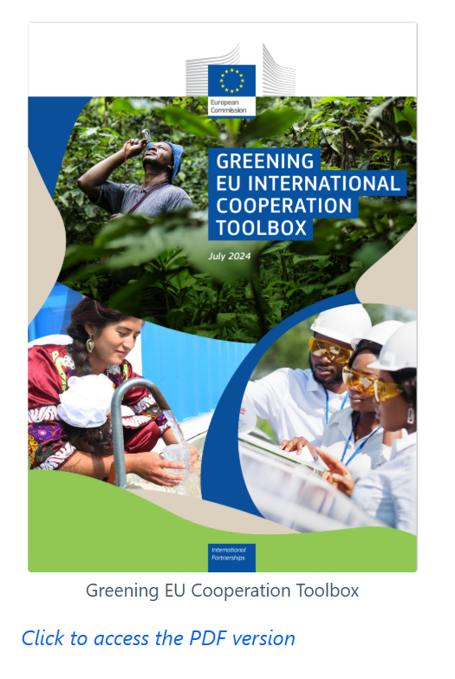
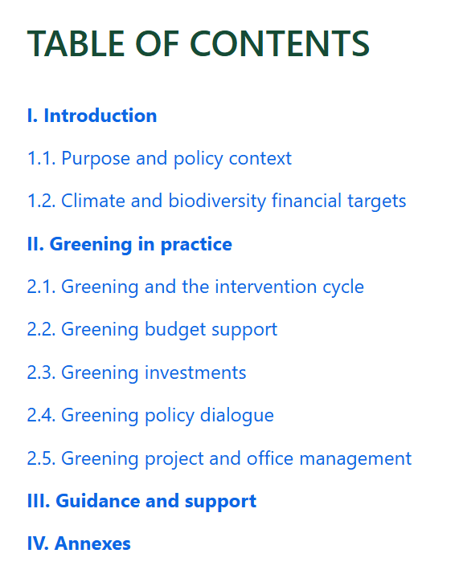



Slide 4

The Green and Clean Principle
🌍 Global Gateway is a climate-neutral strategy
🚀 Aims to speed up sustainable development and recovery…and transition to a cleaner and more circular global economy
🔄 Investing in clean and climate-resilient infrastructures aligned with pathways towards net-zero emissions
🛡️ All projects must comply with the Do No Harm (DNH) principle
🎯 And ensure the use of Environmental Impact Assessments and Strategic Environmental Assessments

Slide 5

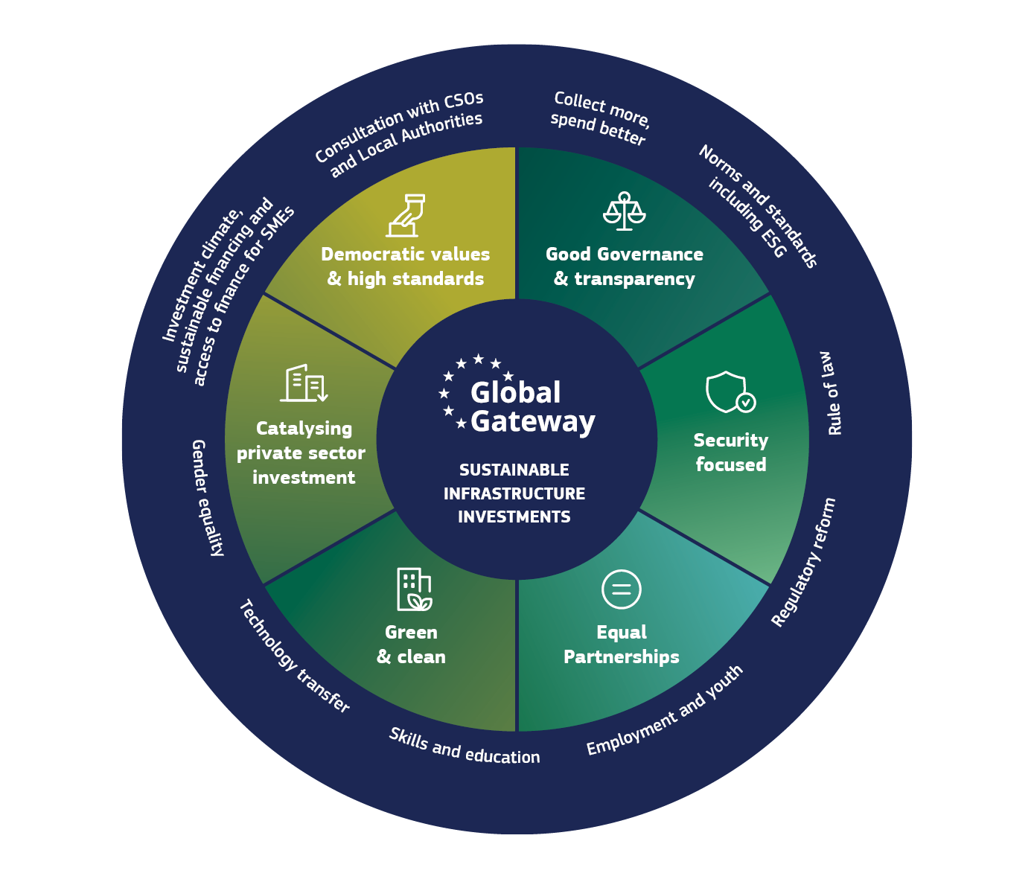
360 degree approach…
GG is not only about infrastructure
also about…
Environmental standards and legislation
Environmentally sound policies
Enabling business environment conducive to green investments
Green technology transfer
Green skills
Creating green Jobs
Access to green finance,…

Slide 6
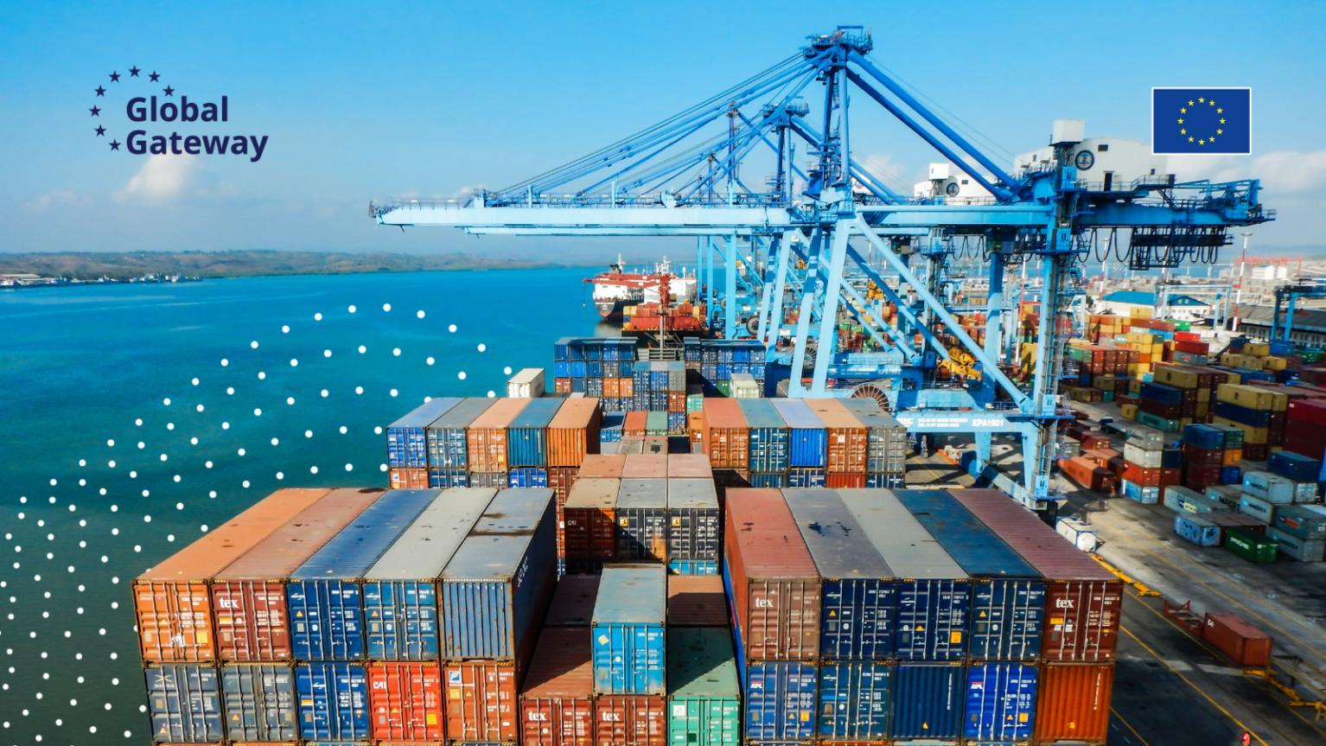
EU added value…
We will not compete on price alone
Alignment to EU values and standards
EU is leader on environmental governance
Facilitate trade by promoting EU-aligned standards
Opportunities for EU companies to provide clean technologies and know-how
Opportunities to address migration at source (low carbon and resilient business opportunities)
Notes:
EU is a Pioneer on environment & social governance standards…innovative…pulling for greening
Net zero ambition

Slide 7
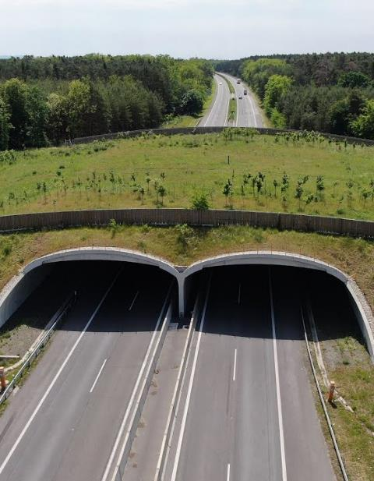
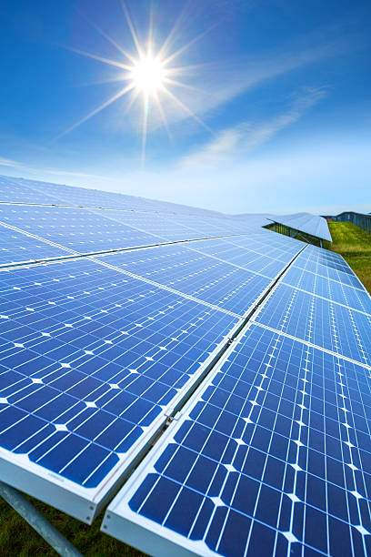

Greening investments – key points
Obligations…
Do no harm
No conflict with NDC
We should promote…
Contributions to environmental and climate objectives
We must keep in mind…
ESS not covered by the pillar assessment
Reputational risk
Environment & climate risk screening
Climate & environmental resilience
Shared responsibility
No fossil fuels
NBSAP alignment

Slide 8
Reputational risk…
Question from a journalist from the EUObserver to the Commission regarding a project supported by the EU (May 2025):
“As the Commission has signed a strategic partnership for [ ], has promised European investments and has indirectly financially supported the [ ] project,…I would like to offer the European Commission the chance to comment on the following issues:
That there are significant concerns regarding the environmental impacts of [ ]…
…while the biodiversity value of the entire park is high, it is especially high on the peninsula where [ ] is planned to be built…former assessment of [ ] haver raised that the environmental impact of [ ] would be a ‘significant’ concern’…

Slide 9
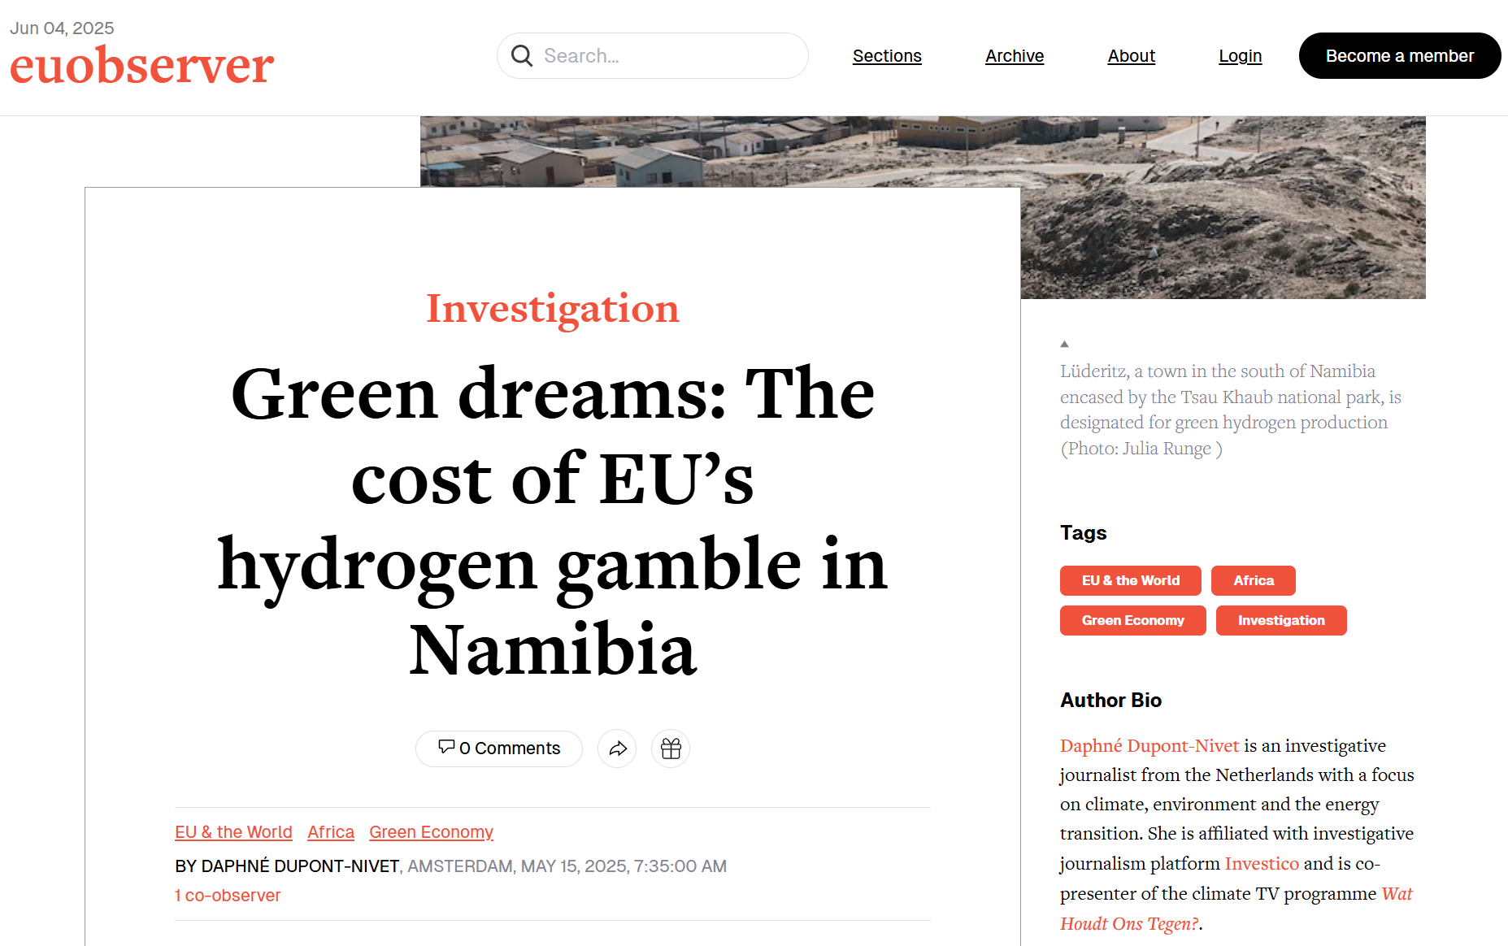

Slide 10
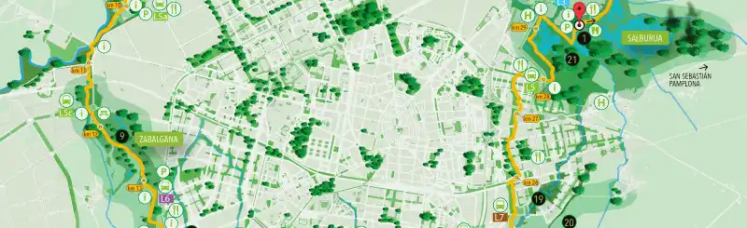


Start upstream and be proactive
Promote environmentally-integrated sector strategic planning (SEA)
Bring environment & climate change into the policy dialogue
Contribute to the preparation of project pipelines
Promote projects with potential for transformational change and that avoid carbon lock-in and stranded assets
Promote and prioritise biodiversity- and climate-positive projects
Notes:
Sectors with potential for transformational change: renewable energy, sustainable transport, water management…

Slide 11
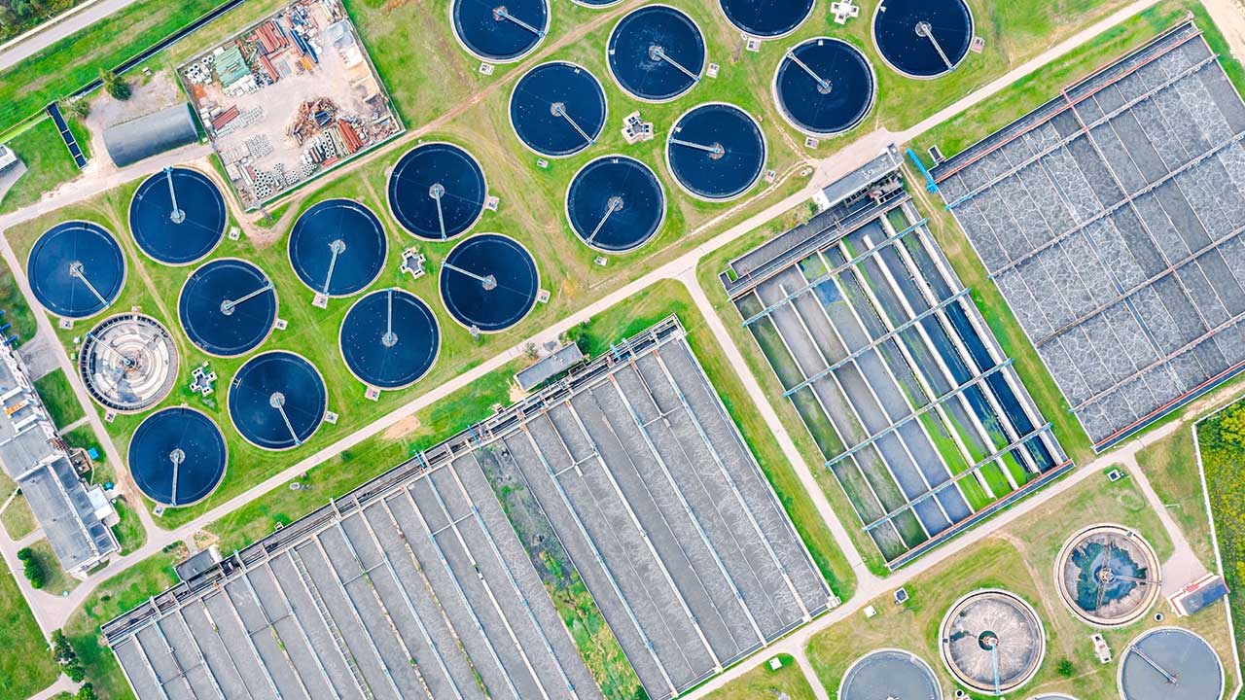
Get to know your partner FI and their ESS
Which are their environmental (and social) safeguards?
Are they transparent, of high quality, and guarantee DNH?
Does it ensure the quality of standards of intermediary FIs?

Slide 12


Screen proposals
Does it avoid excluded activities (Art 29)?
Intermediary FIs involved? Screening procedures?
What is the environment and climate risk category?
Is an ESIA and/or CRA required? Documents available? of high quality?
What are the ESIA/CRA findings? Are they integrated into the design?
Are contributions to biodiversity and climate targets justified?
Does the monitoring reflect env/cc objectives and risks?
Use the pipeline screening tool in Annex 13 of the Greening Toolbox!

Slide 13
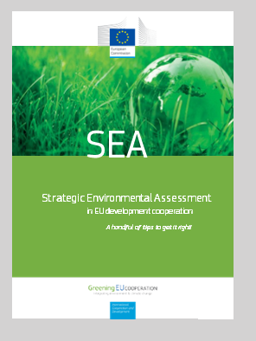
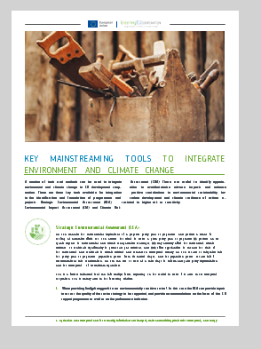
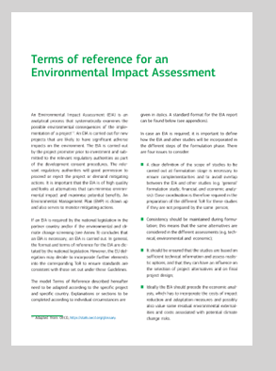
Request and check relevant documents
Environmental & Social Impact Assessments
Environmental Management Plans
Climate Risk & Vulnerability Assessments
Biodiversity Management Plans (esp. for HPP)
River Basin Management Plans
Ensure these are reflected in contractual documents and M&E system
Such documents should be shared by the FI as a matter of routine. If not, ask for them!
E(S)IAs are public documents!

Slide 14
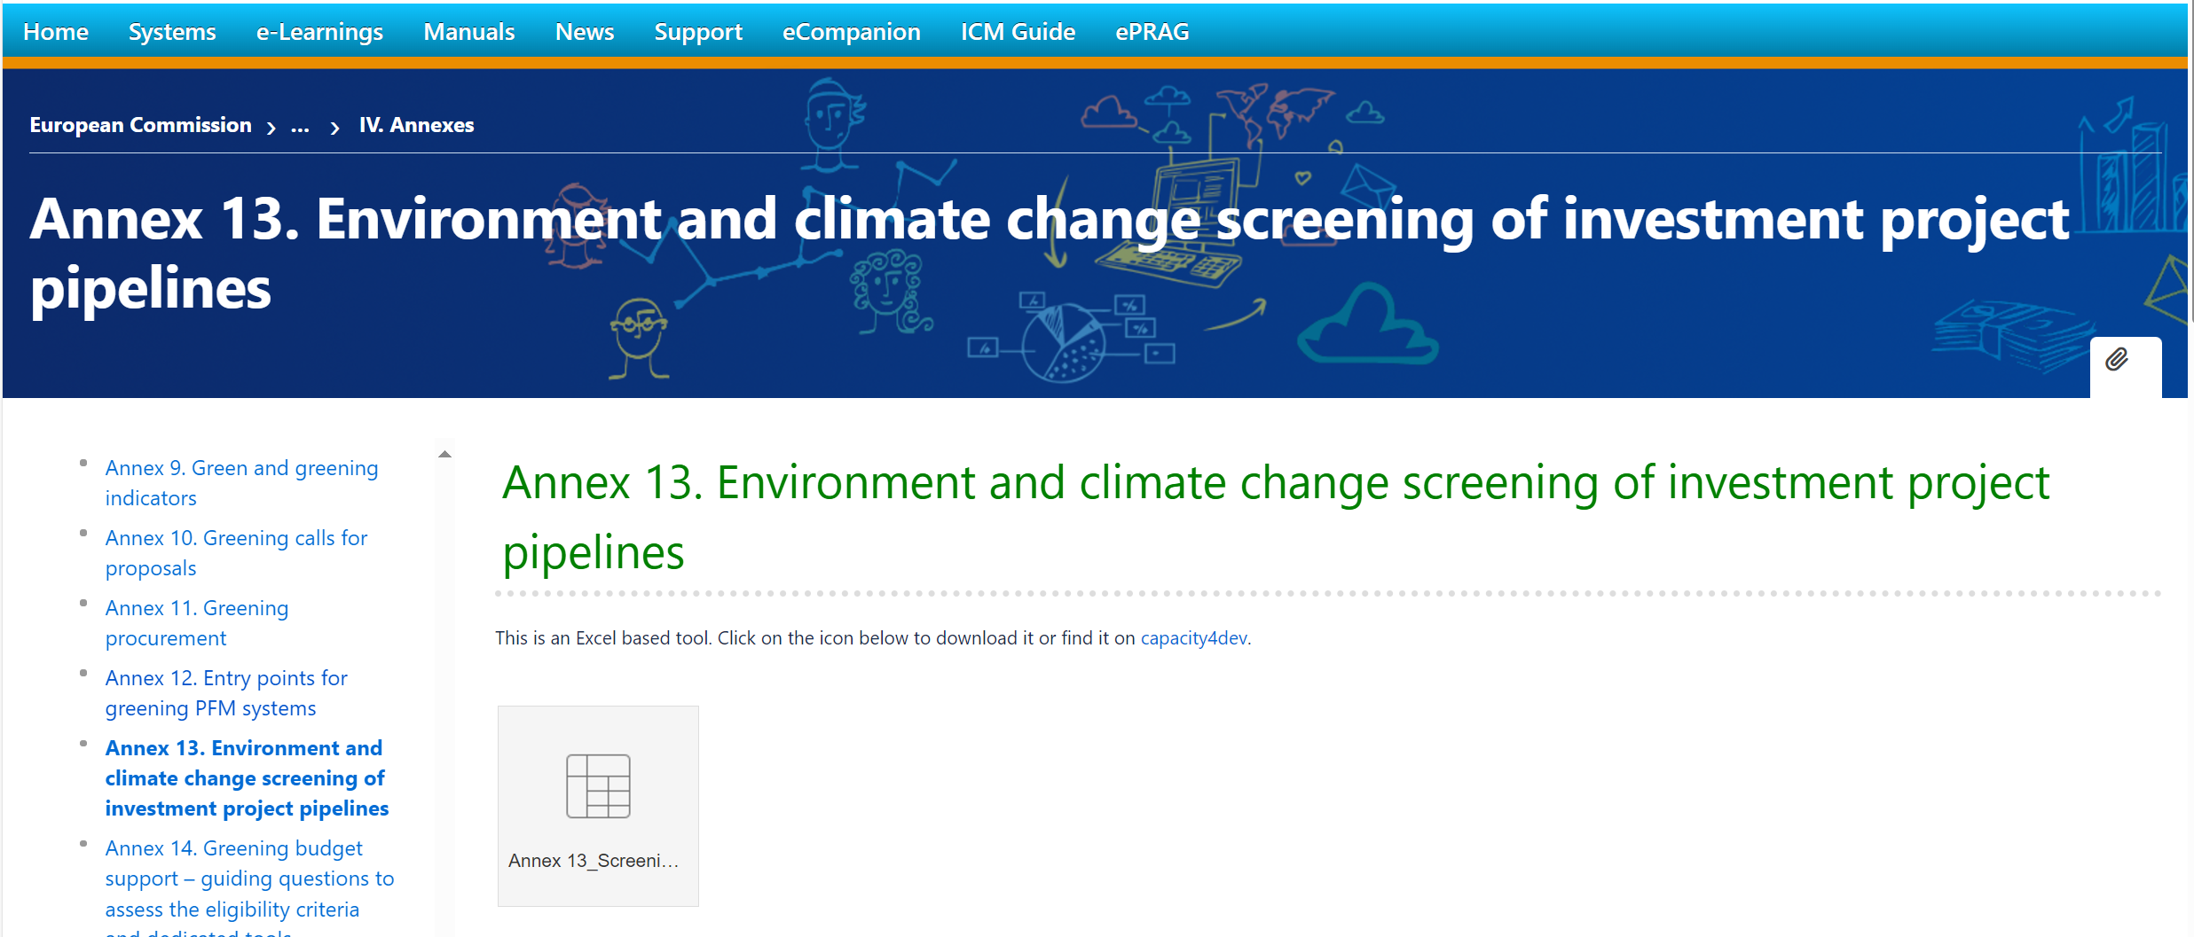
Screening of investment pipelines tool
Excel-based
Traffic light system
Structured around DAC purpose codes
Potential Rio markers

Slide 15
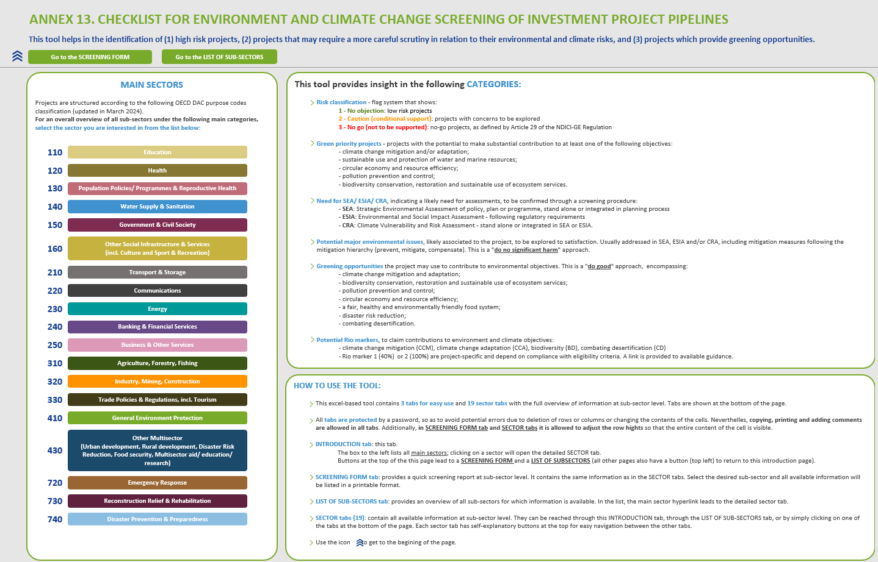

Slide 16
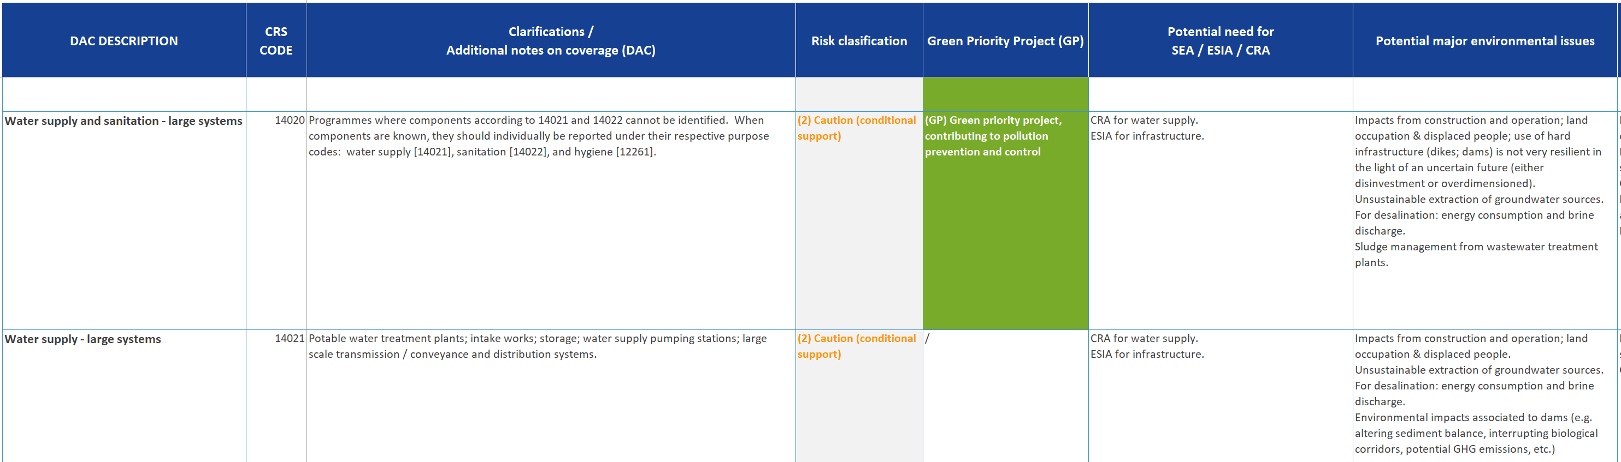
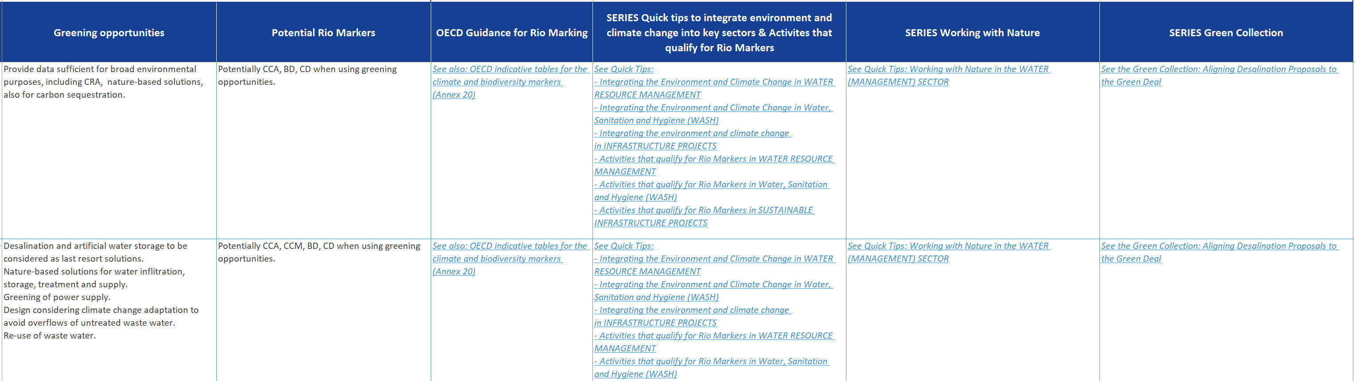

Slide 17
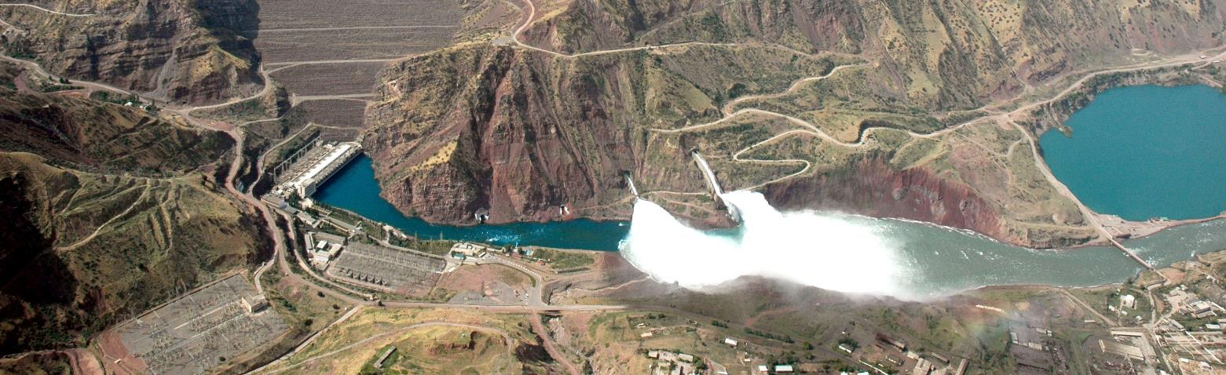

Be mindful of minimum requirements
Preparation of ESIAs and CRVAs are not an EU additionality, they are minimum requirements in most jurisdictions and should be part of the loan
Climate proofing is always relevant for infrastructure projects

Slide 18

…further downstream…reiterate key points in formal consultations
Pre-TAM consultations
EIB Guarantees: Art. 19 consultation

Slide 19
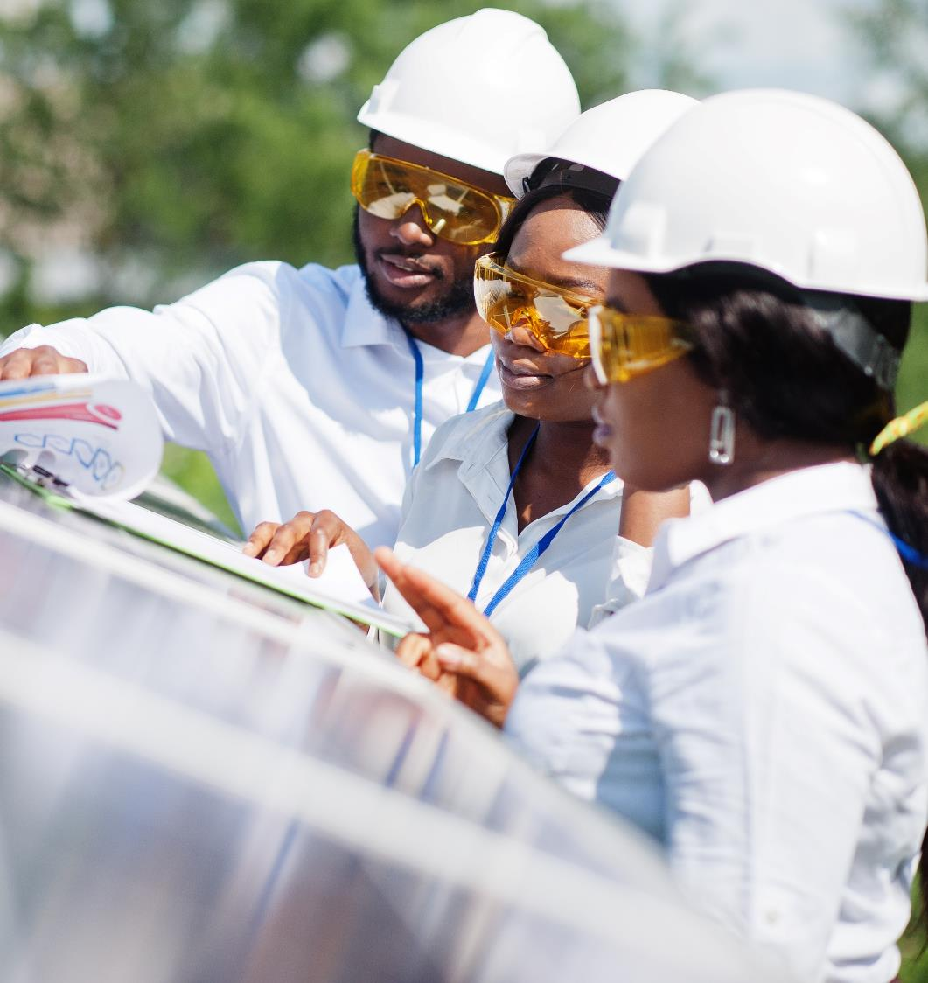
Get involved…
If relevant, engage in the monitoring and evaluation
Unforeseen environmental and social impacts need early solutions!
Remember…
If intermediary FIs are involved, normally the LFI should provide TA

Slide 20
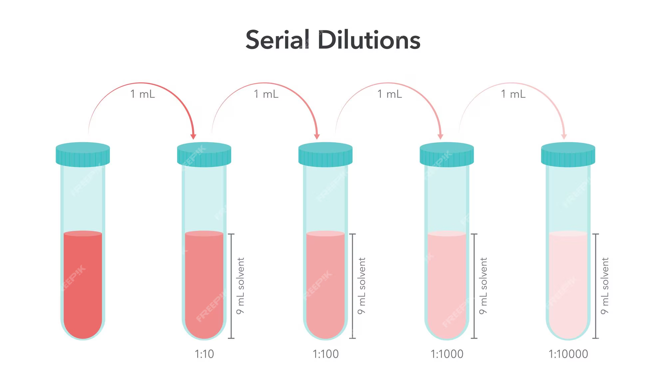
A caution about environmental safeguards: be mindful of the dilution chain
ESS on paper
Effective use of tools & procedures
Implementation of mitigation measures
Effective monitoring
Effective remedial action

Slide 21

Be strategic…the case for SEAs
Do investment proposals respond to a sector strategy?
What are the environmental and climate contributions and risks of the sector strategy?
Are we supporting projects in high-risk sectors? Are these projects the most sustainable to achieve strategic objectives?
Analysis of alternatives within a project (ESIA) vs analysis of alternative projects to reach strategic objectives (SEA)

Slide 22
