Slide 1
Greening EU Cooperation Toolbox
A toolbox to deliver on our environmental and climate objectives under the Global Gateway
Webinar 4: Environment & climate risk screening,
and greening tools

Slide 2
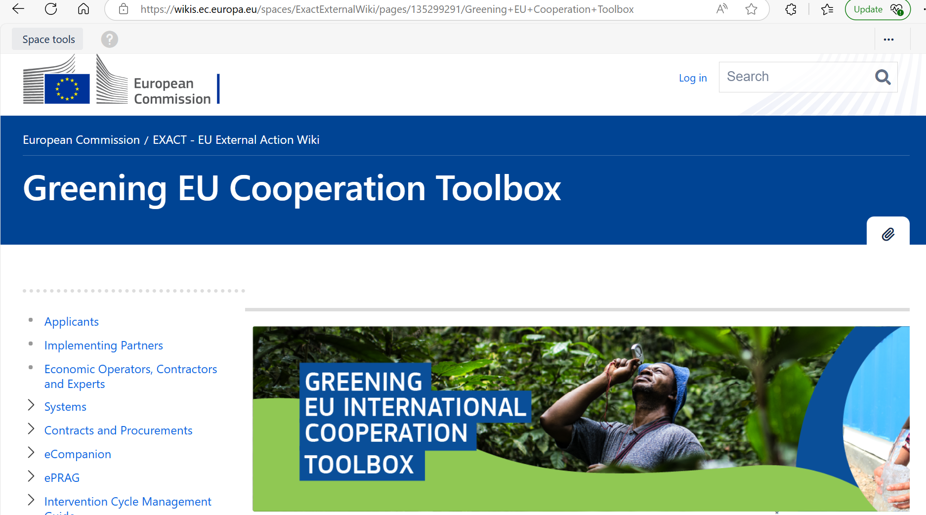

link
link
Notes:
Greening EU Cooperation Toolbox - EXACT External Wiki - EN - EC Public Wiki

Slide 3
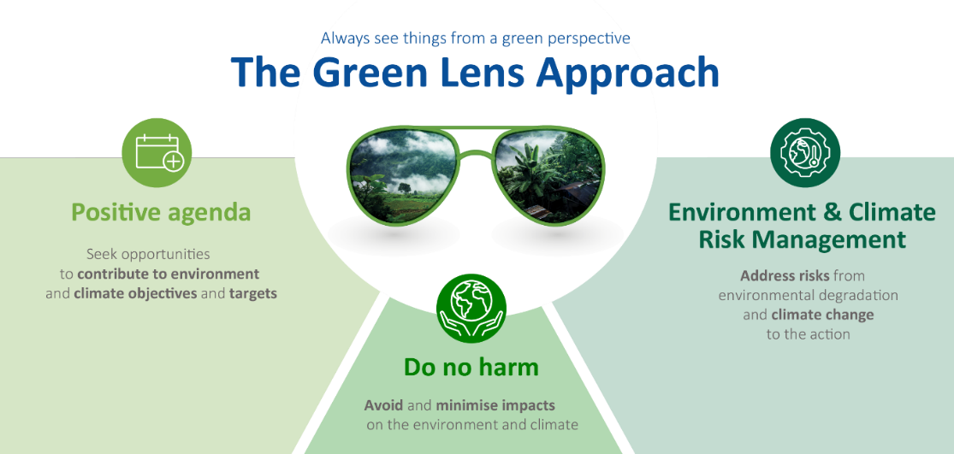

Slide 4

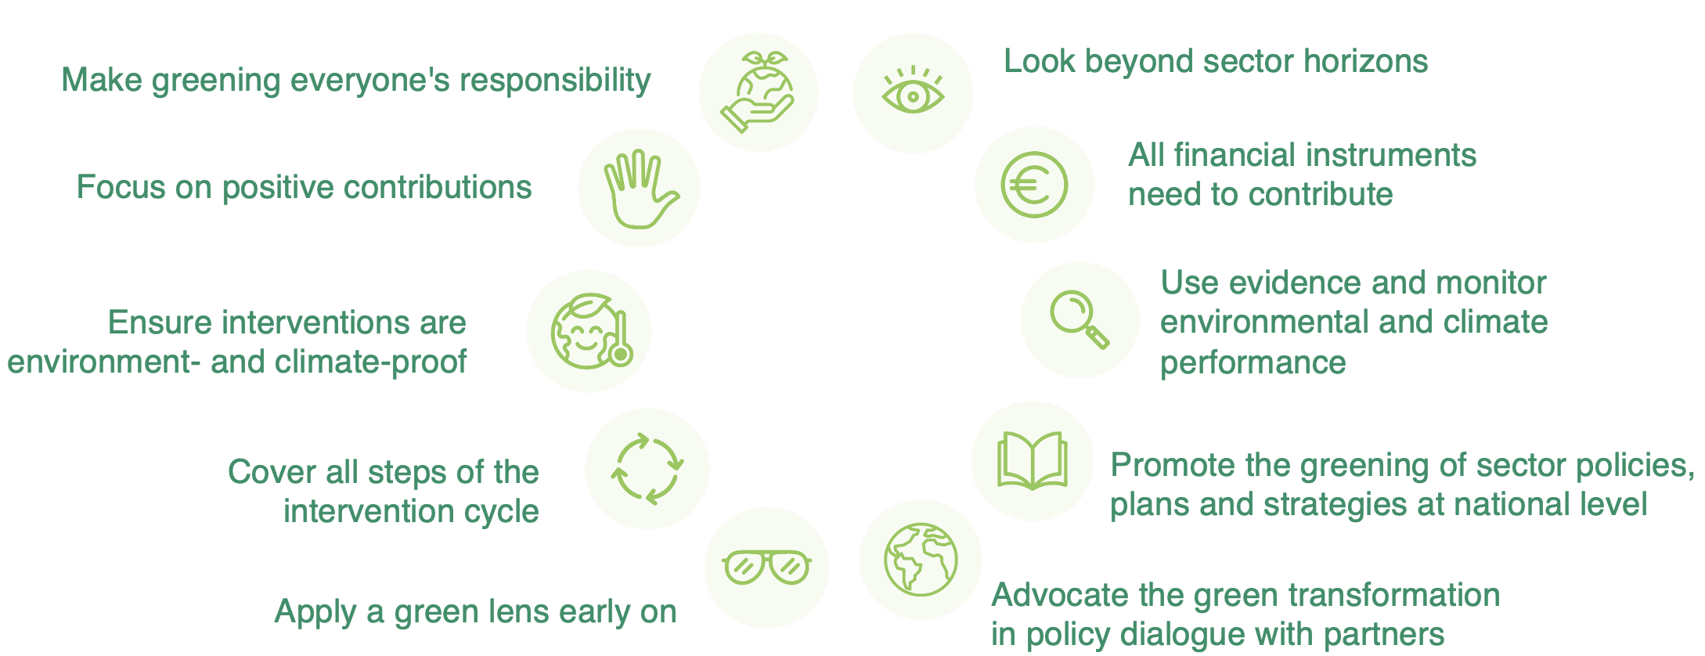
Recap: get the design right!
Notes:
2.1.5. Greening formulation - EXACT External Wiki - EN - EC Public Wiki
Maximise opportunities and minimise risks!
Opportunities to contribute to env/cc objectives - Green whenever possible!
Be explicit!
Avoid excluded activities
DNH as bare minimum
Risk management: ensure environmental sustainability and climate proofing
Greening should be a starting point, not an after-thought!

Slide 5
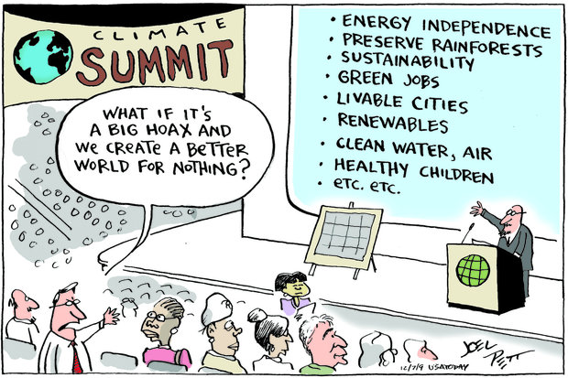

Slide 6
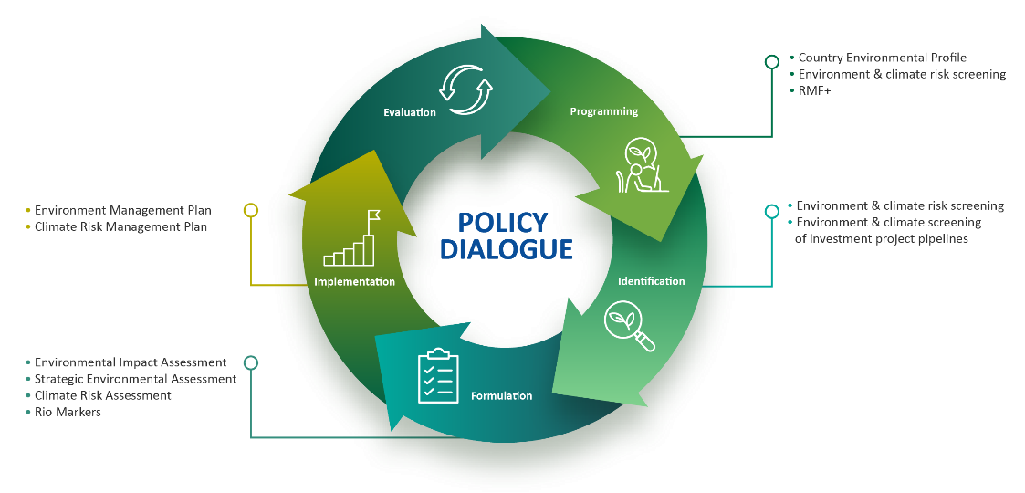
Recap: get the design right!
Notes:
2.1.5. Greening formulation - EXACT External Wiki - EN - EC Public Wiki
Maximise opportunities and minimise risks!
Opportunities to contribute to env/cc objectives - Green whenever possible!
Be explicit!
Avoid excluded activities
DNH as bare minimum
Risk management: ensure environmental sustainability and climate proofing
Greening should be a starting point, not an after-thought!

Slide 7
Strategic Environmental Assessment

Slide 8
Strategic Environmental Assessment
“the process and tool for evaluating effects of proposed policies, plans and programmes on natural resources, social, cultural and economic conditions and the institutional environment in which decisions are made”
IAIA (International Association for Impact Assessment)

Slide 9
EIA: we know what we want to assess

Slide 10
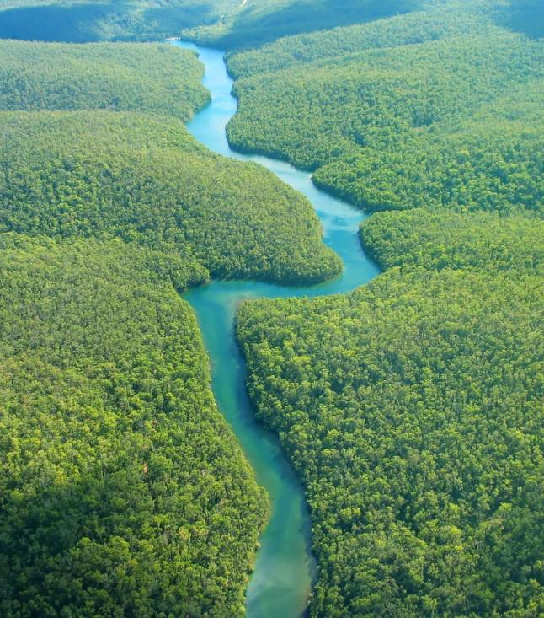
SEA: we have an idea of what we want, but don’t know exactly what will be done

Slide 11
SEA vis-à-vis EIA
EIA | SEA
Project-level | Policies, plans & programmes
Focus on informing development consent authorisation process | Focus on enhancing policy-making/planning process
Relatively standard approach | Different approaches available
Quantitative analyses dominate | Qualitative analyses dominate
Analyses alternatives within a project | Analyses alternatives to achieve strategic objectives

Slide 12
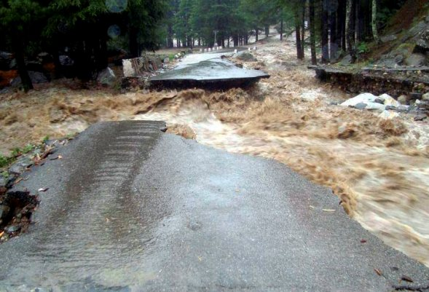
Our approach to SEA
What are the likely environmental consequences of implementing the policy/plan/programme?
Are the environmental threats faced by the sector being addressed?
Are the potential effects of climate change on the sector taken into account?
And on the proposed actions?
© GCCA/Catherine Paul

Slide 13
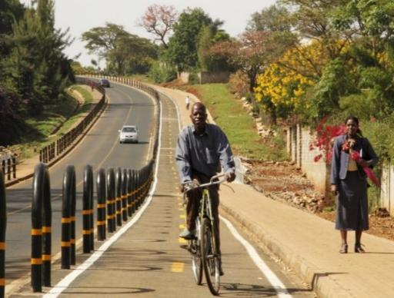
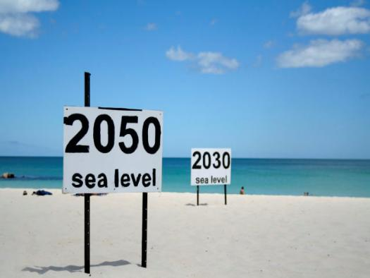
Our approach to SEA
Also addressed in EU cooperation:
Are there opportunities to enhance:
  Environmental sustainability?
  Low carbon development?
  Climate resilient development?
© GCCA/Catherine Paul

Slide 14
When can SEA be useful?
When providing budget support to an environmentally-sensitive sector
  To assess budget support eligibility criteria
  To inform the budget support programme preparation
  To identify performance indicators
When providing broad strategic-level support
When supporting sectoral policy-making and planning processes

Slide 15
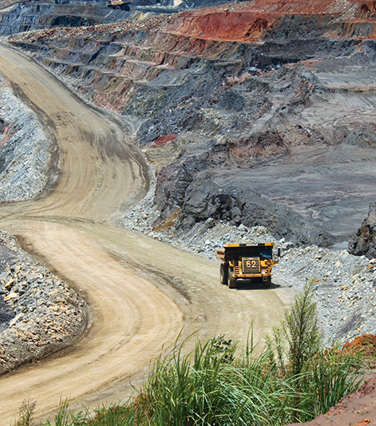

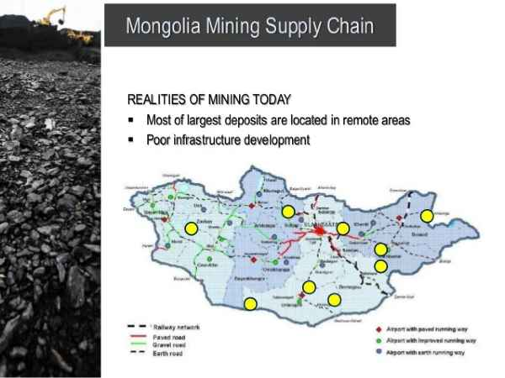
SEA in the context of the
Global Gateway
Green & Clean Principle
…Projects will live up to the European Green Deal oath to ‘do no harm’ and ensure the use of environmental impact assessments and strategic environmental assessments”.
Support national partners integrate env/cc in strategic planning, e.g. for:
CRM, transport, agriculture

Slide 16
SEA
Recommendations
To the EU
Delegation
To the partner
government
To address through
policy dialogue
Improve formulation
of EU support programme
Improve sector
strategy

Slide 17

SEA of Rwanda’s agriculture sector strategy – seizing opportunities
Recommendations on soil & water conservation and soil acidity informed performance targets on agro-forestry, reduction of soil acidity in areas of public investment…
SEA was reference for design of feeder roads development policy and strategy.
Findings on soil nutrient management informed GoR’s review of inputs subsidy scheme and recommendations for pest and disease management to be promoted.

Slide 18
Practical tips to get a SEA right!
Clarity of the purpose
Partner country in the driving seat
Right timing
Coordination with other int’l partners
Clear expectations, right ToR
Mind climate change
Have the right team
Importance of scoping
Participation and transparency
Ensure conclusions are focused
Support national SEA systems

Slide 19
Environmental Impact Assessment

Slide 20
Environmental Impact Assessment
“
the process of identifying, predicting, evaluating and mitigating the bio-physical, social and other relevant effects of development proposals prior to major decisions being taken and commitments made
IAIA (International Association for Impact Assessment)
”

Slide 21

Basic facts
Widely established world-wide
Applicable to projects with potential significant adverse impacts on the environment and health
Decision-informing in development consent
Traditionally impact-centered
Often also addresses social impacts (ESIA)

Slide 22

EIA regulatory framework
Use national systems – unless not up to standard!
EIA Directive (2011/92/EU amended by 2014/52/EU)
Aarhus Convention (access to information, public participation, access to justice)
Espoo Convention (transboundary impacts)
Performance Standards of Financial Institutions (relevant for blending)

Slide 23
Main EIA steps
Public Participation
Screening
Positive lists
Scoping
Participatory
Assessment
Different techniques
Screening criteria
Mainly quantitative
Beyond compliance
Inter-disciplinary
Define ‘mitigation measures’ – Mitigation Hierarchy
Avoid, minimise impact
Calculate residual impact
Maximise positive impacts
Prepare Environmental Management Plan
Public enquiry
Formal, additional to other opportunities
Decision
Go
Monitoring
Control and verification
Key aspects, methodologies, approach
Implementation / follow-up of EMP
No-go
Conditional

Slide 24
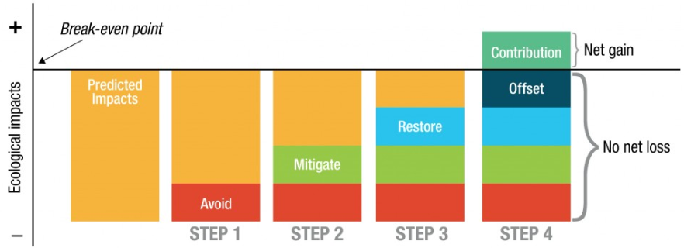
Mitigation hierarchy

Slide 25
Key contents to highlight
Non-technical summary
Analysis of alternatives (including baseline scenario)
Cumulative impacts
Addressing climate vulnerability
Impacts associated to vulnerability to major accidents and/or disasters
All phases of the project
Associated developments
Transboundary consultations
Notes:
FIND AN ILLUSTRATION

Slide 26
Matrices

Slide 27
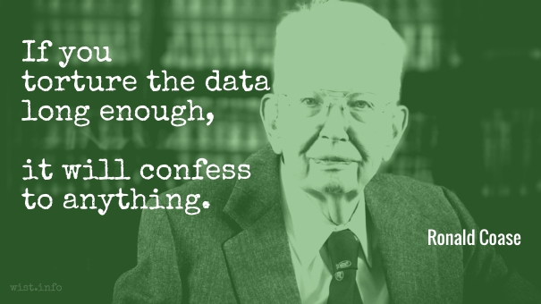
Common shortcomings in EIA
Catch-all’ approaches
Limited participation
Manipulation of data
Unclear/un-precise
…
Notes:
Catch-all’ approaches
Limited participation
‘Salami-slicing’
Manipulation of data
Unclear/un-precise
Lack of quality control
Little or no follow-up

Slide 28
Environmental Management Plan (EMP)
DO
CHECK
ACT
PLAN
Details for implementation and monitoring of mitigation measures
What? How? Who? When? How much?
Must be reflected in contractual documents
Link to monitoring and evaluation

Slide 29
Impacts/ concerns | Mitigation actions | Mitigation timeframe | Responsibility | Verification/control
General | Maintain Incident register to record any complaint of local residents or other affected stakeholders, any accident with impact on the environment or human health, or any other irregularity concerning the environmental management of the LSWEP | Throughout the Construction phase | Contractor | Incident register
Air pollution Exhaust emissions from boats, construction machinery and vehicles (on shore). Dust generated during the movement of vehicles (on shore) and construction materials handling | Ensure all construction vehicles, engines and machinery are maintained and operated in accordance with design standards and specifications No engines to be left running when not in use Staff trained/briefed in and aware of construction best practice All potential sources of dust emissions on site (on shore) i.e. unpaved roads used by LSWEP-related vehicles, areas of uncovered soil, etc., should be sprayed with water every four hours on working days, and more frequently as necessary to prevent dust emissions during dry and windy weather conditions Loose material (if any) shall be bunded and covered when transported to or off-site | Throughout the construction works | Contractor – construction company, all sub-contractors operating machinery | Daily visual assessment of dust plumes Random machinery checks Registered complaints for noise
Noise Ambient noise from drilling activities, and vehicles and boats operation. | Organizing construction works and transport of the materials only during the day time i.e. between 7am and 6pm. Notify any nearby residents if construction work is planned outside of those times. If complaints regarding noise are received from residents, consider installing partial screening around the noisiest activities and/or mufflers on noisy equipment. Maintain all generators, vehicles, vessels and other equipment in good working order to inimize exhaust fumes and excess noise. | Throughout the construction works | Contractor – construction company, all sub-contractors operating vehicles/boats | Registered complaints for noise

Slide 30
EIA – the role of the EU delegation
Screening for EIA*
Verify national systems are up to EU standard
Quality check ToR**
Quality check EIA/EMP
Reflect relevant elements of EMP in design, contractual documents and project monitoring indicators
* Annex 4 of the Greening Toolbox
** Model ToR for an EIA available in Annex 7 of the Greening Toolbox

Slide 31
EIA in the context of blending and guarantees
Environmental & Social Safeguards (ESS) of lead Financial Institution apply
IFC Performance Standards as international benchmark
Need to verify applicable standards and their quality – special attention to intermediary FIs!
Reflect EMP in contractual conditions and monitoring system

Slide 32
Climate Risk Assessment

Slide 33
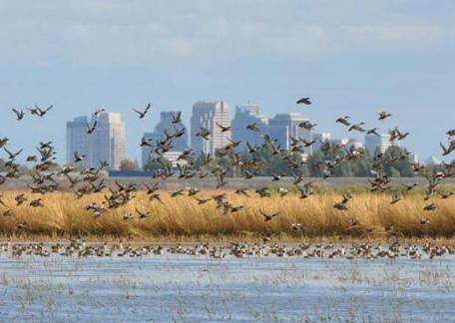
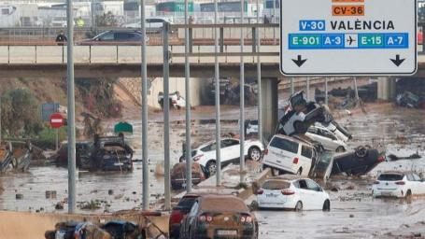
Climate Risk Assessment
Ex-ante assessment
To reduce the project’s vulnerability to climate change
To reduce climate damage by preventive measures
To optimise positive impacts
Through technical/scientific studies and stakeholder consultations
Notes:
CRA: to assess which measures should be put in place
Not all measures are to “climate proof” infrastructure
Not mandatory, Little legislation, useful to guide design. Not common at project level.
Some projects designed CRAs e.g. Mauritania at regional level (also Sao Tomé)…indicating what projects Will be following
Some IFIs do have climate proofing standard

Slide 34
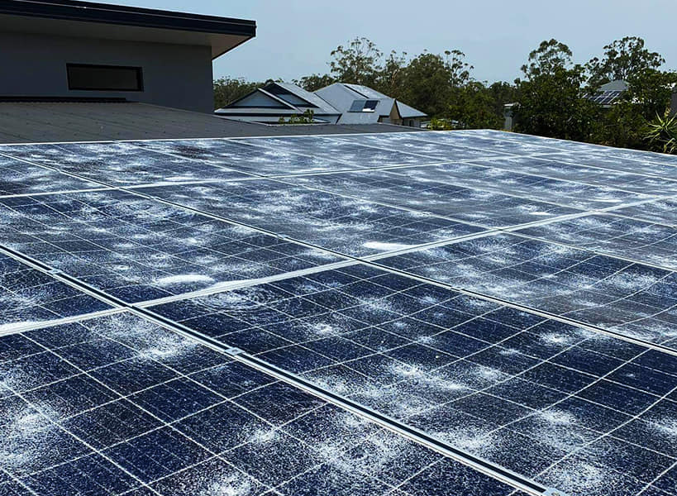
CRA and EIA synergies
Under the EU EIA directive, an EIA can assess the project´s vulnerability to climate change
Not often foreseen under national EIA systems
Notes:
If we use national systems, this Will normally not be required

Slide 35
Going beyond “climate-proofing”
”No regret”, “low regret” measures
  Have an acceptable cost for society in view of their benefits
“Robust” measures
  Produce net benefits or deliver good outcomes across various possible scenarios
Notes:
Key: concept of uncertainty.
In absence of clear risk: no regret or low regret measures
Examples of measures:
Capacity building
Early warning systems
Agroforestry (image)

Slide 36
Environment & Climate Risk Screening

Slide 37
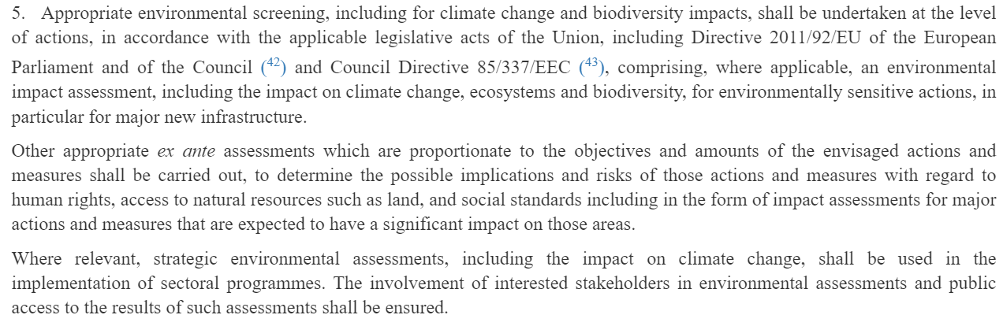
Environment & climate risk screening
Required under Art. 25.5 of the NDICI-Global Europe regulation

Slide 38
Environment & climate risk screening
Annex 4 of the Greening Toolbox
Helps decide on the need for:
  Strategic Environmental Assessment (SEA)
  Environmental Impact Assessment (EIA)
  Climate Risk Assessment (CRA)
The screening process gives us hints for better integration, even if dedicated tools are not necessary
Project/Programme
Screening
criteria
SEA?
EIA?
CRA?

Slide 39
Environment & climate risk screening
Part A: SEA screening
  Sensitive sectors (e.g. agriculture, energy)
  Implementation modality
Part B: EIA screening
  National legislation
  “Positive” list
  Screening questionnaire
Part C: CRA screening
  Screening questionnaire

Slide 40
Part A: SEA Screening
Plans, programmes and other strategic documents which:
  Are prepared in ‘environmentally-sensitive’ sectors
  Set the framework for development of projects which may require EIA
  May have significant impacts on sensitive habitats and ecosystems

Slide 41
Part A: SEA Screening
When supporting an environmentally-sensitive sector:
  When supporting policy-making or strategic planning
  When considering budget support
  When a project provides strategic level support
  When support includes preparation/revision of a sector-wide strategic or planning document in an ‘environmentally-sensitive’ sector
For budget support programmes in other sectors, with potential significant adverse impacts on the environment – based on screening questionnaire

Slide 42
Part B: EIA Screening
Projects with potential significant adverse impacts on the environment
  Projects that require an EIA under national legislation
  Category A projects (as per EIA Directive)
  Category B projects, based on screening criteria

Slide 43
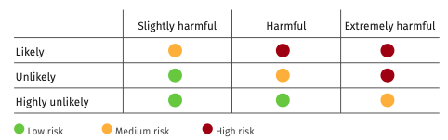
Part C: CRA Screening
Projects at significant risk from climate change
Based on a screening questionnaire that helps determine the level of risk

Slide 44
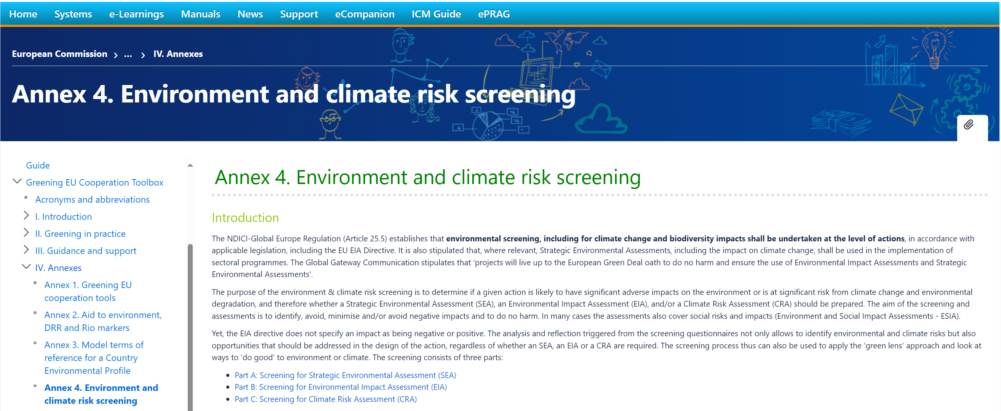
Where to find the screening process?
Annex 4 of the Greening Toolbox

Slide 45
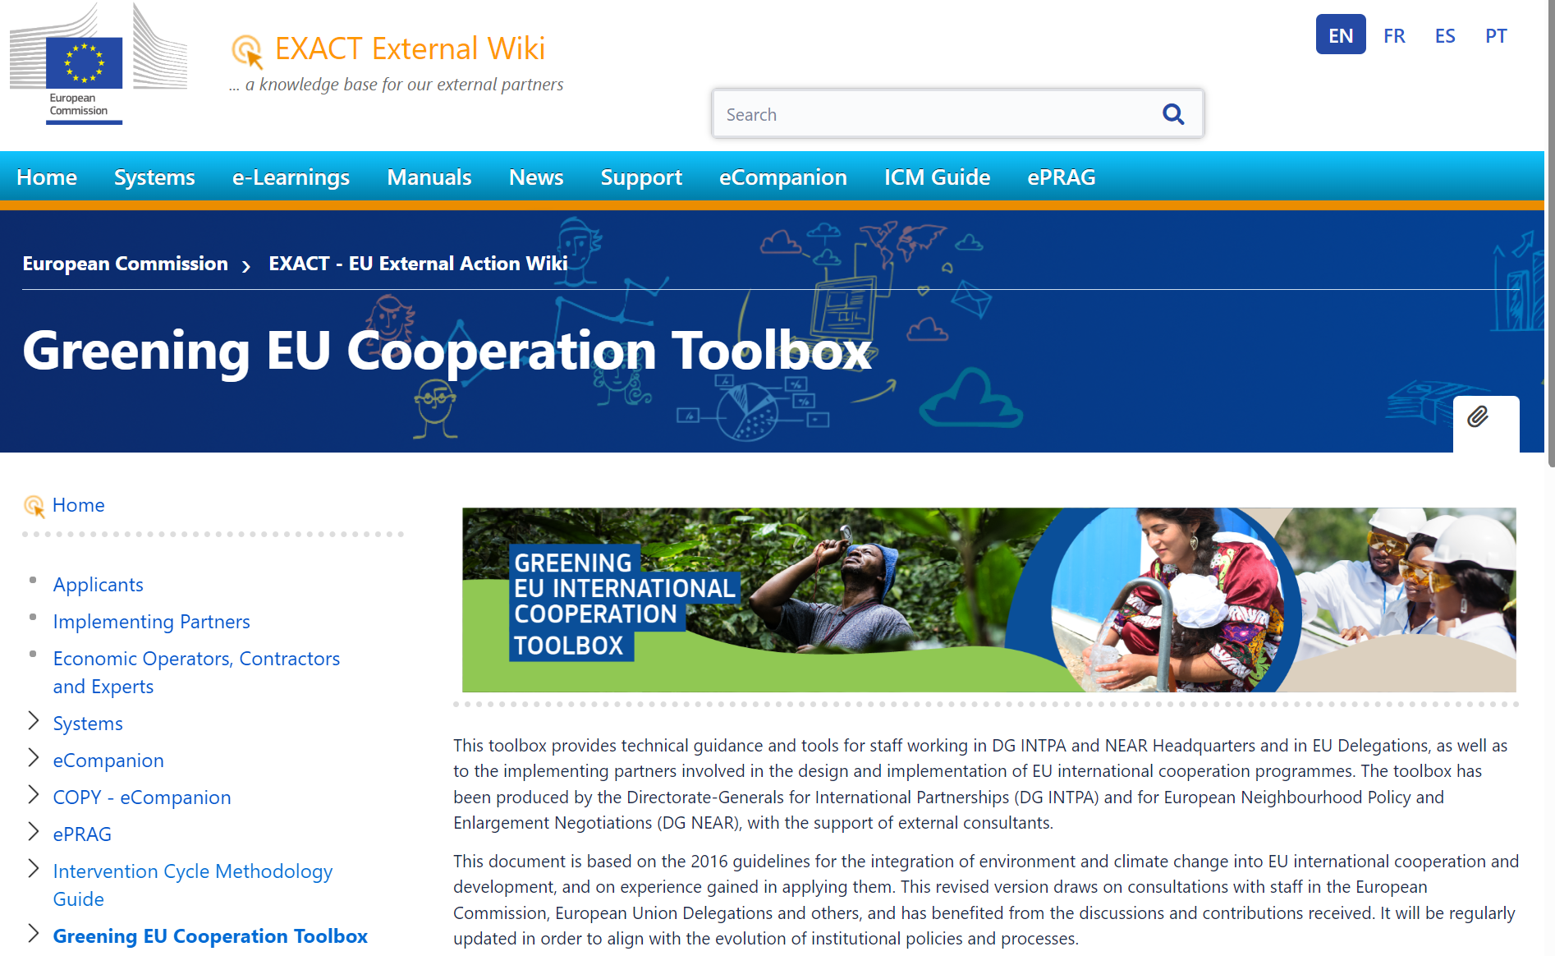

The Greening EU Cooperation Toolbox
Online tool
EXACT External Wiki - EN - EC Public Wiki
PDF document
Capacity4dev

Slide 46
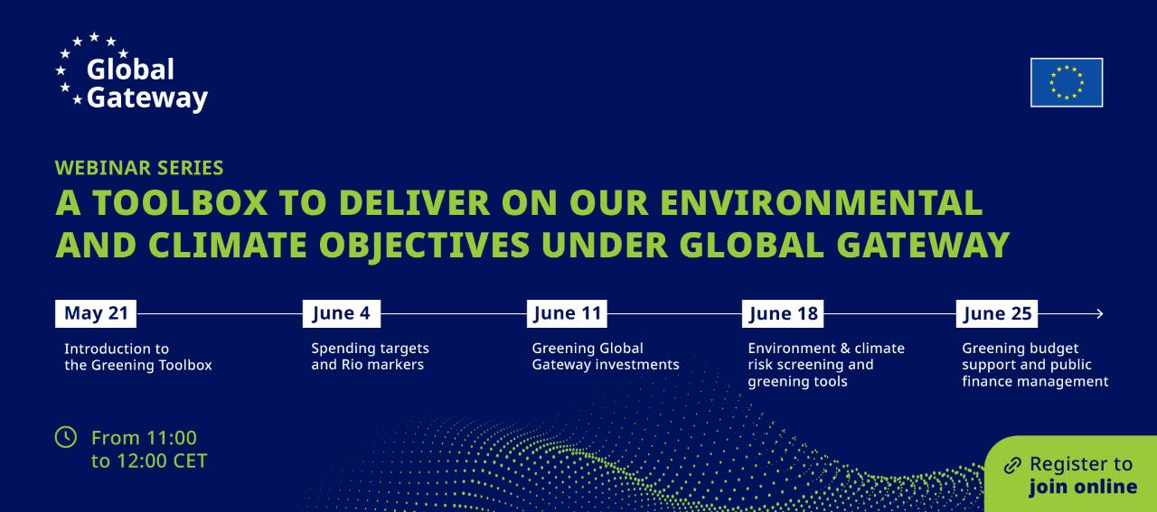



Slide 47
