Slide 1

Greening EU Cooperation
Greening country systems and policies through macro-fiscal actions and budget support
INTPA E1 – Gabija ZYMONAITE, Jean Bernard DE MILITO

Slide 2
Overview
1. Economic and fiscal impact of climate change
2. Greening PFM systems
3. Recap – Quiz (1)
4. Greening budget support
5. Recap – Quiz (2)

Slide 3
Economic & fiscal impact

Slide 4
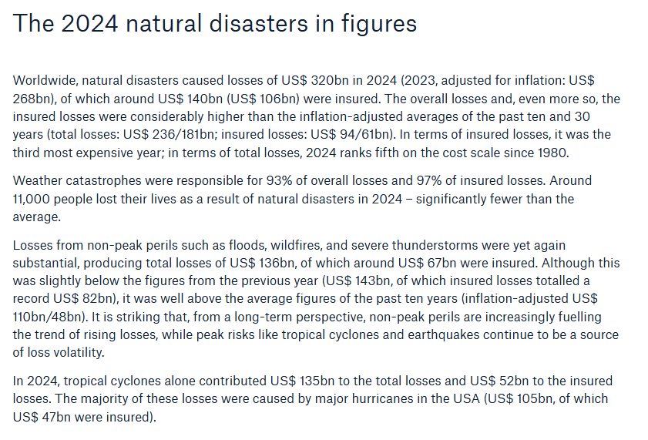
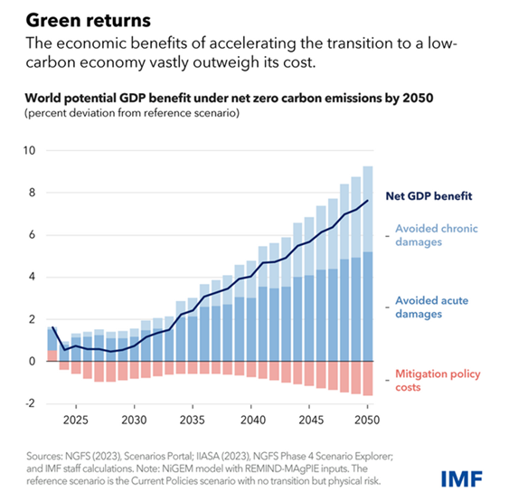

A macro-critical question
but
Source: munichre.com

Slide 5
Greening PFM systems

Slide 6
Greening PFM systems
WHY?
NDCs, SDGs ←→ government policies (climate/environmental impact, direct or indirect)
Expenditure side: national budget – a tool to achieve national policy objectives
Revenue side: fiscal space for policy implementation, incentives for behavioural change
Green PFM is the integration of an environment/climate-friendly perspective into PFM practices, systems, and frameworks (especially the budget process) with the objective to support fiscal policies that are responsive to environmental and/or climate concerns.

Slide 7
Greening PFM systems
WHERE ARE WE?
Green PFM practices remain nascent in most countries, including in advanced economies
60% of the OECD membership are not implementing any green budgeting (OECD, 2021)
Various diagnostics and studies carried out, but limited follow-up
Green taxation is already relatively widespread. Over 70 non-OECD countries having some green taxation in place

Slide 8
Greening PFM systems
WHAT ARE THE ENTRY POINTS?
Legal framework
4 stages of the budget cycle
Beyond the budget cycle (state-owned enterprises, sub-national governments)
Also, green taxation, removal of the harmful subsidies

Slide 9
4 stages of the budget cycle
Strategic planning and fiscal frameworks
Budget preparation
Budget execution and accounting
Control and Audit
Green dimension to be integrated into national development strategies, MTFF.
Fiscal risks – CC/ENV dimension to be considered
Green audits
CSO participation in the field of CC/ENV
Legislative oversight of « green » budgets and spending
Led by the MoF
Budget circular – key for sending a signal on the importance of CC/ENV issues
Environmental impact assessm.
Tagging climate related expenditure in the prep. phase
Integration of green aspects into medium-term budgetary frameworks
CC/ENV-related expenditure tracking (budget tagging)
CC/ENV sensitive green public procurement

Slide 10
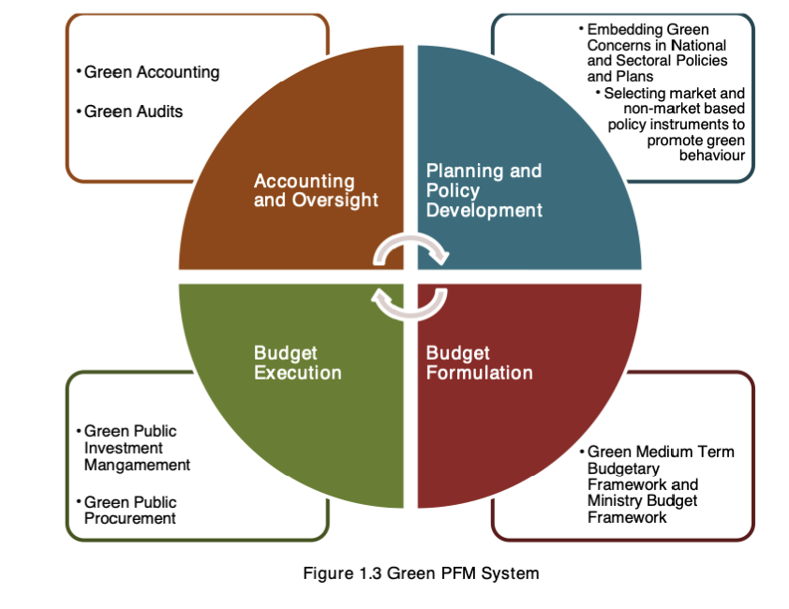
Example: Green PFM in Bangladesh
Priority on making economic growth sustainable
Recognises the value of natural assets
Standalone approaches at sector level (e.g., forestry) are not enough in the long run
Full embedding at each stage of the PFM system

Slide 11
EU’s support to greening PFM systems in partner countries. HOW?
Policy dialogue
Budget support
Support/encourage the use of relevant diagnostic tools
Dedicated projects
Working with international partners (WB, IMF, OECD, etc.);
  Global Public Finance Partnership (IMF)
  PFM-PP (IMF, financed by the EU)
  IMF Regional Capacity Development Centres
  Multi-donor Trust Funds (e.g. EUD Bhutan’s work through WB PFM MDTF)
INTPA Facilities: Macro-fiscal facility (E1); Greening facility (F2)

Slide 12
Relevant diagnostic tools (1)
With
EU
Support
PEFA Climate framework
PEFA secretariat
PIMA climate change module (C-PIMA)
Lead: IMF
MAPS Sustainable procurement module
MAPS secretariat (hosted at OECD)
PFM system readiness to support and foster the implementation of government climate change policies.
Key public investment management practices from the climate change perspective
Quality and performance of public procurement systems from social, economic and environmental point of view.
Other
Public Environmental Expenditure Review (PEER)
Lead: WB
Climate Public Expenditures and Institutional Reviews (CPEIRs)
Lead: UNDP
Climate change financing frameworks (CCFF)
Lead: UNDP
Government resource allocations, their efficiency and effectiveness in the context of environmental management framework and priorities. Identifies reforms needed
Opportunities and constraints for integrating CC concerns within the national and sub-national budget allocation and expenditure process
Aligning a country’s climate policy framework with its budgetary process and integrating climate finance into its existing PFM systems

Slide 13
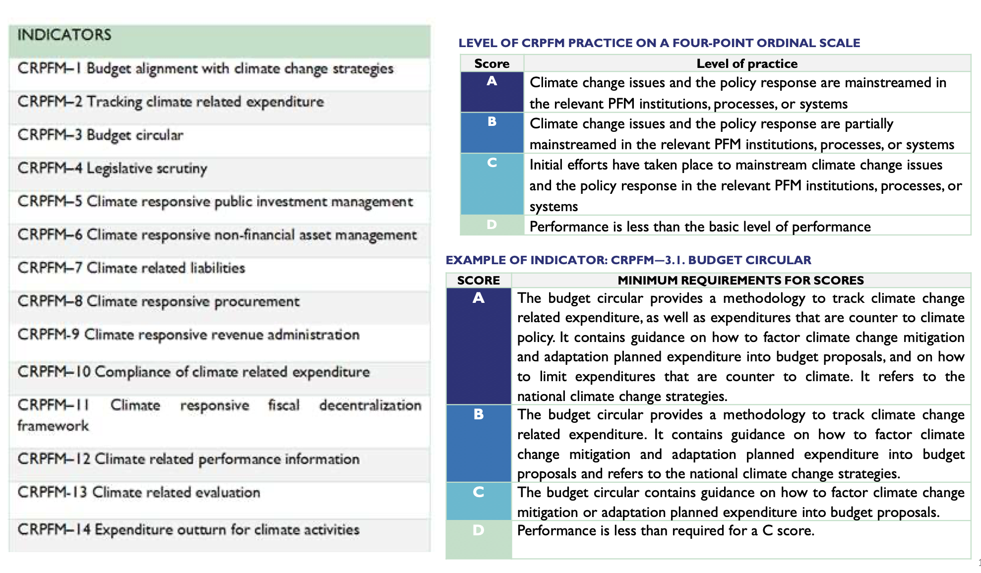
Relevant diagnostic tools (2)
Example: PEFA climate module

Slide 14
Projects to support green PFM/DRM in partner countries
Green PFM project, INTPA.E1 (with GIZ)
  Objective: support selected countries in introducing green fiscal reforms, covering both revenue and spending
  Countries of focus: Cameroon, Rwanda, Benin, Ghana, Malawi, Namibia, Zambia (Sub-Saharan Africa); Mexico, Central American Integration System (SICA) (Central America), Peru (Latin America).
  Project activities: Navigating Green PFM: a reference guide, methodology on designing green fiscal reforms, green PFM seminar in Kigali (Jan 2025), ongoing bespoke technical assistance (Ghana, Benin, Zambia)
Green PFM in South and South-East Asia, INTPA.C2 (with OECD)
  Objective: Improved integration of climate change, SDGs targets and gender mainstreaming in the budget cycle
  Countries of focus: Bangladesh, Bhutan, Cambodia, Indonesia, India, Laos, Malaysia, Maldives, Mongolia, Myanmar, Nepal, Pakistan, Philippines, Sri Lanka, Thailand, Vietnam.
  Project activities: in-person workshops, in-country knowledge sharing missions

Slide 15
Working with international partners:
Support to green PFM/DRM through EU Programmes with the IMF (1)
Global Public Finance Partnership (GPFP–EU contribution EUR 15M in 2024-29)
  Objective: Strengthening fiscal institutions and supporting public finance reforms through a comprehensive approach, covering both revenue and spending
  Beneficiaries: Open to LICs, LMICs and a small number of UMICs. Priority given to fragile and conflict-affected states and to LICs.
  Expected outputs: countries are supported in (a) reforming their public investment management systems through Climate Public Investment Management assessments (CPIMA) and capacity development to follow up on recommendations; (b) reforming their budgetary processes through green PFM and climate budgeting, (c) integrating climate change issues into their macro-fiscal frameworks, (d) implementing green taxation, among others.
  How to request for support: Demand-driven programme - authorities send their requests to the GPFP Secretariat.

Slide 16
Working with international partners:
Support to green PFM/DRM through EU Programmes with the IMF (2)
EU-IMF Public Finance Management-Partnership Programme phase 2 (PFM-PP2 – exclusively financed by the EU with EUR 8 mil. in 2024-29)
  Objective: Strengthening institutional capacity across core PFM and spending areas including improved fiscal policies and institutional frameworks to combat climate change and its impact. The program will provide tailored support based on IMF FAD’s analysis of green PFM framework, and the CPIMA
  Beneficiaries: PFM-PP2 focuses on fragile and conflict-affected states (FCS), low-income countries (LICs), and lower-middle income countries (LMICs)
  Expected outputs: C-PIMA assessment and follow-up, PFM climate policy diagnostic, climate mitigation policy Strengthen effectiveness of management and reporting of climate related fiscal risks …
  How to request for support: Demand-driven programme

Slide 17
Support to green PFM/DRM through INTPA’s facilities
Greening facility (F2)
  Objective: improved integration of environment, biodiversity, climate change and Disaster Risk Reduction (EBCD) in EU supported policies, programmes and investments
  Beneficiaries: INTPA HQ, EUD staff
  Expected outputs: a dedicated PFM expert to review new programmes, action documents, fiches. Possibility of short-term missions to support EUDs in programme design.
Macro-fiscal facility (E1)
  Objective: To enhance INTPA’s capacity to identify macroeconomic and fiscal challenges and support the design and implementation of appropriate macro-fiscal policies in partner countries
  Beneficiaries: Demand-driven support to INTPA HQ, EU Delegations and INTPA countries
  Expected outputs: analytical notes on selected issues, conferences, workshops, country missions

Slide 18
RECAP – QUIZ (1)
1. Which of the following tools is used to assess the readiness of PFM systems to support the implementation of government climate change policies?
  a) Climate Macroeconomic Assessment Program
  b) Public Expenditure and Financial Accountability (PEFA) Climate framework
  c) Global Public Finance Partnership (GPFP)
2. In which stages of the budget cycle can green PFM elements be integrated?
  S1 - Strategic Planning and Fiscal Frameworks and S2 - Budget Preparation
  S3 - Budget execution and accounting and S4 - Control and audit
  Green PFM elements can be integrated in all budget cycle stages

Slide 19
Budget support

Slide 20




Budget support: not just money!
Dialogue
Capacity building
  As budget/policy stakeholder
  Always encompassing macroeconomic, PFM/DRM and fiscal transparency (eligibility)
  All levels (technical > political)
Use of country systems
Requirements (e.g. costing/ monitoring)
Interministerial coordination
Dedicated technical assistance
Support/empowerment CSOs
Performance monitoring
Financial transfers
Indicators drawn from policies, or aligned with these at least
Outcome indicators if possible
Inclusive reviews, where possible
Use of country statistical systems
O
Ex post payment (i.e. after actions taken, costs incurred, reforms completed, result achieved)
Once and only if conditions met
No earmarking on the use of funds

Slide 21

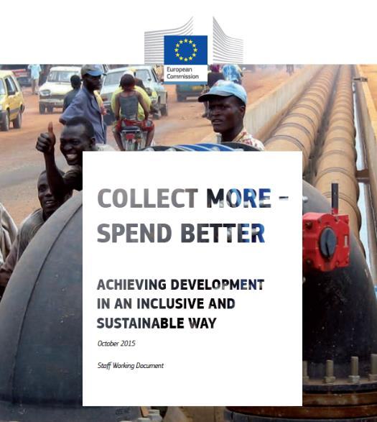

EU budget support for the Global Gateway
Relevant and credible development and sector policies: financing; legal and regulatory framework; capacities; investment component and maintenance costs; reporting and monitoring systems
Macroeconomic stability: fiscal policies (revenue and spending – recurrent and investment), debt sustainability
Public finance management & fiscal transparency:
tax and customs administration
budgeting (gender and green)
public procurement
public investment management
state-owned enterprises
public debt management
external control & anti-corruption
Enabling factors for successful investments, maximising their returns

Slide 22
Eligibility criteria are all greening entry points
Initial analysis
Design
Progress monitoring
Policy dialogue
SEA encouraged to help:
Assess policy relevance in view of CC, environment & biodiversity – also links with fiscal policies and PFM
Define dialogue priorities
Design the operation (specific objectives, source of verification for the general conditions, indicators)
Identify capacity development needs
National/sectoral policies and reforms
Macro-economic policies
Public finance management
Transparency and oversight of the budget
Useful inputs also to find in the Risk Management Framework +

Slide 23
Policy analysis – sector, macro-fiscal, PFM
Does the sector/development policy meaningfully address environmental and climate issues? Coherence with ambitions/commitments?
What are the policy implementation likely impacts to the environment and to climate resilience? Adequate measures to avoid/minimise them?
Does the policy take up opportunities to contribute to low carbon development, and thus to the transition to a greener economy?
Can we count on official and public data to monitor progress?
Administrative/institutional capacities? HR? PFM issues (e.g. natural resource management)? Interministerial coordination? Local entities involved?
Financing constraints factored in? Link up policy costing/sector medium-term expenditures and country fiscal framework (revenue, spending)? – Improving relation between MoF and line ministries (budgeting)? Does it incentivise private investments where relevant and possible?
Priorities
Credibility
Relevance

Slide 24
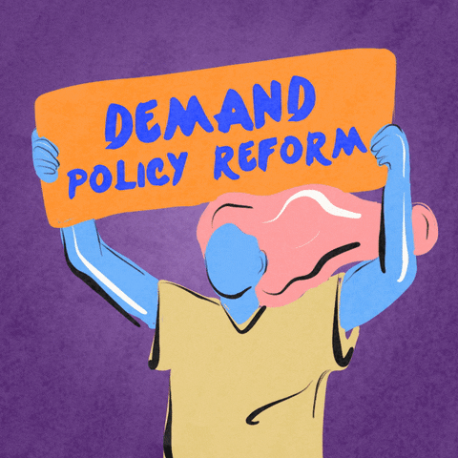
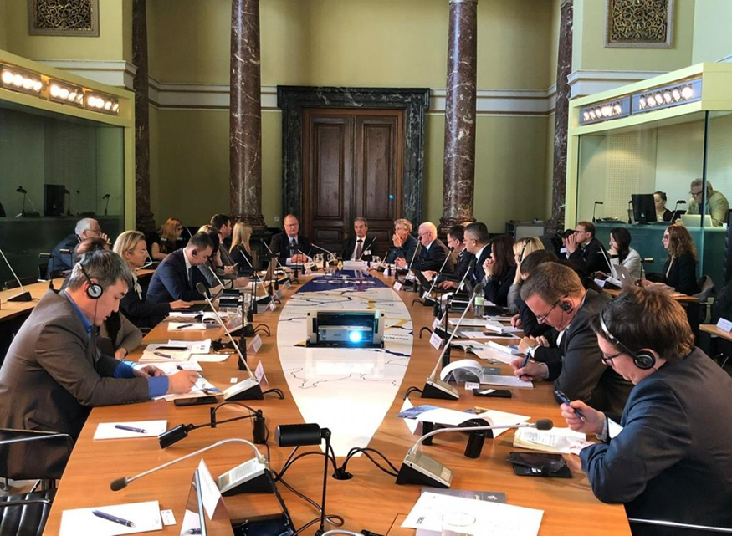
Transparency matters
  Communication to explain reforms and transparency to feed domestic accountability
  Disclosure of subsidies and tax expenditures with their costs, beneficiaries and environmental assessment in budget documentations (e.g. tax holidays on large farms or plantations, mining, forestry, water pricing, energy pricing, types of transport)
  Open and inclusive policy dialogue (whole of government and non-state entities) with transparency on results and challenges
  Empowering regulatory agencies, control bodies (e.g. performance audit) and civil society
  Fostering open public-private sector dialogue (hearing from local SMEs and business associations)

Slide 25
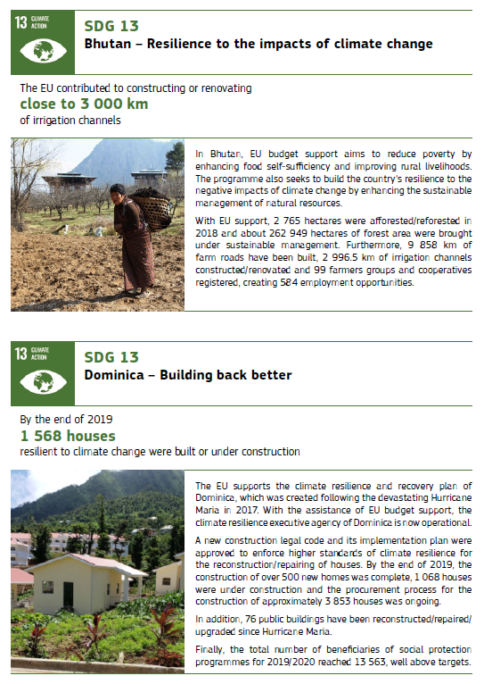
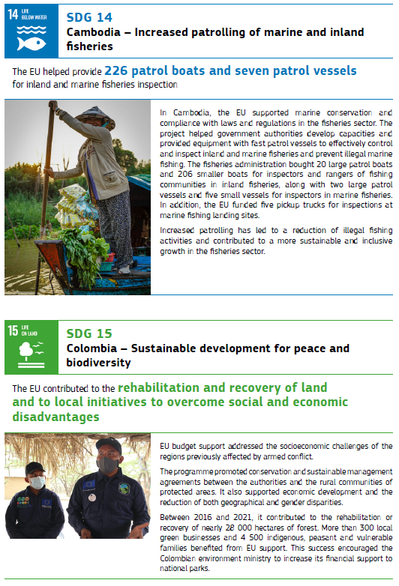
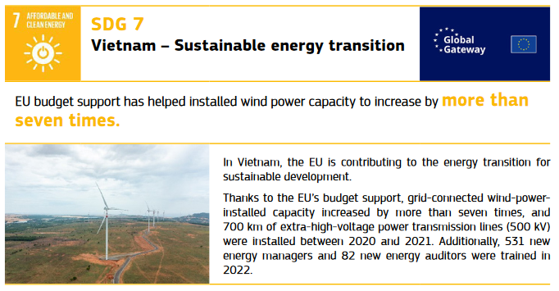
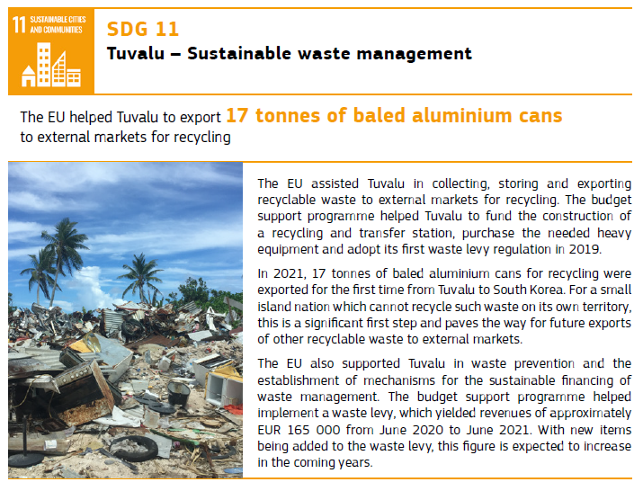
Promoting policy results

Slide 26
RECAP – QUIZ (2)
  As a policy- and result-based instrument, a budget support operation can help greening EU cooperation through:
    Variable tranche indicators
    The public policy that it supports and the other 3 general conditions (macro, PFM, transparency)
    The public policy that it supports, the other 3 general conditions (macro, PFM, transparency) & variable tranche indicators
  Greener policies are promoted through:
    Dedicated sector reform performance contracts in relevant policy fields i.e. biodiversity/forestry protection; energy; climate change mitigation
    All types of budget support operations to the maximum extent, even in the case of State and Resilience Building Contracts

Slide 27
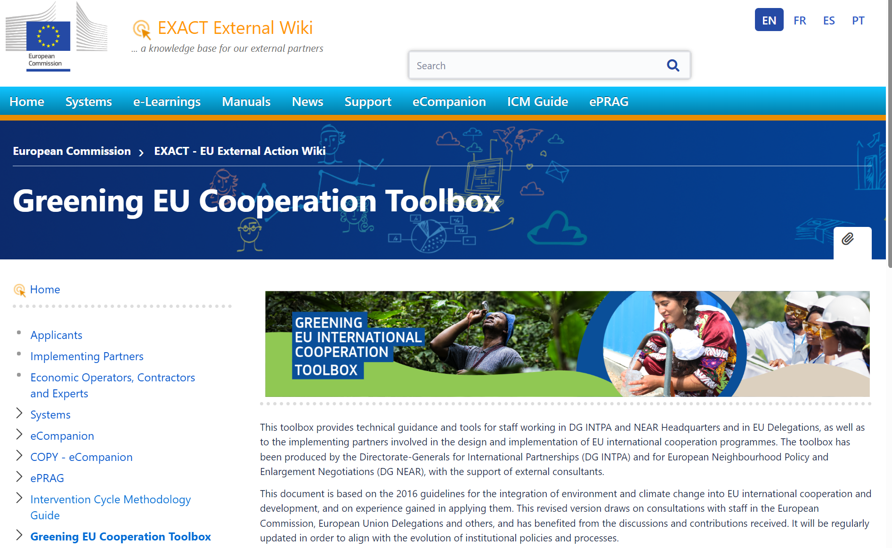
The Greening EU Cooperation Toolbox
Online tool
EXACT External Wiki - EN - EC Public Wiki
PDF document
Capacity4dev

Slide 28
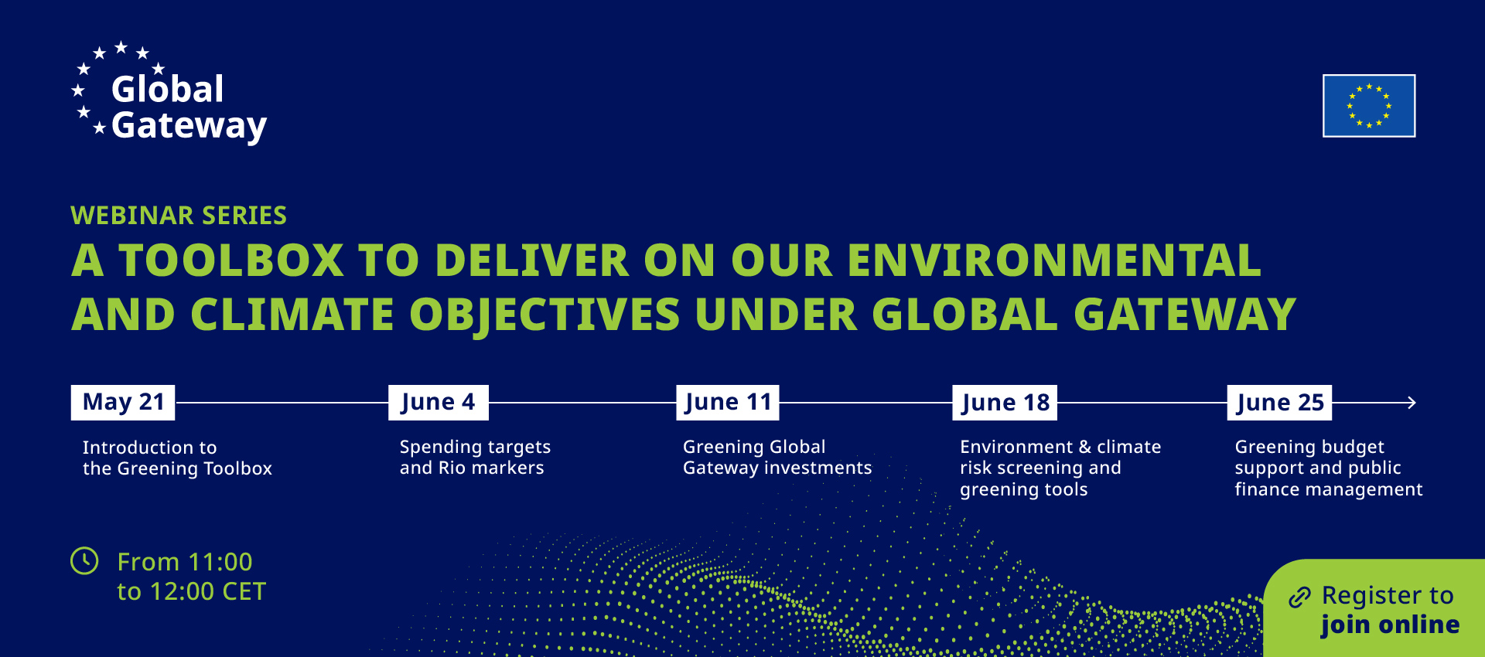



Slide 29
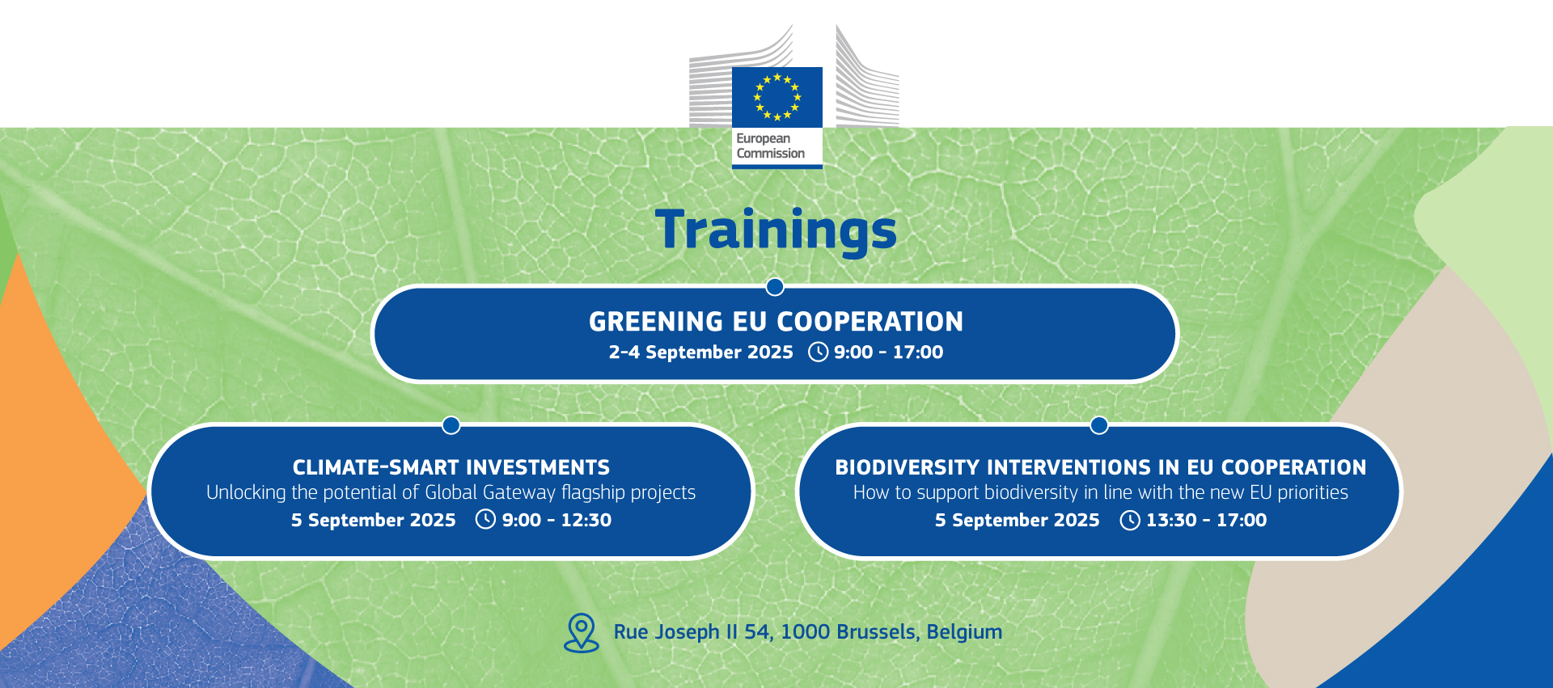

Slide 30
Thank you
Useful links:
Webpage with budget support guidelines
INTPA E1 intranet page with technical e-notes on Green PFM, Green taxation, Green taxation and development, Green Budgeting in the context of the Global Gateway
Climate module of the Public Expenditure and Financial Accountability framework (PEFA)
Methodology for Assessing Procurement Systems (MAPS)
Climate-Public Investment Management Assessment (C-PIMA)
IMF’s Climate-Sensitive Management of Public Finances—”Green PFM”
IMF – How to Make the Management of Public Finances Climate-Sensitive–“Green PFM”
Joint EU-IMF-OECD publication “Green Budgeting: Towards Common Principles”
UNDP/IIED – Global Climate Public Finance Review
EC-GIZ Navigating Green PFM: a reference guide

