Slide 1
Public Financial
Management (PFM) reform virtual training
Day 1 – Approaches to PFM Reform

Slide 2
Start
Welcome (+ Introduction trainers)
Housekeeping rules
Test in
Introduction participants and identify familiar country (mural)
Notes:
This last bullet will be presented on Mural

Slide 3





Housekeeping Notes
Our daily sessions are scheduled to last 4 hours (breaks included).
Make sure to have a headphone connected to your computer, the sound will be better.
Please mute yourself when not talking.
During the training, you can use the chat box to drop questions to the trainers.
For all technical related issues, please send a private message to the LINPICO team.
Keep next to you a good coffee and a bit of patience, sometimes technology is not perfect.
Notes:
Other housekeeping notes can be:
You are invited to turn on your camera when talking;
Please mute yourself when not talking;
Please signal via the chat if you would like to say something during the discussion;
Please state your name, country and the institution/unit you work for.
Please note that, with your approval, the meeting will be recorded for internal purposes.
Or:
Please make sure:
You have a good internet connection and the webcam ON;
You keep next to you a good coffee and a bit of patience, sometimes technology is not perfect;
You have a notebook where to take notes;
You have your phone next to you (we might use it);
You have a headphone connected to your computer, the sound will be better.

Slide 4
Test-in
Dear participants,
please refer to chat box for completion of the test-in survey

Slide 5
Introduce yourself and a country you are familiar with (on Mural)
Name country you are familiar with
State main problems you feel the country has
State what you think the main changes needed for PFM system
State what you think the country wants from the development partners
Notes:
This will be presented on Mural

Slide 6
PFM reform - Course Objectives
To provide tools for understanding, analyzing and sequencing Public Finance Management (PFM) reform
To introduce the importance of and rationale for sequencing and scheduling PFM reforms
The course is centred around PFM at the level of the central government administration
Notes:
2 objectives and one comment.
It further needs to be mentioned that the coverage of a PFM system is the general government, including Sub National Governments (SNGs).

Slide 7
Day 1: Approaches to PFM Reform
  Module 1.1. PFM introduction (basics)
  Module 1.2. SDGs, aid effectiveness and use of country systems
  Module 1.3. The Challenge of PFM reform
Notes:
Module 1.1 is some repetition of PFM1 training.
Explain also the programme for day 2, 3 and 4 (with extensive case studies and exercises).

Slide 8
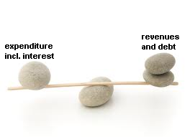
What is PFM?
PFM deals with management of public resources: the allocation and use of resources collected from the economy
3 basic elements of public finance:
  Public expenditure
  Revenues
  Government debt
Notes:
There should be some balance between the expenditure and the revenue. If the expenditure are higher than the revenue, it will often lead to an increase in debt. This debt should be sustainable.
Be aware: animation
Ask:
what is relationship between 3 elements?
When is a debt sustainable? (e.g. EU Maastricht Treaty: gross debt lower than 60% of GDP)
What is link to current situation? (increasing interest rates, high inflation, increasing health expenditure, etc.)

Slide 9
What is the Government?
General government comprises all government units
  Central government
  State government, in federal countries
  Local government
Public sector also includes, corporations and quasi-corporations controlled by the government units
Notes:
Central govt. versus General Govt. versus Public sector

Slide 10
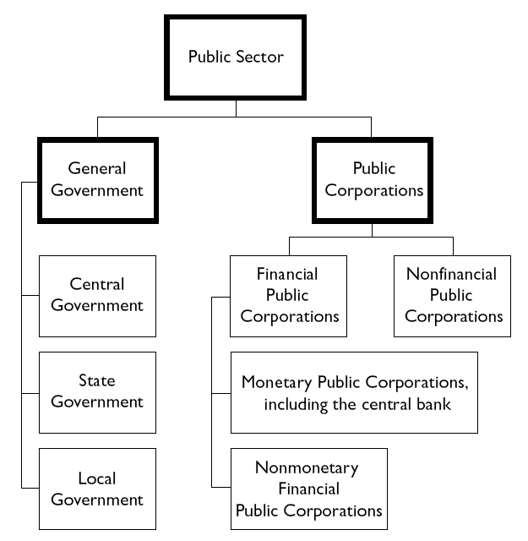
Source: Government Finance Statistics (GFS). IMF
Notes:
Central government is composed of budgetary, extra-budgetary and social security funds

Slide 11
The purpose of PFM
PFM systems help:
Implementing public policies
  e.g. macroeconomic policies to create stability, taxation policies or policies to achieve the Sustainable Development Goals (SDGs)
Controlling management of resources and limiting fraud, waste and corruption
Notes:
Also social policies

Slide 12
Independence from policies
PFM system is independent from public policies
But only in part
  PFM capacity and systems will limit/affect policy choices and reform sequencing
  Approaches that are adopted regarding PFM are in part influenced by societal choices and public policy objectives
Notes:
Pipeline/tube: input = money and policies; output = outputs, outcomes and impact (results)
To limit policy choices: e.g. complex tax measures not possible if PFM capacity is weak.
Last bullet: the government might develop systems to restrict misuse of social security benefits or refrain from it. This also depends on how this is assessed in society. E.g. if society does not reject misuse of social security benefits, than it is unlikely that the PFM system will combat this. There is a close relationship between what happens in the public sector on the one hand and in society and the private sector on the other.

Slide 13
The objectives of PFM - reminder
Objectives of ’traditional’ approach
Financial compliance (budget discipline)
Compliance (to rules and regulations)
Objectives of ‘modern’ performance-oriented approach
Aggregate fiscal discipline
Strategic allocation of resources in compliance with public policy objectives
Efficient delivery of public services
Notes:
Traditional, compliance oriented versus performance oriented
The difference between financial compliance and compliance to the rules: the first one focuses on the budget law while the second is more general compliance to all formal rules and regulations.
Explain the distinction between financial compliance and aggregate fiscal discipline: The first has a narrow focus mainly within one year that the budget deficit is not too large. In the latter the focus is broader, more on macro-economic stability and sustainable deficits in a multi-year perspective.

Slide 14
‘Traditional’ budgeting
Focus on inputs & means
Strengths
  Ensuring basic processes
  Building a culture of discipline and compliance
Weaknesses
  As a general rule, little consideration is given to public policies and their results
  Often, heavy bureaucratic processes
Notes:
Focus on economy, controls and due processes. The MOF may perform tight control on spending
Example: centrally planned economies such as the former Soviet Union.

Slide 15
Modern ‘Performance-oriented’ budgeting
Focus on output/efficiency and/or outcome/effectiveness
Strengths:
  Reflect the actual objective of budgeting
Weaknesses:
  Require solid institutional frameworks
  Effectiveness depends on country context
Notes:
Budgeting for results
Aimed at better achieving the 3 objectives of PFM
Different orientations depending on the focus: output/efficiency or outcome/effectiveness.
However their effectiveness depends on the country context.
Solid institutional frameworks: partly created by traditional budgeting (external control and compliance focus).

Slide 16
Process of public service provision & aspects of performance
The concept of performance
Effectiveness (fulfil objectives) and efficiency (be productive) – take into account quality
Notes:
Explain the difference between traditional approach and the performance oriented approach
Performance oriented: full chain

Slide 17
Three objectives of PFM
Outputs/
Efficiency
Aggregate fiscal
discipline
Allocative
efficiency
Operational
efficiency
  Is there a hierarchy amongst the 3 objectives?
Outcomes/
Effectiveness
Notes:
Ask:
why the interrelationship?
why aggregate fiscal discipline at the top?
Fiscal discipline: level of MoF
Allocative efficiency: level of line ministry
Operational efficiency: level of line manager (within line ministry)

Slide 18
PFM objectives and budget cycle
PFM objectives
Policy Review
1 - Aggregate Fiscal Discipline
Reporting &
Audit
Strategic Planning
2 - Efficient resource allocation
Accounting &
Monitoring
Budget Preparation
3 - Operational efficiency /
value for money
Budget Execution
18
Notes:
i.e.: Value for money = operational efficiency
Explain the budget cycle and the impact of the 3 objectives on the different phases of this cycle.
Budget preparation: 1 and 2
Budget execution: 1, 2 but especially 3

Slide 19
Hierarchy amongst the three PFM objectives
Objectives of PFM are interdependent, but:
Maintaining an adequate level of fiscal discipline (sustainability) is a necessary pre-condition to safeguarding other objectives
Without fiscal discipline, there is no accountability, public policy choices may not be respected and there is no efficiency
Without overall budgetary discipline it does not make sense to prioritize
Notes:
Without fiscal discipline, the sky is the limit and no choices have to be made. Then there is no reason to allocate in a efficient manner.

Slide 20
Key messages
The main objectives of modern PFM:
  Aggregate fiscal discipline
  Strategic allocation of resources
  Efficient provision of public services
PFM reforms aim at moving:
  From: traditional approach of legal compliance
  To: a modern approach with greater efficiency and accountability of public finances

Slide 21

Short exercise:
Scoring policy measures which help to achieve PFM objectives or undermine them
Score each of the policy measures:
Which PFM objective does this measure helps achieving?
Which PFM objective might this measure undermine or conflict with?
Use the A to E numbering from the next slide

Slide 22
The objectives of PFM
Objectives of ‘modern’ performance oriented approach
Aggregate fiscal discipline
Strategic allocation of resources
Efficient delivery of public services
Objectives of ’traditional’ approach:
D. Financial compliance (probity, regularity)
E. Compliance to rules and regulations

Slide 23
Exercise (mentimeter): example
 | Supports | Possible Undermines
Freezing spending in a cash crisis
A
B/C

Slide 24
These 6 questions have been put in mentimeter
 | Supports | Possible Undermines
Ex ante control of commitments by MoF | A/D | C
Making virement rules (transfer between budget titles) more flexible | B/C | D
Establishment of extra-budgetary fund for certain pro-poor activities | (C) | B/E
Notes:
Extra-budgetary is also project aid
Third statement (5-6 question) to be decided whether to be conducted depending on the group level.

Slide 25
Day 1: Approaches to PFM Reform
  Module 1.1. PFM introduction (basics)
  Module 1.2. SDGs, aid effectiveness and use of country systems
  Module 1.3. The Challenge of PFM reform

Slide 26

SDGs
According to the United Nations:
The Sustainable Development Goals (SDGs) “are the blueprint to achieve a better and more sustainable future for all”
Notes:
They address the global challenges that the world faces:
poverty
inequality
climate change
environmental degradation
peace and justice

Slide 27
Link to SDGs 16 and 17 and Aid Effectiveness to allow use of country systems

Slide 28
The Strengthened Approach to Supporting Public Financial Management Reform
embodies three components agreed in the five high level meetings in Rome (2003), Paris (2005), Accra (2008), Busan (2011) and Mexico (2014):
a country-led agenda; a government-led reform program for which analytical work, reform design, implementation and monitoring reflect country priorities and are integrated into governments' institutional structures;
a coordinated program of support from donors and international finance institutions - in relation to both analytical work, reform financing and technical support for implementation;
a shared information pool on public financial management - information on PFM systems and their performance which is commonly accepted by and shared among the stakeholders at country level, thus avoiding duplicative and inconsistent analytical work
Notes:
Bullet 3: Government’s institutional structures are PFM includes PFM.
Bullet 4: shared information pool, mainly PEFA and other shared tools.

Slide 29
The Busan Partnership for Effective Development Co-operation (2011):
The partnership signed by 160 governments and 50 other organisations
https://www.oecd.org/dac/effectiveness/49650173.pdf
Notes:
Busan Partnership primarily focus on reforms in PFM. It provide a more elaborated framework how to implement these reforms.
Puts Paris Agreement content into context of PFM.

Slide 30
SDG Indicators directly referencing PFM issues
SDGs:
16.5 - Reduce Corruption
16.6 - Develop Accountable and Transparent Institutions
  16.6.1 – Proportion of Expenditure as proportion of original approved budget
Notes:
The SDG video is 1,24 minutes

Slide 31
Importance for democratic improvement and scrutiny
This video presents the central role of government budgets in addressing global development challenges and links civil society budget advocacy to better policies, implementation, and outcomes for people (international budget partnership)
Watch this video when you get back to the office
https://www.youtube.com/watch?v=PkNVY5hN4Mw&list=PLQ1WGH8_cXF8W4jBeav3ETBzrkIvymQlJ&index=2
Notes:
PFM reforms is for the people and therefore civil society is one of the most important groups to hold the government to account and to ensure that marginalised groups are serviced.

Slide 32

Collect More – Spend Better:
An EU Approach to help countries to better mobilise domestic resources
The document outlines core elements to expand fiscal space and to support developing countries in three critical areas:
Improved domestic revenue mobilisation
More effective and efficient public expenditure
Debt management
Notes:
Busan also aims to build up domestic resources.

Slide 33
Evaluation of EU Collect More Spend Better
(2015-2020)

Slide 34




Conclusions

Slide 35
Effectiveness of EU CMSB support
C11 > C16 EU contribution to PFM reinforcement: significant progress achieved, that remains to be consolidated for bringing about outcomes |  | A more systemic approach to PFM reforms
EU contribution to PFM reinforcement: significant progress achieved, that remains to be consolidated for bringing about outcomes |  | Strengthening tax administration systems
 |  | Introduction of programme budgeting and results-based management, including medium term budgeting
 |  | Improving transparency and accountability and reinforcing the fight against corruption
 |  | Rolling out PFM reforms in priority sectors (agriculture, education, health, and justice), including social protection
 |  | No evidence of systemic improvements in the budget execution cycle, except for some stages (internal audit and expenditure control stages)
 |  | Limited support for the development of statistical and M&E systems
 |  | Less EU attention on public investment than might have been expected
 |  | Very limited involvement in the financial management of state-owned enterprises

Slide 36
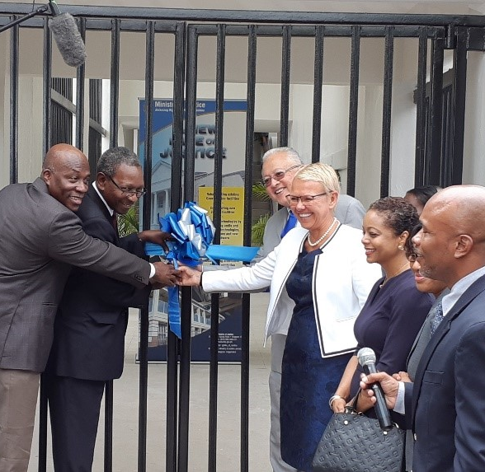
Recommendations

Slide 37

Strengthen EU global strategic approach in DRM, PFM and debt management
R2 | While maintaining a demand-driven approach, prioritise EU support in CMSB areas where the EU has a comparative advantage.
 | Prioritise support in the area of transparency and accountability, with a multi-stakeholder approach that is more explicitly linked to the fight against corruption. Give greater importance to public service delivery, with a focus on fiscal and budgetary management within sector ministries and deconcentrated and decentralised authorities, especially in areas targeted by the Global Gateway. Focus more on public investment management, public procurement and debt management within the framework of the support developed by the EU to boost investment, including public-private investment.

Slide 38
Examples – PEFA Pilots

Slide 39
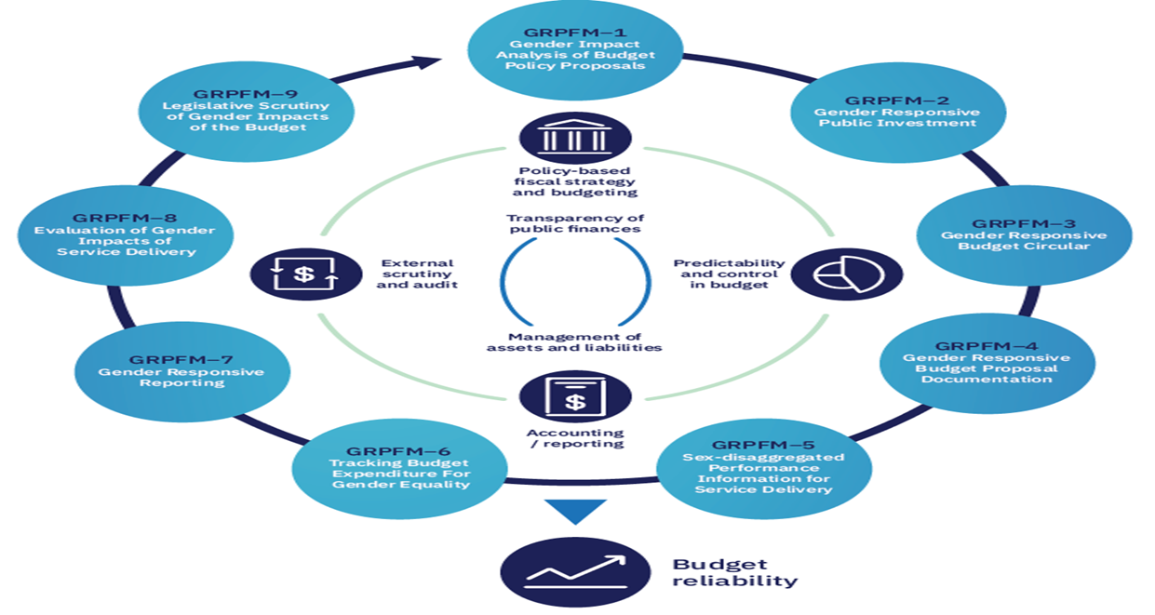
SDG 5 – Gender Equality – Example PEFA Norway 2020
Notes:
Link to budget cycle.
PEFA pilots: SDG 5 (gender) and SDG 13 (climate)
e.g. Ukraine gender PEFA in 2021.
Embedding SDGs in PFM system.

Slide 40
Gender Action Plan – putting women and girls' rights at the heart of the global recovery for a gender-equal world
85% of all new actions throughout external relations will contribute to gender equality and women’s empowerment by 2025
Shared strategic vision and close cooperation with Member States and partners at multilateral, regional and country level
GAP III calls for accelerating progress, focusing on the key thematic areas of engagement
Leading by example
Measuring results
https://eeas.europa.eu/headquarters/headquarters-homepage/89112/gender-action-plan-iii-towards-gender-equal-world_en
Notes:
GAP = Gender Action Plan.

Slide 41
SDG 13 – Climate Action
Watch this clip of pilot PEFA assessment on climate responsiveness
https://www.pefa.org/news/samoa-first-country-pilot-test-pefa-climate-module
Notes:
Time of video 1.03 minutes

Slide 42
Day 1: Approaches to PFM Reform
  Module 1.1. PFM introduction (basics)
  Module 1.2. SDGs, aid effectiveness and use of country systems
  Module 1.3. The Challenge of PFM reform

Slide 43

The challenge of PFM reform
Notes:
You have to deal with resistance….(sumo wrestler)
We explain in the next slides why

Slide 44
The challenge of PFM reform
Which obstacles to PFM reform do exist?
Technical solutions can be copied from international good or best practice, but implementation is challenged or impeded by:
Capacity constraints
Political factors
Complexity
Notes:
Be aware: animation.
Ask: what are the main challenges?
1, 2 and 3 explained in next 3 slides.

Slide 45
The challenge of PFM reform
1. Capacity constraints
A well qualified public administration will make PFM reform more achievable
Challenges:
Education in general and training in PFM in particular
Salaries in the public sector to retain the best officials
Notes:
Risk of high staff turnover
Capacity building – competence based training (not sending staff abroad for a PhD).

Slide 46
The challenge of PFM reform
2. Political economy of PFM reform
Technical improvements can help resolve capacity constraints …
… but political incentives often explain why there is resistance to change
For example:
Moving internal audit to an ex-post function
Clearance of payment arrears
Payroll management
Notes:
Technical reforms are much easier to achieve than institutional and behavioural change.
Vested interests

Slide 47
The challenge of PFM reform
3. Why is PFM Reform complex?
Notes:
A PFM system is a series of connected subsystems. The interrelated sub-systems makes reform extremely complex.
One part might be working against other parts and a reform and improvement in one part does not lead to better results. For the latter, often a number of preconditions needs to be fulfilled e.g. successful external audit requires independence of the auditor, timely annual accounts and audits and (timely) follow up by management (ministries). Link to PEFA.

Slide 48
PFM reform
Change | Functional | Political
Internal
External
Increasing risk
Notes:
Increasing risk of failure.
Internal functional reforms are easy to execute but….
Functional = technical; political = institutional
External: other players outside MoF or public service are involved.

Slide 49
PFM reform
 | Functional | Political
Internal | Strategy, systems, structures, work processes, internal relationships (reporting format, budget classification, etc.) | Leadership, power distribution, material and nonmaterial incentives, rewards and sanctions, vested interests, conflicts
External | Legal framework, timeliness and adequacy of resources, results-based performance targets, oversight bodies, formal accountability requirements | Political governance, pressure from clients, customers, competitors, media attention, civil society & public watch dogs
Notes:
Internal: within MoF or public service

Slide 50
PFM reform process in practice
optimal
Institutional / Political
Better public service delivery, sound macro-economic & social development
Real?
planned
crisis
Technical / Functional
Notes:
Be aware: Animation
Reform in practice is never a straight line.
Adaptive process, learning by doing.
Only technical reforms will not lead to improved performance.

Slide 51


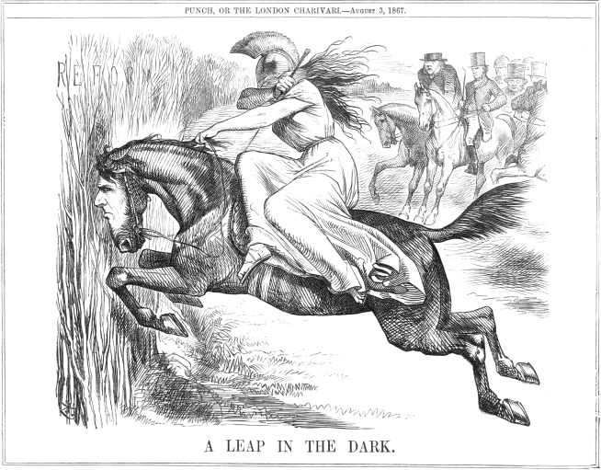
Improving a PFM system
Improving performance of a PFM system usually requires a mix of three different approaches:
Strengthen compliance
Improve functioning of systems
Reform
Notes:
In practice, a PFM reform strategy is a mix of all three of them.

Slide 52

Improving a PFM system
Strengthen compliance with existing systems:
Better use existing manuals, systems and procedures
Provide training and coaching on existing systems and procedures
Based upon internal and external audit reports

Slide 53
Improving a PFM system
Improve functioning of systems
Improve manuals, IT systems and procedures
Provide training on improved systems and procedures and new tools
Based upon systems audits (matrix of corrective measures)
Notes:
Still existing PFM systems.

Slide 54
Improving a PFM system
Reform of PFM systems
Change laws, regulations, contracts and tender documents, manuals
Change institutional arrangements
Introduce PFM reform management structures
Build capacity including new skill sets
Based upon diagnostic studies and assessments
Notes:
More fundamental
Leap in the dark: insecurity.

Slide 55
Improving a PFM system - summary
Relative importance of each approach depends on the country context
PFM systems should be constantly improving and evolving
Only periodically is this a real reform process
Notes:
A PFM reform strategy contains a mix of the three approaches.
To implement a reform strategy successfully takes 5 to 10 years on average for developed countries.

Slide 56
PFM Reform: Public Financial
Management – Advanced virtual training
Day 2 – Developing a reform strategy - 1

Slide 57
Wrap up of day 1
    What do you remember from yesterday? (open discussion)
      Objectives of modern PFM?
      Focus of modern PFM?
      Main challenges of PFM reform?
57
Notes:
Asking participants directly (by mentioning names).
Focus of modern PFM: result orientation i.e. full chain = input-output-outcome-impact
Main challenges: Capacity, Political economy and complexity.

Slide 58
Day 2: Developing reform strategy -1
  Module 2.1 Conditions for successful reform
  Module 2.2 The Public Expenditure & Financial Accountability (PEFA)
  Module 2.3 PFM diagnostic tools
  Module 2.4 Sequencing of reforms (part 1)
58

Slide 59
Objectives of the module
Many reform programmes do not achieve expected results
This module identifies some of the causes for failure or difficulties, and examines the conditions for success

Slide 60
Conditions for successful PFM Reform
Possible causes for failure or difficulties
The conditions for a successful reform
Beware of pitfalls

Slide 61
Possible causes for failure (1)
Reforms carried out without a strong internal demand (e.g. reforms pushed by an external party):
Little political support
External parties &/or political push for reforms, but resistance from administration
Reform measures are technically questionable:
  Copying a more advanced & complex reform from another country (‘best practice’) - not viable in country context
  Technically questionable measures (e.g. Sectorial MTEFs not compliant to financial constraints)
  Over ambitious targets

Slide 62
Possible causes for failure (2)
Insufficient capacity
  Institutional capacities: separation of Plan and Finances, difficult Finance-sectors relations, etc.
  Human Resources
Insufficient reform steering mechanisms
  Fragmentation of the steering force
  Poor co-ordination of capacities (e.g. Timing of IT projects not aligned to PFM reforms)

Slide 63
Facades of reforms
Formal procedure for drafting budget have been modernised, but systems stays flawed
Budget as theatre: ‘Formal & informal institutional makings of budget process in Malawi’ (DFID 2004)
“Reforms” that seek solely to satisfy external pressures or to comply to a trend
Potemkin Villages: 'The Medium-Term Expenditure Framework in Developing Countries’ (Schiavo-Campo: Public budgeting and finance, Summer 2009)
Notes:
Political economy needs to be well understood.
Formal procedures might have been changed but in practice behaviour is the same.
Potemkin villages: building a façade only, no real change. Potemkin was first minister for Katherine the Great (Russia). He built only facades of villages to cheat her.
MTEF these days pretty sound in most countries

Slide 64
Conditions for successful PFM Reform
Possible causes for failure or difficulties
The conditions for a successful reform
Beware of pitfalls

Slide 65
Conditions for success: Gleicher’s equation
SDxVxFS>R
Shared dissatisfaction
(Shared) Vision
First successful steps (Quick wins)
Resistance to change (R)
There must be:
SD>0 dissatisfaction regarding current system
V>0 a vision
FS>0 visible short-term gains
Combination of SD, V, & FS must overcome resistances
Notes:
Find common grounds.
Quick wins: low hanging fruits, mainly technical in nature because they don’t threaten the power relations.

Slide 66
Discussion point:
Shared dissatisfaction and vision?
Discuss key issues from Mural exercise from day 1
For the country with which you are familiar (i.e. the one you chose in the icebreaker this morning)
Enter the shared vision for PFM system held jointly by the Development Partners and the Government
If there is no shared vision state “No Shared Vision”

Slide 67
Exercise (mentimeter, no more than 3 answers):
Shared dissatisfaction and vision?
For the country with which you are familiar (use the one you chose in the introduction)
Enter the shared vision for PFM system held jointly by the Development Partners and the Government
If there is no shared vision state “No Shared Vision”

Slide 68
Conditions for success: what does experience tells us? (1)
Three conditions:
  Strong political commitment to implement reforms
  Reform conception & implementation models adapted to institutional context & capacities
  Strong coordination arrangements, carried out by government representatives in order to monitor and stir the reform

Slide 69
Conditions for success: what does experience tell us? (2)
Strong technical leadership important: helps in a context of political commitment, but does not replace it
External pressure (civil society, donor, etc.) may strengthen political commitment, but not enough to create it
Learning process is necessary, in order to adapt reform conception & implementation models
Influence of NGOs & legislative power must not be overestimated
Notes:
Technical leadership: MoF
Political leadership Prime Minister’s office

Slide 70
Donor support: what effect? cf. Lawson
Considerable influence in countries benefitting, or if external resources are funding a government programme
Attempts to openly influence contents & rhythm of reforms through ‘conditionality’ have been inefficient & often counterproductive
Efficient only if focuses on specific & clearly defined objectives
Many reform programmes suffer from bad advice & promotion of inadequate reform models from external agencies
Notes:
Not too many conditionalities or to predictive and aggressive.

Slide 71
Conditions for successful PFM Reform
Possible causes for failure or difficulties
The conditions for a successful reform
Beware of pitfalls

Slide 72





Should leading edge practices be imported ("best practice")?
.
Notes:
Lamborghini or Lada?

Slide 73
Other pitfalls
Promptness does not mean efficiency
  Reform is a long-term, continuous process
  Deadlines should not be too short & must take into account that similar reforms took years in more developed countries
Accumulation of micro-measures is not equal to reform
‘Reform fatigue’ may develop, or scepticism due to changing recommendations
Notes:
Speed is only beneficial if it reforms happen in an efficient manner.

Slide 74



An accumulation of techniques may create the illusion of reform, but does not constitute a real reform
Improved Tax Registration
programme budget !
Two performance contracts !
… I carried out a lot of reforms today !
One regulatory law!
New Audit Manual
"

Slide 75
Key messages
Success of a reform relies on strong national commitment & country’s capacity to respond to dissatisfaction with PFM
Reforms must be adapted to country context: unlikely to be successful if mechanical copies of “good practices”

Slide 76
Day 2: Developing reform strategy -1
  Module 2.1 Conditions for successful reform
  Module 2.2 The Public Expenditure & Financial Accountability (PEFA)
  Module 2.3 PFM diagnostic tools
  Module 2.4 Sequencing of reforms (part 1)
76

Slide 77

What is the PEFA Programme?
Public Expenditure & Financial Accountability
Objective:
Results orientation in development of PFM systems
Harmonization of PFM analytical work (part of ‘Strengthened Approach’ included in Paris Declaration with shared information pool)
Established:
  Established in 2001 by seven agencies
  Contributing to development effectiveness: builds on the “Addis Ababa Action Agenda” (Third International Conference on Financing for Development)
Notes:
Results orientation discussed on day 1.
Harmonisation: (Paris declaration)donors coordinate, simplify procedures and share information to avoid duplication.
Strengthened approach: shared information pool

Slide 78

What is the PEFA Programme?
  Global Report on PFM, 2022 (showing and comparing PEFA scoring of countries)
  PEFA EXPLAINER VIDEO
Notes:
Global Report on PFM: annually updated.

Slide 79
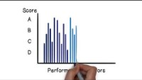
Notes:
Click the button to start the explainer video.

Slide 80









Who are the nine PEFA Partners?
Notes:
Two new partners joined in 2019: Slovak Republic and Luxembourg.
UK will step down in June 2023.

Slide 81
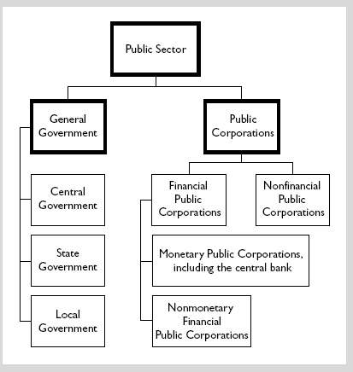
The PEFA diagnostic tool
Central Government Budget
Sub-National Government Budget

Slide 82
The PEFA diagnostic tool
Introduced in 2005 for central government
Revised in 2011, final new version in February 2016…
The 2016 framework:
  31 indicators
  94 dimensions
  7 core pillars
Notes:
one new pillar on asset and liability management
3 indicators on donors performance discontinued.

Slide 83
The PEFA diagnostic tool
The PEFA Operating Design Principles
An open and orderly PFM system that supports the 3 PFM objectives: - Aggregate fiscal discipline
        - Strategic allocation of resources
        - Efficient service delivery
Seven core pillars:
Credibility of the budget
Comprehensiveness and transparency
Asset and liability management
Budget Cycle
  Policy-based budgeting
  Predictability and control in budget execution
  Accounting, recording and reporting
  External scrutiny and audit
Key elements of operational PFM performance:
31 performance indicators
Notes:
Animation: 3 steps
Asset and liability management has been added in 2016 enhancement. It includes:
Public Investment Management (PI-11)
Asset managements (PI-12) and
Debt management (PI-13).
3 ‘modern’ PFM objectives → performance oriented

Slide 84







PEFA and the budget cycle
4. Policy-based fiscal
strategy and budgeting
Budget Cycle
2. Transparency of public finances
PFM Outturns
Cross-cutting Issues
7. External scrutiny and audit
3. Management of assets and liabilities
5. Predictability and control in budget execution
1. Budget reliability
84
6. Accounting and reporting
Notes:
Animation: 3 steps
Another way to look at the 7 pillars of the indicator set is to look at the budget cycle. PEFA 2016 Framework is structured around the phases of the budget cycle.
7 core pillars, 4 of them are phases of budget cycle.
Asset and liability management has been added in 2016. It includes Public Investment Management (PIM), Public Asset management and Debt management.
The diagram illustrates how a budget cycle might work:
Starting with policy based fiscal strategy and budgeting – plans should reflect priorities/ policies of government.
Having got this the budget needs to be executed in a predictable fashion (predictability and control in budget execution) – the best budget in the world is of no use if it cannot be executed. Look at standards, processes and internal control.
Similarly accounting and reporting is essential so as to inform progress in execution of the budget.
External scrutiny and audit is not just for ensuring integrity but also to provide feedback to policy makers on the success or otherwise of policies – this requires more than just looking at the numbers
Across all of these are transparency of public finances/ management of assets and liabilities – has everything been captured?
Budget reliability indicators reflect outputs of the system as a result of the institutional and more qualitative assessment covered by the remainder of the indicator set. Understanding links between the institutional strengths/weaknesses and budget reliability is important for summarizing the assessment.
84

Slide 85
The PEFA diagnostic tool
Operating Design Principles
  Focus on high level standardised performance indicators applied to the central or sub-national government level
  Widely applicable: relevant to countries at all levels of development
  Assessment must be evidence based
  Capable of capturing progress over time
  Facilitates PFM reform, but does not formulates the measures
  Uses data that can be collected cost effectively
  Comprehensive: cover all aspects of the PFM cycle
  Basis of sound PFM rests on the three PFM objectives
85
Notes:
Also stress high level, e.g. only one indicator for procurement (PI-24), one for debt management (PI-13) and one for public investment management (PI-11).
Evidence based ->challenging: just interviews not sufficient.
Progress over time -> repeat assessments

Slide 86
The PEFA diagnostic tool
Operating Design Principles
PEFA does not provide an assessment of:
underlying causes for good or poor performance e.g. the capacity factors
government fiscal & financial or other policies
86
Notes:
Also no attention to political economy
No policies, only the system

Slide 87

The PEFA Iceberg – how comprehensive?
The PEFA diagnostic tool
Procurement
Fixed asset register
Political context
Supply chain management
Market
Engaged civil society
Financial administrative network
Capacity
Quality of expenditure management
Notes:
The PEFA is high level and pretty comprehensive, but focuses only on technical issues and not on causes (why or how questions).
It also does not provide recommendations for reform. Here the government should take the lead.
Since 2016, two features moved above the surface.

Slide 88
The PEFA diagnostic tool
The PFM Performance Report…
Executive summary
Introduction
Country background information
Assessment of PFM performance
Conclusions on the analysis of PFM systems
Government PFM Reform Process
Annexes
    Performance indicator summary
    Summary of observations on the internal control framework
    Sources of information
    Tracking performance to previous PEFA using an earlier version of the framework
s.4.2 Effectiveness of the internal control framework
Notes:
Chapter 3 has all the scoring.
Section 4.2 focuses on the control framework. It summarizes the control environment and risk assessment of the PFM system in a country. It is based on:
Specific PEFA indicators
other documents (e.g. reports from internal and external audit)
It offers some perspective on data reliability form govt. systems.
Annex I: summary with all indicators
Annex IV: tracking performance over time
See the PEFA framework (manual).

Slide 89

  a mechanism for confirming that the processes used in planning and implementing a PEFA assessment and preparing a PEFA report comply with the PEFA 2016 methodology
  Objective: to increase users’ confidence in the findings of a PEFA assessment and provide a level of quality assurance
  The key documents must be submitted for comment to reviewers representing at least four PFM institutions
  The reviewing institutions must include a government representative and the PEFA secretariat, and at least two other independent institutions from within or outside the country
  Without PEFA check no publication
  INTPA HQ doesn’t have capacity to review PEFA’s
Notes:
Bullet 4: Two other independent institutions from within or outside the country (such as international organizations, PFM‐related NGOs, civil society groups, or other governments)
EU HQ does not have capacity to contribute to PEFA check.
Involvement of PEFA Secretariat starts already at ToR phase.

Slide 90
PEFA Scoring
Scoring
  Scores of indicators use a four-point ordinal scale:
D: less than basic level
C: basic level of performance
B: sound performance in line with many elements of good international practices
A: high level of performance that meets good international practices
Two scoring methods:
  Method M1 ‘weakest link among dimensions’
  Method M2 ‘average of dimensions’
90
Notes:
Animation.
Weakest link: indicators might have 2, 3 or 4 dimensions.
Scoring methods: ask when to use which method.
See PEFA Framework 2016: used for exercise. (see p.10 for scoring table M2)

Slide 91
PEFA Scoring
Indicators and Dimensions
  Certain indicators may have more than one dimension
  Intermediate scores (B+, C+, D+) only for multi-dimensional indicators i.e. differences in dimension scores
  Dimensions reflect important elements, that may register significant improvement or deterioration
  Such changes may not be reflected in the overall score of a multi-dimensional indicator!
91
Notes:
For example: B, C and D leads to C while B, C and C leads to B+.

Slide 92
PEFA Scoring
Mini Exercise (mentimeter): PEFA Ethiopia - scoring of a multi-dimensional indicator
Steps:
Refer to the PEFA scoring PI-14 file and to PEFA Framework 2019 (p. 44) in your participants’ pack
Score indicator 14 (3 dimensions) in the PEFA for Ethiopia. Do this by replacing the ? in the table below by your score (A, B, C or D)
92
Notes:
Ethiopia: see PEFA website.
For Ethiopia 30 PEFA’s have been carried out, 4 national and 26 sub-national. All are public. Of these 30, 16 were led by the EU and 10 by the WB.

Slide 93

PEFA Scoring
Interdependencies
PFM linkages are analogous to foundation footing linkages – the strength of a foundation is determined by its weakest footing
That is the reason why the Tower of Pisa leans. The performance of a PFM system is determined by the strength of its weakest PFM activity
As a general rule PFM scores, like the strengths of foundation footings, cannot be averaged
93
Notes:
Analogy with Pisa Tower
Weakest link and getting the basics right first.
Make link to ‘complexity’ discussed earlier

Slide 94
The PEFA reach…
By September 2023...
  783 assessments completed of which 518 are public
  In addition, 71 are draft and 21 planned…
Source: https://pefa.org/
The (annual) Global Report on PFM presents trends in PFM using PEFA data
Link PEFA and SDGs: PEFA secretariat being in charge of the data collection for SDG 16.6.1. This development goal corresponds broadly with PI-1. It compares the aggregate expenditure outturn with the government’s budget approved by the legislature
Notes:
PEFA Secretariat is working on the UN Sustainable Development Goals Initiative that started in 2018 and will continue until 2030, being in charge of the coordination and annual collection of raw data for the indicator 16.6.1: "Primary governments expenditure as a proportion of its originally approved budget”. It corresponds broadly to indicator PI-1 in the PEFA Framework, which compares the aggregate expenditure outturn in recent years with the government’s budget approved by the legislature. The available data as of 2022 is for 152 countries on average for 10 years.

Slide 95
The PEFA reach…
43% of assessment are at SNG level with its own sub-national methodology
783 assessments were completed, 220 led by EU
  449 assessments at national level
  334 sub-national assessments
Of which:
  EAST ASIA & PACIFIC: 81
  EUROPE & CENTRAL ASIA: 135
  LATIN AMERICA & CARIBBEAN: 138
  MIDDLE EAST & NORTH AFRICA: 36
  NORTH AMERICA: 3
  SOUTH ASIA: 43
  SUB-SAHARAN AFRICA: 347
The gender annex (GRPFM) was used in 39 PEFAs (supplementary framework)
Notes:
EU in 2022:
Contributed/led to 32 PEFAs
National 19, SN: 13
Gender module: 15
Climate module: 12

Slide 96
Key messages
  The PEFA Framework measures the performance of PFM systems in achieving their objectives
  But the PEFA does not assess the causes of performance
  It focuses on the “basics” of PFM systems
  It monitors progress in systems over time
  It does not deal with policy issues and does not provide policy recommendations
  There are several other PFM diagnostic tools to assess in detail specific PFM areas
96
Notes:
Causes: why/how.
On purpose, the PEFA does not deal with policy recommendations, because it requires ownership of the government.
Tools in other PFM areas: procurement, debt management, public investment management (PIM).

Slide 97
Day 2: Developing reform strategy
  Module 2.1 Conditions for successful reform
  Module 2.2 The Public Expenditure & Financial Accountability (PEFA)
  Module 2.3 PFM diagnostic tools
  Module 2.4 Sequencing of reforms (part 1)
97

Slide 98
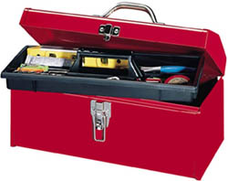
PFM assessment & diagnostic tools
Toolkit
What diagnostic tools to assess PFM systems are you familiar with? (mentimeter)
Notes:
Based on an assessment by the PEFA Secretariat in 2023, there are 64 PEFA tools.

Slide 99
Stocktaking of PFM diagnostic tools
Category | Characteristics of the category | Available PFM tools
A | Tools covering broad multiple aspects of PFM system | 13
B | Tools focusing on individual PFM functions, institutions or subsystems | 27
C | Tools used by development partners to assess fiduciary risk | 10
D | Tools focusing on PFM performance in specific sectors or topics | 14
Total |  | 64
Notes:
Based on the Stocktaking by the PEFA Secretariat in 2023, there are 64 PFM tools.
Group D covers most of the new tools.
In part 2 of the stocktaking all tools are explained in detail.

Slide 100
Tools of Category A: 13 tools
- main examples
Tools covering broad multiple aspects of PFM system | Custodian | Year
Public Expenditure & Financial Accountability Assessment (PEFA) | PEFA | 2005
Fiscal Transparency Evaluation (FTE/FTR) – IMF | IMF | 2014
Open Budget Survey | International Budget Partnership (IBP) | 2006
Public Expenditure Review (PER) | WB | 1996
Country Policy & Institutional Assessment (CPIA) | WB/AfDB | 1970/2012
Notes:
FTR: Financial Transaction Report

Slide 101
Tools of Category B: 27 tools - main examples
EU is main contributor and strong promotor of PEFA and these 4 tools
Tools focusing on individual PFM functions, institutions or subsystems | Custodian | Year
Methodology for Assessing Procurement Systems (MAPS) | OECD | 2004
Debt Management Performance Assessment (DeMPA) | WB | 2007
Tax Administration Diagnostic Assessment Tool (TADAT) | IMF | 2013
Public Investment Management Assessment (PIMA) | IMF | 2015
Public Expenditure Tracking Surveys (PETS) | WB | 1996
Supreme Audit Institutions Performance Measurement Framework (SAI-PMF) | INTOSAI | 2016
Notes:
Based on an assessment by the PEFA Secretariat in 2023, there are 64 PEFA tools.

Slide 102
Tools of Category C: 10 tools - main examples
Tools used by development partners to assess fiduciary risk | Custodian | Year
Operational Assessments (ECFIN AO) | ECFIN (EU) | 1990s
Fiduciary Risk Assessments (FRA) | FCDO | 2008
Notes:
Tools of specific DPs to assess fiduciary risk.

Slide 103
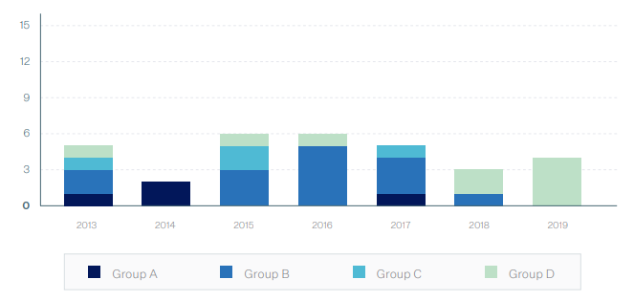
Tools of Category D: 14 tools - main examples
Tools focusing on PFM performance in specific sectors or topics | Custodian | Year
Gender Responsive PFM Framework (GRPFM) | PEFA | 2019
Report on Observance of Standard and Codes (ROSC) | WB | 2001
Climate Responsive PFM Framework (CRPFM) | PEFA | 2020
Climate PIMA (C-PIMA) | IMF | 2021
After 2017, most new tools were in group D
Notes:
Mainly newer tools with specific focus.
2020: Climate Responsive PEFA (CRPFM)
2021: Climate PIMA (C-PIMA)

Slide 104
PFM diagnostic tools
OECD Methodology for Assessing Procurement Systems (MAPS)
How does the procurement system work?
  Reason:
    Need for a detailed procurement tool and consistent approach
  Introduced in 2004 following the PEFA approach, relaunched in 2018
    12 indicators, 54 sub-indicators
    Base Line Indicators (BLIs)
    Compliance/Performance Indicators (CPIs)
  Enables tracking progress over time
  Does not include recommendations for reforms, but based on the MAPS report countries can formulate a capacity development plan to improve its procurement system
104
Notes:
MAPS is linked to PI-24 of PEFA with a similar set up.
The MAPS assessment will provide a basis upon which a country can formulate a capacity development plan to improve its procurement system.

Slide 105
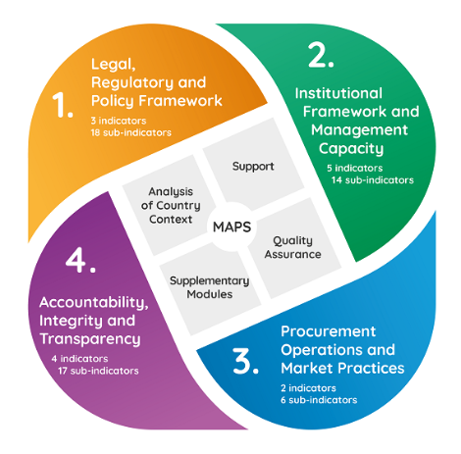
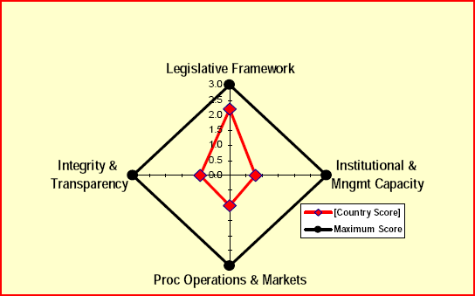
OECD Methodology for Assessing Procurement Systems (MAPS)
PFM diagnostic tools
Notes:
Four dimensions, same scoring as in PEFA.
Relaunched recently after it almost died earlier.
Small secretariat hosted by OECD DAC, Paris. Financed by a donor group. Now also quality checks provided by secretariat.

Slide 106
PFM diagnostic tools
Debt Management Performance Assessment (DeMPA)
How is public debt managed?
  Reason:
    Limited coverage of debt management in PEFA and other tools
    No insight into underlying causes of weak performance
  Methodology launched by World Bank in 2007 (revision in 2015)
    DeMPA modelled on PEFA
    5 pillars, 15 indicators, 35 dimensions
  Enables tracking progress over time
  Does not include recommendations for reforms or action plans
106
Notes:
Linked to PI-13 of PEFA Framework. IMF/WB led
The DEMPA report is a statement of current government DM performance and does not include recommendations for reforms or action plans.
DeMPA deals with debt management while an Debt Sustainability Analysis (DSA of IMF) deals with the debt sustainability (policy related). DMFAS (UN) is an IT tool to manage the debt.
The DeMPA offers a sound diagnostic framework that allows a country’s DM processes and institutions to be evaluated against sound international practice, identifying core strengths and weaknesses, and thereby helping strengthen capacity and institutions so that countries can manage their government debt effectively and sustainably. It will assist countries that want to undertake debt management reforms, helping to monitor progress with achieving government DM objectives consistent with international sound practice. The DeMPA is modeled on the Public Expenditure and Financial Accountability (PEFA) indicators, however, it uses a more comprehensive set of indicators, spanning the full range of government debt management (DM) functions, to provide a detailed assessment of government DM.

Slide 107
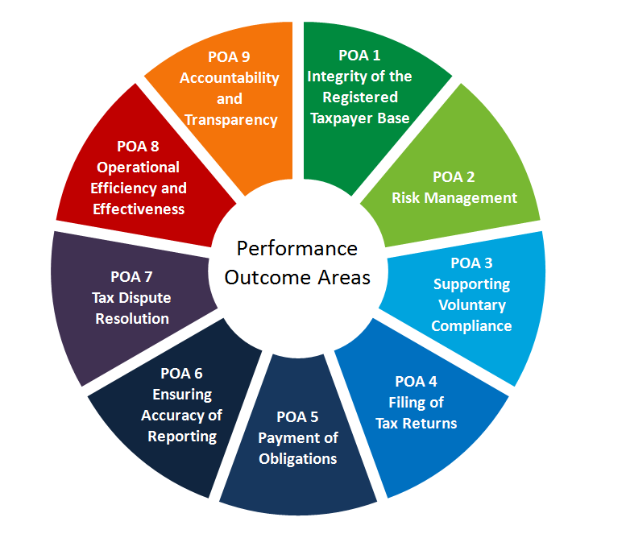
PFM diagnostic tools
Tax Administration Diagnostic Assessment Tool (TADAT)
All businesses, individuals, and other entities that are required to register are included in a taxpayer registration database. Information held in the database is complete and accurate.
The tax administration is transparent in the conduct of its activities and accountable to the government and the community.
Tax administration operations are efficient and effective in performing key functions and achieving expected outcomes.
The tax administration’s management of compliance risks results in higher levels of voluntary compliance and community confidence in the tax administration.
The tax dispute resolution process is independent, accessible to taxpayers, and effective in resolving disputed matters in a timely manner.
Taxpayers have the necessary information and support to voluntarily comply at a reasonable cost to themselves.
Taxpayers report complete and accurate information in their tax returns.
Taxpayers file returns on time.
Taxpayers pay their taxes in full on time.
Enables tracking progress over time
Provides a basis on which a country can formulate a capacity development plan (but does not include recommendations)
107
Notes:
TADAT is intended to provide a common tool which developing countries and donors can use to assess the quality and effectiveness of procurement systems. The assessment will provide a basis upon which a country can formulate a capacity development plan to improve its procurement system.
POA: Performance Outcome Indicator. IMF led.
Linked to PI-19 and PI-20 of PEFA dealing with revenue administration.
There are 9 key performance outcome areas (POAs) covering most critical tax administration functions, processes and institutions. They are assessed on 32 high-level indicators, each built on 1 to 5 dimensions adding up to 55 measurement dimensions, making TADAT a comprehensive but administrable diagnostic tool.
The first 7 POAs are linked to the tax cycle while POA 8 and 9 are cross cutting.
TADAT focuses on the performance of the major national taxes: Corporate Income Tax (CIT), Personal Income Tax (PIT), Value Added Tax (VAT) (or its indirect tax equivalent such as sales tax), and Pay As You Earn (PAYE) amounts withheld by employers (which, strictly speaking, are remittances of PIT). Social Security Contributions (SSCs) may also be included in assessments where SSCs are a major source of government revenue and are collected by the tax administration, as is the case in many European countries.

Slide 108









The Tax Administration Diagnostic Assessment Tool (TADAT)
PFM diagnostic tools
TADAT is supported by international development partners and institutions
http://www.tadat.org/
Notes:
Certified assessors exist for TADAT (not for PEFA).

Slide 109
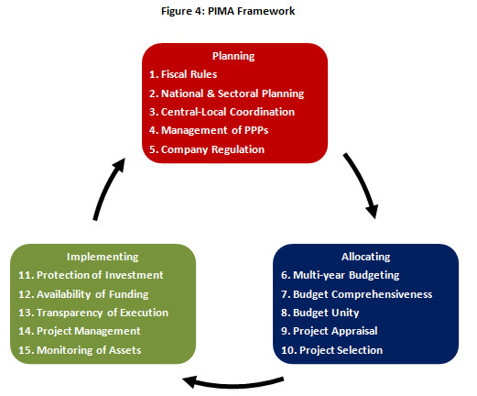
PFM diagnostic tools
Public Investment Management Assessment (PIMA)
The PIMA evaluates 15 institutions that shape public investment decision-making:
Planning sustainable investment across the public sector
Allocating investment to the right sectors and projects
Implementing projects on time and on budget
Enables tracking progress over time
Includes a sequenced reform plan
Show summary assessment PIMA Bangladesh
Notes:
Linked to PI-11 of PEFA Framework. IMF led. Linked to 3 phases of investment cycle.
PIMAs summarize the strengths and weaknesses of country public investment processes, and set out a prioritized and sequenced reform action plan. PIMA provides concrete recommendations tailored to country specific needs and capacities, which are ready to be implemented.
Next to PIMA, there is also Climate PIMA (C-PIMA)
The revision of the PIMA framework in 2018 retained the key features of the 2015 framework, including the three-phase structure (planning, allocation, and implementation) with five institutions assigned to each phase, three dimensions under each institution, and three possible scores (not met, partially met, fully met) under each dimension.
Zoom in the blue block where ’institution’ 6, 7, and 8 show a close link to PFM. Budget unity deals with the integration of recurrent cost and capital cost.

Slide 110
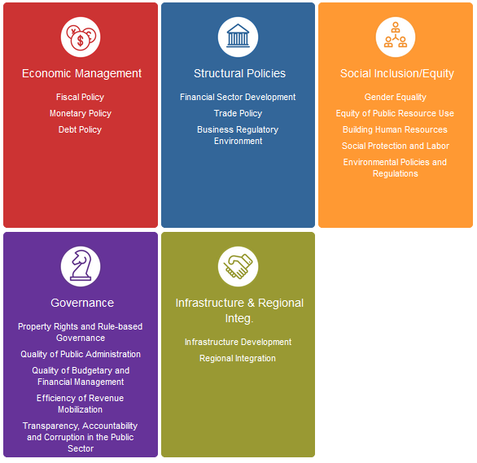

PFM diagnostic tools
World Bank
Country Policy & Institutional Assessment (CPIA)
Each country's performance scoring is assessed against a questionnaire of 18 criteria, grouped on 5 clusters based on:
Coherence of its economic management
Coherence of its structural policies
Degree to which its policies and institutions promote equity and social inclusion
Quality of its governance and public sector management
Degree to which its regulatory framework is enabling infrastructure development and regional integration
Notes:
The World Bank’s IDA Resource Allocation Index (IRAI) is based on the results of the annual CPIA exercise that covers the IDA eligible countries. So, this tool is used to allocate resource to eligible countries.
The Governance cluster covers PFM issues.
The CPIA rates countries against a set of 16 criteria grouped in four clusters: (i) economic management; (ii) structural policies; (iii) policies for social inclusion and equity; and (iv) public sector management and institutions. The criteria are focused on balancing the capture of the key factors that foster growth and poverty reduction, with the need to avoid undue burden on the assessment process.

Slide 111
PFM assessment & diagnostic tools
 | PEFA | FTE | PER | PETS | MAPS | DeMPA | TADAT | PIMA
Identification of PFM strengths & weaknesses | X | X | X | X | X | X | X | X
Integrated Focus (comprehensive) | X | X | X
Focused on part of the Budget Cycle |  |  |  | X | X | X | X | X
In-depth analysis of capacity factors |  | X | X |  | X | X | X | X
Recommendations for reform |  | X | X | X |  |  |  | X
Track progress over time | X |  |  |  | X | X | X | X
Assess fiduciary risk to public/external funds |  | X
Notes:
Focus on the second and third feature: some tools are ‘comprehensive’ and ‘cover the full budget cycle’, while others are ‘focusing on one or two phases’.
Tracking progress over time is also worth mentioning.
‘Recommendation for reform’ and ‘tracking progress over time’ are also complementary, it is either one of the other
PIMA is also a bit different from the other ‘top-5 tools’ because it provides recommendations and is tracking over time is less straightforward

Slide 112
PFM assessment & diagnostic tools
SAI-PMF (INTOSAI)
1 policy design & review
3 budget Preparation
4 budget Execution
5 accounting & Reporting
6 external audit & scrutiny
2 strategic Planning
PEFA / FTE / PER
PETS / PIMA
IPSAS
PETS, TADAT
MAPS, DeMPA, PIMA
Notes:
IPSAS is international standards, not a tool
INTOSAI is umbrella organisation, not a tool

Slide 113
Day 2: Developing reform strategy
  Module 2.1 Conditions for successful reform
  Module 2.2 The Public Expenditure & Financial Accountability (PEFA)
  Module 2.3 PFM diagnostic tools
  Module 2.4 Sequencing of reforms (part 1)
113

Slide 114
Maintenance of systems
A budgetary system is shaped by a number of factors, both political & cultural - changing these to reshape the system takes time
Maintenance is a continuous & permanent process: crucial to go through the process of learning by experience (There is no magic formula!)
    Correct errors
    Adapt to changes
    Step by step improvement
114

Slide 115

Combine:
(i) strengthen
(ii) improve
Maintenance is Ongoing
Strengthen existing system
  Training
  Introduce tools
Improve
  Manuals, systems & processes
  Training
These are constant activities to maintain any system and will be ongoing as technology and understandings emerge
Notes:
115

Slide 116
PEFA Volume IV
Volume IV: Using PEFA to support PFM reform
BROCHURE - Overview of Handbook Volume IV: Using PEFA to support Public Financial Management Improvement
https://www.pefa.org/resources/brochure-overview-handbook-volume-iv-using-pefa-support-public-financial-management
Volume IV: Using PEFA to support Public Financial Management Improvement:
https://www.pefa.org/resources/volume-iv-using-pefa-support-public-financial-management-improvement
Notes:
MKS (moderator) will screen share the PEFA diagram pdf/screenshot, which is extracted from the Volume IV Handbook
Pay special attention to the flow chart (steps to design ‘reform programme’), reform 1, 2 and 3 (platform)

Slide 117
Co-Ordination of development partners
The reform sequence is crucial to prevent reforms supported by different agencies working against each other and becoming dysfunctional
Different donors have different priorities and provide different types of support
Interconnection of different PFM subsystems is essential
(Remember Busan Partnership from yesterday)
Notes:
Bullet 2: donors have different approaches, e.g. EU - gradual build up; WB – big bang.

Slide 118
How to handle such situations?
Ensure mechanisms to co-ordinate all development partners in the design of the reform sequence
Regular meetings of co-ordination committees
Sharing/pooling information wherever possible
(Busan Partnership agreement. We look at mechanics on the final day)
118
Notes:
Third bullet: some document you don’t want to make public such as risk assessments or political economy analysis.

Slide 119
Why establish a sequence of reforms? (1)
Be opportunistic – Ad hoc reforms as they meet country needs/wishes – OK when improving systems
Strategic plan to meet the three aims of PFM:
  Aggregate Fiscal Discipline
  Allocative Efficiency
  Operational Efficiency
  Needs to be sequenced when changing the aims and purposes of the system including changes to technology, human resources, and institutional frameworks to achieve new aims and objectives. – Remember SDGs.
119
Notes:
Opportunistic, but with a risk to protect vested interests.
Ad hoc advanced reforms might also be for policital reasons and build facades of reforms without behaviour change.

Slide 120
Public Financial
Management (PFM) reform virtual training
Day 3 – Developing a reform strategy – 2

Slide 121
Wrap up of day 2
  What do you remember from yesterday? (open discussion)
      Main conditions for successful PFM reform (Gleicher)?
      What are the main features of PEFA?
      What diagnostic tools to assess PFM systems are you familiar with?
121
Notes:
Open discussion with direct questions to participants.
Gleicher: shared dissatisfaction * shared vision * quick wins > resistance
PEFA: 3 objectives, 31 indicators; progress over time; evidence based; high level; no underlying causes (why, how)
Other tools: Maps, Tadat, Dempa, Pima, CPIA (around 64 PFM tools).

Slide 122
Day 3: Developing reform strategy -2
  Module 3.1 Sequencing of reforms (part 2)
  Module 3.2 PEFA platform exercise – Ethiopia
  Module 3.3 Basics and beyond
122

Slide 123
Getting the basics right
  Individual Exercise – Quick Wins (mentimeter)
  Where can I find a quick win?
123

Slide 124
Group Exercise – Quick Wins
According to the Gleicher, one of the pre-requisites for successful change management are some successful first steps.
From the list of PFM reforms shown on the next slide which ones would you identify as good candidates for successful first steps?
List the main reason why your selection reforms would be good candidates for quick wins?

Slide 125
Group Exercise – Quick Wins
Civil service reform project covering the implementation of a new integrated personnel database and payroll management system
Reform of the constitution to address the independence of the auditor general and to clarify the role of parliament in the approval of the appropriations law
Implementation of the pilot phase of the IFMIS project
Reform of debt management
Reform of the mechanism for transfers of tax revenue to the consolidated revenue fund and the implementation of daily reconciliations between the revenue agencies and the ministry of finance.
Implementation of a Medium Term Expenditure Framework (MTEF)
Implementation of new procurement procedures that include the institution of an independent procurement review board and a public procurement oversight authority
Implement programme based budgeting
Introduce a Treasury Single Account (TSA)
Notes:
Successful quick wins: quick, mainly technical (not dealing with vested interests), stand alone (limited people involved) and immediate impact
Not quick. Political sensitive (ghost workers) and might involve IT. An audit on civil servants is also not easy.
SAI independence depends on legislative context of the country.
3. Even a pilot phase of IFMIS is time consuming.
4. Technical, stand alone, and with immediate impact (e.g. less interest cost)
5. Consolidated revenue funds can be technical and quick.
9. TSA: Technical only and with immediate impact.
TSA: same institutions are holding bank accounts. It is purely accounting. It should not be political with high level of resistance.

Slide 126
Why establish a sequence of reforms? (1)
In developed countries, experience demonstrates that budgetary reform takes a long time
  Over 18 years for accruals accounting reform in UK to be completed. Announced 1993 first whole of Government accounts 2011/12 (published 20 months late)
  In France: Accruals accounting reforms – prepared in 1999; voted in 2001; Implemented in 2006 Budget
126
Notes:
UK did do it in stages as part of a broader reform.

Slide 127
Why establish a sequence of reforms? (2)
Experience shows that premature introduction of complex instruments in developing/transition countries is counterproductive
127

Slide 128

What are the objectives?
Aggregate fiscal discipline
Be accountable towards citizens, be receptive
Role of Parliament in democratic societies
Resource allocation & fiscal policy consistent with objectives
Efficient public service provision and tax administration
?
Proper procedures (integrity, regularity)
Notes:
All with regard to priority of reforms depends on what we want to achieve. Therefore some sequencing is needed.

Slide 129
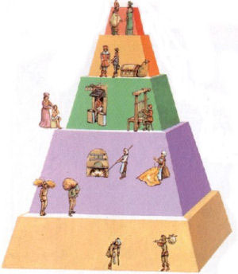
The Platform approach (Peter Brooke, 2003)
  It aims at implementing a package of measures or activities designed to achieve increasing levels (‘platforms’) of PFM competence over a manageable timeframe
  Each platform establishes a clear basis for consolidation and launching to the next step, based on the premise that a certain level of PFM competence is required to enable further progress to take place
Notes:
Useful approach conceptually. In practice more complicated.

Slide 130
The Platform approach
  It facilitates broad reform focus for the individual components and serves as a basis for aligning and coordinating activities
  There are no standard platform specifications, but they seem to conform broadly to a sequence of:
    Fiscal Discipline (first steps)
    Efficiency (performance) in Service Delivery (second steps) and finally
    Strategic Allocation of Resources (final steps)
Notes:
However, there have been a number of criticisms, aimed both at the approach itself and how the approach has been applied.
First, some doubt the validity of technical arguments for identifying some processes as more important, on which other PFM processes depend, for inclusion in successive platforms.
Second, given each platform is an amalgam of various reform activities it has been argued that it is often difficult to agree with the definition and objective of each platform, or hence reach consensus on its achievement.
Third, the approach is often criticized as being overloaded in reform actions and over-engineered in design, hence difficult to manage, and therefore prone to failure and reform fatigue. It should be noted that as the approach has become more popular, the platform approach has also attracted criticisms that could be applied to almost all other reform strategies, and the term itself has perhaps been indiscriminately used as a way of packaging reforms to better ―sell them to donors and country authorities. (Diamond, 2012, p. 7)

Slide 131

The Platform approach -example
Platform 1: A credible budget delivering a reliable resource to budget managers
Platform 2: Improved internal control to hold managers accountable
Platform 3: Improved links of priorities to budget planning
Platform 4: Integration of accountability and review processes

Slide 132
Example: Sequence of Platforms
Platform 4
Integration of accountability
and review processes for
both finance and
performance management
Enables more accountability for performance management
Enables focus on what is done with money
Platform 3
Improved linkage of priorities and service targets to budget planning and implementation
Enables a basis for accountability
Broad Activities
Platform 2
Improved internal control and public access to key fiscal information to hold managers accountable
Full design of FMIS
Develop IT management strategy
Initial design of asset register
Platform 1
A credible budget delivering a reliable and predictable resource to budget managers
Broad Activities
Re-design budget cycle (e.g. MTEF)
Pilot program based budgeting & budget analysis
Further fiscal decentralize-tion
Broad Activities
Re-design budgeting classification system
Initial design of FMIS for core business processes
Strengthen external audit and define internal audit function
Broad Activities
Integration of budget (recurrent & capital budgets)
Strengthen macro and revenue forecasting
Streamline spending processes
Source: See “Study of measures used to address weaknesses in Public Financial Management systems in the context of policy-based support,” by Peter Brooke, at www.pefa.org
Notes:
No country starts from zero, it can build on exisiting systems.
Platform 2 contains FMIS: not integrated (separate systems)
Platform 4: full IFMIS

Slide 133
Cluster approach (Jack Diamond)
The subset of Platform approach
Three main stages:
Ensure core PFM functions are operating (reach core level functionality by 3 top-level priorities)
Consolidation: establish an adequate IT basis, an accounting system, and regulatory framework, to anchor subsequent reforms
Subsequent PFM reforms, sequenced along three clusters:
      further improving compliance
      medium term planning
      programme and performance budgeting
133
Notes:
Diamond, p. 17.
This approach is also called ‘Good Practice Approach’. It can be seen as part of the platform approach or a subset of the Platform approach.

Slide 134
Cluster approach (Jack Diamond)
Cluster approach – stage 1: 3 top-level priorities
Notes:
Diamond, p. 17.
This approach is also called ‘Good Practice Approach’

Slide 135
Cluster approach (Jack Diamond)
Cluster approach – stage 2 and 3
Notes:
Diamond, p. 17.
This approach is also called ‘Good Practice Approach’

Slide 136
Cluster approach (Jack Diamond)
Cluster approach – stage 1
Sequencing decisions should focus on the three top-level PFM priorities
These priorities, determining the overall sequencing strategy, should be the same for all countries
Attempting to leapfrog this hierarchy in the top PFM priorities will likely lead to unsuccessful reforms
The first top-level priority in PFM reform is to establish a core (or basic operational) level for the core PFM functions
This core level can be defined by using the ratings of PEFA indicators
Notes:
Diamond, p. 17.
This approach is also called ‘Good Practice Approach’

Slide 137
Cluster approach
Cluster approach – stage 2
Before advancing to reforms aimed beyond core PFM functions, it is important to establish:
  A financial management information system
  Accounting system that can meet International Public Sector Accounting Standards (IPSAS) cash reporting standards for central government operations
  Budget legislation that meets critical control standards and is adequately enforced
Notes:
FMIS: not integrated.

Slide 138
Cluster approach
Cluster approach – stage 3
Reforms aimed beyond core PFM functions
Focus on policy and performance
Sequenced along three clusters:
  Further improving compliance
  Progressive move from annual to medium term budget planning
  A staged move from traditional line-item budgeting to programme (and eventually performance) budgeting

Slide 139
The Dilemma
Sometimes need to go against logical sequence, it may be driven by:
  Pressure from donors
  Internal determination to show that country is on the path of modernisation & capable to carry out complex reforms, etc.

Slide 140
How to handle such situations?
Strengthening foundations must be priority: however, if not possible to avoid complex reforms, is necessary to:
Ensure that basic measures & necessary pre-conditions for the complex reform are included in reform programme
Reshape complex reform measures & limit their ambition
  E.g., a programme budget may initially be limited to an information document

Slide 141
Day 3: Developing reform strategy -2
  Module 3.1 Sequencing of reforms (part 2)
  Module 3.2 PEFA platform exercise - Ethiopia
  Module 3.3 Basics and beyond
141

Slide 142
Group exercise - PEFA Ethiopia
Break out groups
Review the PEFA Summary Assessment for the Federal Republic of Ethiopia, 2018
Make a judgment on the likelihood for PFM reform in Ethiopia linked to the platform approach
Notes:
Ethiopia has piloted the Volume IV of the PEFA, in spite of the political situation.
Ethiopia also conducted SNG PEFA at the same time and has piloted the Climate Responsive PFM (CRPFM) Assessment in 2022 (‘PEFA Climate’). This document is PEFA checked but not made public yet).

Slide 143
Group exercise - PEFA Ethiopia
Review the Summary Assessment of the PEFA for the Republic of Ethiopia, 2019, discuss it in your group and do the following:
Make a shared judgment on the likelihood of successful PFM reform in Ethiopia
Detail the sequence of PFM reform activities you would recommend in the first platform
e.g. would you regard the following as basics (link to Diamond’s hierarchy)?
  The adoption of MTEF
  The adoption of Accrual Accounting
Notes:
Using Mural
The document is a mix of the summary and the conclusions of the PEFA Assessment for Ethiopia.

Slide 144
Day 3: Developing reform strategy -2
  Module 3.1 Sequencing of reforms (part 2)
  Module 3.2 PEFA platform exercise – Ethiopia
  Module 3.3 Basics and beyond
144

Slide 145
Objectives of the module
To examine the key sub-systems of PFM
For each sub-system, we look at:
  The level of development regarding ‘foundations’
  Developments beyond the foundations
145
Notes:
Foundations = basics
Sub-systems linked to phases of budget cycle.

Slide 146


Allen Schick: the foundations first!
In 1998, Schick reacted against the attempts to export and apply the New Zealand model to developing countries
He recommends to first consolidate ‘foundations’, rather than “leapfrogging”: often referred to as “core functions” (basics) first
Schick, Allen, 1998. “Why Most Developing Countries Should Not Try New Zealand Reforms.” The World Bank Research Observer
Notes:
One of his articles: Why Most Developing Countries Should Not Try New Zealand Reforms
New Zealand model: programme and accrual budgeting running the government as a company and with large responsibilities to line manager.

Slide 147
Examples of basic functions
Administrative as well as economic classification of expenses (consistent with GFS)
Satisfactory level of comprehensiveness of budget
Taxpayer registration
Regular monitoring of financial budget – cash & commitments
Registry of physical assets for “risky” assets (e.g. vehicles, computers)
Suspense Accounts
End-of-year accounts
External Audit
147
Notes:
Budget comprehensiveness: linked to extra-budgetary units, extra-budgetary funds of budgetary units and donor-funded projects.
A suspense account is a temporary resting place for an entry that will end up somewhere else once its final destination is determined. There are two reasons why a suspense account could be opened: A bookkeeper is unsure where to post an item and enters it to a suspense account pending instructions.
A suspense account is an account used temporarily or permanently to carry doubtful entries and discrepancies pending their analysis and permanent classification. It can be a repository for monetary transactions (cash receipts, cash disbursements and journal entries) entered with invalid account numbers.

Slide 148
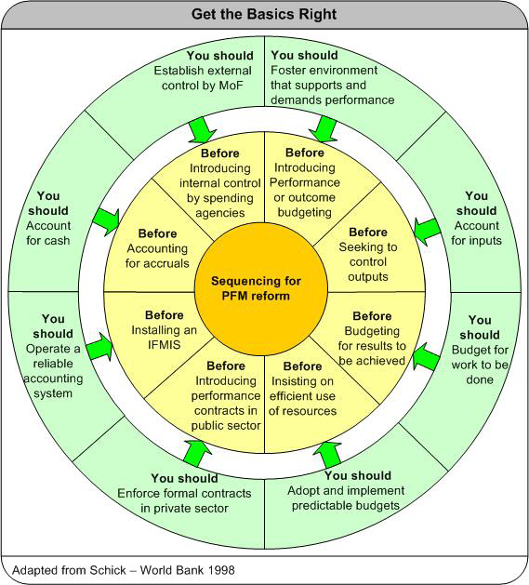
Getting the Basics Right
(Allen Schick)
Notes:
Operate a reliable accounting system before installing an integrated financial management system (IFMIS)
Have effective financial auditing before moving to performance auditing
Adopt and implement predictable budgets before insisting that managers efficiently use the resources entrusted to them
The government should foster an environment that supports and demands performance before introducing performance or outcome budgeting
Enforce formal contracts in the market sector before introducing performance contracts in the public sector
First external control (MoF) than internal control (Line Ministry) and management responsibility to line manager.
Predictable budget: if the budget is not credible than how to implement it?

Slide 149
How to define ‘foundations’?
Suggested definitions:
Set of functions necessary to ensure that other functions are sustainably applicable and cost effective
This set of functions aimed at:
  Ensuring ‘‘budget credibility’’ (in budget preparation)
  Ensuring budgetary discipline (integrity, regularity – financial compliance in budget execution)
149
Notes:
Link to complexity of PFM systems and to interrelationship between different functions in budget cycle and to weakest link (PEFA).
Point 1, budget credibility is PEFA PI-1, 2 and 3 (comparing budget with outturn).
Point 2 is the traditional PFM objective as discussed on day 1.

Slide 150
The PFM Foundations:
1. ensuring credibility of the budget
PEFA pillar 1 (budget reliability)
PEFA pillar 2 (transparency) and
PEFA pillar 4 (budget preparation):
  Budgetary and macroeconomic framing (PI-14)
  A budget formulation process that (PI-18):
    eases strategic decision-making and
    leaves enough time for line ministries to carry out internal decisions: “two stage” budget process
  Budget calendar that is clear and enforced (PI-17)
150
Notes:
Refer to PEFA pillar 1, 2 and 4.
First bullet related to PI-14 (and the PEFA scoring exercise).
Two stage: bottom up and top down.

Slide 151
The PFM Foundations:
2. ensuring budgetary discipline
PEFA Pillar 5: Predictability and control of budget execution
Schick identifies 3 stages to the development of control systems:
  Basics: supervision by third party, external to spending ministries (i.e. MoF)
  Internal supervision within spending ministries
  Strengthen managerial accountability
151
Notes:
Point 1 shows the basics.
It is linked to pillar V and VI of PEFA (budget execution and accounting)
Many less developed countries in stage 1.

Slide 152
The foundations: economic and administrative classification (PI-4)
Going beyond:
  more advanced classification for analysis of public policy and performance: functional and programme classification
Notes:
Economic and administrative classification versus functional and programme classification for budget formulation, execution and reporting. See indicator PI-4.
Functional: by purpose these expenses are intended for, e.g. education, health, social security. COFOG.
This is also linked to the shift from input to performance orientation in modern budgeting.

Slide 153
Going beyond the basics: the MTEF
A Medium-Term Expenditure Framework (MTEF) is defined as:
An additional budget document showing the multi-year expenditure forecasts
A change of approach to budgeting
A tool to embed the annual budget process in a medium term budget and policy framework with:
  A rolling multi-annual expenditure programme
  Established on a yearly basis
  The first year is the next year budget
153
Notes:
The last 3 sub-bullets will be explained in the next slides.

Slide 154

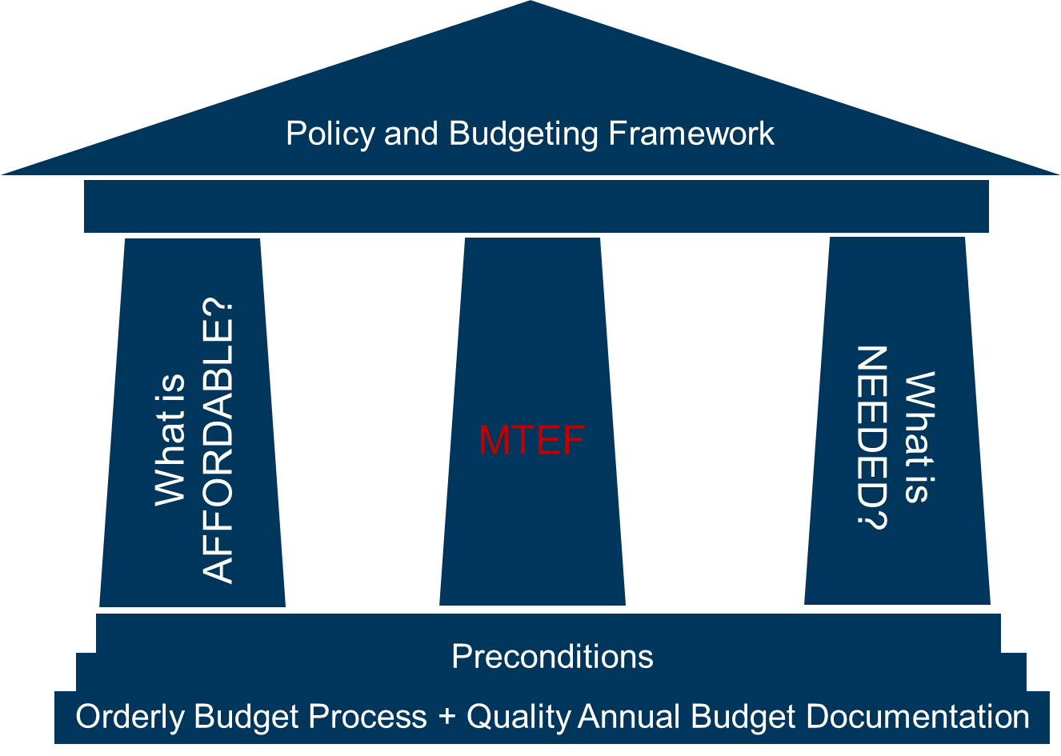
What is top-down / bottom-up in an MTEF?
Main features of MTEF
Top-down
Bottom-up
Notes:
Top-down and bottom up processes.
This process is also part of the orderly preparation of the annual budget, but a medium term focus creates more flexibility and allows you to deal with the (larger) fiscal space for new projects and programmes.

Slide 155
Main features of MTEF
Top-down
Bottom-up
Top-down budget preparation
  Multi-year projections of resource envelope targets (what is affordable)
Bottom-up budget preparation
  Multi-year cost estimates of sector programmes (what has to be financed, with a focus on programme performance)
Integrating these two pillars
  Institutional (political-administrative) decision-making process to make the necessary trade-offs
Notes:
Top down is also linked to fiscal discipline and bottom up to the other 2 PFM objectives.

Slide 156
Top-down ceiling
Main features of MTEF
Costing
MTEF expenditure projections
Expenditure ceiling
Fiscal space for new programmes and policy change
Baseline
Savings on existing programmes
Year 0
Year 1
Year 2
Year 3
Notes:
Animation added.
Compare with incremental budgeting where you just increase the budget by x%.
The baseline assumes continuation of the current policies. It may consist of:
- For personnel and goods and services: the current level of activities (The actual budget plus the impact of the inflation and decisions already made)
- Transfers related to the existing legally binding commitments
- Ongoing investment projects, including their recurrent costs

Slide 157
Main features of MTEF
Rolling Budget
Budget
Forward Estimates
T
T +1
Budget
Forward Estimates
T +2
Budget
Forward Estimates
t +1
t +2
t +3
t +4
t+5

Slide 158
MTEF process
MTEF process
Notes:
Also applicable to annual budget preparation process.

Slide 159
Risks of ‘leapfrogging’ the basics - MTEF
IMF – World Bank:
"developing comprehensive MTEFs can be effective when circumstances and capacities permit.
Otherwise, it can be a great consumer of time and resources and might distract attention from the immediate needs for improving the annual budget and budget execution processes.
…in a number of African countries, the MTEF was introduced prematurely, and is turning out to be merely a paper exercise".
IMF — World Bank "Global Monitoring Report 2006" page 146.
159
Notes:
159
In many countries, MTEF has been sort out lately, but similar mistakes are made by reforms in other areas (e.g. accounting).

Slide 160
Budget execution
This section examines key points about the budget execution cycle
  Management procedures of the expenditure cycle
  Personnel, procurement
  Financial monitoring and accountancy
  Internal audit
Aims at identifying the “basics”
Brief examination of a few issues that go beyond the basics, including accrual accounting
160
Notes:
160

Slide 161
Guaranteeing foundations
Take measures to make budget execution effective
Make sure funds are available, improve predictability
Rationalise controls within the executive by accounting for specific aspects of budgetary system
  Francophone countries: rationalise control within the MoF, ensure transparency of Treasury
  Anglophone countries: follow commitments, audit internal controls, strengthen Treasury
  Post-conflict countries: put in place a centralised payment monitoring and management system
161
Notes:
Anglophone system: weak on commitment controls; more internal controls in LM (less top down) and commitment controls
Francophone: centralised (MoF) and strong on commitment controls; not always transparent to line ministries.
Review quarterly or six-monthly the budget, but supplementary budget (i.e. going back to Parliament) only in exceptional circumstances (i.e. change in government with new priorities or external crisis)
TSA: Purely accounting/bookkeeping exercise. Offset balance of different accounts (assets against liabilities) at the end of every day. Not changing authority to bank accounts.

Slide 162
Payment systems: points to consider
Single Treasury Account (STA):
cash centralisation - desirable for sound treasury management
Notes:
TSA is purely an accounting function. Linking bank account to reducing interest cost by preventing borrowing money while there is money on other bank accounts.
TSA is usually a quick win and not about compliance.
TSA: Purely accounting/bookkeeping exercise. Offset balance of different accounts (assets against liabilities) at the end of every day. Not changing authority to bank accounts.

Slide 163
Accounting methods
Cash-based accounting
Keeps track of expenses when paid for, implementation of revenue when registered (i.e. when cash moves)
Accruals-based accounting
Used in commercial world
Keeps track of events when they occur: assets, liabilities, net assets/net position, outputs & expenses (including depreciation, inventory stocks, etc.)
Notes:
Cash accounting is good for control and compliance (discipline), control of cash.
In accrual accounting, discretionary power is needed for valuation of assets and liabilities.
Pensions not recognized in cash accounting.

Slide 164
Accounting methods
Depends on the country: variants between the extremes
Accruals-based accounting, (commercial accounting)
Modified accrual basis
Modified cash basis
Cash-based Accounting
Notes:
Accrual budgeting: no middle income country is economically advance enough for this.
No country is only using cash. In practice, only modified systems exist.
IPSAS: international accounting standards.
Can developing countries introduce accrual accounting faster? Yes, there is a lot of expertise and documents developed. Technical issues to comply with the private sector. Big problem is sustainability of the system and to keep the expertise (and experts) on board.

Slide 165
The basics
The accounting system must enable the basics in terms of budget preparation, control, reporting, & publication as per country regulations: this requires:
Adequate budgetary classification
Registration of expenditure at both commitment & payment stages
Reports on arrears & other liabilities
Reports on financial assets
Asset register at least for those physical assets liable to misappropriation or waste
Notes:
Risky assets: cars, computers.
Starts off with reporting on financial assets. Later on, physical assets (highways, buildings) can be added. Accrual accounting needs all assets recorded.
Liabilities includes arrears.

Slide 166
External Audit
Undertaken by Supreme Audit Institution (SAI: Court of Audit, Court of Finances, National Audit Office, etc.)
Key point is the independence of the SAI should (must!) be guaranteed by the constitution according to International Organization of Supreme Audit Institutions (INTOSAI )
Notes:
Change in constitution not easy, but it depends on political will (e.g. EU Members States to change Maastricht Treaty in a few months).

Slide 167
Different types of Audit
Compliance audit: assessing extent to which legal & administrative requirements are followed; integrity & suitability of administrative, financial & management control systems
Financial audit: review of financial statements & accounting systems which underlie them
Performance audits: assesses management & operation performance of government programs & MDAs to evaluate effectiveness & efficiency with which program or organization uses resources
167
Notes:
Compliance is most basic audit, in accordance with the law.
Financial audit is auditing the (annual) accounts. Accounts should reflect true and fair view (of what has happened).
Performance audit is most advanced. These are ‘next stage’ audits, dealing with performance measurement.

Slide 168
End-of-year Accounts
End-of-year accounts are first submitted to the SAI, then to parliament (often with significant delays)
  Major weaknesses
    Long delays
    Administrative & management accounts are often incomplete & difficult to compare
168

Slide 169
Legislative and Regulatory framework
Constitution
[Organic] Budget Act (or Public Finance Management Act, Budget Framework Law, etc.)
Other laws and regulations
  Audit Act
  Fiscal responsibility law
  Public Accounting Law
  Financial regulations
169
Notes:
Organic Law is a law that ‘grows’ out of the constitution – i.e. is required by the constitution and is in that sense one step below the constitution. They may require specific majorities in parliament to be amended. Rights laws etc. It is also a comprehensive law (albeit subject to detailed defining regulations, etc.). It sets binding principles for the full cycle. Anglo Saxons don’t have this; They depend on regulation / series of laws etc.

Slide 170
Key points of the legislative framework
Provide a framework for parliamentary authority
Establish responsibilities (Countries in transition: strengthen the powers of the Minister of Finance)
Define principles of sound fiscal management
Define reporting obligations
170

Slide 171
Management Information Systems
Management information is necessary
  For scheduling, implementation and surveillance
  For the MoF & sectoral ministries
Not a mere collection of statistical data
  Financial & Physical Information
  Dashboard
  Must be available quickly in order to enable to take decisions
It is not only IT, but may be useful to classify, sort & publish data in various formats
171

Slide 172
Integrated Financial Management System
“Heart” of the accounting system (General Accounting)
  Setting standard exchanges between systems
  Covers all financial transactions
Other Systems:
  Budgetary module: Accounting & budgetary control
  Preparation of budget
  Treasury management
  Debt management
  Revenue
  Management modules for managers
Notes:
Real question: how important is integration and sophistication of systems.
Lada or Lamborgini?
An Financial Management System is not very complicated but an integrated one makes it real challenging.
From the shelve systems; SAP/Oracle.

Slide 173

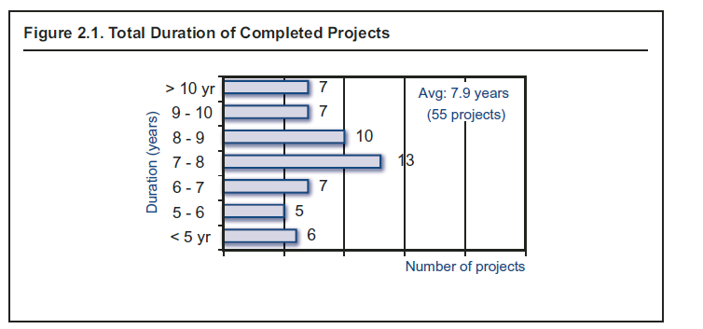
In practice
A large majority of the integrated systems are only partially implemented
Yet, the implementation process is time consuming
Dener: WB 2011
Notes:
Garbage in – garbage out

Slide 174
Public Financial
Management (PFM) reform virtual training
Day 4 - Change management and institutional arrangement

Slide 175
Wrap up Day 3
  Open plenary discussion:
  What are the three top level priorities in the Cluster approach?
  Get the basic rights (first) – What does it mean in the PFM reform context?
  In the ‘basics and beyond’, which ‘beyonds’ did we discuss?
      In budget preparation?
      In budget execution?
      In external oversight?
175
Notes:
open discussion with asking questions.
Platform approach: what does it contain?
Cluster approach:
Stage 1: financial compliance
Stage 2: a credible budget
Stage 3: efficiency and effectiveness
What are the basics in budget preparation?

Slide 176
Day 4: Change management and institutional arrangement
  Module 4.1 Change Management and Capacity Building
  Module 4.2 PFM strategy Uganda - case study
  Module 4.3 Reform strategy, Programme and management
176

Slide 177
Module 4.1: objectives
  Examine some essential issues related to the preparation and monitoring of a PFM reform
  Discuss more specifically about change management and capacity reinforcement
177

Slide 178
Strengthened Approach (Paris Declaration)
  Reform programme carried out by national governments
  Coordinated donor support
  Monitored progress of the reform through a common pool of information
178

Slide 179
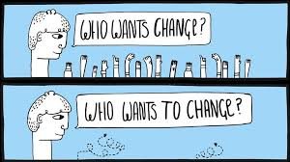
What is change management?
  The process of building the required capacity to implement and manage the change
  Helping individuals impacted by the “change” to understand the need for change and to motivate them to take actions, which may result in sustained changes in behaviour
  Change management refers to:
      a set of basic tools or structures intended to keep any change effort under control
      it is about adaptive leadership (or change leadership) for addressing non-technical challenges
Notes:
Educational is crucial

Slide 180
PFM Reform as change process
Main drivers of PFM Reform:
      Political: authorities decide to adopt new PFM policies and practices to implement strategic priorities
      Institutional: implementation of new regulations and norms, including capacity strengthening efforts and process improvements
      Technological: new ICT solutions become available or there is a need to modernize existing systems
Change may be either incremental or radical
In case of the incremental approach
      less resistance to change
      but organizations might get “change fatigue”
      adapting too much for culture / office politics can dilute the desired outcomes of the change
Notes:
Incremental might mean constant change and lead to fatique, while rational for reform got diluted.
Corruption vs Fraud
Fraud: - within the PFM system
Corruption: outside the PFM system

Slide 181
Core tasks (1)
  Ensure that there is:
  A comprehensive understanding of:
  current status of PFM model
  legal & regulatory framework & institutions
  both in order to evaluate where a reform is needed and
  to what extent PFM system may be reformed
  A realistic assessment of:
  political commitment to the change
  macro-economic context
  constraints in terms of capacity & how reform may be carried out
Notes:
We have to work with and within the constraints.

Slide 182
Core tasks (2)
  Make sure that:
  Change management and capacity building have been accounted for in the preparation of the reform
  The institutional arrangements to manage the reform are well outlined and established
  The reform activities have been properly sequenced
  The modalities for the alignment and coordination of the donors are properly outlined
  The reform programme is fully budgeted and funded
  There is a framework for monitoring and assessment
Notes:
Complications:
- Reform programme time frame might be longer (e.g. 7 years) than for budget support programme (3 yrs).
Donors have different cycles for funding.

Slide 183
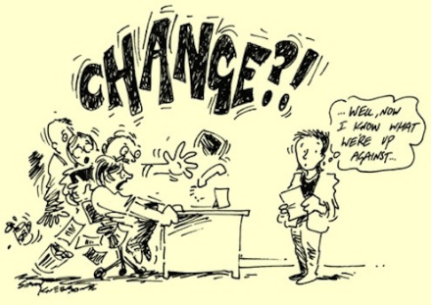
There is no functional change without resistance
  Self-interest
  Fear of the unknown
  Conscientious objection or differing perceptions
  Suspicion
  Conservatism
Notes:
Self-interest: can be solved by promotion.
Fear of unknown requires education process and a communication policy.
Conscientious objection or differing perceptions: most difficult to deal with, because more info will not help. The ultimate solution might be to remove them
Suspicion: accepting, but …
Conservatism: <> objecting
Always winners and losers in a reform process.

Slide 184
Evaluating current capacities of PFM system
  Is there leadership in the Ministry of Finance?
  Are legal & regulatory requirements enacted in practice?
  Is tax collection effective?
  Is there reliable banking system with national coverage?
  Is there an active, functioning private market?
  Are there any identified critical gaps in capacity?
184
Notes:
Be aware, the public and private sector (and broader society) don’t operate in isolation. Looking at the broader economy.

Slide 185
Opportunities for reform
  Is there a democratic environment with active engagement of civil society?
  Are public and private administrations concerned with corruption?
  Is there political will?
  Have strong measures for macroeconomic stability & economic growth been taken?
  Have other major reforms been carried out?
  Is there a group of financial specialists & experienced managers, and do they have adequate incentives
Notes:
Civil society can put pressure on the government but cannot force reform. Motivate and engage CS migth help.
Corruption: many benefit from it.
Macroeconomic stability and economic growth more difficult post Covid
Have other major reforms been carried out? Esp. civil service reform.
Last bullet: retention of skills is key. special remuneration for some experts, esp. Accountants and tax officials.
Change in salary structure might help but is risky: staff implementing the policies will earn more than their bosses in MoF who design the policies. This can undermine the reforms.
Possible solution: set up autonomous sections outside the civil service.

Slide 186
Threats to PFM reform
  Difficulty in keeping experienced and qualified personnel
  Corruption
  Fragmented funding sources
  Poor reform sequencing
  Fatigue from previous reforms
Notes:
Fragmented funding sources, e.g. donor funding insecure.

Slide 187
The conditions for change management
  Change will be perceived as legitimate if there is a conjunction of certain factors: dissatisfaction; a shared vision; & a will for change
  Reminder: Gleicher’s equation
  There must be one or more champions. Without political support & strong leadership to prevent resistance, reform will not succeed!
  Champion: Finance Minister, Prime Minister, etc.
187
Notes:
Lack of resistance is not enough. We also need champions, technical as well as political.

Slide 188
Change management (1)
  Set out the expected results: prepare & publish reform strategy
  Assess resources available for reform
  Assess capacities: human, material, institutional capacities
  Prevent resistance: predict ‘losers’
188
Notes:
188
Manage ‘losers’ before they become blockers in the system.
Predict losers and deal with them.
If powerful positions: move them by a restructuring (sideways move).
In training: take the servants with you by offering training, but if they don’t want, early retirement for older staff. For younger staff push them, otherwise no career opportunities.

Slide 189
Change management (2)
  Management capacity
  Effective leadership
  Institutional arrangements
  Building consensus
  Include sector ministries in the management of the reform
  Find "FS” of Gleicher (quick wins, immediate results)
  To who’s advantage? MoF? Donors? Sector ministries? Parliament?
  Organise reform management on a long-term basis
Notes:
Make a link here to the Uganda PFM reform strategy, section 5.2 (change management), esp. P. 95
Third bullet: quick wins for whom? Quick wins as political tool to deal with resistance.
Quick wins – to keep momentum, but don’t use them all at the start but manage them politically.

Slide 190
Assessment of capacity for Reform implementation
Institution
Laws, regulations, rules
Organisation
Capacity to deliver
Conditionalities: financial and human resources, leadership and management
Staff
Human capabilities
Willingness to change
Capacity to plan and renew
Relevant values (it ought to)
Notes:
Staff: resistance mainly from senior level (vested interests)

Slide 191
Capacity building
  Institutions (formal & informal rules): aims of the reform
  Organisations
  MoF (+Prime Minister, Planning …): Must be in charge of monitoring, & organised in such a way that it can carry out dialogue with other sectors
  Sectorial Ministries: often side-lined in reforms; or, on the contrary, are sole focus of donors, who disregard system as a whole
  Key aspect: finance-sector dialogue (or finance-sector-plan)
191

Slide 192
Capacity building
Individuals’ skills and motivations
  Upgrading skills
  Technical training
  General training and raising awareness
  Incentives
  Attracting, retaining & motivating skilled individuals
  Low compensation is a problem in many DC, but financial constraints reduce possibilities of substantial raises
  Other forms of incentives? E.g. promotions; beware in patronage-dominated systems
192
Notes:
Autonomous institutions / Agencies established to circumvent the salary structure of Govt. Are not a panacea.
Advantage: keep staff on board.
Risk: deskilling of staff of MoF (leavers).
Market supplements to accountants (UK)

Slide 193
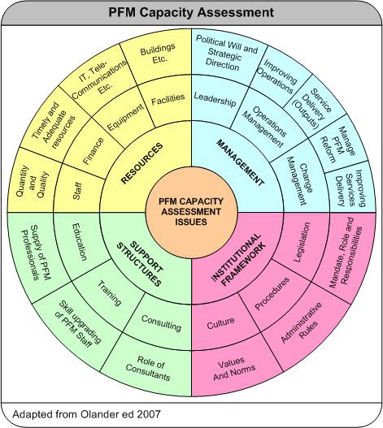
Capacity assessment
193
Notes:
We could make a link here to the Uganda PFM reform strategy, section 7.3 (capacity assessment)

Slide 194
Addressing Capacity gaps
  Capacity building: human capabilities, equipment, networking, management
  Capacity supplementation: provision of continuing support to staff undertaking certain functions, delivered through advisors, internship schemes, and regional organisations and professional bodies
  Capacity substitution: “outsourcing” of specific PFM functions on a long-term basis, with external specialist individuals or agencies performing line functions on a long-term or permanent basis
194

Slide 195
Regional Training Centres such as:
IMF
https://www.imfmetac.org/content/metac/en1.html
INTOSAI
https://afrosai-e.org.za/about/

Slide 196
Key messages
  A national will is essential to any PFM reform
  Great care must go into change management
  Capacity building is a key issue, that must go beyond simple training actions
196
Notes:
A national will?

Slide 197
Day 4: Change management and institutional arrangement
  Module 4.1 Change Management and Capacity Building
  Module 4.2 PFM strategy - case study
  Module 4.3 Reform strategy, Programme and management
197

Slide 198
PFM Reform Strategy Uganda – case study
  Assessing the Relevance and Credibility of PFM Reforms
  You are requested to assess this PFM reform strategy document by using the check list. This checklist covers seven features which a strategy of PFM reforms should have.
  You will work in sub-groups. Given time limitations, we ask you to respond only to the questions related to the following two features of the PFM Reform Strategy.
  3. Integrated and effectively sequenced
  7. Monitoring and performance indicators
198
Notes:
Mural in breakout groups

Slide 199
Day 4: Change management and institutional arrangement
  Module 4.1 Change Management and Capacity Building
  Module 4.2 PFM strategy - case study
  Module 4.3 Reform strategy, Programme and management
199

Slide 200
Module 4.3: objective
  Examine core issues related to the preparation and management of a PFM reform

Slide 201
“Reform Strategy” Document
  Relatively brief document by Council of Ministers
  Used as programme for implementation
  Detailed examination of PFM reform programme
  Puts forward institutional framework
  Identifies considerable risk factors (legal framework, procurement, viability, etc.)
  Outlines a multi-annual expenditure programme
  Puts forward a proposal for deployment of activities, a sequence & agenda for implementation
  Defines monitoring & assessment modalities
  Puts forward proposal for funding modalities
  Defines responsibilities of different components
  Serves as basis for agreement on approach amongst different concerned parties
Notes:
The reform strategy document is a more concise document from Cabinet to Parliament.
See Uganda document for the more detailed document.
Puts forward institutional framework: also covering donor framework.

Slide 202
The reform programme (1)
  Defines global objective of PFM reform programme
  Establishes list of all reform components
  Defines reform sequencing
  Defines, for each component: main objective, purpose, main institution in charge & link with other components
  Prepares agenda for carrying out each component, with a summary of results, inputs, activities, stages requiring monitoring, & calendar for implementation
  Estimates expenditure provisions, identifies administrative budget lines of national budget from which funding is drawn (including external financing)
202

Slide 203
The reform programme (2)
  Outlines modalities for monitoring & assessment
  Defines single financing instrument
  Outlines rules of financial management & procurement
  Outlines institutional dispositions – including high-level steering group, technical direction committee, & work groups
203
Notes:
One central pool of financing, often a trust fund (bullet 2).
High level steering group – permanent
Separate groups for different technical areas.

Slide 204
Risks in carrying out PFM reform programme
  Absence of political will
  Risks due to content of the reform: errors in evaluating technical & capacity constraints
  Risks from reform management institutional factors
  Inadequate management structure
  No long-term support of cooperating partners
  Inefficient monitoring & assessment framework
  Incomplete or inefficient legal & regulatory framework
  Risks in implementation
  Delays in activities (e.g. procurement, funding)
  Inadequate implementation agenda
Notes:
Delays in activities (e.g. procurement, funding), especially it the funding depends on donors. It is key how these risks are managed. Mitigation measures as far as possible and otherwise define exit strategy.
Will for reform might disappear over time, e.g. due to election.
Absence of political will: might also disappear due to losing a champion

Slide 205
Risk mitigation and management
  Strong sustained engagement of political actors
  Monitor capacity building
  Adequate & efficient management structures
  Coordinated, flexible & unique funding mechanism, adequate control publication of reports
  Coordinated approach in legal & regulatory framework
  Effective & efficient procurement system
  Adequate agenda
  Particular attention to management of link between different components, implementation & sequencing of agenda
  Coordination of PFM reform programme with other public sector reforms
205
Notes:
Monitor capacity building: if too many staff is leaving, you have to start from scratch again.
Last bullet: not in isolation, e.g. civil service reform in parallel, or measures to make the economy more market oriented.

Slide 206
Budgetary and financial management of PFM reform programme
  Preparation of:
  expenditure programme (5 to 7 years) & cash flows
  annual budgets (work programmes) with explicit result objectives, indicating funding sources
  procurement plans, which distinguish:
  Recurring & non-recurring expenditures
  Direct & indirect costs
  monthly expenditure reports
  annual monitoring & audit reports
  annual control statements
Notes:
expenditure programme (5 to 7 years) & cash flows in developed countries
Non-recurring: cost of new systems
Indirect cost: time of civil servants to contribute to reforms (away from daily routine)

Slide 207
Monitoring and assessment
  Monitoring of:
  inputs
  activities
  number of trained employees
  preparation & finalisation of legal & regulatory texts
  reports published
  PFM outputs indicators
  PEFA & OECD/CAD procurement indicators
  Indicators not tackled by PEFA
Notes:
See Chapter 8 and annex D of Uganda PFM reform strategy.
Don’t use PEFA indicators.

Slide 208
‘Viability’ conditions
  Integration with national budget
  Management rooted in public administration structures
  If possible, permanent positions in Reform Secretariat
  Retaining of office trained personnel
  Regularly informing all parties of progress
208

Slide 209
Reform management: three levels
  Strategic level: defining objectives, approach & decisions
  Inter-ministerial committee, Council of Ministers
  Management board
Technical, national level
  Reform Secretary
  Technical Thematic task force
Ministerial departments level
209
Notes:
Technical, national level: e.g. PMU in MoF. How to keep them motivated? Offering benefits, like training and study tours (EU: no top up of salaries).
See also Uganda Reform Strategy.

Slide 210
Recommendations for Governments
Ensure clear and coherent support for PFM reform within the Executive (Cabinet as well as MoF): broaden support across the political spectrum over time!
Give serious attention to design and staffing of PFM reform coordination and management structures
Those responsible for coordinating PFM reforms should control external support to PFM & dialogue with Budget Support donors
Structures for monitoring PFM reform should promote the practise of learning from experience and adapting implementation plans accordingly
Finally, the regular training of PFM staff needs to be a consistent priority
210

Slide 211
Key messages
A reform strategy & programme must be established
An efficient reform management system must be put in place
211

Slide 212

Test Out and Participants’ feedback survey
212

Slide 213








Keep in touch
ec.europa.eu/
europeancommission
europa.eu/
@EuropeanCommission
@EU_Commission
EUTube
@EuropeanCommission
EU Spotify
European Commission
Notes:
Delete/update as appropriate

Slide 214

Thank you
© European Union 2020
Unless otherwise noted the reuse of this presentation is authorised under the CC BY 4.0 license. For any use or reproduction of elements that are not owned by the EU, permission may need to be sought directly from the respective right holders.
Notes:
Update/add/delete parts of the copy right notice where appropriate.
More information: https://myintracomm.ec.europa.eu/corp/intellectual-property/Documents/2019_Reuse-guidelines%28CC-BY%29.pdf

