Slide 1
Enhancing EUDR Compliance: Public Data and Value Chain Analysis for National Risk Assessments

Slide 2
Reminder: The "What?" and the "How?" of EUDR
… introduce to the market...
1
… Deforestation-free.
Art. 3
Prohibition of...
… of relevant raw materials and products that are not ...
… produced in accordance with the relevant legislation.
What?
2
… trade or export...
3
… covered by a DD statement
Traceable. Geolocation of production plot, information on suppliers and buyers.
Deforestation-free. Provide evidence that it did not occur in deforested areas after December 31, 2020
Legally produced: Provide evidence that the laws of the producing country have been respected,
… collection of information, data and documents (art. 9)...
1
Art.
8-9-10-11
Operators will exercise due diligence, including...
… a risk assessment (Article 10)...
How?
2
… risk mitigation measures (Article 11)...
3

Slide 3







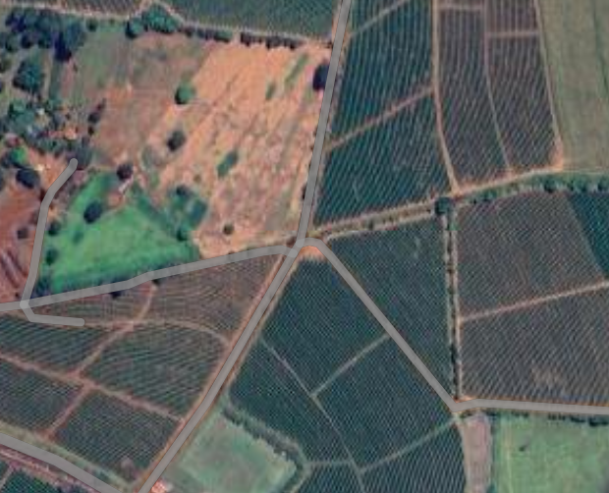





Efficient implementation depends on how value chain information navigate between actors
Frontera del país productor
EU border
DDS
Producers
Cooperatives
Intermediaries
Exporters
Importer
Distribution
Intermediaries
(informal)
Transformation
EU Transformation
Competent authorities
Producing countries do not have obligations or to introduce additional controls
However, they can support trading partners by facilitating DD, including by providing relevant data and information
Responsibility for compliance with the EUDR lies with the EU side of the border
EU operators submit DD declarations, undergo audits by competent authorities and face fines in case of non-compliance.

Slide 4




But what is a Due Diligence System?
SOPs Manual
  For data and information acquisition
  For internal and independent audits
  Complaints mechanisms
  …
Databases, information system and digital tool
  Spatial database and information systems, quality and control system
  Information on the legality of production
  Farm-level information system
  …
Partnerships /agreements with third parties or suppliers
  Code of Conduct and Supplier Evaluation
  Adoption of third-party services for automated reporting
  Mitigation actions with national actors
  …

Slide 5

Geolocation

Slide 6
Geolocation requirement & traceability
Description
Quantity
Country of production
Geolocation of all plots in which raw materials were produced (GPS points or polygon if >4ha)
Date and period of production
Name, postal address and email address of any company or person who supplied the relevant products to them
Value chain analysis can provide information on:
Existing and registered farmers (numbers)
Average yields (useful for controlling if plots are voluntarily omitted in the DDS)
Challenges and opportunities for declaration in excess of plots
The level of organisation in the value chain:
  % associated farmers, % certified farmers
  % of indirect sourcing or commodity sold to intermediaries
Localize bottlenecks for segregated traceability in the value chain
Governance over value chain data in the country and conditions for enabling farmers national data base or traceability systems

Slide 7

Deforestation-free

Slide 8
Value chain data can complement spatial information
Operators must use and combine the best available information to determine the risk of non-compliance: private, public
No single dataset or map can provide information sufficiently with 100% accuracy... But the convergence of evidence allows for a first risk assessment
The RDUE is not prescriptive about the type of information an operator should use: spatial data, terrain data, etc.
Article 9
1. "Operators shall collect information, documents and data demonstrating that the products comply with Article 3."
(g) sufficiently conclusive and verifiable information that the relevant products are deforestation-free.

Slide 9
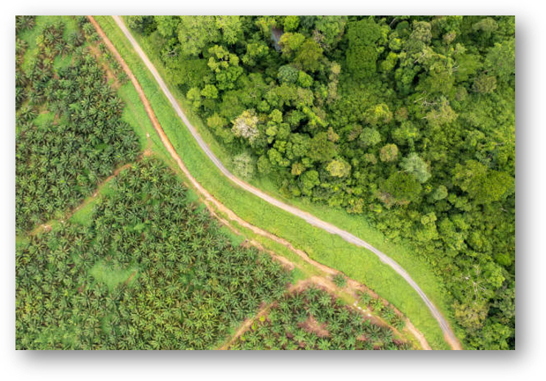
Value chain data can complement spatial information
Proxys for deforestation risk:
Trends in volume produced
Expansion of area of production
Evolution of price
The governance of the sector can help also provide useful information on land use and how authorities have been able to limit forest conversion

Slide 10

Legality

Slide 11


Risk assessment: what kind of information is most useful?
Documents
Paperwork becomes unmanageable on a large scale, as do digital equivalents (photos/scans/PDFs).
Documents are not necessarily more authentic or reliable:
Having the correct document is not a guarantee of legality, for example, property titles can be forged or "bought".
Not having the correct document does not imply illegality, for example, land that is legally occupied, but not documented, or when it is necessary to prove that "something is not being done"
Data
The most useful form of information for conducting a large-scale risk assessment is quantitative data
Public datasets can provide an overview of legal compliance in a country or geographic subunit
In the absence of public information, or as a complement, the private sector may collect its own data on legality (including those of NGOs and/or service providers).

Slide 12



If consultations confirm that there are no complaints or litigation on production land: no further due diligence action
The producer owns the land.
Or
The producer is a regular or irregular possessor of the land.
Or
The producer exercises the right of use over the land without the intention of ownership, through mere tenure that includes: usufruct, lease and loan.
Stakeholder consultations
Confirm that there are no complaints or litigation on the production lands. (national or international press, NGOs, among others)
Consult complaints system.
If the consultations indicate that there are complaints or litigation on the production lands.
  Collect IHCAFE Carné
  Collect documents: Public deed registered in the IP; title deed, lease contract or cadastral certificate; title of full ownership; title of useful domain; Loan or usufruct...
  Procedures: Promote programs to support producers to land titling with their suppliers
For affected areas (only)

Slide 13
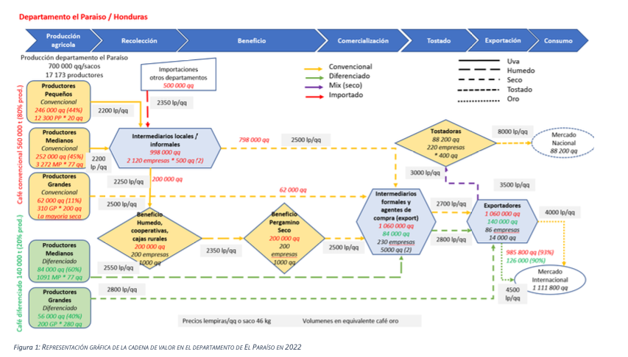
Lower risks ?
Lower risks ?

Slide 14


Muchas Gracias frederic.baron@efi.int
Javier.Ortiz@efi.int

