Slide 1

Together for Better Public Services
Brussels, 10 May 2012
1st Interim Meeting of the Policy Forum on Development
European Commission
Alessandro Bellantoni
Public Governance and Territorial Development Directorate
Organisation for Economic Co-operation and Development (OECD)

Slide 2
What is co-production?
Co-production is defined as “a way of planning, designing and delivering public services which draws directly on input from citizens, service users and CSOs”
Occasional or mainstreamed?
Independent / prompted by agency action?
Working with or instead of professional?
Short or long term partnership?
≠ from simple citizen involvement
≠ from contractual arrangements

Slide 3
OECD study on co-production: Together for Better Public Services
Focus: map & analyse the current position and direction of policy & practice
  Type of coproduction: addition or substitution
  Stages: planning, delivery, review / evaluation
  Degree of change: incremental or radical / new initiative or embedded practice
  Tools: ICT (web 2.0), training of citizens and professionals
  Impacts: service quality, vfm, better outcomes, innovation, gov capacities
  Risks: accountability, probity
Methodology: desk research + survey of 26 OECD countries (national level) + collection of 58 country examples
Areas covered: General public services; Defence; Public Order and Safety; Economic Affairs; Environmental Protection; Housing and community amenities; Health; Recreation, culture and religion; Education; Social Protection

Slide 4
Understanding co-production
IMPACT OF COPRODUCTION
(based on the analysis of selected country examples)
 | Type of Impact
 |  |  | Outcomes |  |  | Notes
 | Effective Involvement | Cost reduction | User satisfaction | Service quality | Overall Efficiency / Value for Money
General Services | √ | no | no | no | no
Defence | √ | √ | no | no | no | Cost reduction through volunteer work
Public Order and Safety | √ | √ | √ | √ |  | Cost reduction in cases of substitutive co‑production (Time Dolla Youth Court, US)
Health Services | √ | √ | √ | √ | √ | Cost reduction e.g. reduced hospital admissions, emergency visits and nurse home treatment (Health Buddy Scheme, the Netherlands; Telecare, US;) High level of user satisfaction (Expert Patient, UK) Improved outcomes and cost effectiveness e.g. mental health, less pain (CPSMP, Canada; Expert Patient, UK)
Social Protection | √ | √ | √ | √ | √ | Cost reduction (Self directed Social Care Services, UK; Self Managed Budgets for people with mental illness, US; Disability Services Commission, Australia) Increased service availability (Netari, Finland)
Economic Affairs | √ | no | no | √ | no
Housing and Community Amenities | √ | no | no | no | no | Cost reduction through volunteer work
Environmental Protection | √ | no | no | √ | no | Cost reduction through volunteer work
Recreation, Culture and Religion | √ | no | no | no | no
Education | √ | no | √ | no | no | Improved educational attainment (Community Conversation, US) and changed behaviour (National Peer Mentoring Program, UK)

Slide 5
Understanding co-production
 | Type of Co‑production |  | Co‑producers |  |  |  | Stages |  |  | Type of change |  | Depth of change
 | additive | substitutive | Citizen | User | CSO | PSO | Planning | Delivery | Monitoring / reviewing | Incremental | Radical | Early stages | Mainstreamed
General Services | √ |  | √ |  |  |  | √ | √ | √ | √ | √ | √ | √
Defense | √ |  | √ |  | √ |  | √ | √ |  | √ |  |  | √
Public Order and Safety | √ |  | √ | √ | √ |  | √ |  |  | √ | √ | √ | √
Health Services | √ | √ | √ | √ | √ | √ |  | √ |  | √ | √ | √ | √
Social Protection | √ | √ | √ | √ | √ | √ | √ | √ |  | √ | √ | √ | √
Economic Affairs | √ |  | √ | √ | √ | √ | √ |  | √ | √ |  | √
Housing and Community Amenities | √ | √ | √ | √ | √ |  | √ | √ | √ | √ | √ | √ | √
Environmental Protection | √ | √ | √ |  | √ | √ | √ |  | √ | √ | √ | √ | √
Recreation, Culture and Religion | √ |  | √ |  |  |  |  | √ |  | √ |  | √
Education | √ |  | √ | √ |  | √ |  |  | √ | √ |  | √ | √

Slide 6
Understanding co-production
DEMAND FOR COPRODUCTION
(% of countries)
REASONS FOR USING
COPRODUCTION
(% of cases reported by countries across alll services)

Slide 7
Understanding co-production
FACTORS ENHANCING COPRODUCTION

Slide 8
Understanding co-production
FACTORS REPRESENTING BARRIERS TO COPRODUCTION

Slide 9
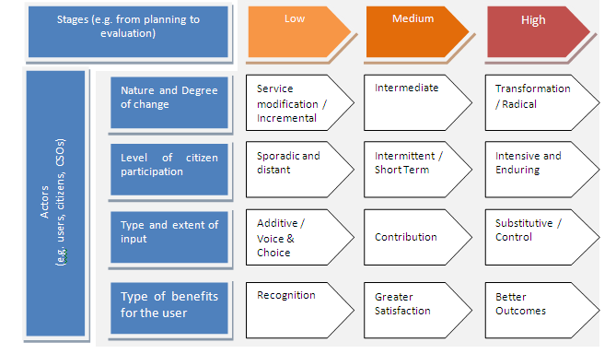
Type and level of change involved in co-production

Slide 10
SUCCESS FACTORS FOR
CO-PRODUCTION
Leadership
Learning
Resources
Culture
Processes
Partnership

Slide 11
CHECKLIST FOR
CO-PRODUCTION
Objectives
What are the needs, problems and outcomes?
Degree of change
What level of service change is desired?
Type of change
What type of co-production in terms of cost/benefits?
Risk Factors
What are the barriers and risks to be managed?
Choice of partners
Who should be the co-producers?
Management of
partnership
What it the government relations with co-producers?
Choice of instruments
What tools will be developed to co-produce (ICT, Web 2,0)?
Change Management
What changes in front and back office?
Resources
How will co-production schemes be funded?
Evaluation
How and from whom will services be monitored?

Slide 12
OECD OBSERVATORY OF PUBLIC SECTOR INNOVATION
MAPPING
PROMOTING
ASSESSING

Slide 13
Contact
Alessandro Bellantoni
MENA-OECD Governance Programme
alessandro.bellantoni@oecd.org
Marco Daglio
Public Sector Reform Division
marco.daglio@oecd.org

