Slide 1
New phase of DeSIRA: DeSIRA+ and RMRNs in Agroecology
Christophe Larose Team Leader : Sustainable Agriculture
INTPA F3
Information/Dialogue session – EU Delegations
October 16, 2025

Slide 2
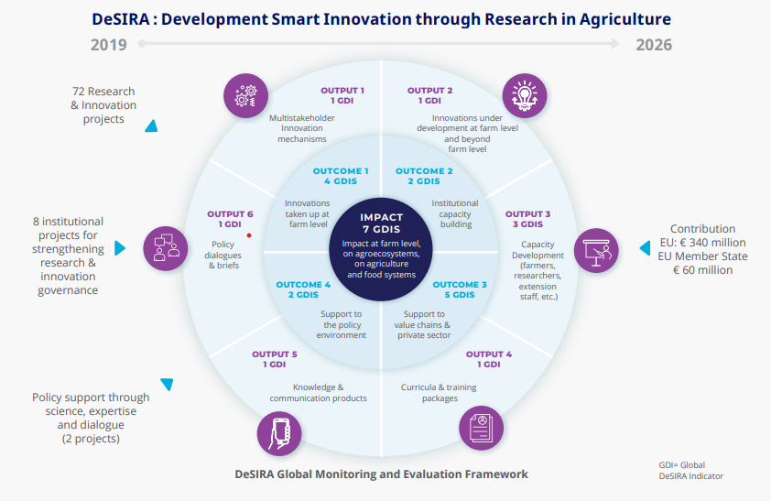

Slide 3
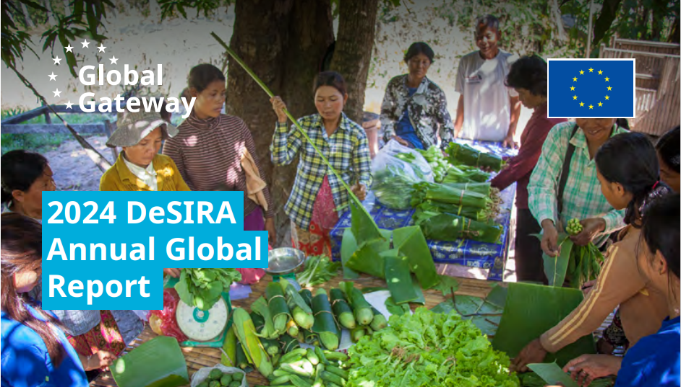
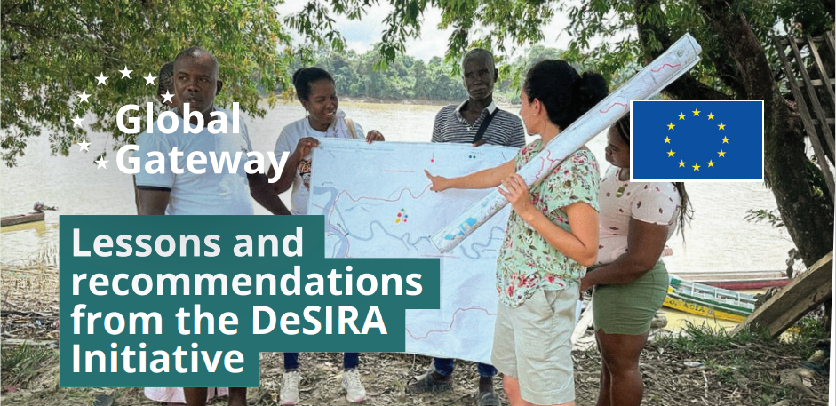

DeSIRA : Development Smart Innovation through Research in Agriculture
DeSIRA | Capacity4dev
DeSIRA-LIFT

Slide 4
NEW PHASE OF DeSIRA
RMRNs : Regional Multi-Actor Research Networks on Agroecology
Strengthen the scientific and technological capacities of African R&I organisations
Increase the RMRN’s contribution to scientific knowledge generation and innovation for agroecology.
Enhance the RMRN support to practitioners, scientists and policy-makers
Improve academic curricula on agroecology in African universities
DeSIRA+
Scale agroecological innovations in Sub-Saharan Africa (SSA)
Strengthen enabling environment for agroecological transitions in SSA

Slide 5
Regional Multi-actor Research Network (RMRN) for agroecology
JRC
Technical assistance
FARA & RUFORUM:
SUPPORT TO THE 3 RMRNs & DIALOGUE AT CONTINENTAL LEVEL
CORAF
CCARDESA
ICIPE
ARCx programme
RMRN West : RADIUS
Burkina Faso, Ivory Coast, Senegal
RMRN South
Malawi, Zimbabwe, Tanzania, Zambia, Uganda
RMRN East
Kenya, Uganda, Tanzania, Rwanda
TPP on Agroecology + Coalition on AE

Slide 6
Specific objectives of DeSIRA+
Increased co-creation and adoption of agroecological innovations (products, technologies, models and/or services) by small-scale farmers and SMEs of the agri-food sector.
Increased capacity of farmers’ organisations, civil society and private sector actors (SMEs) to scale innovation from one phase to another phase by addressing the key barriers and by mobilizing the appropriate levers.
Improved enabling policy environment for agroecology at national, regional and continental levels.

Slide 7
DeSIRA => DeSIRA+ … Any difference?
Development-smart & Climate-relevant => Agroecological agenda
Global => Africa
“Innovation through research” => “Innovation with support from research”
“Experimenting at scale” => “Getting impact at scale”
Stronger alignment to EU country actions
Better integration of the Global Gateway strategy, with a focus on value chains

Slide 8
DESIRA+ topics
Agrobiodiversity (crops, animals), including farmers’ seeds systems
Bio-solutions inputs and integrated pest & disease management
Soil health and Integrated Soil Fertility Management, Water resources management
Agroforestry
Adapted mechanisation for small-scale farmers
Neglected & Under-Utilised Species crops, Legumes, plant-based and/or alternative proteins
Sustainable Value chains & Access to markets (circular economy)

Slide 9
DESIRA+
=> (Multi-) Thematic actions on agroecological innovations
=> Agroecological Value chains approaches
=> Transversal actions for knowledge generation and policy dialogue

Slide 10

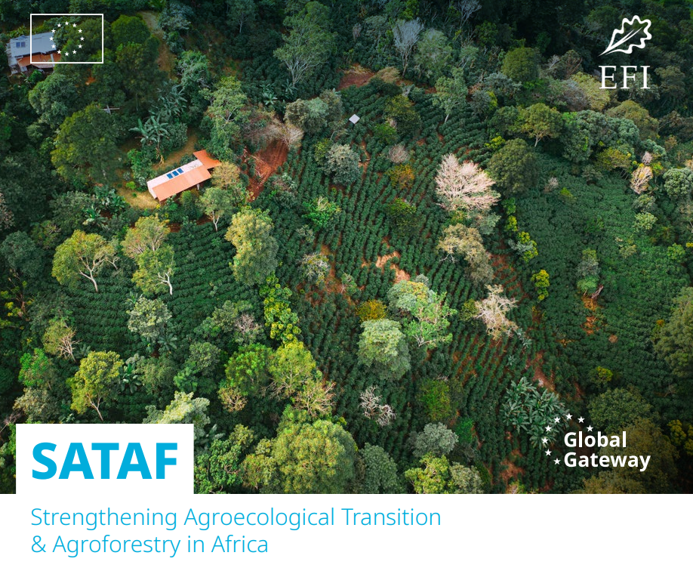
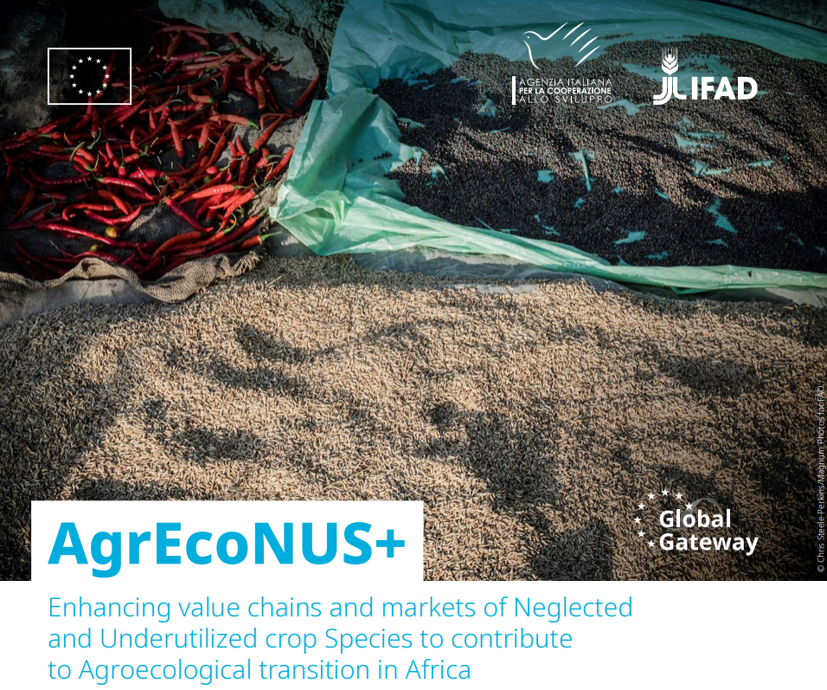
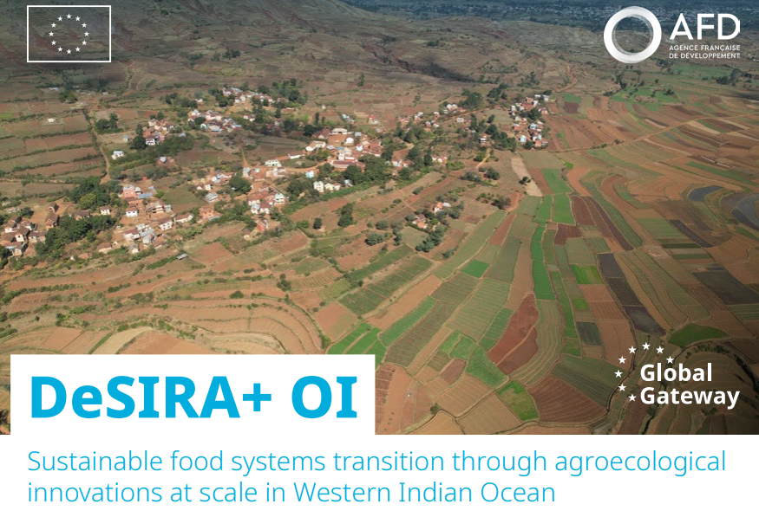


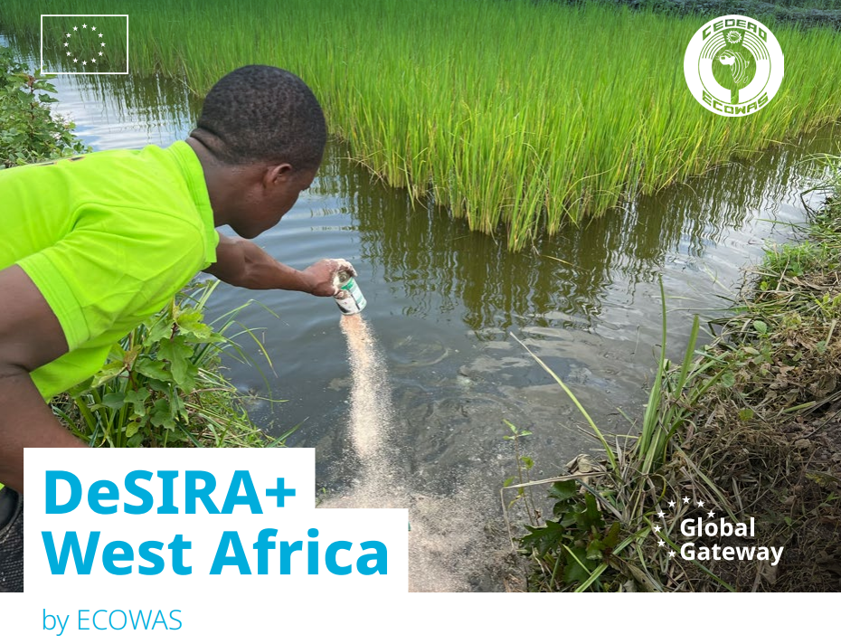
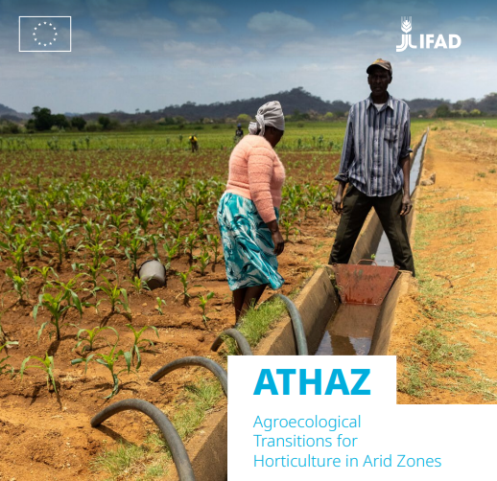
DESIRA+ : Project fiches

Slide 11
DESIRA+: (Multi-)Thematic actions on agroecological innovations
Western Africa
Transition towards AE food systems
AFD/EUD BF
Impl. Partners: ECOWAS/EAS, RAAF, consortia FOs/R&I/CSO
ECOWAS countries (incl. SSA)
On-going
10 M€ (+ 10M€ AFD)
Central Africa
Transition towards AE food systems
ENABEL/EUD DRC
Impl. Partners: ENABEL, consortia FOs/R&I/CSO
Burundi, DR Congo, Rwanda
On-going
10 M€
Eastern Africa+
Innovations for Soil Health and Agroecology
GIZ/EUD to AU
Impl. Partners: GIZ, AUDA-NEPAD, CGIAR, FO, CSO, NARS
Ethiopia, Kenya, Cameroon, continental (others/BMZ & others)
On-going
10 M€ (+ 10 M€ BMZ)
Indian Ocean
Scaling of AE innovations
AFD/EUD Mauritius
Impl. Partners: AFD, CIRAD, NARS, FOs, CSOs
Madagascar, Mauritius, Comoros, (Seychelles, Réunion)
On-going
5 M€ (+ 2M€ AFD)

Slide 12
DESIRA+: Agroecological value chains
FO4Impact
Farmer-led agroecological innovations in value chains
IFAD/INTPA F3
Impl. Partners: Agricord, FO at different levels
Sub-Saharan Africa
About to be signed
DeSIRA+ contribution: 6M EUR
AgrEcoNUS+
Neglected and Underutilised crop Species (NUS)
AICS, IFAD/INTPA F3
Impl. Partners: CIHEAM, SWISSAID, R&I
GH, IC, BF, Niger, Guinea, MAU, SEN, TZ, ZIM
Under finalisation
16 M EUR (+2M EUR from AICS)
SATAF (Agroforestry)
Strengthening AE Transition & Agroforestry (Cashew, Coffee, Cocoa)
European Forest Institute/INTPA F3
Impl. Partners: NITIDAE, CIRAD, IRD, nat R&I, CSO, FO
IC, MOZ, TZ, UG
Starting
18 M EUR
ATHAZ (Horticulture/ Irrigation)
Scaling up AE innovations in irrigated areas (soil, IPM) and horticulture
IFAD/INTPA F3
Impl. Partners: Icipe, Biovision AT, FiBL
BOT, ZAM, ZIM
Status: in preparation
14 M EUR

Slide 13
DESIRA+: Transversal actions
TAPE+
Underpinning agroecological practices and policy with cutting-edge metrics
FAO/INTPA F3
Impl. Partner: FAO, JRC, Stat4SD, CIFOR-ICRAF
Burundi, Cabo Verde, Kenya + continental
On-going
Budget: 2 M€ (0.2M€, FAO)
MoSAFS
Modelling pathways for a sutainable and agroecological transition of food systems in Africa
JRC/INTPA F3
Impl. partner: JRC,UN SDSN, CIRAD, CGIAR, national R&I
Senegal, Kenya, Mozambique
on-going
0.5M€
Mainstream
Mission-oriented agrifood innovation systems for sustainability transition through agroecology
FAO/INTPA F3
Impl. Partners : AKIS actors (tbi)
Senegal, Kenya, Zimbawe + continental
On-going
6M€
DeSIRA-LIFT+
Learning and monitoring/Information sharing/Dialogue & Impact
Agrinatura/INTPA F3
Impl. Partners: Agrinatura & members, FARA, Biovision AT, RUFORUM
Sub-Saharan Africa
In preparation
3M€

Slide 14
DESIRA+: Geographical coverage

Slide 15
DESIRA+: What governance mechanisms?
At project & DeSIRA+ initiative levels:
EU delegation leads and INTPA/F3
Learning from the DeSIRA experience:
Roles of African partners
Building on existing platforms (e.g. International Research Consortium and its Secretariat)
Forging collaborations with Horizon Europe/Africa initiative actions (i.a. on agroecology and agroforestry)

Slide 16
Links with EU partnership with CGIAR in Africa
EU pledge to CGIAR (140M€, 2021-27, incl. 40M€ from Africa Regional MIP)
Support to CGIAR global portfolio (a selection of Science Programmes) and bilateral projects (Headquarters and EU Delegations) => activities at country level
Need to connect most relevant EU-funded CGIAR activities with actions under the new phase of DeSIRA (DeSIRA+ and Regional Multi-Actor Research Networks) and EU portfolio/priorities

Slide 17


To add a picture, please move the grid elements on the side and then place back.
Thank you!
Conference | Boosting agrifood research and innovation cooperation for impact at scale

