Slide 1
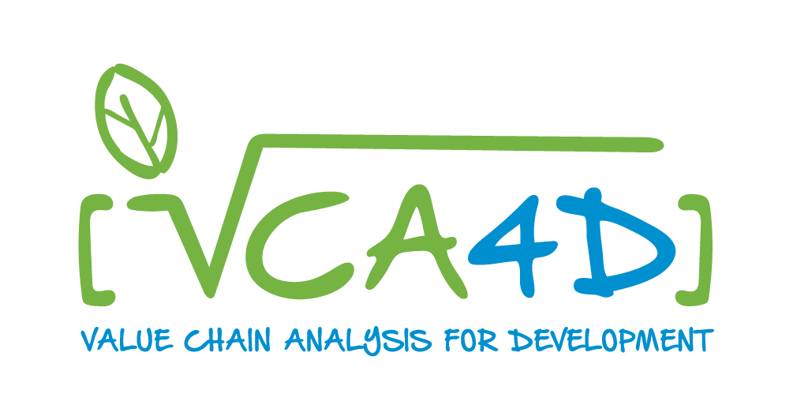


Value Chain Knowledge Sharing for Action
16th October 2025
How can VCA4D support your decision-making process
Frédéric Lançon
VCA4D Scientific Director
frederic.lancon@agrinatura-eu.eu
for

Slide 2
What is Value Chain Analysis for Development?
A facility created by DG INTPA to back up EU Delegation decision making in supporting value chain development to achieve development goals
« Knowing what it is happening and informing decision through evidence-based analysis »
A partnership between FG INTPA and Agrinatura in charge of implementing VCA4D through the provision of expertise and capacity building
A methodology combining robust analytical tools
Applying the VCA4D Methodology: elaborated by DG INTPA and updated by Agrinatura
Revamping of quantitative data
Multi-disciplinarity
Methodology features
Appraising the inclusiveness and sustainability of agri-based VCs
To have a robust diagnosis on the state of affairs of a VC, the bottlenecks and opportunities, the impact and results of investments… → instrument for policy dialogue and operations

Slide 3
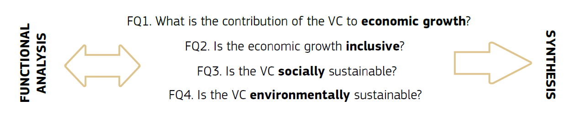
The VCA4D Analytical Framework
Framing questions (4)
  Core questions (20)
    Indicators (quantitative and qualitative) (95)
National level (sub-national/territorial level)
The analytical process is 3-fold:
Functional analysis
Economic, social and environmental analyses to respond to the 4 FQ
Synthesis: Critical issues, recommendations

Slide 4
VCA4D Process
8 to 14 months
Phases
Demand formulation
Study Launching
Study Implementation
Outreach
Activities
EU delegation or INTPA formulate a request,
INTPA approved
ToR formulation by the PMU in interaction with INTPA and EUD
PMU recruits experts from Agrinatura or other (50%)
  1 economist,
  1 social-scientist
  1 environment specialist
  1 national expert
Training of experts
Briefing of experts with EUD/INTPA
Phase 1
Phase 2
Phase 3
Report edition and dissemination
Policy brief
In country workshop to present and discuss results to stakeholders (optional)
Review of information and sources
Function analysis
Brief note (issue prioritization, data collection plan)
Briefing with EUD//INTPA
Quantitative and qualitative date collection completion
Data analysis
Draft report
Draft report review by the PMU
Draft report discussion meeting with EUD/INTPA
Report validation by EUD and INTPA
Outputs
TOR
Brief Note
Report
Policy Brief

Slide 5
VCA4D study : a heavy systematic assessment
A long list of indicators selected by INTPA
Risk to ignore important issues that are not considered by the current narrative (path dependency to previous assessment)
Respective relevance of the indicators may evolve between the study formulation/implementation period and its use in the following years.
  VCA4D aims at producing baseline
Not necessarily more time and resources (data) consuming to generate a sub-sample of indicators than the full list.

Slide 6
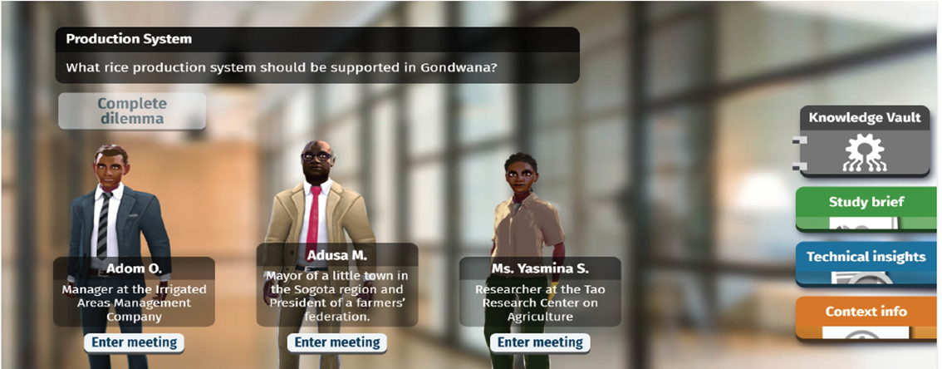
Using the report
No simple and integrated assessment of the VC based on one or few indicators.
There is no benchmarking for a unique VC. Relative assessment compared to another VC.
But you can assess if the VC performance is aligned with your policy objective and priority.
Being selective in using the report indicators.
Learning selection process using the VCA Game
Play VCA Game at https://value-chain-game.agrinatura.dev.seriousgames.net
Video introducing the VCA Game https://capacity4dev.europa.eu/projects/value-chain-analysis-for-development-vca4d/info/6-vca-game_en

Slide 7
How a VCA4D study can fit in the decision making process?
VC analysis is not an end but a mean.
VCA4D Status:
  Ex-ante analysis: Ex-ante assessment of the potential offered by a VCA4D study to perform on selecting criteria and identification of priority areas to maximize its effect on development.
  Monitoring of impact of on-going programs: there is already a number of activities implemented, a sequence of projects and phases, the VCA4D study can feed the reflection on follow-up

Slide 8
Aligning VCA4D studies implementation with INTPA multiscale planning process
Multiannual Indicative Plan
Scope is broader than a VC.
Past studies can be an input into the definition of objectives and formulation within the policy dialogue and negotiation.
A VCA4D studies cannot by itself produce a strategy.
Annual Action Plan and Action document
VCA4D Study is an input to build evidence-based advocacy plan.
Demonstrate how a VC can be (or not) the proper policy instrument, support to achieve the expected outcome(s).
Project:
Monitoring tool for sequence of project
Assessing the impact of changes in the supported VC environment ( EUDR, Global Gateway, Green Deal, EU accession,…)
Keep in mind that VCA4D studies are not a feasibility study or project formulation tool

Slide 9
Challenges: Timing
Formulation: Start with the issue to be addressed, then select the most relevant VC (hypothesis) to plan a study. This can take time.
Implementation: in terms of effective working time a study can be implemented in a few months:
but constraining factors:
  Experts continuous availability (international and national) –
    PMU and Agrinatura concerns
  Ability to work in the country: agreement of national authorities, insecurity, political risk.
    EUD concerns

Slide 10
Challenges - Scope
One versus several values chains?
Analysing several value chains simultaneously (part of a food system, a sector…) reinforces the decision making potential of the study.
But: requires more data readily available to reduce the expertise time or additional human resources (capacity building)
  Experience with fisheries Tanzania, Flours processing in Tchad, Cereals in Moldova

Slide 11
Lessons and perspectives
Capitalizing on and expanding capacities
  Experts:
    Mastering well the VCA4D study process and analytical process can significantly reduce the time required.
    But high turnover.
  EUD staff:
    better knowledge of the VCA4D offer to improve their capacity to fully exploit VCA4D output.
    good Handover between staff rotation limits loss of knowledge and expertise
Agrinatura and F3 address these issues through:
  Training : the VCA game, the VC Knowledge sharing 4 action seminars, Community of practice, capacity building component embedded into study implementation.
  Building a pool of experts in the next phase

Slide 12
Take away messages
Plan several month ahead: Dialogue with HQ and F3 is key.
Select the VCA4D facility if it responds to your need. This is not an instrument that fits all
Play the VCA game!!!!

Slide 13
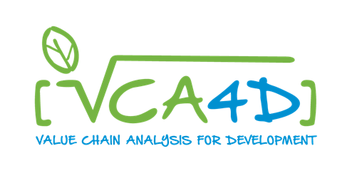
Thank you for your attention
Play the VCA Game at https://value-chain-game.agrinatura.dev.seriousgames.net
Video presenting the VCA Game https://capacity4dev.europa.eu/projects/value-chain-analysis-for-development-vca4d/info/6-vca-game_en
More info on VCA4D project and library of deliverables at https://capacity4dev.europa.eu/projects/value-chain-analysis-for-development-vca4d_en

