Slide 1
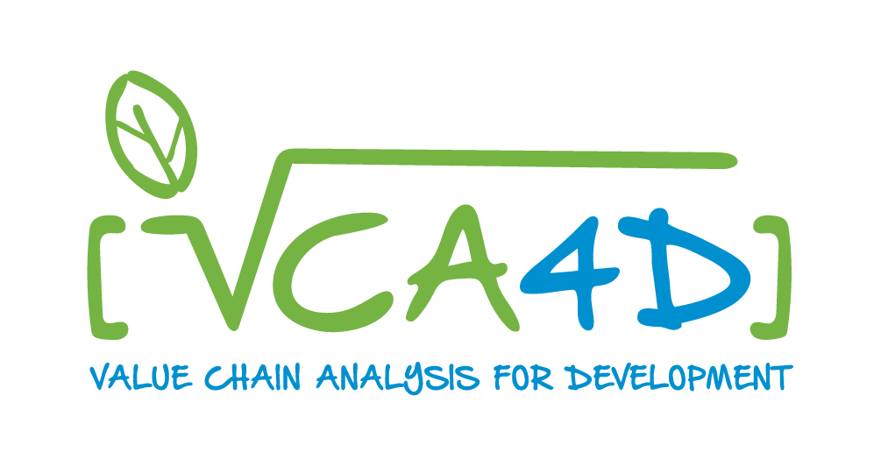
VCA4D for EU Policy Implementation
The Case of EU Gender Action plan GAP III
Laura Gualdi - INTPA F3 - 20th November 2025

Slide 2
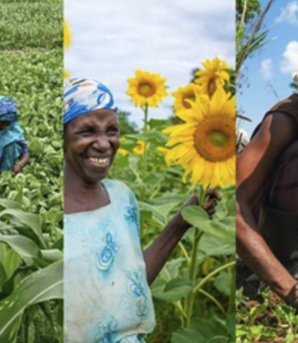
Key messages from this session
EU Money for EU policies and commitments
Policies and commitments be specific : EU specific
Analyse, design, implement, report and be accountable
Notes:
Thank you, Giorgia. And hello everyone - it’s a pleasure to be with you.
Let me start by indicating the key messages I would like participants to retain:
-EU Money for EU policies. Maybe obvious maybe not. All our Action documents starts with the box on Policy markers DAC, Rio, Gender, Nutrition…
-In what are the policy marker EU specific?
-Where do we stop to be accountable for How we spend EU Money? Design? Contracting? Reporting? Ex post, Legacy?
Last night a colleague shared the latest Court of Auditors report on the EU support to food security in sub Saharan africa

Slide 3
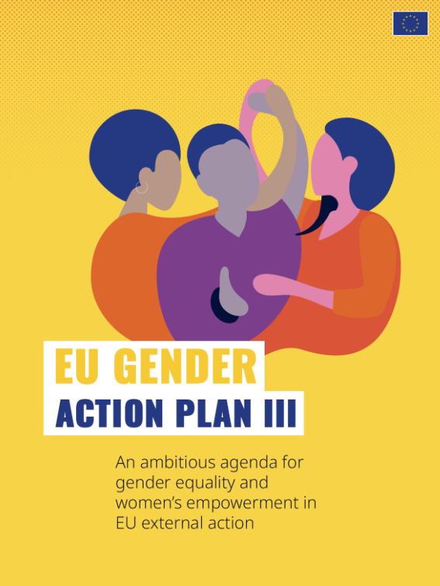

VCA4D for EU Policy Implementation: Gender Action Plan III
To add a picture, please move the grid elements on the side and then place back.
Policy GAP III
Agri Value-chain investments
VCA4D tool to bridge EU policy ambition and field realities
Notes:
Today I propose to look at three elements
one EU policy GAP III
One approach within the Food systems approach
One tool we set up VCA4D

Slide 4
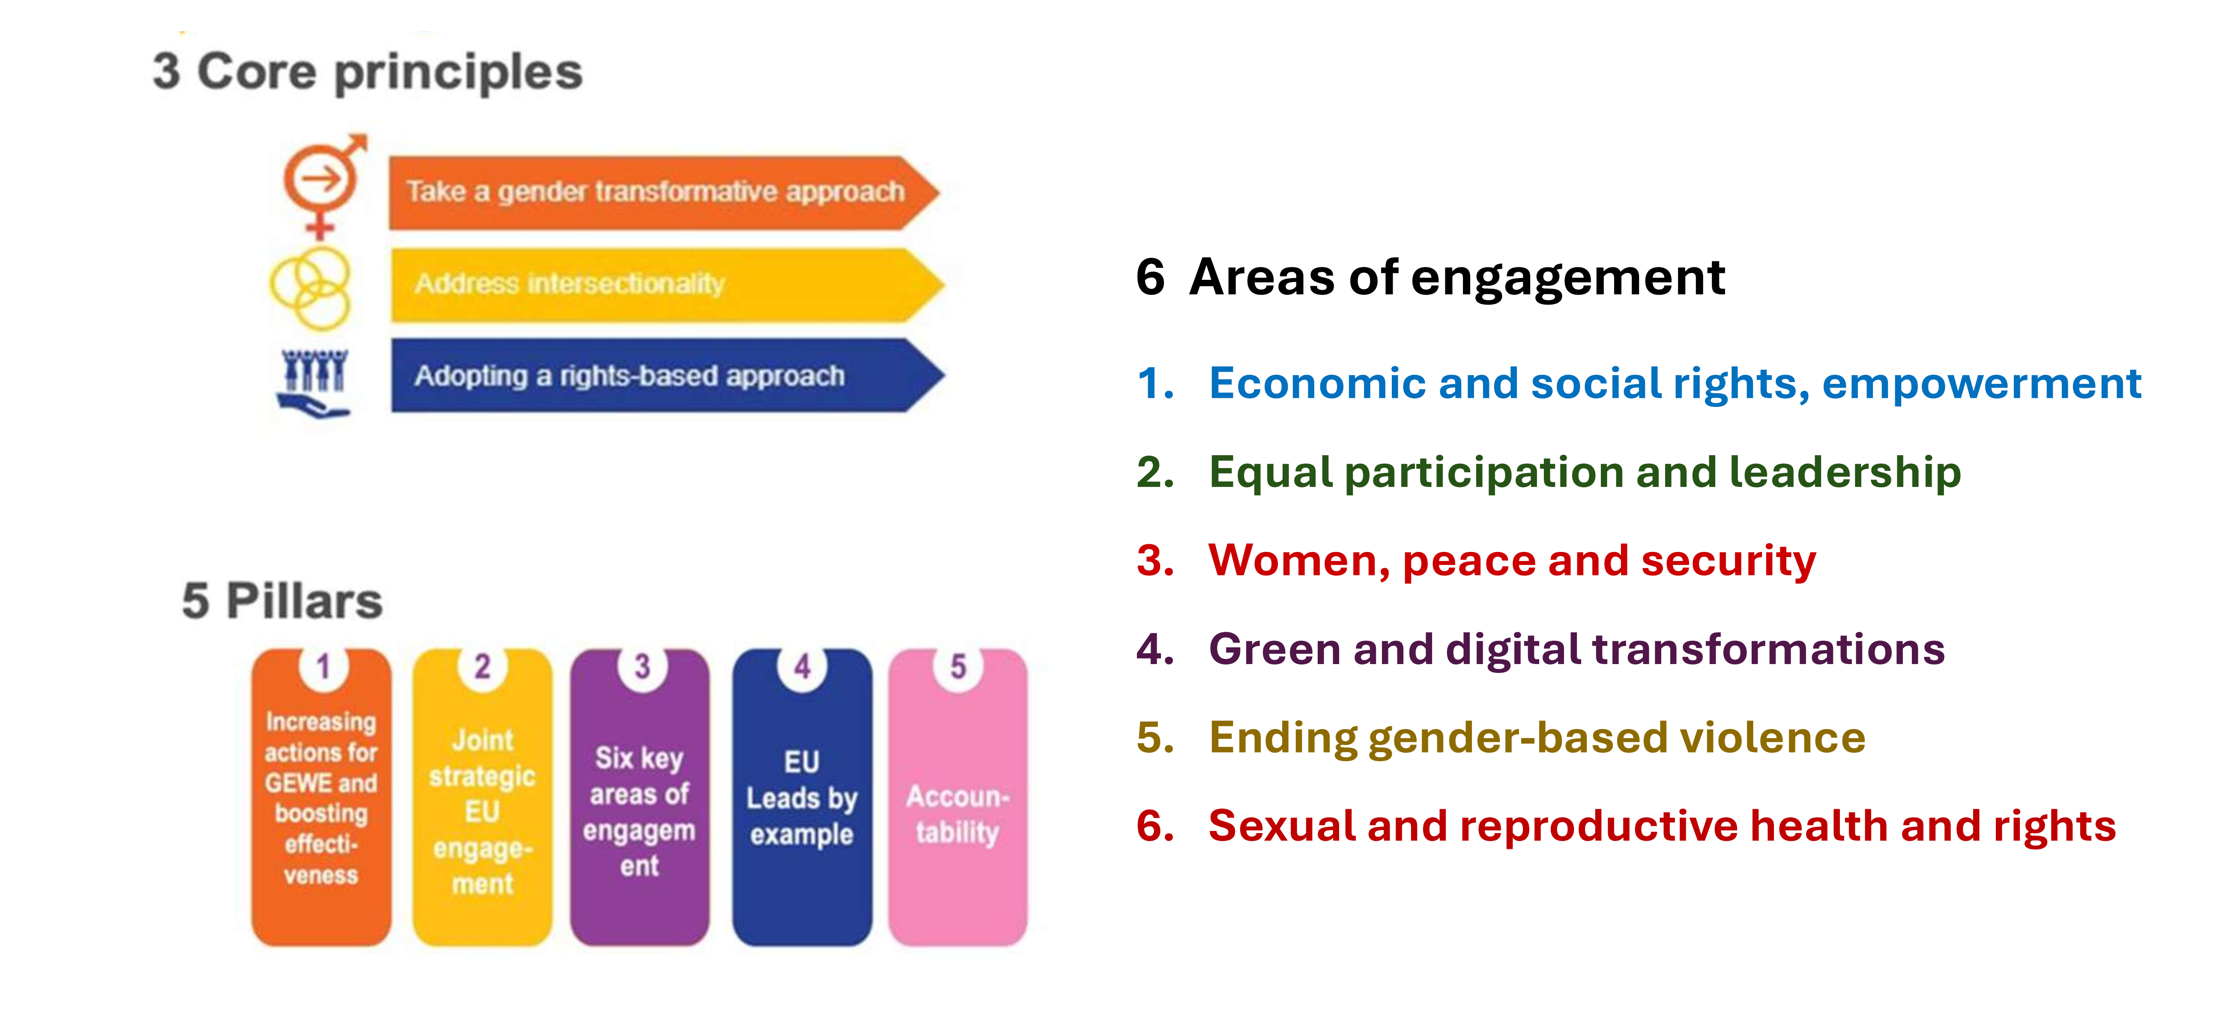
1. GAP III in a Nutshell
Mandatory EU approach to gender equality
Not treating women as a homogenous group (Intersectionality)
Gender Transformative Approach – focus on tackling the root causes (link to RBET: Reach - Benefit - Empower – Transform)
Notes:
I will not go into the details of GAP III as many in the audience today are Gender Focal points
I want to focus on 3 aspects only
GAP III target that 85% of the EU programmes have a positive effect on gender equality. This makes it a nearly mandatory requirement
GAP III is not a generic gender strategy how we must approach gender equality. - it tells us that women are not a homogeneous group and they are not necessarily vulnerable, and they are not necessarily a minority.
GAP III tell us And its centrepiece is the Gender Transformative Approach.
This means we aren’t just looking at access to services or training. We are looking at power: power over decisions, over income, over time, over mobility. We are looking at the norms that underpin inequality.
The operational language we can use for this is RBET:
Reach: Are women even being included?
Benefit: Do they actually gain anything?
Empower: Do they also gain voice and agency?
Transform: Are the underlying structures shifting?
This is the lens Delegations must apply when designing value-chain actions and when engaging with partners. And it’s the lens we invite you to use as we go through today’s session.

Slide 5
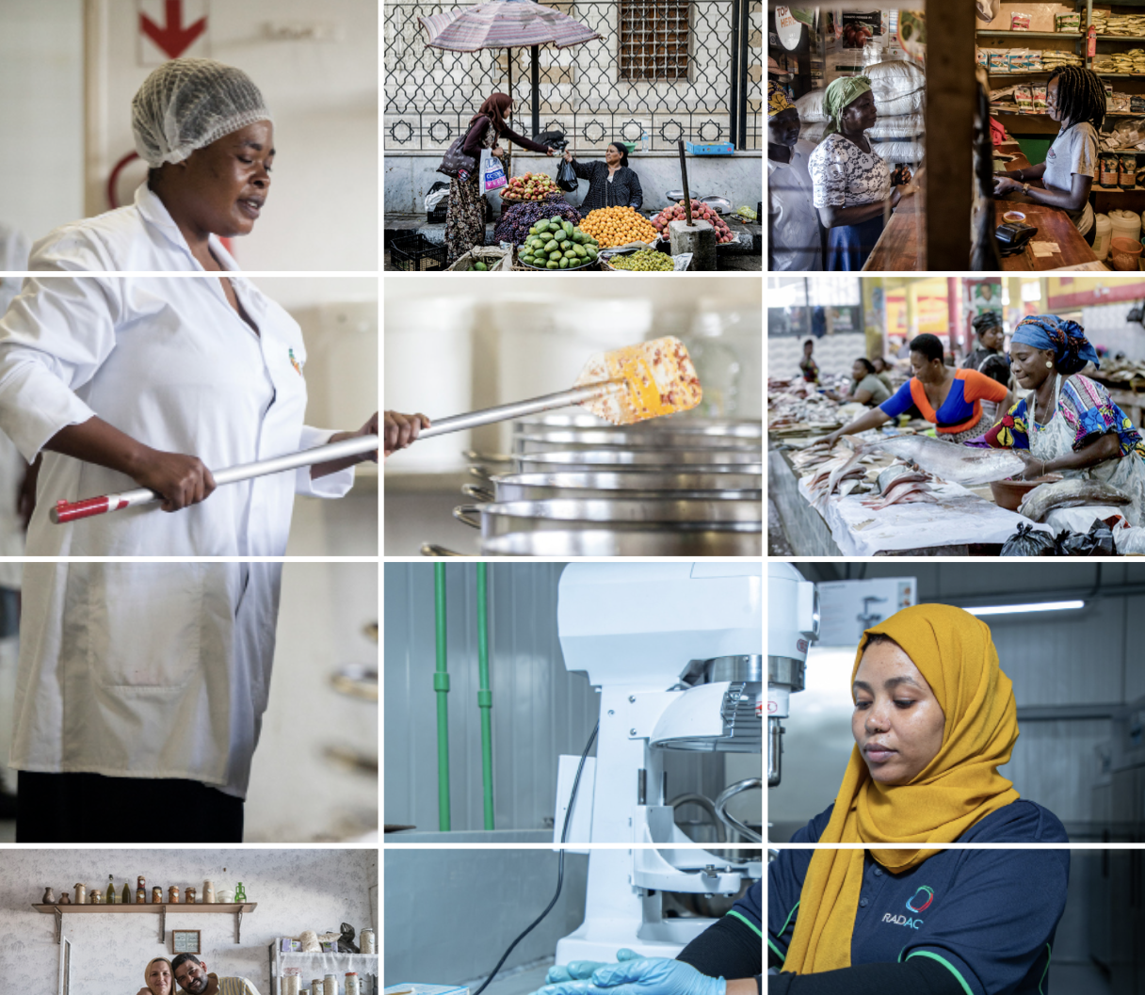
2. Why Value Chains matter for Gender equality
Value chains expand the questions: what , who – gains, decides, where – in, from, to, how – inclusive, fair, labour intensive
Unveil Intersectionality
Call for expanded analyses to avoid risks & exploit opportunities
Do No Harm → Do Good → Transform
Notes:
Value chains are an opportunity for gender equality if we are ready to use it.
Value chain approach looks at the whole system that brings the farm to the fork
They offer the opportunity to explore the system, to go beyond the individual, the household and the communities. And by doing so they give the chance to address systemic issues and constraints
Women do play different roles along a value chain. It is possible to understand and grasp what intersectionality means in practice, and to see that women are not a homogenous entity.
not neutral spaces. As will be detailed in Margarida’s presentation, they reinforce existing inequalities unless we actively address them.

Slide 6
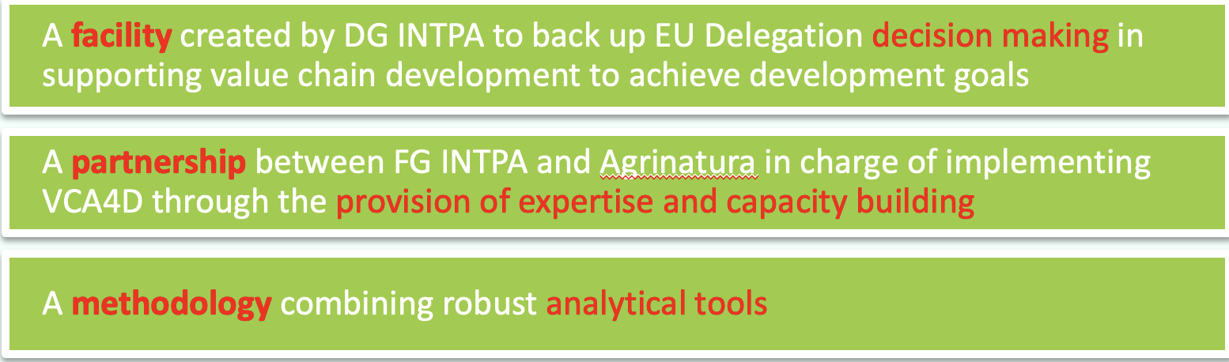
3. How VCA4D Supports EU Policy Delivery
Evidence for policy dialogue and for design & contracting
A practical tool to align EU investment with EU values
Integrated analysis: economic - social - environmental
Gender equality at the core of the social profile
Notes:
VCA4D provides a structured, multidisciplinary analysis: economic, environmental, and social. And within the social pillar, gender equality is a core domain.
This gives Delegations three things:
Design inputs: so that programmes reflect actual constraints and opportunities.
Dialogue material: to engage governments and private-sector partners on necessary reforms.
Contracting and monitoring signals: so gender commitments are not lost between the Action Document and the Description of Action.
VCA4D doesn’t provide the solutions, and it isn’t meant to. But it does tell us clearly where the problems lie - and where the priorities for action might be.

Slide 7
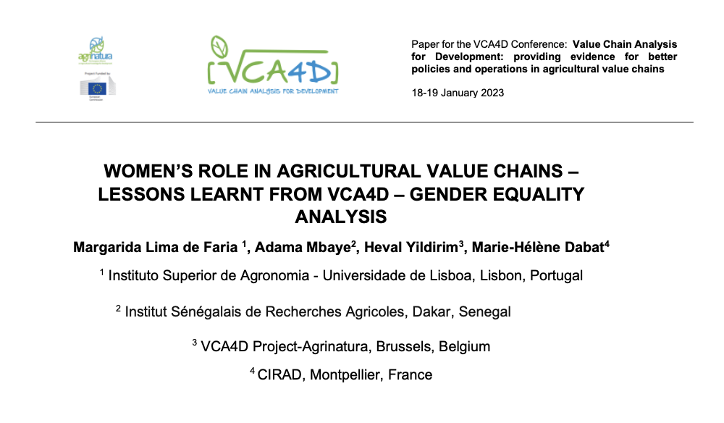
Setting the Scene
Over 40 studies - consistent gender patterns identified
Clear signals on exclusion, workload, voice and land rights
Today’s aim: Learn / Reflect / Act
Listen with a RBET logic!
Notes:
Margarida’s work synthesising 36 VCA4D studies provides powerful evidence. Across countries and commodities, the patterns are strikingly similar: heavy workloads, poor land rights, limited voice, and constrained decision-making.
As you listen to her presentation, I invite you to apply the RBET logic. Notice where women are being reached - or not. Notice where benefits are fragile. Notice where empowerment may or may not be emerging - and where structural barriers are holding firm.
We will return afterwards to discuss what Delegations can do with this evidence. For now, let me hand over to Margarida.

Slide 8



VCA4D – Gender equality analysis
Margarida Lima de Faria
for

Slide 9
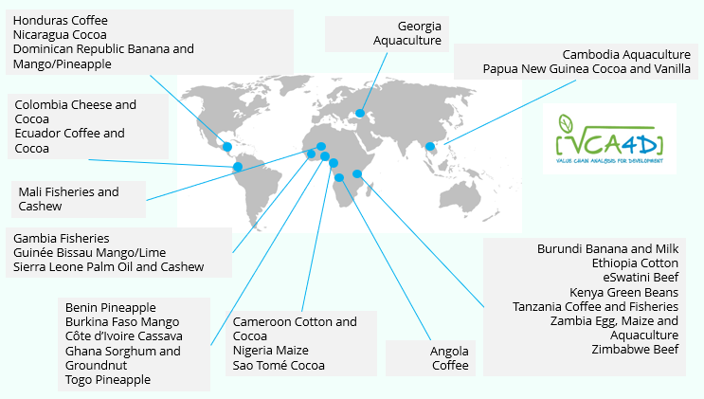
Gender equality - learning lessons from a cross-cutting analysis of 36 studies across 4 continents
By Margarida Lima de Faria, Marie-Hélène Dabat, Heval Yldirim, Adama Mbaye
2016 and 2022
This study aimed to assess women’s participation vs. risks of exclusion across agrifood value chains.
We expected that examining 36 reports would shed light on new aspects of gender equality in agrifood systems and its transformative dimensions.

Slide 10
The social analysis
A holistic understanding of the social sustainability of the VCA
Approaching the VC actors in the field, questioning the realities of the VCA to achieve an analytical understanding
Six domains in the VCA4D method: working conditions, land and water rights, gender equality, food & nutrition security, social capital, living conditions
Five gender equality sub-domains: economic activities, access to resources and services, decision making, leadership and empowerment, hardship and division of labour subdivided in seventeen questions (17 questions)
Scores assigned to the different questions (per domain and sub-domain): high, substantial, moderate/low, not at all respect for women’s rights.

Slide 11
The overall picture of gender equality
Strong negative assessment of gender equality accross the 36 studies
The experts have scored as moderate/ low –more than half of the questions accros the gender sub-domains – 53%;
And as not at all –12% of the questions.
These negative assessments combined, correspond to 65% of all the scores.
Women participation in the VCs had the more positive scores.
Inequality of workloads, inequality of land rights, hardship of women’s work and access to credit were considered highly critical.
Highly positive = 7% (40/612)
Substantially positive = 26% (163)
Moderate/low = 53% (324)
Not at all positive = 12% (74)
Not applicable (n.a.) = 2% (11)
17 questions x 36 studies = 612 answers and scores given
Since multiple value chains were analyzed per country (Ghana, Cameroon, Dominican Republic), and some commodities (such as cocoa and coffee) were studied across different countries, we examined the scores to see if they were influenced by country or by commodity.
The country effect proved stronger than the commodity effect, likely due to the combined influence of national legislation and implementing policies, and country-specific cultural norms.

Slide 12
Special features related to the five specific sub-domains
Women actively participate across value-chain economic activities, yet they are often denied access to labor-saving technologies, and risk exclusion if / when mechanization replaces manual labor.
Women’s limited access to land is the primary barrier to their deeper involvement, constraining access to credit and, to a lesser extent, to extension services and training.
Women’s decision-making indicators are strongly related with women earning their own income and retain control over both their earnings and the organization of their work.
However, women’s participation and leadership in groups, trade unions, and farmers’ organizations is scored as moderate to low, and their influence in territorial or political decision-making is generally minimal.
Women carry a disproportionate daily workload, a challenge emphasized by all experts.

Slide 13
Key points highlighted by the VCA4D findings
Even when women own land, it is generally mediated by men, resulting in small, low-quality plots.
Men typically own high-value livestock such as cattle, while women primarily own sheep, goats, and chickens.
The economic and political focus on men’s crops (e.g., coffee) reduces women’s autonomy and control over resources.
Women’s engagement in commercial crop production exacerbates their lack of discretionary time.
Single women, widows, and women in polygamous marriages face significant barriers to social and economic autonomy.

Slide 14
Women empowering trends that require critical evaluation
Women control over short value-chains:
This happens mainly in the case of specialized short value chains in which, women have control over the whole stages of the VC, even if it is a short value chain (i.e. control over lime juice in Guinea-Bissau, cashew processing in Sierra Leone, milk in Kenya, pito brewing in Ghana, neem oil in Cameroon).
Women increased agency as a result of their engagement in salaried work
In Burkina Faso, the fact that women workers return home with a salary has considerably increased their negotiating capacity at the household level (Burkina Faso mango).

Slide 15
Final key messages
From the different reports it is possible to observe a wide range of both women empowering and disempowering trends, driven by factors that operate at different levels.
Women’s situation is complex and dynamic. It is crucial to identify the empowering drivers as well as those that unexpectedly bring women to a stage of greater dependence and lack of autonomy.
It is also important to understand how initial resistance to women’s autonomy can be a sign of changing power dynamics. With the right support, such moments can evolve into long-term transformative gains for women and for food systems.
Finally, the country effect revealed through the experts’ scores suggests the potential for more effective political influence on creating an enabling environment for women’s equality.

Slide 16
Laura Gualdi
DG INTPA F3
2nd Presentation

Slide 17

1. The Findings of this Study Reinforce the Broader Evidence
Economic gains do not necessarily mean empowerment
Gender based constraints (norms, land, mobility, workload) constrain advancement
Inclusive is not the same as gender-responsive
Complementary interventions matter – they can really make a difference (childcare, addressing social norms and workloads etc.)
Women’s groups & collective action have the potential to be strong enablers
Notes:
Thank you, Margarida. Your presentation reinforces the evidence that continues to emerge. It underscores the premise of the EU’s existing Gender in Value Chains Brief while also aligning with more recent analysis by FAO (2023) and CGIAR (2024) on this subject. In particular Five insights are consistent:
- Economic improvement does not equal empowerment. Women may earn more, but without shifts in workload, norms, control over income or decision-making, empowerment does not follow.
- Gender-based constraints are the real bottlenecks. Land rights, mobility restrictions, unpaid care burdens, limited time, lack of networks, and discriminatory norms hold women back far more than lack of skills.
- Inclusive business is not enough: value chains must be gender-responsive, not just inclusive. Without explicit intention to reduce gender based constraints, inclusive models still reproduce inequity.
- Complementary interventions are essential. Evidence repeatedly highlights the importance of childcare, labour-saving technologies, social norm change, and men’s engagement.
- Collective action works. Women’s groups, cooperatives and associations are repeatedly shown to increase access to markets, bargaining power, finance, networks and leadership opportunities.
This evidence strengthens the message: Delegations must look beyond the core value chain interventions and also address the structural, social and institutional environment.

Slide 18
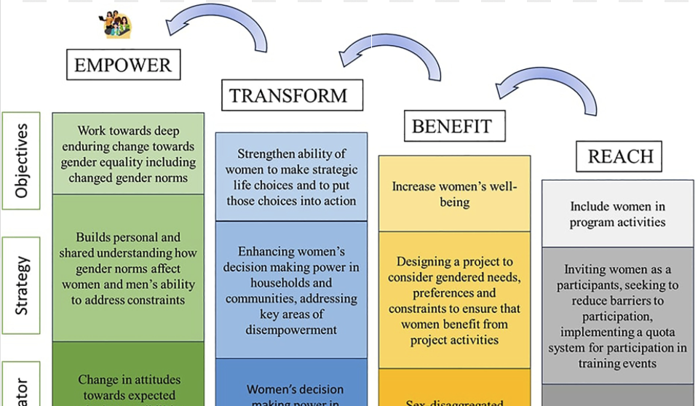
2. Take aways to implement GAP III in agri Value chains programmes
VCA4D can provide a starting point for engagement - the challenge for Delegations is then how to use these insights
Move from ‘women related add-ons’ or ‘women included’ approaches - towards a gender-transformative VC design by using RBET across the full project cycle to address gender-based constraints
Delegations and HQs have the power and influence to require adequate gender analysis to inform the project cycle and ensure implementation of this EU Policy.
Notes:
While VCA4D identifies where gender inequalities sit in the value chain - it is Delegations who determine what happens next.
Four key messages:
VCA4D is the starting point. It shows us the realities women face - workloads, exclusion, land insecurity, limited decision-making - but the response must come from us.
We must shift from ‘VC + women’s activities’ to genuinely gender-transformative design that tackles structural causes, not just symptoms.
We must apply RBET alongside analysis of gender-based constraints. This means not only asking who benefits but also identifying constraints such as norms, workloads, mobility restrictions, and lack of land or finance.
Delegations have responsibility and leverage - the authority to set requirements in designs, contracts, policy dialogue and M&E. EU money must implement EU policy, and Delegations are the frontline of that commitment.

Slide 19
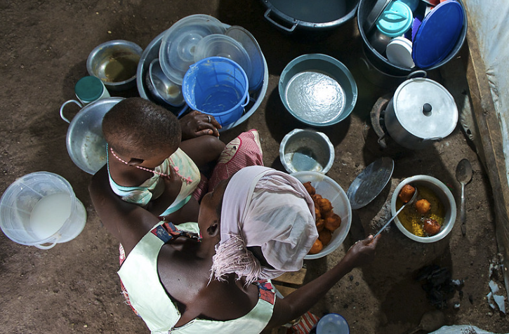
3. Building on VCA4D Findings
Integrate gender across all three pillars (economic, social, environmental)
Strengthen evidence by ensuring gender-balanced teams, intersectional analysis and generating stronger qualitative insights
Better data informs better dialogue and better decisions
Notes:
We can deepen the way we work with VCA4D by integrating gendered thinking across all three analytical pillars. Economic and environmental findings are never gender-neutral: mechanisation has gendered implications; climate impacts are gender-differentiated; income distribution influences bargaining power.
Economic gains for women do not automatically translate into empowerment.
Without confronting norms, workloads, land rights and organisational barriers, women stay stuck in low-return nodes.
Delegations can strengthen the quality of evidence by:
requesting mixed-method approaches,
ensuring gender-balanced or women-led validation workshops,
and asking for intersectional analysis — age, marital status, disability, socio-economic status.
Good evidence leads to better contracting, design and dialogue.

Slide 20
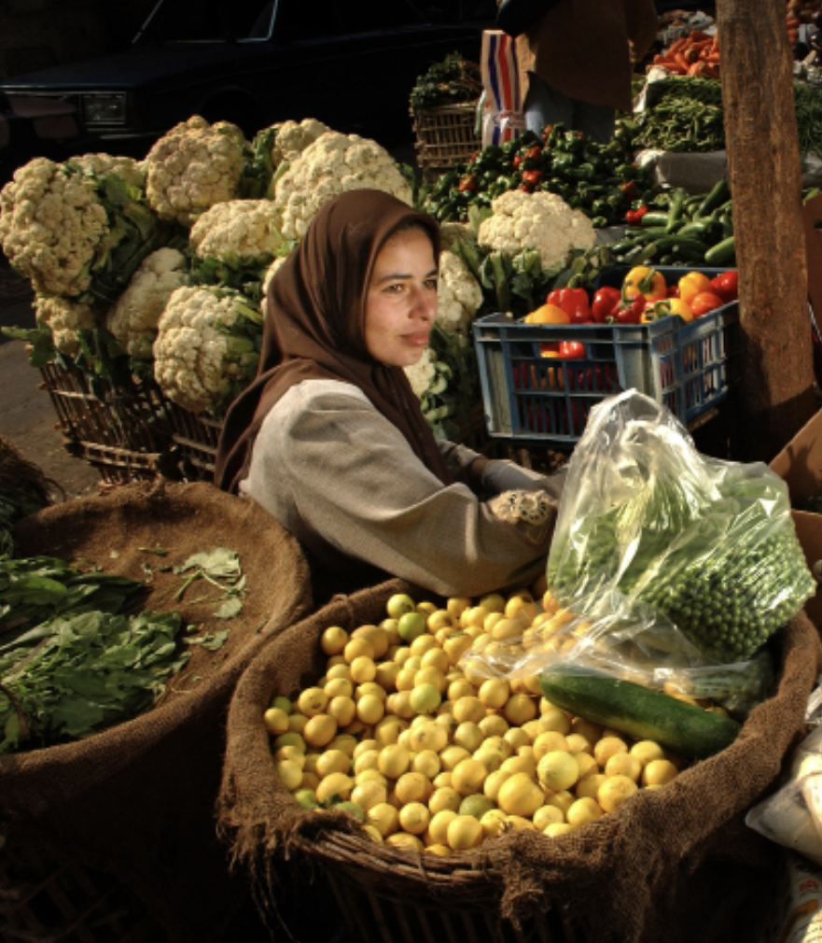
4. Knowledge to Action - Practical Takeaways
Turn evidence into design choices, contracting processes & policy dialogue
Focus on strengthening gender expertise – not just involving gender experts - in ToRs, contracts, M&E
Continue to use understanding of gender-based constraints and RBET logic to steer implementation and reporting - not just design
Notes:
Translate evidence into design and dialogue. If VCA4D shows unequal land rights, heavy workloads, lack of voice or exclusion from high-value nodes, your design must address these directly. Bring this evidence into structured dialogue with ministries, farmer organisations and the private sector.
Embed gender-transformative requirements early. Build GBC analysis, RBET logic and gender obligations into ToRs, procurement, contracts, staffing requirements and monitoring systems. Economic empowerment alone isn’t enough — we need to address norms and power.
Apply analysis of gender-based constraints and RBET logic throughout the cycle. Move beyond Reach and Benefit to ask:
Are women gaining voice?
Are workloads reducing?
Are norms shifting?
Are women gaining control over assets and income?
This is what gender-transformative value chain programming looks like.

Slide 21
5. Potential Questions to Feed Our Discussion….
To what extent were you already familiar with and clear about GTA and RBET?
Do you have good examples to share of applying such approaches to VCA and Food Systems Approaches?
Are you coming across this kind of thinking among partners (e.g. FAO, IFAD etc.)
How do you see these issues linking to Global Gateway and the 360-degree approach
Can you identify any barriers or challenges that have been faced?
Is there any specific evidence or or additional support (e.g. around indicators) and other tools that could help you translate VCA findings into action to advance gender equality?
Notes:
We have a clear picture of the structural gender constraints that repeatedly emerge across value chains. What matters now is how Delegations can use this evidence in practice. To guide our discussion, we would like to hear from you on six concrete areas.
1. To what extent are you already familiar with and clear about GTA and RBET?
This first question helps us understand where colleagues feel confident and where further clarity or guidance is still needed. GAP III expects Delegations to use the Gender Transformative Approach - and RBET is an operational way of doing that. Your feedback will help us tailor future support.
2. Do you have good examples of applying these approaches to VCA or wider Food Systems work?
We know many Delegations are already experimenting with ways to integrate RBET, social norms work, or gender-based constraint analysis. We are in the process of compiling such examples and believe that sharing them can help build an important knowledge base and collective sense of what works - and what can be drawn on and adapted.
3. Are you seeing this kind of thinking among partners—FAO, IFAD, NGOs, private sector?
This is important because the EU does not work alone. Understanding how far partners are adopting gender-transformative approaches helps us assess alignment, identify gaps, and consider where we may need to influence or support them to strengthen their gender analysis.
4. How do you see these issues linking to Global Gateway and its 360-degree approach?
Global Gateway places strong emphasis on policy coherence, investment quality and social sustainability. We are interested in how you see gender-transformative issues fitting within the larger investment operations - whether through safeguards, standards, contracting, dialogue, or monitoring.
5. ‘Can you identify any barriers or challenges you have faced?’
This is where we want to hear about what constrains you - whether it is data gaps, limited time, lack of gender expertise in implementing partners, difficulties influencing key stakeholders including ministries, or challenges integrating gender into financial or investment operations.
6. Is there any specific evidence, tools or support that would help you translate VCA findings into action?
Finally, this is crucial. We want to know what kind of support would make the biggest difference - more practical tools, examples of gender-transformative VCs, help strengthening ToRs, guidance on contracting, tailored training, peer learning, or methodological improvements to VCA4D.
These questions are meant to open a practical conversation. The aim is to hear directly from you about your experiences, challenges and needs so that we can strengthen the way VCA4D evidence is translated into gender-responsive and gender-transformative value-chain programming under GAP III and Global Gateway.

