Slide 1
State of play of the ADP negotiations from Bonn (ADP 2.11) Paris COP 21
Mariama Williams South Centre
Notes:
ACP Subcommittee on Sustainable Development in preparation for the 21st Session of the Conference of the Parties (COP21) of the UNFCCC ACP House, Brussels 28th and 29th October 2015

Slide 2
outline
Introduction & overview
I. A Unbalanced and Unfair Text
II. RIGHTING THE TEXT
III. Political challenges on the way to Paris I: “Fair share” of contributing to the global action.
IV. Political Challenge on the Way to Paris II: Finance and other MOIs

Slide 3
introduction

Slide 4
After a tumultuous start with the outright rejection of the co-chairs non paper of October 5, 2015 as the basis for negotiations, the G77 & China got down to work and submitted many company positions that was able to integrate back into the negotiations some of the critical elements of the positions of developing countries that help to balance the text on Monday Oct 19.
The co-chairs non-paper issue by Daniel Reifsnyder (US) and Ahmad Djoghlaf (Algeria) was widely repudiated as being one-sided, representing the views of the Umbrella Group, particularly the United States.

Slide 5
Starting Oct 20th, through the process of sending specific articles of the draft agreement to Spin off groups with some elements left to an open –ended contact group that met about twice a day a revised paper containing a more balance text of about 30 pages was developed. This text, which after light editing and some streamlining by the Secretariat will be forward to Paris as the basis for negotiations starting on November 30.
The goal of the G77 & China in particular the Africa Group and the LMDC was to ensure that that negotiating process and negotiating text remained in the hands of the Parties negotiating in the ADP. They also sought to keep the process open, inclusive and transparent and to have a party driven and a party owned text.
This was achieved successfully.

Slide 6
“As such this text can constitute a basis and a starting point for negotiations during the next session. It is important that the integrity of this text is maintained.” South Africa for G77 & China, Oct 23, 2015, closing plenary on Friday 23rd October 2015,

Slide 7
I. A Unbalanced and Unfair Text

Slide 8
Ambassador Nozipho Mxakato-Diseko of South Africa, speaking for the G77 and China: the Co-chairs’ text “seems to attempt to rewrite, reinterpret and replace the Convention.
It is extremely unbalanced and lopsided, to the extent that it jeopardizes the interests and positions of developing countries.”

Slide 9
I. A Unbalanced and Unfair Text
The co-chairs text was unbalanced in that:
The draft Agreement is one-sided in favour of developed countries.
It departs from or dilutes the principles and provisions in the Convention, especially its Article 4.
There is no differentiation between developed and developing countries in the proposed operational provisions. They are all treated in a like manner, wiping out the notions of historical responsibility and equity.
In mitigation, there is a downgrading of developed countries obligations and an upgrading of developing country obligations.
The focus is overwhelmingly on mitigation, with no obligation for developed countries to provide the needed funds (with no mention or roadmap to the earlier promised US$100 billion a year by 2020).

Slide 10
Other points of departure
Balance/parity in the level between Adaptation and Mitigation
MOIs
Reflections of CBDR/differentiation between developed and developing countries
Transparency
Compliance
Institutional architecture (including institutional linkage of Paris Bodies to the UNFCCC existing bodies)
Linkage between WS 2 and WS 1

Slide 11
II. RIGHTING THE TEXT

Slide 12
The Process
Spin-off groups and informal-informals and contact group that were set up for the main issues that would be decided in Paris
The negotiated text produced from the spin-offs with brackets was re-issued as non-part with elements for the Paris Agreement negotiations
Parties were unable due to time constraint to fully discus the draft decisions so this is also forwarded to Paris as is with a footnote qualifying that it had not been so discussed and so should not prejudice the position of the parties.
The revised non paper will be the outcome of ADP 2.11 and will go the Paris as the basis for the continued work of the ADP through the same process as started in Bonn this session: ADP Open-ended Contact Group and its Spinoff Groups.

Slide 13
The structure of the DRAFT AGREEMENT
Preamble
Art 1: definition
Art 2: Purpose (Art 2bis General)
Art. 3 Mitigation, (art 3 bis REDD plus) art 3 terr on mechanism to support sustainable development)
Art 4: Adaptation
Art 5: loss and Damage
Art 6: Finance
Art 7: Technology Development and Transfer
Art 8: Capacity building
Art. 9: Transparency
Art 10: Global Stocktake
Art 11: Facilitating implementation and Compliance
Art 12: CMA
Art 13 (secretariat); Art 14 (SBSTA and SBI)
Art 15 (Bodies and Institutional arrangement to serve agreement)
Art 16: Signature and instruments of Ratification, Acceptance, Approval or Accession)
Art 17: Further requirements and Decision-making rights
Art 18: Entry into force
Art 19: Amendments
Art 20: Annexes; Art 21 (settlements of disputes); Art 22 (voting); Art 23 (depositary), Art 24 (Reservations); Art 25 (withdrawal); Art 26 (language)

Slide 14
The DRAFT DECESION (ON WORKSTREAM 1 AND 2)
Preamble
Adopting of he (Paris Agreement or Paris Implementing Agreement under the UNFCCC
INDCs
Decisions to give effect to the Agreement
General, Mitigation, Adaptation, Loss and Damage, Finance, Technology Development and Transfer, capacity building, transparency of Action and Support. Global stocktake. Facilitating and implementation and compliance, procedural and institutional provision
[WORKSTREAM 2]
Administrative and budgetary matters

Slide 15
DRAFT DECISION ON WORKSTREAM 2
Preamble
Mitigation
Support

Slide 16
III. “Fair share” of contributing to the global action
The Political Challenge on the Way to Paris: I

Slide 17
Principles, Article 3.1, UNFCCC, 1992
“The Parties should protect the climate system for the benefit of present and future generations of humankind, on the basis of equity and in accordance with their common but differentiated responsibilities and respective capabilities.”
Notes:
17

Slide 18
Principle 7, Rio Declaration, 1992
“In view of the different contributions to global environmental degradation, States have common but differentiated responsibilities. The developed countries acknowledge the responsibility that they bear in the international pursuit of sustainable development in view of the pressures their societies place on the global environment and of the technologies and financial resources they command.”

Slide 19
Equity, Fair share and the INDCs
There many analysis of the INCS submitted—all agree the aggregate of the INDCs od not put the world on a 2c pathway
A joint Civil Society approach focused on an Equity and fair share approach of submitted INDCs: Fair Shares: A civil society equity review of INDCs.
The results of this are compelling and stark.
The country’s actions have been submitted as “intended nationally determined contributions” (or INDCs), and these are a key feature of the Paris agreement.
Together, the commitments captured in INDCs will not keep temperatures below 2C, much less 1.5C, above pre-industrial levels. Even if all countries meet their INDC commitments, the world is likely to warm by a devastating 3C or more, with a significant likelihood of tipping the global climate system into catastrophic runaway warming.
The current INDCs represent substantially less than half of the reduction in emissions required by 2030
Notes:
See for example
Fair Shares: A civil society equity review of INDCs
www.CivilSocietyReview.org #FairShares
“Beyond the Numbers. Understanding the Transformation Induced by INDCs” has been prepared by the MILES project Consortium under contract to DG CLIMA (No. 21.0104/2014/684427/SER/CLIMA.A.4).
Carbon Budget and Climate Justice. GGCC Universitat Polittechnica De Catalunya

Slide 20
Assessing ‘fair share’
A country’s fair share depends on two factors: its historical responsibility, (i.e. its contribution to climate change in terms of cumulative emissions through the years), and capacity to take climate action, using national income over and above what is needed to provide basic living standards as the principal indicator.

Slide 21
Too Little Ambition
The ambition of all major developed countries falls well short of their fair shares, which include not only domestic action but also international finance. Those with the starkest gap between their climate ambition and their fair shares include:
Russia: INDC represents zero contribution towards its fair share
Japan: INDC represents about one tenth of its fair share
United States: INDC represents about a fifth of its fair share
European Union: INDC represents just over a fifth of its fair share

Slide 22
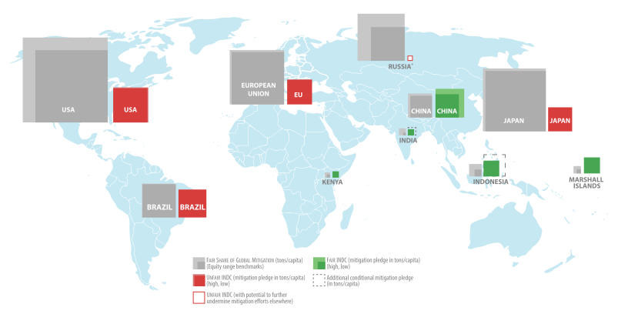
Results: fair shares and INDCs

Slide 23
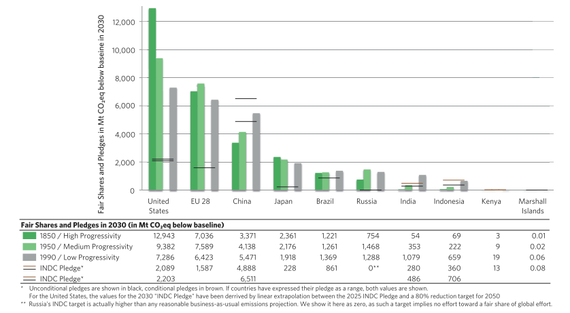
Results: fair shares and INDCs

Slide 24
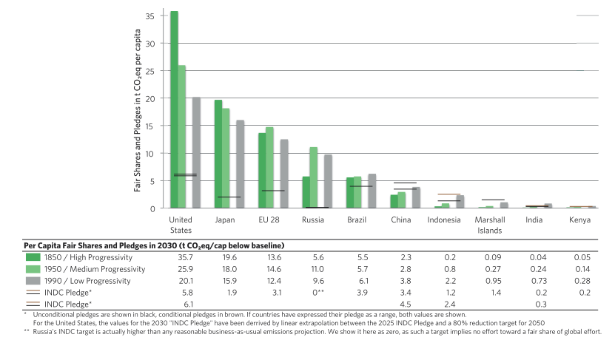
Results: fair shares and INDCs
Notes:
e report “Beyond the Numbers. Understanding the Transformation Induced by INDCs” has been prepared by the MILES project Consortium under contract to DG CLIMA (No. 21.0104/2014/684427/SER/CLIMA.A.4).

Slide 25
Too little ambition 2?
Most developed countries have fair shares that are already too large to fulfill exclusively within their borders.
The remainder of their fair shares must therefore be accomplished by enabling an equivalent amount of emissions reduction in developing countries through financing and other support.
This accounts for almost half of the reductions that need to take place globally, which indicates the need for a vast expansion of international finance, technology and capacity-building support

Slide 26
Too Heavy a Load?
The majority of developing countries have made mitigation pledges that exceed or broadly meet their fair share, but they also have mitigation potential that exceeds their pledges and fair share.

Slide 27
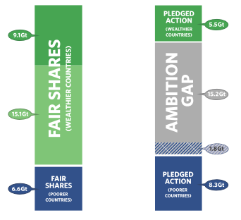
Results: fair shares and INDCs (in aggregate)

Slide 28
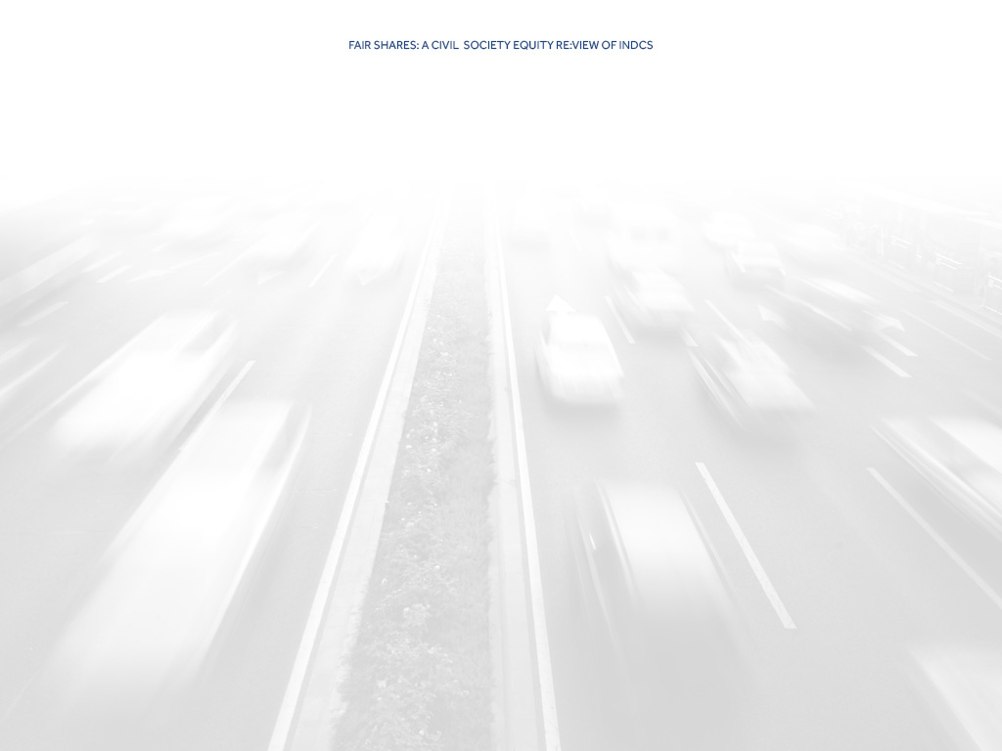
PARTICIPATING ORGANISATIONS
Fair Shares: A civil society equity review of INDCs
ActionAid International
Asian Peoples Movement on Debt and Development
CAN South Asia
CARE
Center for International Environmental Law
Christian Aid
CIDSE
Climate Action Network Latin America
EcoEquity
Friends of the Earth International
International Trade Union Confederation
LDC Watch International
Oxfam
Pan African Climate Justice Alliance
SUSWATCH Latin America
Third World Network
What Next Forum
WWF International

Slide 29
Not Enough Support
Although climate finance is critical for developed countries to deliver their fair shares, there is a striking lack of clear commitments.
Massively scaled-up international public finance is required to support developing countries’ efforts.
In addition, significantly increased public climate finance is needed to meet the cost of adaptation, and to cover loss and damage in developing countries, particularly for the most vulnerable.

Slide 30
Whither the $100 billion?
OECD/Climate Policy Initiative Report, Climate Finance in 2013-14 and the USD 100 Billion goal, launched on October 7th 2015:
‘significant progress’ made towards the $100 billion goal
It says that the annual average over the two years (2013 and 2014) of climate finance mobilised by developed countries was USD 57 billion
$52.2 billion in 2013
$61.8 billion achieved in 2014.
77% of the climate finance mobilized is allocated towards climate change mitigation
16% towards climate change adaptation
7% targeted to both.

Slide 31
Adding UP…
According to the OECD’s data: 2013
loans comprise about $20 billion of the reported flow for 2013
private finance accounting for another $20 billion,
Grants account for only $13 billion.

Slide 32
Challenges with the numbers
What counts as climate finance?
How is it measured? Accounting/Methodology and Assumptions
Is it new and additional?
Who is delivering the funds? Delivery Channels (funds under the Convention vs MDBs, TNCs.)
Who is getting the finance?

Slide 33
The Way forward to Paris
Paris is not an end in itself, it is about enhancing the implementation of the Convention. So it must build on the provisions and principles of the convention.
Developing countries are taking ambitious action on climate change even as they seek to eradicate poverty and a good standard of living for the women, children and men in their countries.
Developing countries are also the ones most vulnerable to the increasing impacts of climate change.
The Paris Agreement must be ambitious with regard to Adaptation, Mitigation, Finance and Technology Development and transfer and capacity building. These must be treated in a fair and balance way
Above all the Paris agreement must be fair and equitable and just recognising the right to development of developing countries .

