Slide 1
UNDP
Current and post-2015 Climate Change Support
Jan Kellett, Bureau for Policy and Programme Support
Presentation, ACP, October 2015

Slide 2
UNDP, CLIMATE, DEVELOPMENT

Slide 3

Sustainable Development

Slide 4
UNDP VISION FOR THE CLIMATE NEGOTIATIONS: A Global Agreement
An ambitious deal on climate change
Capitalizing on existing successes
Post 2015 development is the opportunity of meaningful integration of climate change and development
Coherence across development frameworks is essential.
Guaranteed adequate and sustained financing

Slide 5
UNDP VISION FOR THE CLIMATE NEGOTIATIONS: Country Level Practicality
Delivering at the country level must be central to any agreement.
Looking for synergies between new frameworks and how this can support countries
Integrated across all development objectives (finding complementarity and avoid overburden at national level)
Building new partnerships to deliver

Slide 6
CLIMATE AND THE SDGs
Going forward, UNDP will be supporting “readiness” for the implementation of the climate aspects of the SDGs through:
Ongoing engagement in the development of indicators for the targets under SDG 13 through UN Task Team
Continued support to drafting the new One UN strategy on Climate Change which will be finalized after Paris
Identification of programmatic interventions UNDP is implementing which can be scaled up under SDG 13
Analyzing and identifying synergies between climate change elements of the SDGs and Paris Climate Agreement for country implementation in 2016 and beyond

Slide 7
UNDP
Strategic
Plan
2014-2017
UNFCCC
Negotiations
NAPs, LEDS, NAMAs, NCs,
BURs, INDCs, GCF
Global support programmes - Supporting strategies and processes to access and implement climate finance
NAP-GSP
GCF Readiness
NC/BUR/
iNDC-GSP
REDD +
LECB
Helping to think through what it means to integrate climate into planning and budgeting, scale up actions/portfolio, facilitate greater on-the-ground impact and deliver on the Strategic Plan outcomes

Slide 8
Intended Nationally Determined Contributions

Slide 9
UNDP Support for INDC Preparation
International dialogues and technical training on INDCs (o assist countries in (technical elements, institutional context, and consultation processes)
  7 regional dialogues, a global workshop, a high-level INDC forum, and 3 targeted workshops were held in 2014-2015 (over 1000 participants from 140 countries,)
  In partnership with UNFCCC Secretariat and others; supported by several donors
Financial support for the preparation of INDCs provided to 34 developing countries from all regions (through contributions from the EC, GEF, and Germany)
Low Emission Capacity Building (LECB) Programme technical assistance and coordination for INDC preparation, as well as in related areas (e.g. NAMAs, GHG inventory) - funded by EU, Germany, and Australia
Global Support Programme technical assistance on NatComs, BURs, and INDC-related activities (in partnership with UNEP and funded by GEF)
A guidance document on Designing and Preparing INDCs developed in collaboration with WRI to assist countries in INDC design
Development of a lessons learned report and webinars to facilitate exchange of information among countries on INDC preparation

Slide 10
Key Lessons Learned through INDC Assistance
  National priorities determined contribution types and scope
Identification of a lead institution, policy/sectoral experts, technical teams and a stakeholder process were critical to building trust
  A coherent message, including a long-term vision, was needed to strengthen INDC support and implementation
Sustainable development benefits and linkages with national plans were seen as critical elements to consider when prioritizing proposed contributions
One of the challenges faced was how to strike a balance between sound information, linkages with political processes, and realistic goals
Prioritization of policies and actions with highest implementation and impact potential to avoid dispersion is very important for INDC design and implementation
Identification of what may be domestically funded vs. what could be undertaken with additional support was key to understand resources needed

Slide 11
UNDP Support After Paris
INDC implementation plans: Articulating timeframes, assessments of next steps, strategies for removing barriers to implementation of underlying actions, etc.
Data systems: Constructing and maintaining robust GHG inventory systems that serve as a foundation for reliable tracking
MRV: Strengthening countries’ MRV capacity and data-sharing mechanisms to improve understanding and communication of progress
Institutional structures: Establishing durable institutional structures or arrangements to facilitate effective implementation of INDCs
Finance: Developing financial models and risk-reduction measures to help attract large-scale finance and public and private investments for mitigation and adaptation actions
Private sector engagement: Helping countries understand private sector financial flows and priorities, as well as strategies for engaging the private sector in low-carbon actions
Co-benefits: Identifying and leveraging non-GHG impacts of mitigation actions in order to secure political and financial support

Slide 12
UNDP’s COMMITMENT post-Paris

Slide 13
UNDP’s Commitment to Post 2015 Climate Change Support
UNDP:
Zero Carbon, Resilient Development
Zero Carbon Development:
Delivering Green and Sustainable Growth
Climate-Resilient Development:
Delivering on a Risk-Informed Future
BUILDIING CLIMATE AND DEVELOPMENT CAPACITY
CATALYSING FINANCE
NEW PARTNERSHIPS FOR DEVELOPMENT

Slide 14
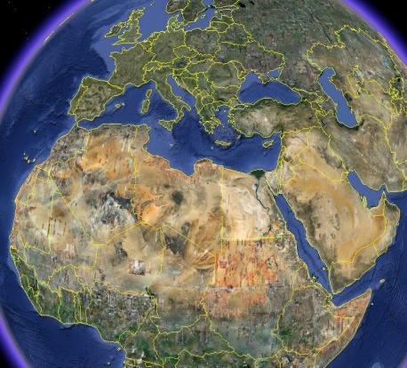
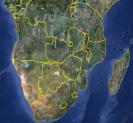
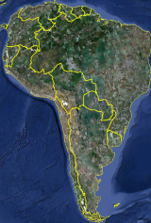
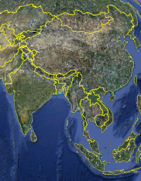
Scale of Work: 143 countries

Slide 15
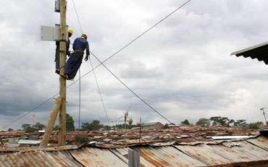

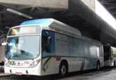
Mitigation: US$4 bln, US$640 grants
  2
    Access to electricity (on- and off-grid)
    Access to electricity (on- and off-grid)
    Energy efficiency and conservation
    Sustainable transport systems

Slide 16
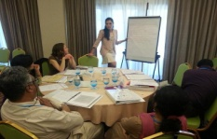

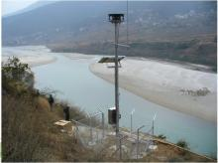
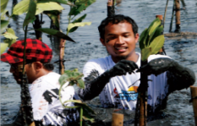
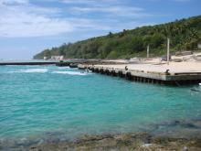

Adaptation: $3.5 bln ($815 mln grants
    Integrated Strategies
    Resilient Livelihoods
    Climate Information & Early Warning
    Ecosystem Based Adaptation
    Resilient Water Management
    Resilient Energy & Infrastructure

Slide 17
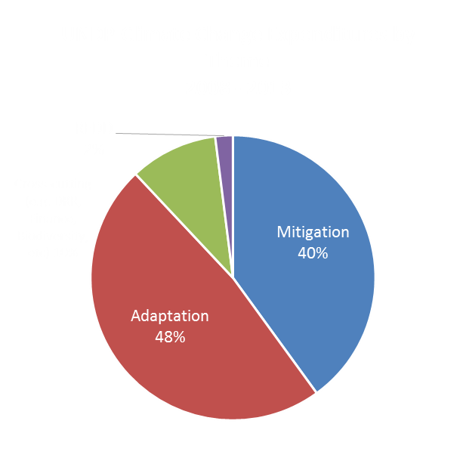
At a Glance
Sept 2015: $1.72 billion portfolio of mitigation and adaptation projects in over 140 countries

Slide 18
Zero Carbon Development: Delivering Green and Sustainable Growth
Strengthening Intended Nationally Determined Contributions (INDC). Scaling up ambition; integrating into development planning; linking them to SDGs; and support for monitoring, reporting & verification.
Zero-Carbon Solutions. This includes support for UNFCCC mechanisms, including national mitigation actions (NAMAs) and low emission development strategies (LEDs).
Energy Efficiency. Sustainable energy, reducing demand for energy, reducing costs, reducing emissions.
Sustainable Energy Access. By supporting partners to invest in clean energy, and helping to create a conducive environment for private sector investment.
Forests and CO2. UNDP will support efforts to protect against deforestation and forest degradation through scaling up the UN REDD programme.

Slide 19
Climate-Resilient Development: Delivering on a risk-informed Future
Risk Governance. This includes support to incorporate climate action and disaster risk reduction into governance systems and arrangements. (5/10/50)
Adaptation Solutions: This includes supporting UNFCCC adaptation mechanisms, such as National Adaptation Plans (NAP) and National Adaptation Programs of Action (NAPA), as well as scaling up projects at country level.
Risk-Informed Disaster Recovery. UNDP will integrate climate action into disaster recovery efforts, and this as an opportunity to build back better and more resilient.
Ecosystem Based Adaptation. Acknowledging the relationship between development, environment and climate change, UNDP will support ecosystem based adaptation programs.

Slide 20
The end: climate and development

Slide 21
Sustainable Development

Slide 22
Thank You!

