Slide 1

Mobilizing the private sector
for climate action and sustainable industrialization
in the context of the 2030 agenda and COP 21
GCCA Intra-ACP program and special meeting of ACP Sub-committee on SD preparing for COP 21
ACP Secretariat, Brussels 28-29 October 2015
Christophe Yvetot
Head of UNIDO Liaison Office to the European Union

Slide 2
Key messages
Focus on industry and energy is essential for real impact
Need of international tools for knowledge, technology transfer and sharing best practices
Work more holistically: nexus issues, resilience, maximizing co-benefits

Slide 3
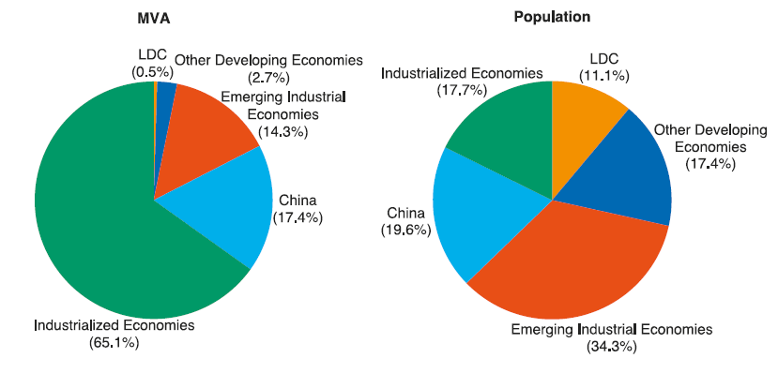
Value addition: key for development
MVA of industrialized countries:
10 times higher than developing countries
90 times higher than LDCs
Notes:
- CAGR from 2005 to 2010 (most data available)

Slide 4
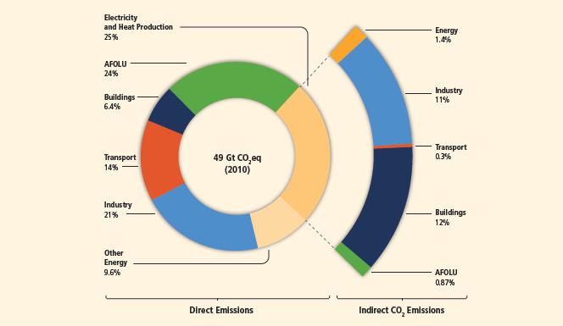
Focus on industry and energy
Source: IPCC 2014

Slide 5





Means of Implementation for SDGs and climate action
UNIDO/UN global instruments for 2030 Agenda
All supported by the EU and its Member States

Slide 6
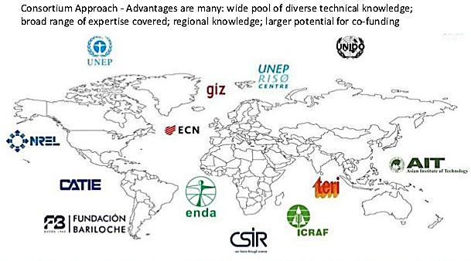
Climate Technology Center and Network co-led by UNIDO and UNEP
https://www.ctc-n.org/

Slide 7
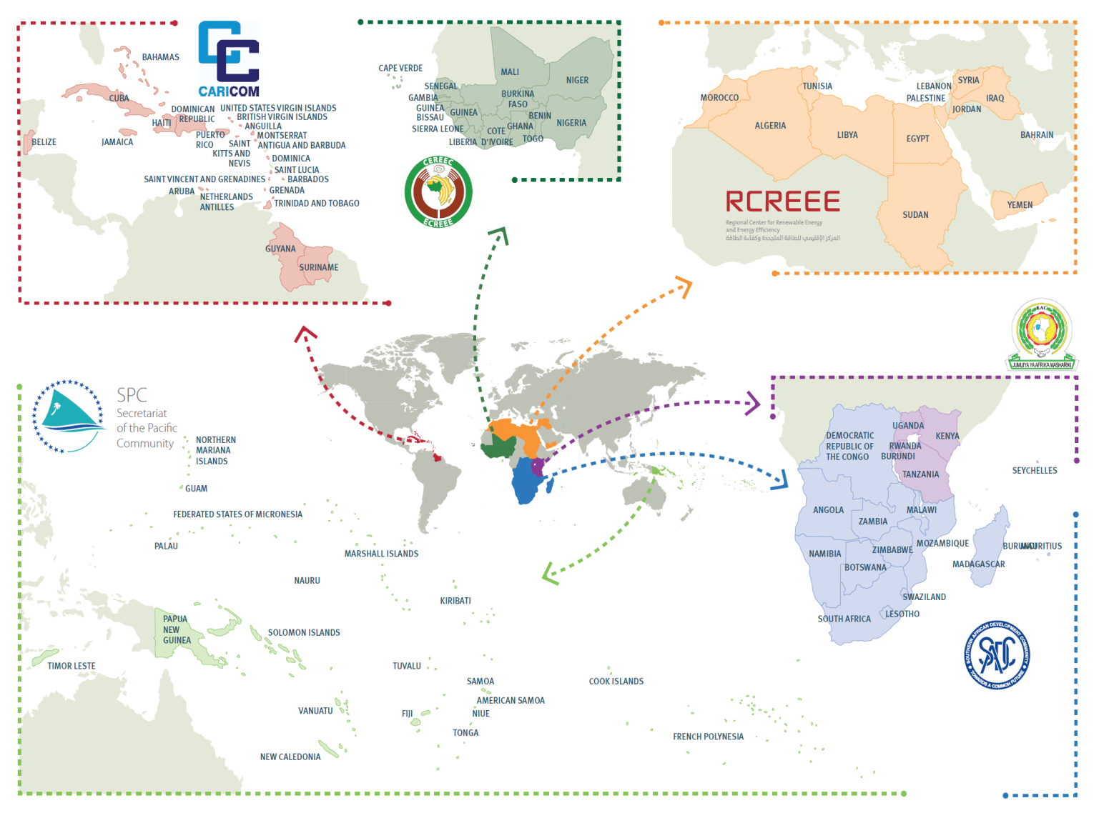
Sustainable Centres: Overview and Functions
Tailored Policy Frameworks and Quality Standards
Facilitate Capacity building
Advocacy, Awareness Raising, KM and Networking
Implementation of RE and EE projects
Model: http://www.ecreee.org/
PCREEE
Notes:
Location of all centers

Slide 8
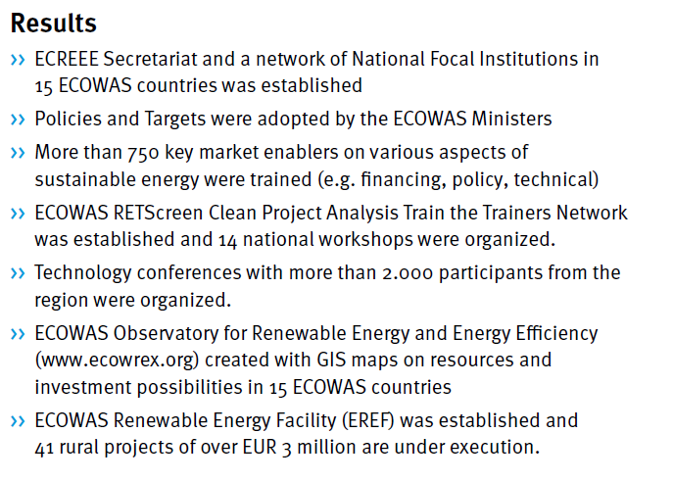
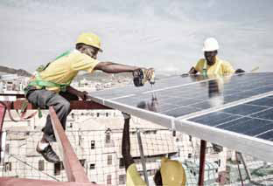
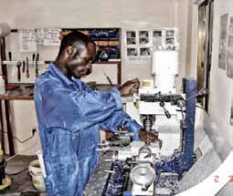
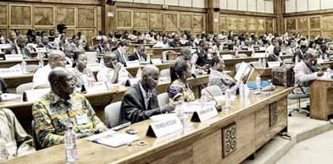
ECOWAS Center for RE and EE (ECREEE)
+ ECOWAS Observatory for RE and EE (ECOWREX)

Slide 9

UNIDO key role in technology transfer
Institutional role
  UNIDO as co-host of CTCN
  FfD3 technology mechanism
Special programmes
  Clean Tech programme for SMEs
  Low carbon clean energy TT
  Transfer of Env. Sound Tech
Promotion through networks
  Specialized Networks ITPOs,
  SECs, RECP, etc

Slide 10
Tackling climate change: some highlights
Montreal Protocol:
  Each year: 5-6 times of 1st phase of Kyoto Protocol in CO2e avoided
  Until 2010: 70,287 tonnes Ozone Depleting Potential
  UNIDO: 1200 projects, globally 27% share, 100 countries, best implementing agency
Sustainable Energy efforts:
  SE4ALL objectives in line with 2 degree Celsius target
  By 2015: 200 million with electricity and 400 million clean cooking
  80 countries opted-in and 118 with RE policy targets
  UNIDO: ~100 projects, 50+ countries
Adaptation
  New: climate resilient industries along energy-water-food nexus
  UNIDO: several Large Maritime Ecosystems (LME) rehabilitation

Slide 11
Green Industry: Flagship Programmes
Resource Efficiency | Water | Energy | Chemicals Management
Resource Efficiency & Cleaner Production (RECP) | Transfer of Env. Sound Technologies (TEST) | Industrial Energy Efficiency: EMS & System Optimization | Persistent Organic Pollutants (POPs) Phase-out
Environmental Management Standards | Mercury Programme | Renewable Rural Energy for productive use | Ozone Depleting Substances (ODS) Phase-out
Corporate Social Responsibility – REAP 26000 | Large Marine Ecosystems (LME) Rehabilitation | Low Carbon Technologies | Chemical Leasing
 |  |  | E-waste Management
Climate Change Mitigation and Adaptation

Slide 12
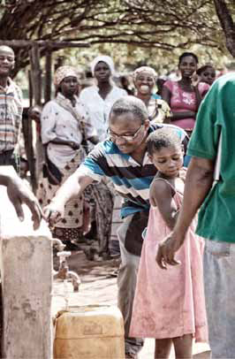
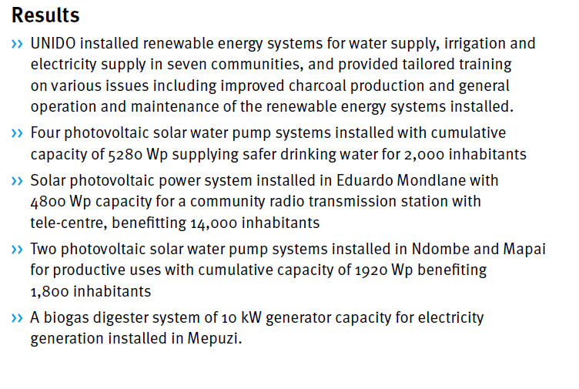
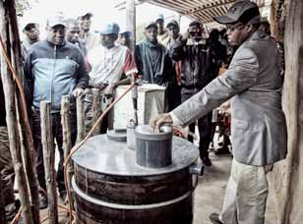
Mozambique: Renewable energy for water supply

Slide 13
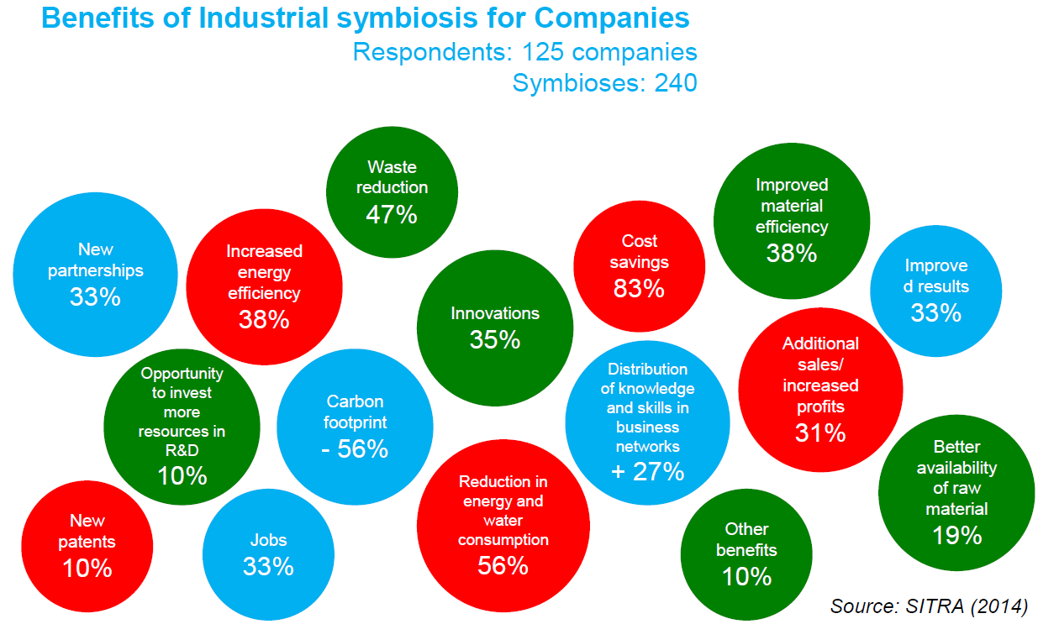

Slide 14

Financing for low carbon development
Official Development Assistance
MEAs, GEF, GCF
Leveraging private sector/ industry
  Local private sector: TEST & IUMP
  PPPs & supply chains
Blending/ de-risking
  EIB, EBRD, WB, AFD, etc.
Environmental tax reform
  From labor to resource productivity

Slide 15

Leverage effect of GEF financing: UNIDO Energy
GEF 4
US$ 89.1 Million
GEF 2/3
US$ 18.6
Million
GEF 5
US$ 141.1 Million
GEF FUNDING
= US$248.86 Million
GEF 4
US$ 548.8
Million
GEF 5
US$ 689 Million
GEF 2/3
US$ 29
Million
CO-FINANCING: Local governments and private sector
= US$ 1,267.5 Billion
GEF 4
32
GEF 5
49
GEF 2/3
3
NO. OF PROJECTS
GEF Co-funding requirements:
LDCs <50% and non-LDCs <25%
= 84
15

Slide 16

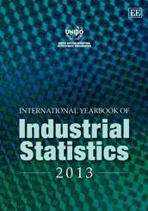



Measuring progress

Slide 17
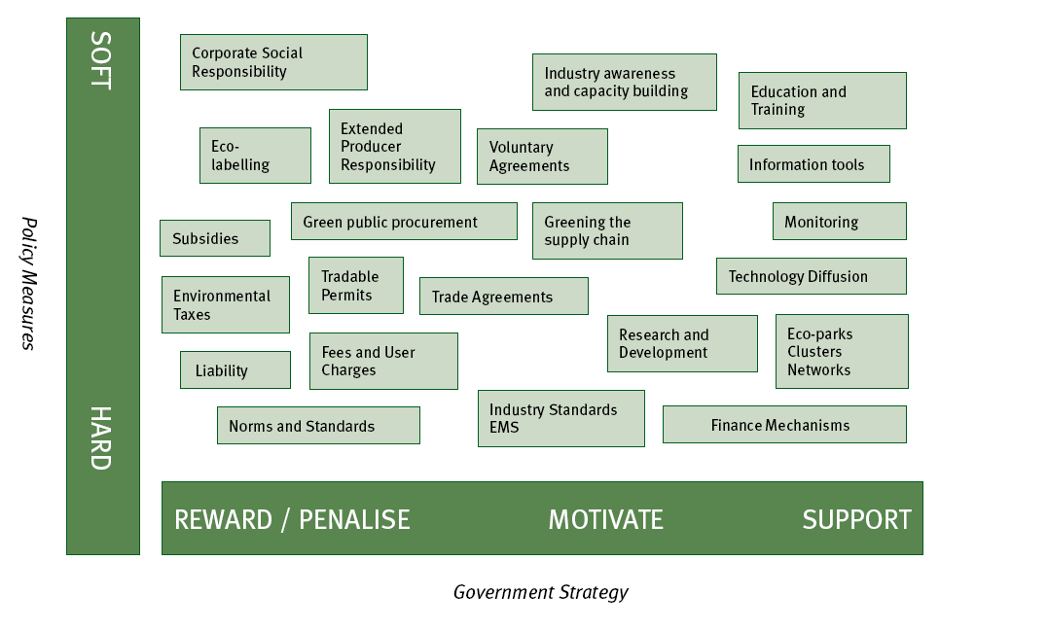
Green Industry needs a mix of instruments

Slide 18
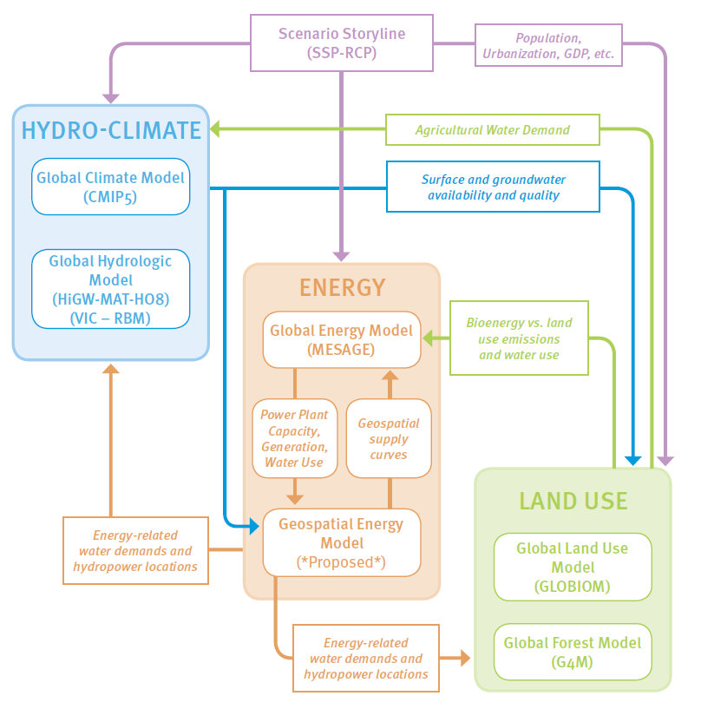
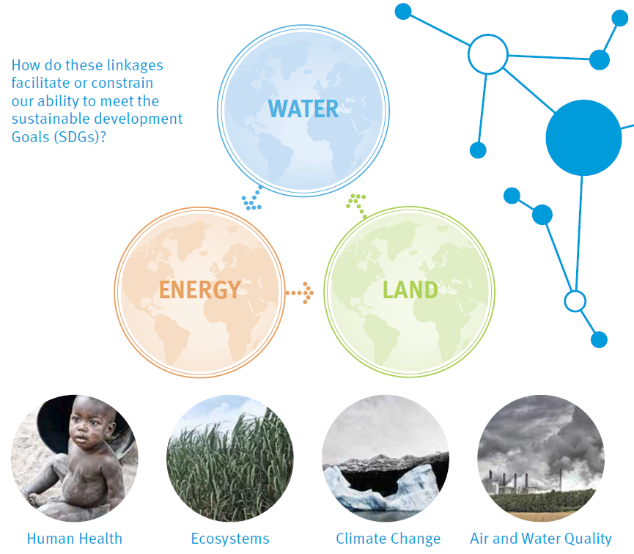
Nexus project & modelling (with IIASA)

Slide 19
Adaptation: Climate Resilient industries
  Nexus and resilience
    Integrated solutions along water-energy-food nexus
    Analysis, modelling and case studies to support nexus work
  Adaptation experience based on:
  Sustainable industrial & economic diversification policy advice
  Greening of value chains in private sector (cooperation with CGF)
  Water resource management
New GEF-6 cycle integrated approaches: “Commodities“ and “Food Security” based on 3 climate sensitivities:
  industrial activities dependent on climate-sensitive resources;
  industrial activities vulnerable to climate change;
  climate-sensitive markets

Slide 20
Gambia, Vietnam, Morocco: climate resilient fishing
Rationale: Fishing industry is major economic activity and employer Refrigeration technologies key of the overall fishing industry and value chain (cold stores, fish processing, handling and ice-making plants, freezing units of fishing vessels, transportation, etc.), but 50-90% of energy consumption
Goal: To promote a more inclusive and sustainable development of the fishing industry through environmentally sound investments:
Elements of Strategy:
  Income, job and wealth generation through increased competitiveness of fishing sector and community livelihood
  Technological upgrade by leapfrogging HFCs and introducing alternative refrigerants with zero ozone-depleting and low global-warming potential
  Increase of impact through IEE optimization and introduction of RE energy sources
  Close coordination with national HCFC Phase-out Management Plan

Slide 21
“Industrial activities are often associated with pollution and difficult work conditions. But I believe that we can address those issues while making industry synonymous with dynamism, jobs and sustainability”
Ban Ki-Moon, UN Secretary General, UNIDO, 4 Nov. 2014

Slide 22
Let’s work together for climate action!
Selected side-events at COP 21:
UN energy Day 07.12. whole day
EU-UNIDO on Tech Transfer 09.12. 16.30 EU Pavilion
UN exhibit energy and industry all COP
Christophe Yvetot
Head of UNIDO Brussels Liaison Office to the EU
Rue Montoyer 14, 1000 Brussels
c.yvetot@unido.org

