Slide 1

Consultation on the
Regional Multi-annual Indicative Programme for Asia and the Pacific
(2021-2027)
INTPA C - Asia and Pacific
4 December 2025

Slide 2
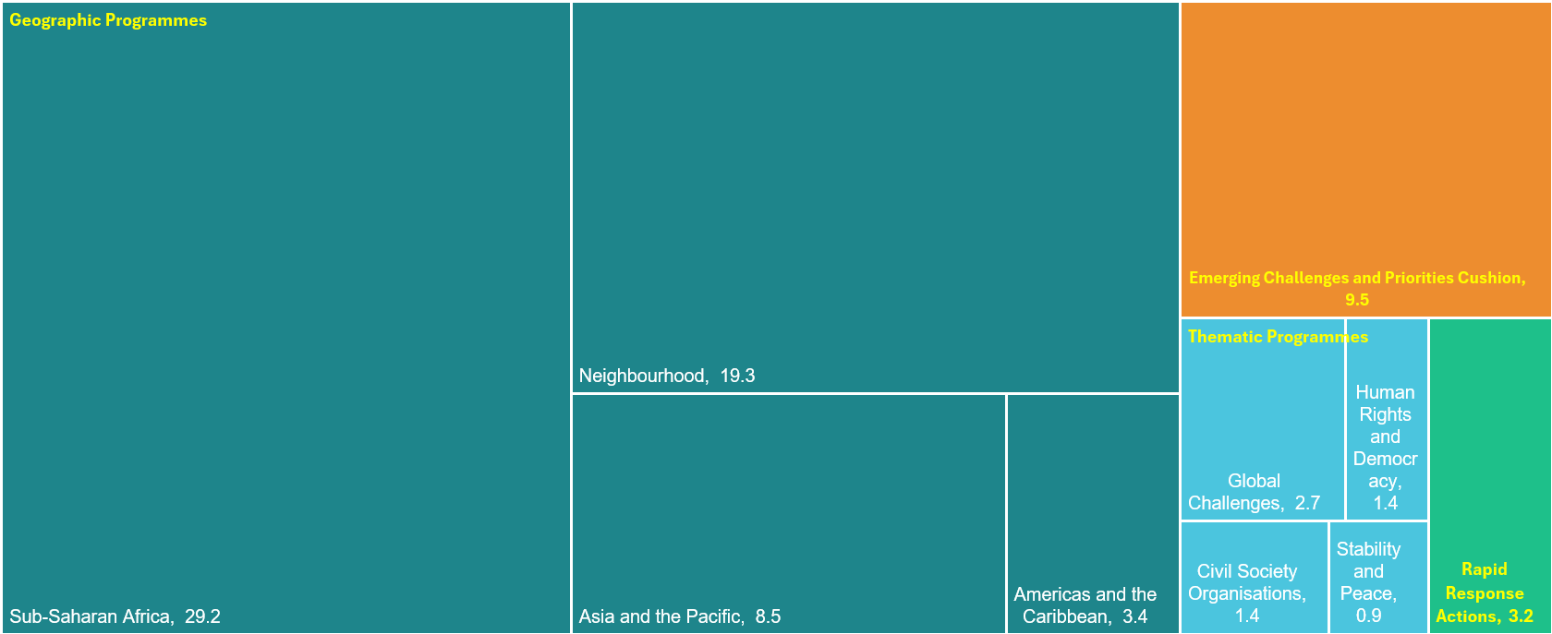
The Neighbourhood, Development and
International Cooperation Instrument (NDICI)
Allow the EU to account for emerging challenges and priorities
Provide stability & conflict prevention in crisis situations
Strengthen resilience & better link humanitarian and development action
Address the EU’s foreign policy needs and priorities
* Figures in billion EUR
Notes:
The NDICI funding instrument is a cornerstone of the European Union’s commitment to global solidarity and sustainable development.
With a budget of over €79 billion for 2021-2027, it is designed to address pressing global challenges, promote human rights, and foster inclusive growth.
As you can see, the bulk of funding (identified by the large green rectangles) is destined to the geographic programmes, followed by Thematic Programmes, the “Cushion”, and the Rapid Response Actions allocation.
Source: https://www.consilium.europa.eu/media/45109/210720-euco-final-conclusions-en.pdf

Slide 3
The Neighbourhood, Development and
International Cooperation Instrument (NDICI)
Priority Areas (under the 'Global Challenges' thematic programme):
  People: EUR 1,83bn.
  Planet: EUR 0.79bn
  Prosperity: EUR 0.69bn
  Partnerships: EUR 0.30bn
* Figures in billion EUR
Notes:
Under Global Challenges four Priority Areas are identified:
People: EUR 1,835,000,000, covering health, education and skills, gender equality, children and youth, migration, decent work, social protection, and culture ² .
Planet: EUR 793,000,000, addressing climate change, disaster risk reduction, environment and natural resources, and green transition ² .
Prosperity: EUR 697,000,000, focusing on investment climate, private sector, employment, trade, digital transformation, and sustainable agri-food systems ² .
Partnerships: EUR 304,000,000, for strategic cooperation with global and multilateral organizations, economic governance, and local authorities ² .
Source: https://www.consilium.europa.eu/media/45109/210720-euco-final-conclusions-en.pdf

Slide 4
The Neighbourhood, Development and
International Cooperation Instrument (NDICI)
* Figures in billion EUR
Notes:
For the Asia and Pacific region, NDICI has allocated €8.5 billion to support critical priorities such as poverty alleviation, education, gender equality, climate action, disaster resilience, and sustainable development.
These investments aim to empower communities, protect the environment, and create opportunities for all.
Civil Society Organisations play a vital role in this effort. They are the voice of the people, driving grassroots change, advocating for rights, and ensuring accountability.
NDICI recognizes their importance by dedicating resources to strengthen their capacity and enable them to address local needs effectively.
Through NDICI, we aim to build partnerships that transcend borders, fostering a shared vision for a more equitable, peaceful, and sustainable future.

Slide 5

The Neighbourhood, Development and
International Cooperation Instrument (NDICI)
Notes:
Around 55% of the amount dedicated to Asia and Pacific is financing country MIPs. Dialogue with Civil Society concerning these allocations are normally organised at country level and managed locally by the EU Delegations.
In our case, we manage centrally the Regional MIP.

Slide 6


The Asia-Pacific Regional Multi-Annual Indicative Programme
The Regional Multi-Annual Indicative Programme for Asia and the Pacific is designed to support priorities and EU interests in the region - in full complementarity with country and thematic MIPs, supporting key strategies like
Global Gateway
EU – Indo-Pacific Strategy
EU – Central Asia Strategy
Notes:
The Global Gateway strategy is the EU flagship initiative to promote sustainable, inclusive, and high-quality global connectivity.
It aims to address the global investment gap, foster green and digital transitions, and support economic recovery through partnerships and transformative projects.
In the Asia and Pacific region, the Global Gateway aligns closely with the Regional Multiannual Indicative Programme (MIP) for 2021-2027.
The MIP prioritizes regional integration, sustainable development, and addressing global challenges such as climate change, clean energy transitions, and disaster resilience. These shared goals create a strong synergy between the Global Gateway and the MIP, enabling impactful collaboration.
Through investments in infrastructure, renewable energy, digital connectivity, and regulatory frameworks, the Global Gateway complements the MIP’s efforts to promote sustainable and rules-based connectivity. Together, these initiatives aim to bridge the digital divide, support green growth, and strengthen partnerships between Europe and Asia-Pacific countries.
For the people and Civil Society Organisations in the region, this interaction means more opportunities to address local challenges, enhance resilience, and foster inclusive development.

Slide 7
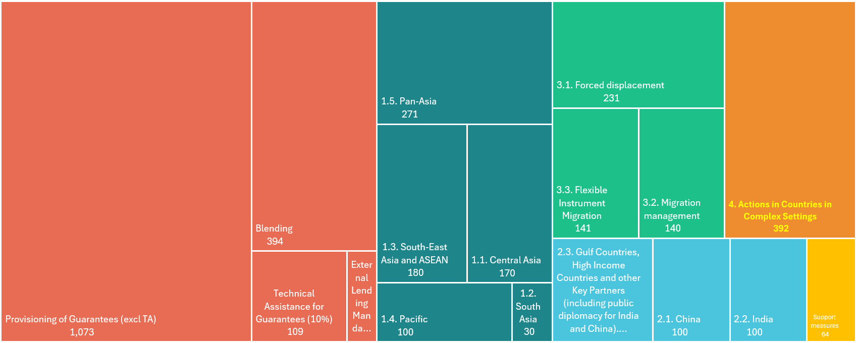
Regional Multi-annual Indicative Programme for Asia and the Pacific
€ 3.66 billion (2021-2027) - Post Mid Term Review
*Figures in mln EUR

Slide 8
Regional Multi-annual Indicative Programme for Asia and the Pacific
€ 3.66 billion (2021-2027) - Post Mid Term Review
Investments
44%
*Figures in mln EUR

Slide 9
Regional Multi-annual Indicative Programme for Asia and the Pacific
€ 3.66 billion (2021-2027) - Post Mid Term Review
Regional Cooperation
21%
*Figures in mln EUR

Slide 10
Regional Multi-annual Indicative Programme for Asia and the Pacific
€ 3.66 billion (2021-2027) - Post Mid Term Review
Migration
14%
*Figures in mln EUR

Slide 11
Regional Multi-annual Indicative Programme for Asia and the Pacific
€ 3.66 billion (2021-2027) - Post Mid Term Review
Countries in complex settings
11%
Afghanistan, Myanmar,
Iran, Yemen
DG MENA
*Figures in mln EUR
Notes:
DG MENA: Middle-East and Northern Africa

Slide 12
Regional Multi-annual Indicative Programme for Asia and the Pacific
€ 3.66 billion (2021-2027) - Post Mid Term Review
Foreign
Policy
Instruments (FPI)
service
Collaboration with key partners
9%
*Figures in mln EUR
Notes:
FPI stands for Foreign Policy Instruments, is a service of the European Commission responsible for the financial and operational components of EU foreign policy. FPI plays a key role in supporting EU external actions and ensuring compliance with international standards.
The FPI operates in the Asia-Pacific region, including High-Income Countries (HICs) such as China, Japan, South Korea, Australia, and Singapore, to advance the EU’s strategic interests and promote sustainable development.
Key aims of FPI’s activities include
fostering regional cooperation through initiatives like "UrbanHICs+", which supports urban and territorial innovation, and promoting EU standards in areas such as health and safety, particularly in competitive sectors like the green economy and automotive industry.
building strategic partnerships with influential global players,
enhancing the adoption of EU standards,
addressing shared challenges such as climate change, sustainable connectivity, and good governance,

Slide 13
Regional Multi-annual Indicative Programme for Asia and the Pacific
€ 2.3 billion (2021-2027)- Pre Mid Term Review
Priority Area 1: Regional Integration & Cooperation € 721 million
Central Asia South Asia South-East Asia and ASEAN Pacific Pan-Asia
Priority Area 2: Pursuing EU interests with key partners € 355 million
China India Gulf Countries, High Income Countries and other Key Partners, incl. public diplomacy with China and India (FPI)
Priority Area 3: Migration, forced displacement & mobility € 422 million
Forced displacement Migration management Flexible instrument migration
Support to investments under EFSD+ € 802 million
Guarantees (incl. up to 10% for Technical Assistance) Blending External Lending Mandate Legacy
Support Measures € 64 million
*Not included: Contributions to Erasmus+ (EUR 370 million) and to transregional thematic knowledge hubs/technical assistance facilities (EUR 78 million)

Slide 14
Regional Multi-annual Indicative Programme for Asia and the Pacific
€ 2.3 billion (2021-2027) - Post Mid Term Review
Priority Area 1: Regional Integration & Cooperation € 751 million
Central Asia (+30) South Asia South-East Asia and ASEAN Pacific Pan-Asia
Priority Area 2: Pursuing EU interests with key partners € 331 million
China (-10) India (+10) Gulf Countries, High Income Countries and other Key Partners, incl. public diplomacy with China and India (FPI) (-4)
Priority Area 3: Migration, forced displacement & mobility € 512 million
Forced displacement (+90) Migration management Flexible instrument migration
Priority Area 4: Actions in Countries in Complex Settings € 329 million
Afghanistan Myanmar Yemen Iran
Support to investments under EFSD+ € 1610 million
Guarantees (+623) Technical Assistance (+59) Blending (+104) External Lending Mandate Legacy (+22)
Support Measures € 64 million

Slide 15
Regional Multi-annual Indicative Programme for Asia and the Pacific
Responsibilities
Priority Area 1: Regional Integration & Cooperation € 751 million
Central Asia (+30) South Asia South-East Asia and ASEAN Pacific Pan-Asia
Priority Area 2: Pursuing EU interests with key partners € 331 million
China (-10) India (+10) Gulf Countries, High Income Countries and other Key Partners, incl. public diplomacy with China and India (FPI) (-4)
Priority Area 3: Migration, forced displacement & mobility € 512 million
Forced displacement (+90) Migration management Flexible instrument migration
FPI
Priority Area 4: Actions in Countries in Complex Settings € 329 million
Afghanistan Myanmar Yemen Iran
Support to investments under EFSD+ € 1610 million
Guarantees (+623) Technical Assistance (+59) Blending (+104) External Lending Mandate Legacy (+22)
Support Measures € 64 million
MENA

Slide 16
Previous Consultations
May 2021 Consultation on programming 2021-27
March 2023
Consultation
July 2024 Consultation on MTR
Sept 2024 Consultation
Dec 2025 Consultation

