Slide 1
Global Public Goods and Challenges
POSSIBLE OPTIONS
TO SUPPORT EDUCATION IN FRAGILE AND CONFLICT-AFFECTED CONTEXTS

Slide 2
Objective of the session
to discuss and identify expected results under some of the suggested options and approaches that can guide future programmes as part of EU GPGC programme on Education and Fragility.

Slide 3
GPGC – Education, knowledge and skills
Support education policy and practice
Access to and quality of education
Education in fragile contexts
Notes:
2014-2020
DCI financed
Complementary to bi-lateral support Issues that are best addressed globally, regionally but can also be used for country specific programmes
Grouping together a number of thematic areas: migration, food security, health and education
Under education there are 3 components:
A number of initiatives that we finance under component 1 & 2

Slide 4
Supporting better education opportunities in situations of fragility, including conflict affected and crisis areas.
Notes:
Objective of the education component on fragility

Slide 5
The program should promote…
Education provision
Transitional strategies,
LRRD
Country capacity development
Education in fragile contexts
Conflict sensitive education, analysis, planning and implementation
protection
Education and peace-building
And other areas…

Slide 6
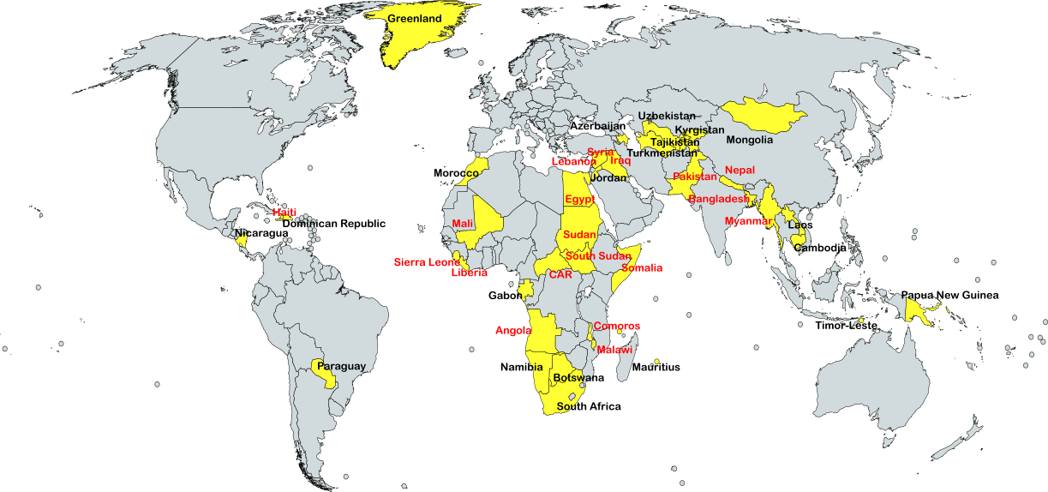
Education as sector of concentration in 40 countries
60% of bilateral aid for education goes to 19 fragile countries
Notes:
As a quick reminder:
Total portfolio: 40 countries (the countries in red are fragile)
Total bilateral aid budget: EUR 2.730 billion
60% of the total budget for bi-lateral aid goes to fragile countries (increase of 20%)
Sub-sectors: mainly primary and lower secondary education, TVET and some countries higher education
Regional breakdown: almost same nr countries in SS Africa and Asia

Slide 7
EU Definition of fragile and conflict affected situations …
“…where the social contract is broken due to the State’s incapacity or unwillingness to deal with its basic functions, meet its obligations and responsibilities regarding service delivery, management of resources, rule of law, equitable access to power, security and safety of the population and protection and promotion of citizen’s right and freedoms.”

Slide 8
Process so far
Analysis (options paper)
Consultation EU delegations, HQ
Member States feedback
Brainstorm annual seminar
Brainstorm key stakeholders
Member States meeting
Finalization AD
DCI Committee (feb. 2016)

Slide 9
A number of options… but
Limited funds available, where can we add value?
Trend to have fewer but larger contracts
A number of other initiatives ongoing
Look to potential of existing initiatives…

Slide 10
3 current options…
Support to strengthen institutions and national capacities (conflict analysis, planning, data collection, teaching learning materials…)
Teachers (PD, accelerated accreditation, teacher management, teacher well-being, …)
Cross-border challenges for education (coordination, teacher accreditation, curriculum materials, language of instruction)

Slide 11
Key implementing actors education
Unicef
UNESCO
GPE/Local Education Groups
UNHCR
INGOs
Academic institutions
Global Cluster on EiE (Unicef/Save)
Others…

Slide 12

Brainstorm … 25min…
What: main expected results
How: main activities
Where: regions/countries
Who: key actors for implementation

