Slide 1
Budget Support
Day 1: Core Concepts
Definition of EU budget support and eligibility criteria
Online Sessions

Slide 2





Ground Rules – Virtual Class
Our daily sessions are scheduled to last 4 hours (20 minutes break included). Please be on time!
Please ensure you have your webcam ON during the sessions`; if not possible, switch it on when intervening ☺, it makes our sessions livelier!
Make sure to have a headphone connected to your computer, the sound will be better
Please mute yourself when not talking – but do not hesitate to intervene with questions, suggestions and contributions!
Keep next to you a good coffee and a bit of patience, sometimes technology is not perfect. And let colleagues and supervisor know you are on training!

Slide 3
What is Budget Support for the EU?

Slide 4
EU funding modalities
Jointly with other financiers (Team Europe, Investment banks, others)
EU support to public sector development (projects, loans, budget support, blending mechanisms, technical assistance, twinning)
EU support to private sector development (loans, guarantees, capital investment, training, others)
Economic Development,
Trade Relations
Governance
Notes:
Loans (i.e. European Investment Bank)
Capital Investments and Guarantees (European Investment Fund)
Macro-economic support (Balance-of-Payments Assistance Facility)
Blending mechanisms (incl. with international development banks)
Technical Assistance and institutional twinning
Grants Projects or / and Budget support

Slide 5


EU Approach to budget support
4 eligibility criteria
4 interrelated components
Credible and relevant development/sector policy
Relevant and credible PFM reform programme
  Performance & assessment criteria
Policy dialogue
  Financial transfers (grants)
Stability oriented macro-economic policies
Transparency and oversight of the budget
  Capacity building
+ consideration of the commitment towards - and respect of - EU’s fundamental values
3 types of multiannual contracts
  Sustainable Development Goals Contract (SDG-C)
  State and Resilience Building Contract (SRBC)
  Sector Reform Performance Contract (SRPC)

Slide 6
Payments once conditions met (ex post)
Partner country’s Central Bank
Tax &
non tax revenues (incl. financing)
EC External
Assistance €
Foreign Exchange Reserves (€)
Treasury Account
Conditions for
disbursement
Budget implementation through the partner country's Public Financial Management System, subject to the prior positive eligibility assessment of the budget transparency and PFM reform implementation eligibility criteria
Once actions taken, costs incurred and reforms/results achieved by partner country

Slide 7
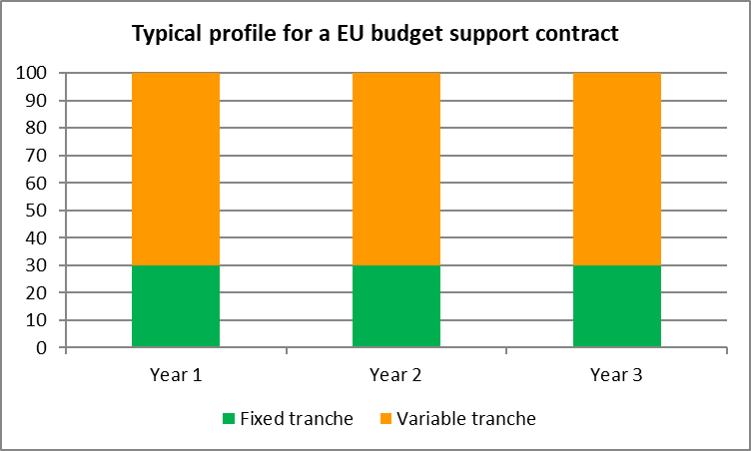
Payments on performance
Example: 10M€
10M€ paid
Ind. 7 (1M€)
Nothing
paid
Ind. 7 met
Ind. 6 (1M€)
ONCE ACTIONS HAVE TAKEN PLACE
AND RESULTS CAN BE MEASURED
Ind. 6 met
Ind. 5 (1M€)
7M€ paid
Ind. 5 met
V
A R
I
AB
L
E
Ind. 4 (1M€)
Ind. 4 met
Ind. 4 met
Ind. 3 (1M€)
Ind. 3 met
Ind. 3 met
Ind. 2 (1M€)
Ind. 2 met
Ind. 2 met
Ind. 1 (1M€)
Ind. 1 met
Ind. 1 met
Fixed tranche
≠
unconditional, guaranteed
or pre-financing
Fixed component
(3M€)
Fixed component
(3M€)
Fixed component
(3M€)
Typical design
30% fixed / 70% variable
Example 1: general conditions
not met
Example 2: progress on general conditions & 4/7 indicators
Example 3:
progress on general conditions
& all indicators met
– 3 scenarios (no, partial or full payment) –

Slide 8

Thinking about the flow of funds of budget support, can you draw any parallels with this photo?
Notes:
This is a donor’s dilemma: both fungibility and fiduciary risk are at the side of the donor.
Fungibility is obviously important for the partner country given the flexibility the financing by budget support offers.
Various water flows feed the water fall ( compare domestic revenues and various BS donors). Once flown into the main river, the origin of the water can not be traced any longer (= fungibility). While falling into the main river some on the water evaporates (exchange rate due to reconversions), while after the fall some of the water deviates from the main stream (see right bottom; that may represent mis-appropriation or corruption. It is beyond the donor’s direct control.

Slide 9
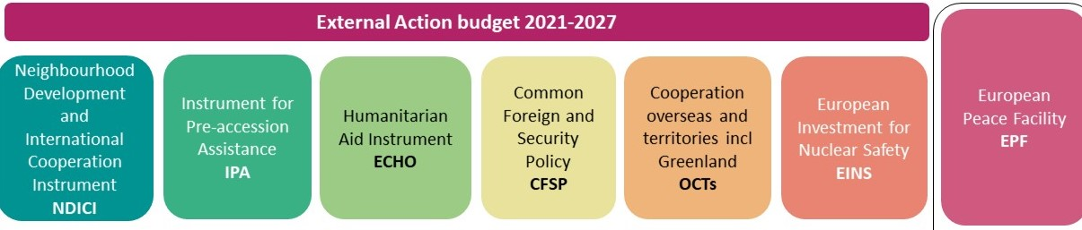
Budget support, External Action, Team Europe
Budget support, an asset for Team Europe (Initiatives)
Coordination with EU MS/DFIs, EIB, EBRD
Integrated in the EU Multiannual Indicative Programmes
Reflected in plans for Global Gateway implementation
In ENEST/MENA countries, synergies with Facility & Macro-financial Assistance

Slide 10
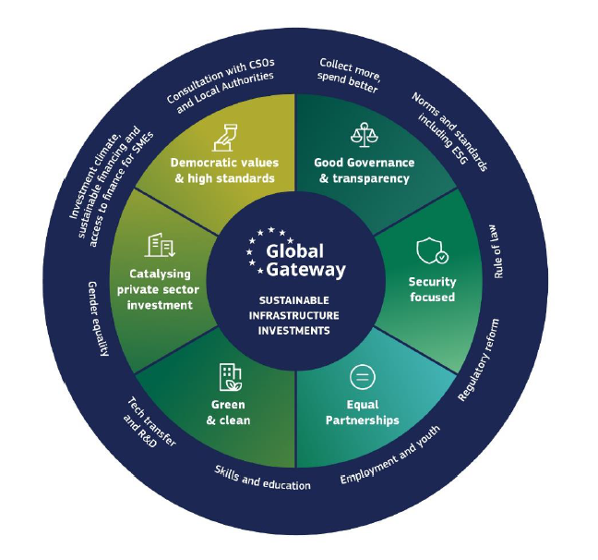

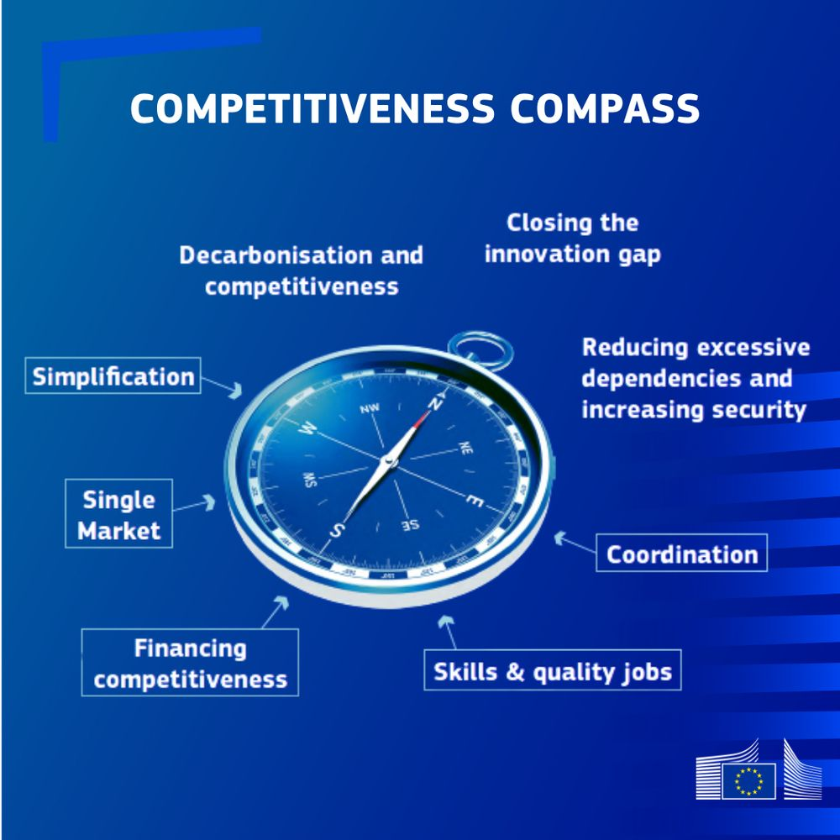
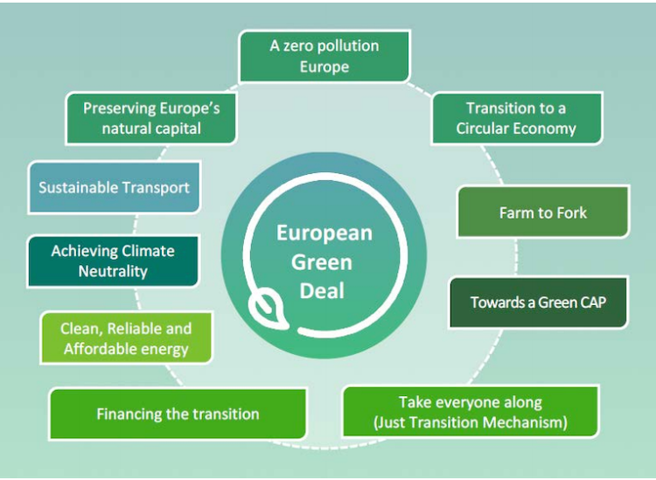
The Global Gateway and broader policies
The Global Gateway and its 360° approach

Slide 11

Economic governance & Global Gateway
Foster an investment-friendly environment for mobilizing increased investments in infrastructure meeting high technical, competitive, environmental, social and governance standards.
The EU supports:
Strengthening domestic resource mobilization, public finance management and debt management
Reforms of regulatory frameworks for greater sustainability, transparency and non-discrimination
Sustainable finance flows
The capacity of partner countries to develop infrastructure plans and prepare credible projects
Adherence to international standards for infrastructure spending by other donors
Active participation in international standard setting bodies
https://commission.europa.eu/system/files/2021-12/joint_communication_global_gateway.pdf
https://international-partnerships.ec.europa.eu/document/download/f2a837cc-95be-420a-ab89-d8eee453b1a8_en?filename=swd-collect-more-spend-better_en.pdf
Notes:
https://eur-lex.europa.eu/legal-content/EN/TXT/?uri=CELEX%3A52021JC0030
3.2 An investment-friendly environment
An enabling environment plays a key role in mobilising increased infrastructure investments that also meet high technical, competition, environmental, social and governance standards. The EU will use its various tools to improve conditions for attracting quality investments in partner countries. This will include working on different tracks:
·Strengthening domestic resource mobilisation, public finance management and debt management, and improving debt sustainability;
·Facilitating reforms in partner countries to establish transparent, non-discriminatory, and sustainable regulatory frameworks aligned with international standards, and building their capacity to enforce compliance with legal obligations;
·Improving the flow of sustainable finance, by promoting relevant taxonomies, standards and disclosures. The Commission is developing a comprehensive strategy to scale up access to sustainable finance in low and middle-income countries;
·Enhancing the capacity of partner countries to develop infrastructure plans and prepare credible pipelines of projects aligned with national development strategies and needs;
·Encouraging adherence to international standards for infrastructure spending by other bilateral and multilateral finance providers.
·Actively participating in relevant international standard-setting bodies.

Slide 12


Budget support for Global Gateway
Relevant and credible development and sector policies: financing; regulatory frameworks; public investment component with maintenance and recurrent costs; reporting and monitoring systems
Macroeconomic stability: fiscal policies (revenue and spending – recurrent and investment), debt sustainability
Public finance management & fiscal transparency:
tax and customs administration
budgeting (gender and green)
public procurement
public investment management
state-owned enterprises
public debt management
external control & anti-corruption
Conditions for successful & sustainable investments, maximising their returns

Slide 13
Budget support Intervention Logic (OECD/DAC 2012)
GOVERNMENT POLICY & SPENDING ACTIONS (STRATEGY)
Inputs to Government policy & spending actions
Budget Support inputs
Direct Outputs
Induced Outputs
Outcomes
Impacts
Funds
Conditions / indicators
Capacity development
Policy Dialogue
Improvement in the relationship between external assistance and the national budget and policy processes
Improved public policies, public sector institutions, public spending and public service delivery
Positive response by beneficiaries to government policy management, reforms and service delivery
Sustainable Growth & Poverty/Inequality Reduction,
Stability
EXTERNAL FACTORS, CONTEXT FEATURES AND FEED BACK PROCESSES

Slide 14

Quiz time
What is policy dialogue about?
Let’s go to Menti!
Notes:
Mentimeter (scale 1 to 5)
Policy dialogue is about…
- EUD dialogue with high level Government representatives about policies supported by budget support
- formal and informal discussions on sector performance between sector stakeholders
- formal discussions about eligibility criteria and performance indicators
- technical and strategic discussions of sector results and bottlenecks

Slide 15
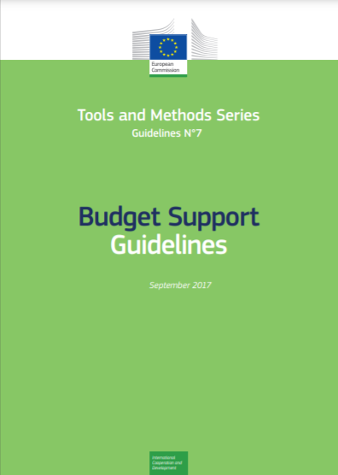
What is Policy Dialogue?
ESSENTIAL activity (under Budget Support) and CRUCIAL (for other interventions)
It is expected to CONTRIBUTE to the objectives of budget support & other interventions
Used to MITIGATE some of the RISKS
COHERENT and in line with the AGREED OBJECTIVES
Adaptation of Annex 13, Budget Support Guidelines 2017

Slide 16
Policy dialogue is a continuous, dynamic, multidimensional, non-linear, purposeful exchange
PD DPs DP – Gov Gov Democratic space Civil Society & Private Sector
Global
Regional
National
Sector
Sub-national
District
Municipal
Grassroots
… between:
Intra / Inter donor
Donor-country
Domestic stakeholders (“democratic space”)
… at multiple levels:
… and evolving over time !
Notes:
Global/Regional/national/sub-national levels
Technical and strategic levels
Formal and informal
Content focus and depth
This is a kind of ‘ideal’ situation, with dialogue opportunities and structures at different geographical levels from grassroots to national or even supranational level.
At all these levels there are dialogue opportunities among (1) donors, (2) between countries (or country governments) and donors and (3) inclusion of the domestic stakeholders (called the democratic space)
Domestic stakeholders: also without DPs and other external support there will be (the need for) a policy dialogue
Donor-Country: differs per country, smaller-larger. Even if PD is only linked to operational activities, still domestic change is the key objective. + How does the donor-country PD fit into the wider domestic dialogue, only then the DP is relevant.
Inter-donor: in name always present, not always easy to speak with one voice
Not all Policy Dialogue is meaningful. In various occasions there is “dialogue fatigue’:
Stereotypes, lack of trust
PD can be trapped in over-formalised settings
Lack of solid content and result-oriented focus
Conducted with the “wrong” actors
Ad hoc organisation of PDs
Political economy factors on the EU/donor side
“Little leverage” -> little interest
…
There are various considerations and dilemma’s in practice
The timing of policy dialogue is very important. Not only on the regularly agreed upon moments (i.e. quarterly) but also at any ‘opportunity of convenience’
Be aware that government is not a monolite, not uniform, so in different arena’s different positions can be taken. Keep track of these differences and –if necessary- try to reconcile
It is open to debate whether an active and leading role should be taken in i.e. the sector working groups. Advantage: the Delegation is well acquainted with everything; disadvantage…the Delegation might loose some degrees of freedom and might be considered by other stakeholders (CSOs, donor with project aid) as just representing the views of government.
In domestic process:
Broker: bring information =>understanding the context and assessing the content of PD
Capacity Development: support to stakeholders for their effective/owned participation
Table setting becomes a key roles for donors and agencies (including NGOs) to make the process credible and purpose-led: support to stakeholders for their effective participation
In Donor-Country dialogue:
Structuring of the process while leaving the leadership to the national parties around the table
Donor-Donor dialogue:
Division of Labour becomes critical for mobilising resources and coalition building

Slide 17
Policy dialogue: main features
A continued policy dialogue during the budget support formulation and implementation
A focused dialogue to engage with partner country around critical areas:
  Domestic reform agendas (governance, accountability, regulatory & institutional framework)
  Global Gateway objectives and other EU objectives
  Eligibility criteria (policies, macroeconomics, PFM, transparency) and indicators
  Efficiency and effectiveness of sector policy formulation and implementation processes
  Public investment plans, of which Global Gateway investment projects
  Reforms to improve the investment climate and the quality of/access to public services
  Specific sector PFM issues that are not particularly covered by generic PFM reforms

Slide 18
Quiz time: What is capacity development in the context of budget support?
Let’s go to Menti!
Notes:
Support to Capacity Development is (more than one correct answer)
An optional technical assistance
An input to the BS programme’s intervention logic
Necessary to make sure EU disburses all its planned funding
A way to foster dialogue
Designed to ensure performance indicators are met

Slide 19
Capacity development objectives
  Enhance Government capacity to design, implement, monitor, and evaluate policies and to deliver public services
  Support PFM reforms (e.g. revenue administration, procurement, investment management) and promote effective, accountable and inclusive institutions
  Support regulatory/institutional reforms to improve investment climate in sectors in connection with Global Gateway objectives and in relation to GG projects
  Promote stakeholders’ engagement in policy design, implementation & monitoring
  Strengthen the national monitoring & evaluation framework / statistical system
  Integrate gender equality measures and greening PFM systems/fiscal policies
  Mitigate risks, where there is commitment to reform but lack of capacity
Notes:
«

Slide 20
Any questions?

Slide 21
Four eligibility criteria needed to be satisfied
For programme approval
For programme implementation
1. Existence of a credible and relevant programme to restore/maintain macro-economic stability
1. Maintenance of a credible and relevant stability-oriented macroeconomic policy or progress made towards restoring key balances
2. Existence of a credible and relevant programme to improve public financial management (PFM)
2. Satisfactory progress in the implementation of reforms to improve PFM, including Domestic Revenue Mobilisation (DRM), and continued relevance and credibility of the reform programme
3. The proposed or enacted budget is published
3. Satisfactory progress with regard to the public availability of accessible, timely, comprehensive and sound budgetary information.
4. Credible and relevant national/sector policy supports poverty eradication/inequality reduction/sustainable and inclusive growth and job creation, consolidation of democracy and peaceful society, and the promotion of gender equality
4. Satisfactory progress in the implementation of the national/sector strategy and continued credibility and relevance of that or any successor strategy.

Slide 22
The centrality of the budget
(ii)
Macroeconomic policy
(iii) Public Finance
Management
  Objectives
  Macroeconomic stability and fiscal sustainability
  Sustainable and inclusive growth
  Instruments
  Monetary and exchange rate policy
  Fiscal Policy
  Revenue mobilisation policy
  Public expenditures policy, including investments
  Debt policy
(i) Public Policies
  Function
  Manage Funds to implement public policies
  Objectives
  Financial compliance
  Fiscal discipline
  Allocation of resources according to policy objectives
  Efficient public service delivery
Budget
Domestic Revenue Mobilisation
Public Expenditure
Financing: loans & grants, incl. budget support
Transparency and Oversight
(iv) Transparency and Oversight
Notes:
It is BUDGET support, so the key word is BUDGET.
The four eligibility criteria are all directly related to the budget: the macroeconomic stability influences the chances that the budget can be implemented as envisaged, while the stability itself is -in part- influenced by the way the budget is financially managed: the fiscal discipline. The budget is supposed to reflect the Governments’ policies: it plans and provides the financial means to implement these policies.
Thereto these policies should be relevant and credible and the costs well projected in realistic multi-annual budget planning. And these policies can be implemented adequately only in case the budget resources scheduled are well planned, spend, controlled and audited according to international standards: the public finance management system.
And to enable each citizen to know how much Government has planned and spend to implement its policies, it is necessary that all budget documentation is made public and that each citizen has access to this information: the transparency and oversight criterion.
Suggest that they take a PFM and macro training to understand the importance of a stable macro environment and a functionning PFM system.
EU: three-tier approach for PFM/DRM support – country level (budget support, TA and/or twinning/TAIEX); regional level (IMF technical assistance centres) and global level (partnership with IMF; support to diagnostic tools such as PEFA, TADAT, PIMA, MAPS; support to OECD and UN on tax issues; support to debt management with IMF/WB and UNCTAD)

Slide 23
Why start the assessment of macro-economic policies at an early stage?

Slide 24
Macro-economic stability
Ensures a favourable context for development – think about volatility!
Is essential for investments, private sector development and job creation – think about planning!
Contributes to equity – think about inflation!
A relevant macro-economic policy will address imbalances through monetary, exchange rate, and fiscal policies
A credible macro-economic policy is where institutions are capable to plan, finance and implement effectively policies backed by political commitment with predictability for departments in charge of service delivery

Slide 25
Macro - Analytical grid
  Four building blocks:
  (1) Real economy: Evolution of main macro-economic aggregates and potential sources of instability: composition of GDP, sources of GDP growth, external balances
  (2) Fiscal operations, policies and aggregates: overall revenue and expenditure levels, tax policy and exemptions/waivers, financing of the deficit, debt sustainability
  (3) Monetary indicators and policies: control of inflation, money growth, regulation of the banking sector, credit requirements, regulation of the financial market, etc.
  (4) Balance of Payments. Imports / Exports / Financial flows. Vulnerability to external shocks and resilience efforts
  ➔ Is the policy mix conducive to stability? Are fiscal, monetary exchange rate policy concurring into balancing the economy? Does it improve the investment climate?
  See Guidelines Annex 4

Slide 26
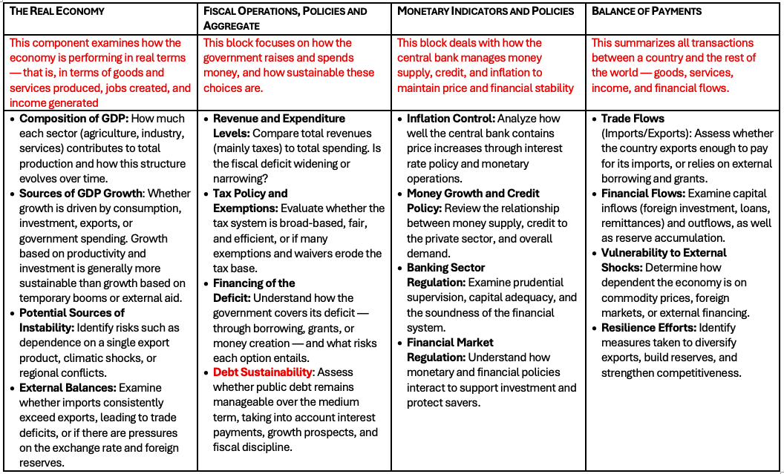
Macro – Navigating the 4 Building Blocks
1. Real Economy
2. Fiscal policies
3. Monetary policies
4. Balance of payment
  See Guidelines Annex 4

Slide 27
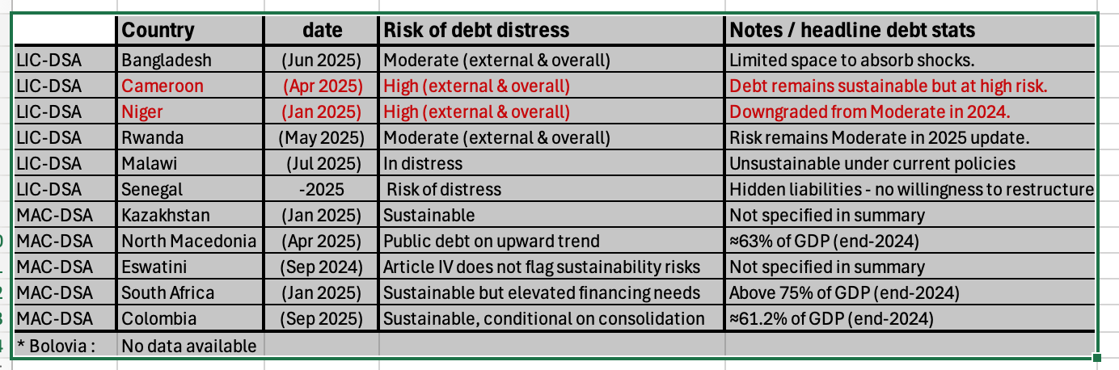
Quick look at the debt situation

Slide 28
DRM : tax to GDP ratio
Country | Tax / GDP ratio | year
Bangladesh | 7,40% | 2024
Niger | 9,60% | 2022
Kazakhstan | 11,86% | 2023
Malawi | 12,50% | 2023
Rwanda | 13,52% | 2023
Cameroun | 14,00% | 2023
Colombia | 15,28% | 2023
North Macedonia | 17,39% | 2023
Senegal | 19,50% | 2023
Bolivia | 23,90% | 2023
Eswatini | 24,70% | 2023
South Afruca | 26,10% | 2023
Around 15% of GDP is widely cited as the minimum level
of tax revenue needed for the state to perform its core functions.
Below this level, countries generally:
Struggle to maintain consistent funding for health, education, and infrastructure.
Depend heavily on external grants or debt.
Experience weak institutional capacity and service delivery.
Rule of thumb:
< 10% → Fragile fiscal capacity, unable to sustain core services.
10–15% → Basic service delivery possible but uneven; donor dependence remains.
15–20% → Moderate fiscal space; more reliable service financing.
> 20% → Capable of sustaining and expanding quality service delivery.

Slide 29
Exercises
Notes:
Open ended question

Slide 30
Fictiland and sector context
Fictiland a mountainous country, mostly rural population, numerous ethnic groups, three tier government structure
Rapid economic growth over past 30 years: now a LMIC with poverty rate < 6% and substantial progress towards achievement of SDGs
Strong infrastructural development but coming up against rising demand for electricity, to which access remains uneven (quality and grid)
ECF has monopoly over grid but not over electricity generation (hydropower 38%, coal 32%, gas 17%)
Power = 85% of Fictiland’s GHG by 2030 (growth GHG/capita +5% year) with population and economy highly vulnerable to climate impact

Slide 31
EU cooperation with Fictiland
Agreed focus for the next Multi-Financial Framework: renewable energies and climate action
Intended modalities:
€100 million as a SRPC to the renewable energy sector (eligibility criteria have been verified as satisfied)
€30 million as a co-financing of investment costs in transmission lines with Member States, the ADB and the WB (probably blending)
Possible additional assistance in capacity strengthening (considering twinning)

Slide 32

Exercise 1: Macro-economic policy
20’ in groups
15’ plenary feedback
Section 2 of the Background Document (text and the IMF Article IV table) provides you with macroeconomic information in a summary. Exercise 1. focuses on sustained Fiscal balance only. Have a closer look at government’s fiscal policies.
Discuss in your group:
Which section of the IMF-table refers to the Government Financial Operations? In which line would you expect information about Budget Support?
Are Fictiland’s fiscal policies aimed at fiscal stability and hence contribute to macro-economic stability?
Based on the information about the fiscal balance only, would you consider Fictiland’s eligible for budget support on the macroeconomic criterion?
Notes:
Documents: an IMF table and summary review

Slide 33
Exercise 1. Table1.1: Macro-economic assessment – Macro-economic aggregates
Issues | Issues identified | Support to capacity building | Point of Policy dialogue | Possible conditions (Performance Indicators)
Economic growth and stability; composition of GDP and sources of growth (real sector) | Lack of information about vulnerability to world eco context (exports, Foreign Direct Investment, remittances). Lack of information about climate risks.
Fiscal balance – overall revenue and expenditure levels incl. investments, financing of deficit, debt sustainability (public sector) | Appears healthy but fiscal deficit to monitor in case of economic slowdown. State guarantee of Sate owned enterprises (like ECF) commercial loans could become a risk . No recent Debt Sustainability Analysis
Inflation (monetary sector) | High economic growth has the risk of overheating. In Fictiland. Inflation is partly ‘imported’.
External balances (Balance of Payments) | Not an issue at the moment but risky in times of world recession. Foreign reserves are below international standards
I L L U S T R A T I O N
Tip: Read Sections 1 and 2 and Annex 1 of Fictiland document provided
To find out more, use the Guidelines pages 33-36 and Annex 4, pages 92-97 for macro-economic assessment and pages 53 and 167 for Domestic Resource Mobilisation DRM policy

Slide 34
Exercise 1 – Table 1.2. Macro-economic assessment – Macro-economic policies
Issues | Issues identified | Support to capacity building | Point of Policy dialogue | Possible conditions (Performance Indicators)
Fiscal policies, including Domestic Resource Mobilisation (DRM) | DRM need support on tax impact studies? Macro/revenue projections support needed? Sufficient contingency built into the budget for climate risk?
Monetary policies (money growth, regulation of the banking sector and financial market, credit requirements, etc.) | IMF provides monitoring and Technical Assistance
Debt management | OK at the moment but no information about strategy in relation to State Owned Enterprises.
Trade policies (External sector) and vulnerability to external shocks | Monitor FDI, remittances, volume of foreign reserves
I L L U S T R A T I O N
Tip: Read Section 2 of Fictiland document provided
To find out more, use the Guidelines pages 33-36 and Annex 4, pages 92-97 for macro-economic assessment and pages 53 and 167 for Domestic Resource Mobilisation DRM policy

Slide 35
Any questions?

Slide 36
Budget Support
Day 2: Core Concepts
Definition of EU budget support and eligibility criteria (continued)
Online Sessions

Slide 37
Quiz time: Budget support and eligibility criteria
RECAP Day 1
Notes:
Open ended question

Slide 38
A simplified PFM framework
www.pefa.org

Slide 39
Analytical Grid PFM
  Diagnostic of the PFM system: aggregate fiscal discipline, strategic allocation of resources according to policy objectives, efficient use of resources for service delivery, compliance with laws and regulations.
  Respect of PFM principles: legitimacy and norms; rules, procedures, and due processes; transparency and accountability.
  Key weaknesses: reforms and milestones for monitoring progress?
  PFM reform: action plan, monitoring arrangements, sequencing and prioritization of reforms, political buy-in; corruption and fraud; institutional arrangements, institutional and financial resources, coordination, capacity strengthening needs, gender-responsive budgeting; green budgeting; key reforms for investment climate/business environment.
  Assess all phases of the budget cycle (and esp. domestic revenue mobilisation, transparency and oversight), at national and subnational / sector levels.
  See Guidelines Annex 5

Slide 40
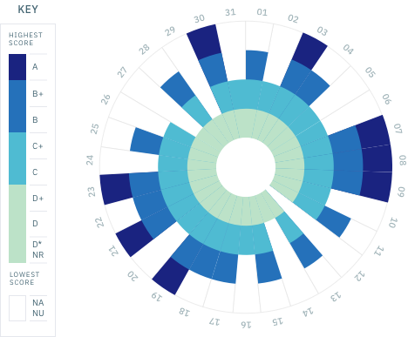
How to analyse PFM: PEFA Measurement tool
PEFA is a methodology for assessing public financial management performance. It identifies 94 characteristics (dimensions) across 31 key components of public financial management (indicators) in 7 broad areas of activity (pillars).
Method updated in 2016;
Various ‘drill-down’ instruments
Current focus at PFM Reform
www.pefa.org

Slide 41
How to analyse PFM: other tools
Public Expenditure and Financial Accountability Assessment (PEFA) – multiple organisations
Tax Administration Diagnostic Assessment Tool (TADAT) – IMF
Public Investment Management Assessment (PIMA) – IMF
Methodology for Assessing Procurement Systems (MAPS) – OECD/DAC – World Bank
Supreme Audit Institutions Performance Measurement Framework (SAI-PMF) – INTOSAI Development Initiative (IDI)
Debt Management Performance Assessment (DeMPA) – World Bank
  Those diagnostics and your dialogue / monitoring feed the Annual PFM report and its monitoring table

Slide 42
Exercise 2: Public Finance Management
40’ in groups
15’ plenary feedback
To ensure (continued ) satisfaction of eligibility at either the start or during programme implementation, the PFM expert has identified a number of areas of concern. These are shown in Table 2.
Amongst these issues of concern in each of the analytical areas, please identify:
Those requiring close monitoring and attention in policy dialogue and/or specific conditions
Those that could usefully benefit from complementary assistance
Take the Fictiland document provided, read section 3 (PFM) and annex 2 (PEFA) and fill Table 2. The most relevant paragraphs for this exercise are marked in green

Slide 43
Exercise 2 – Table 2.1: PFM assessment
Issues | Issues identified | Possible CB | Point of Policy dialogue | Possible conditions (Performance Indicators)
Diagnostic of PFM: aggregate fiscal discipline, strategic allocation of resources according to policy objectives, efficient use of resources for service delivery, compliance with laws and regulations. | Investment and recurrent budget planning separate threatening sustainability, budget credibility, strategic allocation of resources are weak. Efficient use of resources? Public investment management in particular at subnational level (energy)? Regulatory framework is in process of improvement
Respect of PFM principles: norms, rules, procedures, due processes, honesty/probity, legitimacy, transparency and accountability | PEFA PIs 15 to 23 score OK although expenditure commitment controls and internal audit need improvement. Procurement merits attention in a country with high public investment
I L L U S T R A T I O N
!
Tip: Use the Guidelines pages 36-41 and Annex 5, pages 98-116 for PFM assessment and pages 53 and 167-168 for tax administration

Slide 44
Exercise 2 – Table 2.2: PFM assessment
Issues | Issues identified | Possible CB | Point of Policy dialogue | Possible conditions (Performance Indicators)
PFM Reform: action plan, monitoring arrangements, sequencing and prioritization of reforms, political buy-in, corruption, fraud, institutional arrangements, institutional and financial resources, coordination, capacity strengthening needs, gender issues | Poor relation between policies and budget. (multi-annual-) The institutional linkage between MOF and MOP is not conducive to improvement in budget formulation (dual budgeting). The Reform programme leaves out the investment component. Nothing is said on gender budgeting, so possible opening there
Tax administration: tax collection and administration capacities, legal framework, illicit financial flows | Tax administration works efficiently. However, there is an (political?) issue of tax revenue collection at provincial level.
I L L U S T R A T I O N
!
  Look at all phases of the budget cycle (and esp. domestic revenue mobilisation, transparency and oversight), at national and subnational levels.
Tip: Use the Guidelines pages 36-41 and Annex 5, pages 98-116 for PFM assessment and pages 53 and 167-168 for tax administration

Slide 45
Requirement and focus for Transparency and oversight of the budget
  For programme approval: an ‘Entry point’ must be met. Focus on the publication of the Budget: either Executive’s budget proposal or enacted budget within the previous or current budget cycle. Due attention to fiscal and audit reports (also follow-up).
  During implementation: For each tranche disbursement: ‘entry point still met?’ means satisfactory progress (or no deterioration) in the production, public availability / accessibility, timeliness of release of budget/audit documents, quality and comprehensiveness of budget documentation (e.g. tax expenditures, borrowing plan)
Assessment of transparency and oversight
Six major budget documents: budget proposal; enacted budget; in-year reports [mid-year report]; year-end report; audit report and other documents (citizens’ budgets).
  See Guidelines Annex 6

Slide 46
Budget cycle and essential budget documents
Key documents:
Budget Law proposal
budget annexes
Legislative examines audit reports
Budget planning and preparation
Executive Budget Proposal
Key documents:
SAI reports (opinion on the executed budget)
Legislative examines and votes budget proposals
Budget law including annexes (e.g. borrowing plan)
External audit and evaluation
Budget execution
SAI report
Annual performance report
Performance audit report
Key documents:
Budget law
Legislative report
Various reports (e.g. tax expenditures, gender, climate)
Monitoring, accounting and reporting
Key documents:
Budget execution reports
External scrutiny
Citizen budget
Annual budget execution report
Quarterly and half-yearly execution reports

Slide 47
Exercise 3: Budget transparency and external oversight
20’ plenary discussion
Table 3 shows the areas that should be analysed when assessing the country’s eligibility to budget support with regards to budget transparency and oversight. With a view to ensure effectiveness of budget support and continued satisfaction of eligibility during programme implementation, please identify:
Issues of concern that require close monitoring and attention in policy dialogue and/or specific conditions
Issues that could usefully benefit from complementary assistance

Slide 48
Exercise 3 – Table 3: Budget transparency and external oversight assessment
Issues | Issues identified | Support to capacity building | Point of Policy dialogue | Possible conditions (Performance Indicators)
At programme approval: Entry point met: Publication of the Budget within the previous or current budget cycle (either Executive’s budget proposal or enacted budget) | Needs coherent budget classification Needs compatible reporting formats Scarce information at sector level
During implementation: Entry point still met? For each tranche disbursement, verified satisfactory progress (or no deterioration) in the production, public availability, timeliness of release of budget documents | Trend is positive but publication doesn’t mean that the documents can effectively serve as support to analysis
Check on documents available: Budget proposal | Yes with flaws
Enacted budget | Yes but late
In-year reports (mid-year reports) | Yes
End-year report | Yes
Audit report | Yes, but late & covers 60% only
Other (such as citizens’ budgets) | Yes
I L L U S T R A T I O N

Slide 49
Public policy process
Initial situation (economic, social, political)
Strategy/policy formulation
Budget preparation, approbation and execution
Public Finance Management
Situation aimed at by the policy
Public services delivery (infrastructure, social services, law and order, ….)
Need to understand where decision are made, by whom
Political Economy Analysis (PEA), Policy Dialogue process and Stakeholders analysis

Slide 50
Public policy analysis
  Policy content and policy formulation process
  Policy coherence
  Monitoring, evaluation and coordination mechanisms
  Communication strategy
  POLICY FRAMEWORK
  Adequacy of Government response to country or sector challenges (contribution to sustainable growth, sector reform and service delivery, domestic accountability and oversight, resilience, crosscutting areas, …)
  POLICY RELEVANCE
  Past track record
  Policy financing
  Institutional capacities & ownership
  Quality of data underpinning Policy
POLICY CREDIBILITY
50
  See Guidelines Annex 3

Slide 51
Exercise 4: Sector Policy
40’ in groups
20’ plenary feedback
The government of Fictiland has developed a new energy strategy for 2020-2050, with an implementation plan 2020-2030 which the EU is ready to support. The sector has been analysed and a summary can be found in the documents provided (sections 1 and 5). Similar to the previous exercises, from the analysis of the documents provided, please discuss and note in the template:
Problematic areas
Issues that might benefit from capacity building support
The priority areas for Performance indicators of variable tranches
The areas that need priority attention in monitoring (risks) and policy dialogue
Any missing information you will need to design the budget support.
Tip: Read Section 1 (Sector context) and 5 of documents provided
To find out more, use the Guidelines pages 33-34 and Annex 3, pages 86-91
Notes:
Documents: 3 or so doc with background info on the sector, strategy, newspaper article.

Slide 52
Exercise 4 – Table 4.1 – Sector Policy assessment
Issues | Issues identified | Support to capacity building | Point of Policy dialogue | Possible conditions (Performance Indicators)
Policy framework: policy content and formulation, investment component with maintenance/recurrent costs, M&E system, coordination mechanisms, coherence of policies, communication strategy | There is no M&E system so data not reliable? There is a policy document but need more specifically on rural expansion of power. Large number of stakeholders: levels of Gov't, donors, sources of funding, beneficiaries. Are they all engaged? Pivotal role of Provinces. Reaching remote areas: equity considerations.
Policy relevance: contribution to overall objectives, response to sector challenges, inclusiveness of service delivery access and quality, sector governance (incl. oversight), tackling of cross-cutting issues (gender, youth) | Rural electrification is a priority of the national development policy Questions about the sustainability of expanding further the power Trade-offs between speed of roll-out and reaching remote communities Multiple objectives: green issues, gender, equity affordability, cost recovery, sustainability
I L L U S T R A T I O N
Tip: Read Section 1 (Sector context) and 5 of documents provided
To find out more, use the Guidelines pages 33-34 and Annex 3, pages 86-91
Notes:
Documents: 3 or so doc with background info on the sector, strategy, newspaper article.

Slide 53
Exercise 4 – Table 4.2 – Sector Policy assessment
Issues | Issues identified | Support to capacity building | Point of Policy dialogue | Possible BS Condition (Performance Indicators)
Policy credibility: track record in policy implementation, policy financing (costing, MT budget allocations, budget comprehensiveness, financial sustainability, fiscal decentralisation), institutional capacity and ownership, quality of data underpinning policy | Weak human resources esp. at Provincial level Track record is positive Strong political commitment Financing is questionable (ODA is not secured, tariffs are still subsidised - will prices be adjusted? How will it affect rural incomes/equity? How is the grid going to be maintained?
Other risk areas that require close monitoring | Energy pricing Uneven institutional capabilities (stable staffing?)
Missing elements required for analysis and decision-making | Policy documents (details), annual plans and costing Credibility of assumptions?
I L L U S T R A T I O N
Tip: Read Section 1 (Sector context) and 5 of documents provided
To find out more, use the Guidelines pages 33-34 and Annex 3, pages 86-91
Notes:
Documents: 3 or so doc with background info on the sector, strategy, newspaper article.

Slide 54
Budget Support
Core concepts: Choice of contracts and intervention logic
Online Sessions

Slide 55

Attention to fundamental values
State and Resilience Building Contract
Sustainable Development Goals Contract
Sector Reform
Performance Contract
SRPC
SRBC
SDG-C
Country’s commitment to Fundamental Values and/or political response to improve the situation should be taken into account as part of the RMF+.
A forward-looking approach.
Opportunity of intervention vs. risk of inaction
Country’s adherence to Fundamental Values taken into consideration as part of the Risk Management Framework (RMF+).
At sector level the supported interventions should not harm and do maximum good (Rights-based approach)
  A mutual and shared commitment to universal Fundamental Values assumed.
  Positive assessment of country’s adherence and commitment to Fundamental Values.

Slide 56
EU Cycle of operations
EU External Action Policy &Partner Government Policy
Preparation
of next Budget support if any
Multiannual Indicative programme, Global Gateway objectives, other EU priorities: focal sectors
Evaluation & follow-up
Programming/ Strategic Planning
Final Report and Evaluation: focus on joint evaluations
Strategic Steering Committee (INTPA) – SSC- fiche; Country Annual Action Plan, incl. BS
Disbursement process Monitoring, dialogue, assessment of conditions
Implementation
RMF+ (+ FV assessment for SDG-C)
Opinion on disbursements when applicable
Design
Strategic guidance choice of BS modality, contract type, design, policy dialogue (QRCP)
Finalisation of FA TAPs + Appendix
QRM: Final Draft AD & supp. documents
Strategic Steering Committees (INTPA) or Financial Assistance Steering Committee (FAST-NEAR/ENEST-MENA): Continuous political and policy steer of BS programmes
Notes:
EU Cycle of operations
QRCP : Quality review collaborative platform
QRM : Quality review meeting

Slide 57
The context analysis at the centre:
A continuous and iterative process
Overall national policy
Choice of overall objectives/results
Harmonization and synchronization
Choice of sectors
Global Gateway & Team Europe Initiative,
Results achieved versus what was planned. Final Report incl. analysis of the reasons for possible ‘gaps’
Programming
Closure
Country context analysis
Public Policy Analysis
Stakeholders’ analysis
Political economy analysis
Proposed objectives & results
Proposed scale and form
Status of 4 eligibility criteria
Prior actions & supporting measures
Preliminary design & implementation proposals
Main risks & next steps
Disbursement upon proven performance and progress
Design
Implementation
Continuous monitoring:
Verify IL, contract timeliness, conditions, factors affecting performance
Identify corrective measures, undertake PD, amend FA if needed
RMF+
FA
Appendix
Finalize intervention logic, budget & calendar, stakeholders, donor coordination, implementing modalities (disbursement criteria), Capacity development, Policy dialogue, gender analysis, inequality, climate resilience, M&E, domestic accountability, …), communications and visibility

Slide 58
Budget support Intervention Logic (OECD/DAC 2012)
GOVERNMENT POLICY & SPENDING ACTIONS (STRATEGY)
Inputs to Government policy & spending actions
Budget Support inputs
Direct Outputs
Induced Outputs
Outcomes
Impacts
Funds
Conditions / indicators
Capacity development
Policy Dialogue
Improvement in the relationship between external assistance and the national budget and policy processes
Improved public policies, public sector institutions, public spending and public service delivery
Positive response by beneficiaries to government policy management, reforms and service delivery
Sustainable Growth & Poverty/Inequality Reduction,
Stability
EXTERNAL FACTORS, CONTEXT FEATURES AND FEED BACK PROCESSES

Slide 59
Any questions?

Slide 60
Budget Support
Day 3 Continuation intervention logic; design
Online Sessions

Slide 61
Quiz time: Budget support eligibility criteria and intervention logic
RECAP Day 2
Notes:
Open ended question

Slide 62
Exercise 5: Intervention Logic
30’ in groups
10’ plenary feedback
The EU analysed the complementary information and documentation received from the government and the policy eligibility criterion is satisfied. The EU has decided to provide a €100 million SRPC over 2025-2027 to support the expansion of sustainable energy in rural areas. Budget support design can start.
You are now tasked with preparing the Action document for the operation. As a first step, you will prepare the intervention logic of the operation, enabling you to clearly identify the expected contributions of budget support to the sector’s objectives, understand the dynamics that will produce the expected results, the assumptions made and the risks entailed. Please place the different elements at the right place in the intervention logic.
Tip: Remember esp. Sections 1 and 5 of documents provided and read section 6 (lessons learned
To find out more, use the Guidelines pages 21 and 22 and Annex 2, pages 81 to 85.
Notes:
Use the same documents plus maybe some extractions from the RMF

Slide 63
Exercise 5 – Table 5: Intervention Logic of support to the energy sector of Fictiland
 | Results chain | Indicators | Mechanisms, processes, challenges/ risks and assumptions
Overall objective: impact
Outcome(s)
Induced Outputs
Direct outputs
I L L U S T R A T I O N

Slide 64
Exercise 5.1 – IL of support to the energy sector of Fictiland - Example
Results chain | Indicators | Baseline (year) | Targets (year)
Overall objective: impact Improved living conditions in remote areas | Increased economic value generated by small businesses operating in rural areas Income levels in remote areas Health outcomes and literacy rates in remote areas | No known baseline | 2023 baseline available 2025: +30% business 2025: Income :10% 2030: social indicators +5%
Outcome(s) Coverage of remote areas by off-grid electricity supply | rural, mountainous and island areas households’ access to a reliable electricity supply Reduced hours of outages accountability in sector | 2021: 98% - | 2030: 100% Reporting Yearly basis on budget, extension of access, number of households
Induced Outputs Improved Governance of energy sector | M&E system operating Disaggregated and detailed electricity data availability Increased share of green power supply Revision of tariff mechanism Improved MT budget planning at province level Improved management investments | 2021: no baseline | M&E by 2022 Data by 2023 Tariff revised each year MT Budget available 2022
Direct outputs Funding of projects CB in PFM, project management, data collection Studies in electricity tariffs | No of projects funded by ECF No of projects funded by Provinces No of feasibility studies completed Trained staff at Provinces for budget management Trained staff in project management Data collection & treatment systems Electricity tariff simulations | Not known | 2030: 50 overall
Assumptions/risks
ECF technical back up provided to Provinces
ECF & GoF prioritise programme
GoF, ECF, DPs provide funding
I L L U S T R A T I O N
DPs =TA pool funding
Gvt commitment to update tariffs/costs
Overcome political reluctance on improved budget mgmt
Proper technical back up must be provided by ECF to Provinces

Slide 65
Budget Support
Design and design simulation
Online Sessions

Slide 66
Design considerations
The design flows from the sector and eligibility criteria analysis and the ensuing policy dialogue. It involves:
  Connecting with Global Gateway priorities/projects, also with risks in RMF+
  Agreeing with government on basis for assessing macro-economic stability
  Agreeing with government on the PFM Reform Strategy and its monitoring framework: essential for assessing and disbursing.
  Agreeing with government on policy: essential for assessing and disbursing.
  Agreeing with government on areas requiring capacity building support, including macro-economic, public finance and sector governance.
  Agreeing with government on access to information, means of verification and assessment, timing, principles and rating.
  Agreeing with government on coordination and monitoring frameworks.
  Deciding amounts, duration, size, phasing.
  Agreeing with government on fixed and variable tranches: number, amount, distribution.
  Agreeing with government on disbursement conditions: incl. indicator definition, baseline, target, timing, scoring method.
  Agreeing with government on Transparency and external oversight: entry point and milestones for the programme implementation.
Notes:
We have already done in previous modules the eligibility criteria, including the PFM reform strategy and monitoring, the national/sector policy reform analysis and the transparency and oversight as well as the RMF. Here we take lessons from these analysis into account for the design of the operation and we look into more detail at the remaining issue.

Slide 67
The role of Government Institutions
Foreign cooperation Liaison Office
Line Min.
Ministry of Finance
Key institutions involved and roles in preparing budget support
Policy
definition
Programming
PFM Reform Strategy:
Design and Implementation
Coordination within administration and with donors
Alignment with cooperation (accession) strategy
Coordination of reform effort with other PFM institutions (SAI, Parliamentary Committee) and line ministries
Policy
dialogue
Monitoring link to IPA sub-committees
Coordination through SWG with donors, strong monitoring and reporting
Fulfil the agreed policy implementation within specified timeframe:
  A dynamic interpretation of each eligibility criterion
  The fulfilment of agreed indicators for performance tranches
Notes:
Renamed the NAO’s office…

Slide 68
Funding arrangements
  Understand the ‘additionality’ of budget support
  Ex post payment, i.e. once government has acted, incurred costs and achieved the agreed reforms/results
  Once paid, budget support funds are additional to domestic revenues
  Consider effects on the Medium-Term Fiscal Framework, strategic resource allocations according to overall policy priorities and within sector(s)
  Consider recurrent cost implications and sustainability.
  Additionality ≠ targeting – incentives for both MoF and line ministries (i.e. make required budget available for the line ministries to meet indicators)
  Focus dialogue, incentives and conditions on results and on the effectiveness and efficiency of policies/expenditures
Notes:
Section 5.2.3:
All budget support funds are additional to a partner country's domestic revenues in the budget. At sector level, a certain degree of additionality or earmarking may be a prime objective of the budget support contract. In such cases, an increase in (sub) sector allocations and expenditure should be agreed with the partner country in the context of the medium-term expenditure framework. As budget support is a results-based financing mechanism, conditions are normally framed in relation to results rather than budgetary inputs. Hence, such an agreement would normally not be translated in a specific disbursement condition but rather be assessed as part of the public policy eligibility assessment (policy financing chapter). Second, it should be considered whether the increase is appropriate given the existing macroeconomic and budgetary framework and whether it may undermine strategic resource allocation. Third, the financial sustainability of the proposed increase should be appraised, particularly if the increase concerns recurrent expenditure. Finally, note that this option does not entail any targeting, i.e. the specification of specific expenditure items, which once executed and audited, can be reimbursed by budget support.
In other cases, the emphasis of budget support contracts will be on the effectiveness and efficiency of sector policies and expenditure. In this context, the budget support contract provides additional fiscal space at macro level whilst focussing the dialogue, incentives, and conditions on results at sector level.

Slide 69
Timing of disbursement and duration:
BS predictability
Predictability in the short term: align to budget cycle and treasury cash flow
YEAR N-1
YEAR N
Detailed time-table in TAPs
Year N budget preparation
Information on future
Disbursement provided
in time for budget preparation
Disbursement in line
with cash flows
Predictability in the medium term: duration of contract:
SDG-C and SRPC (3-4 years in principle), usually repeated
1- 3 years for SRBC (depending on volatility of situation, and specific objectives of the operation i.e. short-term stabilisation or structural fragility)
No floating tranches
Notes:
See section 5.2.4 for the duration:
The duration of a SDG-C or SRPC should be between 3 to maximum 6 years. A contract of 3-4 years should be the preferred option, given the difficulties in anticipating the design, context and prospects for a longer period. The duration of a SRBC should be comprised between 1 to 3 years (longer durations are especially relevant in the case of structural fragility situations). The more the situation is volatile, the shorter the duration of the contract should be.

Slide 70
Size and phasing of variable tranches
  Variable Tranche meant to have incentive effects and to signal specific performance issues: larger VT may have stronger incentive effect, but the PC is taking higher risks.
Maximise
the benefits
  Balance needed between creating incentives and avoiding unpredictability and volatility of disbursements (start basis 30% Fixed Tranche and 70% VT)
Minimise
the risks
  Disbursement profile specific to each operation (caution with 100% VT, which may tend to lower the importance of general conditions)
Notes:
See section 4.4.2 and Annex 8 section 1
While many factors are likely to influence performance, larger variable tranches are expected to have a stronger incentive effect. This is particularly true in weak policy environments and where there is some stability in the indicators used over time. There are equally indications that the incentive effect is dependent on the alignment of objectives between cooperation partners and countries, and that countries are sensitive to the signalling effect of any reduction in payments, regardless of size.
No clear rules regarding the appropriate share of fixed and variable tranches can be defined. A balance needs to be struck between creating incentives and avoiding excessive unpredictability or volatility in disbursements, particularly in more aid dependent contexts. As a starting point, a fixed component of 60% and a variable component of 40% could be considered, but this ratio will eventually depend on the country context and the possibility of 100% fixed or 100% variable contracts remains open. The variable share might be expected to be larger in the following circumstances: the smaller the budget support contract's share of the partner country's budget; the weaker its track record of budget support implementation; the weaker the country’s commitment to reform; and/or the higher the risk. EU Delegations should follow a pragmatic approach taking into account the above elements. EU Delegations should also co-ordinate decisions on the size and phasing of variable tranches with other cooperation partners in the country.

Slide 71
Funding profile: Energy SRPC in Fictiland
SRPC to the Energy sector of Fictiland of a maximum of €100 million over 2025-2027 with annual tranches of financial support with a fixed and a variable component, the variable component being performance based
Disbursement: amounts in Euros (= Maximum) and schedule
 | 2025 |  | 2026 |  | 2027 |  | Total
 | In € m | Timing | In € m | Timing | In € m | Timing | In € m
Fixed tranche
Variable tranche
Total BS
CSA
I L L U S T R A T I O N
Maximum total amount €100m

Slide 72
Illustration of funding profile: Energy SRPC in Fictiland
SRPC to the Energy sector of Fictiland of a maximum of €100 million over 2025-2027 with annual tranches of financial support with a fixed and a variable component, the variable component being performance based
Disbursement: amounts in Euros (= Maximum) and schedule
 | 2025 |  | 2026 |  | 2027 |  | Total
 | In € m | Timing | In € m | Timing | In € m | Timing | In € m
Fixed tranche | 20 | Q3 | 20 | Q2 | 15 | Q2 | 55
Variable tranche |  |  | 10 | Q2 | 15 | Q2 | 25
Total BS | 20 |  | 30 |  | 30 |  | 80
CSA | 20 | Q4 |  |  |  |  | 20
I L L U S T R A T I O N
Maximum total amount €100m

Slide 73
Complementary support actions: Choices of capacity building support for Fictiland’s energy sector
Background: SRPC to the Energy sector of Fictiland of a maximum of €100 million over 2025-2027 with €20m set aside for CSA
Area of change that requires strengthening | Type of capacity strengthening | Ministry/ Agency benefiting | Timing and length of intervention
Budget management at provincial level | Training | Provinces | continuous
Procurement | TA by EU Reform programme | Provinces | continuous
Energy information systems: from collection to treatment & publication | TA, training of statisticians, hardware if needed | FSO | asap
Tariff studies | Study | MOF and ECF | asap
Support to feasibility studies (greening) | Study, consultancies | ECF, market parties | asap
Studies on compensations for vulnerable groups (when electricity subsidy is lifted) | Study & research | MOF, other ministries | At the same time as tariff study
Legal and regulatory frameworks, norms and technical standards development for Renewable Energy & Independent Power Producers | TA, studies | Regulator, ECF, MOE | 2022
Reinforcement of audit function (central & Province) | EU twinning with MS SAI | SAI | 2021-2025
Participation in Pool fund on PFM TA | n/a funding only (PIMA Province to be foreseen) | Through IMF
Participation in Pool fund on Energy TA | n/a funding only | Through ADB
I L L U S T R A T I O N

Slide 74
Which indicators for budget support?
Quantity
of resources
Measurable service /
physical aspect
Direct results
of the actions
Changes in social /
economic conditions
Input
Process/
activities
Output
Outcome
Impact
Increased funding
for education
Improved strategic planning / budget
More schools and qualified teachers
More children at school/TVET
Higher quality of education
Increased literacy
/employability
Funding
Construction tenders
finalized, training needs identified
NB of schools built/teachers trained
Enrolment and completion; learning outcomes
Literacy rate male/female
Employment rate
Effectiveness: ratio of input/outcome OR output/outcome
Efficiency: ratio of input/output

Slide 75
The landscape for monitoring and performance
Demand
Supply of information
Users
Parliament
Supreme Audit Institution
Civil Society
Central Statistical Office
Academia
M&E structures
Mandate
Responsibilities
Tools
Adequate capacity for M&E
Specialised
human resources
Policy & Strategy
Objectives, indicators, baselines & targets
Data
Integrity
Collection (administrative, surveys, evaluations)
Storage & Dissemination
Access/Use
Culture of
Monitoring
and performance
Internal/external demand for it
Management use and remedial actions taken
Use by external stakeholders

Slide 76
(…) Most (variable tranche performance indicators) were focused on short-term actions rather than longer-term results, (…) Only 13 % of the 248 indicators reviewed measured outcomes or impacts in the supported sectors (…) which would enable the Commission to better measure longer-term results (..)
More than one third of the indicators were vaguely defined or had incorrect baselines, or none at all. This allowed for different interpretations as to whether targets had been achieved (..)
Particular attention should be paid to:
(a) Using performance indicators that are specific and do not allow different interpretations;
(b) Using baseline values and targets

Slide 77
Other ECA recommendations
The Commission should:
update baseline information prior to contract signature or correct the baseline values during contract implementation if necessary, by amending the budget support contract
avoid situations in which the partner country achieves targets exclusively due to EU-funded technical assistance
refrain from using sub-indicators in order to limit the actual number of indicators to the maximum described by the guidelines.

Slide 78
Practical steps in defining, verifying and using indicators
Ensuring reliable sources of data
Don’t forget:
Establishing robust M&E arrangements is necessary to use indicators.
Pay attention to the design of data collection systems and quality
Fine-tuning the results chain in a participatory way
Capturing change
indicators,
Elaboration, reconstruction of the intervention logic
indicators,
Identification, selection of indicators
Identify sources
Setting the extent of the desired change
The starting point of a given change
Identify baseline values
Establish targets
Contrasting theory and reality in a participatory way
Validate indicators

Slide 79
Indicator Template (AD template June 2021)
Full Title Indicator
Base line year 0 | Source:
Target for year 1 | Period under review; indicative date of completion; sources of verification, expected date of transmission to Commission; what would be considered partial completion; amount attached
Target for year 2 (etc) | As above
Indicator type | Process/ input/ output/ outcome (select 1)
SDG marker | No more than 3 SDGs
Purpose | 5 digit purpose code (OECD-DAC Creditor Reporting System)
Relevance / reference to country’s public policy | Demonstrate alignment (incl. exact reference if possible); relevance to the intervention logic and to policy dialogue priorities
Definition and calculation | Formula (numerator, denominator) or as used in government official documents; measurement unit (%, km, national currency etc.)
Disaggregation | If available by gender, geographic area, population groups
Data collection and publication | Department in charge of data collection, processing, analysis and publication; Usual publication periodicity, timeliness or delays observed in the past
Data quality | Data quality assurance (diagnostics, national strategy strengthening statistical systems); statistical weakness; confidence level; mitigation measures to overcome weaknesses
Risks or exogenous factors | Describe. Mitigating measures?
Notes:
Should be consistent with Synopsis table 1.1 of the Action Document, that – in turn- shoud be derived from the Multiannual Indicative Programme.

Slide 80
Exercise 6: Agreement on Performance Indicators
50’ in groups
20’ plenary feedback
After 18 months of intense discussions, the EUD and the Fictive Government are about to reach a final agreement on the performance indicators, to be disbursed in the form of 2 variable tranches (2026 and 2027)
Gradually the choice has been narrowed down to 12 indicators (see the list in section 8 of the background document) and negotiations now need to conclude on a final 8 indicators.
Use the criteria provided to assess and discuss which indicators are fit for purpose. Retain only 3 out of the 4 indicators proposed (in your group).
Group 1: Grid and Solar development: Please look at indicators 1, 4, 7 and 12
Group 2: Grid and Governance: Please look at indicators 1, 5, 6 and 8.
Group 3: Grid and Social Assistance. Please look at indicators 1, 8, 10 and 11..
Work in groups for 40 -50 minutes.
Notes:
We had 2 groups and gave even numbers to Group 2 and odd numbers to Group 1.

Slide 81
Table 6.1: Agreement on Performance Indicators
Indicator name | PI 1 | PI 2 | PI 3 | PI 4 | PI 5 | PI 6 | PI 7 | PI 8 | PI 9 | PI 10 | PI 11 | PI 12
Type (input, output, process, outcome)
Quantitative or qualitative?
Target, baseline?
Periodicity?
Degree of annual change sufficient (Δ>5%)?
Source (admin. Data or survey)?
Methodological aspects clear?
Under Government control?
Disaggregation possible?
Means of interpretation?
Conclusion: keep or not?

Slide 82
Traps to be avoided with Budget Support
  Over-asking (more than reasonably can be achieved).
  Multiplicity of conditions (use of sub-indicators).
  Conditionalities beyond Government’s control (e.g. for legislative/judiciary).
  Lack of clarity in the FA, in particular related to the monitoring / measurement of indicators.
  Taking over government’s responsibilities (e.g. TA delivers on a target directly).
  Micro-management (as opposed to government ownership).
  Any reporting and auditing over and above what is agreed upon.
  Overloading the BS because of perceived fears of risks.
Notes:
Note that conditions –like money – are fungible (and hence cannot impose issues on government)
QUESTION TO PARTICIPANTS
What other experiences with traps?

Slide 83
Any questions?

Slide 84
Budget Support
Day 4 Monitoring and Disbursement simulation
Online Sessions

Slide 85
Quiz time
Let’s go to Menti!
Notes:
Please score from 0 (low) to 5 (high) the validity of the following statements:
-Fixed tranches are disbursed when eligibility criteria (and pre-conditions if any) are satisfied
-The variable tranche represents a reward for performance: payment is proportional to achievement of pre-agreed targets on agreed indicators
-Variable tranche disbursement depends only on performance achieved in reaching agreed targets on agreed indicators
-Variable tranche funding is fully controlled by the line Ministry of the relevant sector
-The line Ministry is likely to advocate for a high share of the BS to be paid in the form of a VT
-A key benefit of budget support is that once you have signed the Financing Agreement the funding is entirely predictable.

Slide 86
Monitoring

Slide 87
Monitoring and evaluation (M&E)
What is it ?
Continuous system of routine collection of information.
What does it do?
Determines progress in carrying out planned activities and measures progress towards achieving sector strategy objectives.
Why use it ?
To provide feedback to programme implementors, sector stakeholders, wider Government, donors, any other interested parties.
Notes:
Ask the participants each time

Slide 88

Snapshot assessment of statistical systems
To quickly produce a concise situation of the National Statistical System in the country
To serve as a first level assessment to a more in-depth NSS assessment (NSDS)
To help the NSS/NSO and their governing bodies to monitor the NSS development and performance
To inform “statistics partners” to help designing fitted/efficient support programmes and evaluate their impacts
To assess the quality of official statistics and identify strengths and weaknesses of the NSS as a whole
Developed with Eurostat
(Link)
Updated version in Spring 2023
Public good, available for all
SNAP
SHOT
Notes:
UNHIDDEN NOW 14.04.2023

Slide 89
What is subject to monitoring?
External factors, context, feedback processes
Inputs
Outputs
Induced Outputs
OUTCOME
IMPACTS
  Financial transfers
  Policy Dialogue
  Disbursement conditions
  Capacity development
  Improved relations between external support and national budget and policy processes
  Strengthened public policies
  Strengthened public sector institutions
  Strengthened public spending
  Strengthened public service delivery
  Positive beneficiaries’ responses to government policy management and service delivery
  Sustainable and inclusive growth
  Poverty & Inequality reduction
  Empowerment
  Social inclusion
  Climate resilience
  Biodiversity protected
Assumptions
Assumptions
Assumptions
Assumptions
Monitoring and dialogue:
  Eligibility criteria
  Fundamental values
  Performance indicators
Notes:
TRAINER NOTE
The monitoring ought to refer to three interrelated aspects:
Continuous eligibility of the four criteria (of importance for disbursement of the fixed tranche)
The progress in the budget support operations following its intervention logic
The performance indicators (of importance for disbursement of the variable tranche)
There are however constraints in achieving all three at the same time (data availability, time required for impact measurement, etc.)
Analyse :
Strengths and weaknesses of statistical systems
Availability of data and timing of publication
Availability of policy analysis
Monitoring systems should produce and disseminate / provide access to:
Annual progress reports
Result indicators with baseline values and targets: information for national accountability mechanisms, awareness raising and evidence-based decision making.
This slide refers mainly to the second aspect: the monitoring of the progress in the budget support operations. And below we see the word ‘assumption’…that refers to the assumptions made when we designed the logical framework. Part of the monitoring is to test whether these assumptions are still valid or not.
It also entails the Conditions set, the technical assistance provided as complementary measures, the quality of the policy dialogue process.
Based on the inputs and condictions, the monitoring would try to assess whether that has produced any measurable (or ‘most likely’) output in the form of
Improved relations between aid and national budget and policy processes:
- Has more aid channelled via the national budget
- Is more aid un-earmarked and using gov procedures
- Is the policy dialogues (more) meaningful?
If that were the case, can we observe then any induced output in the sense of
Positive changes at the level of the recipient Government as regards:
Strengthened macro-economic and budget policies
Strengthened public sector institutions
And subsequently:
- Improved appreciation of beneficiaries for quantity and quality of goods and services delivered by Government?
For example, increased business confidence and private sector investment and production.
And as impact:
- Enhanced sustainable and inclusive economic growth
- Reductions in income and non-income poverty
- Empowerment and social inclusion of poor people and disadvantaged groups
Definition of a M&E performance matrix: it refers to a summary table which brings together the policy objectives, activities, expected results and indicators (with their targets and source of verification) that form the basis for budget support donors to monitor progress. It is assumed that a Performance Framework should be a balanced reflection of and an integral part of the supported national/sector policy.
Address the “missing middle” of the processes for public service delivery (specific sector PFM process, institutional organisation and responsibilities…)
In the remainder of this session, we will leave that component of monitoring a bit apart and we will focus on the monitoring of the eligibility criteria and the momitoring of the performance indicators as being those relevant for disbursment of financial tranches.

Slide 90
Quiz time
How and when does the EU monitor?
Let’s go to Menti!
Notes:
When and how does the EU monitor?
Please give a maximum of 5 answers (words)

Slide 91
Monitoring a Budget Support programme:
A continuous process
Follow up
and data collection
Analysis
Disbursement Note/
annual report
  Reports from Min Finance, Central Bank
  IMF/WB / ECFIN Reports
  Sector reports (implementation)
  Enacted budget
  Reports on budget execution
  Assessments of PFM (PEFA, TADAT, PER, OBI)
  Implementation reports of PFM Action Plan
  Human rights reports
  M&E and disbursement indicators
Macroeconomic framework
Progress in implementing policies
Relevance/credibility of the policies
Progress of PFM reform
DRM (revenue) and Budget (expenditure) execution
Availability/accessibility of budget documents
Monitoring of performance indicators, achievement of results, specific objectives.
Evolution of risks
Monitoring of risk and mitigating measures
  Verify continued relevance/credibility of policies
  Macroeconomic assessment
  Annual progress on PFM Reform
  Assessment of progress in transparency
  Risk Management Framework (RMF+)
  M&E systems
POLICY DIALOGUE
Notes:
TRAINER NOTE
Monitoring of a BS programme is a continuous process and NOT determined in time by the calendar for disbursement.
To a large extent is the monitoring by the DEU something of discipline, of keeping track of the release of important documents, of ‘group work’ at the Delegation.
Whether that is feasible in practice depends on various factors, including the number of BS programmes dealt with by the Delegation (in the case of the Pacific and Caribbean that might be many countries and programmes simultaneously); it can also be a question of government’s official language that implies that documents are easy to access or not; the level of internet information provided by government.
One important moment in time is the end of the year when the RMF has to be updated.
Important national sources of information are the reports by the Statistical Office, the Central Bank, the Supreme Audit Institute.
This may entail Household surveys (such as the LSMS – Living Standards Measurement Study; or DHS – Demographic and Health Survey
BS is not monitored by ROM. That was a pilot, but not very successful, so discontinued

Slide 92
The landscape for monitoring and performance
Demand
Supply of information
Users
Parliament
Supreme Audit Institution
Civil Society
Central Statistical Office
Academia
M&E structures
Mandate
Responsibilities
Tools
Adequate capacity for M&E
Specialised
human resources
Policy & Strategy
Objectives, indicators, baselines & targets
Data
Integrity
Collection (administrative, surveys, evaluations)
Storage & Dissemination
Access/Use
Culture of
Monitoring
and performance
Internal/external demand for it
Management use and remedial actions taken
Use by external stakeholders

Slide 93
Disbursement

Slide 94


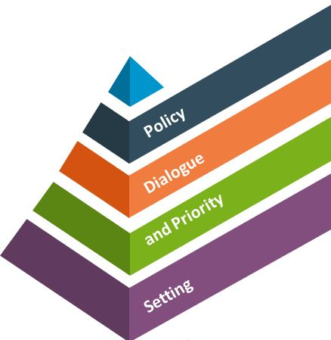

Disbursement as expression of collaboration
Notes:
TRAINER NOTE:
Disbursement takes place at a date indicated in the Financing Agreement. However, the disbursement decision is not ‘judgement day’ with the partner country with the partner country having to pass its exam and the EC in the role of the exam committee. Disbursement is more the expression of collaboration, of mutual efforts to achieve the EU BS supported Government policies, with leadership by the partner country.
Disbursement is enhanced by proper and effective policy dialogue, by joint priority setting, by timely facilitation through complementary measures and by proper monitoring of progress in the achievement of the performance indicators, while maintaining eligibility. It is also the moment for reflection of the appropriateness of the performance indicators and to assess what could be done to assist government to enhance its capacities to achieve the indicators.

Slide 95
Disbursement process
Partner country
Request for tranche release & engage in dialogue with EUD
EU Delegation
Engage in dialogue with national authorities, analyse tranche release request, assess tranche release and prepare a disbursement file. Submit clear recommendation
INTPA
Country Cooperation Teams (CCTs) make decisions on operations and payments, potentially involving discussion by the geographic Strategic Steering Committee (SSC)
The SSC formally approves (or not) the operation and payment
EU Delegation
Geographical director provides visa for payment and issues letter – through the HOD- with key messages to be taken up in dialogue
Verification of payments (incl. exchange rate verification)
Notes:
The five main steps for disbursement are described in the Guidelines section 5.6. You will find more information there on these steps, at whom is involved within each category, what is required and when.
Note that this step-wise procedure reflects the formal sequence. In practice, you might be in continuous contact to ensure that the request for disbursement contains all the information needed, that the Delegation realizes its checks and assessments in time, possibly coordinated with Brussels, and the like. Since most countries have more than one budget support operation running simultaneously, each with its annual disbursement moment, this is of particular importance for the eligibility criteria that are (almost) the same for all disbursement requests that year.
Reminder: Timeliness of payment is critical, and every effort should be made to adhere to the indicative disbursement timetable set out in the Financing Agreement and/or disbursement schedule agreed subsequently you. This will require the MOF to be very proactive in mobilising the various relevant ministries in producing their contribution to the disbursement report. Someone needs to be in the lead, to ensure that the process of overall monitoring of the BS runs smoothly, that bottlenecks and challenges are addressed in time and that solutions are found: this is the pivotal and crucial role of the MOF.
Who are involved?
Line Ministries (in particular in case of SRPC, preparation of sector policy update, sector performance and sector indicators)
Ministry of Finance (Budget preparation and execution – Treasury, macroeconomic and fiscal policies and PFM reforms)
National Authorising Officer/ Ministry of European Integration / Ministry of Finance… (coordination and preparation of disbursement request file and of request letter)
Agencies and other stakeholders (if relevant)
Within the Delegation:
analysis, PFM reforms dialogue and analysis, sector specific economic analysis)
Sector Sections (sector dialogue, sector policy analysis, targets for sector indicators)
Contract & Finance (account for transfer, contract, invoice, forecasts)
Head of Co-operation, Political officer (if and when required)
Head of Delegation (recommendation for disbursement)
At HQ:
Geographic Directorate
INTPA/NEAR (ENEST/MENA) unit in charge of BS (Strategic Steering Committee), macroeconomic governance and PFM
Relevant Thematic units including horizontal aspects such as Fundamental values
EEAS geographic directorate for political opportunity to disburse (not for IPA)
ECFIN for the macroeconomic situation (ENI & IPA only)
SSC/Country Cooperation Teams /FAST (if and when required)
After the payment or indirectly:
European Court of Auditors and European Parliament
External audit in partner country (Supreme Audit Institute)
Member States
Civil society (both in the EU and partner country)

Slide 96
Requirements for disbursement
 | What is assessed by the EU | Required from Government
Public policy | Continued credibility and relevance of the strategy Satisfactory progress in implementation | Report on strategy implementation and sector progress Highlights on areas of special interest Progress on agreed performance indicators Challenges met & response provided
Macro-economic stability | Stability oriented policies aimed at restoring key balances The country’s vulnerability to external shocks | Report on annual macro-economic performance, incl. fiscal performance and DRM Challenges met & response provided
PFM and budget transparency | Progress in implementation of Public Finance Management reforms Satisfactory access to budget information Progress in Domestic Resource Mobilisation | Report on progress of Public Finance Management reform implementation, incl. Domestic resource mobilisation Report on budget transparency Challenges met & response provided
Notes:
Disbursement takes place at a date indicated in the Financing Agreement. However, the disbursement decision is not ‘judgement day’ with Nepal having to pass its exam and the EC in the role of the exam committee. Disbursement is the expression of collaboration, of the joint efforts to achieve the Government policies, supported by EC Budget Support.
Now, decisions on disbursement are a lot easier if we count with a good BS design, if we have a proper and effective policy dialogue, if we have the timely facilitation through complementary measures and by proper monitoring.
The request for disbursement is also the moment for reflection of the appropriateness of the performance indicators and to assess what could be done to assist government to enhance its capacities to achieve these indicators (in case there are flaws or bottlenecks) or to modify the formulation or yardsticks.
The assessment requirements for tranche release refer to the eligibility criteria (for the fixed tranche, all or nothing) and to the indicators for the variable tranche
To speed things up and to make life easier, in case there are no clear changes in the eligibility criteria, there is no need to elaborate new assessments every year and the assessments remain valid for a period of three years, except the combined monitoring of the PFM and budget transparency. The latter is easy to understand: every year new reports are published and the extent to which these are made available to the public may vary from year to year.
The PFM criterion refers to the ‘core’ concept of budget support, so progress in relation to the reform process (that is usually being reported upon anyhow in the frame of the PFM annual reporting) has to be mentioned and analysed.

Slide 97
Illustration Fictiland : June 2026 assessment, Performance indicators
Indicator | Baseline | Baseline | Year 2025 |  | Weight | Maximum amount | Score | Score
 |  |  | Target | Actual
Objective 1: Grid development
1. PI1. Access | 120500 | 120500 | 155000 | 147000 | 10% | €1M | 0.5
2. IP4: Renewable energy consumption | 70000 | 70000 | 95000 | n.d. | 10% | €1M | 0
Objective 2: Sector governance
3. IP6: Energy Information System | n.a. | n.d. | yes | yes | 20% | €2M | 1
4. IP5: Recurrent Budget (%) | 2.50% | 2.50% | 2.50% | 1.76% | 10% | €1M | 0
5. IP8: Electricity subsidy | 68% | 68% | 80% | 68% | 15% | €1.5M | 0
6. IP9: Feed-in tariff | n.a. | n.d. | yes | yes | 10% | €1M | 1
7. IP12: Solar development plan | n.a. | n.d. | yes | yes | 10% | €1M | 1
Objective 3: Social protection
8. IP10: Social assistance scheme |  | n.a. | yes | yes | 15% | €1.5M | 1

Slide 98
Calculating the Variable tranche
  Standard method: Assess individual indicators:
          0 = no progress;
          0.5 = significant progress;
          1 = target met
        Pro rata payment: aggregate the amounts for each indicator
        Other methods possibles but more complex (check guidelines) – Bottom-line: not unambiguous and fully understood by all sides
Notes:
NOTE: These are examples or indications, but not strict options. In principle free to negotiate, as long as it is clear and transparent.
See 4.4.4
Conditions, criteria, procedures and timing for disbursement should be clearly defined with and understood by the PC in order to enhance predictability and respect the country's budgetary, planning and reporting cycles. Mutual understanding is a core element of the budget support contract between the EU and the partner country. To the extent possible, assessments and decisions regarding disbursements should take place in a timely manner to support the budget execution for the fiscal year into which the funds are to be disbursed. Floating tranches, i.e. without a decision date defined in the financing agreement, should be avoided.
EUD should agree with the authorities and in consultation with other cooperation partners on an appropriate and transparent methodology. Undisbursed funds should not be 'recycled' in later tranches as this can reduce the initial incentive effect of variable tranches. They should be de-committed and where possible returned to the country's national/multi-annual indicative programme according to the applicable rules, or, if relevant and feasible, allocated to the complementary support component of the contract.
Nonetheless, the financing agreement may allow for the possibility to waive or neutralise a variable tranche indicator in exceptional and/or duly justified cases, e.g. where unexpected events, external shocks or changing circumstances have made an indicator or its target irrelevant. In these cases, the related amount could either be reallocated to the other indicators of the variable tranche the same year or be transferred to the next variable tranche the following year. The financing agreement may also provide for the possibility to re-assess an indicator the following year against the original target, if there was a positive trend and the authorities did not reach the target because of factors beyond their control.
Show example of pa144 if they don’t understand or to illustrate the calculation of the amount for the VT

Slide 99
Illustration Fictiland : Calculation of tranche
Indicator | Weight | Maximum amount | Score | Method 1 | Montant à décaisser
Objective 1: Grid development
1. PI1. Access | 10% | €1M | 0.5 | €0.5M | €0.5M
2. IP4: Renewable energy consumption | 10% | €1M | 0 | €0M | €0M
Objective 2: Sector governance
3. IP6: Energy Information System | 20% | €2M | 1 | €2M | €2M
4. IP5: Recurrent Budget (%) | 10% | €1M | 0 | €0M | €0M
5. IP8: Electricity subsidy | 15% | €1.5M | 0 | €0M | €0M
6. IP9: Feed-in tariff | 10% | €1M | 1 | €1M | €1M
7. IP12: Solar development plan | 10% | €1M | 1 | €1M | €1M
Objectif 3: Social protection
8. IP10: Social assistance scheme | 15% | €1.5M | 1 |  | €1.5M
TOTAL DISBURSEMENT |  |  |  |  | € 6.0M
TOTAL to disburse : € 6 million out of a maximum of € 10 million

Slide 100
Exercise 7: Disbursement negotiation, June 2025
50’ in groups
20’ plenary feedback
A first year of budget support has passed. During 2025, you have kept close to the MoE and its various technical departments to monitor progress. You participated in the SWG with the other development partners and stakeholders. With the COVID-19 pandemic and its aftermath, policy plans could not be implemented as originally designed.
To support the Government in coping with the economic and fiscal consequences of the critical situation of Fictiland following the massive floods at end-2024, the EU already brought forward the payment of the 2025 fixed tranche. You are now sitting down with the authorities to discuss the disbursement of the 2026 variable tranche, which is based on the performance for 2025. Four out of the 8 indicators did not reach their 2025 targets, which were agreed in 2024….
For this exercise, you will be divided into two groups, one group representing the EUD, the other group representing the Fictive Government. Please nominate a speaker. Prepare your arguments for disbursement. An article has just been published in the Fictou Daily Post… see the provided documents.
Notes:
No documents, just free for all discussion but want to come out with some real arguments, corrective measures (realised or commitment to) and additional support/revision of indicator targets for end of programme

Slide 101
To be distributed: Instructions exercise 7, Group EU Delegation representatives
Please prepare your argumentation to discuss the way forward with the Ministry of Finance and ECF. Remember that the EU and the Government are bound by a contract and hence all clauses of the contract are to be respected if questioning by the SSC / FAST and ultimately the European Court of Auditors is to be avoided.
Remember that an indicator can be waived or neutralised in case of exceptional circumstances in exceptional and/or duly justified cases, e.g. where unexpected events, external shocks or changing circums­tances have made an indicator or its target irrelevant (see budget support guidelines page 51). In these cases, the related amount could either be reallo­cated to the other indicators of the variable tranche the same year or be transferred to the next variable tranche the following year.
The Government will need to explain what it has done or will do to address the situation. On the EU’s side, you can think about how you can support the GOF so that the same issue doesn’t re-occur in subsequent years.
You finally need to prepare for a possible renegotiation of targets or even indicators (if relevant) for subsequent years. This is foreseen in the Financing Agreement by simple exchange of letters between EUD and MOF.

Slide 102
To be distributed: Instructions exercise 7, Group Government of Fictiland representatives
You desperately need to get a 100% disbursement despite the unfavourable circumstances. The contract you signed with the EU has to be respected but the EU BS guidelines foresee that ‘in exceptional and/or duly justified cases, e.g. where unexpected events, external shocks or changing circums­tances have made an indicator or its target irrelevant. In these cases, the related amount could either be reallo­cated to the other indicators of the variable tranche the same year or be transferred to the next variable tranche the following year.‘
Please prepare your argumentation to discuss the way forward with the EU. Remember that the EU and the Government are bound by a contract and hence all clauses of the contract are to be respected.
Make sure you have arguments at hand to explain the causes of the deviation from targets, what has been done to rectify the situation and/or what is foreseen to be done.

Slide 103
Disbursement report template
  Introduction: Overview table disbursements so far. Significant changes observed with respect to eligibility criteria; main developments country/sector context; follow-up on key recommendations from previous assessment; changes to Risk Management Framework (incl. reputational risk); conclusion on the proposed disbursement.
  Review of the 4 eligibility criteria and policy dialogue
  Annexes
  Government disbursement request
  Delegation’s PFM (including DRM) and Transparency Report (3 years validity)
  Update PFM monitoring table (annually)
  Latest validated RMF
  Financing Agreement or latest amendment in force
  Sources of verification (general conditions and variable tranche indicators)
  In case last payment: Final Report
Notes:
TRAINER NOTE
No new eligibility assessment is required for a first disbursement if the formulation assessment was concluded less than 6 months ago, and if there are no major changes which could affect eligibility. Such a provision would need to be included in the FA
The Logic in the template:
The policy review is followed directly by the assessment of VT indicators (direct link between policy, support (BS) and performance).
The macroeconomic eligibility (table) reflects main indicators directly related to (financial) stability: revenues, lending, debt and current account balance.
Be aware that a mayor part of the macro-economic variables can be found in the IMF reports, but not all. It is recommendable to identify which ones cannot be found in the IMF report (i.e. unemployment), and determine in advance what the most suitable source is (and maintain that source over the period of the BS programme)
The template involves less annexes:
For low/moderate PFM risk countries, the PFM and Transparency report is normally valid for 3 year, but the PFM monitoring table is updated annually.
For countries with a low or moderate PFM risk profile: update in template (valid for 3 years).
No annexes required for eligibility analysis

Slide 104
Which documents to insert / Hyperlink in a disbursement file
  Cover Letter
  (i) Financial information form: validity of bank account and Proof of transfer previous disbursement (exchange rate) (if not done before)
  (ii) Analysis and evidence of continued eligibility and targets achieved for the indicators of the variable tranche
  Calculation variable tranche and amount requested
Partner Country
Formal request from the Government
Template plus:
  Government policy framework (if new)
  Government policy implementation report and action plan
  Aide Memoire of Joint Review (if applicable)
  IMF reports; other macro-economic reports
  PFM Diagnostic reports
  Government PFM Reform progress report
  Policy dialogue framework / plan (if applicable)
EU
Delegation
Notes:
TRAINER NOTE
The formal request from the Government usually requires some ‘joint’ elaboration. Some Delegations do use a kind of template to ensure that all necessary elements are in the request.
That request should contain: reference to the Financing Agreement and sequence of the tranche; affirmation of the receipt of the previous tranche (and if necessary the exchange rate used); that the eligibility criteria are still met; indication of the extent to which the performance indicators have been met; the calculation of the the amount requested; the explicit request for that amount and the account number to which that has to be deposited. In case this account number has changed,, and indicating of that change.
Usually the proof of transfer to the Treasury account (made by the Central Bank) and the exchange rate used is forwarded to the Delegation (and forwarded to HQ) immediately after the deposit. If not, the evidence of the exchange rate used shoud be added to the documentation for the request for release of the next transfer.
Note that the calculations should be precise and in EXCEL
After receipt of the request, that is confirmed by the Delegation. DEU checks completeness of the file and corresponding data. And proceeds with the template.
SHOW AND BRIEFLY BROWSE THROUGH THE TEMPLATE

Slide 105
Finally, data need to be verified!
The Commission should:
review the underlying evidence supporting the performance data provided by partner countries in the disbursement request, unless it has already explicitly concluded that this data is reliable;
when using external reviews, require in the terms of reference the verification of the reliability of key performance data provided by partner countries. Before disbursing the variable tranche, verify that the experts have complied with this requirement.
Source: ECA, Data quality in budget support: weaknesses in some indicators and in the verification of the payment for variable tranches, 2019

Slide 106
If things go wrong:
Gradual and proportional response
Change in Fundamental Values | Response
Stable or positively progressing situation | Minor adaptations for fine-tuning if required
Concerns arising | Mitigation measures to be proposed Roadmap for improvement
Significant deterioration | Report from EU Delegation to Geographic Director (support by INTPA / NEAR-ENEST/MENA, EEAS). Next to SSC / FAST. Suggestions for precautionary measures (complementary actions?); delay in disbursement; reduction of BS
Extreme cases | Suspension and if needed termination of the financing agreement Possible re-allocation of resources to non-governmental activities
Notes:
TRAINER NOTE
Around 75% of all contracts are SRPC’s. For these contracts, the change in Fundamental Values is not reported in the disbursement file, but in the RMF+.
In cases of deterioration of the Fundamental Values this is not automatically and inmediately a reason to not disburse the next tranche, but this may be reported to the SSC / FAST committee that in turn may recommend to take action. That action may vary from suggesting mitigating measures to –in extreme cases- the suspensio of the activities.

Slide 107
Questions and Answers
INTPA Unit E1

Slide 108
Rounding Up: relevant information?
  On INTPA Internet: https://ec.europa.eu/international-partnerships/budget-support_en
  On INTPA Intranet: Always refer to it (for templates, documents etc)
  https://myintracomm.ec.europa.eu/dg/intpa/eu-development-policy/budget-support-public-finance-domestic-revenue/Pages/budget-support.aspx
  Links to Videos:
    What is EU budget support? – https://bit.ly/EUbudgetsupportVideo1
    How EU budget support operates – https://bit.ly/EUbudgetsupportVideo2
    EU budget support, a partnership for results – https://bit.ly/EUbudgetsupportVideo3
    EU budget support at the time of crisis, the State and Resilience Building Contract – https://bit.ly/EUbudgetsupportVideo4
  On Capacity4Dev platform:
  Restricted group « Budget Support Network » - https://europa.eu/capacity4dev/bsn
  Public Group: « Economics, public finance, domestic revenue mobilisation & budget support » - https://europa.eu/capacity4dev/macro-eco_pub-fin - Training material available here

Slide 109
Training Evaluation Form
Dear participants,
please refer to chat box for completion of the form before leaving the virtual training.

Slide 110
TEST OUT
Dear participants,
please refer to chat box for completion of the survey before leaving the virtual training.

Slide 111






Keep in touch
Use your EU Login credentials to join Capacity4dev.eu
Connect with us

Slide 112

Thank you
© European Union 2020
Unless otherwise noted the reuse of this presentation is authorised under the CC BY 4.0 license. For any use or reproduction of elements that are not owned by the EU, permission may need to be sought directly from the respective right holders.
Notes:
Update/add/delete parts of the copy right notice where appropriate.
More information: https://myintracomm.ec.europa.eu/corp/intellectual-property/Documents/2019_Reuse-guidelines%28CC-BY%29.pdf

