Slide 1
Session 14: Inclusive VET: Gender equality integration in TVET programmes
ANNUAL EDUCATION & TVET SEMINAR
Brussels, 19 – 23 October 2015
Thursday 22 October
15:30 16:20

Slide 2
Objective
Learning objective: identify the entry points for mainstreaming gender equality into the programme cycle management of TVET programmes using EC tools.
What to expect from this session?
Identify the reference documents on the rationale for gender equality mainstreaming into EC/ EU funded programmes
Identify and use EC/ EU references on gender equality and gender mainstreaming methodology in TVET sector
Identify and exploit entry points for mainstreaming gender into the EC cycle of operations

Slide 3
Empowerment: definition
Kabeer (1999) defines empowerment as expanding people’s ability to make strategic life choices, particularly in contexts in which this ability had been denied to them.
The ability to exercise choice encompasses three dimensions:
  Resources
  Agency
  Achievements (well-being outcomes)

Slide 4
Definitions
Gender: a concept that refers to the social differences between women and men that have been learned, are changeable over time and have wide variations both within and between cultures.

Slide 5
Definitions
Gender equality: the concept meaning that all human beings are free to develop their personal abilities and make choices without the limitations set by strict gender roles; that the different behaviors, aspirations and needs of women and men are considered, valued and favoured equally.

Slide 6
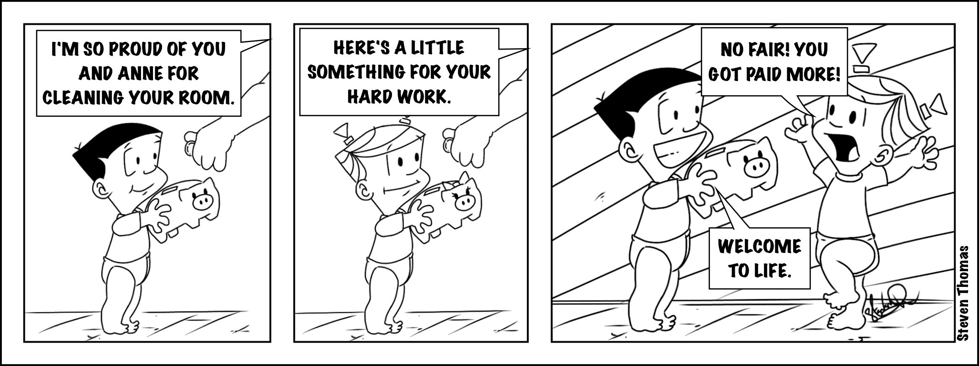
Definitions
Gender roles: A set of prescriptions for action and behaviours allocated to women and men respectively, and inculcated and maintained.

Slide 7
Definitions
Gender mainstreaming: concerns planning, (re)organisation, improvement and evaluation of policy processes so that a gender equality perspective is incorporated in all development policies, strategies and interventions, at all levels and at all stages by the actors normally involved therein.

Slide 8
Why gender equality?
Human rights and commitment towards the International Community
Condition for sustainable development and poverty reduction (equitable growth)
(Macro) Economically sensible
>

Slide 9
GEWE: Transforming the Lives of Girls and Women through EU External Relations 2016-2020
Brussels, 21.9.2015 SWD(2015) 182 final >
C. Thematic Priority: Economic, Social and Cultural Rights - Economic and Social Empowerment
Goal: By 2020 the EU will have contributed in a measurable manner to girls’ and women economic and social empowerment, to their active participation in the economy and to the prevention of economic exploitation.
13. Equal access for girls and women to all levels of quality education and vocational education and training (VET) free from discrimination. | 13.1 Primary completion rate for girls and boys (SDG 4.33) 13.2 Secondary completion rate for girls and boys (SDG 4.35) 13.3 Tertiary enrolment rates for women and men (SDG 4.37) 13.4 Literacy rate of 15-24 year-olds, women and men (SDG 4.5) 13 .5 % of pupils enrolled in primary and secondary schools providing drinking water, adequate sanitation, and adequate hygiene services (SDG 6.4) 13.6 Personnel in Research and Development (per million inhabitants) (SDG 9.63) | Support legislation and national capacity full coverage of quality and non-discriminatory education for learners of all ages. Ensure a safe, free of sexual and gender based violence environment that responds to child protection principles. Provide education (both formal and non-formal), that addresses gender stereotypes, and allows for lifelong learning. Promote gender-equal role models in the transition from education to the labour market through curricula and gender parity among teachers. Support vocational and professional training for girls and boys that enable them to be change agents.

Slide 10
SDG 5 >
5.1 End all forms of discrimination against all women and girls everywhere
5.2 Eliminate all forms of violence against all women and girls in the public and private spheres, including trafficking and sexual and other types of exploitation
5.3 Eliminate all harmful practices, such as child, early and forced marriage and female genital mutilation
5.4 Recognize and value unpaid care and domestic work through the provision of public services, infrastructure and social protection policies and the promotion of shared responsibility within the household and the family as nationally appropriate
5.5 Ensure women’s full and effective participation and equal opportunities for leadership at all levels of decision-making in political, economic and public life
5.6 Ensure universal access to sexual and reproductive health and reproductive rights as agreed in accordance with the Programme of Action of the International Conference on Population and Development and the Beijing Platform for Action and the outcome documents of their review conferences
5.a Undertake reforms to give women equal rights to economic resources, as well as access to ownership and control over land and other forms of property, financial services, inheritance and natural resources, in accordance with national laws
5.b Enhance the use of enabling technology, in particular information and communications technology, to promote the empowerment of women
5.c Adopt and strengthen sound policies and enforceable legislation for the promotion of gender equality and the empowerment of all women and girls at all levels

Slide 11
Example: Impact of empowerment of women on health and wellbeing for them and their children
Autonomy in agricultural production decisions emerges as a key determinant of almost all mother and child health outcomes
The number of hours in paid and unpaid work is positively associated with maternal dietary diversity, children’s dietary diversity, and children’s weight-for-height and height-for-age However, beyond a threshold (more than 10.5 hours per day) it becomes detrimental to mother’s nutrition status.
Control of income is important as a determinant of maternal BMI and child’s weight-for-height
Group membership is positively associated with maternal BMI.
Reference: Agriculture, Production Diversity, and Nutrition IFPRI Discussion Paper December 2013
>

Slide 12
How does gender inequality manifest in TVET
Location, journey to venue, and timing, training venues responsiveness to women
Lower initial levels of education can prevent women accessing further training
Perceptions and cultural norms ; gender norms may be imposed on women, or they may be internalised
Insufficient (financial) resources; adaptation of facilities; transport; female trainers recruitment and placing; more funding available for programmes that men tend to enroll on, and less for those that women tend to take.
Training needs to be both relevant and of an acceptable quality standard if participation is to be encouraged; training needs to balance the welfare, basic and technical skills
Training programmes, particularly apprenticeships, can be segregated along lines of
Quality of teachers
Reference: 2012/ED/EFA/MRT/PI/03 Gender and Skills Development Kate Shoesmith & Kathleen Collett 2012

Slide 13
Examples of positive impact of GEWE in economic development
Closing gender gaps in the labor market would raise GDP in the United States by 5%, in the United Arab Emirates by 12%, and in Egypt by 34%.
Nalt Enterprise, a Vietnamese garment factory, established a kindergarten for workers’ children -- staff turnover fell by one third.
Odebrecht, a global corporation, encouraged more women to apply to its pre-hire engineering and construction skills training programs -- was able to recruit more workers, engage with local communities, and provide women with a foothold in the construction industry.
Reference: Women, Work, and the Economy: Macroeconomic Gains from Gender Equity IMF 2013 >

Slide 14
Models
Two related Latin American programmes, FORMUJER and PROIMUJER,
  Basic competencies which enable individuals to ‘learn how to learn’, and prepare them for lifelong learning (including literacy and numeracy skills where needed).
  Mainstream competencies (learning how to do) where individuals learn how to apply knowledge and skills to problems. This includes planning and managing resources, and starting up businesses.
  Attitudinal competencies (learning how to be) including the development of personal skills, leadership skills, teamwork and negotiation skills.
  Technical sector competencies, which extend and refine mainstream competencies so that they can be used in a particular occupation
    The projects found that: ‘employability and the exercise of citizenship rights are strengthened when individuals are able to adapt their abilities, needs and knowledge to the competencies required by the labour context and when they can see themselves as creators of their own future, identifying their own skills, wishes, possibilities and difficulties and thereby make their way in life.’
In Ghana, a number of agricultural training programmes encourage female participants to begin the training programme by sharing any concerns they may have and to picture their end goal from the training.
    The programme effectively engages the women right from the outset, gives them a sense of purpose and control, and takes into account any problems that may prevent full participation. This also ensures that the facilities are appropriate for girls and women, and that complementary resources which women need, such as childcare, are available
Reference: 2012/ED/EFA/MRT/PI/03 Gender and Skills Development Kate Shoesmith & Kathleen Collett 2012

Slide 15
Example: Ethiopia
Joint facility: FR, AU, EU, UK (2012)
The New Life Community College focuses on female orphans schooling and TVET
Selection of candidates done by a community board
Candidates receive TVET, internships with major employers, eg Ethiopian airline, Coca Cola, etc,
Networking events for those 15 years or older with female business community to match with mentors
Candidates did far better than everybody else in the state exam. Their average is 70% (as compared to 40% of average)
Other examples included in “Briefing note on gender equality and TVET”

Slide 16
Examples
Nicaragua TEC-NICA
Malawi STEP
Other…

Slide 17
On-line resources
http://capacity4dev.ec.europa.eu/topic/gender
http://capacity4dev.ec.europa.eu/public-gender/document/briefing-note-gender-and-tvet
http://www.romgendercourse.eu
http://www.learn4dev.net/expertise/gender/
http://www2.ohchr.org/enlish/bodies/cedaw/index.htm

