Slide 1





BEYOND INPUTS SUBSIDIES: EXPLORING ALTERNATIVE STRATEGIES TO BOOST PRODUCTIVITY OF SMALLHOLDER FARMERS IN AFRICA
for
Value chain knowledge sharing for action
29th January 2026
Gideon Onumah

Slide 2
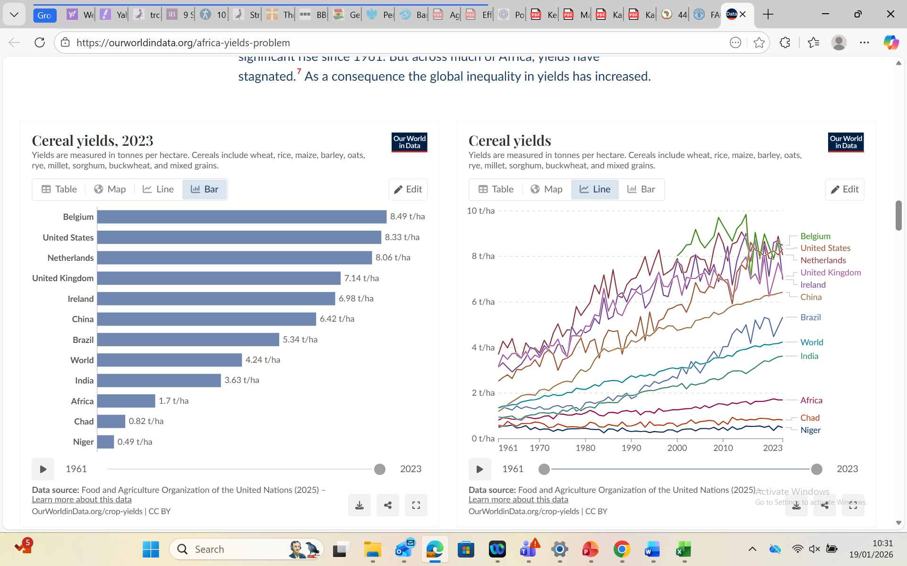
Introduction/context (1):
Increasing farm output/productivity remains high on African agenda:
  A key commitment in the Kampala Declaration 2026-2035 (AUDA-NEPAD, 2025) – implementation from Jan 2026.
  Acknowledges bridging productivity gap, highlighted by FAO (2025); but also
  Stresses goals beyond objectives of Inputs Subsidy Programmes (ISPs), which are:
    Increase yields through subsidising mainly inorganic fertiliser;
    Agrochemicals and “improved” seed/planting materials
Cereals gap 1961-2023 (FAO 2025)

Slide 3
Introduction/context (2):
Commitments in the Kampala Declaration (2025) emphasise:
  Food and Nutrition Security: implying focusing beyond increasing grain output; but also boost output of
  Nutrient-rich foods including “neglected and underutilised species”.
  Systems perspective in sustainable development of agrifood systems:
    Economically sustainable – profitable/financially sustainable for producers; &
      Fiscally sustainable for governments.
    Environmentally sustainable – e.g. enhance climate-resilience; and
    Socially and culturally sustainable
Hence, need for alternative options to boost smallholder productivity:
  Aligned to the objectives of the Kampala Declaration (2025); whilst helping to
  Break smallholders’ low-inputs and low productivity equilibrium (Dorward et al. 2008)

Slide 4
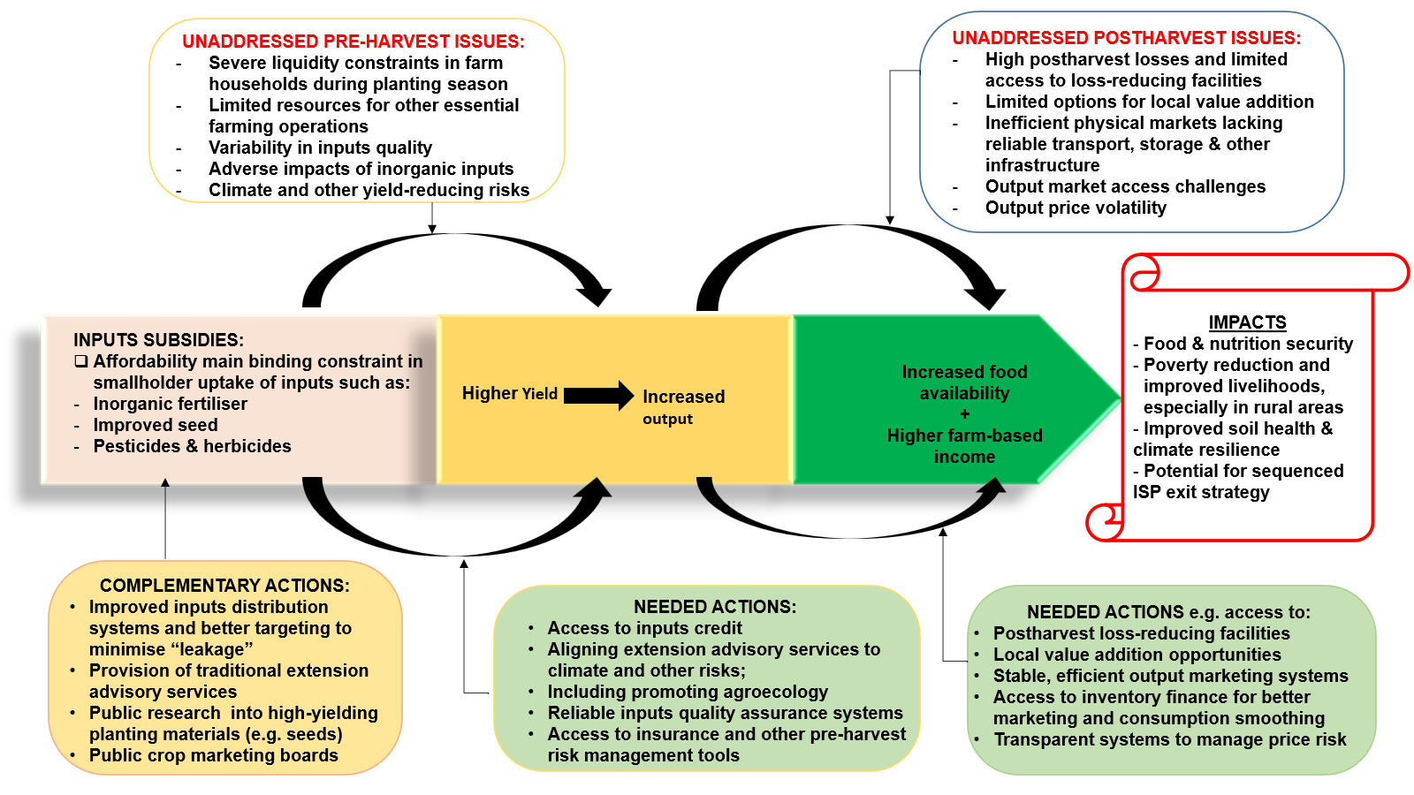
Framework for analysis of ISPs

Slide 5
ISP in Nigeria
Initiated in 1980-90s; modified several times; by 2021/22 subsidies accounted for about 7.2% of federal agriculture budget, excluding 25% subsidy from states
Additional public investment in form of multiple unsustainable credit schemes
Despite this crop yields stagnated or declined between 2013 and 2020.

Slide 6
ISP in Zambia
Launched 2002 to cushion smallholders against severe drought in 2000/2001
Target ballooned from 120,000 (2002) to over 1 million in 2022; subsidy rising from 50% to over 80%; taking up over 30% of sector budget;
Average yield for maize (main national staple and target): low and variable; and
Marginal impact on poverty reduction; poor smallholders account for only 27% of subsidised inputs distributed (Fusillier et al. (2021)

Slide 7
Alternative strategies & options:
Liquidity for access to inputs & services
Business to Farmers model
Linking smallholders to structured trading systems:
Inventory finance for timely inputs access
Integrate into public food procurement
De-risking inputs finance
Farming systems for the environment
Environmental sustainability and “waste” as a resource
Supportive actions
Extension reforms: climate change, soil health and financial sustainability
Prioritise postharvest loss reduction
Conservation agriculture and agroecology
Integrated (zero waste) farming systems
Strengthen linkage between researchers and smallholders.
Ensure supportive policy and regulatory framework

Slide 8
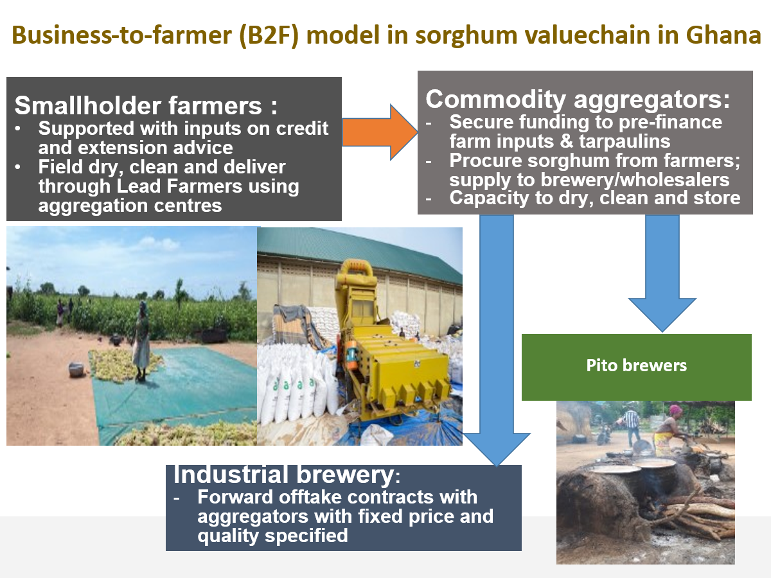
Business to farmer (B2F): Ghana sorghum value chain
Key actors’ interests/benefits and role:
Major industrial brewery:
  Consistent supply of quality sorghum
  Lead in pre-season negotiation of prices
Commodity aggregators:
  Assured offtake market; secures trade finance
  Funds inputs credit and tarpaulin for drying grains
  Field staff provide extension and monitoring
Smallholder farmers:
  Assured market at pre-determined floor price
  Access to inputs credit, extension advice and improved postharvest grain handling
  Evidence of productivity gains impacting household income and food availability
  Anecdotal evidence indicates option attractive to youth (“safer than illegal mining”)
Issues: limited farmers’ involvement in price bargaining; buyer non-performance a risk (not side-selling (occurred during COVID); need to align extension advice to climate change

Slide 9
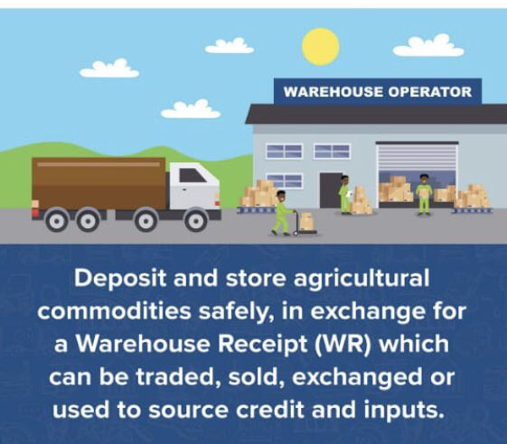
Inventory collateralisation for timely inputs access:
Collateralising durable commodities:
  Grains deposited in certified/licensed facilities (e.g. by ZAMACE, Zambia)
  Receipts issued and transferred to inputs distributors as collateral for inputs on credit
Commercial farmers:
  Over 10,000 tonnes of maize deposited
  US$2.35 million inputs credit at total carrying cost of 5.7% (vs 15.5% interest rate)
  Extra income from delayed sale close to 7%
Smallholders:
  Two cases: 1.0 and 1.2 tonnes
  Inputs credit US$305 and US$345 respectively; incremental income from delayed sale about 18%
Public grain procurement via warehouse receipt system can:
  Upscale this form of inputs financing, especially, where agencies delay payments by 3-6 months

Slide 10
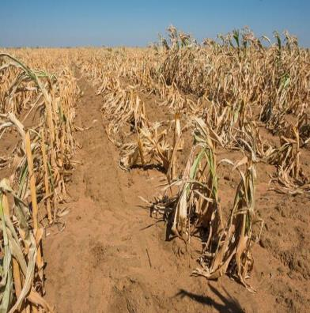
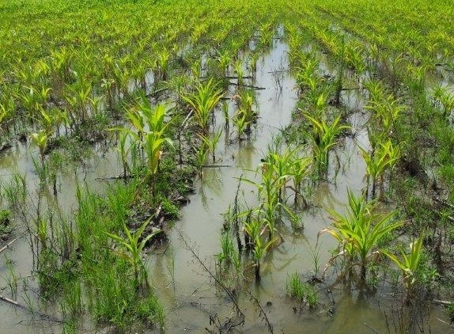
De-risking inputs finance: Zambia case
Weather and other risks discourage agricultural lending
  Unsubsidised insurance (multi-peril and index-linked)
  Commercial inputs finance (cashless: direct to suppliers)
  Forward contracting for grain sales subsequently added
Piloted from 2008/09 to 2014/15 (involving ZNFU/EU-funded FARMAF)
  Participating farmers from: 200 in 2008 to 18690 in 2014/15
  Average cultivated area financed = 2.03 hectares
  Financing: US$120,000 in total in 2008 to US$4.4 million in 2014/15
  Insurance premium: 5% and subsequently reduced to 4.0%/4.5%
  Average claims to premium earned ratio = about 45%
  Interest rate in 2014/15 = 14% (vs prime of 15.5%)
100% loan recovery in first 4 years; dropping to 93.7% in 2014 and 90.9% in 2015
Biggest challenge has been sustainability of insurance scheme during years of catastrophic scale drought (often linked to El Nino)

Slide 11
Working with the environment:
Exponential growth in adoption of conservation agriculture (CA):
  Number of countries in Africa: 2008/09 = 9; 2013/14 = 14; and 2018/19 = 25
  Total land area under CA in Africa
    2008/09 = 485,000 ha
    2013/14 = 903,000 ha
    2018/19 = 2,710,000 ha
  South Africa leads: 50% cropped land
    Followed by: Zambia = 17.6%;
    Mozambique = 9.7%; Ghana = 7.6%
    Malawi = 6.7%
  Commercial farmers lead CA in Africa
Source: Mkomwa & Kassam, 2022.

Slide 12
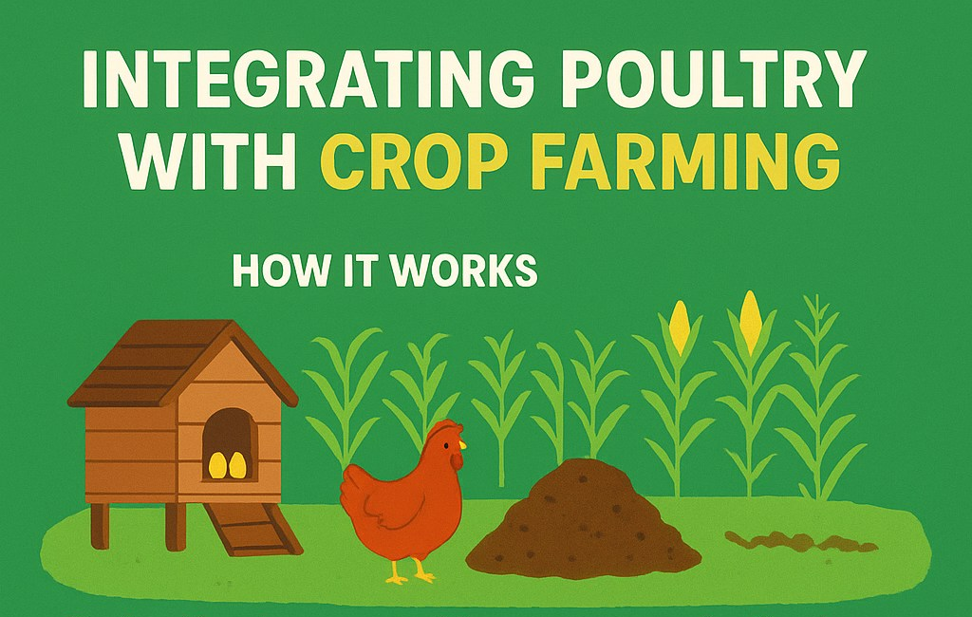
Integrated farming systems – waste is a resource
Poultry/crop farming
  Poultry manure – soil fertilisation
  Grains for feed, food and market
  Eggs and meat – consumption/sale
Cases in Zambia
  Medium-scale egg producers:
    Integrated with commercial vegetable production
  Large-scale egg producer:
    Manure dried and packaged for sale, especially to medium-scale vegetables producers
    Result of collaborative research with University of Zambia
Source: ChixxVille, 2025.
Source: Mkomwa & Kassam, 2022.

Slide 13
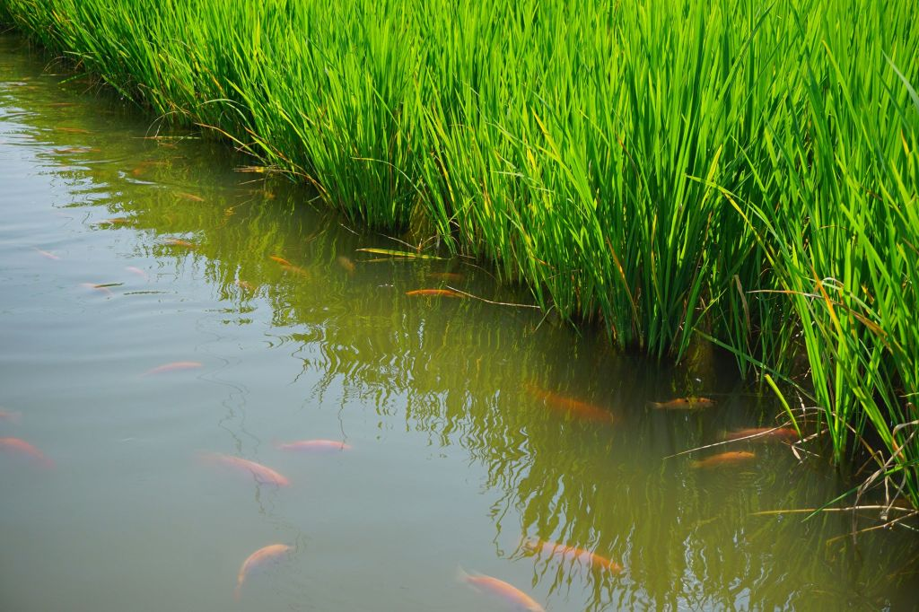
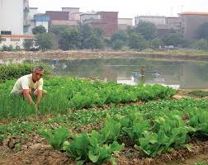
Integrated aquaponic farming systems
Fish with rice:
  Potential being explored for public irrigation facilities in Northern Ghana
  Can produce fish (tilapia and catfish popular) and crustaceans (shrimp)
  Reduce inorganic fertiliser use in paddy production
Fish with vegetables (in Ghana)
  Growth in adoption by medium-scale farmers and women’s groups:
    Vegetable farms irrigated with effluent from fishponds (rich in organic nutrients & safer)
    Dual source of income from fish (mainly catfish) and vegetables (all types)

Slide 14
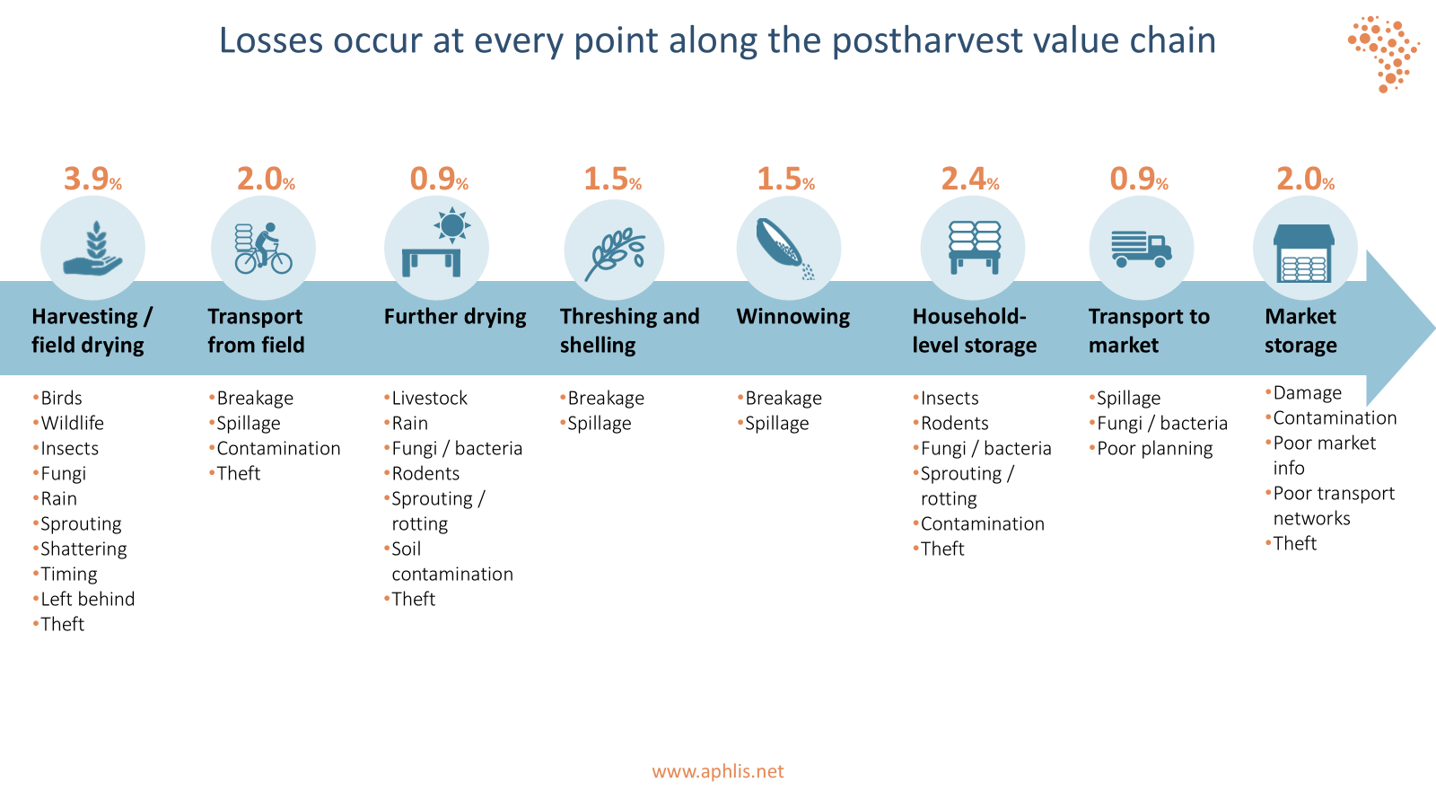
Supportive actions (1)
Extension reforms (PARM 2018 - Ethiopia; and 2019 - Liberia)
  Climate change and profitability of adopting new technologies and practices often marginalised in public extension systems, except in specific projects.
  Limited engagement of smallholders in research and innovation which underpin extension advisories in agrifood systems
Postharvest loss (PHL) reduction (Stathers, Onumah and Lamboll 2024)
  Reduce PHL to improve food availability & profitability of adopting yield-enhancing inputs
  Focus not only on food grains but also perishables e.g. vegetables and fruits
  Interesting emerging cases of SME-led innovations in PHL-reduction

Slide 15

Supportive actions (2)
Enabling policy framework
  Avoid disabling interventions in inputs/output markets
  Strengthen links between smallholders and researchers/innovators
  Sustained start-up funding is critical in promoting innovations that improve soil health whilst enhancing climate resilience and farm productivity
Thank you for your attention

