Slide 1


Joint Programming
Technical Seminar
Brussels, 12 November 2015
Moving at different speeds
DEVCO/A2 Aid and Development Effectiveness and Financing
EEAS/GLOBAL 5 Development Cooperation Coordination Division
Notes:
DEVCO- Bernard San Emeterio
1
1

Slide 2
Update the state of play on JP
Request sent by SG EEAS, DG DEVCO & NEAR to 55 EU Delegations in "Joint Programming" countries, 21 May 2015
Objective was:
  to find out where we currently stand with JP and what needs to be done to further pursue JP
  to disseminate the JP Guidance Pack;
Feedbacks preferably in "Heads of Missions" format, ie to be signed by EU Head of Delegation and EU MS Ambassadors => Joint EU reporting

Slide 3
HoM reports and other feedbacks from the field
HoMs reports received
July-September 2015
(17)
HoC/ HoD feedback received
July-September 2015
(22)
No feedback or insufficient information received
(11)
Countries selected for Phone Interviews
October/
November 2015
(17)
Armenia, Bolivia, Burma/Myanmar, Comoros, Ethiopia, Ghana, Haiti, Laos, Liberia, Mali, Morocco, Mozambique, Palestine, Philippines, Rwanda, Senegal, Zambia
Afghanistan, Algeria, Bangladesh, Benin, Burkina Faso, Cambodia, Chad, El Salvador, Georgia, Jordan, Libya, Malawi, Mauritania, Moldova, Nicaragua, Pakistan, Paraguay, Somalia, Tanzania, Timor Leste, Ukraine, Vietnam
Burundi, Guatemala, Honduras, Ivory Coast, Nepal, Sierra Leone, South Sudan, Togo, Tunisia, Yemen, Zimbabwe
Bangladesh, Burma/Myanmar, Laos, Nepal, Pakistan, Bolivia, Guatemala, Tunisia, Burundi, Chad, Rwanda, Malawi, Ghana, Mali, Senegal, Sierra Leone, Togo
Note: Kenya, Uganda, Namibia and Niger have not sent HoMs reports, but their JP strategies have been recently approved.

Slide 4
Initial pool of countries/ breakdown by region

Slide 5
EU MS Participating in JP
(Number of Partner Countries)

Slide 6
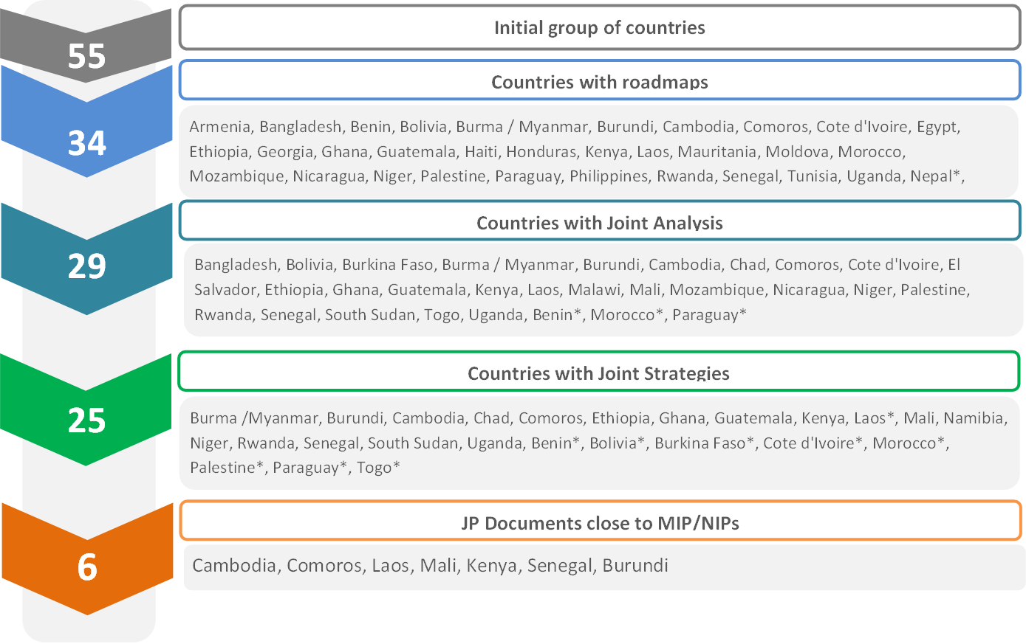
Joint Programming - State of Play by country

Slide 7
Joint Programming - State of Play by region

Slide 8
Trends and benefits
JP has expanded well, with 14 new JP Strategies over the last 12 months
JP lost traction in some of the early JP frontrunners
Evidence of value added, at technical/aid effectiveness level and also more EU leverage
Good results in intra-EU cooperation, more trust and knowledge/burden sharing
Results based management increasingly incorporated in the joint strategies
Increasing consultation with CSOs
New generation of joint strategies progressively approximating to the requirements of a MIP/NIP
Notes:
The 55 countries consulted are a group of EU Delegations that in 2012 and 2013 signalled some interest of potential to develop Joint Programming. The HoMs were asked to focus on monitoring of JP implementation, steps to be taken towards the "next generation of Joint Programming" / assessment of benefits, next steps and timelines towards Joint Programming, possibly including a roadmap, re-assessment of the feasibility of Joint Programming.
No reports received from (inter alia)
Bangladesh, Benin, Honduras, Guatemala Chad, Liberia, Cote d'Ivoire, Rwanda, Pakistan, Sierra Leone, South Sudan, Togo, Nepal, Tunisia, Uganda, Vietnam
Not mentioned these countries like Libya, Yemen, were we cannot expect response at this stage for different good reasons.

Slide 9
Challenges
Mixed picture in involving partner country governments
Transaction costs still high
JP still not seen as "core work" → JP fatigue and the "personality factor"
Some fear of losing visibility
Alignment/ synchronisation with programming cycle remains a challenge
Notes:
Kenya's joint strategy includes an annex on communication and visibility strategy

Slide 10
Looking forward
Request for political and operational support from HQ, including clarity on the procedural aspects and technical assistance from long-term consultants
Facilitation and follow-up of JP to be undertaken pro-actively with field offices to encourage drafting/updating of roadmaps
The co-existence of JP and bilateral documents is a duplication → Prospects of replacing bilateral country strategies by JP documents
Meaningful inter-linkages with possible review of EU & MS programmes are generally not yet seen. So far these two processes are "thought separately"

Slide 11
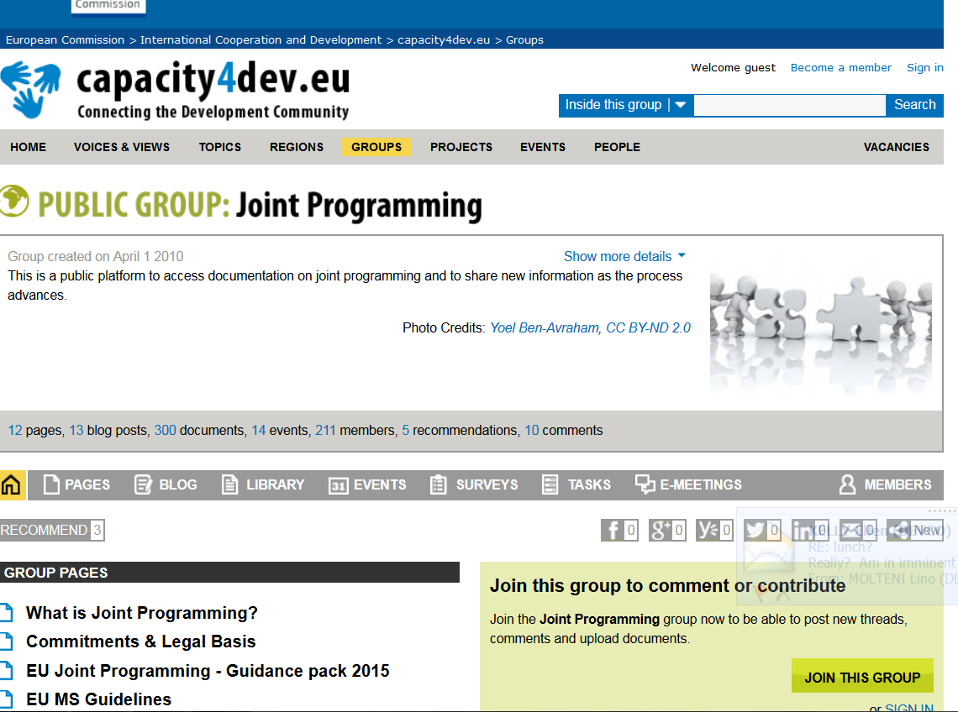
Roadmaps, analyses strategies, debate:
http://capacity4dev.ec.europa.eu/joint-programming
Notes:
DEVCO- Bernard San Emeterio
11
11

