Slide 1

EU Working together
Joint Programming Technical Seminar, 12 November 2015
Brussels
JP Consultant: Veronica White
Notes:
DEVCO- Bernard San Emeterio
1
1

Slide 2
EU Working together: scope and definition
Article 208 of the Lisbon Treaty states that:
“The Union's development cooperation policy and that of the Member States complement and reinforce each other.”
It can either lead to or derive from joint programming:
  From strategic planning (analysis, sector prioritisation etc) to joint actions (identification, formulation, execution, monitoring, evaluation).
  Working together can also lead to JP through sector approches and policy/political dialogue.
No official definition but broadly understood as the act of working in partnership with one or more EU Development partner on a specific action/sector, pooling or otherwise bringing together the resources of several donors.
Understanding varies among EUDPs: from small scale to larger initiatives with pooled funding.
Suggested driving principles: joint contribution, joint responsibility including joint risk sharing.

Slide 3
Working together: demand and drivers - 1
DEMAND
Growing demand from EU MS for jointly implemented actions. Opportunities arise from in-country DoL from which it derives. It builds on the opportunities that Division of Labour presents.
Working together leads to (and can also derive from) a change of mind-set towards more collaborative work among EU DPs with shared and complementary objectives results.
JP is about effectiveness: hence, underlying expectation that joint implementation will lead to a better use of resources, stronger results and more impact.
Partner Governments look forward to the streamlining of procedures, reducing of double reporting, meetings, etc. Transactions costs on implementation reduced for DPs and Governments.

Slide 4
Working together: demand and drivers - 2
DRIVERS
Joint Programming provides a framework to capitalise on new opportunities for joint implementation. In turn, this makes JP concrete. How to work together at practical level?
Programmes-based approaches, sector cooperation etc. also lead to joint implementation and as a consequence, working together increases coordinated dialogue with the Government.
Joint work leads to increased more coordination with EU DPs at country level

Slide 5

Working together in practice
1: Ethiopia
Joint EU+ Cooperation Strategy signed in January 2013. The JCS makes
commitments to joint implementation in its action plan as well as committing
to greater use of joint analysis, joint reviews and evaluation.
There is also an expressed willingness to investigate the possibility
of developing an EU+ common results framework.
Joint Implementation in 4 sectors:
Nutrition (14 EU MS)
Health
Green sector
Migration
Result: the EU nutrition expertise is shared as
a common resources for all EU+ (strateic advice
for programmes/projects, trainings etc.
Opportunity: working together in the health sector could increase sector policy dialogue towards targetted sustained results in the sector and enhanced EU visibility.
Opportunity: working together in Green sector as an opportunity to initiate policy dialogue in an area where no formal coordination group is in place.

Slide 6

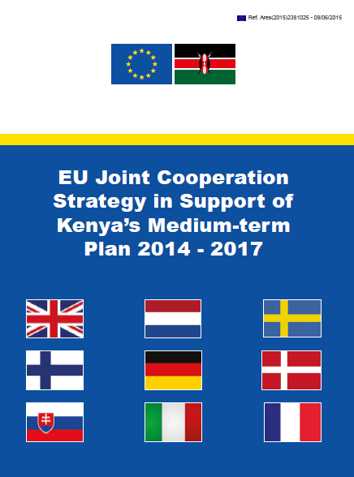
Working together in practice
2: Kenya
The « EU Joint Cooperation Strategy in support of Kenya’s MTP II » was launched on 9 May 2015. Since then, joint implementation actions are already underway in 3 sectors
Joint implementation opportunities were identified as part of the JP process, as a result and building on the Division of Labour process. Ad-how working groups with technical experts from EU DPs were created to help identify JP sectors and potential joint actions within those sectors + Monitoring & Evaluation results and indicators for those sectors.
Commitments to work together in the JP Strategy include a commitment to explore together existing and future opportunities for joint programme. EU HoCs share information on upcoming programmes and initiatives to explore potential for joint action within the group at each opportunity.

Slide 7



Working together in practice
3: European Financing Institutions
The Mutual Reliance Initiative
Discussions on increasing aid effectiveness, division of labour and the to the EU Code of Conduct - have led the European development financing institutions to adopt the Mutual Reliance Initiative (MRI) and agree on a strategy to facilitate concrete action at operational level amongst them.
Jointly elaborated a model for better division of labour in the framework this Mutual Reliance Initiative (MRI). The objective of the MRI is to delegate central tasks in project preparation, implementation and monitoring to the maximum possible extent to the institution which is subsequently resuming the responsibility as Lead Financier.
As a principle, this delegation of tasks and responsibilities is based on mutual recognition, rather than the harmonization of procedures.

Slide 8

Working together in practice
4: Malawi
Decision of EU DPs to strengthened the Use of Joint Implementing Modalities for joint or more complementary implementation and policy dialogue with a focus on:
Joint implementation whenever feasible, reducing transaction costs and providing a basis for more effective policy engagement and ultimately more impact (see below).
Promoting the use of joint technical studies such as joint identification, formulation, feasibility and other technical studies which can help generate a shared understanding of the technical challenges at hand and provide the foundation for designing joint projects or programmes.
Joint monitoring and evaluation at sector level to help promote a shared understanding of the sector challenges and contribute to improved policy and technical dialogue.
Germany, Ireland and the EU have already expressed interest in merging evaluation committees.

Slide 9

Working together in practice
5: Ghana
One of the fore-runners of Joint Programming – overall little process (lost traction)
Lack of synchronisation has made joint initiatives difficult to set up.
A number of partners are phasing out so only DE, FR, DK and EU left to JP and JI
One joint initiative in the area of decentralisation is under way
Driver: Working together in decentralisation as a means of bringing joint programmic to a more strategic level in line with the Government’s plans to develop a new decentralisation policy.

Slide 10
How to move JI forward?
it's already happening/on the move …..
How to make the most of existing opportunities?
Next steps? Take stock, understand, share, assess different experiences.

