Slide 1


Joint Programming
Building on good practice cases – how to move forward
Joint Programming Technical Seminar, 12 November 2015, Brussels
DEVCO/A2 Aid and Development Effectiveness and Financing
EEAS/Global 5 Development Cooperation Coordination Division
Notes:
DEVCO- Bernard San Emeterio
1
1

Slide 2
Structure
Good practices
Ensuring good practices in more countries
  How we worked so far
  How to move forward

Slide 3
JP documents
– where do we stand?
Currently 25 Joint Programming Strategies
7 good practice cases => CAMBODIA, COMOROS, KENYA, SENEGAL, MALI, LAOS, BURUNDI

Slide 4
Good practice elements (1)
JP documents usually contain:
  Overall vision for EU support to the country, based on a joint analysis
  Priority sectors/areas, as well as a justification
  Per sector: brief overview of the situation & the sector objectives

Slide 5
Good practice elements (2)
JP documents usually contain:
  Common positions on key issues to be taken forward, e.g. human rights and governance.
  Indicative financial allocations (overall, per sector and per MS)
  Cross cutting issues, such as gender

Slide 6
Specific, less "wide spread" elements of good practice
Some JP documents contain a complete results framework, i.e.
  Specific objectives
  Expected results
  Performance indicators
But with different shapes…….

Slide 7
KENYA (1)
Kenya EU Joint Cooperation Strategy 2014 – 2017, pages 30 - 34:
  Monitoring of the targeted results and intended outcomes
  Monitoring of the JP process itself
    Indicators as far as possible based on the national development plan
    Rather concise set of objectives, results and indicators

Slide 8
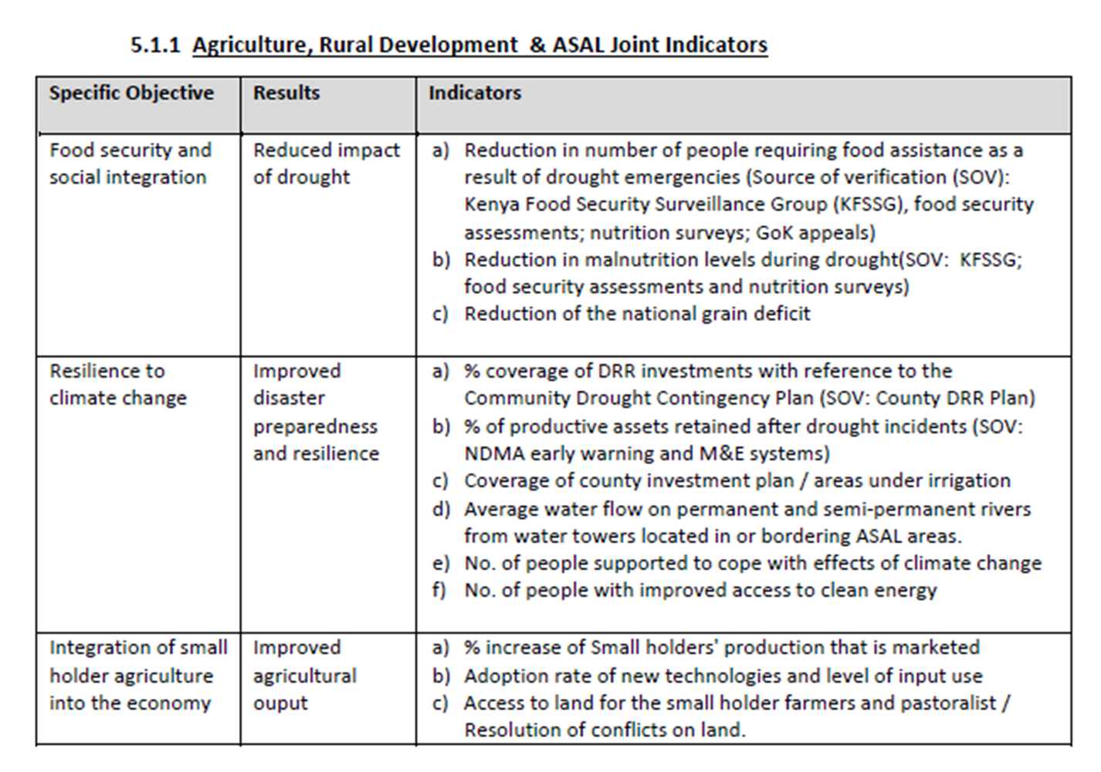
KENYA (2)

Slide 9
MALI (1)
Programmation Conjointe de l'UE au Mali, 2014 - 2018, pages 37 - 78:
  Monitoring of the targeted results and intended outcomes
  No separate monitoring of the JP process itself
  For each sub-sectors a general objective defined, then several "specific objectives", several results per objective, several indicators per result

Slide 10
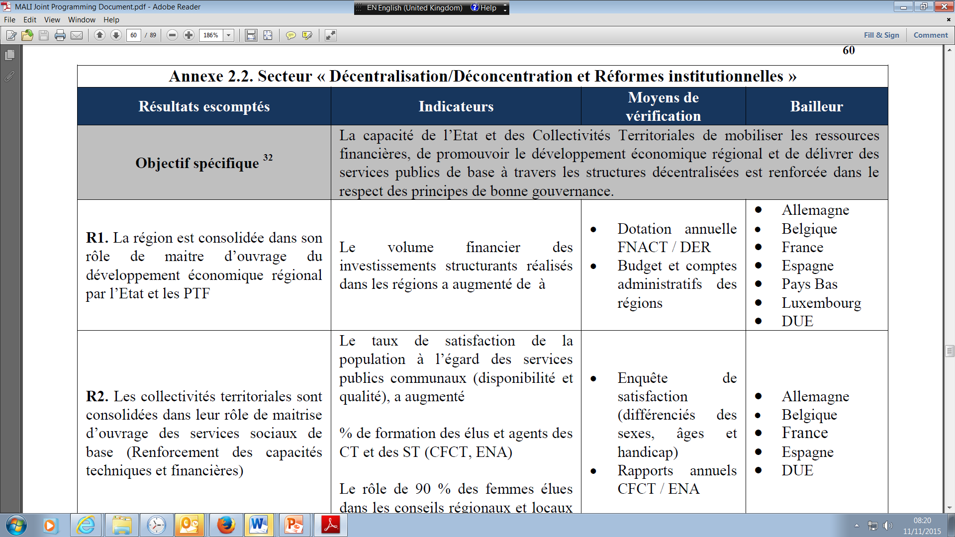
MALI (2)

Slide 11
CAMBODIA (1)
  European Development Cooperation Strategy for Cambodia, 2014 – 2018:
  Contains an "EU strategy results framework", aligned with the national processes for results management.
  It is a concise framework
  Framework will be adjusted, as necessary, to the national results framework

Slide 12
CAMBODIA (2)
  Results framework is a "living document" to be updated during implementation of the joint strategy.
  First progress report drafted and discussed during HoC retreat in October. Will be ready for HoMs in Dec.
  Progress report to be discussed with Government, civil society, parliament, and other development partners early 2016.

Slide 13
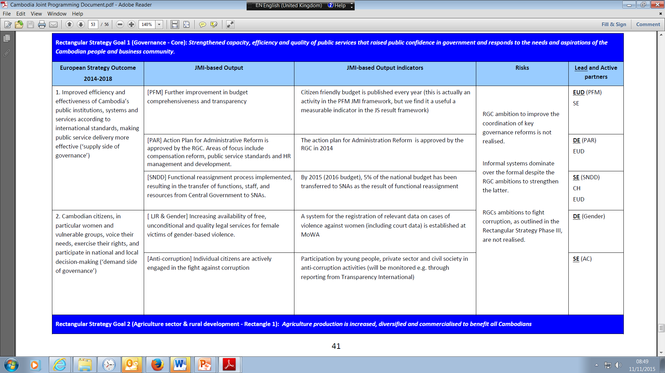
CAMBODIA (3)

Slide 14
SYNCHRONISATION
  According to the guidance package the JP document should contain:
    "main elements" on how EU & EU MS will synchronise
    A table showing the indicative financial allocations
    Development Partners may decide to review these indications every year
      Synchronisation of programming cycles is not necessarily required, as good practice shows
      EU can work under current programming cycle of 7 years (MFF 2014 – 2020)

Slide 15
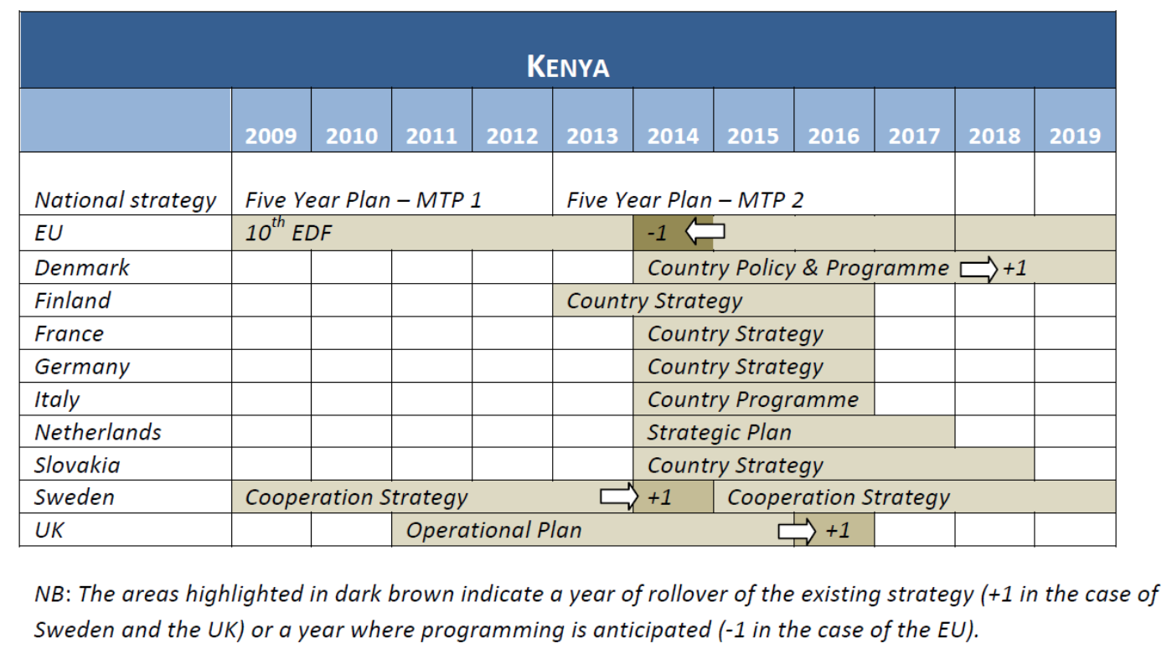
Synchronisation in KENYA (1)

Slide 16
Synchronisation in KENYA (2)
  Relatively good synchronisation with the Kenyan MTP2 cycle.
  "The EU Delegation will ensure synchronisation by carrying out a review to coincide with the adoption of the next MTP cycle. This will allow the EU to re-orient priorities as may needed at that point of time"

Slide 17
Ensuring good practice –
How did we work so far
Guiding Joint Programming processes recently:
Joint Programming Guidance package
Support of consultants, building on good practices
Level of ambition, i.e. on results based frameworks, defined locally. In most cases so far not driven by the consideration of replacing a bilateral document through a JP document.
=> No guidance from HQ on level of ambition

Slide 18
How did we work so far (2)
Great advantage of this process with very cautious steer from HQ was its flexibility and adaptability of the Joint Programming process to local conditions
Disadvantage is the diverse level of content and quality in the Joint Programming documents => possible lost opportunities

Slide 19
How to move forward
After initial phase of JP 2012 – 2015, expectations on the rise:
  Joint Programming documents to replace bilateral programming documents in parts or in full
  OR
  to serve as umbrella for the bilateral programming and/or implementations documents

Slide 20
How to move forward (2)
leave it entirely to the EU delegations and MS embassies, whether to replicate our best practice examples?
Move towards "minimum standards", in order to secure quality/content standard for JP documents?
For the EU: for JP documents to replace MIPs/NIPs, criteria have to be met, as in Kenya/Mali/Cambodia examples = clear objectives, results, indicators of progress

Slide 21
How to move forward (2)
Some EU Heads of Cooperation call for a more binding framework for JP documents
Should – for a selection of good-potential-joint programming countries – more binding quality criteria be defined that need to be fulfilled, based on our best practice cases criteria?

Slide 22
Preliminary ideas on new countries to bring on board
Similar approaches might inspire upcoming JP strategies:
Possible cases in 2016:
  Laos, Morocco, Palestine, Ethiopia
Possible cases in 2017:
  Togo, Burma/Myanmar, Senegal, Tunisia, Egypt
Of course to be discussed with MS and EU country level and HQ colleagues

Slide 23
And what about elsewhere …
For countries not included in the selected group :
do we wish to proceed based on the Guidance package and facilitation tools, as done so far in all cases?

Slide 24
Keeping the balance between leaving full flexibility as needs be locally, and defining minimum standard requirements
… or even building a standard suggested format to facilitate work at country level
Member States views?

