Slide 1
Joint Programming
Technical Seminar
Brussels, 12 November 2015
DEVCO support to JP and knowledge sharing
DEVCO/A2 Aid and Development Effectiveness and Financing
Notes:
DEVCO- Bernard San Emeterio
1
1

Slide 2
Knowledge sharing
Regional Joint Programming workshops
Target group: EU Delegations and MS embassies (Heads of Cooperation);Commission, EEAS and MS HQs
Objectives reached I: exchange of experiences and good practice
Objectives reached II: sound basis for JP Guidance Pack
Recap 2014-2015 Regional Workshops :
  Latin America, Guatemala, 20-21 January 2014 (support: Spain)
  Central, East & Southern Africa, Ethiopia, 13-14 March 2014 (support: Belgium and the Netherlands)
  West Africa, Ivory Coast, 4-5 June 2014 (support: France)
  Neighbourhood, Brussels, 29-30 January 2015 (support: Austria and Italy)
  Asia, Myanmar/Burma, 28-29 April 2015 (support: Germany)
Agreement on concrete next steps country by country
Strong push in several countries

Slide 3
Next Round 2016-2017
Regional Joint Programming workshops
Similar objectives… taking the pulse of new dynamics
To facilitate JP processes and allow for an exchange of experience across countries, learning from best practices
Co-organisation with MS crucial!
2 or 3 per year. 2016: E/S Africa, West and Central Africa, Neighbourhood. 2017: Asia, Latin America?
Your ideas on timing /location / support welcome!

Slide 4
Consultant Support: facts June 2014-Sept 2015
15 countries supported
Need-based, demand-based
Four key senior experts
Repeated short term missions to facilitate and accompany process
Flexible assignment TORs, adapted to local progress, validated by EU HOC
Deliverables shared with EU and EU MS HOCs
Horizontal deliverables: JP "tracker", support to Guidance pack, country fiches, etc. (partially shared)
Support to regional seminars or other events
Notes:
Sensitising EU MS and Government to what joint programming means and involves, existing commitments, potential advantages, practical examples from other countries, etc. ;
Establishing a local roadmap for the process;
Mapping out local programming cycles and sector coverage;
Establishing a synchronisation timetable;
Making proposals for division of labour;
Gathering ideas and making proposals for the structure of a joint programming document;
Assisting in drafting a joint programming document;
Sharing experiences with Joint Programming from other countries;
Supporting planning towards common results frameworks;
Analysing national development plans to advise on EU alignment and harmonisation;
Facilitating EU/EU MS retreats/planning workshops on aid effectiveness, division of labour and EU joint programming;
Providing technical and administrative back-stopping to EU Heads of Cooperation in developing JP.

Slide 5
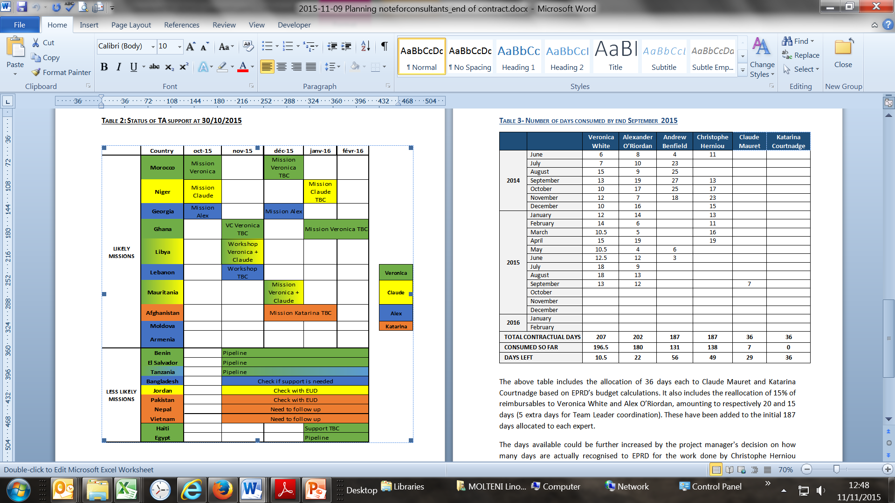
Mission planning 2015-early 2016

Slide 6
New Phase of Support - March 2016-2018
DEVCO-managed contract
Demand-based via EU DEL HOC, initiative of EU MS possible
Support to in-country processes
Methodological support: mapping, analyses, studies
Reinforced components:
  Knowledge Sharing
  Public Communication (Visibility)
Estimated number of missions: 30-35, including to NEAR countries
Demand is expected to grow!
Possible use of experts with strong knowledge of the country
MS welcome to complete/complement / coordinate with this support!

Slide 7
New Phase of Support - KNOWLEDGE SHARING
Closer monitoring of country developments in Joint Programming
Better online data collection, processing and reporting on JP
Better graphical representation of JP activities, including dashboards, charts, graphs, maps
User-friendly searchable database with different access levels

Slide 8
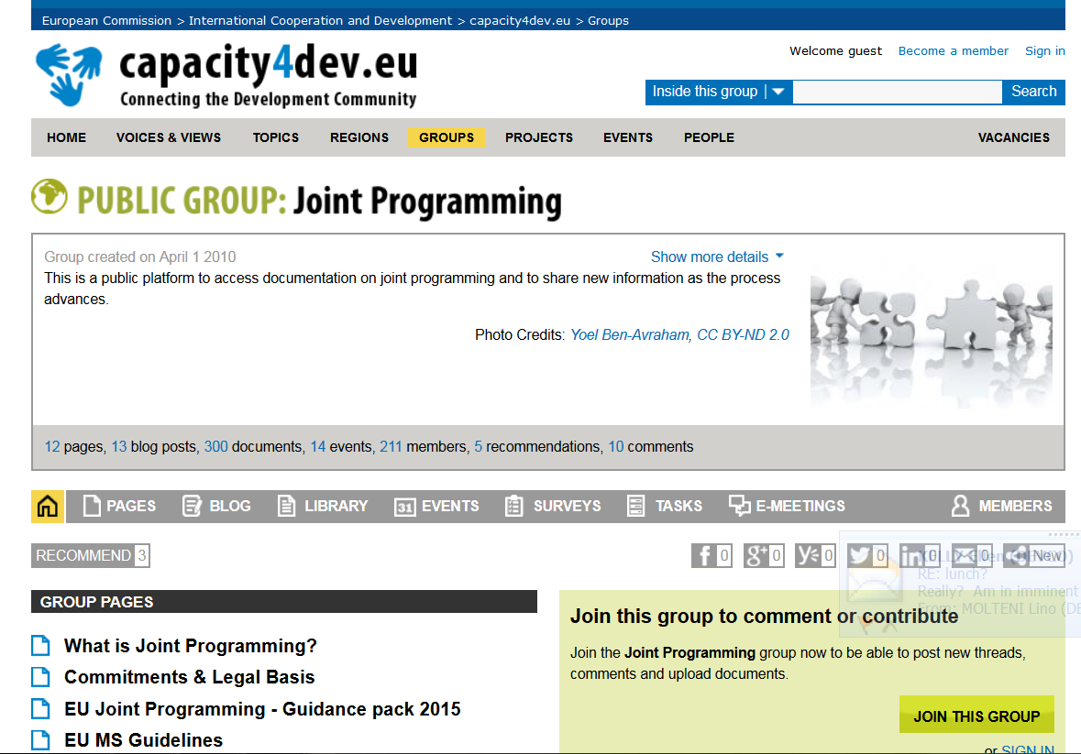
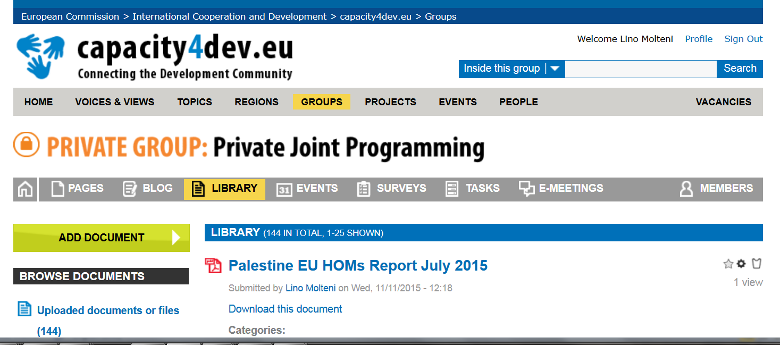
Roadmaps, Joint Analyses, Joint Strategies:
http://capacity4dev.ec.europa.eu/joint-programming
HOMs reports:
http://capacity4dev.ec.europa.eu/private-joint-programming/documents
Notes:
DEVCO- Bernard San Emeterio
8
8

