Slide 1


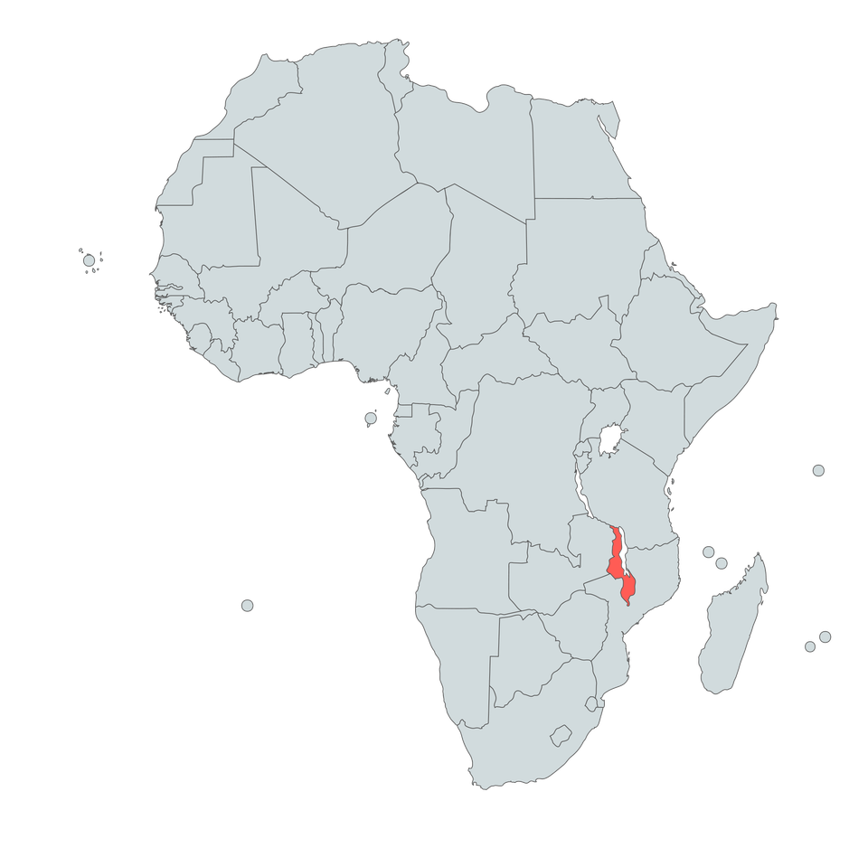
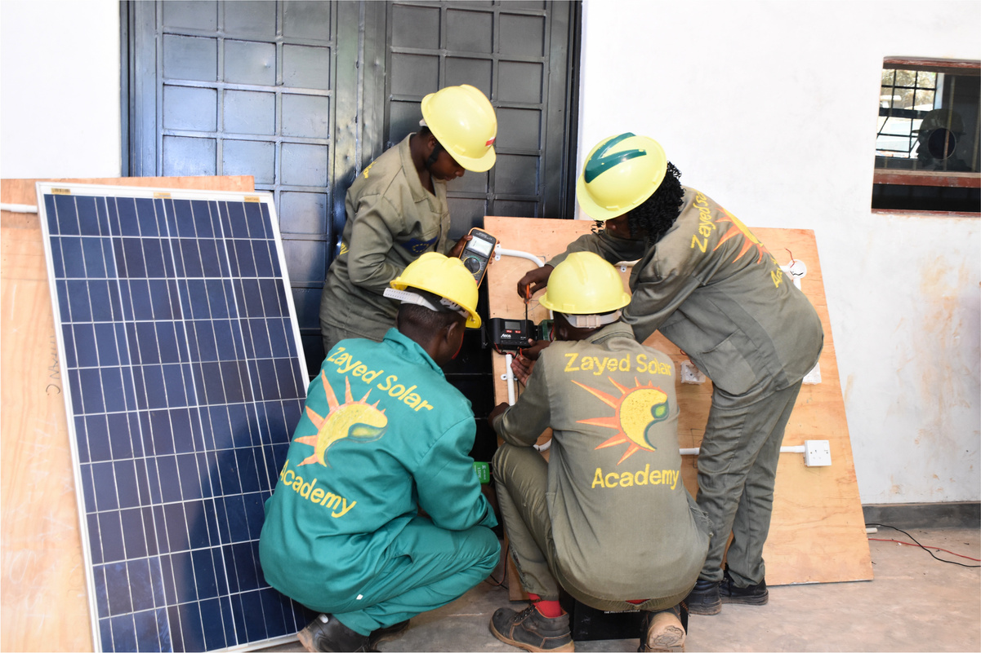

REWARDS – Renewable Energy Workforce Advancement And Recruitment through Demand-driven Skills
Technical, Entrepreneurial and Vocational Education and Training Authority (TEVETA)
Country
Malawi
Sector
Access to Renewable Energy
Duration
01.01.2026 - 31.12.2027
REWARDS equips young people with the industry-relevant skills needed to access concrete employment opportunities in Malawi's growing renewable energy sector
Context
The project’s OP-VET approach
Malawi’s renewable energy sector is expanding rapidly, driven by investment from international partners, industry actors and supportive government policies. This development is creating jobs, especially in the solar energy and power distribution sectors. Malawi’s Technical, Entrepreneurial and Vocational Education and Training (TEVET) system must adapt to the rapidly evolving labour market demands.
The REWARDS project responds to this challenge by equipping young Malawians with relevant, future-ready skills for employment and economic participation. The project partners with industry, develops and adapts tailored training approaches, and strengthens TEVET institutions to ensure skills development is closely aligned with real employment opportunities in the renewable energy sector.
  Starts from concrete job opportunities identified with companies and employers, outlining the skills and qualifications needed for these positions.
  Co-designs and adapts curricula with the private sector and employers to align qualifications with labour market needs in solar energy and energy distribution.
  Promotes structured work-based learning, encouraging industry attachments with solar companies and energy suppliers.
  Advances gender-responsive VET by analysing the barriers young women face in accessing careers in the renewable energy sector, informing targeted training and job placement initiatives.
  Connects TEVET providers, regulators and government with the private sector and employers through a Renewable Energy Sector Skills Council, promoting skills development driven by job opportunities in the renewable energy industry.
© copyright REWARDS
#TeamEurope Initiative “Opportunity-Driven Skills and VET in Africa” - TEI OP-VET

Slide 2






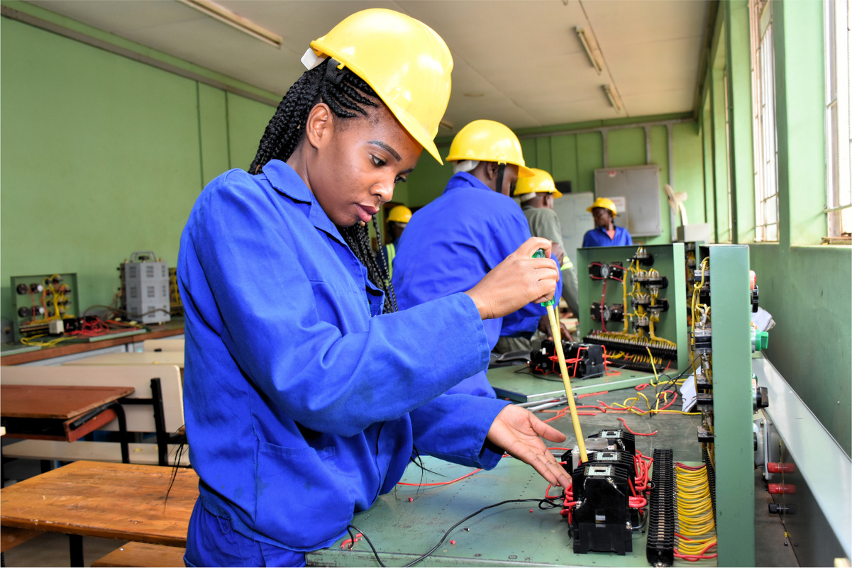

Key activities
Partners
  Conduct an opportunity-driven analysis of skills needs in the renewable energy sector.
  Strengthen TEVET providers’ capacity to meet these needs by updating curricula, training trainers, and equipping institutions with appropriate renewable energy machinery and tools.
  Deliver practice-oriented, gender-responsive renewable energy training and facilitate industry placements for young women and men.
  Establish and support a Renewable Energy Sector Skills Council comprising employers, the private sector, government, and TEVET providers.
Technical Entrepreneurial and Vocational Education and Training Authority
Lead organisation
Renewable Energy Industry Association of Malawi
Technical College Mzuzu
Handwerkskammer Koblenz
Electricity Supply Corporation of Malawi
Why it matters
REWARDS enables young people and women in Malawi to access decent employment in the renewable energy sector. By strengthening TEVET providers’ capacity to deliver opportunity‑driven training, it helps build a skilled national workforce. The project links qualified graduates with employers, which allows renewable energy companies to expand their services, increasing access to clean energy for Malawians in both urban and rural areas. Through the establishment of a Renewable Energy Sector Skills Council, REWARDS fosters sustainable and strong public-private collaboration and contributes to an inclusive and market-oriented VET-system
Expected impact
600
trained people find decent employment or self-employment
1000
people trained (40% women)
42
Renewable Energy companies involved
+42
TEVET providers strengthened
© copyright REWARDS
Contact
Deutsche Gesellschaft für Internationale Zusammenarbeit (GIZ) GmbH
TEI Opportunity-driven Skills and VET in Africa
  Heike Pratsch – heike.pratsch@giz.de
Technical, Entrepreneurial and Vocational Education and Training Authority of Malawi – TEVETA
  Elwin Sichiola – esichiola@tevetamw.com
  Claudia Lange – clange@tevetamw.com
Your Gateway to skills and jobs
Scan here for more info on TEI OP-VET
#TeamEurope Initiative “Opportunity-Driven Skills and VET in Africa” - TEI OP-VET

