Slide 1


The EU Water Development Policy
and the new framework for action
DEVCO C5
European Commission / EuropeAid

Slide 2
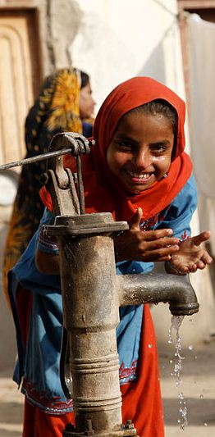
EU Water Cooperation
Present and Future
2014-2020

Slide 3
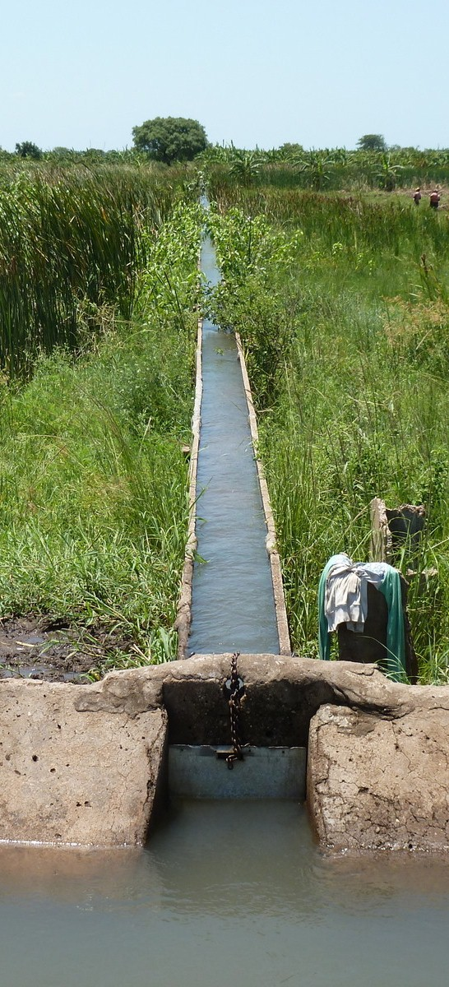
The Agenda for change
REDUCING POVERTY IN A RAPIDLY CHANGING WORLD: More action is needed to tackle global challenges and to deliver global public goods, such as access to water and sanitation.
Human rights, democracy and good governance
Inclusive and sustainable growth for human development
  Business environment, regional integration, world markets
  "The EU should support regional and continental integration efforts through partners' policies in areas such as (…) cross-border cooperation on water, energy and security"
  Sustainable agriculture and energy
  "The EU should (…) tackle inequalities, in particular to give poor people better access to land, food, water and energy without harming the environment."

Slide 4
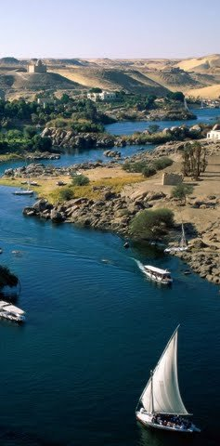
Water diplomacy policy recommendations
EU can offer technical know-how to other parts of the world (Danube, Rhine etc.)
Priority regions: Central Asia, the Nile, the Mekong, the Middle East and the Sahel
Elaboration of action plans aiming to raise political attention to water security
Promote international conventions and other legal instruments as the basis for management of trans-boundary waters
Enhance international partnerships (UN, WB, USA etc.)

Slide 5
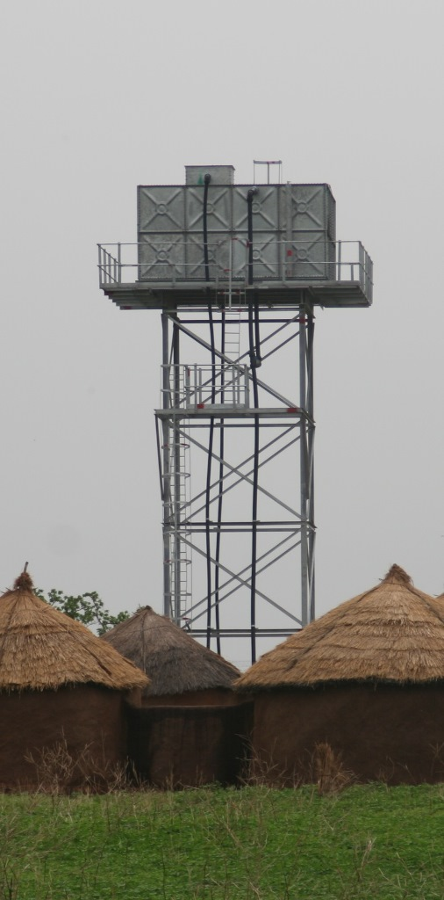
European Citizens Initiative – Right2water
On the 08 Sept. 2015, the European Parliament voted a resolution on the follow-up to the ECI Right2Water, based on Lynn Boylan Report, calling the European Commission to, amongst others:
Calls on the Commission to include water as part of the Agenda for Change
Calls on the Commission to relaunch the ‘Water Facility’ instrument
a strengthening of water operator, greater cooperation amongst water operator and public-public partnership

Slide 6
EU Framework for action
2014-2020
Water for economic growth
Nexus water-energy-agriculture involving the private sector
Water Governance
Management of trans-boundary waters for peace and security
Access to Water and Sanitation
A nutrition sensitive action

Slide 7
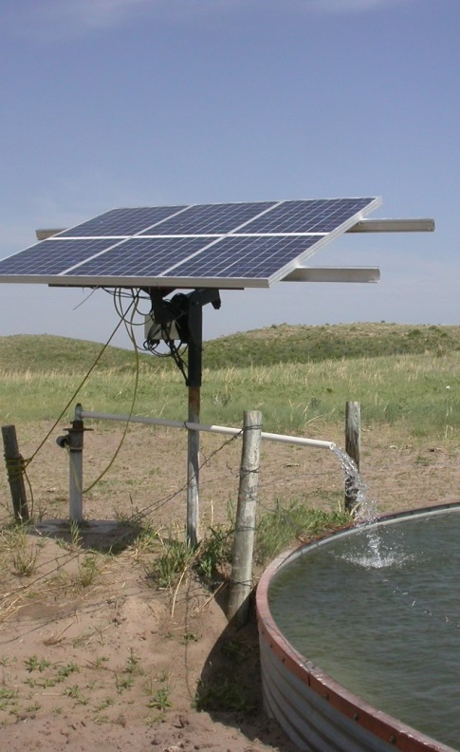
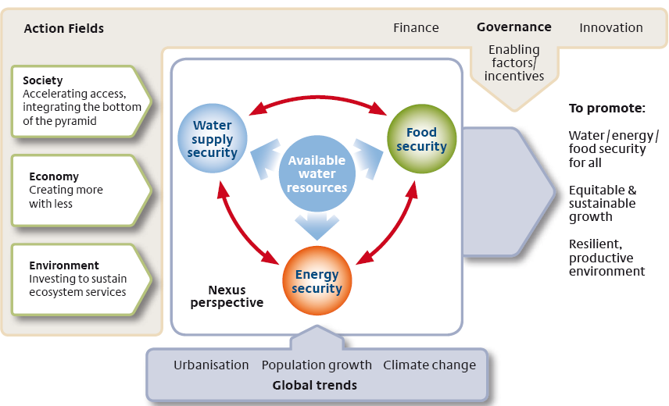
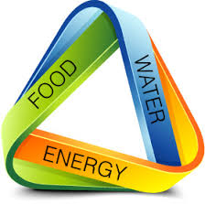
The water-energy-food security nexus

Slide 8
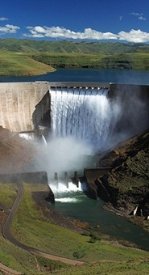
Water diplomacy: the way forward
Confirmed Priorities for 2014-2015: Nile and Central Asia.
To build on existing dialogue in the Nile through, for example, the Nile Basin Initiative and the new CIWA (Cooperation in International Waters in Africa) trust fund.
To build on the existing cooperation initiatives in the water sector in Central Asia (EURECA, EUWI etc.).
To build new partnerships with MS and other donors (UN, USA, WB etc.)

Slide 9
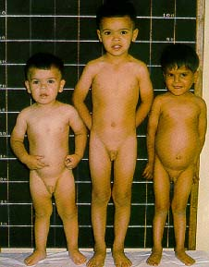
Access to Water and Sanitation:
A nutrition sensitive action
Stunting & WASH
What is Stunting?
Growth failure. The children in this picture were aged 2, 4 1/2 and 5 1/2 years from left to right. The first two are normal but the last is grossly retarded in growth although the weight/height ratio is normal

Slide 10
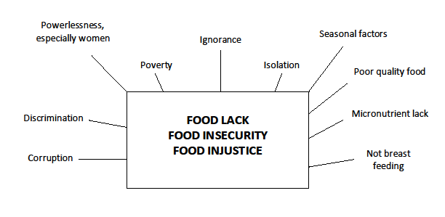
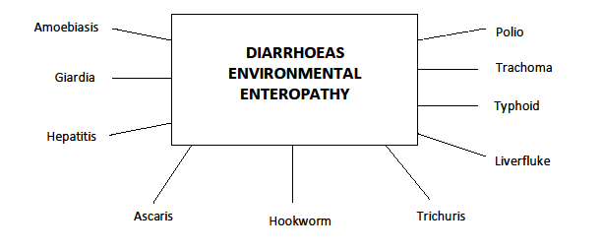
The 5 As of Nutrition
      ORAL -FOOD
AVAILABILITY
ACCESS
ANAL - FTIs
ABSORPTION
    Damaged and diminished gut, evacuation, theft…..
ENVIRONMENTAL ENTEROPATHY, diarrhoeas, nematodes – ascaris, hookworm, trichuris, tapeworms, giardia, bacterial infections etc
ANTIBODIES nutritional energy and proteins
ALLOPATHOGENS other pathogens - liverfluke, hepatitis A, B and E, typhoid fever, polio, trachoma, various zoonoses etc

Slide 11
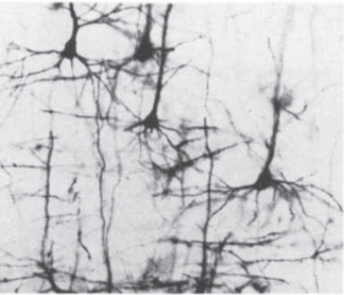
ENVIRONMENTAL ENTEROPATHY has been epidemiologically linked to living in an unsanitary environment
People living in contaminated environments have leaky, chronically inflamed intestines
Gut: short blunted villi, tissue infiltrated with inflammatory cells. Associated with ↑ energy, protein, carbohydrate needs
Diverts nutrients from growth to infection fighting
Typical brain cells
Extensive branching
Impaired brain cells
Limited branching

Slide 12
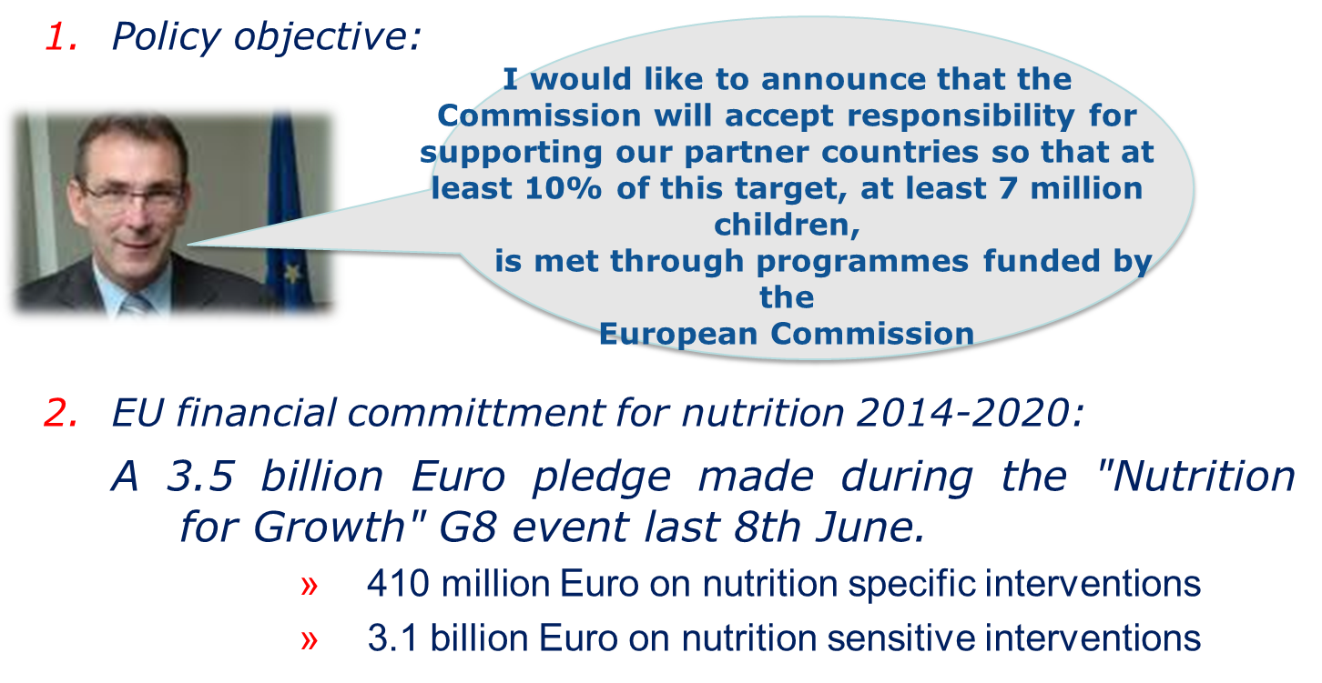
The EU at the forefront of global efforts to fight undernutriton
12

Slide 13
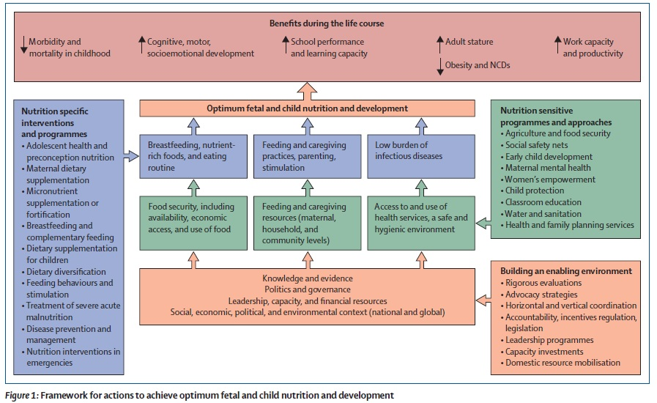
Framework for actions to achieve optimum fetal and child nutrition and development (Lancet 2013)
13

Slide 14
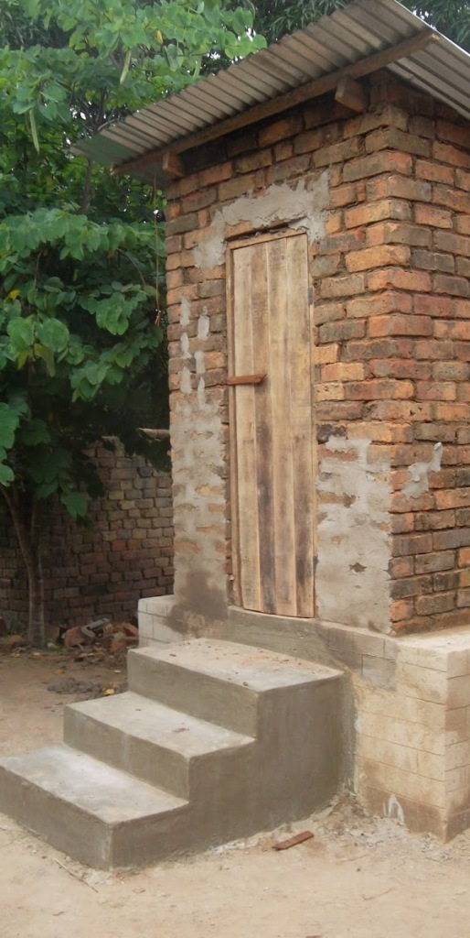
WASH: a nutrition sensitive action
Target : 7 million less malnourished children by 2025
Financial commitment for nutrition: €3.5 billion
  €400 million on nutrition specific interventions
  €3.1 billion on nutrition sensitive interventions
Part of this budget could finance water and sanitation actions as WSS is one of the most relevant nutrition sensitive action.

Slide 15
NIPs and RIPs 2014-2020
Although the EU will in 2015-20 focus its assistance on a reduced number of sectors in each partner country, it remains firmly committed to improving people’s access to water and sanitation
NIPs → Water and sanitation is focal sector in the NIP of 13 countries (and an element of 29 others)
RIPs → Water will also be a focal sector for certain RIP (Central Asia, Central and Latin America and East Africa)

Slide 16
Agenda for Change
the EU must seek to focus its offer to partner countries where it can have the greatest impact and should concentrate its development cooperation in support of:
  human rights, democracy and other key elements of good governance;
  inclusive and sustainable growth for human development
  => Global Public Good and Challenges.

Slide 17
Global Public Goods and Challenges (GPGC) Water
2014-2020 DCI budget €19,6 billion → GPGC €4,9 billion → Water €81 million.
Objective is to highlight the water's leverage effect on economic sectors e.g. environment, cross-border cooperation etc.
Support is foreseen to :
  Regional "Nexus" dialogues and plan of action
  Cooperation on international waters in Africa
  Water Centres of Excellence in Africa

Slide 18
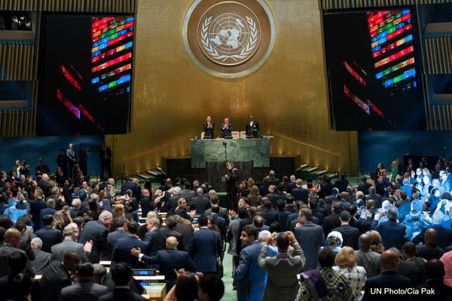
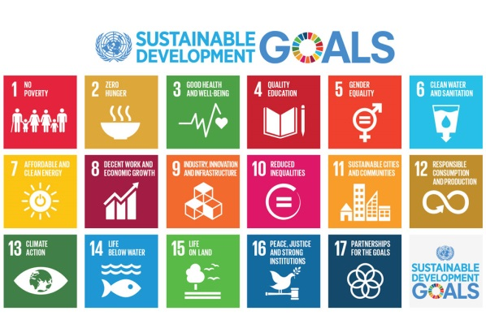
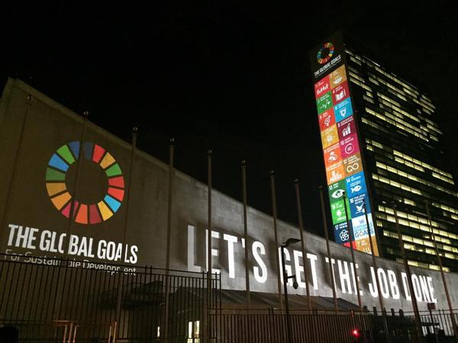
SDG 6
Water in the World We Want

Slide 19
Transforming our World
The 2030 Development Agenda was adopted in New York on 25 Sept 2015 by Heads of State and Government
The agenda includes 17 goals and 169 targets (126 outcome targets and 43 MOI targets)
SDG 6 on "Ensure availability and sustainable management of water and sanitation for all": 6 outcome targets and 2 MOI targets.

Slide 20
Linkages with other goals/targets
In addition to SDG 6, a number of other SDGs either contain specific and quantified water-related targets, or require successful water management for their achievement.
In the first category, we can include the goals on health (SDG 3), cities (SDG 11), consumption–production (SDG 12), marine resources (SDG 14), and terrestrial ecosystems (SDG 15).
In the second category, it has been argued that water underpins the success of nearly all the SDGs.
Water thus emerges as fundamental for achievement of the overall 2030 Development Agenda.

Slide 21



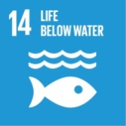

Linkages with other goals/targets
WATER
SDG 6
Ensure availability and sustainable management of water and sanitation for all
Ensure healthy lives and promote well-being for all at all ages
Ensure sustainable consumption and production patterns
Make cities and human settlements inclusive, safe, resilient and sustainable
Conserve and sustainably use the oceans, seas and marine resources
Sustainably manage forests, combat desertification, halt and reverse land degradation, halt biodiversity loss

Slide 22
Next steps: an SDG indicator framework
The challenge of developing an SDG indicator framework is mainly due to the high number and the wide scope of goals and targets
The EC is working to provide inputs to Eurostat for a common EU position based on the following criteria:
The future SDG monitoring framework should use measurable indicators and reliable
The indicator set for the SDGs has to build on frameworks to measure sustainable development already in place in several parts of the world (JMP, GLAAS, etc.)
The development of an SDG indicator framework should not only entail the selection of appropriate indicators, but also – and primarily – a deeper analysis of interlinkages and overlaps between goals and targets
Experience in monitoring sustainable development strategies suggests that the overall number of indicators should remain limited defining a smaller set of core or headline indicators, and a larger set of supplementary indicators.
DG DEVCO is also involved in the consultation for the development of a coherent monitoring framework organised by the Global Expanded Water Monitoring Initiative (GEMI) working under the umbrella of UN-WATER

Slide 23
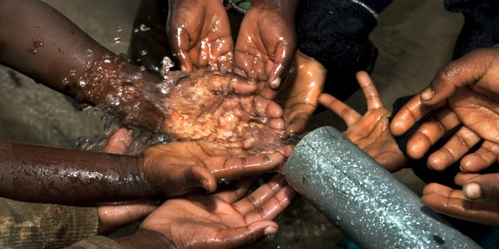
Thank you for your attention
Notes:
Volta river. Akosombo dam

