Slide 1
“It’s the economy working capital, stupid”
Tancrede Voituriez and Alexandre Kaufmann
FAO INVESTMENT CENTRE
18 March 2026

Slide 2

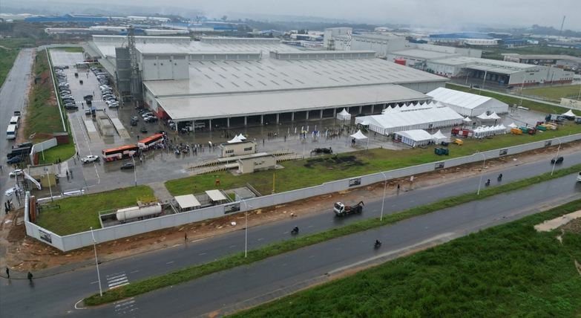
I. WHY THIS WORKSHOP?
  Capex investments in agrifood systems have been rising over years.
  Côte d’Ivoire has attracted more than EUR 1bn of investments to become the largest cocoa processor globally. It has also turned into a major cashew processor.
  But these capex investment come along with growing working capital needs.
  Supply and access to fit-for-purpose working capital finance was already a challenge to export raw materials. It is now jeopardizing the commercial viability of local processing.
  Transcao new cocoa processing plant in Côte d’Ivoire
  This demand for working capital finance represents an opportunity for lenders (local banks, impact funds, DFIs). What is needed to meet this demand?

Slide 3
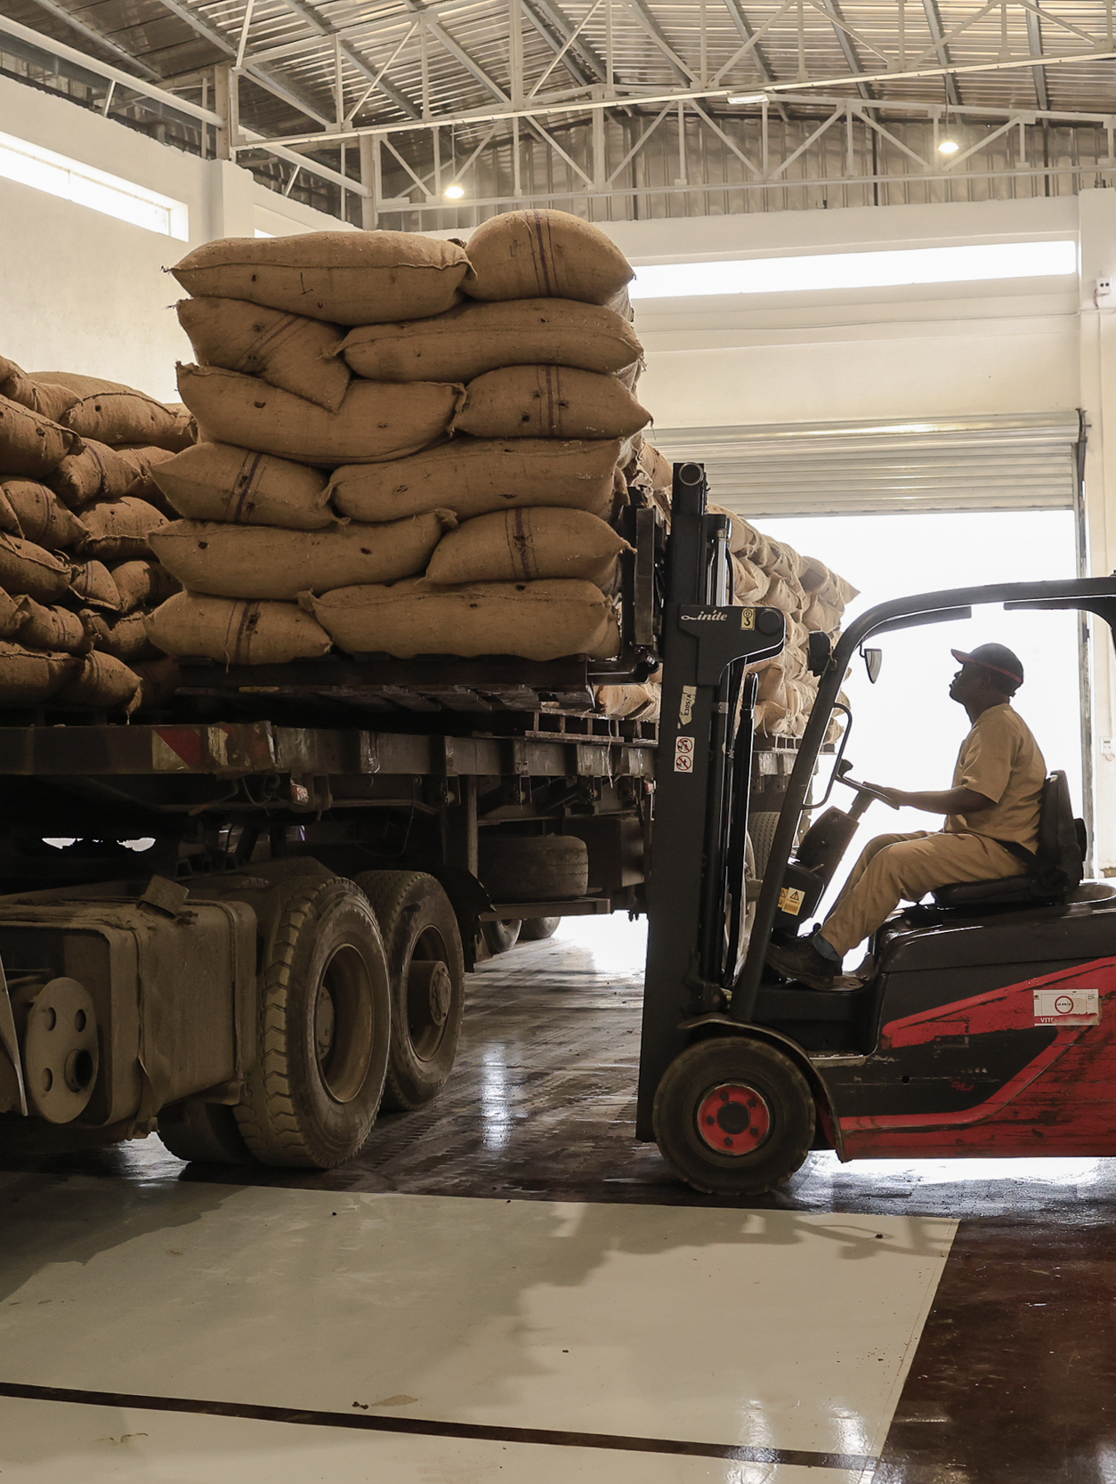
II. EXPECTATIONS?
  Unveil the truth about working capital finance
  Share first-hand experience and lessons learned in working capital finance practices, opportunities and risks
  Structure a community of knowledge among practitioners
  Discuss operational solutions
  Forge a compelling narrative to help unlocking more working capital finance

Slide 4
III. WORKING CAPITAL NEEDS … WHAT ARE WE TALKING ABOUT?
  A liquidity metric corresponding to the amount of money a company requires to finance its operational cycle
  Not OPEX ; more than Inventories
  = Inventories (+) Trade Receivables (-) Trade Payables
  Can be financed via clients, suppliers or banks (trade finance, inventory financing, input financing etc.)
  A function of the following factors:
  Industry
  Structure of the supply chain
  Seasonality
  Volumes
  Prices
  Economic context
  Sources: World Bank Monthly Commodity Price Data (The Pink Sheet)

Slide 5
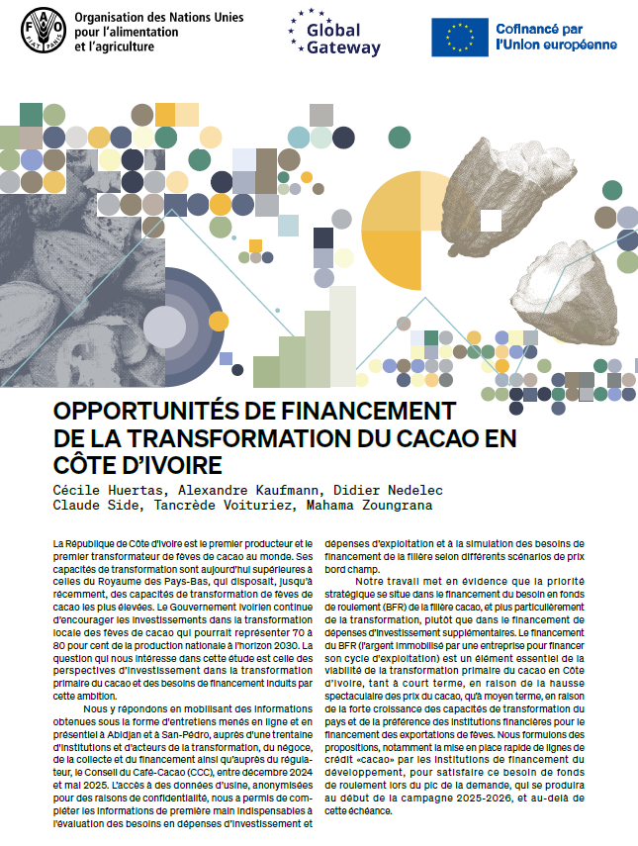
IV. ORDERS OF MAGNITUDE
  Global consumption of agri commodities is forecasted to grow by 13% in the next decade (FAO/OECD)
  In Côte d’Ivoire alone, peak working capital needs are estimated around (FAO):
  EUR 4.3bn in the cocoa sector as of Dec 2025 (+50% y-o-y)
  EUR 800m in the cashew sector as of April 2026
For a typical new 30 000-tonne cocoa processing plant in Cote d’Ivoire (FAO):
CAPEX are estimated at EUR 52 million
Annual OPEX amounted to EUR 90 million during the 2024/25 season
85% of these OPEX were allocated to cocoa bean purchases
65% of these beans are purchased between October and December
  From a sample of 24 agrifood funds with a portfolio of USD 1.8bn (FAO/Tameo):
  80% of the portfolio represented working capital finance
  20% CAPEX
Link to the publication

Slide 6
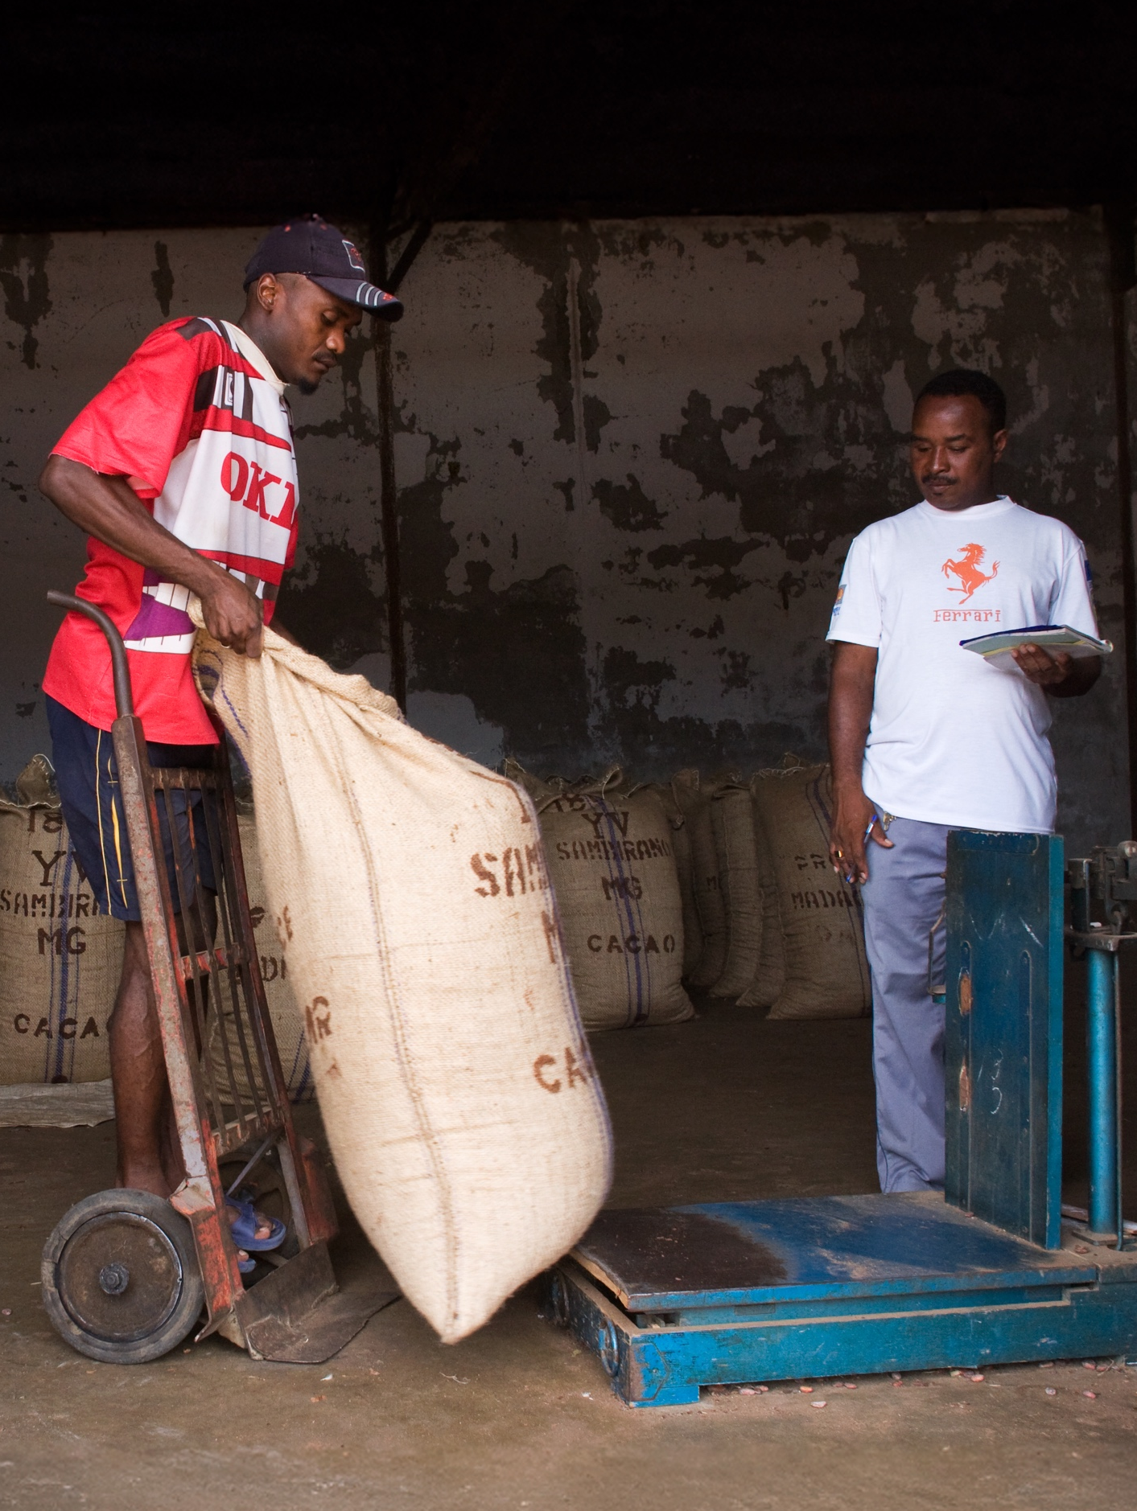
V. CONSIDERATIONS SHARED BY PARTICIPANTS AHEAD OF THE EVENT
  Working capital finance tends to be considered as the “poor cousin” of finance
  Resources intensive:
    annual renewal of credit lines by credit committees
    many disbursements
    requires sectorial expertise, speed and flexibility
    monitoring is key
  Use of proceeds are not easy to control
  Collateral is often an issue (e.g. cashew)

Slide 7

VI. STRUCTURING THE WORKSHOP DISCUSSION
Expose key challenges:
How strategic is working capital finance for your activities?
What is the order of magnitude of your working capital needs? Do you see a gap in your sector?
What is preventing you from accessing/issuing more adequate working capital finance?
Share best practices:
How are your needs currently financed?
How do you approach working capital finance?
What is the share of working capital finance in your agrifood portfolio?
What instruments can you offer to fund the working capital needs of agrifood borrowers?
Explore solutions:
What would you need to access/issue more adequate working capital finance?
Any recommendations for DFIs? What could they do differently?
How could the EU help to unlock more working capital finance?

Slide 8
VII. KEY TAKE-AWAYS FROM THE WORKSHOP
  100 participants (40 in-person), with a mix profile (DFIs, commercial banks, impact funds, EU)
  Consensus on the fact that access to/issuance of adequate working capital finance is a problem justifying the intervention of the development community
  Working capital finance should be perceived as the rich cousin, not the poor parent of finance! It is very complex and highly strategic to the well-functioning of supply chains
  An old problem. Receiving periodic attention. The recent decline in cocoa/coffee prices is an opportunity to strengthen these value chains and prepare the next shock
  No silver-bullet solution
  Small is beautiful. But big is necessary. Scale will come from taking stock of the various innovative answers to this challenge

Slide 9
VII. KEY TAKE-AWAYS FROM THE DISCUSSION
  Lending directly to farmers comes with challenges:
    High transaction costs
    Lack of adequate collateral
    High interest rates
    Lenders lack data about this class of borrowers as well as value chain expertise
  Develop a value chain approach
    Finance farmers through entry points (aggregators, traders, processors, logistic companies)
    They often have data about farmers/small aggregators
    In many cases, they are already (pre)financing them
    But up to a certain limit: “I am not a bank”
  More risk-sharing mechanisms could be a solution
    DFIs tend to rely exclusively on the balance sheet of an aggregator
    A DFI could provide a credit line to a local bank. The bank would on-lend this line to the suppliers of an aggregator. The aggregator would offer off-take contracts to suppliers and share its knowledge and data with the bank and the DFI.
    The risk of this portfolio would be split between the DFI, the local bank and the aggregator

Slide 10
VII. KEY TAKE-AWAYS FROM THE DISCUSSION
  Need to improve the value chain knowledge of lenders
    Risk comes from now knowing what you are doing
    Lenders need to understand the seasonality, risks and opportunities of each value chain
    Financial instruments and monitoring should be adapted accordingly
    Potential for VCA4D?
  Collaboration is key
    Public and private sector players are complementary and need to exchange more
    These discussions need to be facilitated
  Concessional funds are limited and precious
    Talk to the private sector at design stage
  Elephant in the room: FX risk in the case of domestic value chains

